Slide 1
NIST Technical Study
Sofa Super Store Fire
Draft Report for Public Comment
Charleston, South Carolina
October 28, 2010
Dr. William Grosshandler
Mr. Nelson Bryner
National Institute of Standards and Technology
U.S. Department of Commerce

Slide 2
Sofa Super Store Fire Technical Study
Objectives - Technical Study Team
To determine why and how the fire spread so quickly
To study conditions within structure, in terms of temperature, oxygen concentration, smoke movement, & tenability*
To identify specific areas in model building and fire codes**, standards and practices that warrant revision.
* Ability to escape unassisted
**Codes used as national models for building and fire regulations. State and local jurisdictions have the option of incorporating some or all of model code provisions

Slide 3
Sofa Super Store Fire Technical Study
Tasks-
1) Identification of technical issues (why rapid fire spread) and major hypotheses requiring examination.
2) Data collection - design records, video and photographic data, radio transmissions, field data, and interviews.
3) Analysis and comparison of building and fire codes and practices, and review and analysis of practices used in operation of the building.
4) Simulation and analysis of phenomena, including fire spread, smoke movement, tenability, and operation of active and passive fire protection systems.

Slide 4
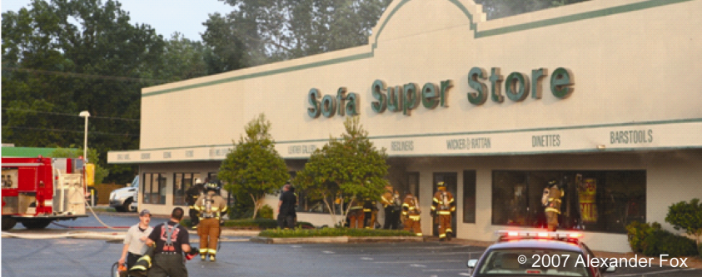
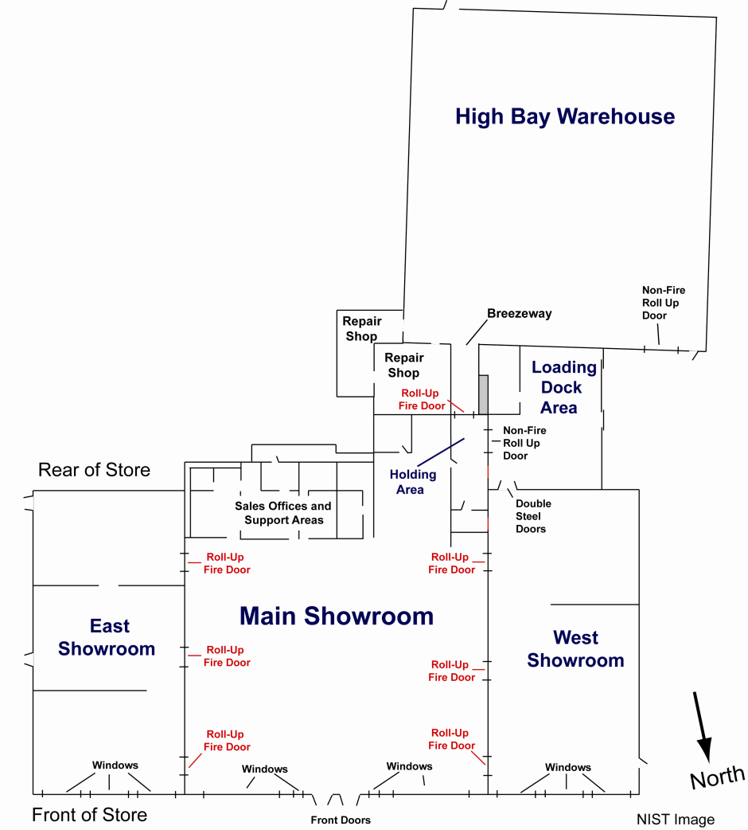
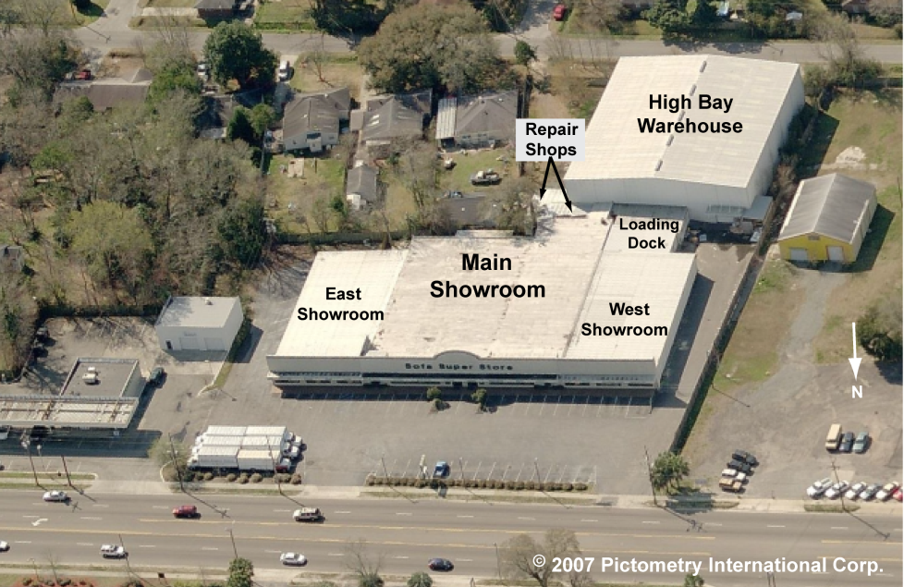
Views of Building
(main entrance)

Slide 5
Overall Time Line
Time Event
6:56 pm - Fire observed at rear of store
- store employee discharges port. fire extinguisher
- fire reported to 911 Center
7:08 - Dispatch receives report of fire behind store
7:09 - Engines 10 & 11, Ladder 5, & Battalion Chief dispatched
7:12 - Engines 10 & 11, Ladder 5, Assistant & Battalion Chief on scene
7:13 - Assistant Chief opens door and locates fire on
loading dock
- Loading dock fully involved with fire
- Fire spreads to holding area and warehouse
7:16 - Fire Chief arrives on scene
7:20 - Engine 10 at loading dock receives water from Engine-12

Slide 6
Overall Timeline continued
Time Event
7:27 pm - Engine-11 at store front receives water from Engine-16
- Trapped employee calls 911
- “Lost or trapped inside “ radio call
7:31 - Employee rescued
- “Mayday”
- Fire Chief “….we need to evacuate building”
- Engine air horns sounded to evacuate building
7:35 - front windows vented
- brown smoke pours out of broken windows
7:36 - black smoke rolls out front windows
7:37 - fire rolls out front windows
7:51 - Portion of main showroom roof collapses
10:00 - Fire under control

Slide 7
Fire Starts Outside Loading Dock
(main entrance)

Slide 8
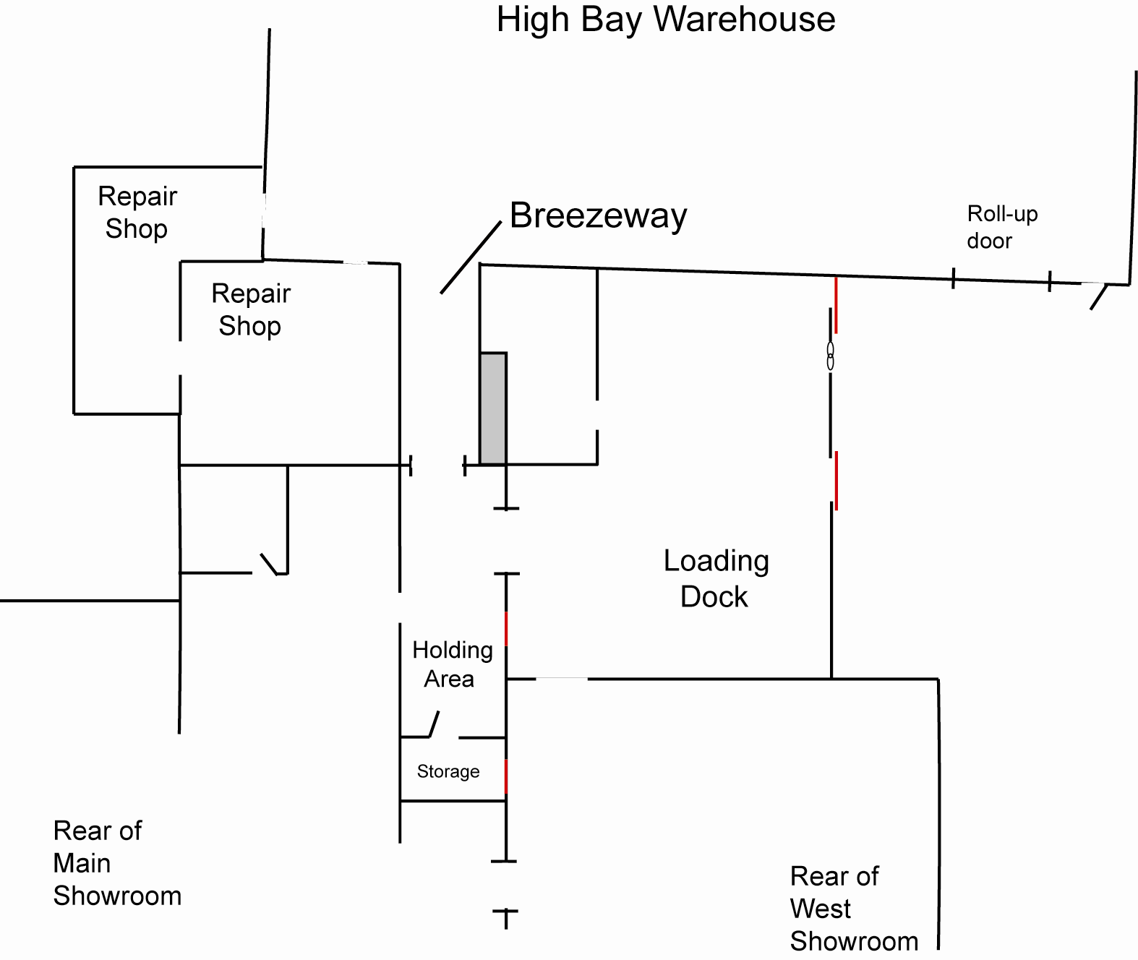
Fire Spread

Slide 9
Sofa Super Store Fire Technical Study
Computer Simulation
Uses data on floor plan, materials of construction, opening of doors and windows, fuel load, weather, etc.
Each computer simulation requires about 4 days to run
(required > 250 runs)
Compared simulation results to photographs, observations, interviews, and data. Most consistent simulation = most probable fire sequence
Multiple scenarios including impact of sprinklers, front windows intact, and roof openings
5) Output temperatures, oxygen concentrations, and smoke & flame within structure

Slide 10
Sofa Super Store Fire Technical Study
Computer Simulation – overall structure

Slide 11
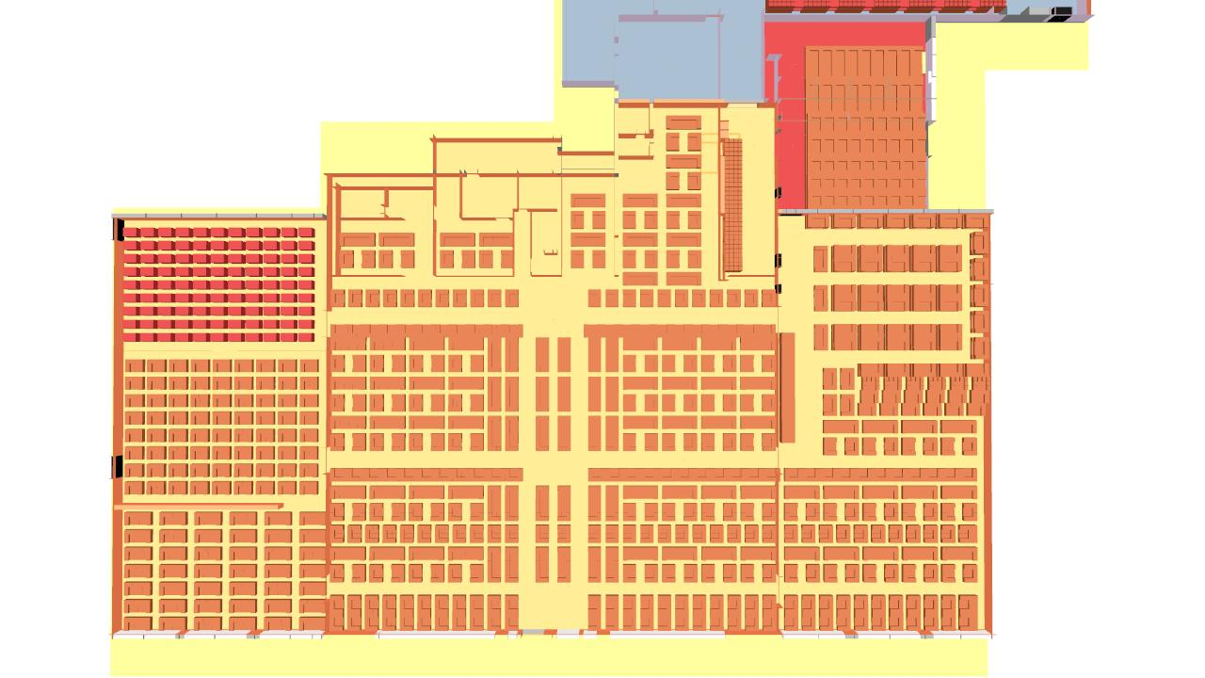
Sofa Super Store Fire Technical Study
Computer Simulation - Floor Plan with merchandise
Holding Area
Loading
Dock
Main
Showroom
East
Showroom
West
Showroom

Slide 12
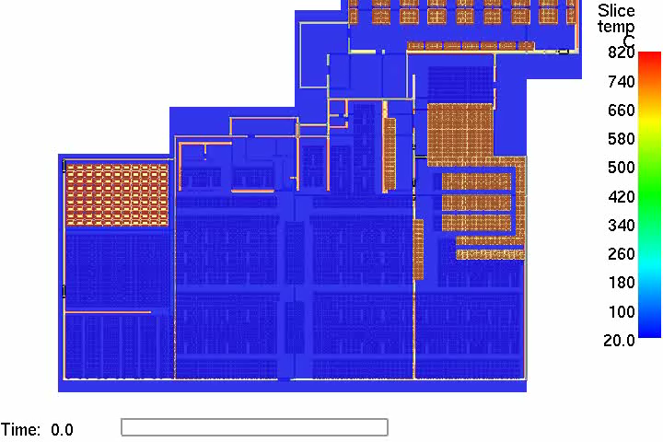
Temperature in the Sofa Super Store
Computer Simulation
1510 ºF
Loading
Dock
Main
Showroom
East
Showroom
West
Showroom
70 ºF
Front of Store
Temperature Slice - 5 ft above floor
20 x real time

Slide 13
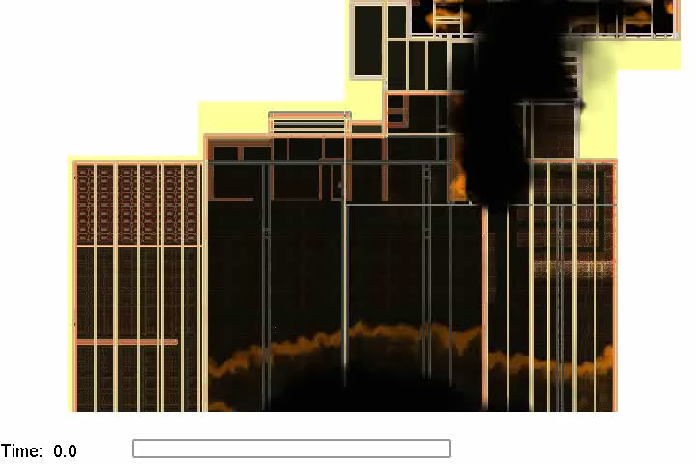
Smoke and Fire Spread in the Sofa Super Store
Computer Simulation
Loading
Dock
Loading
Dock
Main
Showroom
Main
Showroom
East
Showroom
West
Showroom
West
Showroom
East
Showroom
Front of Store
Smoke & Fire Slice Elevation - 5 ft above floor
20 x real time

Slide 14
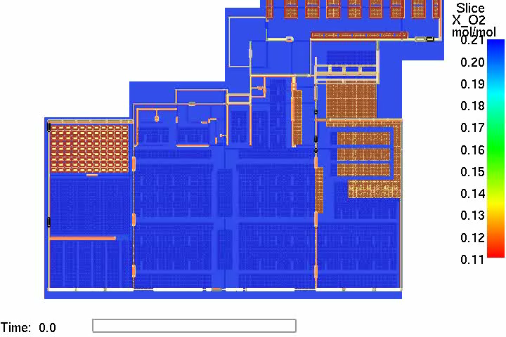
Oxygen in the Sofa Super Store
Computer Simulation
21 %
12 %
Oxygen Elevation - 5 ft above floor

Slide 15
Key Findings – Initial Conditions
1) Large amount of foam-filled furniture in showrooms (480 GJ),
loading dock (130 GJ), and warehouse (840 GJ)*
2) Large open areas
Showroom Warehouse Loading Dock
Main 17100 ft² 15800 ft² 2220 ft²
West 7020 ft²
East 6940 ft²
3) No automatic water sprinklers anywhere in store
* 100 gallons of gasoline contains about 12 GJ of energy

Slide 16
Key Findings – Fire Spread into Showrooms
1) Smoke and flames entered the holding area through
the open roll-up door (non-fire activated).
Fire spread was not visible from the main and west
showroom during the early stages (5 to 10 minutes after
fire department arrived).
3) Smoke and flames flowed from the holding area
into the space above the main showroom drop ceiling.
4) Fire spread into rear of main showroom. Fire spread slowed
by limited oxygen, ventilation limited.
5) Layer of smoke and unburned fuel collected under ceiling in main
and west showrooms; smoke filled floor to ceiling

Slide 17
Key Findings – Fire Spread into Showrooms
6) Fire began to slowly move towards front of store.
7) Front windows broken out.
8) Additional oxygen flowed in through broken windows and
fire spread rapidly to front of main showroom (west side).
9) Fire quickly spread across front of store, moved toward east
showroom, into west showroom, and then rear of main
showroom (east side).

Slide 18
Key Findings – Showroom Conditions
Simulation time when conditions became untenable *-
Time until Temperature Oxygen
Untenable Conditions greater than less than
120 C or 250 F 0.12
West Showroom -
Front 23.3 min 26.6 min
Rear 22.5 min 25 min
West Main Showroom -
Front 15 min 21 min
Rear 15 min 21 min
East Main Showroom -
Front 22.5 min 23.3 min
Rear 21 min 23.3 min
* Ability to escape unassisted

Slide 19

Non-Sprinklered and Sprinklered Simulations
No sprinklers were present in Sofa Super Store
Computer Simulations
Temperature Slice - 5 ft above floor
Sprinklers inside
Loading Dock
Non-sprinklered
Sprinklers activate at
50 seconds and 75 seconds

Slide 20
Key Findings – Fire Spread
Sprinkler Scenario Simulation
1) Sprinklers controlled fire on loading dock
2) Sprinklers activated at 50 s and 75 s
3) Conditions remained tenable throughout showrooms

Slide 21
Study Recommendations:
Furniture Stores represent unique fire hazards:
a) large quantities of foam-filled furniture
b) large open space
1) NIST recommends: All state and local jurisdictions should adopt model building and fire code covering new and existing high fuel-load mercantile occupancies.
Hazardous conditions identified by routine inspections by skilled inspectors with appropriate follow –up
a) lack of sprinklers
b) non-fire roll-up door
c) wood framing of loading dock
2) NIST recommends: All state and local jurisdictions implement aggressive fire inspection and enforcement programs and ensure that inspectors are professionally qualified to a national standard.

Slide 22
Study Recommendations:
Lack of sprinklers
a) no sprinklers in loading dock, showrooms, or warehouse.
b) sprinklers inside loading dock controlled fire in less than
1.5 minutes
3) NIST recommends: All state and local authorities adopt and enforce model code requirements for sprinkler systems
a) for all new commercial retail furniture stores regardless of size; and
b) for existing retail furniture stores with any single display
area of greater than 190 m² (2000 ft²).

Slide 23
Study Recommendations:
Research Recommendations
Upholstered Furniture Flame Spread –
  a) prediction of ignition,
b) prediction of fire spread, and
c) smoke and toxic gas generation
Improving Fire Barriers –
  a) fire spread through walls
  b) fire spread through doors, glass, wood, & metal
  c) perf. of roll-up doors in actual fires and extended service
Decision aids for resource allocation
  a) computer-aided decision tools
  b) computer models to assist communities in allocating resources
4) Ventilation of Burning Structures
  a) characterize how vent. affects growth and spread of fire
  b) provide fire service with guidance on when and how to
  use ventilation to improve fire conditions
Performance Metrics for Fire Protection
  a) performance and effectiveness metrics for community fire
  protections
  b) survey effectiveness of existing fire services

Slide 24
NIST welcomes comments on Draft Report
Web site to view draft final report: http://www.nist.gov/el/investigations/bfrl-investigations.cfm
(All comments received by December 2, 2010 will be considered prior to issuing the NIST Final Report)
Submit comments to:
E-mail: firesafety@nist.gov
FAX: (301) 975-4052
Mail address:
NIST Technical Study: Sofa Super Store
National Institute of Standards and Technology
100 Bureau Drive, Stop 8660
Gaithersburg, MD 20899-8660

Slide 25
Next Steps-
1) Consider and incorporate public comments
2) NIST will work with model code organizations to incorporate
recommendations in national model code
3) NIST will work with the major organizations representing state
and local governments, including building and fire officials, and fire
fighters to incorporate recommendations
4) Develop new performance standards and test protocols for
fire protection systems
5) Conduct additional research in
a) Upholstered Furniture Flame Spread –
b) Improving Fire Barriers
c) Decision aids for resource allocation
d) Ventilation of Burning Structures
e) Performance Metrics for Fire Protection

