Slide 1
Meeting Agenda
Welcome
Cybersecurity Career Week (CCW) Overview
Getting Engaged in CCW
Q&A
Participation and Collaboration
Thank You
Goals
Resources
Notes:
Objectives for the meeting:
Inform stakeholders about CCW and the multiple ways to get involved
Encourage others to commit to doing something independently for the week
Form a tiger team/working group that will meet regularly to contribute to a collective product or activity for CCW

Slide 2
Save the Date slide

Slide 3
What is Cybersecurity Career Week? Inspiring and promoting awareness and exploration of cybersecurity careers
Cybersecurity Career Week is a campaign to promote the discovery of cybersecurity careers and share resources that increase understanding of multiple learning pathways and credentials that lead to careers that are identified in the Workforce Framework for Cybersecurity (NICE Framework).
Notes:
Cybersecurity Career Week (CCW) aims to inspire, educate, and engage citizens to pursue careers in cybersecurity. Previously titled National Cybersecurity Career Awareness Week, starting in 2021, CCW will take place the third week in October. This will support the existing Cybersecurity Awareness Month and better aligns with out international partners/ planned events. [Previously it took place during November’s National Career Development Month. ]
Each day of the week-long campaign provides an opportunity to learn about the contributions and innovations of cybersecurity practitioners, and the plethora of job opportunities that can be found when exploring cybersecurity as a career choice.
During the week, learners of all ages, educators, parents, employers, and the community participate in a national recognition of how cybersecurity plays a vital role in global society and --showcasing how building a nation’s cybersecurity workforce enhances each nation’sl security and promotes economic prosperity.

Slide 4
Cybersecurity Career Week Goals
Inspire, Engage, and Inform
Goal 1: Inspire, Engage, and Inform the Nation
Inspire, engage, and inform the public about the demand, opportunities, and multiple career options available within the area of cybersecurity
Demystify
Goal 2: Demystify Careers in Cybersecurity
Raise awareness about pathways to prepare a highly skilled and diverse workforce for careers in cybersecurity to include expansion of knowledge and application of the NICE Cybersecurity Workforce Framework
Develop
Goal 3: Develop a Highly Skilled and Diverse Workforce
Support successful programs and showcase effective resources, especially those that increase participation of women, minorities, veterans, persons with disabilities, and other underrepresented populations
Notes:
Celebrate how the cybersecurity workforce makes a difference in our world
Increase public dialogue about the need for cybersecurity workforce
Bring cybersecurity to life for kids, educators, and parents

Slide 5
Cybersecurity Career Week Objectives and Key Messaging
Objectives
Raise public awareness and increase engagement in building a strong cybersecurity workforce.
Emphasize the demand and opportunities in cybersecurity.
Increase awareness around the multiple career options within the field of cybersecurity.
Highlight the multiple pathways to enter the cybersecurity career field.
Showcase resources and programs, including those that increase participation of women, minorities, veterans, persons with disabilities, and other underrepresented populations in the cybersecurity workforce.
Key Messaging
Cybersecurity has something for everyone! Skills are needed from a diverse range of backgrounds.
Cybersecurity is a dynamic field so you will never be bored. Cybersecurity evolves quickly so you will always be learning and developing new skills.
There is a high demand for a talented cybersecurity workforce. Data predicts that IT and cybersecurity will be among the fastest growing and best paying jobs over the next decade.
Cybersecurity plays a vital role in the lives of all global citizens and the cybersecurity workforce makes a difference in our world. Building a qualified cybersecurity workforce enhances national security and promotes economic prosperity.
Notes:
Cybersecurity Career Week aims to inspire, educate, and engage citizens to pursue careers in cybersecurity. Cybersecurity Career Week takes place during November’s National Career Development Month. Each day of the week-long campaign provides an opportunity to learn about the contributions and innovations of cybersecurity practitioners, and the plethora of job opportunities that can be found when exploring cybersecurity as a career choice.
During the week, learners of all ages, educators, parents, employers, and the community participate in a national recognition of how cybersecurity plays a vital role in the lives of Americans and how building a national cybersecurity workforce enhances America’s national security and promotes economic prosperity.
Celebrate how the cybersecurity workforce makes a difference in our world
Increase public dialogue about the need for cybersecurity workforce
Bring cybersecurity to life for kids, educators, and parents

Slide 6
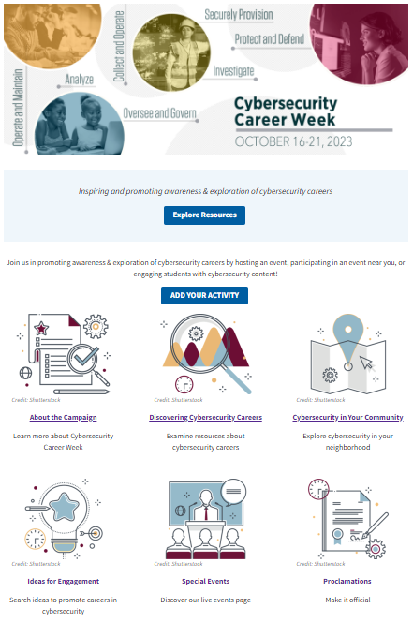
Resources
www.nist.gov/nice/ccw

Slide 7
Discovering Cybersecurity Careers
Career Briefs, Tools, and Resources
Work Role Videos
Posters and Infographics
Workforce Demand Data

Slide 8
Ideas for Engagement
Social Media
#cybercareerweek
#mycyberjob
Downloadable graphics
Downloadable sample social media
Host a twitter chat to answer questions about a cybersecurity related topic
Write a blog or news article
Acknowledge your hard-working cybersecurity co-workers or provide a social or potluck (virtual) to celebrate their contributions
Participate in office-wide cybersecurity related competitions, trainings, or special events.

Slide 9
Ideas for Engagement
Bring your mini/future-cybersecurity worker to workday (virtual)
Encourage your cybersecurity workers/ colleagues to sign up for trainings or compete in a CtF competition
Host a career talk for employees or co-workers
Host a training or professional development activity for educators
Explore cybersecurity resources in your neighborhood. Tour suggestions and virtual tours have been added to Cybersecurity In Your Community section of CCW website
Participate in the GLOBAL call to cybersecurity workers to visit a classroom and introduce K-12 students to careers in cybersecurity (visit the NICE CCW website for resources and ideas)

Slide 10
Examples of Special Events and Activities Partnership Asks
Make a commitment and add your commitment/s to the online portal
Get involved and share
Cybersecurity Career Awareness Capture the Flag Competition
Cybersecurity Career Awareness Scavenger Hunt
Cybersecurity Careers Family Nights
Cybersecurity Careers Story Time
Social Media Competition
Poster contest
Volunteer for a recorded webinar or podcast
Join others in sharing your short videos or stories on social media about what you love most about your cybersecurity career. Or, for fun, ask others to answer the question, “what does a cybersecurity worker do?”
#mycyberjob #cybercareerweek
@NISTcyber LinkedIn: nist-nice/
http://nist.gov/nice/ccw

Slide 11
Save the Date slide image
18
16
17
19
20
21
MONDAY
TUESDAY
THURSDAY
FRIDAY
SATURDAY
WEDNESDAY
Notes:
International Globe Photo Credit:
https://www.google.com/url?sa=i&url=https%3A%2F%2Fen.ir.huji.ac.il%2F&psig=AOvVaw3sJZqaVIg54yIJB9Joruiz&ust=1623272973729000&source=images&cd=vfe&ved=0CAIQjRxqFwoTCODVoqT5iPECFQAAAAAdAAAAABAD

Slide 12
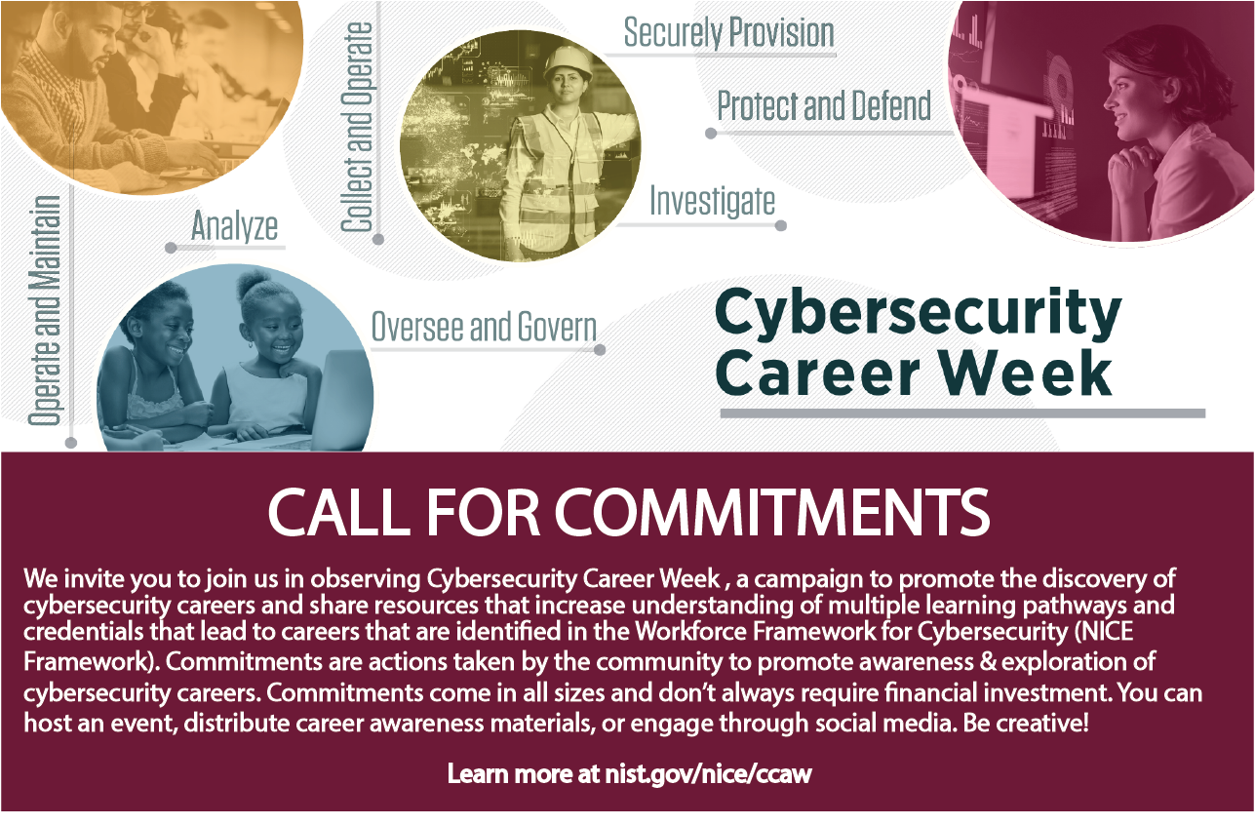
Commitments: https://www.nist.gov/form/nice-ccaw-events
Notes:
Pause to see if any attendees can share (if they participated in past years) or can commit to doing something this year/share ideas they have
Ask to see if others have career resources we can add to toolkit

Slide 13
New ideas and suggestions always welcome!
Planning Goal: coordinate an activities or resources on cybersecurity careers
Please email dpruitt@nist.gov if you have additional ideas or if you would like to join our planning group!
Notes:
Shutterstock/izkes

