Slide 1

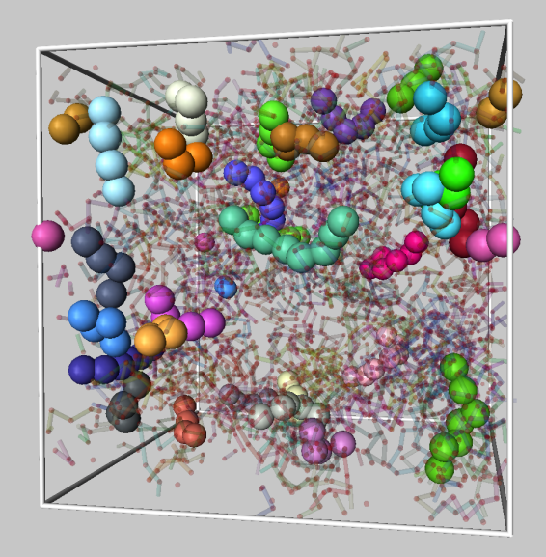


Diffusion and Relaxation in Cooled Liquids and Heated Crystalline Materials
Jack Douglas, NIST
Francis Starr, Wesleyan University
Beatriz Betancourt (NIST)
Hao Zhang, University of Alberta

Slide 2




Beatriz Pazmiño Betancourt
Polymer Thin Films and Nanocomposites, NIST
Francis Starr
Physics Department
Wesleyan University
Hao Zhang
Department of Chemical and Materials Engineering, University of Alberta

Slide 3
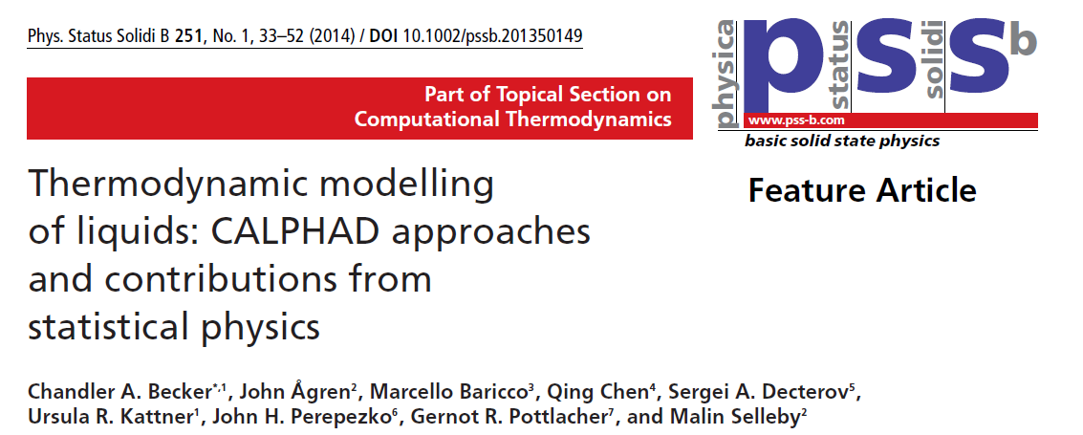
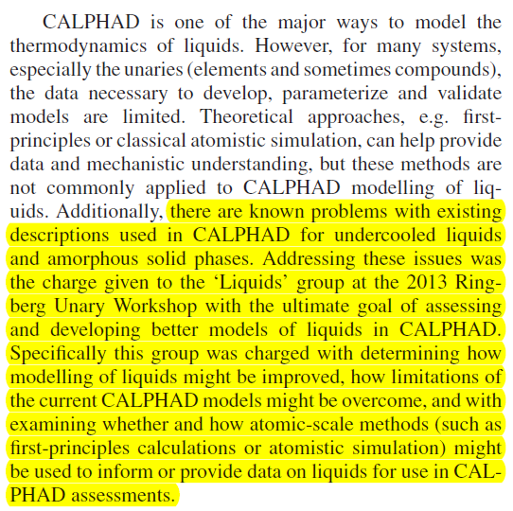

Slide 4
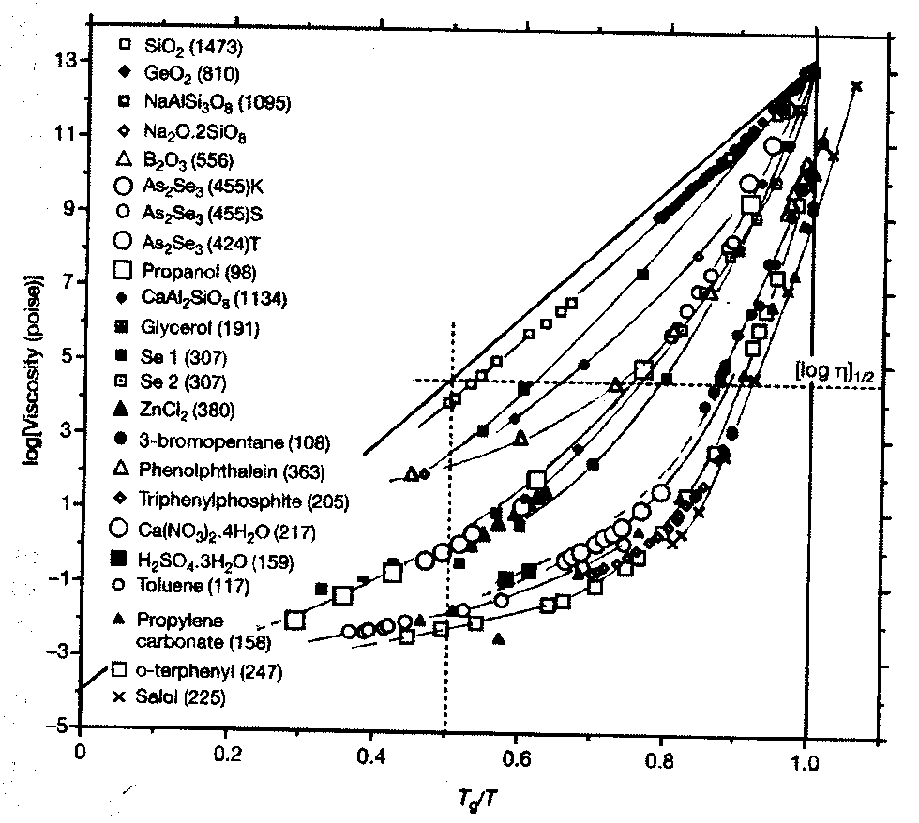
The transport properties of cooled liquids
such as the self-diffusion coefficient, shear viscosity, and structural relaxation times are typically non-Arrhenius over a large T range.
Log η
τ ≈ τ∞ exp [D T0 / (T –T0)]
Volgel-Fulcher-Tammann
Equation
m
T_{g} ≈ (2/3) T_{m}
T_{g} / T

Slide 5
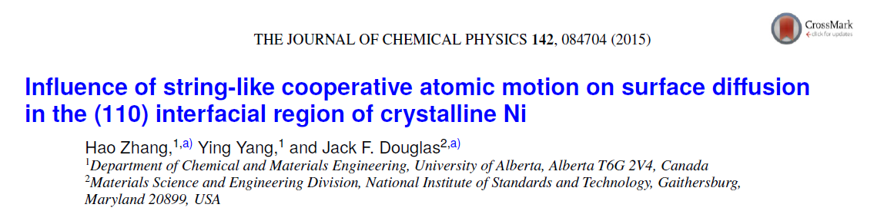
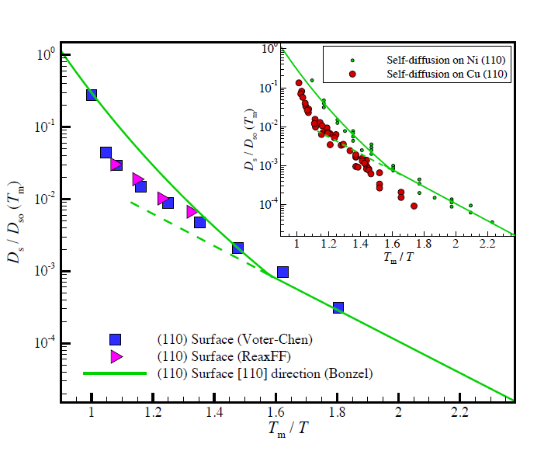
T_{Tammann} ≈ (2/3) T_{m}
Reduced Variables-
Enhanced Potential
Tranferability?

Slide 6
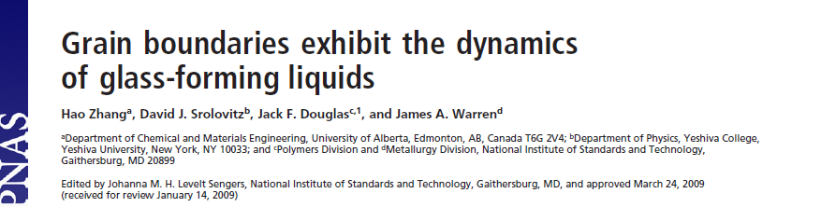
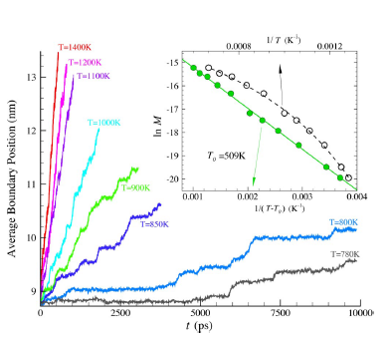

Slide 7
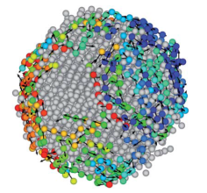
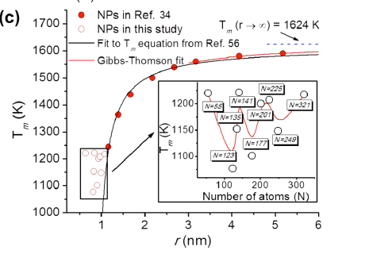
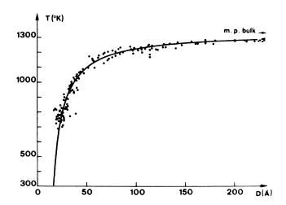
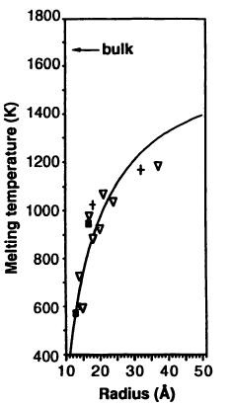

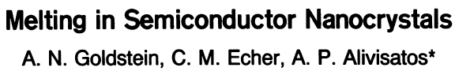
Something to Bear in Mind in Relation to the Relevance of this Phenomena to Metallurgical Interests apart from Metallic Glasses and Melt Processing
The high surface-to-volume ratio of “nanostructured materials” such as nanoparticles, fabricated nanostructures, nanograins of polycrystalline solid metal materials (additive manufacturing context) by virtue of the Gibbs-Thompson effect:
T_{m} = T_{m}(bulk) - # (a /λ) , λ = characteristic confinement length
Au nanoparticles
CdSe
NPs
PRA 13,2287 (1976)
Simulation Ni NPs
ACS Nano 8, 7465
(2014)

Slide 8
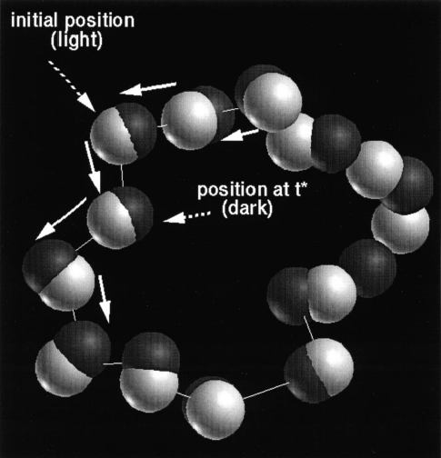
Recently, both simulations and experiments have revealed that the dynamics of diverse condensed ‘amorphous’ materials at equilibrium are characterized by significant heterogeneity in the local mobility and by a progressively increasing collective motion upon cooling that takes the form of string-like collective particle rearrangements linked to
the rate of structural
relaxation and diffusion.

Slide 9
What this means in practice is that the lines between hard and soft matter science start to become Blurred
• Conceptual approaches from complex fluids, especially polymer fluids, begin to take on great relevance to describing the transport properties of metallurgical materials
• Study of metallurgical materials can give great insights into the dynamics of polymer materials- Really!

Slide 10
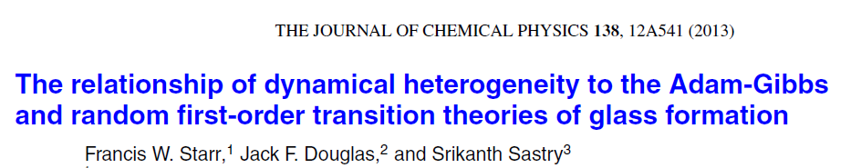
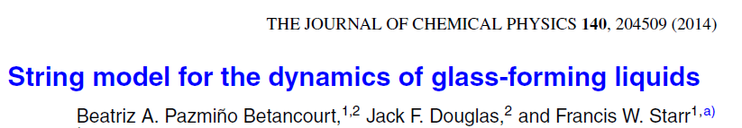
Tune Liquid Dynamics by Varying Structure of Fluid Molecule, Confinement, Additives, Pressure
Polymers Are Great Model Systems For This Type of Study!

Slide 11
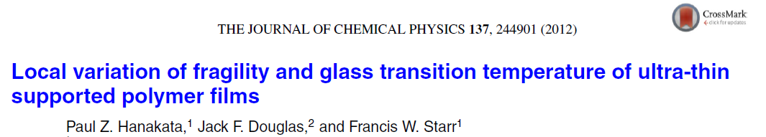

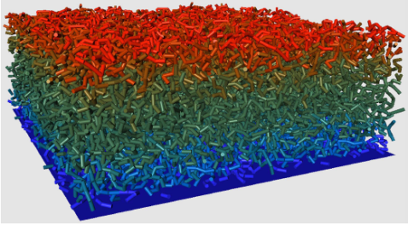
Thin Polymer Films
Riggleman et al., PRL 97, 045502 (2006)

Slide 12
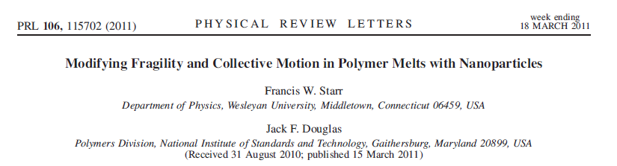
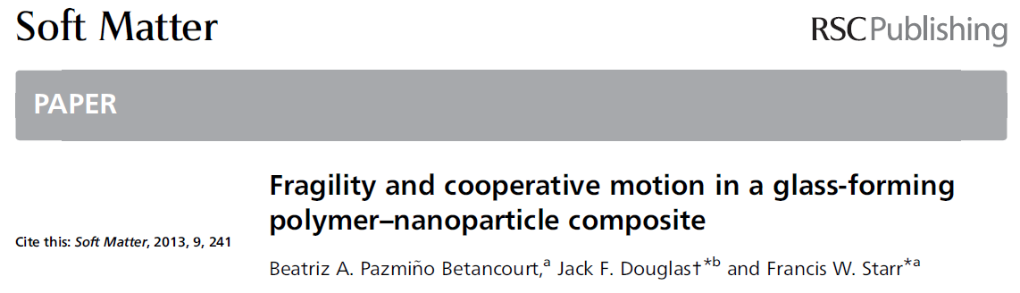
Polymer Nanocomposites

Slide 13
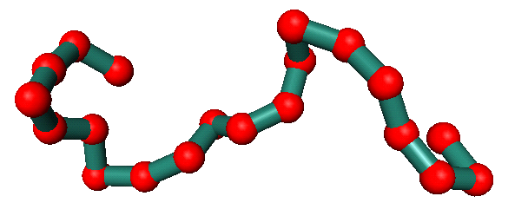
FENE Polymer Model
Equilibrium molecular dynamics simulatin of a dense polymer melt
400 chains of 20 monomers each (un-entangled)
Fixed density ρ = 1.0 / Constant pressure
Wide temperature range: 0.30 < T < 2.5 (T_{A} / ε ≈ 0.7, T_{c} / ε ≈ 0.35)
frustration /glass formation
V
bonds
r
Approximate mapping to real units
  Monomer size ≈ 1 nm to 2 nm
  Interaction strength ε ≈ 1 kJ / mol
  T_{g} ≈ 100˚C
non-bonded
monomers

Slide 14
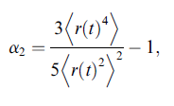
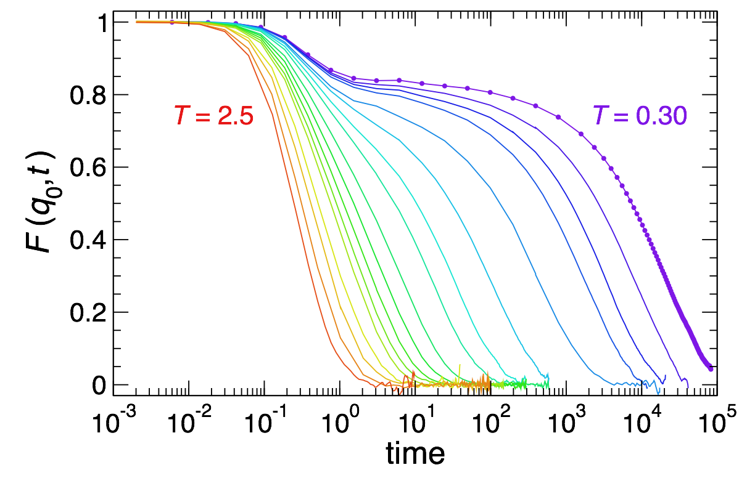
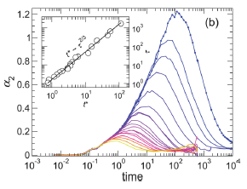

Some Basic Properties: Pure Polymer Melt
Structural relaxation time
“Decoupling”- FSE

Slide 15
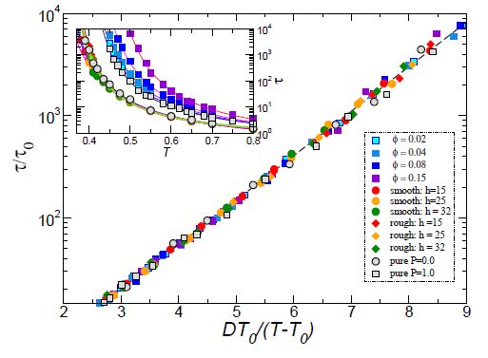
Comparison of Simulations to VFT Relation
Betancourt et al.
PNAS 112, 2966 (2015)

Slide 16
Adam-Gibbs Model / RFOT
Physical argument / three assumptions:
Relaxation is an activated process associated with local
particle motions at high temperatures and cooperative particle rearrangements associated with the precipitous drop in the configurational entropy, s_{c.}
2) The activation energy E_{a} for long wavelength structural relaxation is extensive in the mass L of the dynamic particle clusters (CRR) that are the physical expression
of cooperativity, E_{a} ~ L. Pretty vague about their form!
Thermodynamic Connection
3) L ~ 1 / s_{c .} Bigger clusters - larger τ, fragility ⇒ L(T)

Slide 17
Thermally Activated Transport

Slide 18
Activated Dynamics at High Temperatures
Still not really understood much beyond Eyring arguments
Coarse-Grained Polymer Melt
Riggleman et al., PRL 97, 045502 (2006); JCP 126, 234903 (2007); PRE 76, 011504 (2007)

Slide 19
Cooperative Molecular Motion and Relaxation

Slide 20
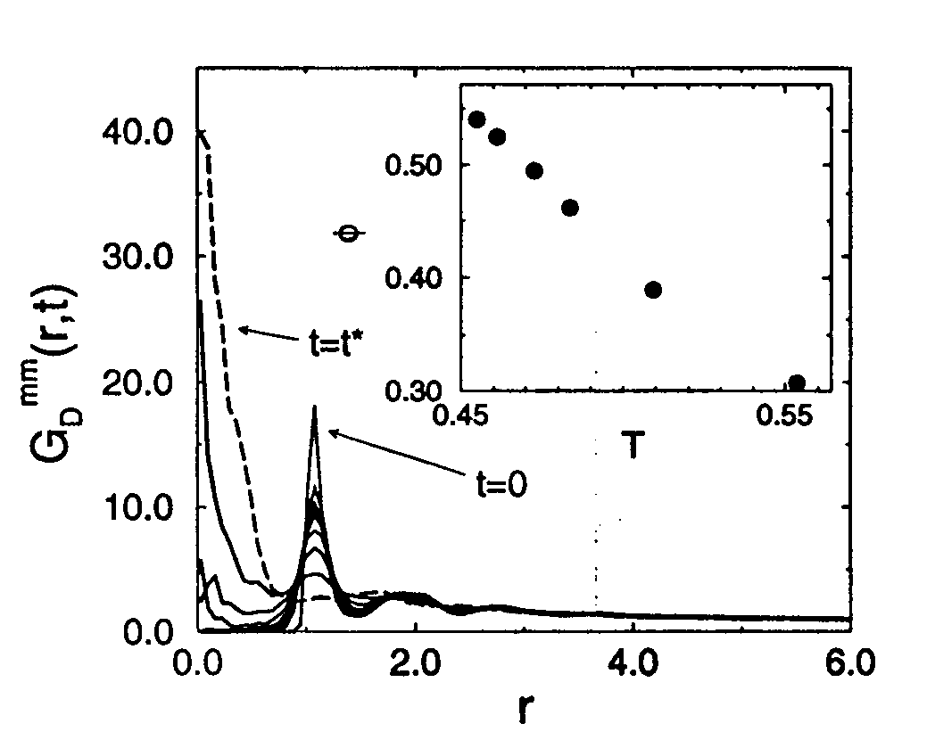
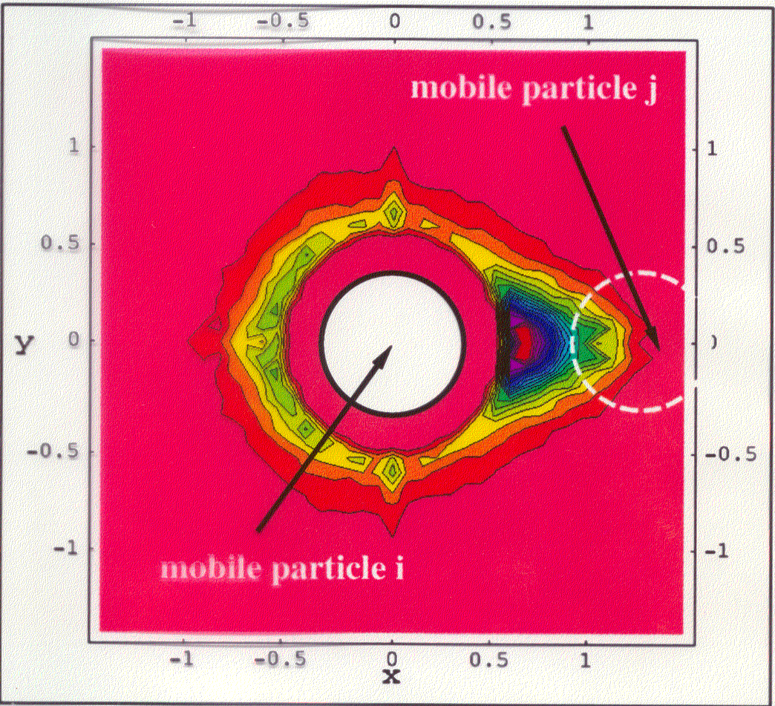
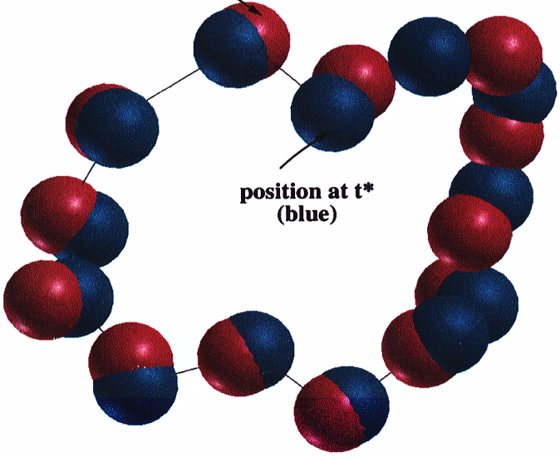
Quantifying Collective Motion
Pronounced asymmetry of distribution indicates that it is more probable for a mobile particle to move in the direction of another mobile particle than any other direction,
‘strings’

Slide 21
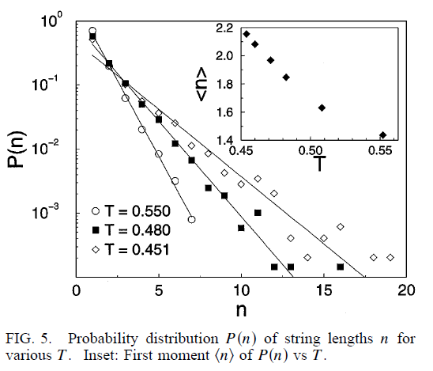
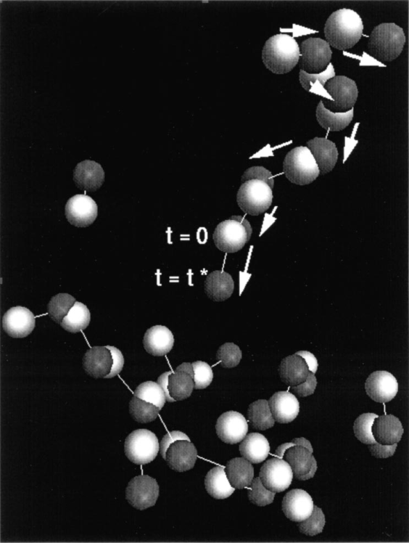
Cooperative Motion in Glass-Forming Liquids
Donati et al., PRL 80, 2338 (1998); Cond Matt 9706277v1
Binary LJ mixture
‘Strings’
L

Slide 22
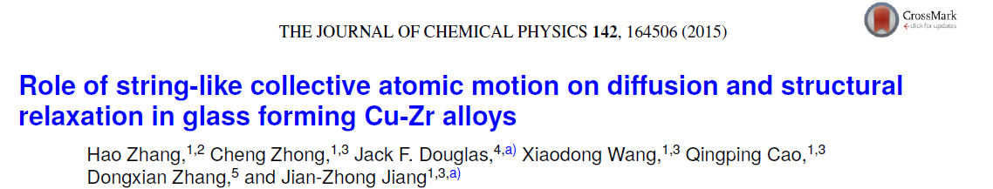
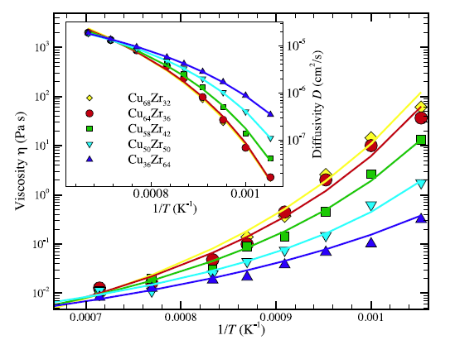
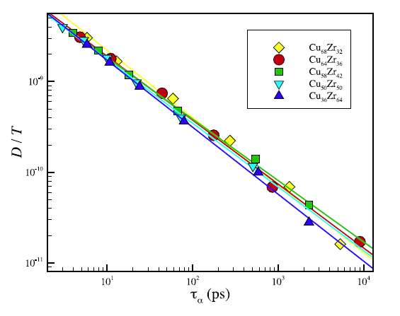
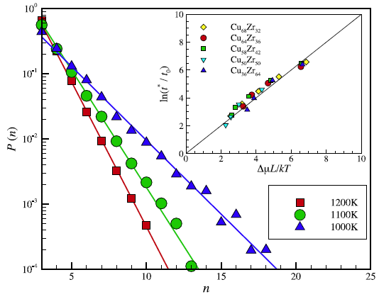
“Decoupling”
“Fractional Stokes-Einstein Relation”
D / T ~ (1/τ_{α})^{1 - ς}
ζ ≈ 0.29 ± 0.03

Slide 23
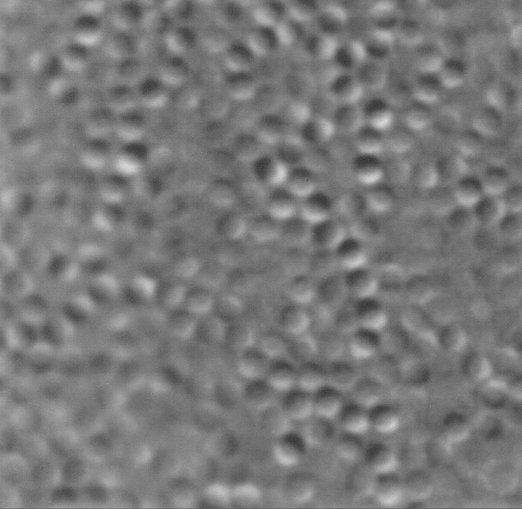
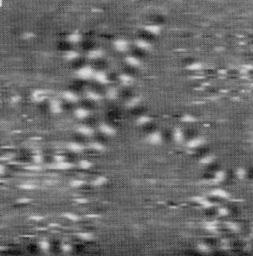
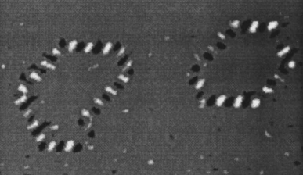
Cooperativity and Adam-Gibbs Model
Dynamic clusters involving cooperative motion growing in scale upon cooling or upon increasing concentration in particle suspensions can be directly observed b
Phenomenon seems to be universal, even more general than glass-forming liquids!
Weeks

Slide 24
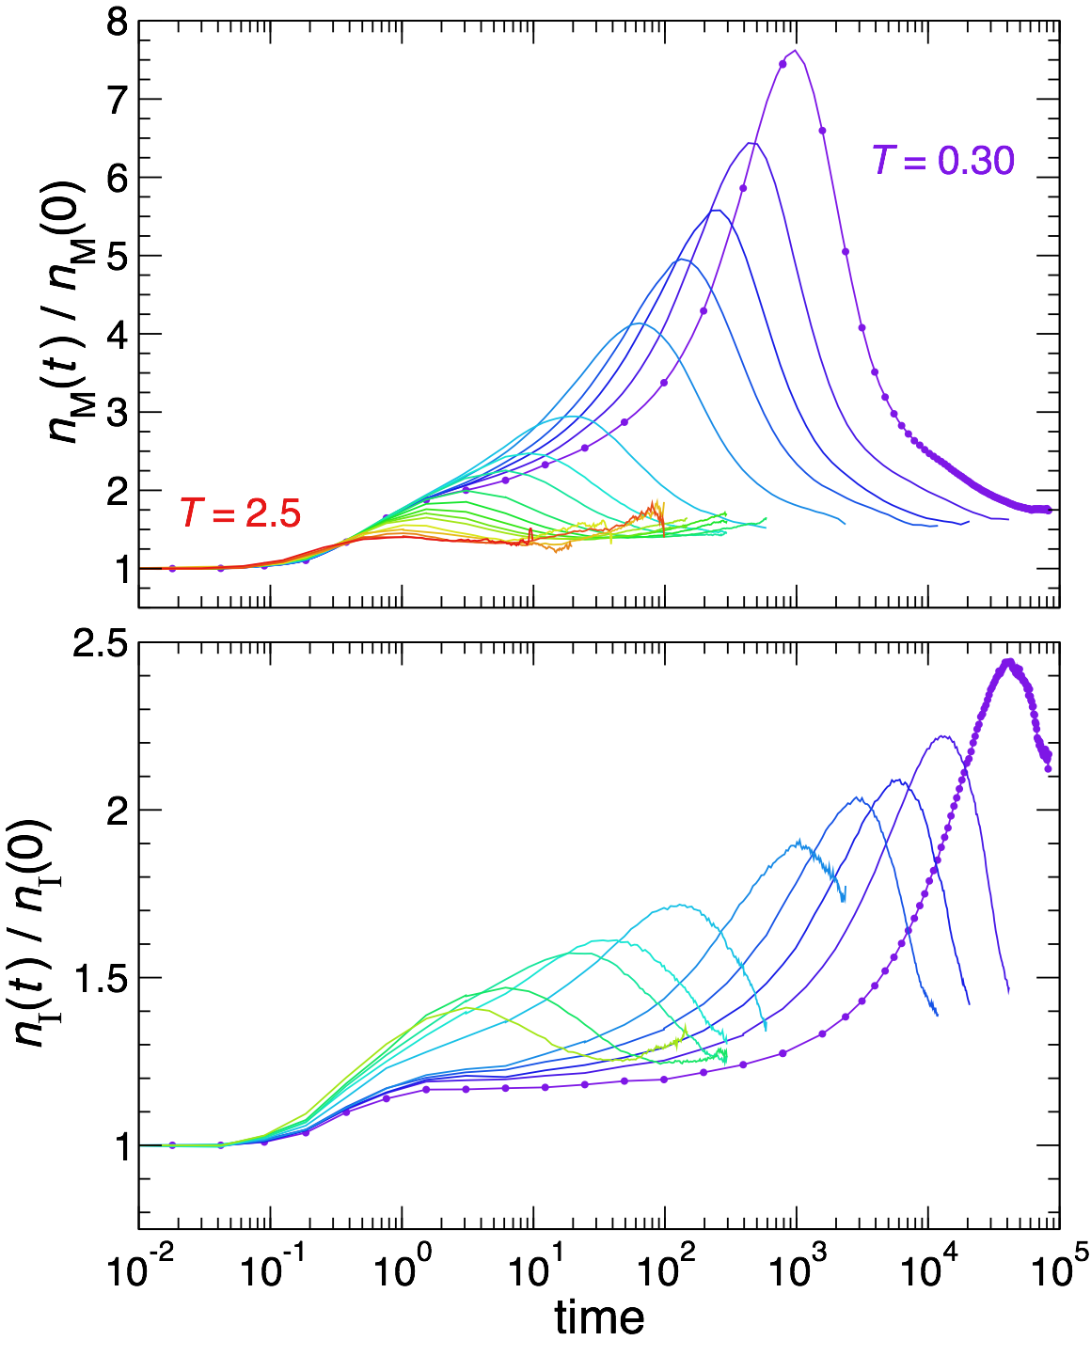
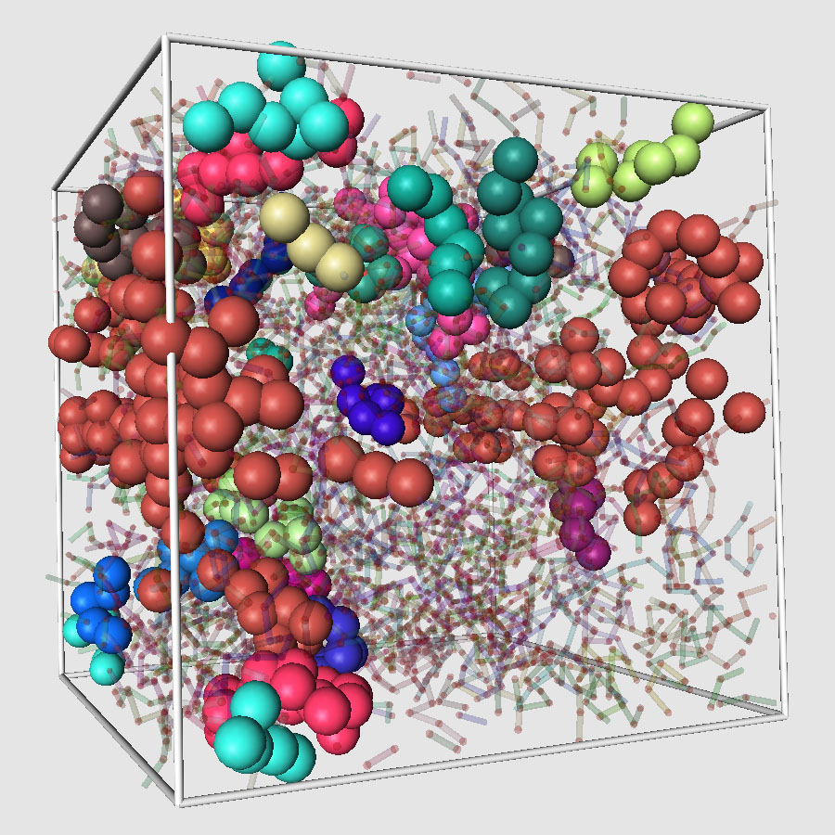
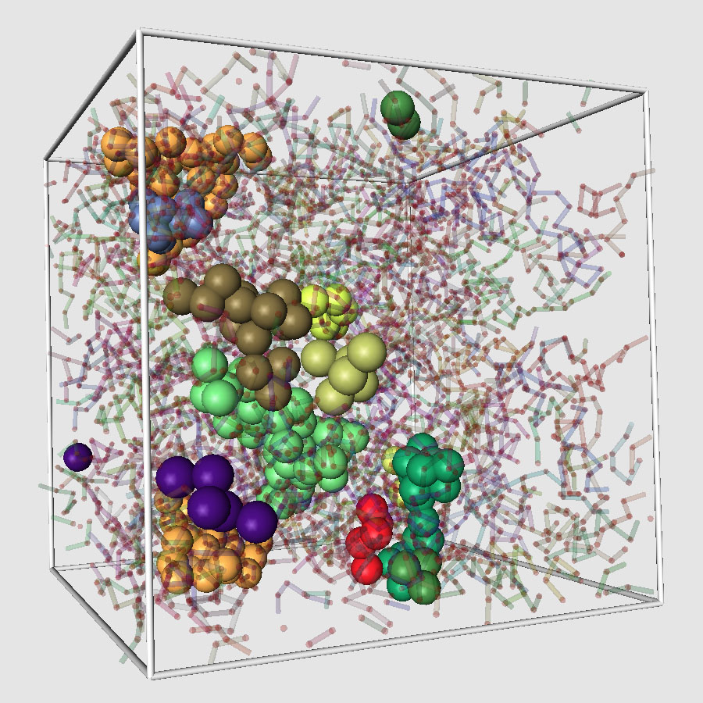
Dynamic Heterogeneity: Polymer Melt
Mobile
Immobile

Slide 25
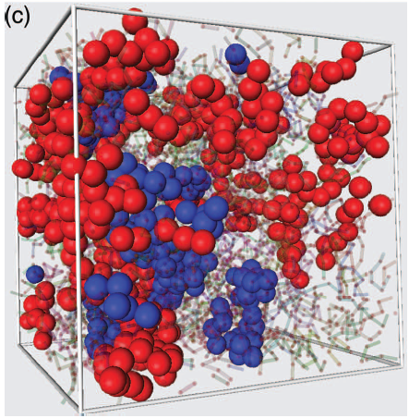
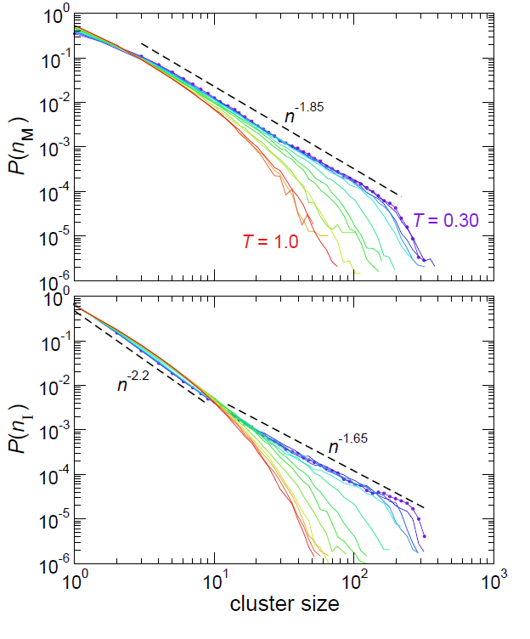
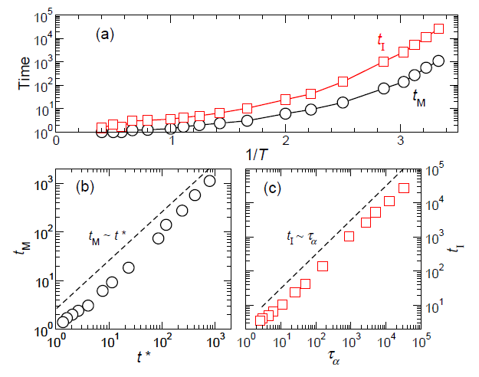
Mobile and Immobile Particle Clusters
Mobile, M
Immobile, I

Slide 26
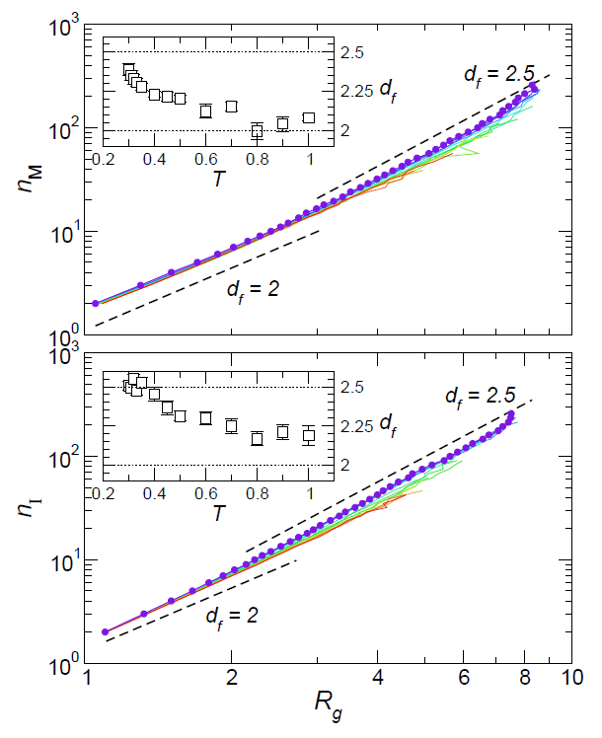
Mobile and Immobile Particle Clusters-
Equilibrium Branched Polymers
Mobile, M
Immobile, I

Slide 27
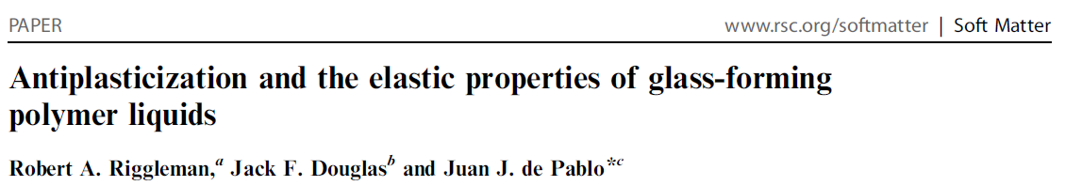
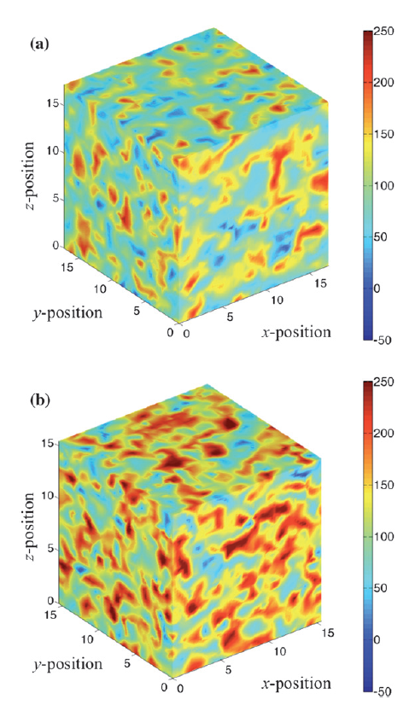
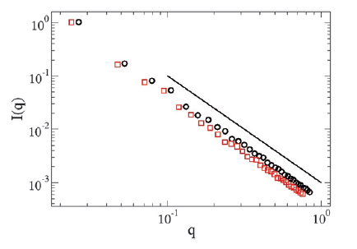
Elastic Constant Fluctuations in Glass

Slide 28
String-like Cooperative Motion in Polymer Melt

Slide 29
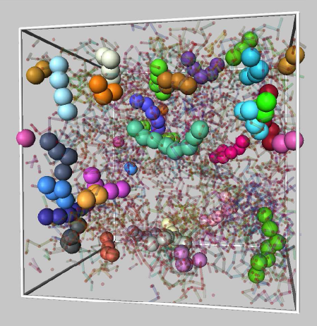
Strings in the Pure Polymer Melt

Slide 30
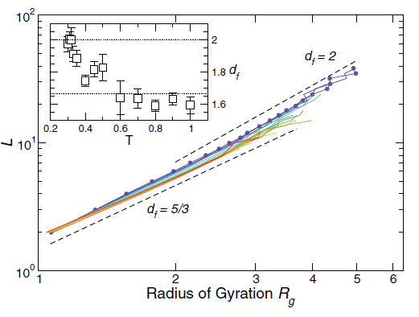
Strings are Self-Avoiding Polymers

Slide 31
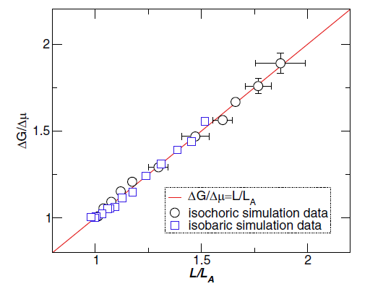



Slide 32

( )

Slide 33


Polymer Nanocomposites
Betancourt, Hanakata, Starr, Douglas, PNAS , March issue (2015))

Slide 34



String-like Collective Dynamics in the
Dynamics of Crystal Interfaces

Slide 35



Physical Aging

Slide 36
Entropy-Enthalpy Compensation

Slide 37

Entropy-Enthalpy Compensation in Polymer Films
Slope defines the
“Compensation
Temperature”
Tcomp ≈ 0.18
Tcomp ≈ T0 of bulk polymer?

Slide 38
Ni Diffusivity / Different X’stal Interfaces
Activation energy and pre-factors for
different surfaces are nicely compensated
See also: Boisvert et al., PRL 75, 469 (1995) ; Papageorgiou
and Evangelakis, Surface Science 461, L-543 (2000)

Slide 39
“Strings” - Ubiquitous Form of Collective Excitation in Condensed Matter

Slide 40



Cooperative Motion in the Glassy Grain
Boundaries of Polycrystalline Materials
Zhang et al., PNAS 106, 7735 (2009)
Granular fluid - PRE
81, 041301(2010)
Expt: Ganapathy et al., PNAS (2011)

Slide 41



Cooperative Motion on NP Surfaces
Ni Nanoparticle (2 nm) / catalytic temperature range
Zhang, Kalvapalle and Douglas, Soft Matter 6, 5944 (2010)

Slide 42

String-like Collective Dynamics in the
Dynamics of Crystal Interfaces
Also:
Cu-Zr
metallic
glasses

Slide 43



Collective Motion in Melting and Freezing
J. Phys. Chem. B, 115, 14068 (2011)

Slide 44



Special issue on glass-forming liquids - online

Slide 45


String-like Collective Dynamics in the Atomic
Motions of Membranes?

Slide 46


String-like Collective Dynamics in the Atomic
Motions of Proteins ?
ubiquitin
T= 277 K

Slide 47
Conclusions
• The problem of understanding the dynamics of liquids, and other forms of strongly interacting non-crystalline matter (“Soft Matter”) is a central difficulty in many materials design applications, especially those involving elevated temperatures and nanostructured materials
• Simulations on a wide range of materials indicate that a general type of excitation exists in non-crystalline materials (“strings”) whose significance for diverse forms of Soft Matter might be comparable to dislocations, and other lattice defects, in their influence on the properties of crystals.

Slide 48



Basic Problem: How to determine string length?
Dynamic Heterogeneity →Mobility fluctuations Mobility fluctuations should imply ‘noise’ ????
New Finding: 1/ f^{α} or ‘colored noise’ having a power α is related to string length, L = <n>.
Zhang and Douglas , Glassy Interfacial Dynamics of Ni Nanoparticles: Parts I – II, Soft Matter (2013)
breathers

Slide 49


Slide 50



Slide 51





Particle and additive induced changes in crystallization morphology
Nature Materials 2, 92 (2003)
PRE 65, 051606 (2002)
Nature Materials 3, 645 (2004)
PRE 72, 011605 (2005)
Spherulites
See also for block copolymers: Phys. Rev. Lett. 99, 216101 (2007)

Slide 52



Relaxation, free volume, elasticity
and collective motion
Different faces of same coin ? PNAS (March Issue)

Slide 53

Andrade Creep
Universal Property of Condensed Amorphous Matter
J(t)
Struik
T ≈ T_{g}
t, sec

