Slide 1
a perspective on usability and safety in health IT
dean calcagni, MD

Slide 2
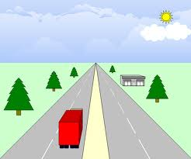
observations intended to provide a perspective and to stimulate conversation

Slide 3
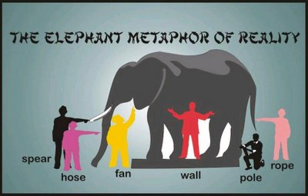

Slide 4

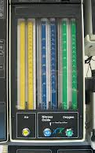
standards

Slide 5
where we have been
agreed
upon
standards
proprietary
standards
open
systems
architecture
DHHS / ONC
carrots
sticks
  if health IT products were more usable, incentives xxxx and penalties wouldn’t be needed
  - financial sector for consumer
    • ATM machine
    • on line banking

Slide 6

detour sign

Slide 7
annual DOD spending on health IT
$200M for R&D
$2B to operate and maintain

Slide 8
AHLTA is at the heart of DOD health IT

Slide 9
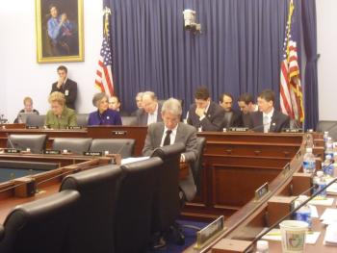
“AHLTA is ‘Intolerable,’ Where Do We Go From Here?”
Actual title of Congressional Hearing
Joint Hearing
  House Armed Services Committee Military Personnel Subcommittee
  Terrorism, Unconventional Threats and Capabilities Subcommittee
March 24, 2009

Slide 10
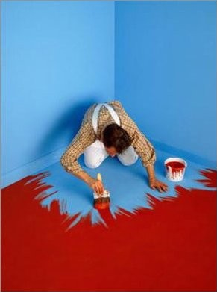
situation with DOD healthcare IT

Slide 11
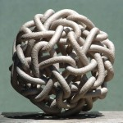
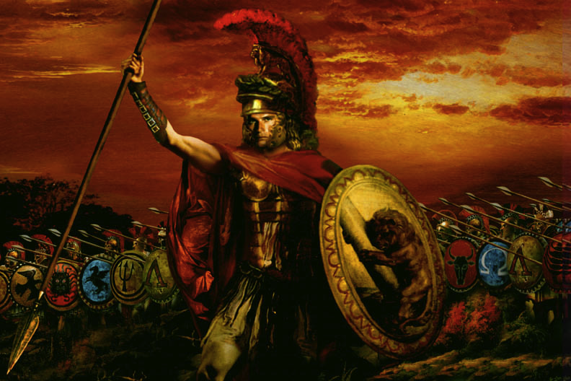
Gordian Knot
in Phrygia [a section of Turkey] there was an intricate knot
it was prophesized that the one to untie the knot would become the king of Asia
Alexander the Great came to Phrygia with great aspirations
initially frustrated in his attempts to untie the knot

Slide 12
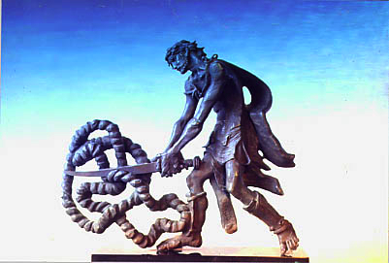
Alexander’s solution

Slide 13
DOD/VA interoperability
iEHR program for ~ 20 yrs
  a succession of generals / admirals in charge
  recently a civilian retired army officer
iEHR office probably will get phased out
RFI on street
likely to move to open systems architecture

Slide 14
where we have been
agreed
upon
standards
proprietary
standards
open
systems
architecture
Dept of Commerce / NIST
encourage
facilitate

Slide 15
NIST
the Nation's Measurement Laboratory
working with industry
  medical software industry
  healthcare delivery ‘industry’
EMR products are B2B products

Slide 16
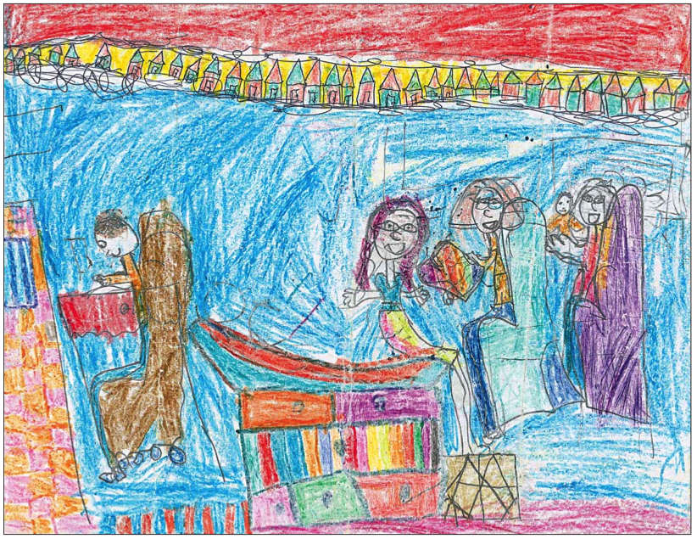
usability
The Cost of Technology JAMA, June 20, 2012—Vol 307, No. 23 p2497

Slide 17
limitations of EMRs
usability
  - data entry
interoperability
disparate databases
The Cost of Technology JAMA,
June 20, 2012—Vol 307, No. 23 p2497

Slide 18
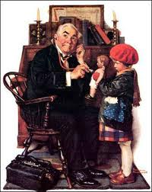




NIST
before / after
before
after

Slide 19
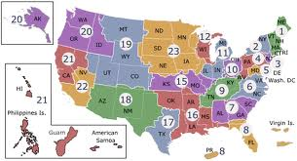
veterans affairs VISN regions
22 regions means more than 22 different versions of VistA

Slide 20
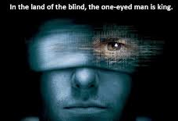
in the land of the blind the one eyed man is king
poster from the movie Minority Report [2002]
latin: in regione caecorum rex est luscus, credited to Desiderius Erasmus's Adagia (1500).

Slide 21
today is about moving to the right
is it in your interest?
low hanging fruit
most obvious, easiest actions
where we have been
agreed
upon
standards
proprietary
standards
open
systems
architecture

Slide 22
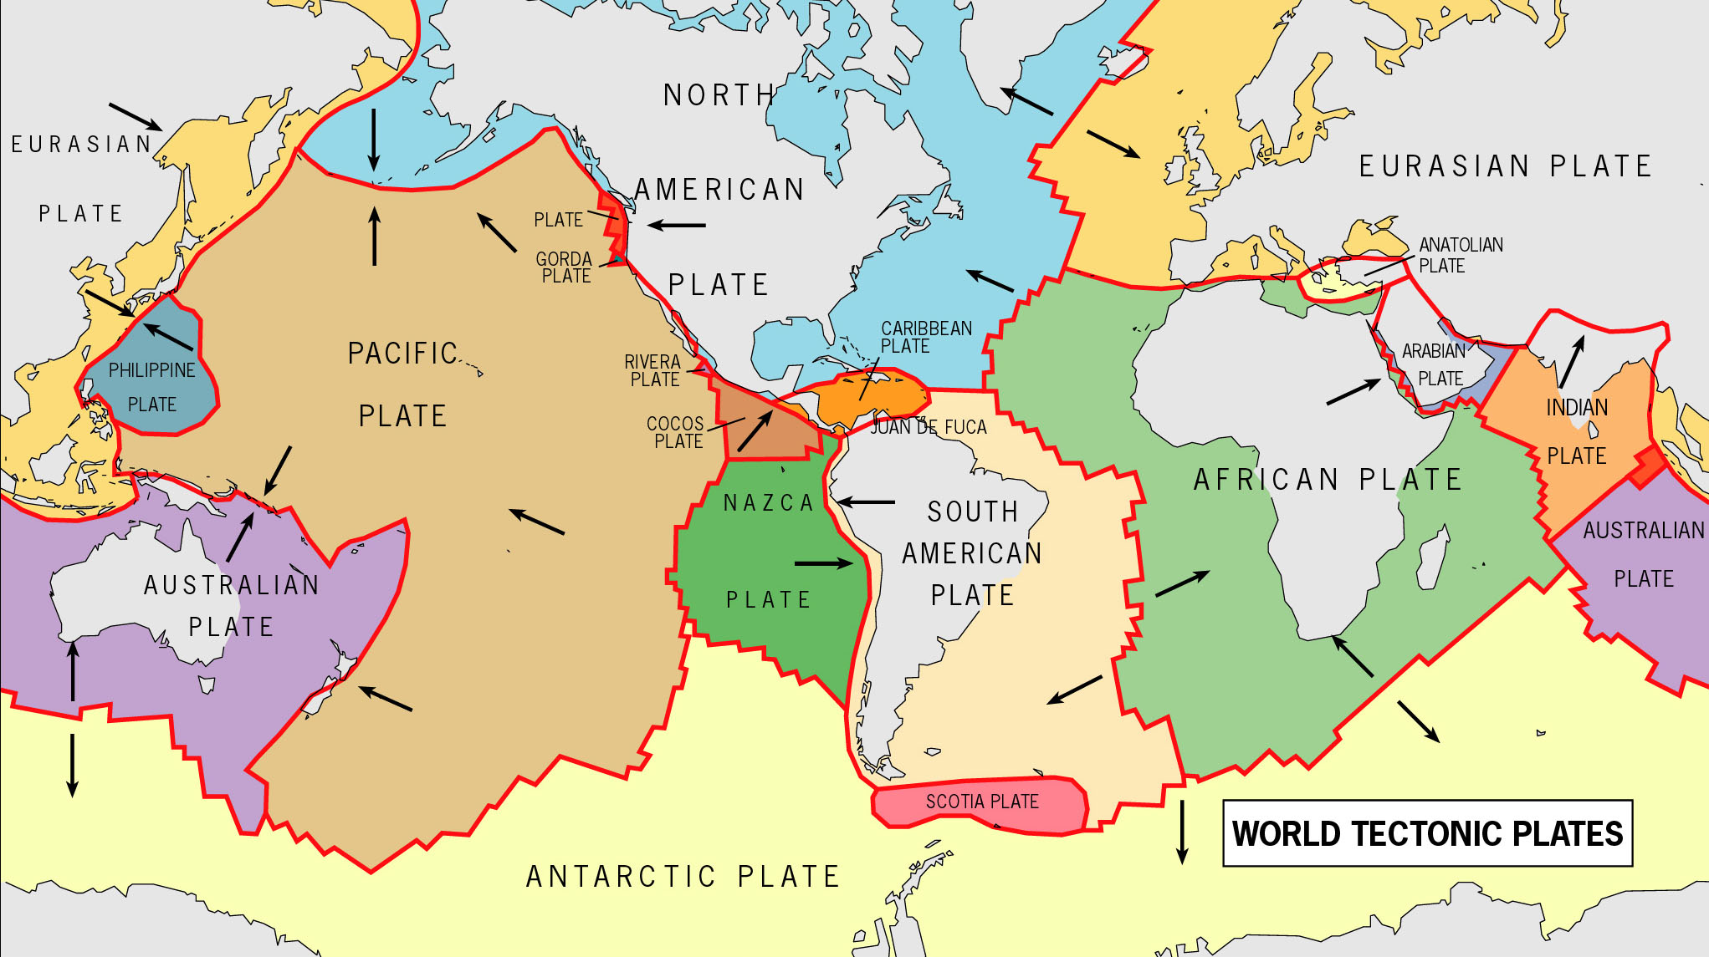
tectonic plates
pressure is building

Slide 23

18% of gdp and increasing

Slide 24
Dean E. Calcagni, M.D. dcalcagni@tiag.net
240-818-6525 / cell
questions?

