Slide 1
From Lab Environments to Production Requirements: Simulating, Deploying, and Operating Commercial QNs
Cara Alexander
VP of Product
Aliro Technologies, Inc.
Aliro · IEEE Quantum Week 2026 · Toronto

Slide 2

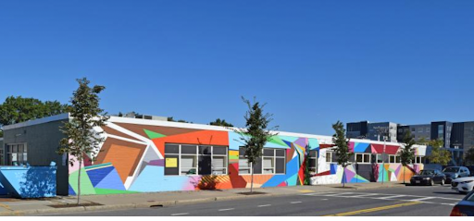
Software for entanglement-based quantum networks
The Quantum Networking Company®
2019
Spun out of a Harvard research lab
Boston
Headquarters
7 years
Building one software suite
Aliro headquarters, Boston
Aliro Simulator
AlirOS
Aliro Orchestrator
Design and predict
Control the node
Run the network
Our goal: bring quantum networking out into the world and realize its full potential.
Aliro · IEEE Quantum Week 2026 · Toronto
2 / 21
Notes:
Aliro spun out of a Harvard research lab in 2019 and is headquartered in Boston. Over the past seven years we've built a software suite for entanglement-based quantum networks. Our goal is to bring quantum networking out into the world and realize its full potential.
This workshop is framed around experiments, simulation, and standards informing each other which is exactly how we think about our own stack. So I want to tell you why, how and where we have been doing this.

Slide 3

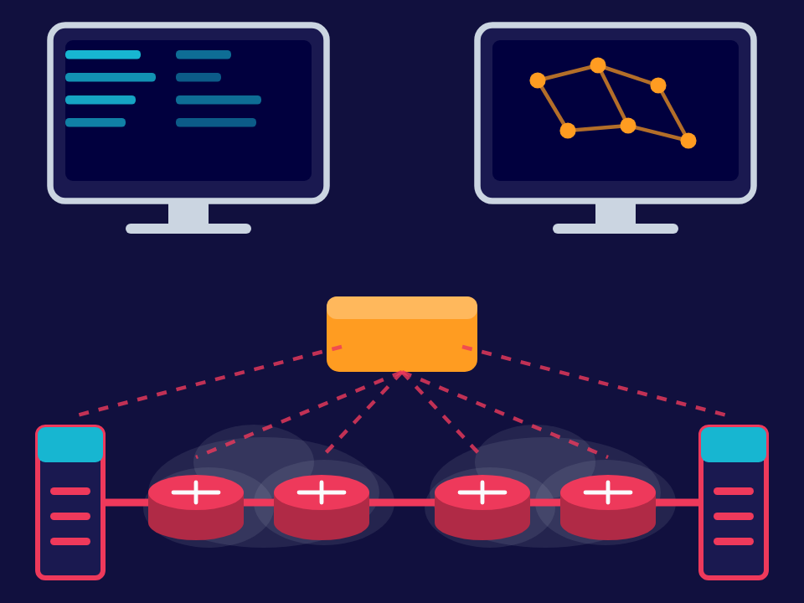
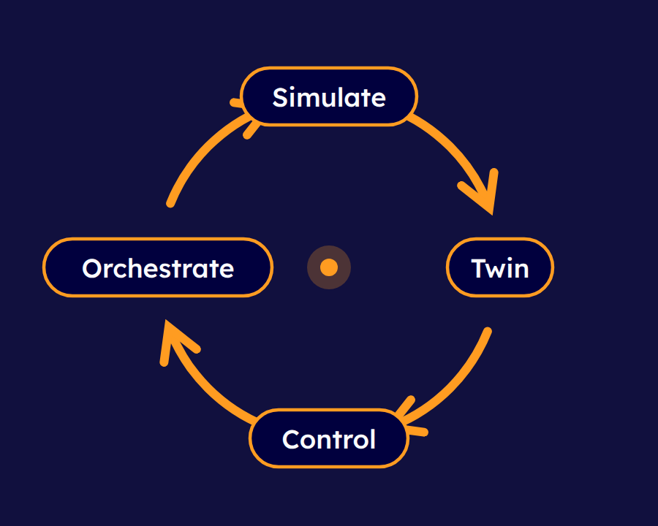
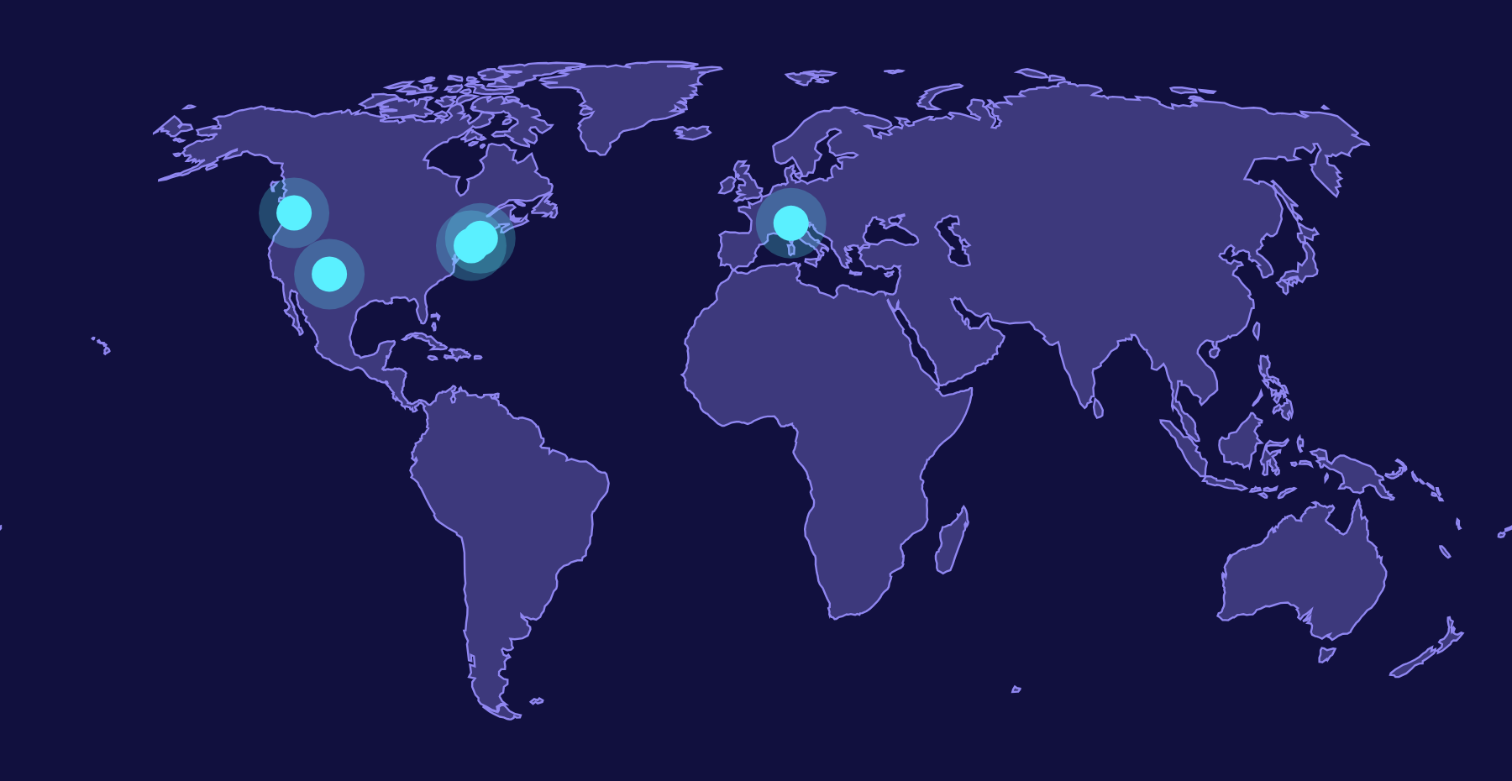
Experiments, simulation and standards informing each other
The Quantum Networking Company®
Why
What
How
Where
quantum networks?
have we built?
do these inform one another?
is all this working?
Aliro · IEEE Quantum Week 2026 · Toronto
3 / 21
Notes:
Why quantum networks?
What we have built?
How do these inform one another?
Where is all this working?

Slide 4
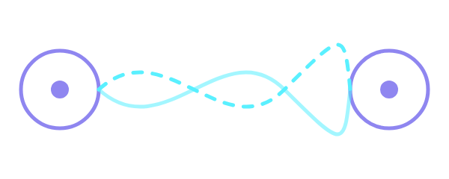
Why quantum networks
The Quantum Networking Company®
To protect
To enable
Trust is under pressure from every side
New services that only entanglement makes possible
Generative AI that can look and sound like anyone
Location spoofing and novel cyber attacks
Quantum computers approaching the threshold for breaking public-key cryptography
Distributed quantum computing
Position verification
Enhanced sensing
…and services yet to be imagined
Entanglement distributes shared randomness rooted in the physics of reality, not in computational assumptions. Encryption, authentication, signatures: a trust fabric no future compute budget can erode.
Aliro · IEEE Quantum Week 2026 · Toronto
4 / 21
Notes:
We are passionate about quantum networks for two reasons, first for their capacity to protect.
With the rise of generative AI that can make you look or sound like anyone, VPN location spoofing, and novel cyber attacks, concrete foundations of trust have never been so critical to human wellbeing and safety. At the same time, quantum computers are getting closer all the time to the threshold at which they will be able to break the math underpinning public key cryptography.
Quantum entanglement provides a future proof foundation of distributing shared randomness based not on computational assumptions, but rather on the quantum mechanical properties of reality itself.
Using this for encryption, authentication, digital signatures, and more will provide society with a trust fabric that can hold up no matter what the future’s compute power throws at us.
Secondly, we see enormous potential for quantum networks to provide new entanglement based services distributed quantum computing, position verification, enhanced sensing, and some that have yet to be imagined.

Slide 5
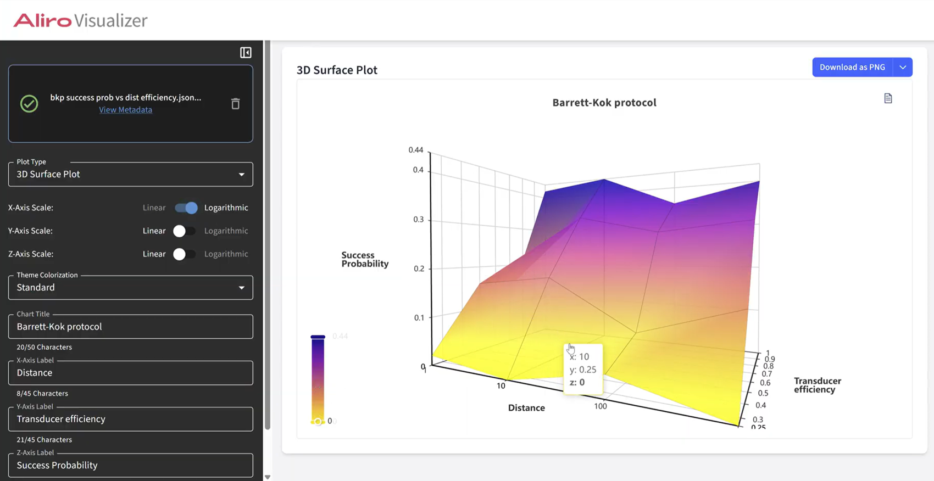
Physics modeling meets network planning
Simulator
The Quantum Networking Company®
Picosecond discrete events
Photon arrivals, clicks and sync windows, validated against real timing
Multiple state backends
From a high-fidelity memory swap to a large heterogeneous network
Component library
Swap sources and detectors, compare vendors, model hybrid networks
Realistic noise, across a day
Loss, decoherence, temperature change, polarization drift, real fiber characterization, moving nodes, and more
Graphical interface
No-code workflows for designing and running simulations
Scalable design tool
Aliro Visualizer: parameter scans and simulation output, no code required
Parameter scans, cloud compute, parallel runs, GPU acceleration, and PennyLane optimization
Aliro Emulator
A faster path to realistic outputs of specific protocol implementations, at the level of abstraction you need
secret keys
raw key bits
detector clicks
Aliro · IEEE Quantum Week 2026 · Toronto
5 / 21
Notes:
Aliro Simulator is a single environment for physics modeling and network planning. As our simulation lead Brian shared at his Monday talk it was shaped to meet research, development, and deployment needs both internally and externally. Because of this, it needed to be flexible enough to work at different levels of abstraction.
Aliro Simulator
Discrete-event simulation. Quantum networks are driven by timed events: photon arrivals, detection clicks, synchronization windows. A discrete-event framework reaches picosecond time resolution and validates designs against real behavior rather than idealized rate formulas. That matters because timing-sensitive effects are frequently the determining factor in whether a protocol works at all.
Multiple state-computation backends. A small, high-fidelity study of a memory-assisted swap and a large heterogeneous network study need different state representations, so the simulator provides several and lets you choose.
A library of quantum and classical device components. Real deployments are hybrid, multi-vendor systems. Generic components mean you can swap a source or a detector, compare vendors, and model mixed environments without rewriting the model.
Realistic noise models. Loss, decoherence, drift, and timing misalignment are central to both performance and security. The simulator models how daylight, temperature change, polarization drift, and even moving nodes change network output over time, and it takes real fiber characterization such as OTDR traces as input. So the simulated network behaves the way a deployed one does across a day, not just at t equals zero.
Usability. No-code workflows for simulation setup, execution, and visualization.
Design Tool: Convenient workflows for cloud compute, simulation parallelization, GPU acceleration, parameter scans, data processing, and optimization via pennylane plugin
Aliro Emulator
A new, faster way to generate realistic outputs of specific protocol implementations at different levels of abstraction (secret keys, raw key bits, or detector clicks).
Behind both is rigorous software validation, maintenance, and high test coverage with industry-standard tooling.
In practice, users estimate realistic quality, capacity, and robustness before deployment; compare hardware modalities and vendors; test protocol logic; evaluate candidate fiber routes and topologies; make strategic hardware design choices; and reduce integration risk before buying hardware.

Slide 6
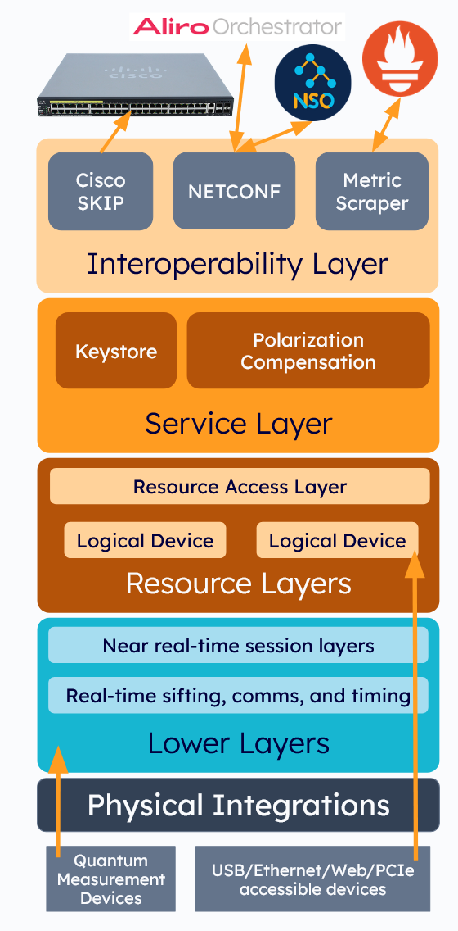
The operating system of a node
AlirOS
The Quantum Networking Company®
Today
Nodes running BBM92 entanglement-based key distribution
Tomorrow
The same platform, built to run the Quantum Internet
Five layers
A layered architecture that combines diverse individual quantum networking hardware components into capable nodes
Aliro · IEEE Quantum Week 2026 · Toronto
6 / 21
Notes:
AlirOS is the control plane and software platform that combines quantum networking hardware components into capable nodes. Today those nodes run BBM92 entanglement-based key distribution. The same platform is built to run the Quantum Internet tomorrow. It's a layered architecture with five layers, so let me go bottom-up.

Slide 7
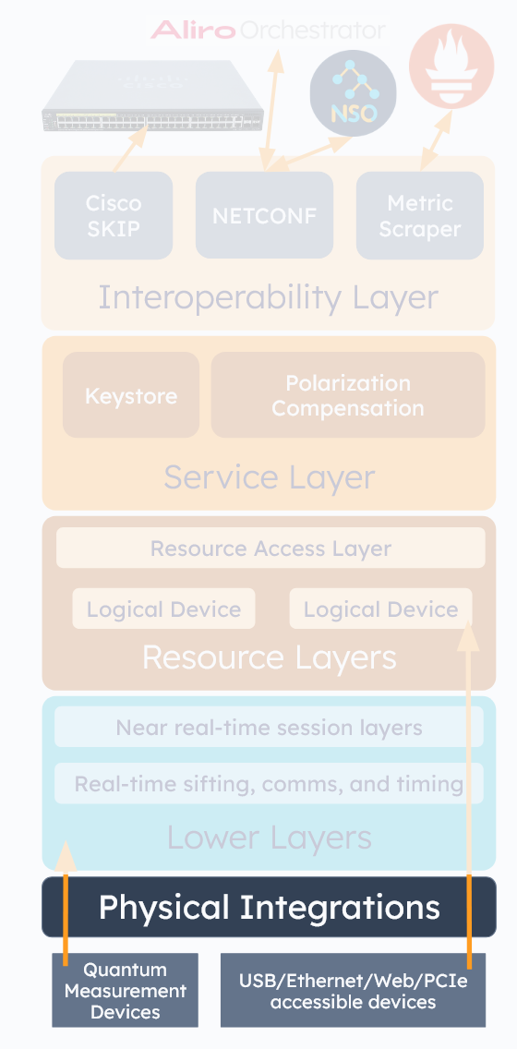
Physical Integrations
AlirOS
The Quantum Networking Company®
At the bottom, AlirOS talks to hardware.
TTL
USB · Ethernet · web · PCIe
Fast, direct connection to photon detectors
Easy integration with anything reachable over a standard interface
Example devices
Entangled photon sources
Photon detectors
Bespoke measurement modules
Motorized polarization controllers
Aliro · IEEE Quantum Week 2026 · Toronto
7 / 21
Notes:
Physical Integrations. At the bottom, AlirOS talks to hardware. Fast, direct connection to photon detectors over a TTL interface, and easy integration with anything reachable over USB, Ethernet, web, or PCIe. Example devices: entangled photon sources, photon detectors, bespoke measurement modules, motorized polarization controllers.

Slide 8
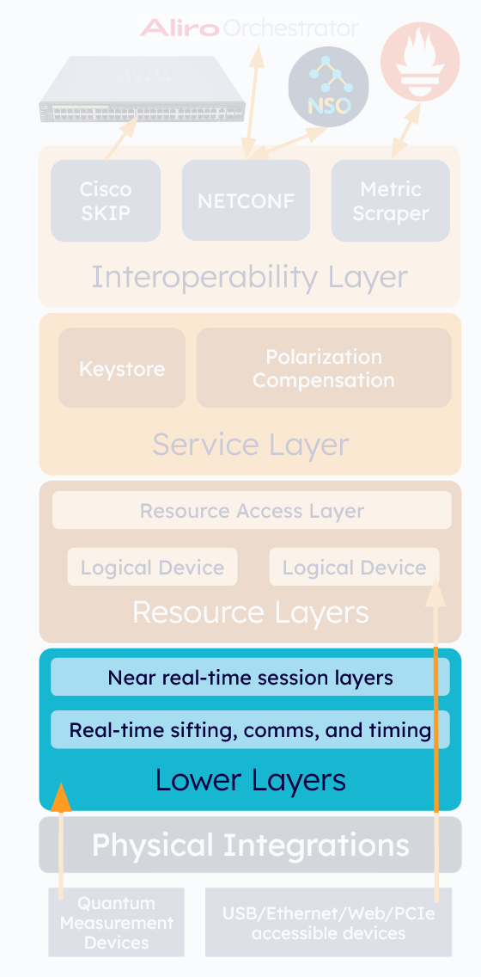
Lower Layers: real-time control
AlirOS
The Quantum Networking Company®
FPGA territory. Coincidence windows and timing feedback happen at nanosecond scales that software can't touch.
Independent timing
Protocol: fully operationalized secure BBM92 implementation
● FPGA logic timestamps detector output directly: no external time tagger, less rack space, lower BOM
● Native clock alignment via Ethernet clock recovery replaces White Rabbit in many deployments (White Rabbit fully supported)
● Software-based synchronization uses the arrival statistics of the entangled photons themselves to normalize propagation delay and identify pairs
coincidence peak finding
link viability
basis sifting
authentication
error correction
information reconciliation
privacy amplification
polarization feedback
key generation
Architected for extensibility
Module Access Layer
Session Management
New real-time modules and new hardware can be added without rearchitecting the node
Kernel & Driver APIs
Aliro · IEEE Quantum Week 2026 · Toronto
8 / 21
Notes:
Lower layers for real-time control. This is FPGA territory, because coincidence windows and timing feedback happen at nanosecond scales that software can't touch.
Independent Timing:
FPGA logic samples and timestamps detector output directly, eliminating an external time tagger, saving rack space, and cutting bill of materials.
Native clock alignment uses Ethernet clock recovery to line up distant nodes' clocks, which replaces a costly White Rabbit system in many deployments; White Rabbit is fully supported where it's preferred.
On top of that sits software-based synchronization, where the statistical arrival patterns of the entangled photons themselves are used to normalize propagation-delay offsets and correctly identify pairs.
Protocols:
Fully operationalized secure BBM92 protocol implementation: coincidence peak finding, link viability, basis sifting, authentication, error correction, information reconciliation, privacy amplification, polarization-control feedback loop, and key generation. Handling this stuff on chip drops CPU load and the platform can run on a much wider range of hardware.
The layer is architected for extensibility: a Module Access Layer, Session Management, and Kernel and Driver APIs, so new real-time modules and new hardware can be added without rearchitecting the node.

Slide 9
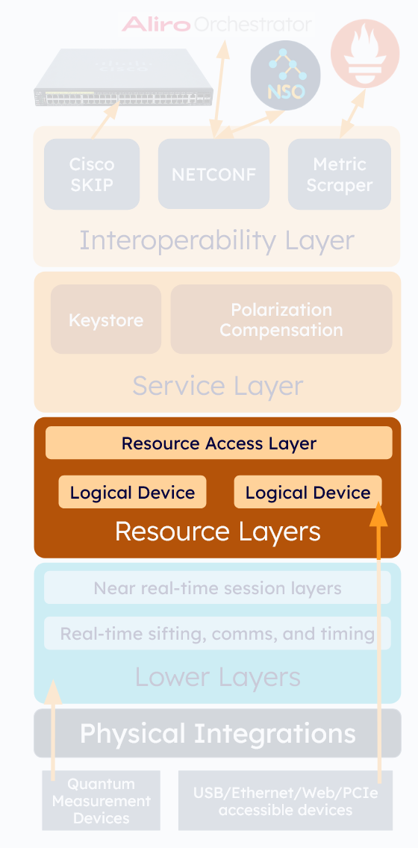
Resource Layers: abstraction and access
AlirOS
The Quantum Networking Company®
Logical Devices
Vendor-specific hardware behind common APIs for each class of device
Vendors
The system
Operators
keep complete implementation freedom
sees one consistent interface
choose on best of breed, ROI, service level, research collaboration, and compose composite devices
Resource Access Layer
brings up
activates
manages
stateful access to devices
Aliro · IEEE Quantum Week 2026 · Toronto
9 / 21
Notes:
Resource layers for abstraction and access.
Logical Devices abstract vendor-specific hardware implementations behind common APIs for distinct classes of devices. Vendors and device builders keep complete implementation freedom; the system sees a consistent interface. That's also what lets an operator select individual devices on the criteria that matter to them, best of breed, ROI, service level, research collaboration, etc and compose components into sophisticated composite devices.
The Resource Access Layer brings up, activates, manages, and provides stateful access to devices.

Slide 10
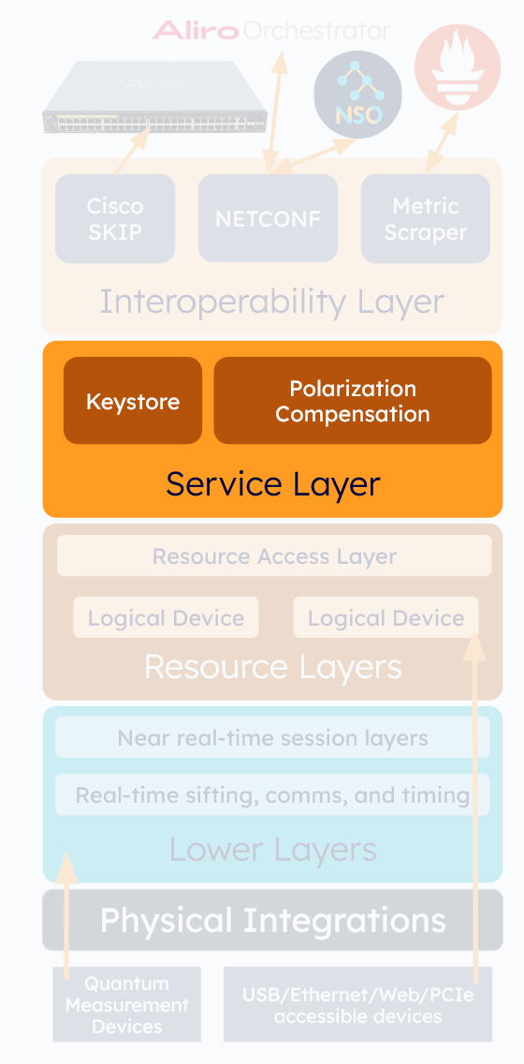
Service Layer: meeting needs
AlirOS
The Quantum Networking Company®
Modular services implement functional capabilities
Device-level interactions
Modular services
Coordinated behaviors
Structured data
Valuable outputs
Examples
Keystore
Polarization compensation
Aliro · IEEE Quantum Week 2026 · Toronto
10 / 21
Notes:
Service layer for meeting needs. Modular services implement functional capabilities, transforming device-level interactions into coordinated behaviors, structured data, and valuable outputs.

Slide 11
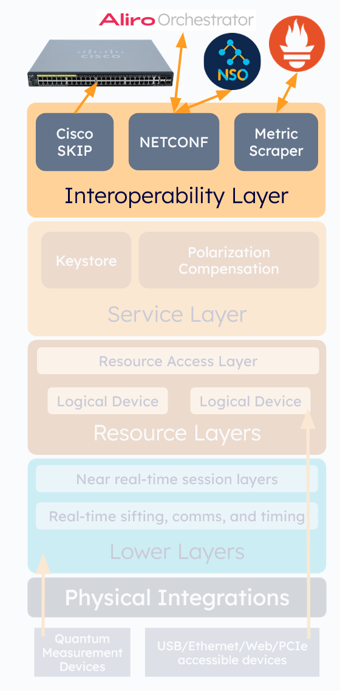
Interoperability Layer: applications and operations
AlirOS
The Quantum Networking Company®
Applications
APIs from the AlirOS RPC layer to control the node and consume quantum-derived data
Cisco SKIP
NETCONF / YANG
Native integration: existing switches and encryptors use quantum-generated symmetric keys directly from AlirOS nodes
Industry-best-practice configuration, management and control for SDN platforms like Aliro Orchestrator and Cisco NSO
Engineered for automation
Metric Scraper → telemetry from services and logical devices → Prometheus
real-time visibility
alerting
diagnostics
closed-loop control
Aliro · IEEE Quantum Week 2026 · Toronto
11 / 21
Notes:
Interoperability layer for applications and operations.
Applications: APIs provided by the AlirOS RPC layer to control the node and consume quantum-derived data, including a native Cisco SKIP integration, so existing switches and encryptors can use quantum-generated symmetric keys directly from AlirOS nodes. Industry-best-practice configuration, management, and control via NETCONF/YANG, for seamless integration with SDN platforms like Aliro Orchestrator and Cisco NSO.
And it's engineered for automation: the Metric Scraper collects telemetry from services and logical devices and publishes it to Prometheus, enabling real-time visibility, alerting, diagnostics, and closed-loop control.

Slide 12
Ready to wear today, a foundation to grow with
AlirOS
The Quantum Networking Company®
Hardware is onboarded through configuration
New interfaces sit behind logical devices with common APIs
The same platform scales as the network does
Aliro · IEEE Quantum Week 2026 · Toronto
12 / 21
Notes:
Put together, this offers a ready to wear application today and an operational foundation for quantum networks to run on and grow with: hardware is onboarded through configuration, new interfaces sit behind logical devices with common APIs, and the same platform scales as the network does.

Slide 13

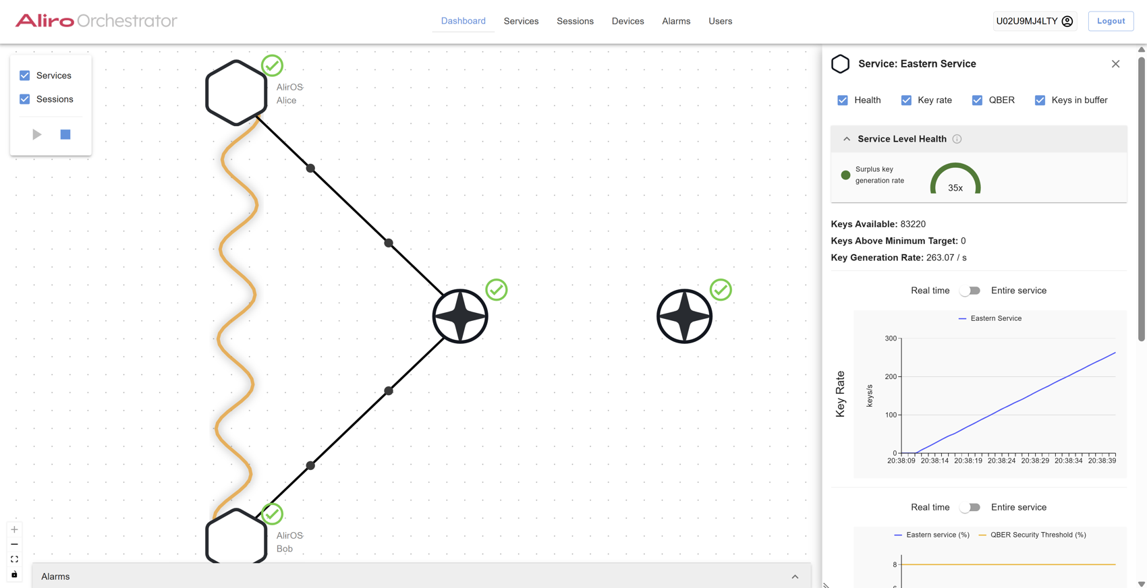



Service Oriented Network Orchestration
Orchestrator
The Quantum Networking Company®
One pane of glass and an equivalent API: view everything, control everything, automate everything.
Manage and monitor every device
Any vendor, through YANG over NETCONF, RESTCONF and gNMI: the vocabulary telecom already speaks.
Provision by application requirement
Ask for a key or entanglement service between two endpoints; the path compiler routes it over real inventory and loss budgets.
See the sessions underneath
Telemetry down to the click: raw, sifted and privacy-amplified key rate, QBER, coincidences.
Automate operations
Alerts trigger workflows that diagnose and remediate, including eavesdropping attempts and link issues.
Live service view: topology, health, key rate, QBER and keys in buffer
✓ Secure login ✓ Multi-tenancy ✓ Role-based access ✓ Automated logging ✓ Network-as-a-service for many research groups
Aliro · IEEE Quantum Week 2026 · Toronto
13 / 21
Notes:
Above the nodes sits the Orchestrator. If AlirOS is the operating system of a node, the Orchestrator is the operating system of the network. It manages the entire life cycle of an entanglement-based quantum network through a single pane of glass and an equivalent programmatic interface, so operators can view everything, control everything, and automate everything.
Manage and monitor every device in one place. Nodes, links, sources, switches, compensation devices, and more, from multiple vendors, through a driver architecture and the management standards the telecom industry already runs on: YANG models over NETCONF, RESTCONF, and gNMI. Operators don't need a new vocabulary, and the same interfaces integrate with AlirOS, third-party quantum components, and external software environments.
Provision services with an application-requirement-oriented workflow. A user asks for a key or entanglement service between two endpoints with the properties the application needs. The Orchestrator's global network view and path compiler route it over the real inventory with real loss budgets, and intelligent service scheduling turns it into sessions. You can watch service health and live performance metrics over time.
See the sessions underneath. Every session the Orchestrator automatically provisions to meet a service's requirements is visible, with session-level telemetry down to the click: raw, sifted, and privacy amplified key rate, QBER, coincidence rates, detection distribution, and more into Prometheus. This granularity lets you detect an issue early, before it touches application performance.
Automate operations. Alerts trigger automated workflows that diagnose and remediate. That includes automatically detecting and diagnosing eavesdropping attempts and other link issues.
And because it's a product built for carriers and testbeds, it has the unglamorous things a shared network needs: secure log in, multi-tenancy, role-based access, automated logging, etc. A testbed owner can offer the network as a service to multiple research groups safely.

Slide 14
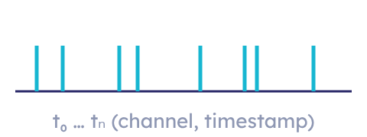
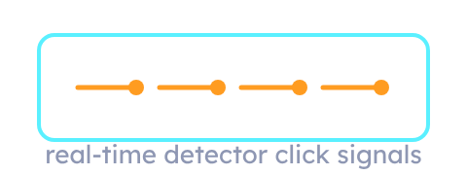
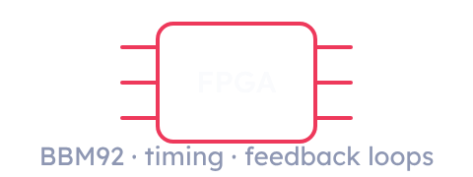
How it works together: pulse files and the digital twin
The Quantum Networking Company®
Simulator / Emulator
Hardware digital twin
AlirOS on real firmware
Generates a pulse file: a time-stamped record of every optical event the network would produce, click by click.
Acts out that exact behavior in real time, emitting detector click signals into the node.
The whole protocol stack, including timing-sensitive FPGA workflows, runs before a single photon crosses real fiber.
The node can't tell the difference.
Simulate → Twin → Control → Orchestrate ↺
Aliro · IEEE Quantum Week 2026 · Toronto
14 / 21
Notes:
Now for how this all fits together.
Our simulator and emulator can generate what we call pulse files, time-stamped sequences of the optical events the simulated network would produce, a record of individual detection clicks.
We take the pulse files from the simulator and feed them into our hardware digital twin which acts out this exact behaviour in real time, sending detector click signals to AlirOS.
That means we can test the entire stack of protocol logic, including the timing-sensitive FPGA workflows, before a single photon is sent over real fiber. When the hardware arrives, the software already works. When something isn't working in a physical network, we reproduce it in the twin. And when field data disagrees with the simulator, the simulator gets better.
It also means the twin is a design tool, not only a test tool. A change to a protocol step, a new vendor's detector, specific fiber environment conditions, a different coincidence window, all of it can be exercised on real firmware against realistic, repeatable optical events, and compared run to run. That's the loop: simulate, twin, control, orchestrate.

Slide 15
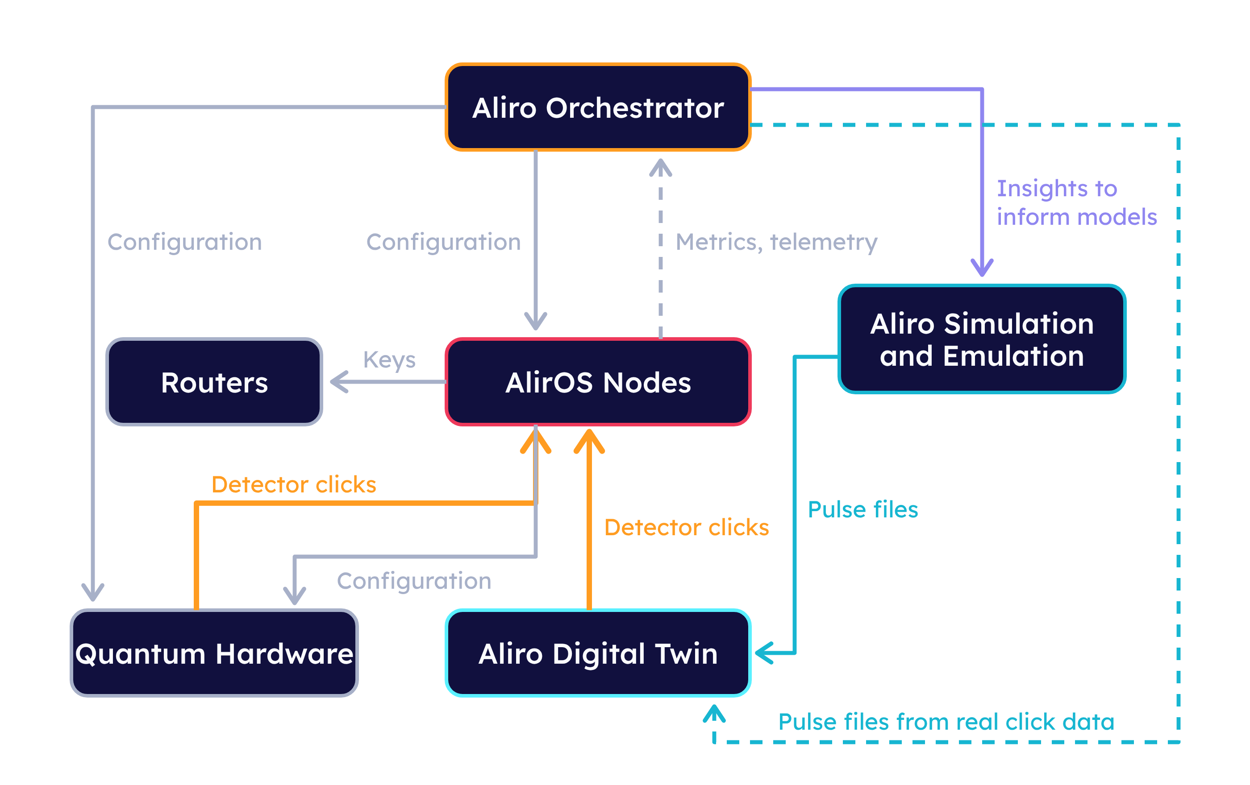
The whole Aliro ecosystem in one image
The Quantum Networking Company®
1 Predict
Simulation and emulation design the network and predict its behavior, then generate pulse files.
2 Validate
The digital twin plays pulse files into the nodes exactly as real detectors would.
3 Execute
AlirOS nodes configure hardware, take in clicks, run BBM92 and hand keys to routers.
4 Observe
Configuration flows down from the Orchestrator; click rates, QBER and key rates flow back up.
5 Correct
Field telemetry corrects the models; real click data can be replayed on the twin as pulse files.
Aliro · IEEE Quantum Week 2026 · Toronto
15 / 21
Notes:
Here is the whole Aliro ecosystem in one image
On the right we have what we just talked about. Simulation and Emulation are used to design and predict the behaviour of a network. Once the high level predicted performance is in your target range, you can proceed to generating pulse files.
The Digital Twin, at the bottom, takes the pulse file and plays it into the AlirOS Nodes exactly the way real detectors would. Look at the two orange arrows coming into AlirOS: one is detector clicks from Quantum Hardware, the other is detector clicks from the Digital Twin. The node can't tell the difference. Every protocol step, every timing window, every feedback loop is exercised on production code before there's a single photon to exercise it.
Now the middle. AlirOS Nodes control the Quantum Hardware, take in detector clicks, run the BBM92 stack, and hand finished keys to the Routers on the left.
Above that sits the Orchestrator. Configuration flows down from it to the nodes and to the hardware itself. Metrics and telemetry flow back up: click rates, QBER, key rates, per link and per session. So the Orchestrator sees what the network is doing in real time and can act on it.
Viewing performance in the Orchestrator and using it to collect telemetry from the nodes gives operators insights that can be leveraged to improve the Simulation and Emulation, so the models are corrected by what the deployed network actually does. You can even generate pulse files from actual detector click data and feed those to the Digital Twin, so a real network's behavior can be replayed, reproduced, and debugged on the same firmware.
Simulation and emulation predict, the twin validates, the nodes execute, the orchestrator observes, and observation feeds the next design. That's the loop this workshop is describing, running as software today.

Slide 16
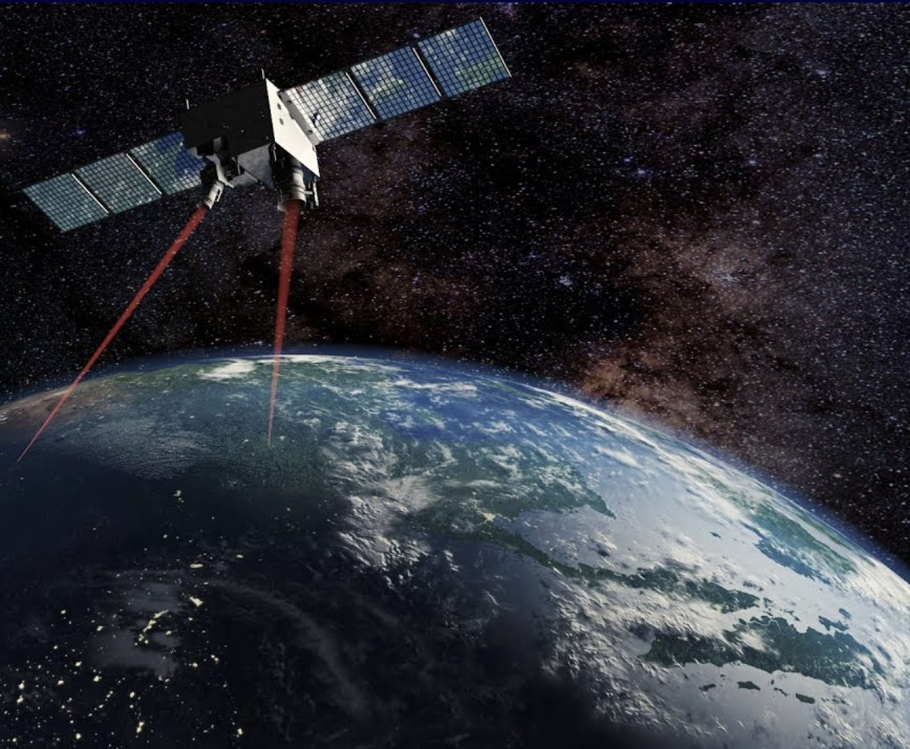
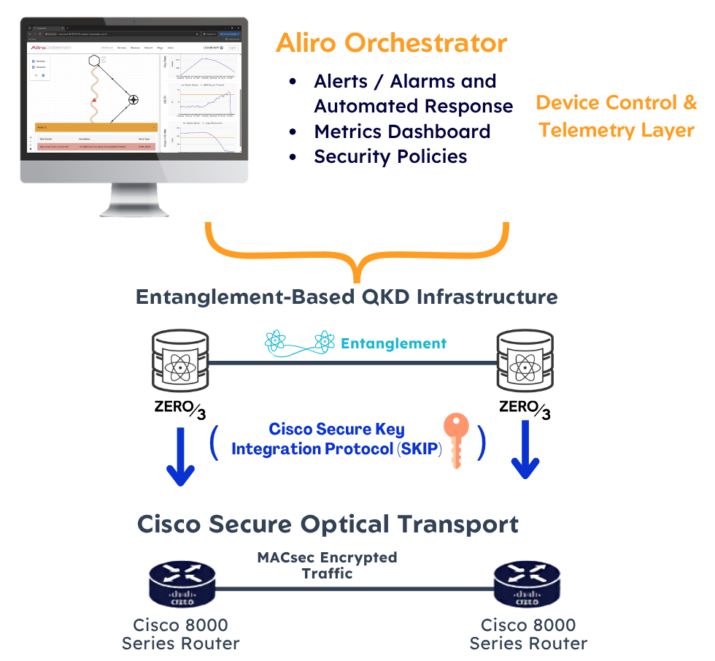
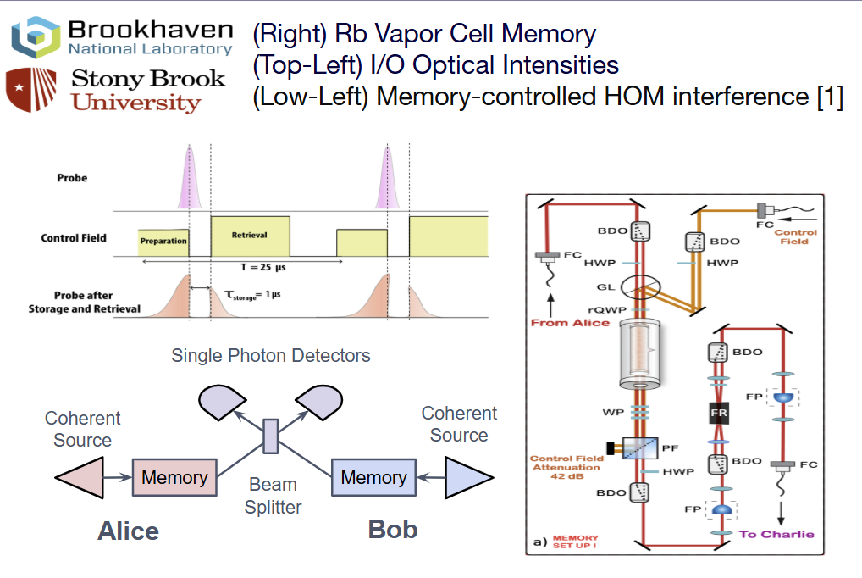
Where this is working
The Quantum Networking Company®
Simulator
Emulator
Orchestrator
Brookhaven National Laboratory
Boeing
Cisco, Milan
Simulation of entanglement swapping assisted by photonic memories.
Emulation of satellite-based quantum secure communications.
Orchestrated key generation with Zerothird hardware, keys delivered via Cisco SKIP.
Aliro · IEEE Quantum Week 2026 · Toronto
16 / 21
Notes:
BNL: Simulation of entanglement swapping assisted by photonic memories, with Brookhaven National Laboratory.
Boeing: Emulation of satellite-based quantum secure communications.
Cisco: Orchestrated key generation with Zerothird hardware at Cisco in Milan.

Slide 17
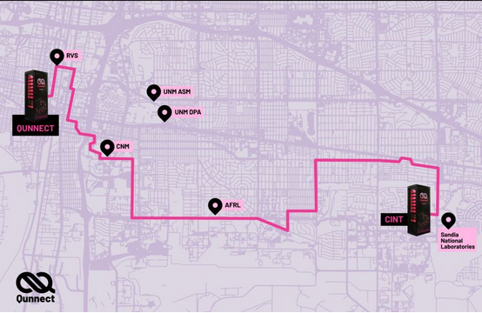

Albuquerque: entanglement keys end to end over deployed fiber
AlirOS
The Quantum Networking Company®
50 km of deployed fiber (including aerial), BBM92 keys end to end on Qunnect quantum hardware.
Predicting and testing in Brighton with the digital twin before deployment allowed successful operation in days.
50 km
120 secure bits/s modelled → 126 secure bits/s measured
Aliro · IEEE Quantum Week 2026 · Toronto
17 / 21
Notes:
ABQ: AlirOS key generation with Qunnect hardware in Albuquerque. AlirOS running on real nodes, producing BBM92 keys end to end over 50km or deployed fiber.
Before we deployed onsite, we went through the flow I described preparing pulse files and using them to test out the entire stack. This allowed us to get up and running in a matter of days and validated our entire approach
Modelled 120 secure bits/s -> Measured 126 secure bits/s

Slide 18
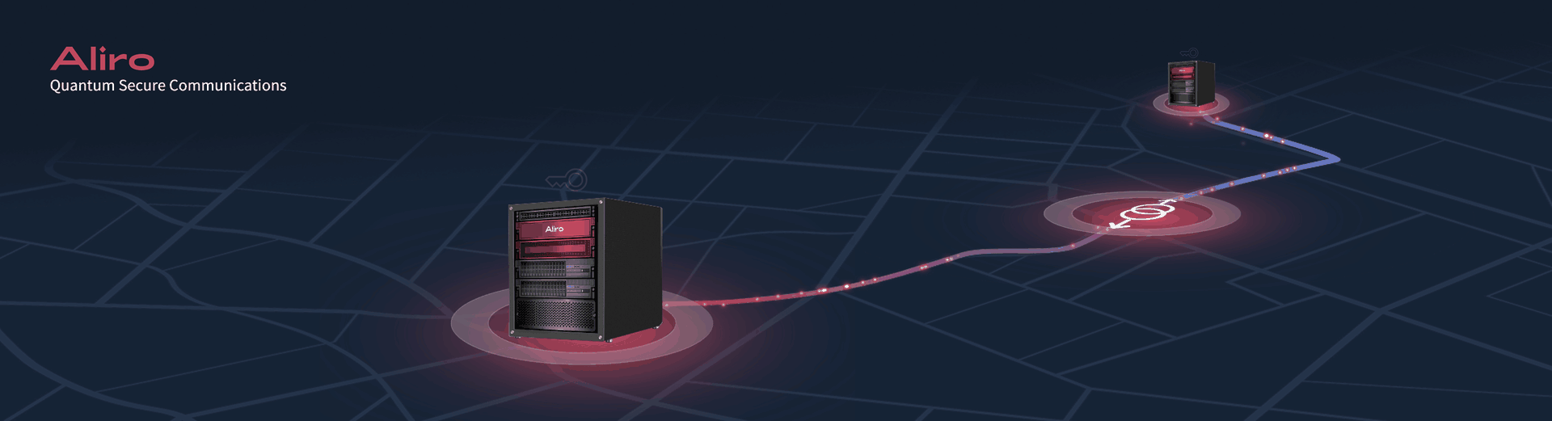
Coming soon
The Quantum Networking Company®
obsignare · to seal
To make something formally and physically unforgeable.
A sealed document isn't secure because breaking it is hard. It's secure because you can tell.
Obsignia
Plug and play
Rack mounted
Entanglement-based keys
Turns fiber you already operate into a quantum-secured service. It delivers AES-256 key material to standard L1-L3 encryptors with continuous physics-based monitoring of the quantum channel.
Combines partner-supplied photonic hardware, Aliro software and firmware, and enterprise networking interfaces in a rack-integrated appliance designed for telecom, financial, research, and critical infrastructure environments.
Entanglement architecture that can support untrusted photon source placement, diverse topologies, expandable node roles, and future services beyond key exchange.
Aliro · IEEE Quantum Week 2026 · Toronto
18 / 21
Notes:
Obsignia is a plug an play, rack mounted system that provides entanglement based secure keys to routers.
The name comes from obsignare, to seal, to make something formally and physically unforgeable. A sealed document isn't secure because breaking it is hard. It's secure because you can tell.

Slide 19

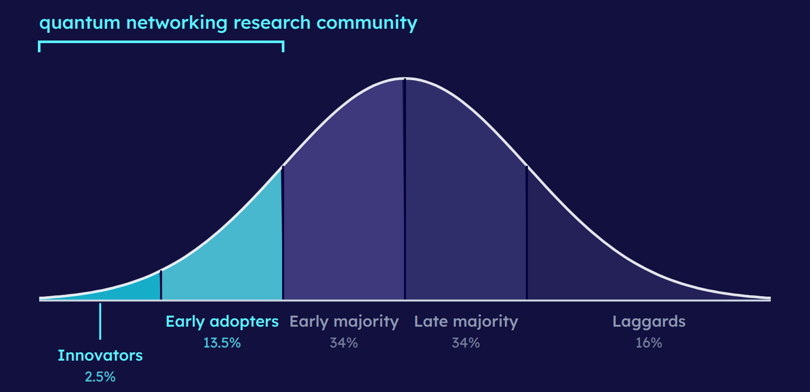
A symbiotic relationship with the research community
The Quantum Networking Company®
We stand on the shoulders of giants
The research community: the earliest adopters
Production-ready versions of systems imagined, theorized, tested and iterated on by decades of dedicated researchers
Simulators, emulators, digital twins, real-time control and orchestration, built to empower the people who adopt this technology first
Fewer months rebuilding and maintaining tools. More months on the research only you can do.
Aliro · IEEE Quantum Week 2026 · Toronto
20 / 21
Notes:
We see our relationship with the quantum networking research community as symbiotic. We stand on the shoulders of giants with gratitude as we engineer production ready versions of systems that were imagined, theorized, tested, and iterated on by decades of dedicated scientists.
We also see the quantum networking research community as the earliest adopters of this technology, and thus a group of users that we want to empower and give back to. We believe that equipping researchers with well engineered solutions in the form of simulators, emulators, digital twins, real time control, and orchestration can significantly accelerate progress in this field. Fewer months rebuilding and/or maintaining tools, more months on the research only you can do.

Slide 20
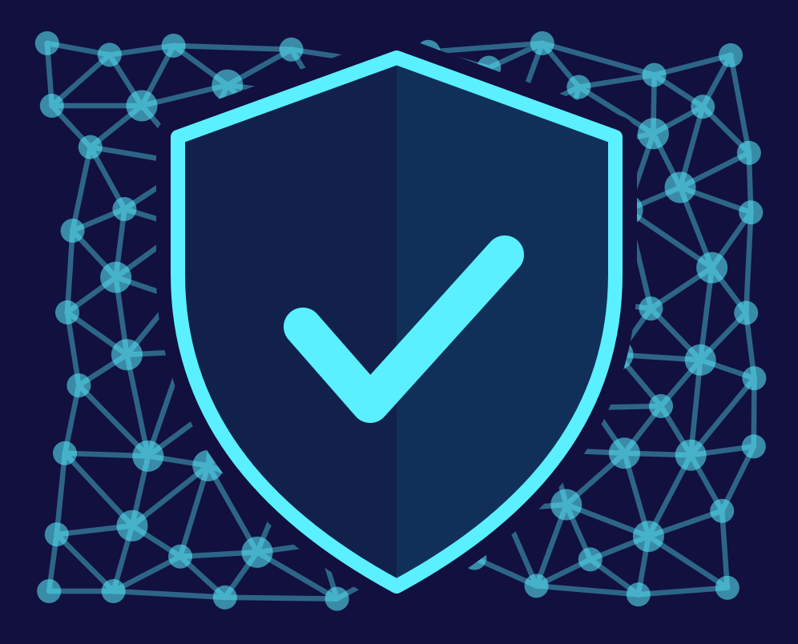
In summary
The Quantum Networking Company®
Why
What
Entanglement gives us a foundation of trust that doesn't depend on anyone's compute budget, and most of the services it enables haven't been invented yet.
A simulator and emulator for design and prediction. A digital twin that pantomimes network behaviour for an audience of real firmware. AlirOS on the node. The Orchestrator over the network. An industry solution coming soon.
How
Where
Not four products, one loop. Simulation predicts, the twin validates, AlirOS nodes execute, the Orchestrator monitors, and what the deployed network actually does goes back and corrects the model.
Brookhaven, Boeing, Cisco Milan, and Albuquerque, where we modelled 120 secure bits per second and measured 126.
Aliro · IEEE Quantum Week 2026 · Toronto
19 / 21
Notes:
Summary
Why. Because entanglement gives us a foundation of trust that doesn't depend on anyone's compute budget, and because most of the services it enables haven't been invented yet.
What. A simulator and emulator for design and prediction. A digital twin that pantomimes network behaviour for an audience of real firmware. AlirOS on the node. The Orchestrator over the network.
How. Not as four products, as one loop. Simulation predicts, the twin validates, AlirOS nodes execute, the Orchestrator monitors, and what the deployed network actually does goes back and corrects the model.
Where. Brookhaven, Boeing, Cisco Milan, and Albuquerque, where we modelled 120 secure bits per second and measured 126.

Slide 21

Let's build the loop together
The Quantum Networking Company®
Collaboration avenues
Five things worth standardizing
1
Simulator and emulator inputs: components, fiber, environments
Device makers
Entangled photon sources, detectors, compensation modules, low-loss switches, quantum memories: talk to us about integration.
2
Simulator and emulator outputs for visualization
3
Pulse files
Testbed operators
License the Orchestrator to open your network to more users, or AlirOS to put existing quantum devices to work providing reliable services.
Node and device type configuration
4
5
Telemetry
Everyone
Let’s work towards common interfaces and data formats so we can all contribute to, and benefit from, the loop that drives our field forward.
Cara Alexander · VP of Product, Aliro · cara@aliroquantum.com
Aliro · IEEE Quantum Week 2026 · Toronto
21 / 21
Notes:
Collaboration avenues
If you make quantum network devices like entangled photon sources, detectors, compensation modules, low loss switches, quantum memories, etc talk to us about integration.
If you run a testbed, consider licensing our Orchestrator to open up your network to more users and/or AlirOS to put your existing quantum devices to work providing reliable services.
Let’s move towards common interfaces and data formats so we can all contribute and benefit from this big loop that drives our field forward.
1. Simulator and emulator inputs describing components, fiber, and environments
2. Simulator and emulator outputs for visualization
3. Pulse Files
4. Node and/or device type configuration
5. Telemetry

