Slide 1
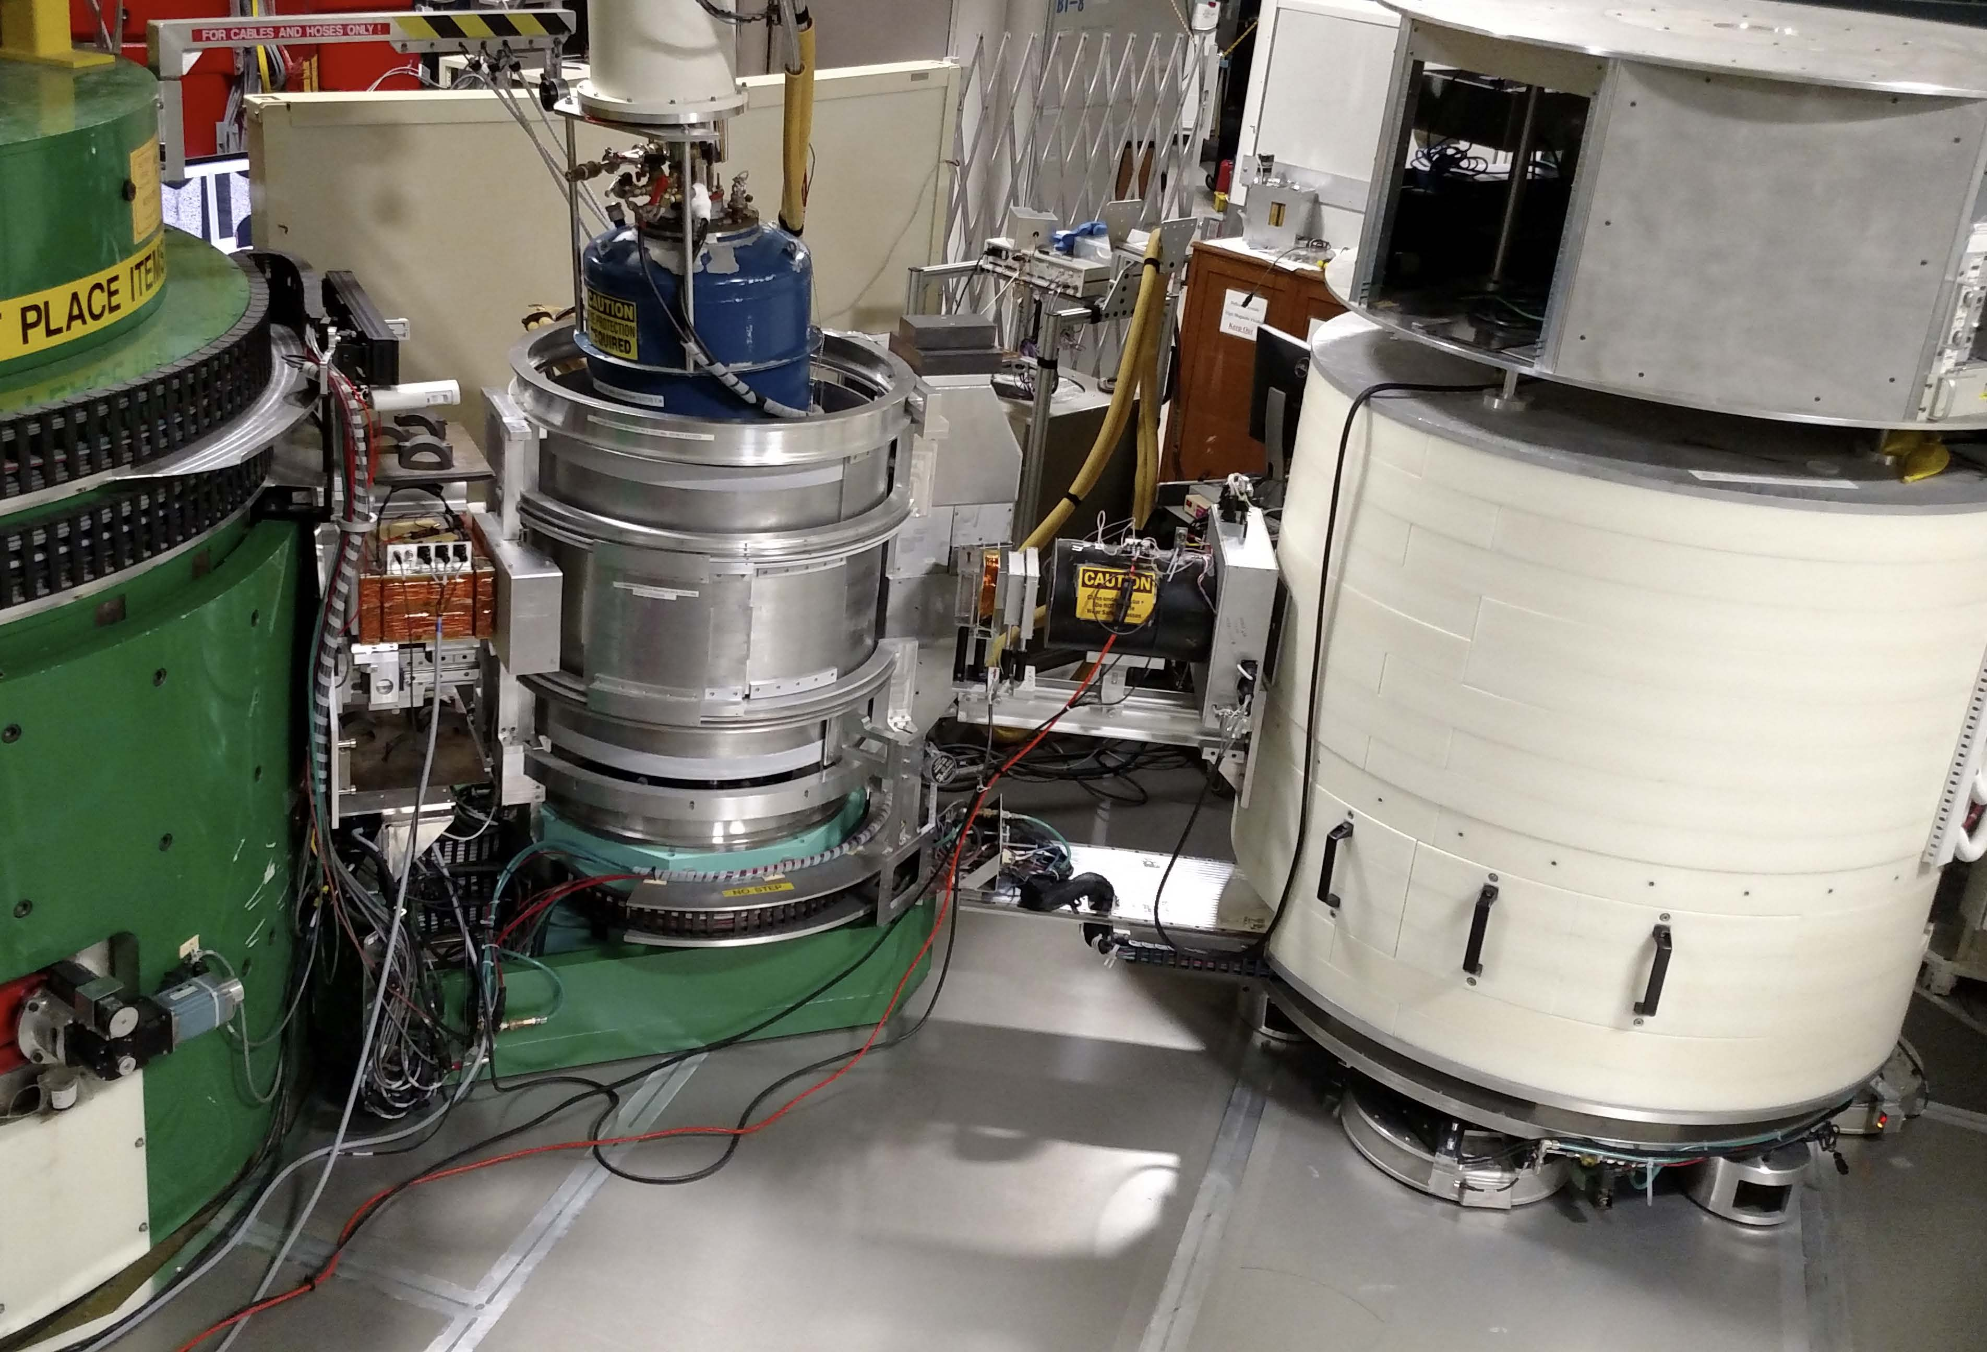
³He neutron spin filter
³He NSF polarized beam capability
BT-7, NCNR
Polarized flux at sample, 4.0×10⁷ n/cm²/s (open) at 14.7 meV
³He neutron transmission 40% - 50% (for desired spin state)
Initial flipping ratio up to 15
Up to 8 spin-dependent cross sections measured (4 each P ⊥ Q, and P || Q)
³He NMR based neutron spin flipping capability
Polarization efficiency correction software developed
VF
³He Polarizer
Flipper
Off/on
³He Analyzer
P_{n}
sample
P_{n}
(+/-)
HF
π/2 spin rotation
W.C. Chen et al, Physica B 397, 168 (2007); W.C. Chen et al, Physica B 404, 2663 (2009)
http://www.ncnr.nist.gov/equipment/he3nsf/index.html

