Slide 1
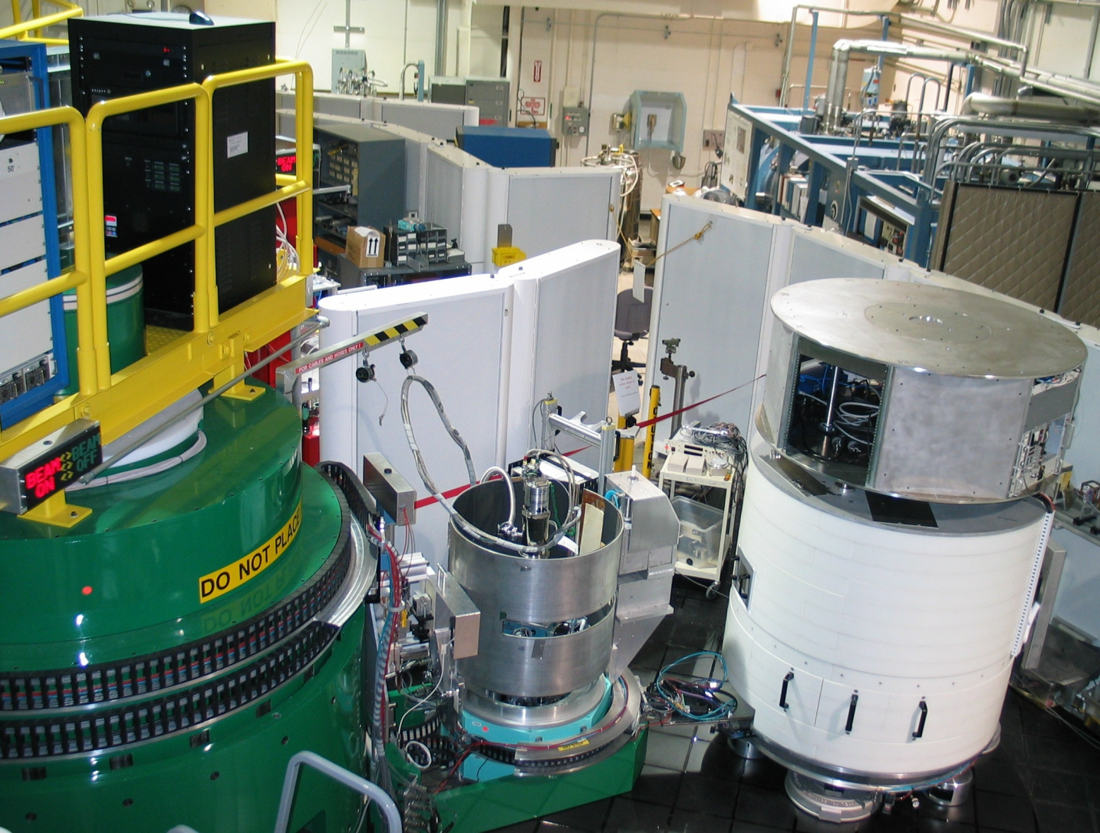
BT-7 Triple-axis Spectrometer
https://www.ncnr.nist.gov/instruments/bt7_new/
Notes:
1

Slide 2
Neutron Basics
λ = wavelength
E = energy
E = ℏ²k² /2m_{n} ∝ 1/λ²
k = wavevector (momentum)
k = 2π/λ
BT-7 uses “thermal” neutrons
Temperature ~300K
Energy peak ~ 40 meV
Wavelength ~1.8 Å
Most common:
E = 14.7 meV
k = 2.66 Å⁻¹
λ = 2.35 Å
SPINS MACS uses “cold” neutron
Most common:
E = 5 meV
Notes:
5-11 I will start with some neutron basics, I wonder whether you have learned the thermal and cold neutron already?
Similar to the electron, we can calculate neutron wave vector and wavelength from the neutron energy
the neutron energy can be moderated by collisions with hydrogen isotope in water or heavy water
The median energy of neutron beam is proportional to the temperature of the water, which can be adjusted.
For example, BT7 use thermal neutron, which is around 300K and 30meV
Generally 1meV is equal 10K
The typical elastic measurements energy at BT7 is 14.7meV and corresponding to wavelength is 2.35A
The wavelength of neutron is comparable with the lattice constant in the crystal
And the energy is comparable with some interest dynamic mode in solid materials, like phonon and spin wave
On the other hand, NCNR also have other triple axis spectrometer uses cold neutron, the SPINS and MACS
The typical elastic measurements energy of cold neutron is 5meV

Slide 3
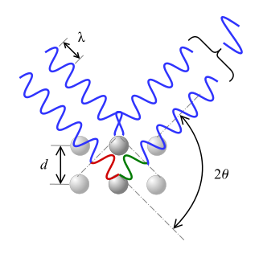
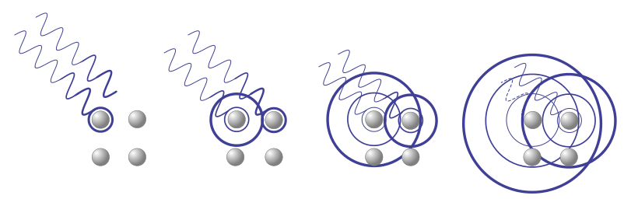
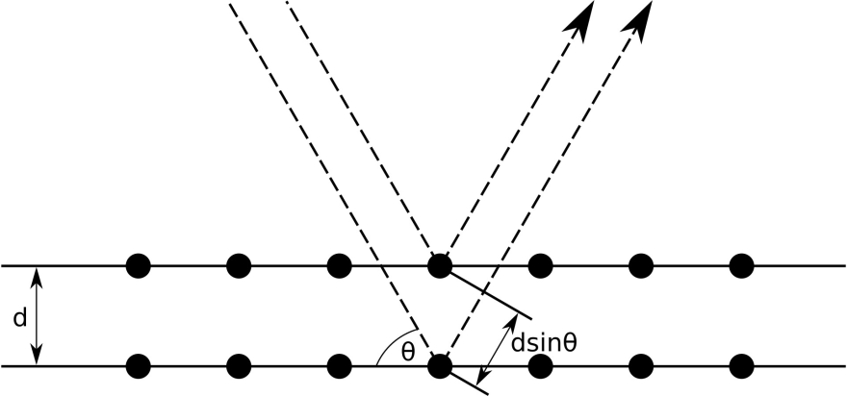
Bragg's Law
nλ = 2d sinθ
n = 1, 2, 3
https://en.wikipedia.org/wiki/Bragg%27s_law

Slide 4
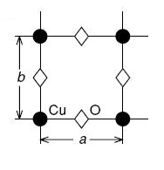
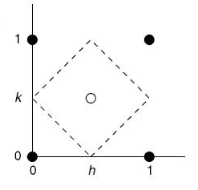
Real Space vs. Reciprocal Space
Fourier transformation
Space-time (r,t)
Energy-momentum (Q, hw)
Real space
Q-space
Time space
ω-space
Φ_{s}
T
ω
2π/T
2π/a
time
Elastic scattering – static structures
Inelastic scattering – dynamics
Notes:
5-11 I wonder whether you have learned the reciprocal space already from solid state physics?
When looking at neutron scattering results of bulk sample, instead of looking at the real space atomic positions, we look at their Fourier transformation into the momentum-energy space (h,k,l,E).
For example, here we show the well-known CuO2 plane very common in high-Tc cuprates.
For lattice constant is "a“, In the momentum space, or, we normally call "the reciprocal space“ nuclear Bragg peaks would appear will appear at 2Pi/a.
The reciprocal peak positions tells us about the periodicities of the real space atomic arrangements.
Neutrons have magnetic dipole moments so that they can interact with unpair spins in the samples.
the system is antiferromagnetic at low temperature, Here the closed/open circles represent spins up and down.
The periodicities become double and will present magnetic Bragg peak at (1/2,1/2).
Besides the static structure, the atoms can vibrate and the spins can fluctuate, which are the so-called lattice and spin dynamics.
These dynamic motion can also be measured by inelastic neutron scattering in Energy.
For example, here an atomic vibrating at a period of T, will result in a peak in energy space at 2pi/T.
The lifetime of the motion, on the other hand , is inversely proportional to the width of the peak in energy.

Slide 5
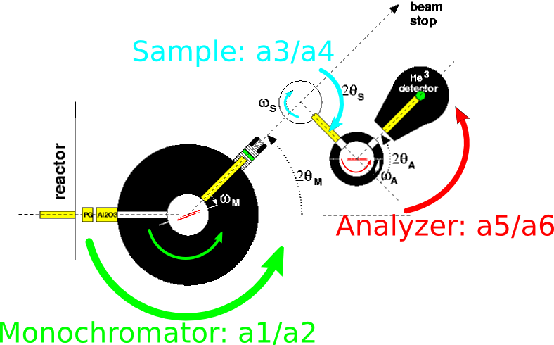
Triple-axis Spectrometer
Notes:
8 Here is a photo of BT7 triple-axis spectrometer.
Why we call it triple-axis, Because there are 3 axis corresponding to monochrometer, sample and analyzer
Which on the left, the green shielding is axis of monochrometer
Which in the middle, the metal cage is the axis of sample
Which on the right, the white shielding drum is axis of analyzer
Here is the schematic diagram of BT7.
There are 6 angles to control the 3 axis, In NCNR we call these 6 angles a1-a6
By adjusting 6 angles, it allows one to measure nearly any energy and wave vector in sample reciprocal space within range.
Then Let’s see how to do that

Slide 6


2 out of 3 axes: ki & kf
n 2π/ k_{i} = 2d_{M} sin(θ_{M})
m 2π/ k_{f} = 2d_{A} sin(θ_{A})
n, m=1,2,3…
E_{i} = ℏ²k_{i}² /2m_{n}
Controlled by a1/a2
E_{f} = ℏ²k_{f}² /2m_{n}
Controlled by a5/a6
Notes:
7 As we just mentioned 3 axis, 2 axis are monochromatic and the analyzer
The monochromator selects a specific incident neutron energy from the white neutron beam from reactor
The analyzer can chose the what final neutron energy you want measure
Both of them normally are PG single crystal at BT7,
Let’s focus on monochrometer, by Bragg scattering on monochromator, wave vector or wavelength of incident neutron are determined by scattering angle theta
By changing a1/a2, the theta and 2 theta of the monochrometer, we can control the Bragg scattering and control the energy of incident neutron
And it’s the same case for the analyzer, we choose Kf by a5/a6

Slide 7
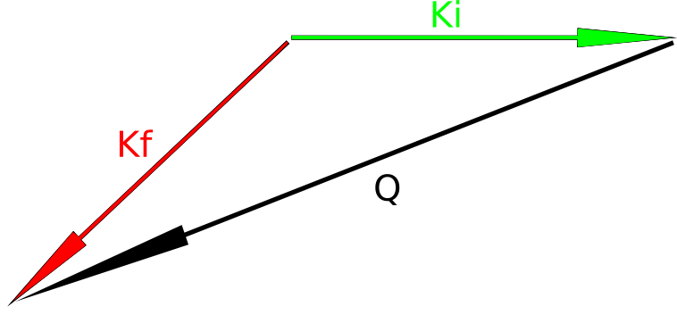
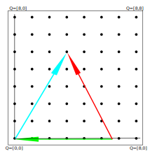
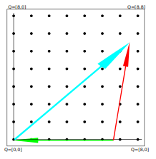
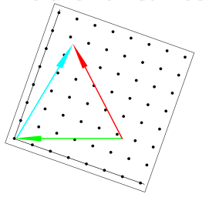
3rd axis : Sample
Q=k_{f}-k_{i}
ℏ²ω=E_{i} -E_{f} = 0 (elastic)
Alignment
a3 : rotation of reciprocal space
a4 : angle between ki/kf
Bragg peak!
No peak...
No peak...
Notes:
8 The 3rd axis is the sample.
From energy and momentum conservation, We can draw a scattering triangle
Both magnitude of Ki and Kf have been decided by monochromatic and analyzer
Change a4 , the 2 theta angle between ki/kf will change the magnitude of Q
Change a3, rotate the sample and indeed rotation of Q in the sample reciprocal space
For elastic measurement To see certain Bragg peaks in reciprocal space, we need both direction and magnitude of Q are reach that point, to get intensities
Each new experiment, we need aligned the sample by scan Bragg peaks and redefine A3 zero
Then we can use computer to control measurements to any energy and wave vector in the sample reciprocal space.

Slide 8
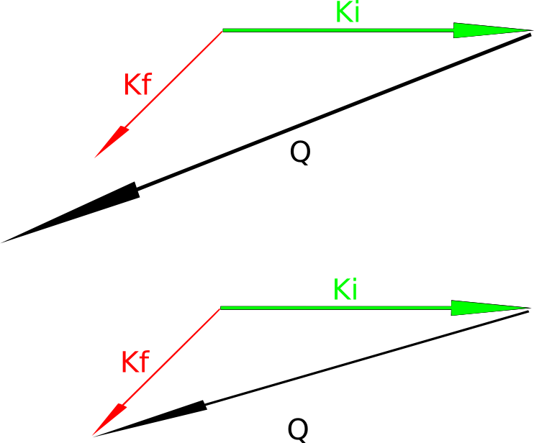
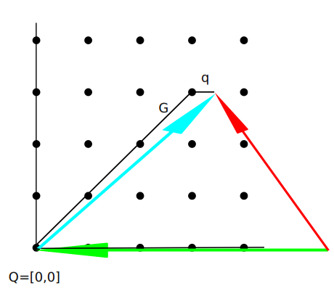
When ki and kf aren't equal...
Q=k_{f}-k_{i}
ℏω=E_{i} -E_{f} ≠ 0 (inelastic)
Phonon
Spin wave
and etc

Slide 9
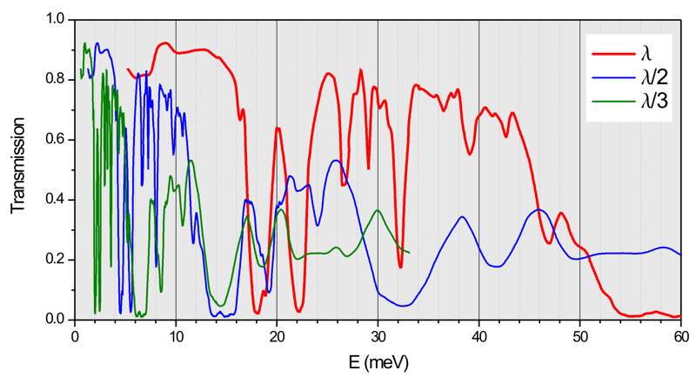
Velocity Selector and Filter
n λ = 2d sinθ
n=positive integer
Pyrolytic Graphite (PG)
E_{i}= 14.7 meV
n λ = 2d sinθ
n=positive integer
v_{n}=L/t ∝f
E_{i} ∝ f²
http://www.neutron.ethz.ch/research/resources/graphite-filter-transmission.html
https://www.ncnr.nist.gov/instruments/bt7_new/VelocitySelector.html
Notes:
12 As we noted before, why we typical use 14.7meV for elastic scattering at BT7?
Because the monochrometer crystal select the incident energy by Bragg’s diffraction.
Bragg’s law allow all positive integer n here, not only n=1, for example the neutrons with n=2 and half lamda also meet the requirement.
You can imagine these neutron can create extra peaks
To avoid that, we usually use a filter, which are used to eliminate the high order neutrons and reduce background
For BT7, we typical use a PG filter, at 14.7meV, the transition of lamda is 90% and half lamda is almost 0.
But filter is only good for certain energy, Then how about inelastic measurement, where energy change continuously
BT7 has a velocity selector.
The velocity selector rotate at certain frequency and only neutron with certain speed can pass the windows on velocity selector
For example The neutron speed should equal the length over time which is proportional to frequency
So the neutrons energy to pass are proportional to frequency square
So the velocity selector can adjust frequency to select the neutron with energy we want and eliminate high order neutrons, which is way off the pass requirement

Slide 10
Position sensitive detector (PSD)
PSD
  48 channels
  ~ 5 degrees A4 coverage
2 – axis diffraction mode
  Single crystal structure
3 – axis mode
Notes:
8 And BT7 have quite flexible choice of several different kinds of sample environments:
For low temperature, we can use orange cryostat with dilute refrigerator down to 50mK
And we can use superconducting magnet with field up to 15T
We can also applied high pressure on the sample cell up to 1GPa
We can also use furnace to do high temperature measurements up to 1600C
We can also applied high electric field on single crystal samples.
All these sample environment help turning the sample to met all different phases of science interests
If you have interests or idea of some experiment, welcome to discuss with us and send proposal to BT7.

Slide 11
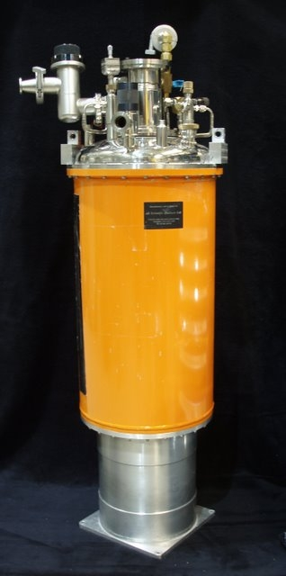
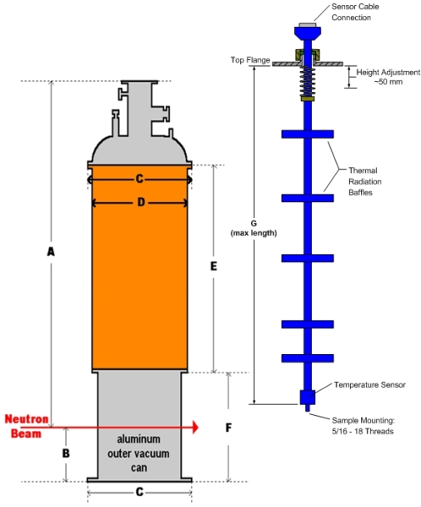
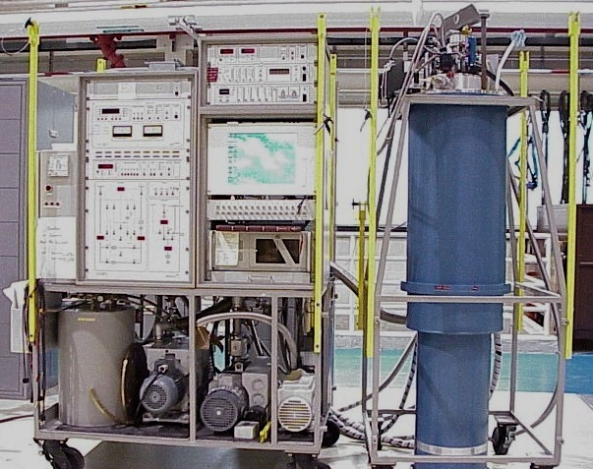
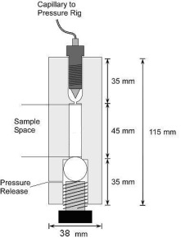
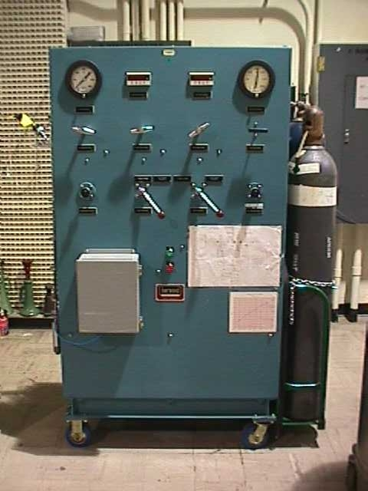
Sample Environment
Low temperature (50mK)
Magnetic field (15T)
Pressure (1GPa)
Furnace (1600C)
Electric field (5000V)
Notes:
8 And BT7 have quite flexible choice of several different kinds of sample environments:
For low temperature, we can use orange cryostat with dilute refrigerator down to 50mK
And we can use superconducting magnet with field up to 15T
We can also applied high pressure on the sample cell up to 1GPa
We can also use furnace to do high temperature measurements up to 1600C
We can also applied high electric field on single crystal samples.
All these sample environment help turning the sample to met all different phases of science interests
If you have interests or idea of some experiment, welcome to discuss with us and send proposal to BT7.

Slide 12
References
https://www.ncnr.nist.gov/instruments/bt7_new/
https://en.wikipedia.org/wiki/Bragg%27s_law
http://paulbourke.net/miscellaneous/dft/
https://en.wikipedia.org/wiki/Brillouin_zone
http://www.neutron.ethz.ch/research/resources/graphite-filter-transmission.html

Slide 13
Instrument Control Environment (ICE) >> NICE

Slide 14
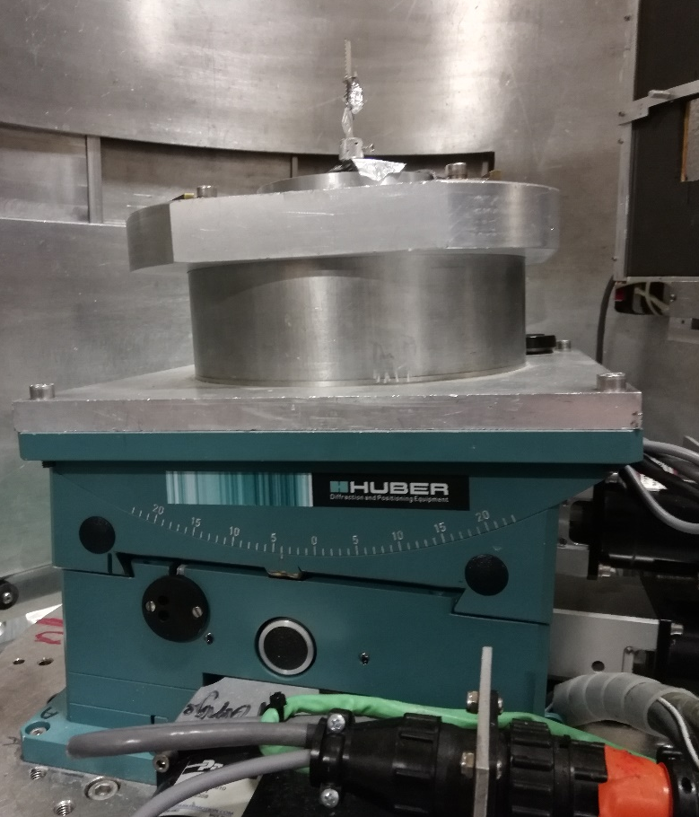
  Lattice parameters
  Scattering plane
  Alignment
    1st Bragg peak
    Define the orientation

Slide 15
Peak Scan (Angles)

Slide 16
Vector Scan (Q, E)

Slide 17
An Introduction to
SpinW
https://spinw.org/
https://github.com/spinw/SpinW

Slide 18
What is SpinW?
Open source MatLab package
Developed at HBZ/PSI
Numerically solves eigenvalue/vectors of spin Hamiltonians using linear spin-wave theory:
Uses Rotating reference frame – can do incommensurate structures.
Lots of tools contained within! (energy minimization, diffuse scattering, fitting, etc.)

Slide 19
Calculating with SpinW
Define the crystalline unit cell and/or symmetries
Define the magnetic unit cell
Define the spin-interaction Hamiltonian
Calculate the spin-wave dispersion 𝜔(Q)
Calculate the magnon-cross section and intensities
Convolute with resolution/fit data if desired

Slide 20
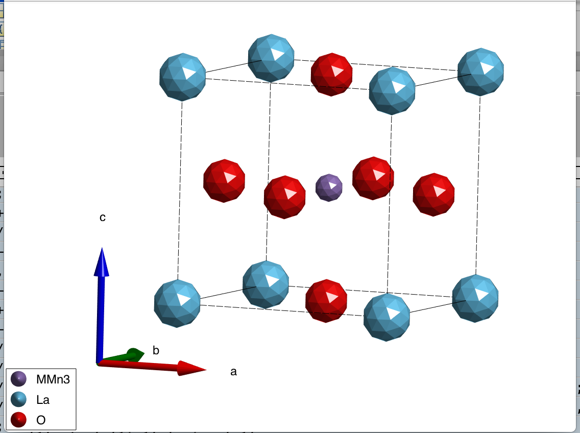
1. Make the Crystal Structure
lsmo = spinw;
lsmo.genlattice('lat_const', [3.8976 3.8976 3.8976],'sym','P m -3 m');
lsmo.addatom('r',[0.5 0.5 0.5], 'S', 2, 'label', 'MMn3');
lsmo.addatom('r',[0.0 0.0 0.0], 'S', 0, 'label', 'La');
lsmo.addatom('r',[0.5 0.5 0.0], 'S', 0, 'label', 'O');
Use FullProf labeling for magnetic atoms!

Slide 21
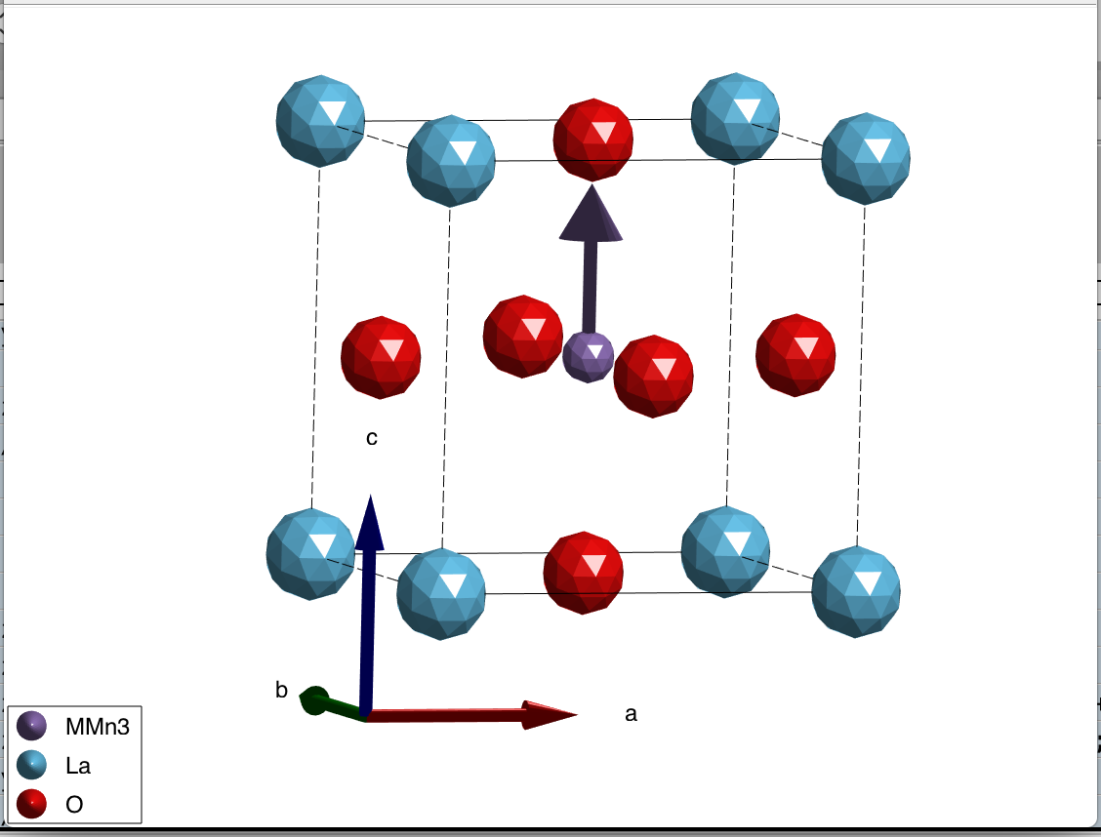
2. Define Magnetic Structure
%% Create the magnetic structure
% Simple ferromagnet along the c-direction
lsmo.genmagstr('mode', 'fourier', 'S', [0 0 1]', 'k',[ 0 0 0]);

Slide 22
3. Construct a Simple Hamiltonian
%% Create the Spin Hamiltonian
J1 = -1; % NN Exchange interactions (meV)
D1 = 0.0; % Local anisotropy
lsmo.addmatrix('value', J1, 'label', 'J1', 'color', 'b');
lsmo.addmatrix('value', D1*diag([0 0 -1]), 'label', 'D1');
lsmo.gencoupling;
lsmo.addcoupling('mat','J1','bond',1);
lsmo.addaniso('D1');
Uniform Zeeman Field with arbitrary g-tensor
By default J_{ij} is a diagonal matrix
Can be anisotropic (J_{xx} ≠ J_{yy} ≠ J_{yy}) or antisymmetric (DM interactions)

Slide 23
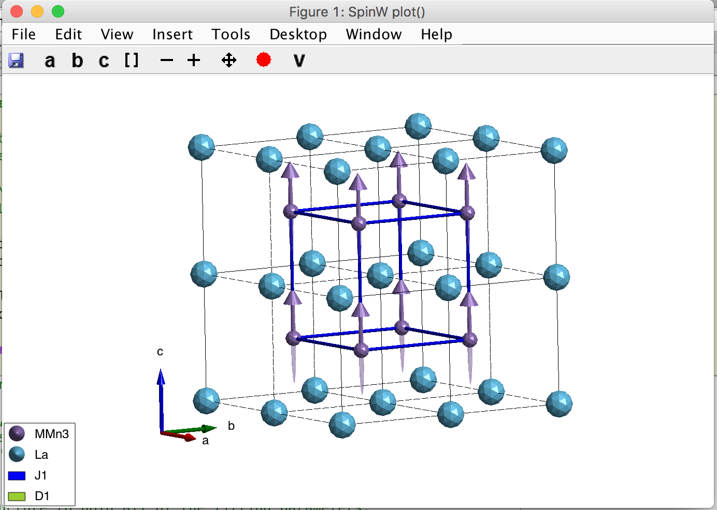

Slide 24
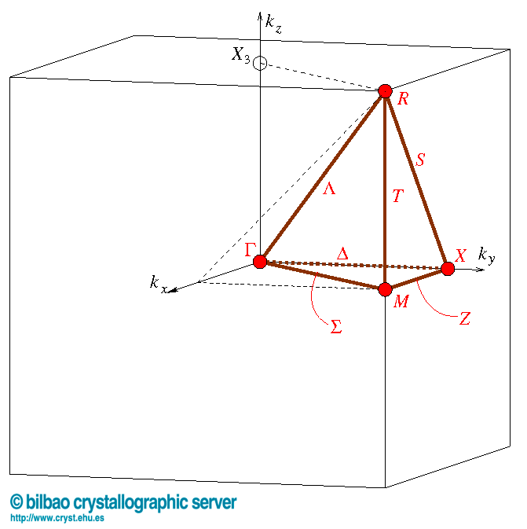
4. Calculate the dispersion
% Define a list of Q-points to calculate dispersion along.
GM = [0 0 0];
R = [0.5, 0.5, 0.5];
M = [0.5, 0.5, 0];
X = [0 0.5 0];
spec=lsmo.spinwave({GM X M GM R GM 1000});
Solves 𝜔(Q) at 1000 Q-points

Slide 25
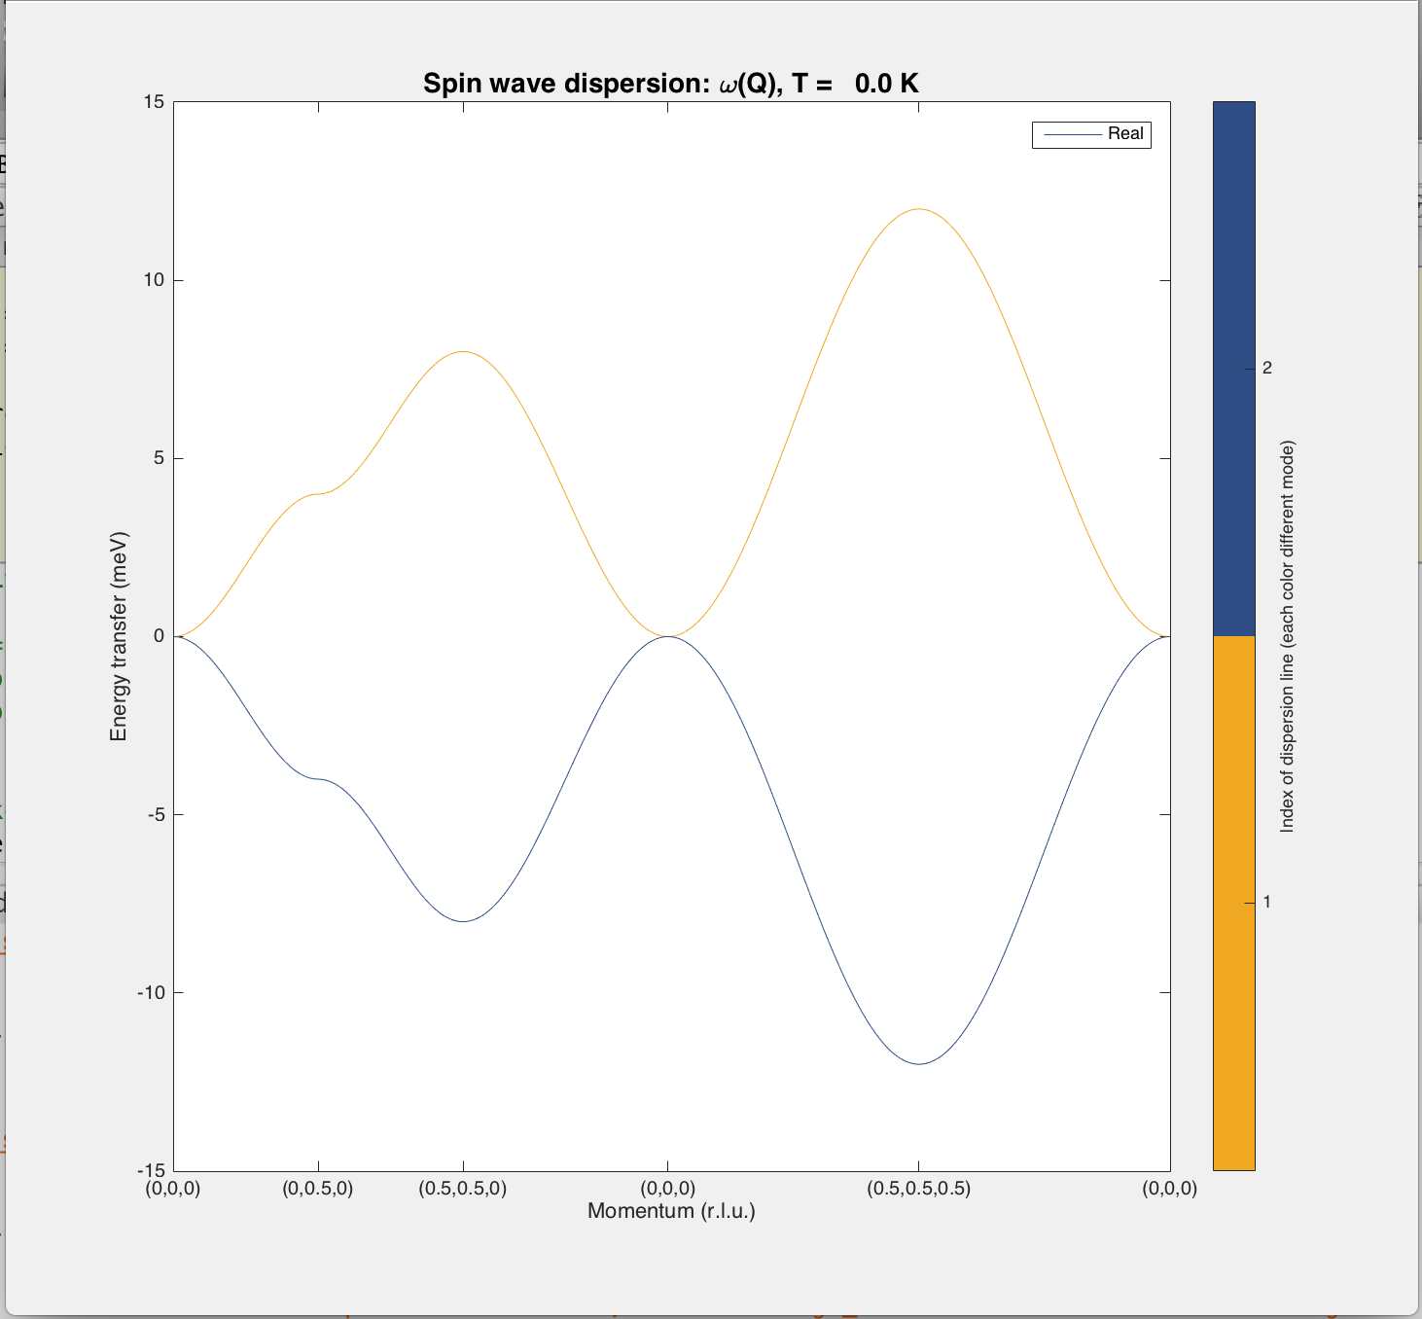
4. Calculate the dispersion
Both positive (magnon creation) and negative (annihilation) modes

Slide 26
4. Calculate cross-section/intensity
% Define a list of Q-points to calculate dispersion along.
GM = [0 0 0];
R = [0.5, 0.5, 0.5];
M = [0.5, 0.5, 0];
X = [0 0.5 0];
spec=lsmo.spinwave({GM X M GM R GM 1000});
spec = sw_neutron(spec);
spec = sw_egrid(spec);
Solves 𝜔(Q) at each Q-point
Calculates S(Q, 𝜔) at each Q-point on energy mesh (default setting here)

Slide 27
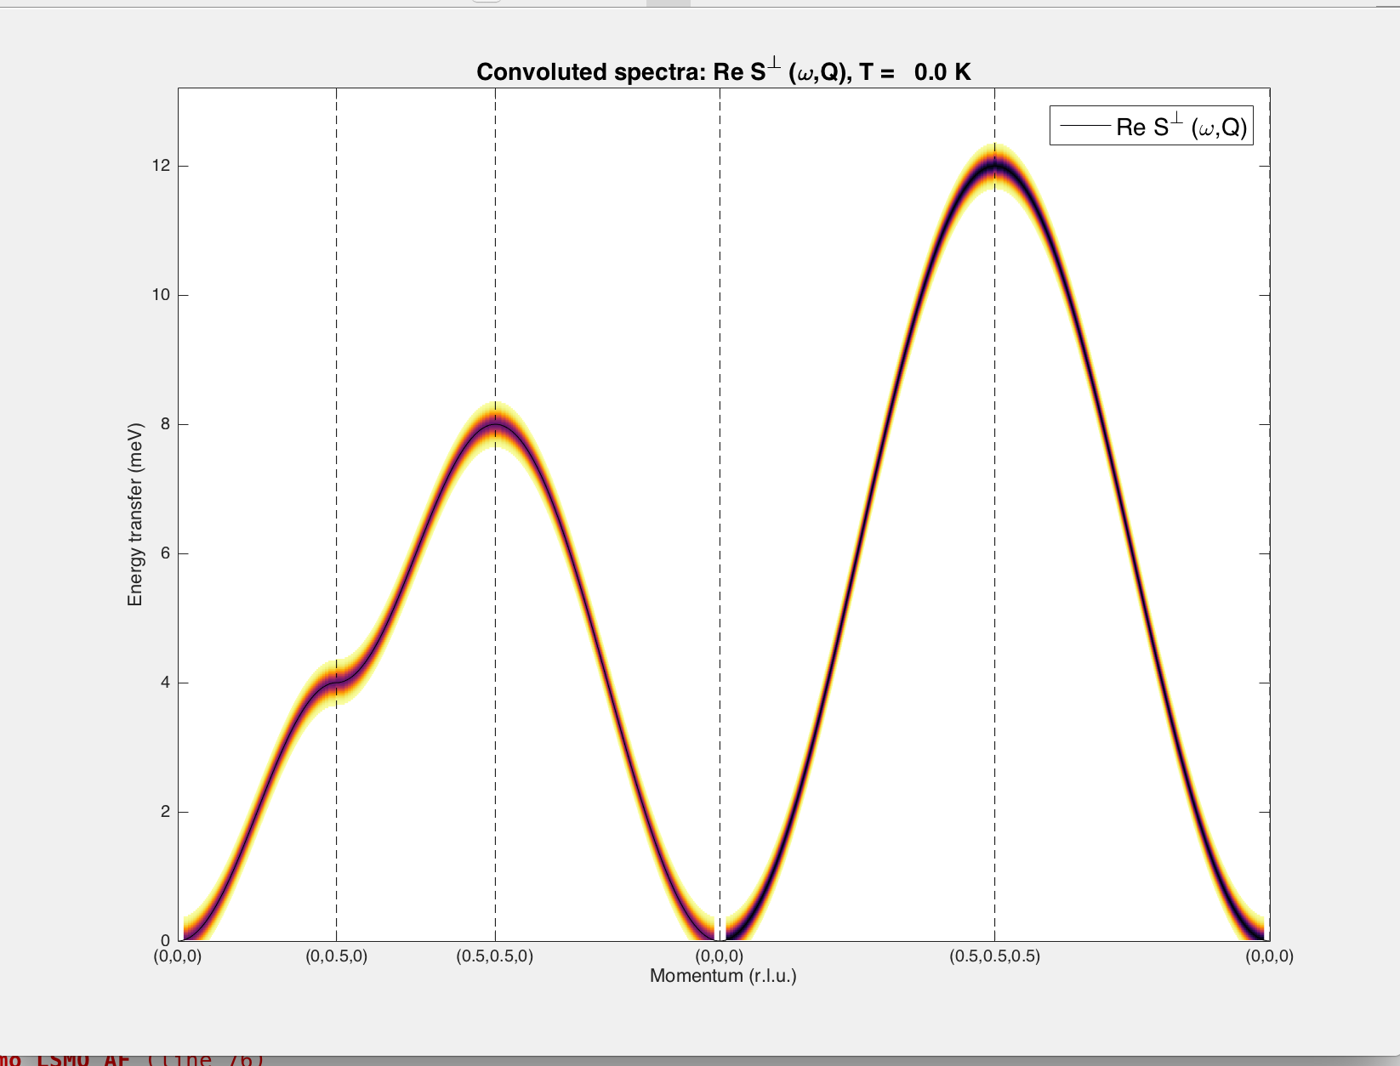
𝜞
X
M
𝜞
R
𝜞
S = 1, J_{NN} = 1 meV
𝜔(Q)~Dq² near zone center

Slide 28
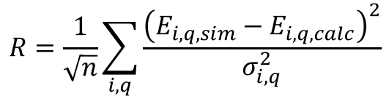
Time to Fit!
We get all modes at each Q simultaneously: faster to fit constant Q data sets
OR
Fit and Reduce data first…
Possible algorithms available:
‘simplex’ (Nelder-Mead) method
  similar to Least-squares
  FAST, but can get stuck more easily
‘Particle Swarm optimization’
  Slower than simplex
  Explores wider parameter space
  ‘’Random” aspect means less likely to get stuck
  Convergence criteria not proven
$$R=\frac{1}{\sqrt{n}}\sum_{i,q}{\frac{{\left(E_{i,q,sim}−E_{i,q,calc}\right)}^{2}}{σ_{i,q}^{2}}}$$
Careful: Fit will crash of parameters don’t produce the given ground state! Limits are helpful!

Slide 29
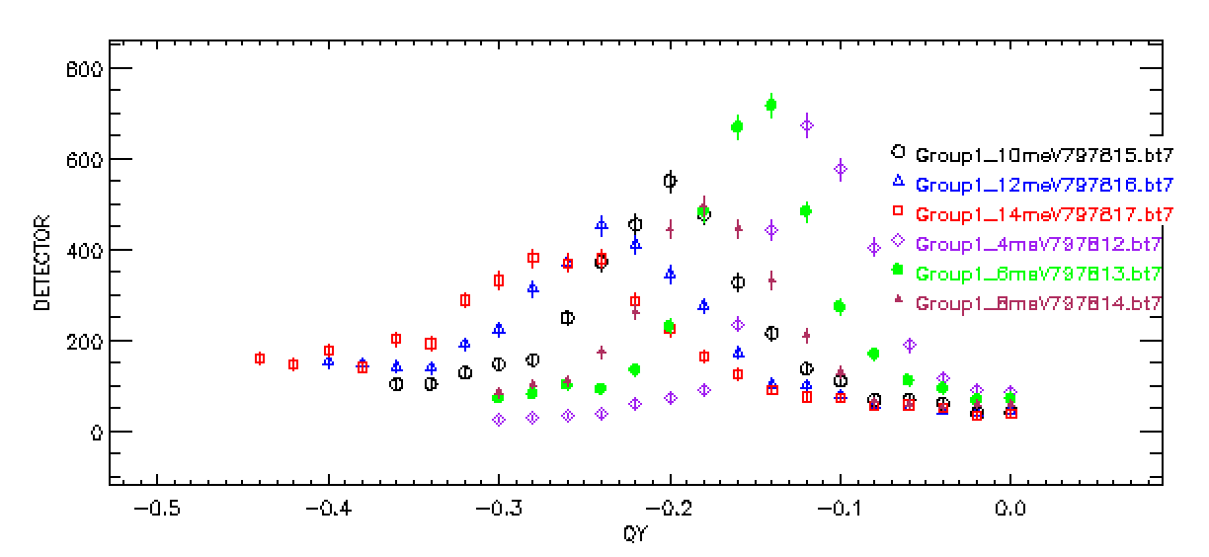
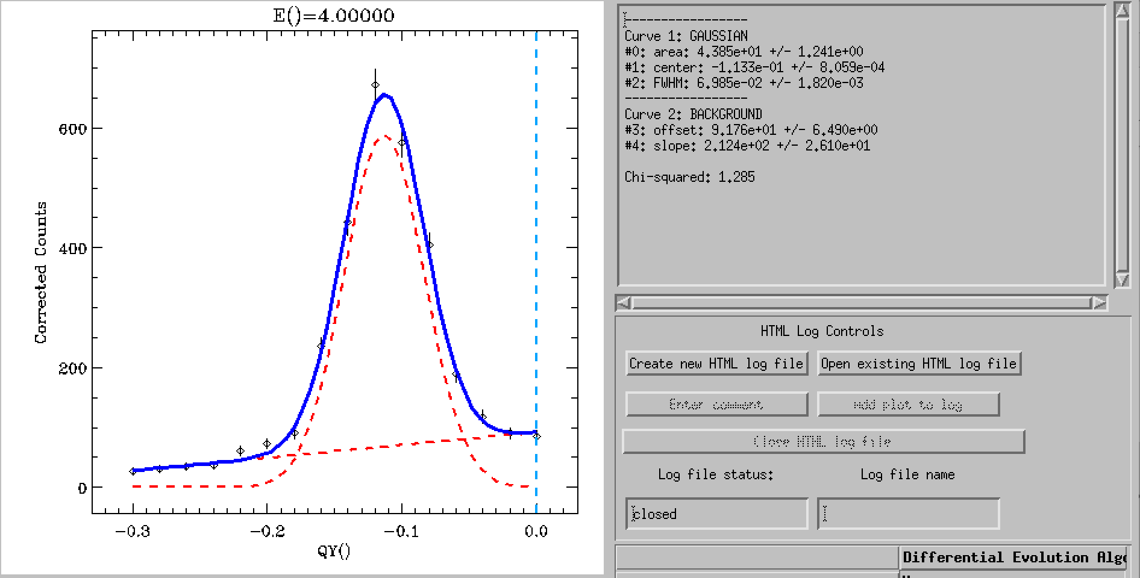
DAVE Analysis – LSMO
Data was taken as constant E scans, so need to fit to find center of peak

Slide 30
Example Data File
Intensity of 1st mode
(Barns/meV/sr)
Error in center
Q-point (r.l.u)
Energy range (meV)
Measured
Center (meV)
QH QK QL ENlim1 ENlim2 I1 EN1 sigma1
1.0000 -0.0685 0 1.0000 20.00 29.8557 3.00 0.1
1.0000 -0.0877 0 1.0000 20.00 20.0286 4.00 0.1
1.0000 -0.1026 0 1.0000 20.00 17.3994 5.00 0.1
1.0000 -0.1189 0 1.0000 20.00 13.7336 6.00 0.1
1.0000 -0.1306 0 1.0000 20.00 11.4993 7.00 0.1
1.0000 -0.1621 0 1.0000 20.00 8.59548 10.0 0.1
1.0000 -0.1722 0 1.0000 20.00 8.76609 11.0 0.1
1.0000 -0.1973 0 1.0000 20.00 8.10216 13.0 0.1
1.0000 -0.2270 0 1.0000 20.00 7.62421 16.0 0.1
This block could be repeated if more modes where measured

Slide 31
Set the fitting parameters
par_fit = struct;
par_fit.datapath = '/Users/smd4/Desktop/SummerSchool2013/fittedData.txt';
par_fit.Evect = linspace(0,20,41);
par_fit.func = @(obj,p)matparser(obj,'param', p, 'mat', {'J1', 'D1'}, 'init', true);
par_fit.xmin = [-100 0.0];
par_fit.xmax = [ 0.0 10.0];
par_fit.x0 = [ -90 1.0 ];
par_fit.plot = true;
par_fit.hermit = false;
par_fit.optimizer = 'pso';
par_fit.maxiter = 100;
par_fit.optmem = 1;
par_fit.nrun = 1;
fitStr = lsmo.fitspec(par_fit);

Slide 32
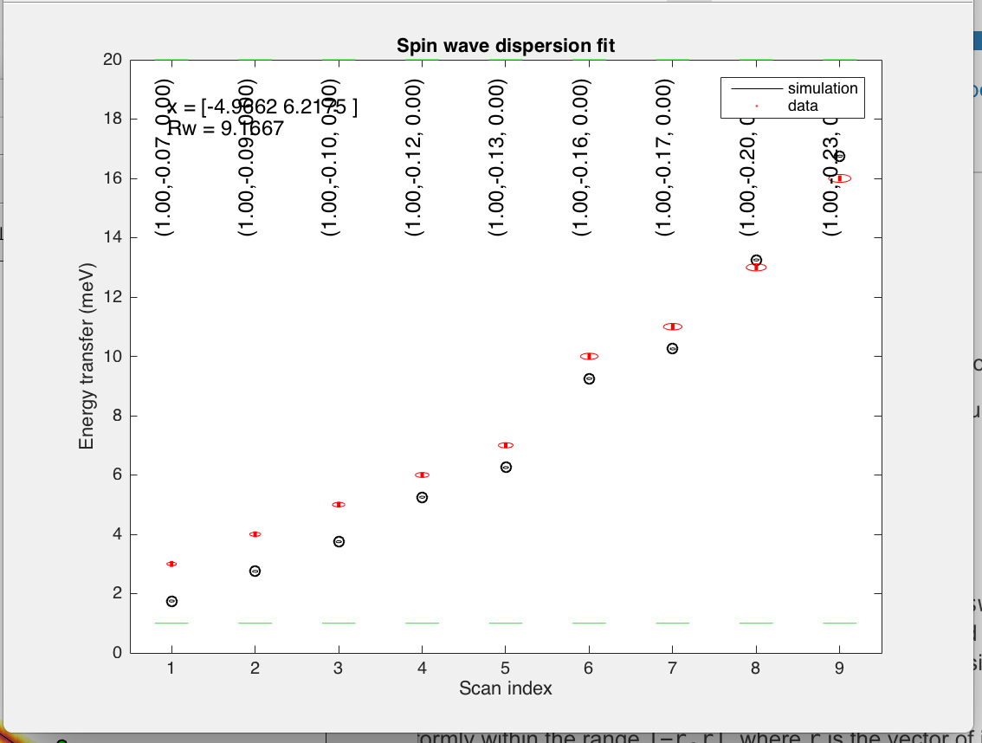
Fitting – In progress

Slide 33
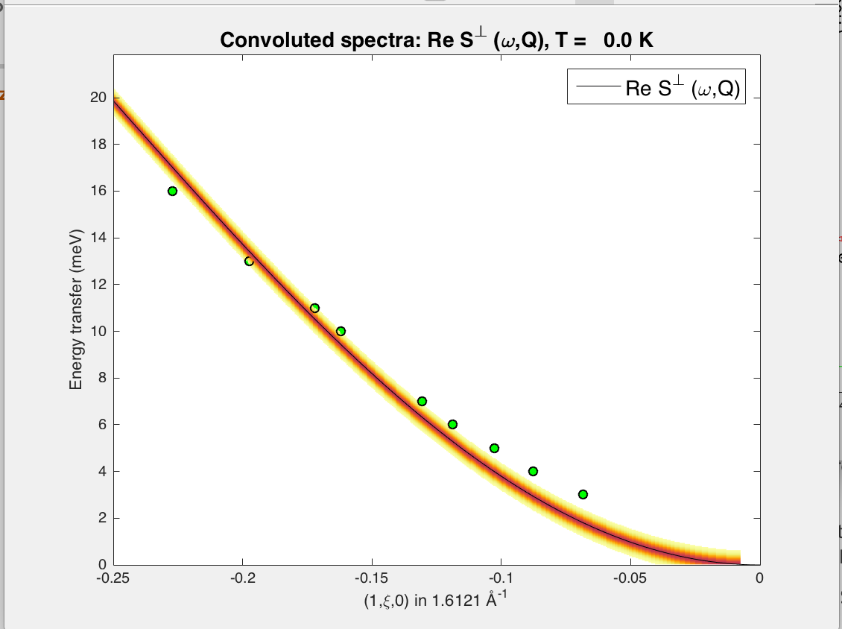
Results
|J| ~ 4.9 meV

Slide 34
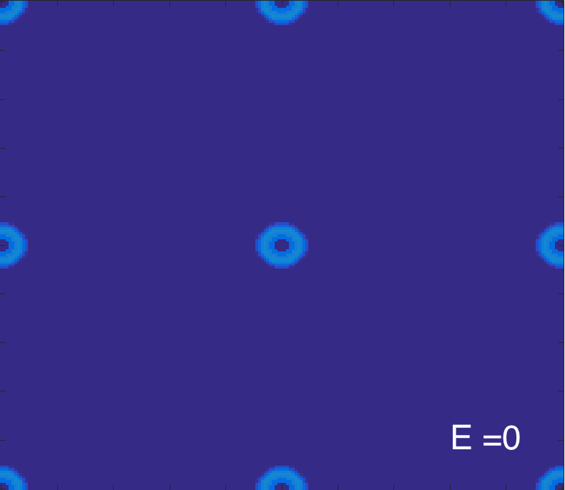
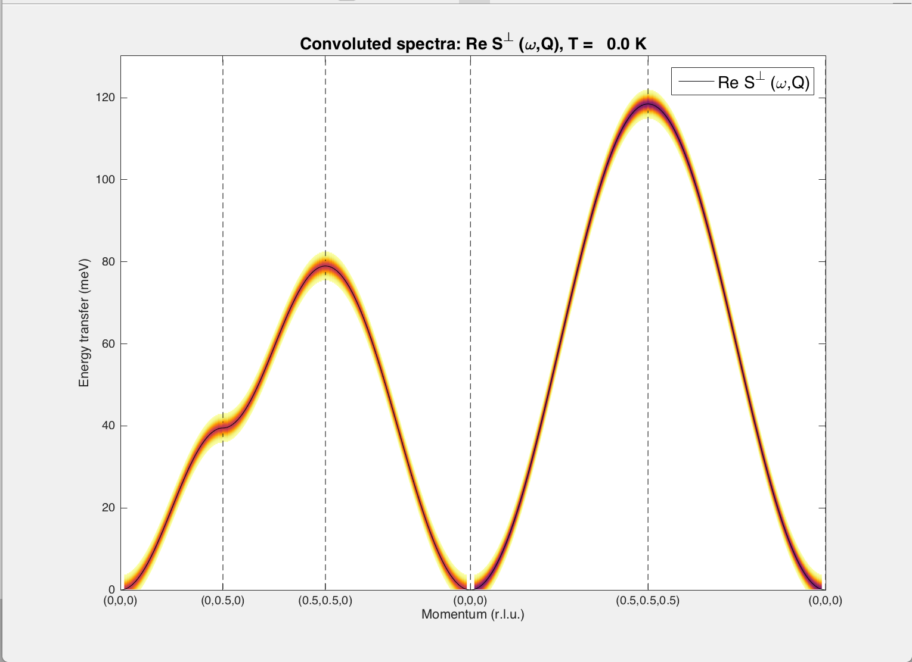
More pictures!
(0K0)
(H00)

Slide 35

DAVE
Quick browse the data files.
Build-in fitting functions
Construct 2-D data
Reduce the PSD data

Slide 36
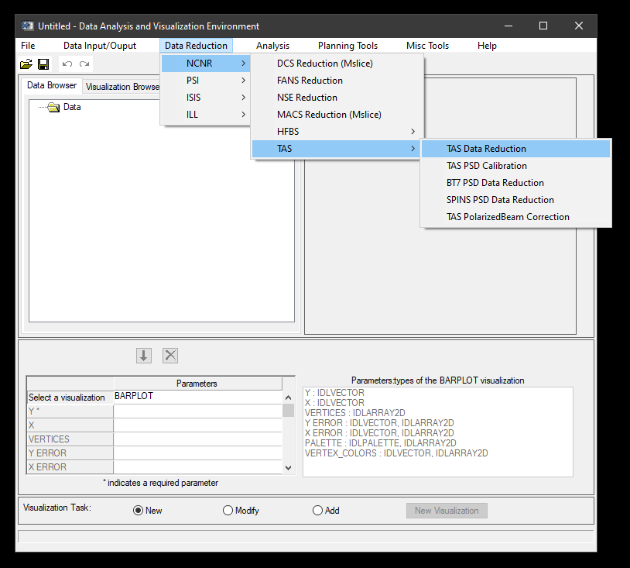
“Data reduction” - “TAS” – “TAS data reduction”

Slide 37
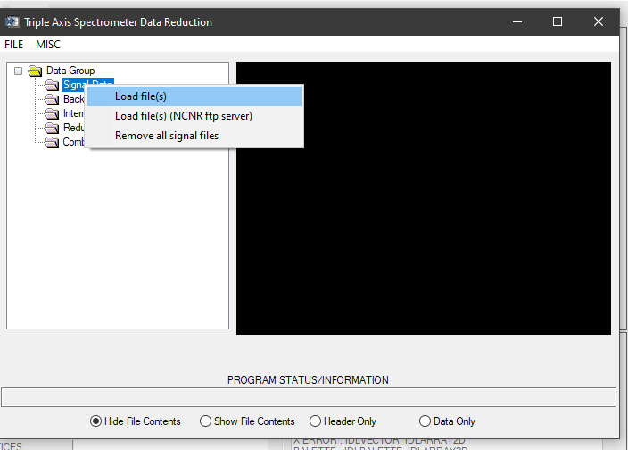
Right click the folder, then select “load files”

Slide 38
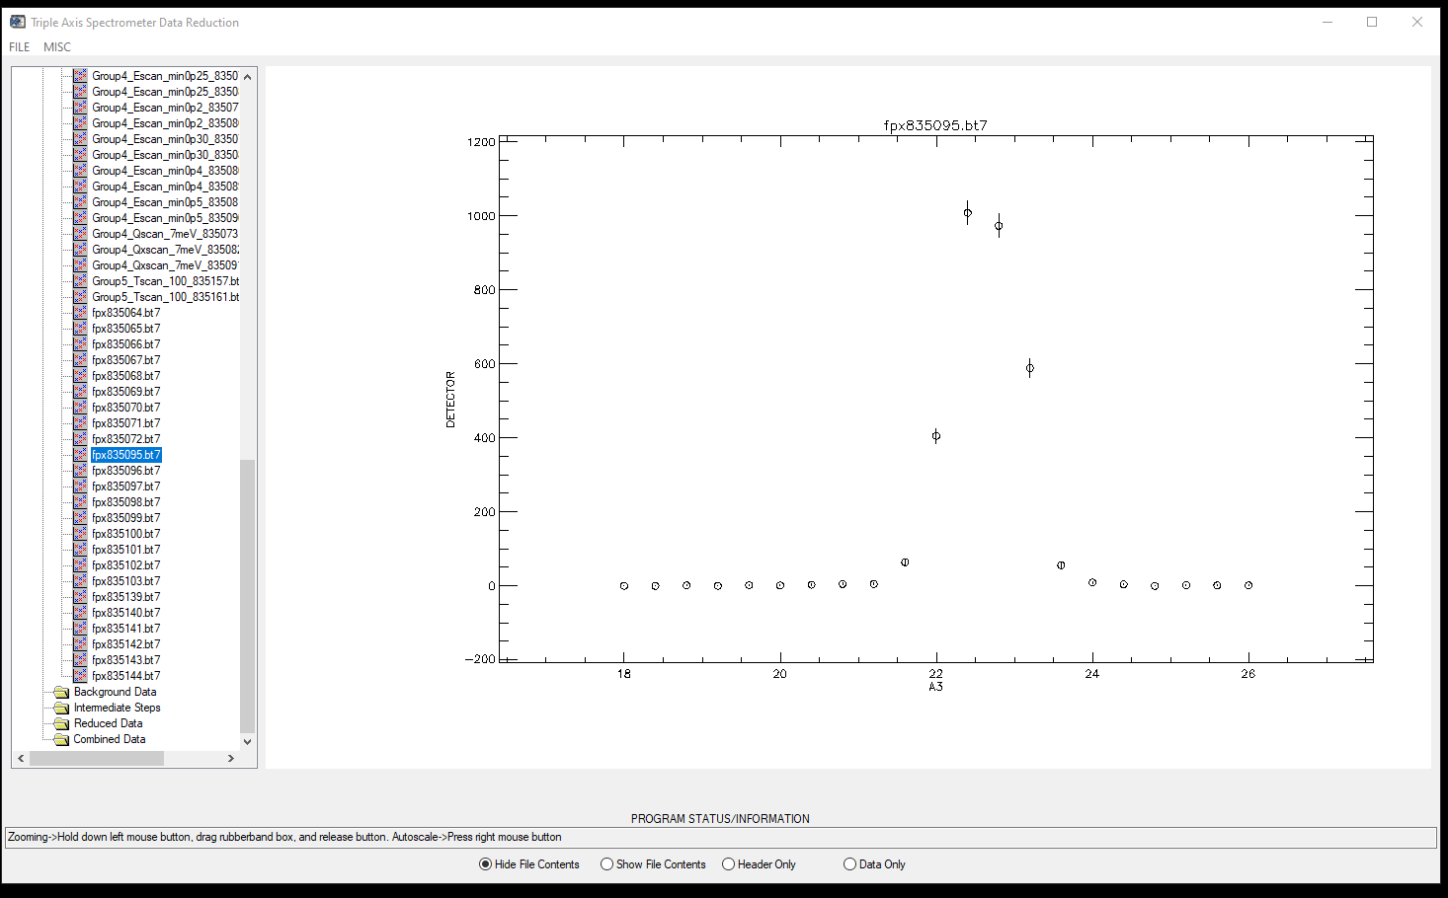
Browse files (angle scan)

Slide 39
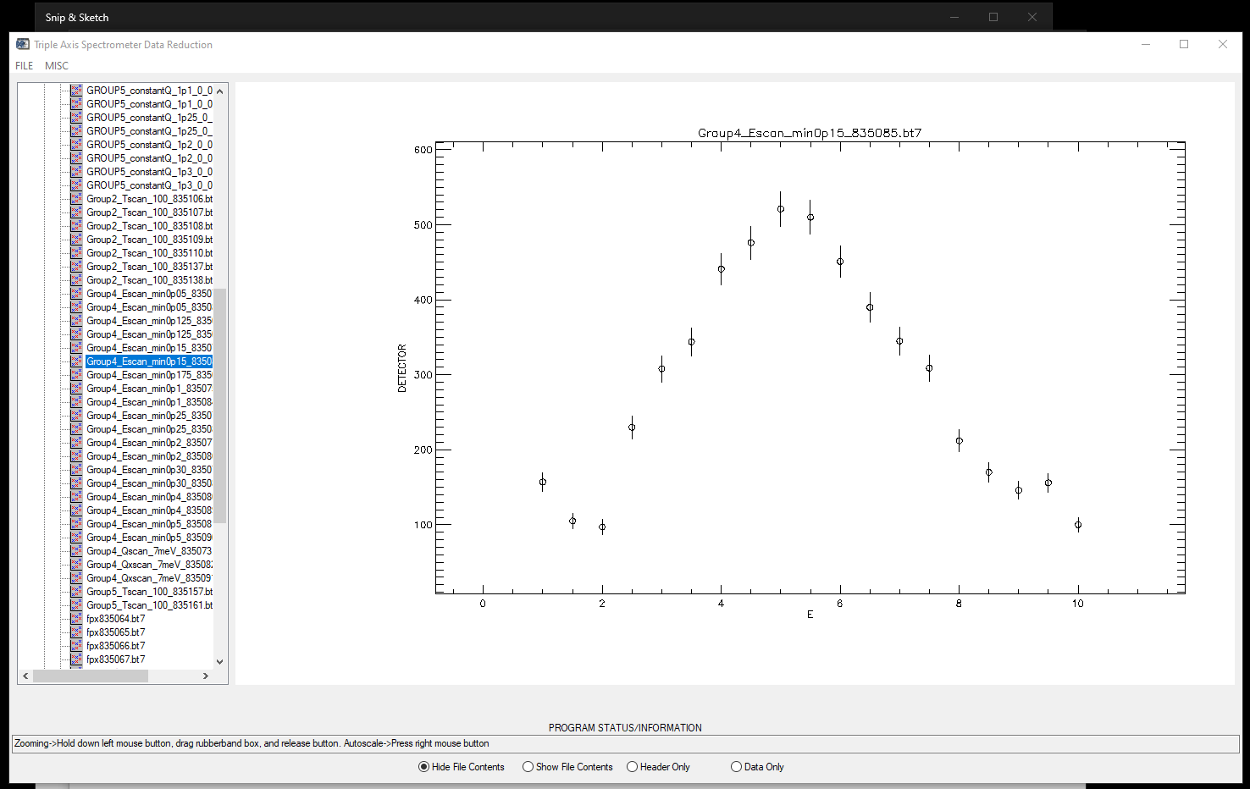
Constant-Q scan

Slide 40
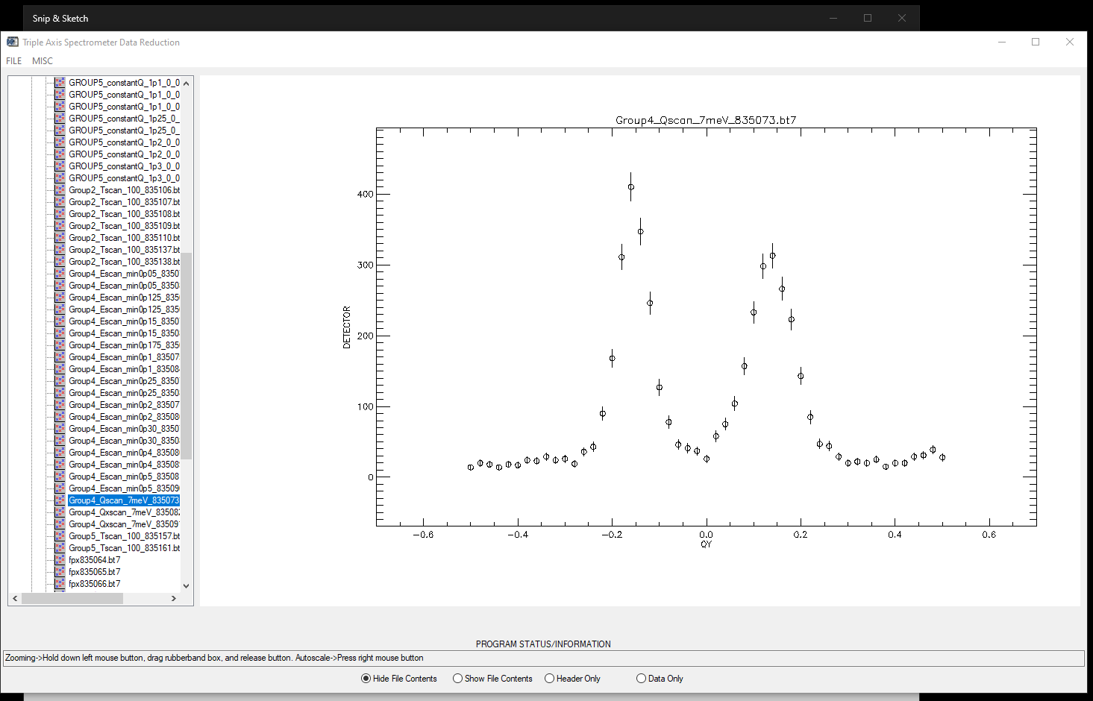
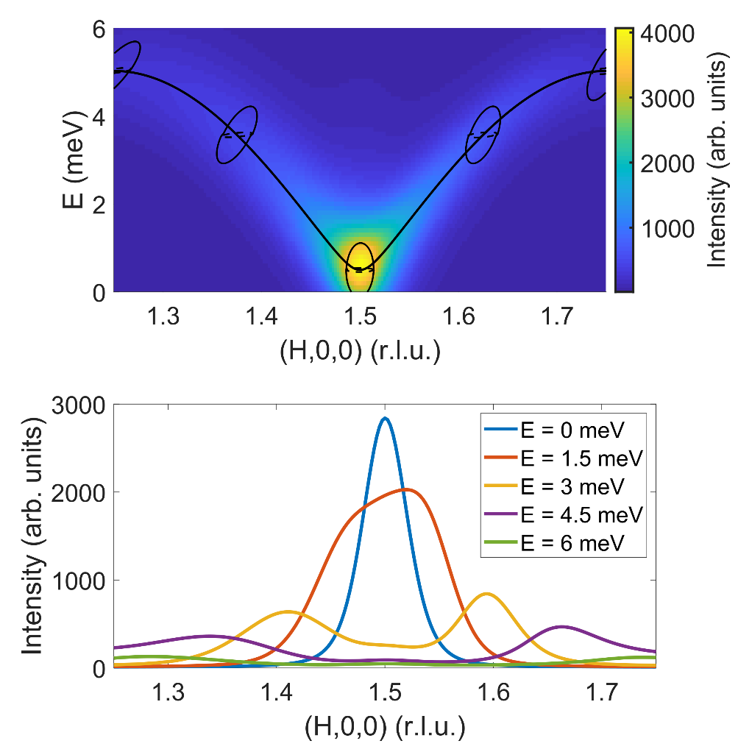
Costant-E scan (focus vs de-focus)

