Slide 1
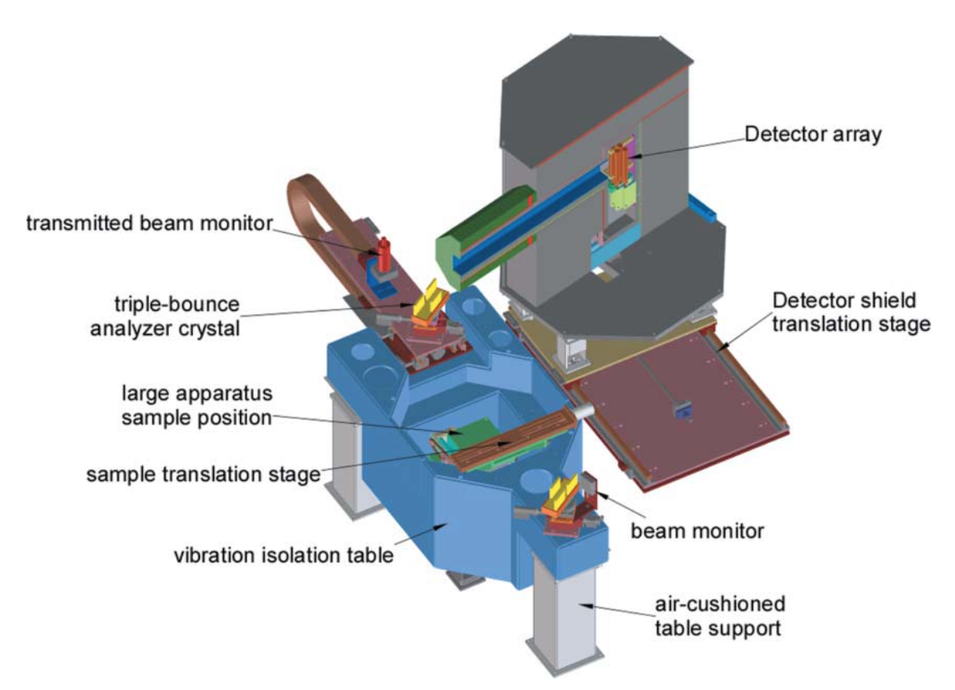


BT5 Double Crystal Diffractometer: How it Works
By: John Barker
Date: 10/17/2022

Slide 2
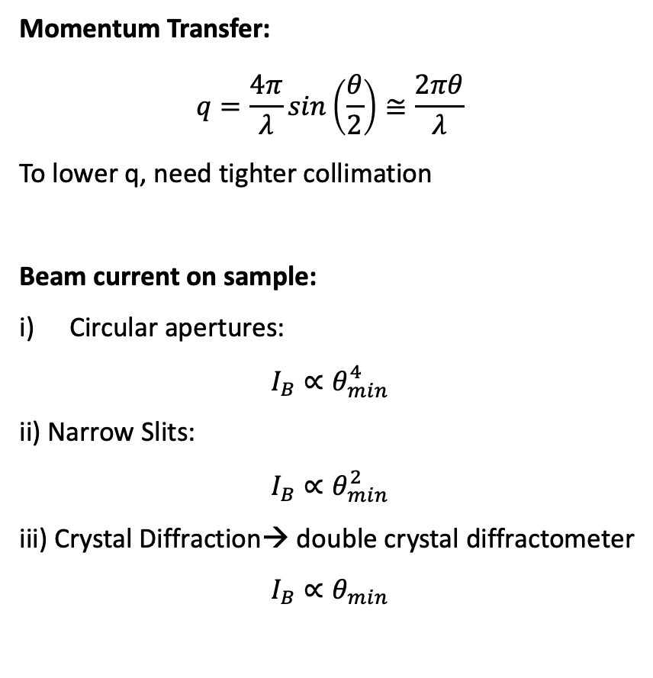
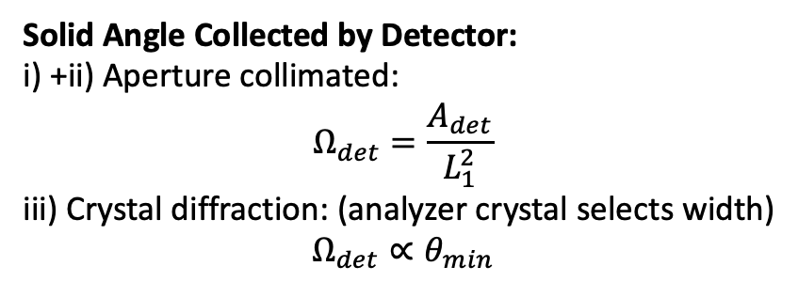
Momentum Transfer:
$$q=\frac{4π}{λ}sin\left(\frac{θ}{2}\right)≅\frac{2πθ}{λ}$$
To lower q, need tighter collimation
Beam current on sample:
Circular apertures:
$$I_{B}∝θ_{min}^{4}$$
ii) Narrow Slits:
$$I_{B}∝θ_{min}^{2}$$
iii) Crystal Diffraction→ double crystal diffractometer
$$I_{B}∝θ_{min}$$
Solid Angle Collected by Detector:
i) +ii) Aperture collimated:
$$Ω_{det}=\frac{A_{det}}{L_{1}^{2}}$$
iii) Crystal diffraction: (analyzer crystal selects width)
$$Ω_{det}∝θ_{min}$$
monochromator
detector
For high resolution, need ii) or iii) with slit-smeared collimation
source
analyzer

Slide 3
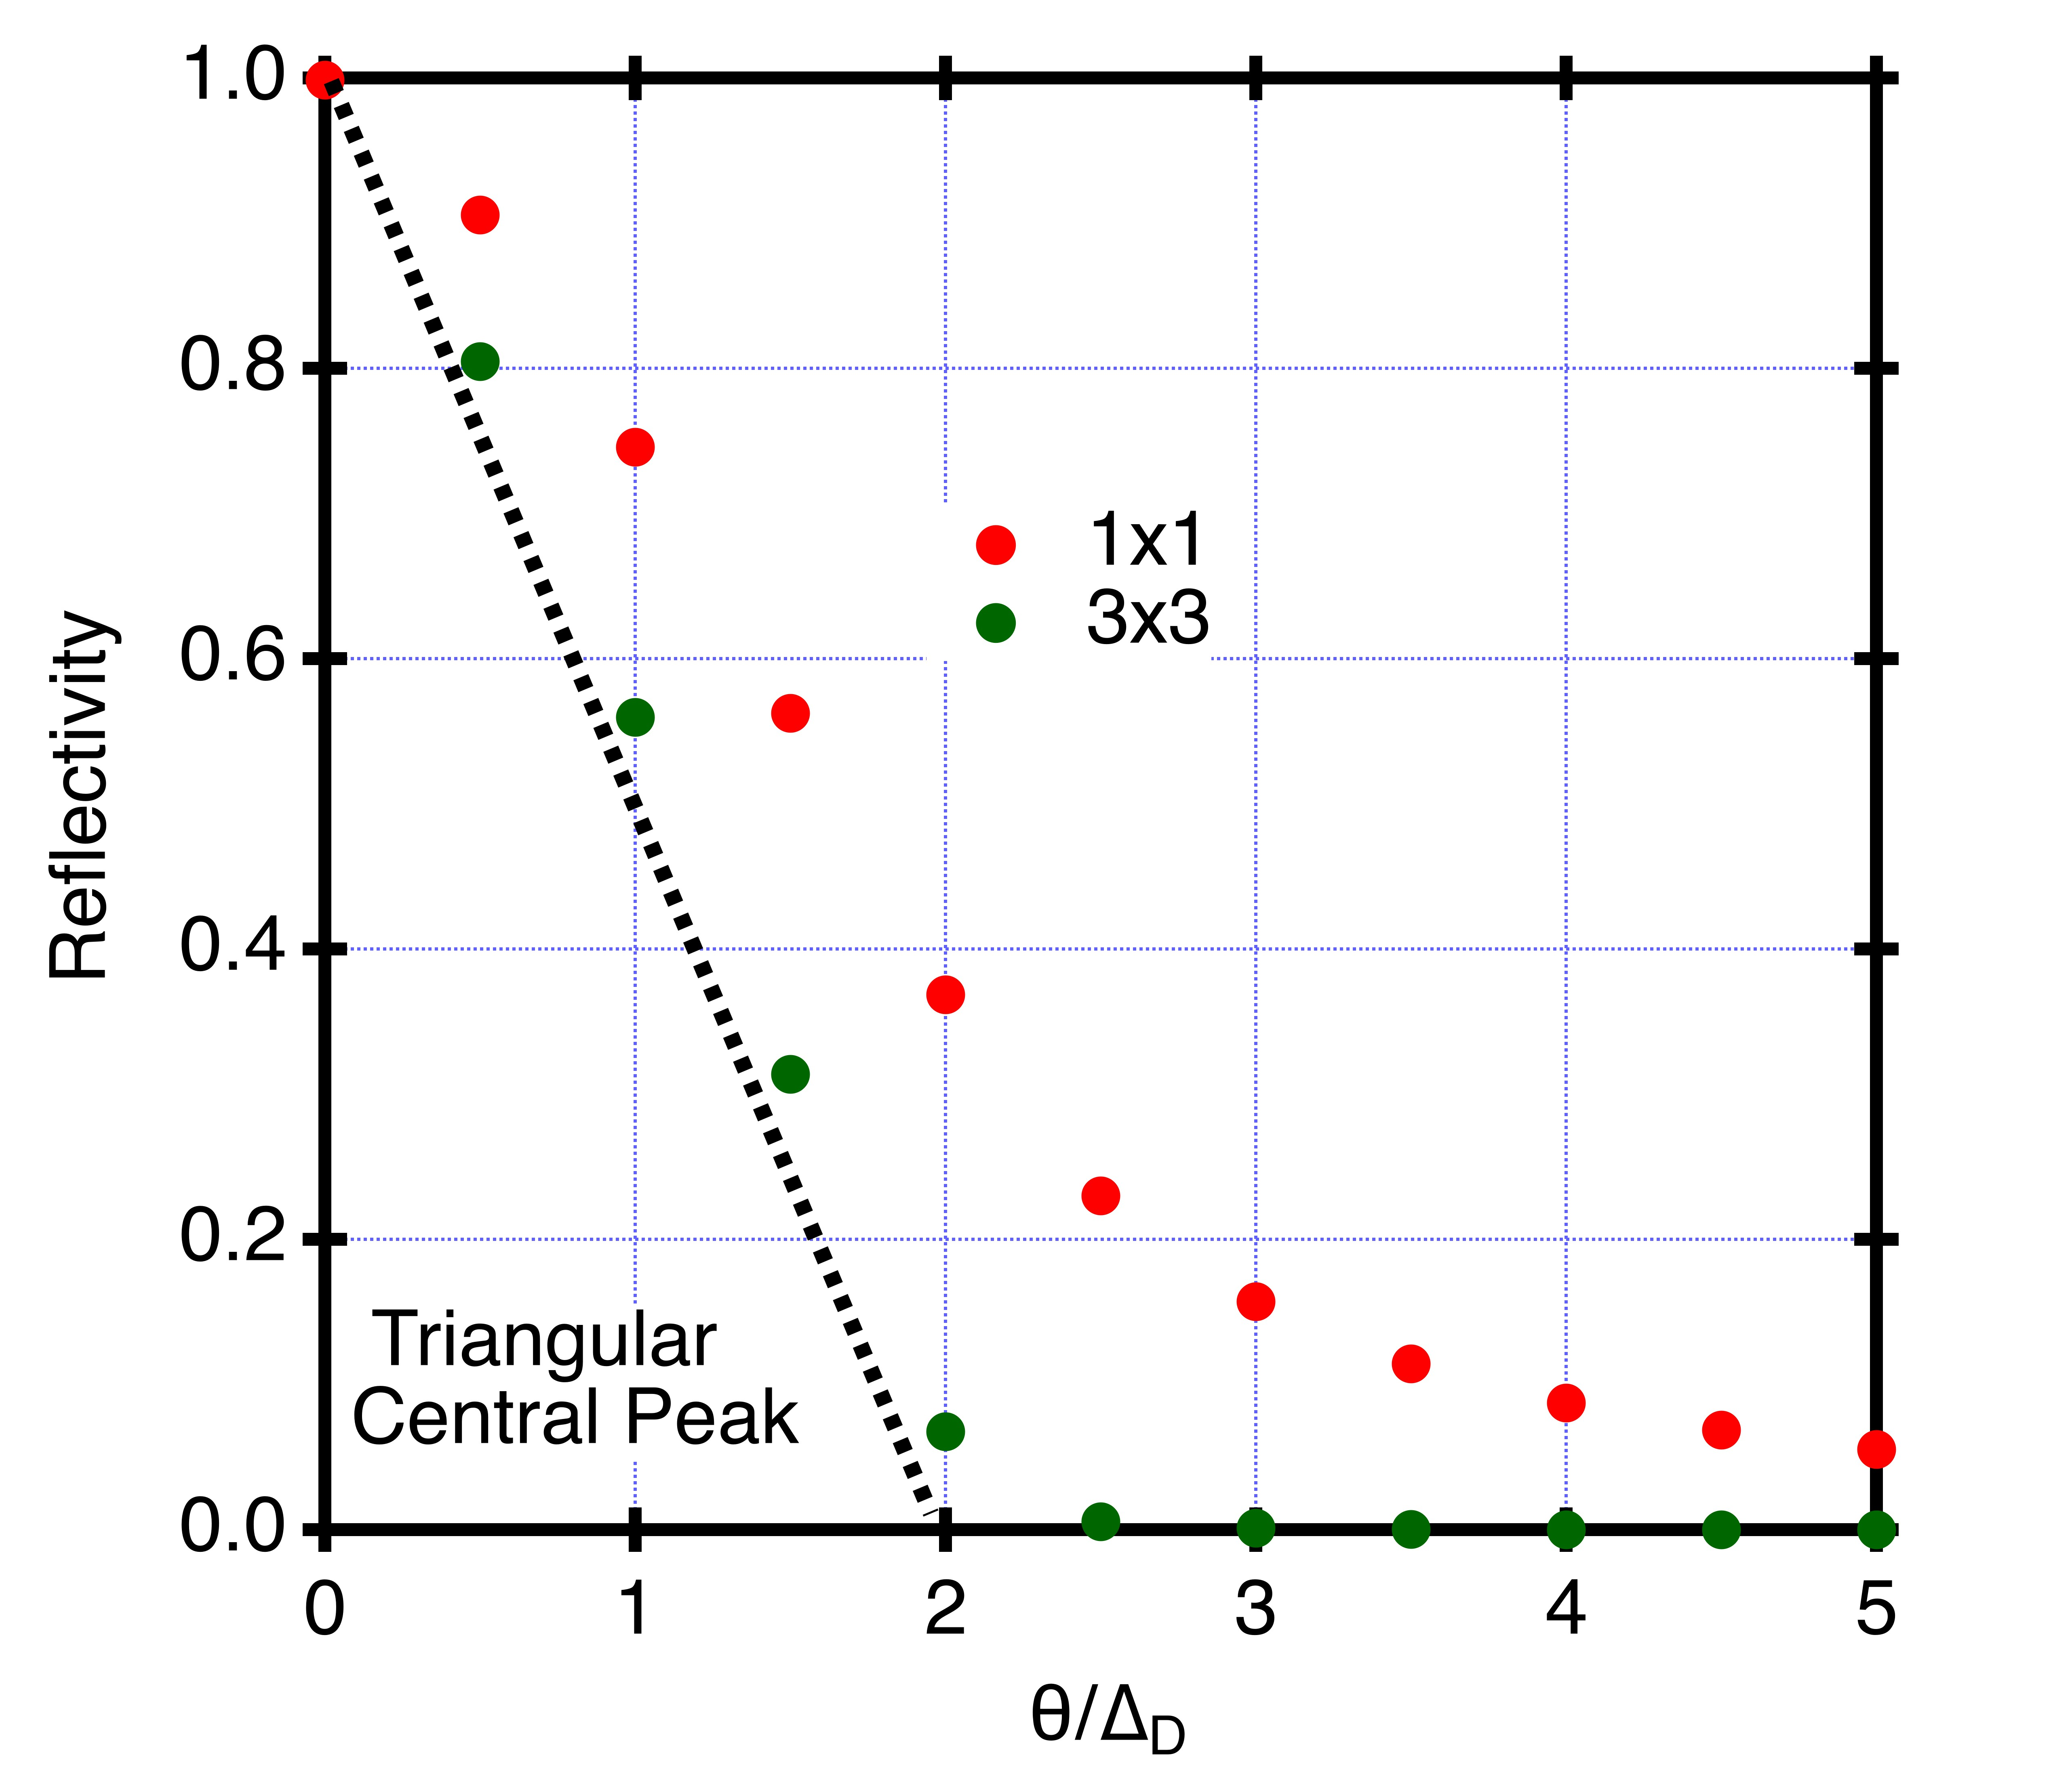
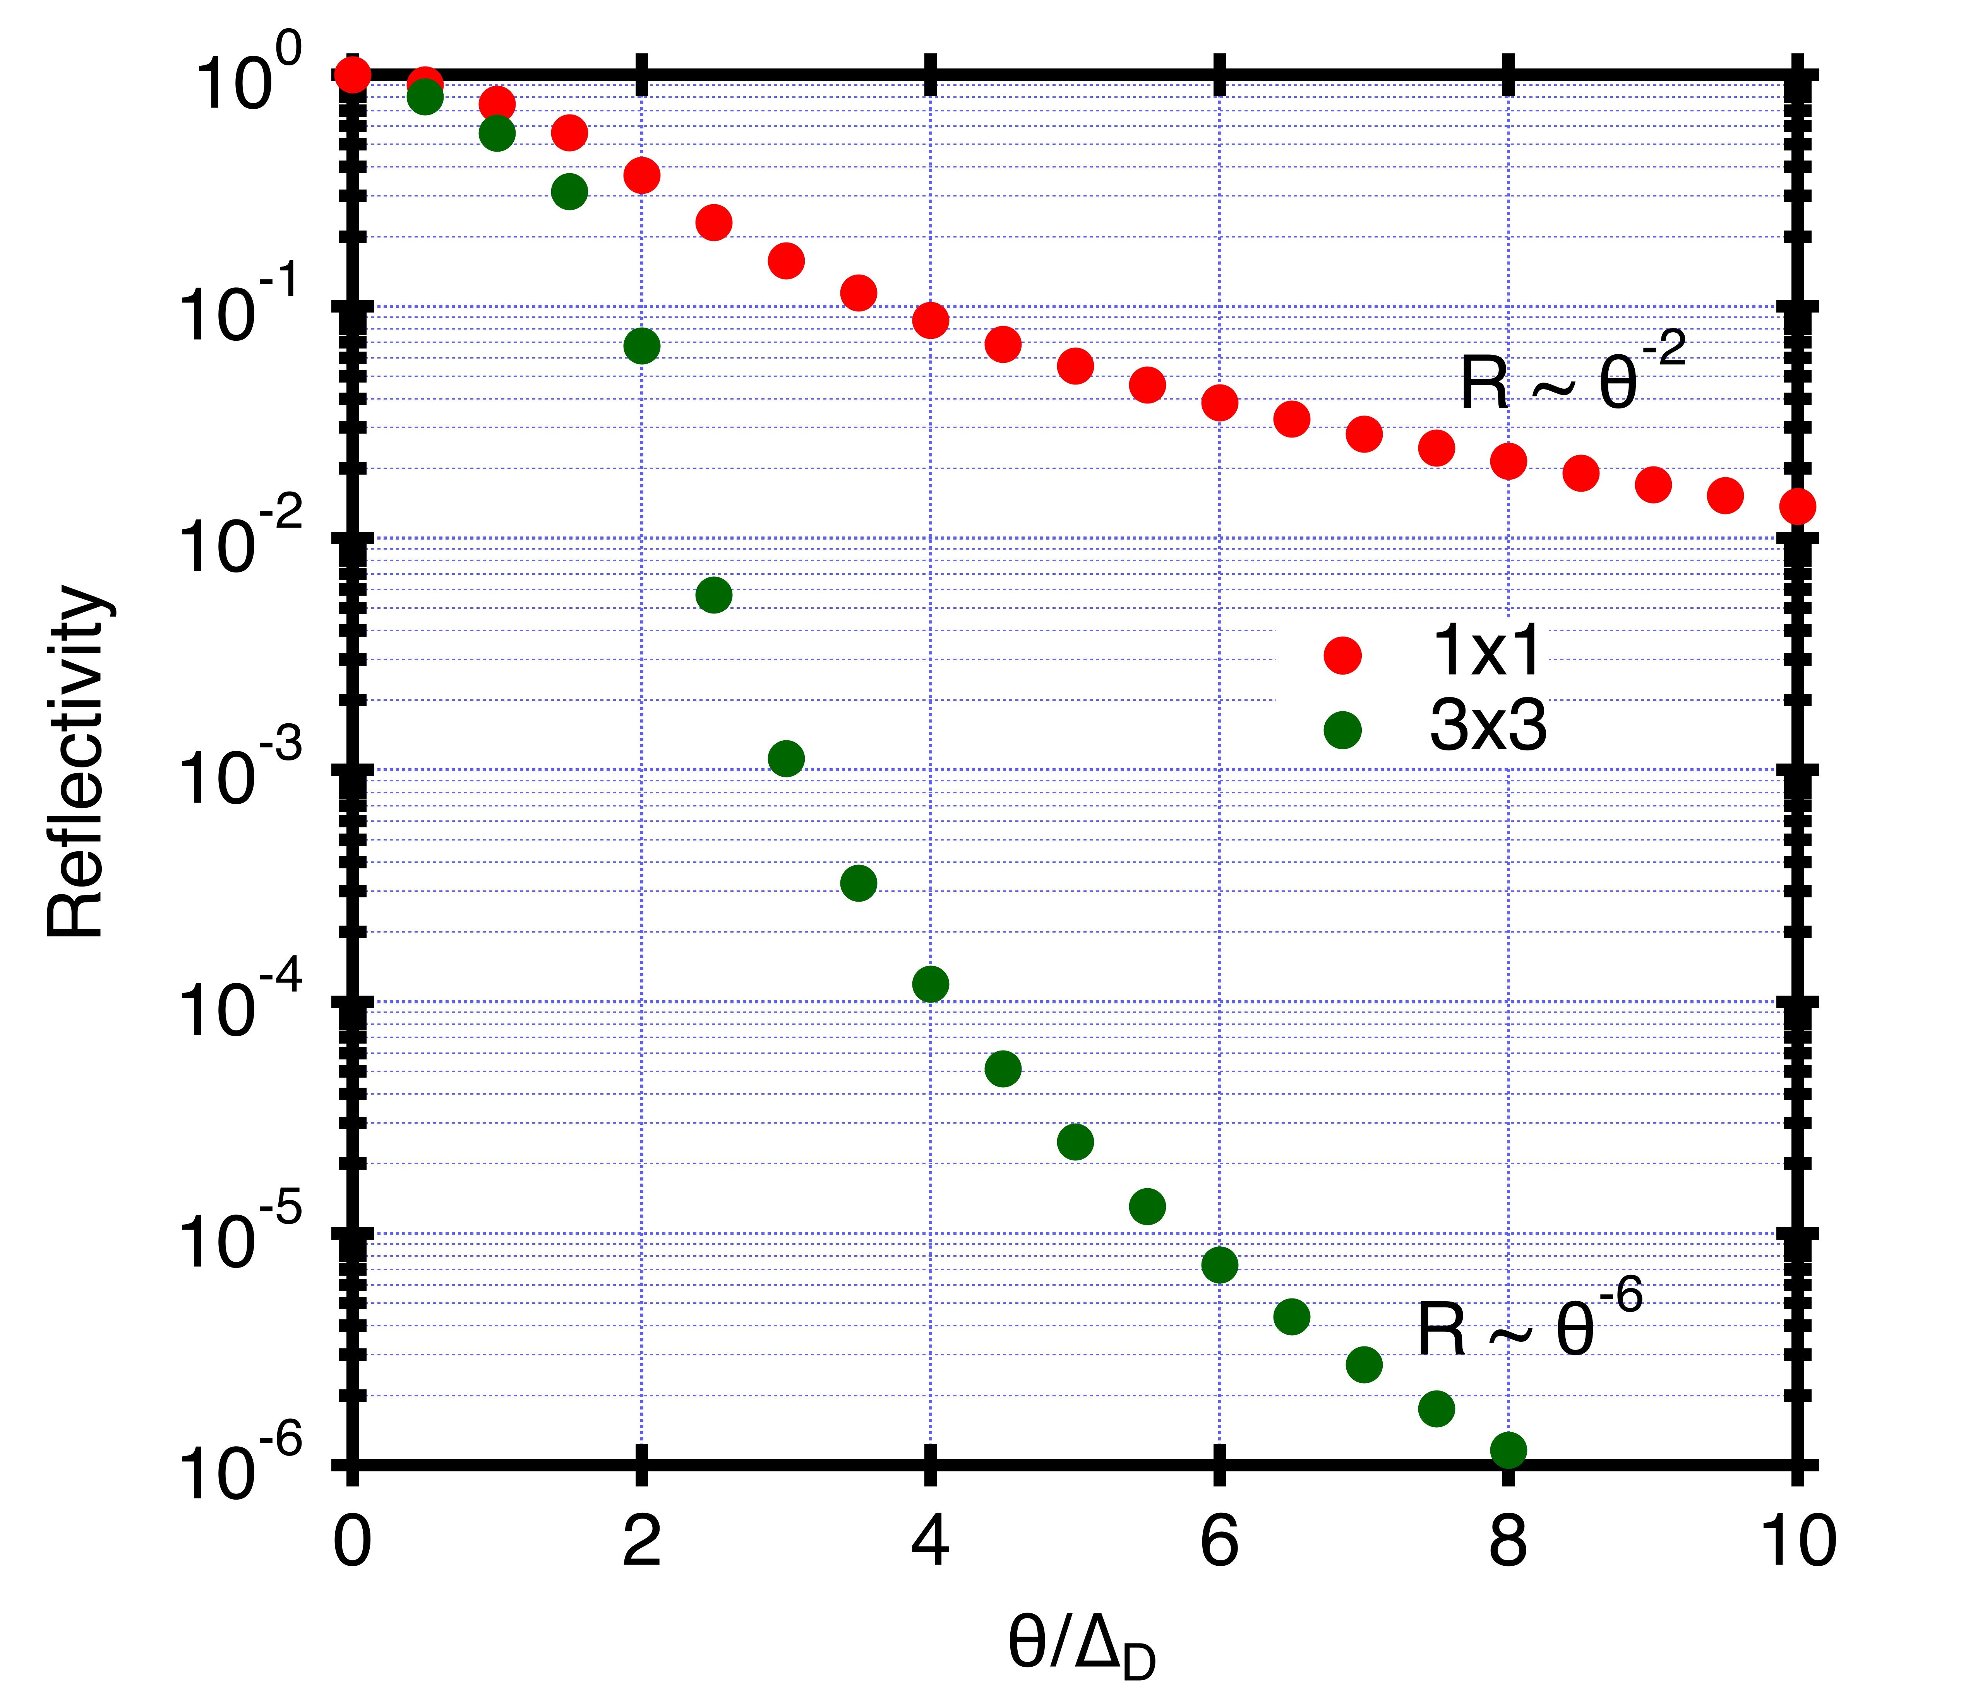
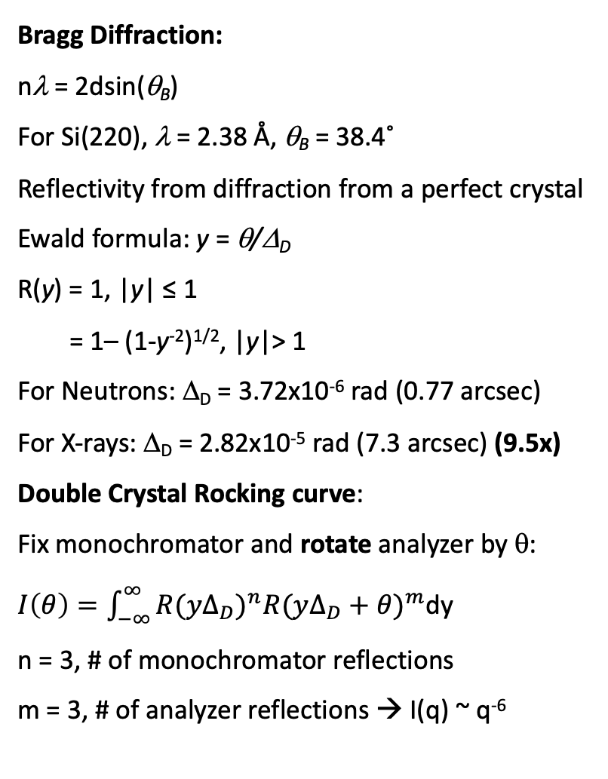
Bragg Diffraction:
nλ = 2dsin(θ_{B})
For Si(220), λ = 2.38 Å, θ_{B} = 38.4˚
Reflectivity from diffraction from a perfect crystal
Ewald formula: y = θ/Δ_{D}
R(y) = 1, |y| ≤ 1
= 1– (1-y⁻²)^{1/2}, |y|> 1
For Neutrons: Δ_{D} = 3.72x10⁻⁶ rad (0.77 arcsec)
For X-rays: Δ_{D} = 2.82x10⁻⁵ rad (7.3 arcsec) (9.5x)
Double Crystal Rocking curve:
Fix monochromator and rotate analyzer by θ:
$I\left(θ\right)=\int_{−∞}^{∞}{{{R(yΔ}_{D})}^{n}{R(yΔ_{D}+θ)}^{m}}$dy
n = 3, # of monochromator reflections
m = 3, # of analyzer reflections → I(q) ~ q⁻⁶

Slide 4
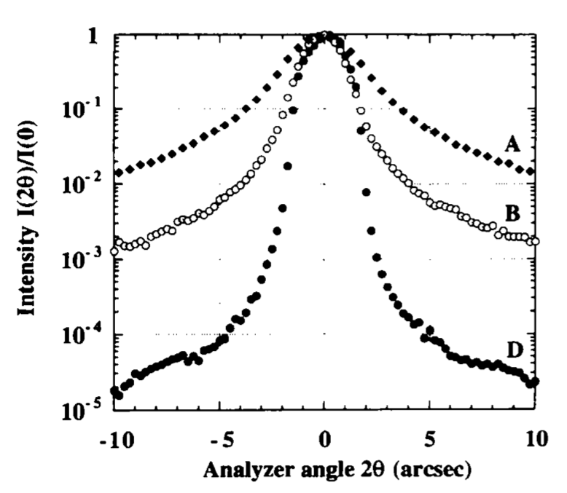
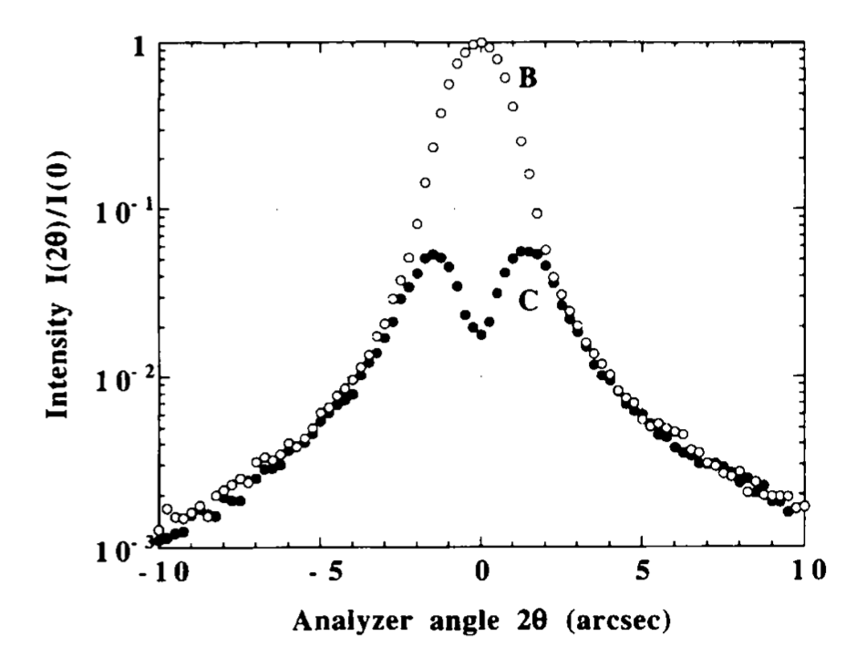
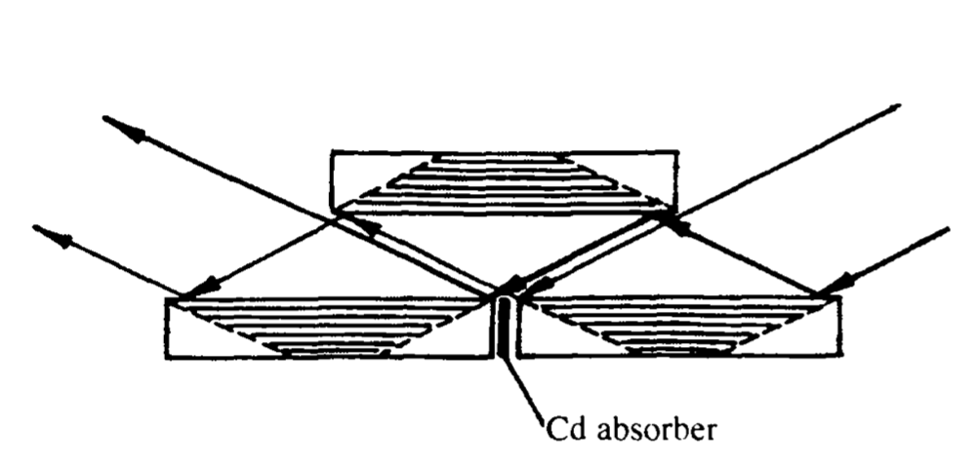
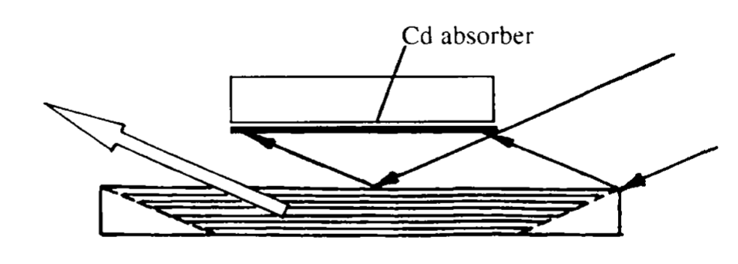
“Agamalian Cut”: add a break in long facet of Crystal
Agamalian et al. (1997). J. Appl. Cryst. 30, 345-352.
3x3
1x1
3x3
2nd ref.
blocked
3x3 + “cut”

Slide 5
High Performance Crystals
To obtain both high reflectivity from crystals to limit beam losses and minimize broadening of curve:
1) Channel-cut Silicon single crystal needs to be strain free:
i) Use float zone growing method for “zero” dislocation density and low oxygen content
(dislocations and oxygen clusters cause strain in the crystal)
ii) Remove surface damage from cutting/grinding operations with deep acid etch
iii) Mechanical support to minimize strain caused by gravity (thick flat base)
iv) dampen vibrations (unnecessary…)
2) Temperature Uniformity
i) Temperature nonuniformity in crystal changes d-spacing via thermal expansion and thus
strains crystal.
ii) Small temperature (~1˚ C) changes between monochromator and analyzer crystals will
shift the ‘q=0’ align position, causing ‘peak drift’ during an experiment.
iii) Large differences (~10˚ C) will cause the ‘q=0’ position to be wavelength dependent,
causing major loss in beam intensity.
{ Strain must be 10x smaller for neutron versus X-ray instruments }
3) Low Background Wings
i) Multiple reflections: I(q) ~ q^{-2n} n → number of reflections ≥ 3
ii) ‘Agamalian Cut’ to crystal to prevent dynamical diffraction from spoiling wings.

Slide 6
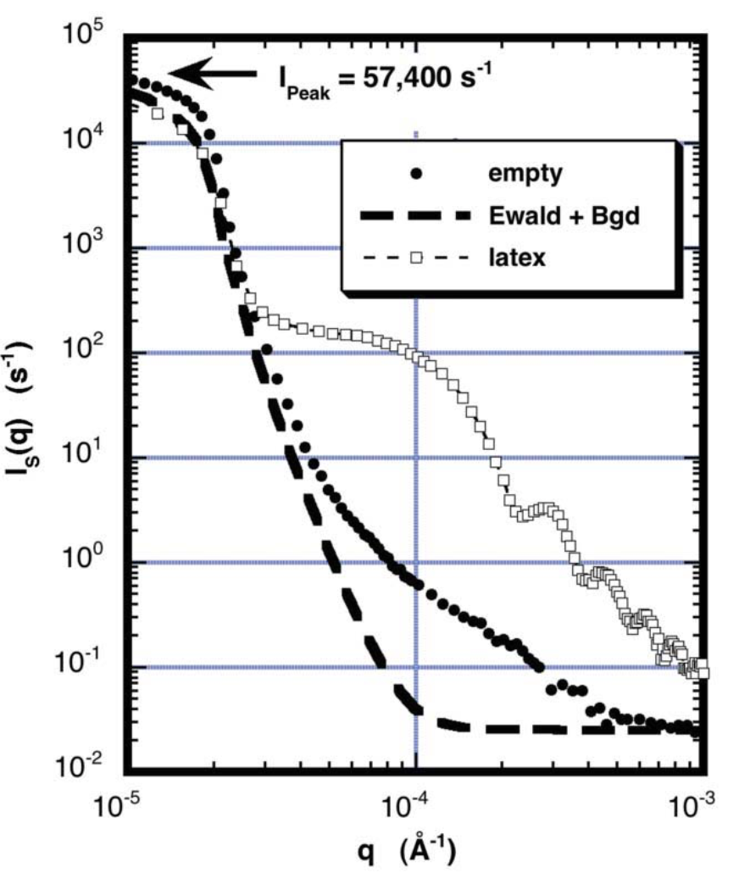
DCD vs. Narrow Slit Collimation
Pros:
• Beam current independent of sample size
• Lower Background
Cons:
• Analyzer width narrow→ Δq = 2x10⁻⁵ Å⁻¹
point by point data collection is slow…
noisy data at large q
SANS Data should be collected using VSANS (q_{min} = 3x10⁻⁴ Å⁻¹)
or SANS+Lens (q_{min} = 1x10⁻³ Å⁻¹) focusing to minimize the
need to collect large q data via USANS DCD.
For q ≥ 1x10⁻³, data collection 1,000x faster on SANS
(4 µm dia.)

Slide 7
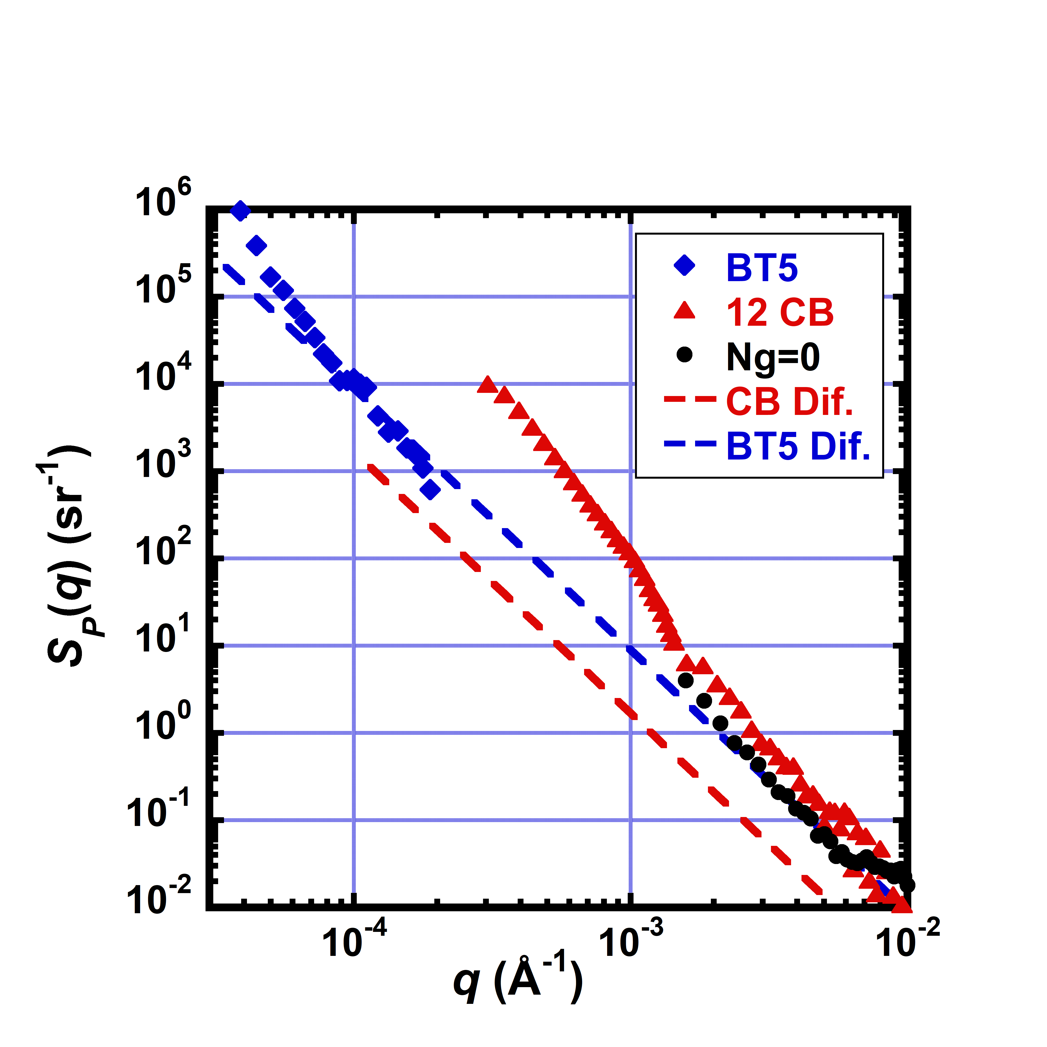
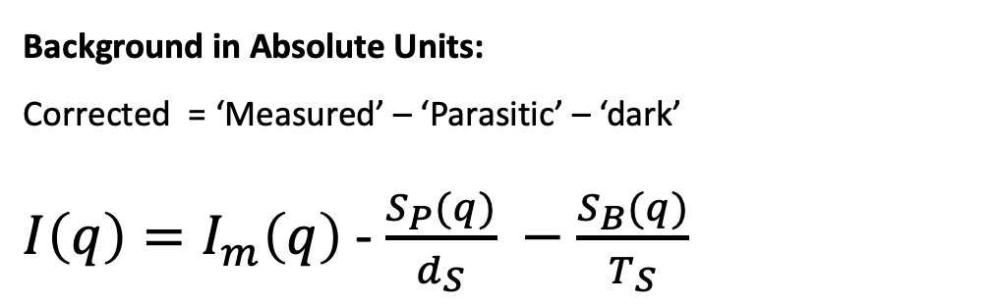
Background in Absolute Units:
Corrected = ‘Measured’ – ‘Parasitic’ – ‘dark’
$I\left(q\right)=I_{m}\left(q\right)$-$\frac{S_{P}(q)}{d_{S}} −\frac{S_{B}(q)}{T_{S}}$
To use narrow slits to produce similar
q-resolution on the VSANS instrument:
Need ~200 micron wide slits
{ unacceptable slit diffracted background }
<< 100 times higher background >>

Slide 8
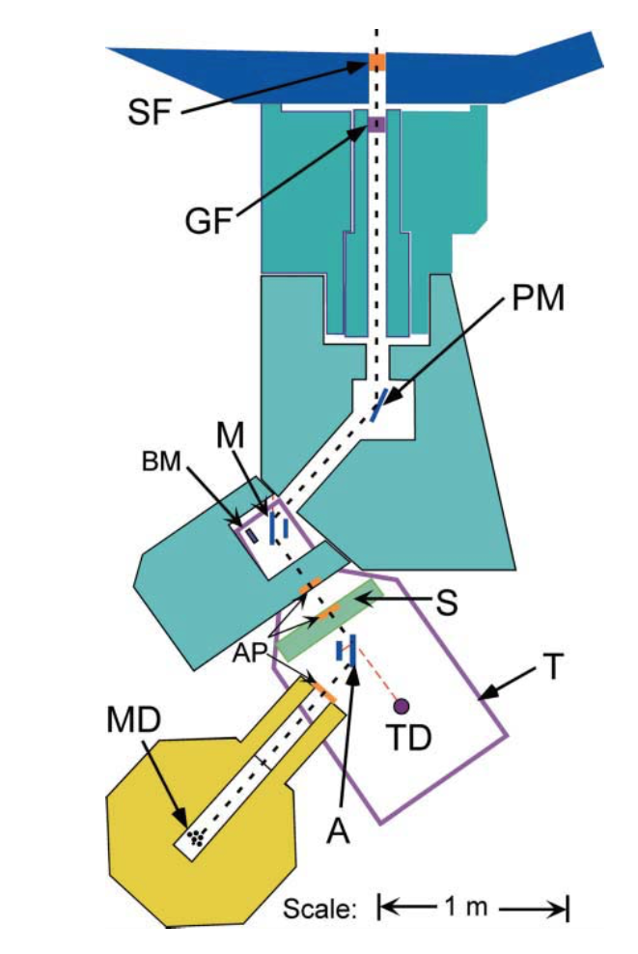
BT5 Double Crystal Diffractometer Components:
(SF) Sapphire Filter: 11 cm thick single crystal removes fast neutron background
(GF) Graphite Filter: HOPG mosaic 2.7˚ removes λ/2 background
(PM) HOPG Pre-Monochromator: 0.5˚ mosaic, doubly curved for focusing
(M) Monochromator: 3-bounce channel-cut Silicon Perfect Crystal
(BM) Beam Monitor: Low efficiency detector of beam from PM
(AP) Apertures: Define size of beam
(S) Sample Area: Adjustable in size
Analyzer: 3-bounce channel-cut Silicon Perfect Crystal → rotates
(TD) Transmission Detector: used to determine sample transmission
(MD) Main Detector: Measures SANS pattern, shielded for low background
Barker et al., (2005) J. Appl.Cryst., 38, 1004-1011.

Slide 9
3D Instrument View

Slide 10
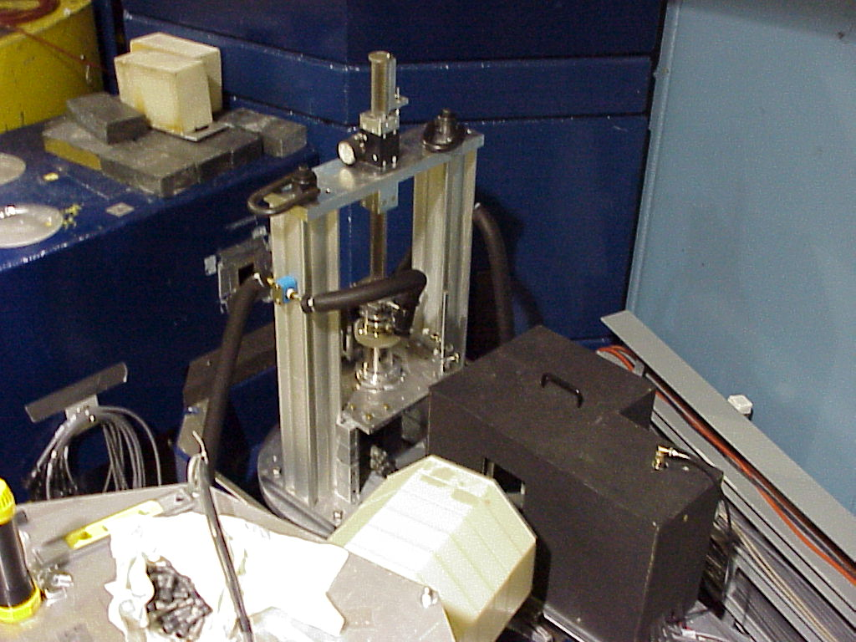

Shear Cell
Detector

Slide 11
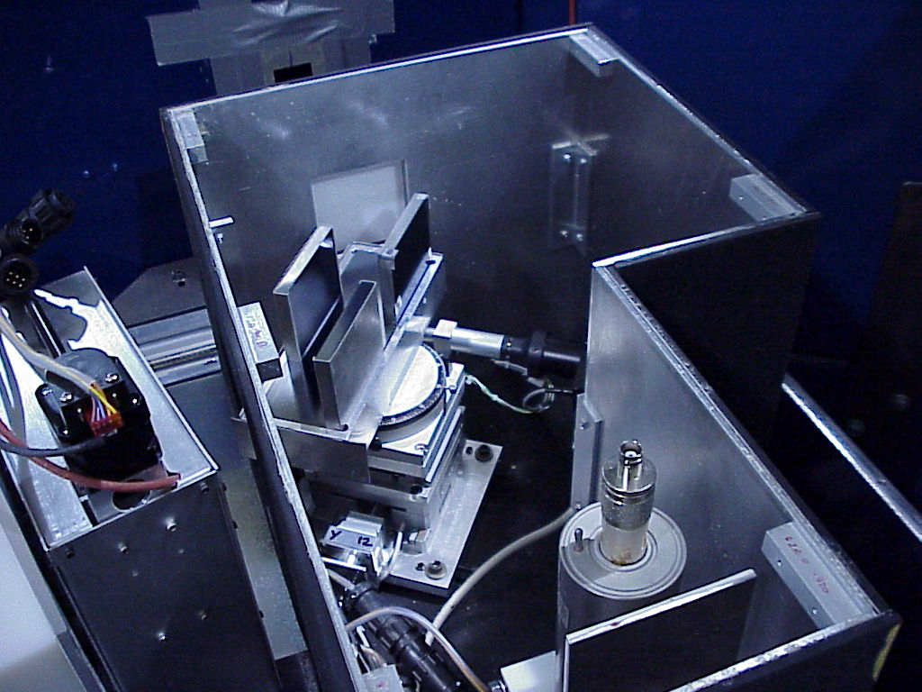
3-Bounce
Channel-Cut
Silicon (220)
Analyzer
Goniometer
Transmission
Detector

Slide 12
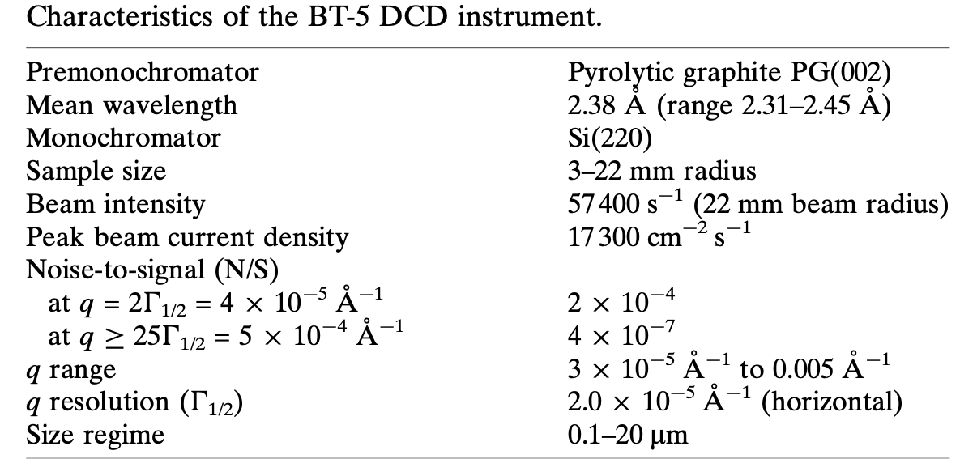
Barker et al., (2005) J. Appl.Cryst., 38, 1004-1011.

Slide 13
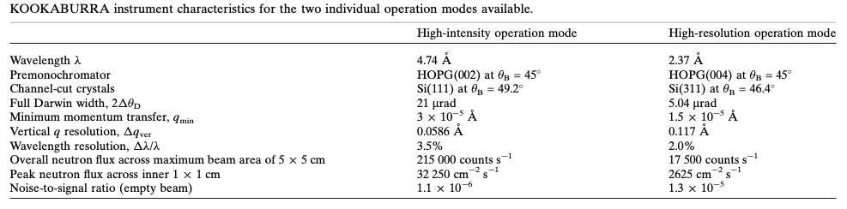
Other DCD instruments:
TOF-USANS at SNS, Oak Ridge, TN
Kookaburra at ANSTO, Australia ← Currently highest sample flux
S18 at ILL, Grenoble, France ← primarily used as an interferometer
Rehm et al., (2018) J. Appl. Cryst. 51.

