Slide 1
Requirements for Common Data Formats and Standards for e-Voting The OASIS View John Borras, Chair Election & Voter Services, Technical Committee NIST Common Data Format Workshop, Gaithersburg, October 29-30, 2009
www.oasis-open.org
blank

Slide 2
Agenda
The Need for Standards
EML
Interoperability Demo
The European experience
Summary
blank

Slide 3
The Need for Standards
blank

Slide 4
The Challenge
It is extremely unlikely that in the future elections will not have some e-enabled component(s). It’s probably more a question of how many components and when they are introduced. But there are still many concerns to be allayed and a good deal of confidence that needs to be built before e-voting solutions become broadly accepted.
Open standards are the base on which to build future e-enabled elections that will be trustworthy, open and creditable.

Slide 5
How to Facilitate Trust
Since democracy was invented - people have sought to “influence” the result of a vote
Our goal has been to reduce the risk that people will use the computer technology introduced into the process to “cheat” in new and interesting ways that were previously not available
Also - computer technology should remove old ways of cheating and therefore minimize the risks that were there previously
People should be able to transparently understand how the computer is handling their information and vote and have the means to independently verify that and hence be confident in and embrace the process.

Slide 6
Essentials for Trusted Voting
Applying the right principles can provide trusted verifiable voting processes
Use of open public specifications is essential
Independent verification and inspection is vital
Each new situation brings its own challenges – no one-size fits all / in-country localization
Future – broad availability of proven infrastructure
Auditability within an Electoral Assurance Framework

Slide 7
Auditability
Transparency and Auditability are key Electoral requirements - in e-voting systems in particular
Using open interfaces can provide transparency of the whole voting process from the time the votes are cast to the final count.
Full scale deployment of systems within an Electoral Assurance Framework incorporating standards provides:
Secrecy of the voter and their vote
Transparency, verifiability and auditability of the whole election
Assurance to the voter and voting watch-dog organizations
Notes:
7

Slide 8
Electoral Assurance Framework
Provides Accreditation, Assessment and Certification of electoral systems and services
Builds trust by enabling public verifiability of the whole voting process
Framework needs to be based on open standards
Provides standardised interface points where voting auditing processes can be independently assessed under the Assurance Framework

Slide 9
Why Interface Standards?
Need for information and data to be exchanged at several points in the election process
Several parties involved
Need to service dissimilar systems and equipment
Interchange has to be an open and transparent process using consistent data

Slide 10
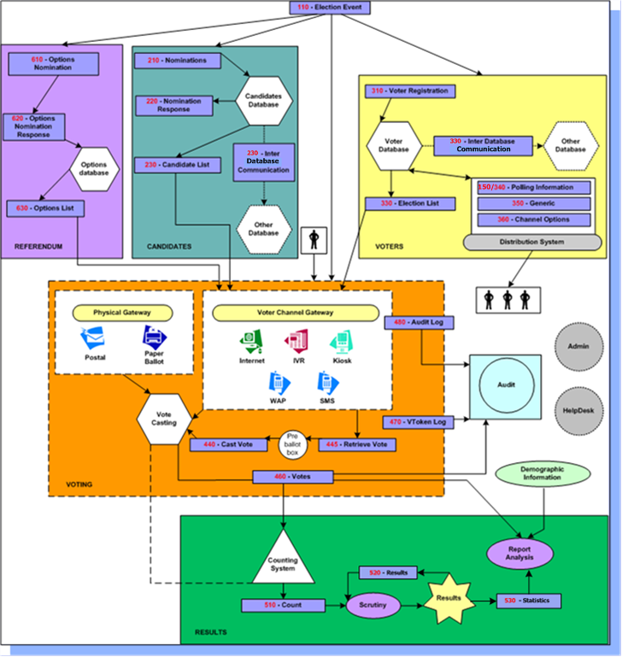
The Voting Process - possible interface points

Slide 11
EML ( Election Markup Language)
blank

Slide 12
Technical Committee Overview
History
Formed March 2001 by 3 USA companies
Chair since Aug 2001- UK Gov’t rep
Membership
Governments
Corporations
Election services providers
Academia

Slide 13
EML ( Election Markup Language)
Specification
Outlines Voting processes
Identifies data requirements
Contains glossary of terms
Addresses security issues
Overview of the XML schemas
Data Dictionary
Defines all exchanged data components
XML Schemas
Family of 38 schema components
29 specific exchange schema
2 new US-driven schema developed for EML 6.0

Slide 14
Coverage
EML provides specifications for :
Candidate Nomination, Response to Nomination and Approved Candidate Lists;
Voter Registration information, including eligible voter lists;
Various communications between voters and election officials, such as election notices, district boundaries and polling places;
Ballot information, including races, contests, and candidates;
Voter Authentication;
Vote Casting and Vote Confirmation;
Election counts, results and statistics;
Audit information pertinent to some of the other defined data and interfaces.

Slide 15
EML V6.0 - Changes
Enhancements
EML 510 and EML 530 for US district reporting needs
EML 150 Geo-district boundary and polling places
Simplification - consolidation of EML120 into EML330
Core Definitions
Improvements to flexibility of logical political boundaries
Clean-up and consistency corrections
Removal of redundant items
Localization Support
New common dictionary format - better discovery / reuse
Localization templates for all 29 exchange schema
Notes:
15

Slide 16
Take-up
Council of Europe Recommendation
UK election modernisation programme
Flemish local elections
European Elections in Germany
Australian General Election
California State Elections reporting
USA VIP project requirements
EU e-Poll project
International solution vendors

Slide 17
Current and Future TC work
Version 6.0 approved as Committee Draft, now released for Public Comment
Submit for approval as an ISO Standard
Provide more advice and guidance on implementation issues
Assist with national localizations
Develop compliance accreditation processes
Ongoing enhancements to accommodate any changes in voting policies/legislation and new requirements

Slide 18
Interoperability Demonstration held 29/30 October 2007 in Ditton Manor, UK

Slide 19
Demo Format
All attendees of the OASIS Open Standards Forum 2007 held in Ditton Manor, UK were invited to participate in an Interoperability Demonstration of EML.
With their help the objective of the Demo was to show how EML can be used in a multi-channel, e-voting ballot involving several suppliers equipment.

Slide 20
Demo Participants
The following organisations participated in the Demo:
Voter Registration
Election list production – Opt2Vote
Ballot papers preparation – Oracle & ES&S
Voting Channels
Paper – ES&S
Internet – Opt2Vote
PDA – Everyone Counts
Telephone – ES&S
Kiosk – ES&S
Counting/Results
Paper ballots scanning – ES&S
Counting and Results – IBM

Slide 21
Process
Upon arrival at the voting station delegates were given a voting registration card which contained the voter ID and password they needed to cast their votes. Voters had a choice of channels to use in casting their votes; via the Internet running on a laptop PC, a PDA, a telephone, a simulated voting kiosk, and paper ballots.
This whole exercise was a very global event as data was being captured by back-end systems in Nova Scotia, Australia, Northern Ireland, as well as locally in Ditton Manor. The paper ballots were scanned locally. All the data was sent electronically to Belgium for counting and then posted to the remote website for use in the final presentation at the Forum.

Slide 22
Outcome
The unanimous opinion of all those involved was that the Demo was highly successful. On the day everything went very smoothly, all the data exchanges worked without a hitch and the results were available within a matter of minutes of the close of the poll.
Clearly this was only a simple demonstration of a small section of EML, with only limited attention to security aspects, but it concentrated on using the real core aspects of EML
It provided the Technical Committee with good confidence that they have developed a product that can be used reliably and safely in real world situations.

Slide 23
The European Experience

Slide 24
Council of Europe
CoE is not the European Commission, separate org with 47 Member States across Europe
CoE Recommendation on e-voting
Legal Standards
Operational Standards
Technical Requirements
https://wcd.coe.int/ViewDoc.jsp?Ref=Rec(2004)11&Language=lanEnglish&Site=COE&BackColorInternet=DBDCF2&BackColorIntranet=FDC864&BackColorLogged=FDC864
Reviewed every 2 years, last time in Oct 2008, report available on COE website.

Slide 25
Specific Examples
UK’s Election Modernization Programme
e-voting pilots
http://www.justice.gov.uk/guidance/may2007electoralmodernisation.htm
Project CORE - Voters’ registration systems
http://www.justice.gov.uk/a-z/electoral-data-standards.htm
Flemish local elections
http://vlaanderenkiest.be/
European Elections in Germany
http://www.verkiezingsuitslagen.nl/

Slide 26
Summary
Technology will not go away; its use is pervasive in society, and in all aspects of elections already
Open standards are the base on which to build future e-enabled elections that will be trustworthy, open and creditable
Using consistent data and exchanging that at recognised interface points is essential for trusted elections
EML meets all election requirements known to the E&VS TC and is the only available international open standard

Slide 27
John Borras john@pensive.eu OASIS TC www.oasis-open.org/committees/election

