Slide 1
AAFS Biological Methods Subcommittee Progress
Kimberly Murga
February 22, 2016

Slide 2
Subcommittee Leadership
Position | Name | Organization | Term | Email
Chair | Kimberly Murga | Las Vegas Metropolitan Police Department | 2 | K10140M@lvmpd.com
Vice Chair | Margaret Sanger | Kentucky State Police | 2 | Margaret.sanger@ky.gov
Executive Secretary | Jason Befus | Maryland State Police | 2 | Jason.befus@maryland.gov

Slide 3
Subcommittee Members
# | Name | Organization | Term | Email
1 | Caroline Zervos | FBI | 2 | caroline.zervos@ic.fbi.gov
2 | Taylor Scott | Illinois State Police | 2 | taylor_scott@isp.state.il.us
3 | Eric Buel | Self Employed, Forensic Consultant | 2 | eric.buel.vt@gmail.com
4 | Peter Vallone | NIST | 2 | peter.vallone@nist.gov
5 | Susan Greenspoon | Virginia Dept. of Forensic Science | 3 | Susan.Greenspoon@dfs.Virginia.gov
6 | Eugene Lien | NYC Office of Chief Medical Examiner | 3 | ELien@ocme.nyc.gov
7 | Elisa Wurmbach | NYC Office of Chief Medical Examiner | 3 | ewurmbach@ocm.nyc.gov
8 | Sean Oliver | Armed Forces DNA Identification Laboratory | 3 | robert.s.oliver28.ctr@mail.mil
9 | Stacy McDonald | Dallas County Southwestern Institute of Forensic Sciences | 3 | smcdonald@dallascounty.org
10 | Amy McGuckian | Palm Beach County Sheriff’s Office | 3 | amy.mcguckiana@pbso.org
11 | Amy Jeanguenat | BODE Technology | 3 | amy.jeanguenat@bodetech.com
12 | Steven Weitz | Bureau of Alcohol, Tobacco, Firearms and Explosives | 4 | Steven.witz@atf.gov
13 | Daniele Podini | The George Washington University | 4 | podini@gwu.edu
14 | Ann Gross | MN Bureau of Criminal Apprehension | 4 | ann.gross@state.mn.us
15 | Debra Glidewell | DoD/Defense Forensic Science Center | 4 | Debra.e.glidewell.civ@mail.mil
16 | Bruce McCord | Florida International University | 4 | mccordb@fiu.edu
17 | Kristine Kadash | Jefferson County Regional Crime Lab | 4 | kkadash@co.Jefferson.co.us

Slide 4
Subcommittee Affiliates
# | Name | Organization | Email
1 | Melissa Suddeth | Florida Department of Law Enforcement | melissasuddeth@fdle.state.fl.us
2 | Bill Gartside | San Bernardino County Sheriff’s Department | bgartside@sbcsd.org
3 | Jeffrey Nye | State of Michigan Department of State Police Forensic Science Division | nyej1@michigan.gov
4 | David Foran | Michigan State University | foran@msu.edu

Slide 5
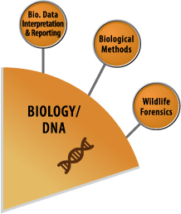
Discipline Description
Biological Methods
The Biological Methods Subcommittee will focus on establishing standards and guidelines that support molecular and biochemical methods used to analyze evidence and reference items.
This encompasses everything from serology through loading samples on a Genetic Analyzer. This subcommittee does not cover anything related to interpretation (serology interpretation or DNA interpretation)

Slide 6
Monthly Telephonic Meetings Held
4 Task Groups
Terminology (being overseen at Biology/DNA SAC Level)
Validation and Method Development
Education /Training/Competency/Certification (ETCC)
Serological Examination of Biological Evidence

Slide 7
Topic 1: Forensic Biology Terminology
Priority Level: High
Description: To develop a standardized list of terms with definitions applicable across the forensic biology disciplines.
Draft Documents Created: 2 Lists, work is in progress
Task Group Chair Name: Eric Buel
Task Group Chair Contact Information: eric.buel.vt@gmail.com

Slide 8
Committee Action Plan
Topic 1: Forensic Biology Terminology
Priority | Planned Actions | Approx. Deadline | Assignee
1 | Evaluate current lists of terms and focus on biology-specific terms (move non-biology terms to a separate list) | March, 2016 | Terminology Task Group
2 | Complete drafts for subcommittee evaluation and feedback | April, 2016 | Terminology Task Group
3 | Incorporate feedback and modify list of terms as appropriate | June, 2016 | Terminology Task Group
4 | List(s) of biology-specific terms completed for review by Biology/DNA SAC | July, 2016 | Terminology Task Group

Slide 9
Topic 2: Validation and Method Development
Description: To Create Standards and Guidelines for the Validation of Standard Operating Procedures
Draft Standards and Guidelines Created: In progress
Task Group Chair Name: Steven Weitz
Task Group Chair Contact Information: steven.weitz@atf.gov

Slide 10
Topic 2: Validation and Method Development
Content: SWGDAM and QAS inspired standards and guidelines
Definitions
Standards related to:
Developmental Validation
Internal Validation
Material Modification
Performance Check
Software

Slide 11
Committee Action Plan
Topic 2: Validation and Method Development
Priority | Planned Actions | Approx. Deadline | Assignee
1 | Develop a guideline related to validation and method development with best practices | March 2016 | Validation Task Group
2 | Develop standards related to internal and developmental validations associated with: DNA Extraction Quantitation STRs Capillary Electrophoresis High Throughput Sequencing (NGS) | May 2016 | Validation Task Group
3 | Present guidelines and standards to Subcommittee for review/comments | June 2016 | Validation Task Group
4 | Present guidelines and standards to Biology/DNA SAC for review/comments | July 2016 | Validation Task Group

Slide 12
Topic 3: Education/Training/ Competency/Certification (ETCC)
Description: This group’s focus is to establish standards and guidelines for training, education, competency, and certification that impact forensic practitioners, laboratory personnel, and the legal community.
Draft Standards and Guidelines Created: In progress
Task Group Chair Name: Kristine Kadash
Task Group Chair Contact Information: kkadash@co.Jefferson.co.us

Slide 13
Topic 3: Education/Training/ Competency/Certification (ETCC)
Content: QAS Inspired Includes:
Detailed educational requirements
DNA training modules
Laboratory tasks and topics to include statistics, CODIS, validation, review, lab policies, interpretation guidelines, and reporting guidelines
Assessment/final evaluation requirements

Slide 14
Committee Action Plan
Topic 3: Education/Training/ Competency/Certification (ETCC)
Priority | Planned Actions | Approx. Deadline | Assignee
1 | Consider comments from SAC on format of the draft Training Standard document and devise a plan to address them. | January 2016 | Task Group
2 | Divide single document into the following sections for elaboration: 1) Guidance document for Education Requirements 2)Guidance document for General Laboratory Issues 3) Training Standard for DNA Isolation and Purification Methods 4) Training Standard for Real-Time PCR Quantification Methods 5) Training Standard for STR Typing via Capillary Electrophoresis 6) Training Standard for Mitochondrial DNA Sequencing Analysis | February 2016 | Daniele Podini/David Foran Kristine Kadash Kristine Kadash Daniele Podini Stacy McDonald Ann Marie Gross
3 | Monthly conference calls (frequency may be changed based on need) | March 2016 | Task Group
4 | Submit drafts of one or more documents to SAC and ASB | August 2016 | Task Group

Slide 15
Topic 4: Serology Standards
Description: These standards focus on serology, body fluid ID, sample identification and collection. Includes sexual assault kits, serological methods, evidence screening, body fluid/tissue identification and contamination prevention.
Draft Document Created: Standards for the Collection and Serological Examination of Biological Evidence
Task Group Chair Name: Caroline Zervos
Task Group Chair Contact Information: caroline.zervos@ic.fbi.gov

Slide 16
Topic 4: Standards for the Collection and Serological Examination of Biological Evidence
Content: SWGDAM Inspired
Includes
Definitions
Training Requirements
Serological Testing Fundamentals
Proficiency Testing Requirements
Evidence Control
Contamination Prevention
Validation Requirements
Equipment Calibration and Maintenance
Reporting and Reviews
Corrective Action

Slide 17
Committee Action Plan
Topic 4: Standards for the Collection and Serological Examination of Biological Evidence
Priority | Planned Actions | Approx. Deadline | Assignee
1 | Review ASTM Standards/ASB formatting | February 2016 | Task Group
2 | Break up document into three main areas: Training/Proficiency Tests Validation Analytical Procedures | February 2016 | Task Group
3 | Submit to Subcommittee vote | March 2016 | Amy Jeanguenat
4 | Submit to Biology/DNA Scientific Area Committee | March 2016 | Caroline Zervos
5 | Identify specific focus documents to establish best practices | April 2016 | Task Group

Slide 18
Research Needs and Gaps Identified
Improving the analysis of serological evidence for the identification of body fluids
Considerable research has been conducted to improve DNA analysis techniques, but little has changed during serological analysis of evidence
It would be beneficial to add methods which would streamline and decrease the serological analysis time on time-intensive items like sheets, clothing, etc.
Probabilistic genotyping of low copy number samples
Low copy number DNA analysis involves the presence of mixtures
Interpretation is difficult due to effects of stochastic amplification, allele dropout and allele drop-in
An expert system for this analysis would assist in the development of applications for this procedure

Slide 19
What’s Next for Biological Methods Subcommittee?
Task Groups are refining draft documents based upon extensive discussions and feedback during the January 2016 OSAC meeting
Adding more details, content, etc.
Gain OSAC approval to submit documents to an Standards Development Organization for approval

Slide 20
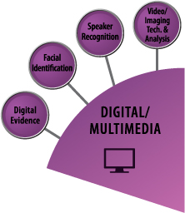
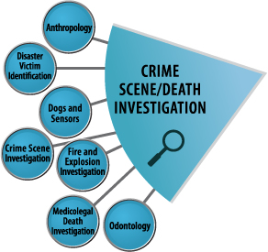
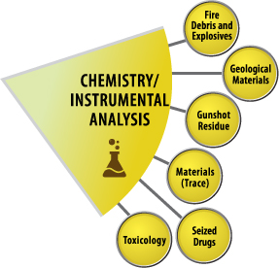
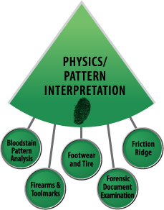

Slide 21
Thank You!

