Slide 1
Towards the Realization of Quantum Secure Direct Communication(QSDC)
LG Electronics, CTO Division
Quantum computing task
Byungkyu Ahn
Notes:
Hello everyone. My name is Byungkyu Ahn at LG Electronics.
We have been developing core technologies for quantum computing and quantum communication for the past seven years, and today I would like to introduce one of them — our work on quantum secure direct communication.

Slide 2
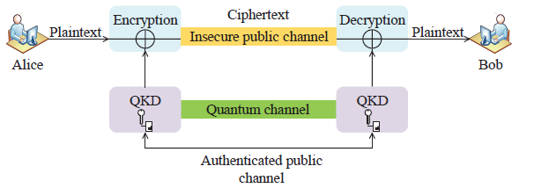
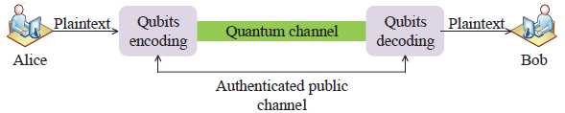
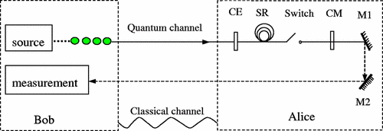
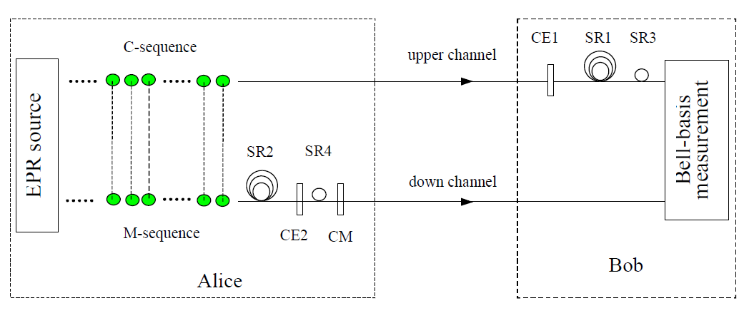
1. QSDC?
Quantum secure direct communication(QSDC)?
  QSDC can guarantee security using the characteristics of quantum mechanics even when a message is directly transmitted through a quantum channel without using a secret key
  Basic QSDC protocols
Fig. Quantum Key Distribution(QKD)
Fig. Quantum Secure Direct Communication(QSDC)
 | DL04 QSDC(2004, [2]) | Two step QSDC(2003, [1])
source | Single photon based QSDC protocol | Entanglement based QSDC protocol
Structure
 | Round-trip structure: the receiver generates single photons and sends them to the sender, which returns them after message encoding so that the receiver can measure them | Structure in which the check sequence and the message sequence are transmitted separately, with a time interval between them
[1]F.-G. Deng, G. L. Long, and X.-S. Liu, ``Two-step quantum direct communication protocol using the Einstein-Podolsky-Rosen pair block,'‘ Phys. Rev. A, Gen. Phys., vol. 68, no. 4, Oct. 2003, Art. no. 042317
[2]F.-G. Deng and G. L. Long, ``Secure direct communication with a quantum one-time pad,'' Phys. Rev. A, Gen. Phys., vol. 69, no. 5, May 2004, Art. no. 052319.
Notes:
The biggest difference is that QSDC can transmit classical information securely over a quantum channel without needing a secret key. There are two basic protocols: (the single-photon based DL04 QSDC protocol, and the entanglement based two-step QSDC protocol.)
The reason we are interested in QSDC is that, unlike QKD, it is not a technology for distributing a secret key — it is a technology for transmitting the message itself.
As you know, the communications market is incomparably larger than the cryptography market, and its impact is far broader.
It was first proposed in China in the early 2000s.
Recently it has since been demonstrated experimentally over fiber links, with satellite-based schemes now under study.

Slide 3
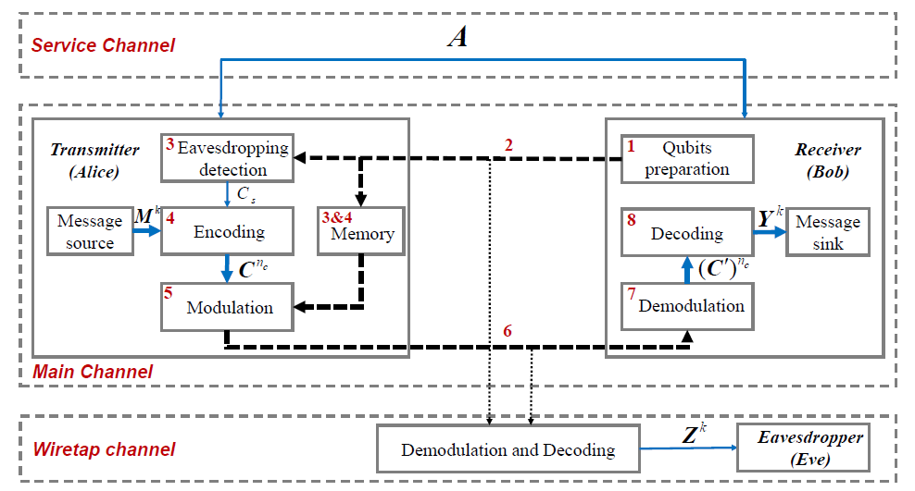
1. QSDC?
DL04 QSDC?
  Provides a method of transmitting classical bits in a two-way system
  Overall process
Classical channel
Quantum channel
Notes:
Today I will focus on the DL04 protocol, it provides a method of transmitting classical bits in a two-way single photon system.
In this protocol, the receiver first prepares the initial quantum states and sends them over the forward quantum channel in step 2.
The transmitter then takes a portion of the initial states it has received and uses them to check whether an eavesdropper is present.
This is the core step that guarantees security.
If the channel is confirmed to be secure, the transmitter encodes the classical message and then modulates that codeword message onto the initial quantum states held in the quantum memory, producing the encoded state.
The receiver obtains the encoded state over the backward quantum channel, and then performs demodulation and decoding in turn to recover the original message.

Slide 4
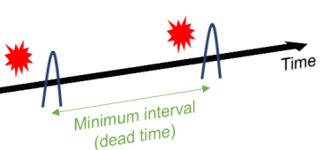
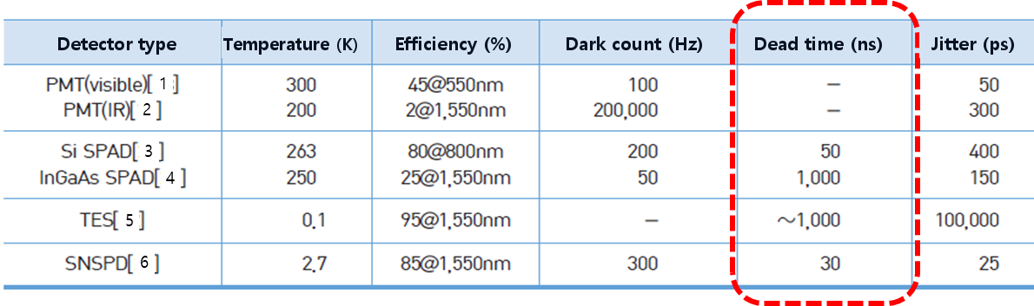
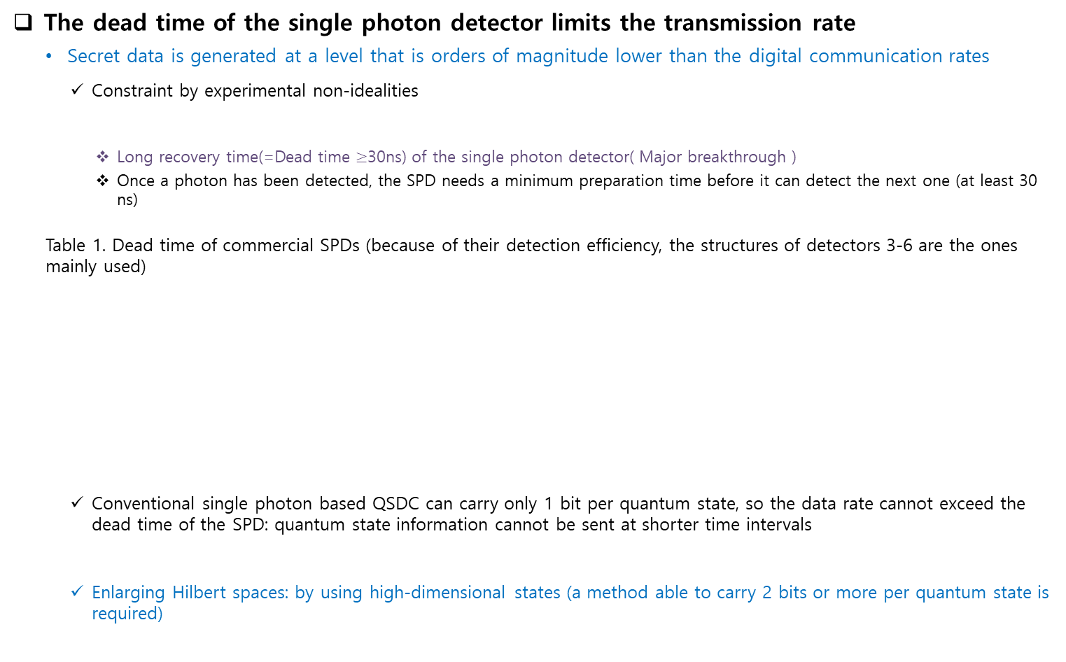
2. Motivation
The dead time of the single photon detector limits the transmission rate
  Secret data is generated at a level that is orders of magnitude lower than the digital communication rates
    Constraint by experimental non-idealities
      Long recovery time(=Dead time $≥$30ns) of the single photon detector( Major breakthrough )
      Once a photon has been detected, the SPD needs a minimum preparation time before it can detect the next one (at least 30 ns)
  Table 1. Dead time of commercial SPDs (because of their detection efficiency, the structures of detectors 3-6 are the ones mainly used)
    Conventional single photon based QSDC can carry only 1 bit per quantum state, so the data rate cannot exceed the dead time of the SPD: quantum state information cannot be sent at shorter time intervals
    Enlarging Hilbert spaces: by using high-dimensional states (a method able to carry 2 bits or more per quantum state is required)
PMT: Photo-Multiplier Tube
SAPD: Single-photon Avalanche Diode
TES: (Superconducting) Transition Edge Sensor
SNSPD: Superconducting Nanowire Single Photon Detector
Notes:
However, this technology has a limit on its transmission rate. Because of the recovery time of the single-photon detector — its dead time —quantum information cannot be measured at intervals shorter than that dead time.
The shortest dead time of today's single-photon detectors is around 30 nanoseconds.
So transmitting quantum information any faster than this interval is impossible, simply because it cannot be measured.
In this work, to overcome that transmission-rate limit, we propose a method that applies high-dimensional message encoding to achieve a transmission rate beyond the detector's dead time.
To overcome this limits, Our team set out to propose the first method to transmit log₂d bits of d-dimensional information per quantum state, and thereby to improve the transmission rate of the existing QSDC protocol.

Slide 5
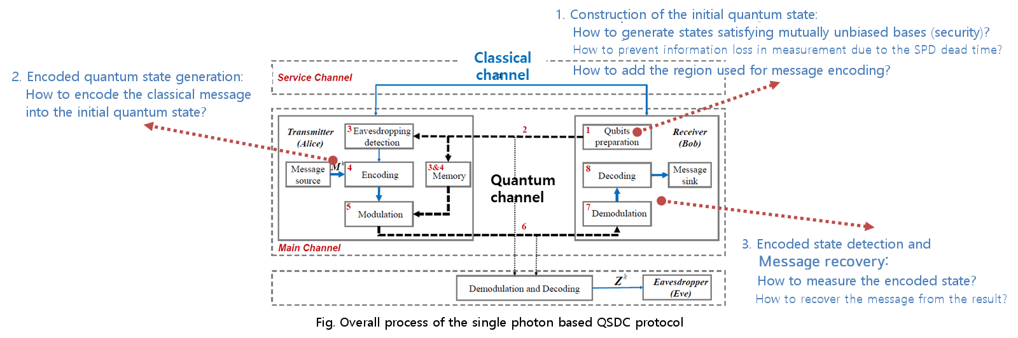
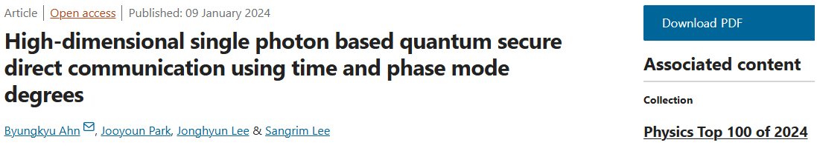
3. Single photon based high-dimensional QSDC
Target
  Development of a single photon based high-dimensional quantum secure direct communication
Challenge points: what is required in order to construct a high-dimensional QSDC protocol
Solution
  Scalable single photon based high-dimensional QSDC using time bin and phase
    A protocol that, using time and phase, can extend and construct QSDC regardless of the dimension of the quantum information
  Proposed.) Ahn, B., Park, J., Lee, J., & Lee, S. (2024). High-dimensional single photon based quantum secure direct communication using time and phase mode degrees. Scientific Reports, 14(1), 888.
Notes:
To construct a QSDC protocol using high-dimensional quantum information, we need to determine how to implement three key components: the message generation module, the message encoding module, and the detection module.
Recently, we published a method for high-dimensional quantum secure direct communication using two optical degrees of freedom, namely time-bin and phase, in the journal paper shown below.
We are currently implementing this technology in collaboration with KT and KAIST, with the goal of demonstrating it over a commercial telecommunications network in Korea by 2027.

Slide 6
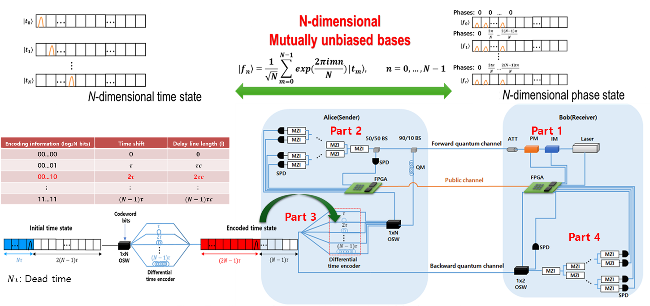
3. High-dimensional QSDC using time bin and phase
A single photon based high-dimensional QSDC protocol using time and phase
Notes:
We are implementing the time phase based high-dimensional QSDC protocol presented on the previous slide based on the system architecture illustrated in this figure.
In Part 1, the initial quantum states are prepared. In Part 2, a subset of the prepared quantum states is used to perform a security check on the forward quantum channel.
If the channel is verified to be secure, the remaining quantum states stored in the fiber-based quantum memory are retrieved and used for message encoding and quantum-state modulation in Part 3.
The encoded quantum states are subsequently transmitted through the backward quantum channel to Part 4, where the original message is reconstructed through measurement and decoding.

Slide 7
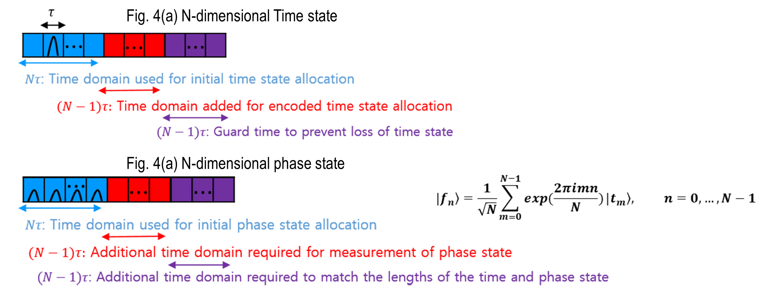
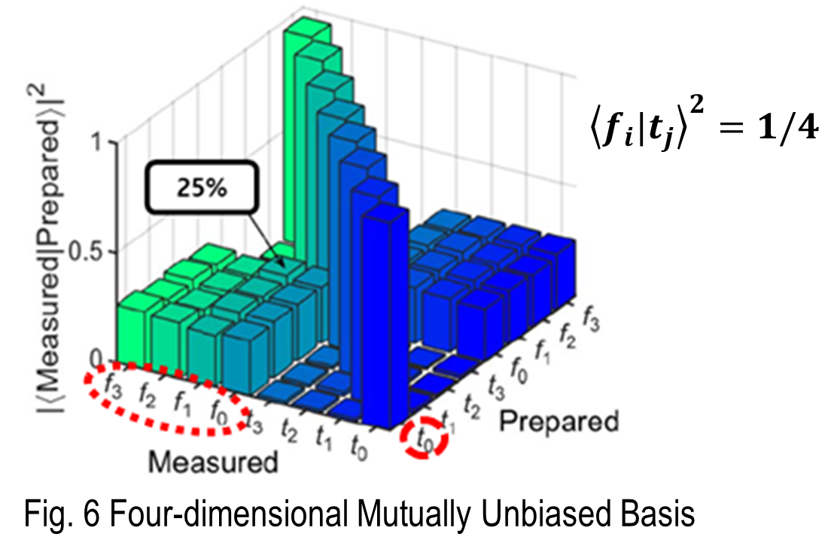
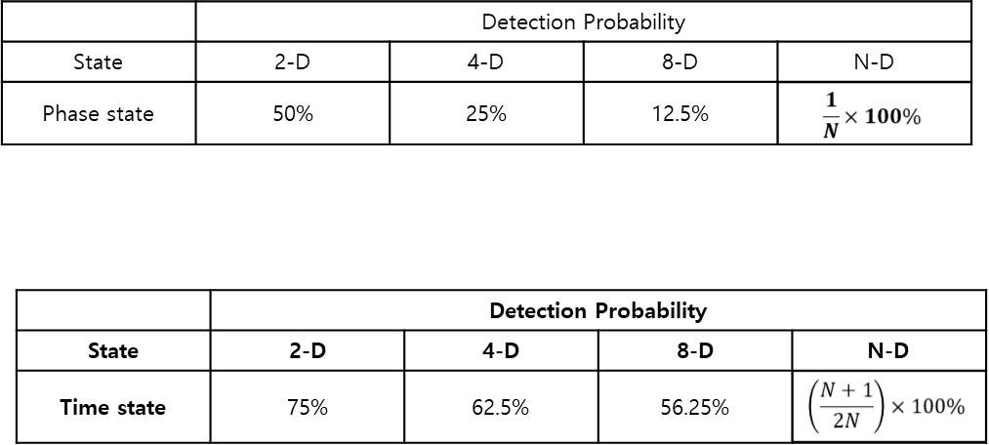
3. High-dimensional QSDC using time bin and phase
Part 1. N-dimensional initial time and phase state generation
  Phase state: used for quantum bit error rate (QBER) estimation
  Time state: used for message transmission and for QBER estimation
  Why the dead time of the SPD has to be taken into account when the two initial basis states are generated: the higher the dimension of the transmitted information, the lower the detection efficiency
    Detection probability of the two basis states, by dimension
Notes:
We encode quantum information using two optical degrees of freedom: time and phase.
The reason for employing these two optical degrees of freedom is that they form a pair of mutually unbiased bases (MUBs), which are essential for guaranteeing the security of the transmitted information.
Time states are identified by the arrival time of a single photon and are used for both message transmission and security verification.
Phase states are identified by the detection outcome after an unbalanced Mach-Zehnder interferometer, which depends on the encoded phase.
As the dimension increases, phase-state measurements require more interferometers, leading to lower detection efficiency. Therefore, phase states are used only for security verification.

Slide 8
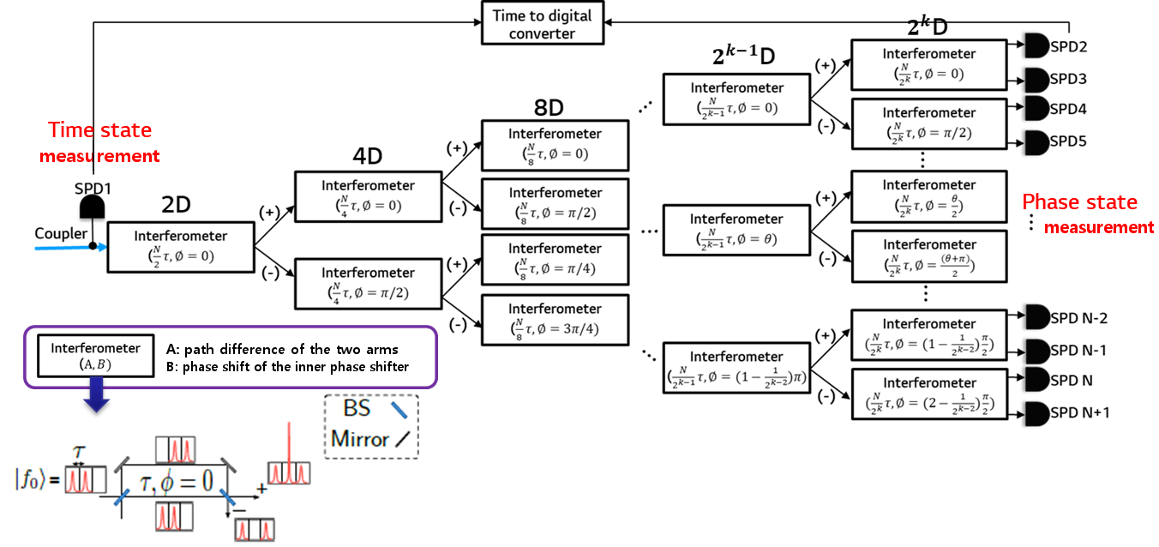
3. High-dimensional QSDC using time bin and phase
Part 2 (and 4). N-dimensional time and phase state detection
  Phase state: Measurement result can be obtained through the cascaded interferometric tree
    measured by distinguishing the measurement path
  Time state: Based on the time information at which a detection event occurred in the SPD
    measured by distinguishing the measurement time
The rules for constructing a new row in the tree structure for measuring the N-dimension phase state are as follows. If the phase and phase difference of the interferometer in the previous row are N/K and θ, respectively, the phase and phase differences of the two interferometers located in the new row connected to it are as follows, respectively. One is N/2K, θ/2, and the other is N/2K, (θ+π)/2.
Configuration of the high-dimensional phase state and time state measurement units
Notes:
The two types of quantum states introduced earlier require different measurement methods.
Time states can be measured relatively straightforwardly by converting the photon arrival time detected by a single-photon detector into digital information.
In contrast, the measurement of phase states requires substantially more resources.
In particular, as the dimensionality increases, the phase-encoded quantum states must pass through an increasingly complex tree-structured interferometer before the transmitted phase state can be identified from the detector click position.
Although high-dimensional phase states can theoretically be distinguished by employing additional measurement resources, their practical implementation becomes extremely challenging due to the increasing complexity and resource requirements.
To address this challenge, we are developing an efficient phase-state measurement technique based on the Temporal Talbot Effect, which enables the discrimination of phase-encoded quantum states using minimal measurement resources.

Slide 9

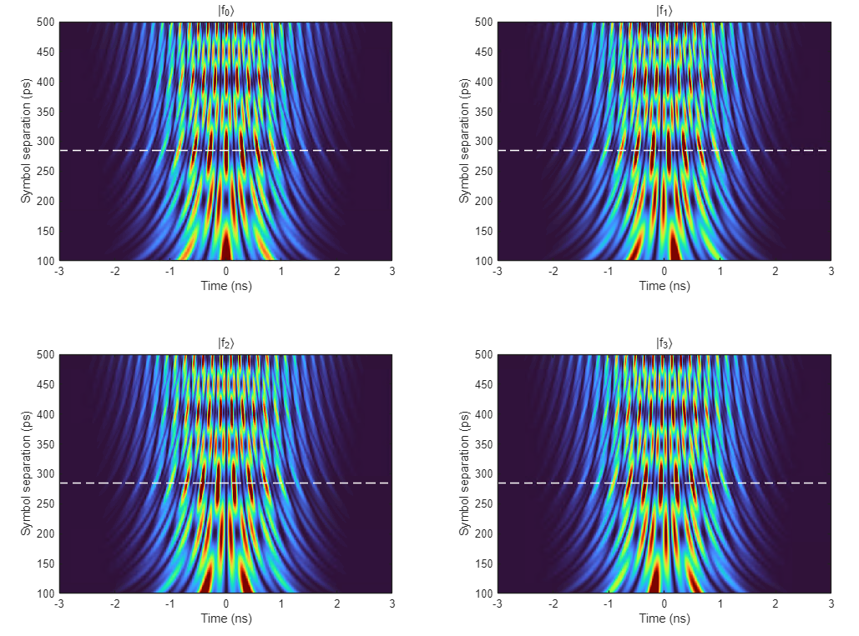
3. High-dimensional QSDC using time bin and phase
Part 2 (and 4). Low complexity detection
  Temporal Talbot Effect
    Time-domain analogue of the spatial Talbot effect
    While the spatial Talbot effect produces self-images of a periodic grating during free-space propagation, the temporal Talbot effect reconstructs periodic optical pulse patterns through propagation in a dispersive medium
  Discrimination of Four-Dimensional(n=4) Phase States Using the Temporal Talbot Effect
DCM
(Dispersion Compensation Module)
SPD
Configuration of the high-dimensional phase state and time state measurement units
Notes:
The Temporal Talbot effect is the time-domain analogue of the spatial Talbot effect, where self-images of a periodic diffraction grating are formed during propagation.
The high-dimensional phase states described by the following equation are mapped onto distinct time slots via the temporal Talbot effect in a DCM.
The four images shown here illustrate the results of applying the temporal Talbot effect to four-dimensional phase-encoded quantum states. As can be seen, the measurement time varies depending on the encoded phase information, demonstrating that different phase states are mapped to distinct temporal positions.
Unlike conventional phase-state measurement methods, which require more interferometers and detectors as the dimensionality increases, this approach requires only one DCM and one SPD, providing a highly efficient and scalable receiver structure.

Slide 10
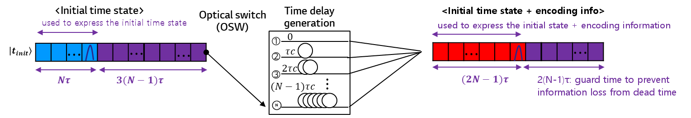
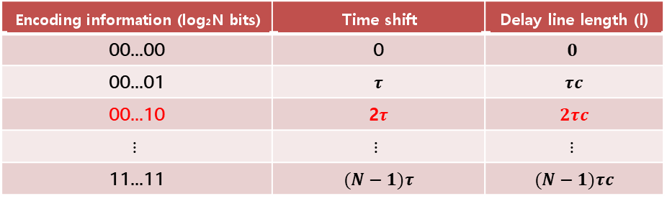
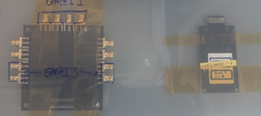
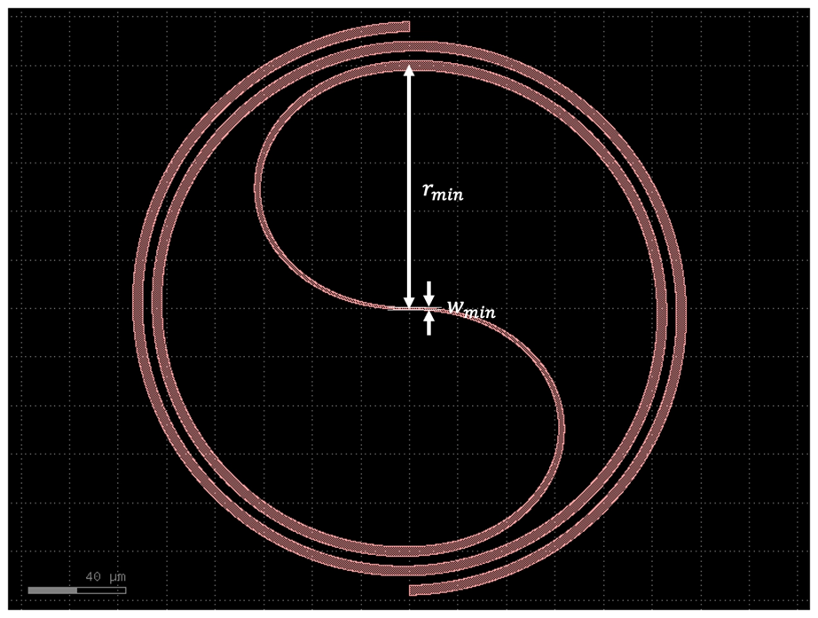
3. High-dimensional QSDC using time bin and phase
Part 3. Encoded state generation
  How to perform message encoding on the initial state without any loss of message information
    The position of the time state is identified using the basis information of the initial state, received from the receiver over the classical channel during the QBER estimation process
    Message coding is performed by selecting only the time state (using an optical switch and a time delay line)
    Message coding based on the time difference is performed by routing the photon through paths of different length according to the classical message value
  Implementation of an Integrated Waveguide Device (with KAIST)
    High speed multi-dimensional optical switch(switching speed <30ns) and ns delay line
Message encoding process
Notes:
In our protocol, only time states are used to carry information.
Message encoding is achieved by routing the initial quantum state through a high-speed optical switch and a selected delay line, thereby introducing a message-dependent temporal delay.
Since each quantum state occupies only a few tens of nanoseconds, ultra-high-speed multi-dimensional switching and nanosecond-scale delay control are required.
Because such components are difficult to obtain commercially, we are developing an integrated lithium-tantalate photonic device that implements both functionalities.

Slide 11
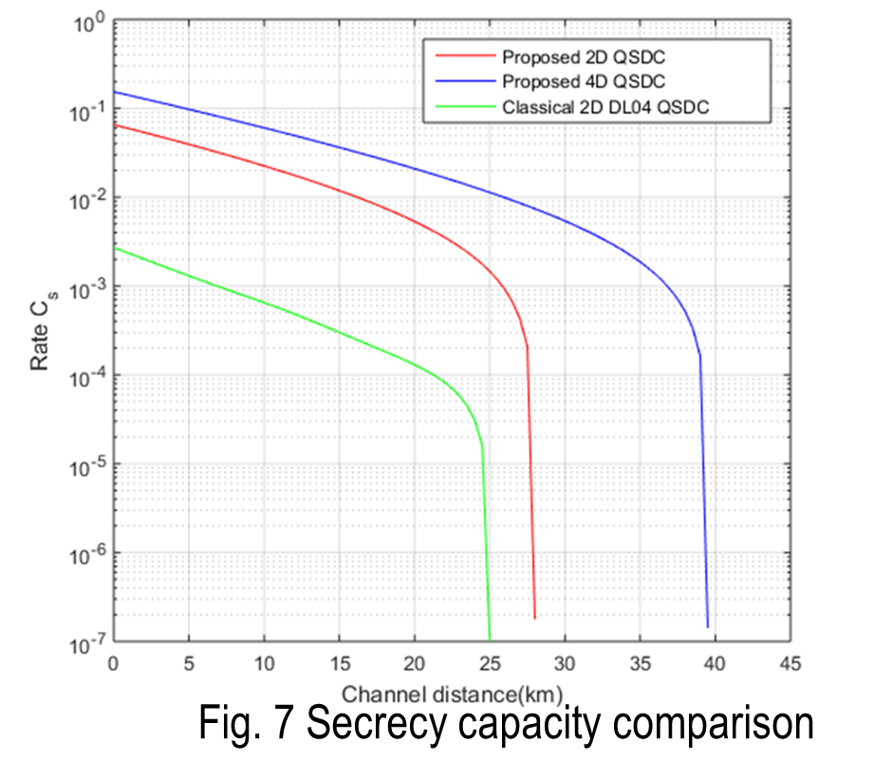

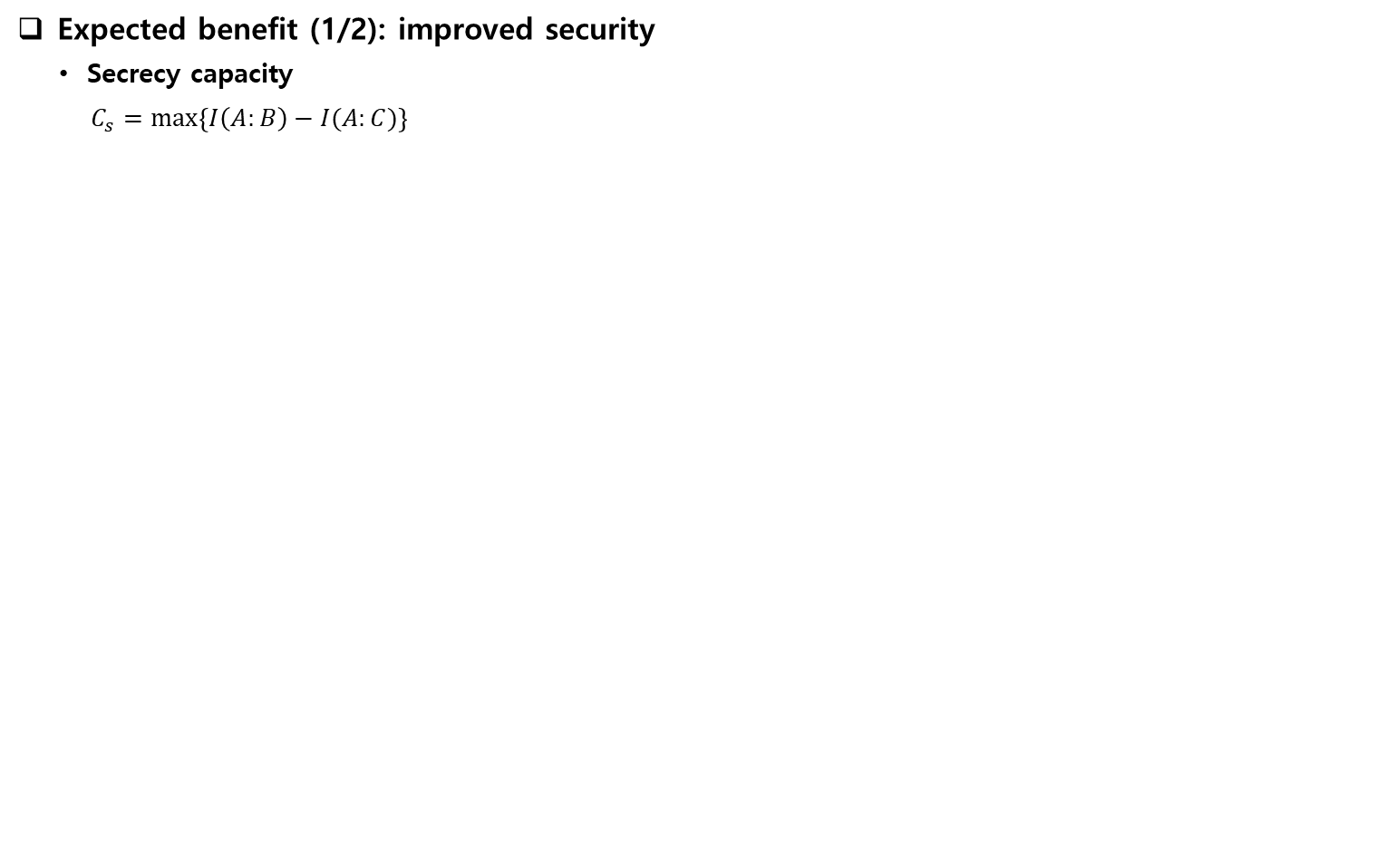
4. Performance Analysis
Expected benefit (1/2): improved security
  Secrecy capacity
    $$C_{s}=\max\left\{I\left(A:B\right)−I(A:C)\right\}$$
Conventional two-dimensional scheme can secure communication up to the maximum channel length of about 25 km
Our two and four-dimensional schemes are capable of secure and reliable communication from attacks up to 28 km and 40km, respectively
  Ref.) Classical 2D QSDC: Qi, R. et al. Implementation and security analysis of practical quantum secure direct communication. Light Sci. Appl. 8, 22. (2019)
Notes:
The secrecy capacity represents the maximum secure information rate and is defined as the difference between the mutual information shared by Alice and Bob and that potentially obtained by an eavesdropper, Eve.
As the transmission distance increases, channel loss gradually reduces the mutual information between Alice and Bob. Beyond a threshold distance, however, the combined effects of photon loss, detector dark counts, and state discrimination errors cause a rapid increase in the error rate, resulting in a sudden drop in secrecy capacity.
Compared with the phase-based QSDC protocol reported in 2019, the proposed scheme provides a higher secrecy capacity for the same transmission distance. In addition, the advantage becomes more pronounced as the dimension of the transmitted information increases, enabling secure communication over longer distances.
This is mainly because the conventional protocol relies on interferometer-based phase-state measurements, which introduce additional optical loss and state-discrimination errors.
By contrast, the proposed scheme encodes messages in time states, thereby reducing measurement-induced losses and improving the overall secrecy capacity.

Slide 12
5. Conclusion
Summary
  By developing a high-dimensional QSDC protocol, the transmission-rate limitation caused by the detector dead time in conventional single photon based QSDC schemes can be overcome
  The single photon based high-dimensional QSDC protocol is realised with the time-bin approach, which is known to give the highest transmission rate, from an implementation point of view, among the current quantum communication implementation techniques
Development Roadmap
  2024: Proposal and validation of a high-dimensional QSDC protocol
  2025~2027: Implementation of a time-phase-based QSDC system
  Demonstration over a fiber-optic communication network
  2028: Implementation of a Quantum memory free QSDC system
Q&A
byungkyu.ahn@lge.com
Notes:
In summary, the proposed high-dimensional QSDC protocol overcomes the transmission-rate limitation of conventional single-photon QSDC schemes and enables efficient high-rate quantum secure communication using time-bin encoding. Our future roadmap includes the implementation of a time-phase-based QSDC system and its demonstration over a fiber-optic network without quantum memory.
We first proposed this technology in a journal publication in 2024. Since 2026, we have been collaborating with several research institutions in Korea to refine the protocol for practical implementation, with the goal of completing a full implementation by next year. In addition, we are conducting follow-up research aimed at eliminating the need for quantum memories and further increasing the transmission rate by 2028.
There are still many challenges that need to be addressed before this technique can be implemented as a commercial solution. If you are interested in this work or have any questions, please feel free to contact us via the email address below.
Thank you for your attention.

Slide 13
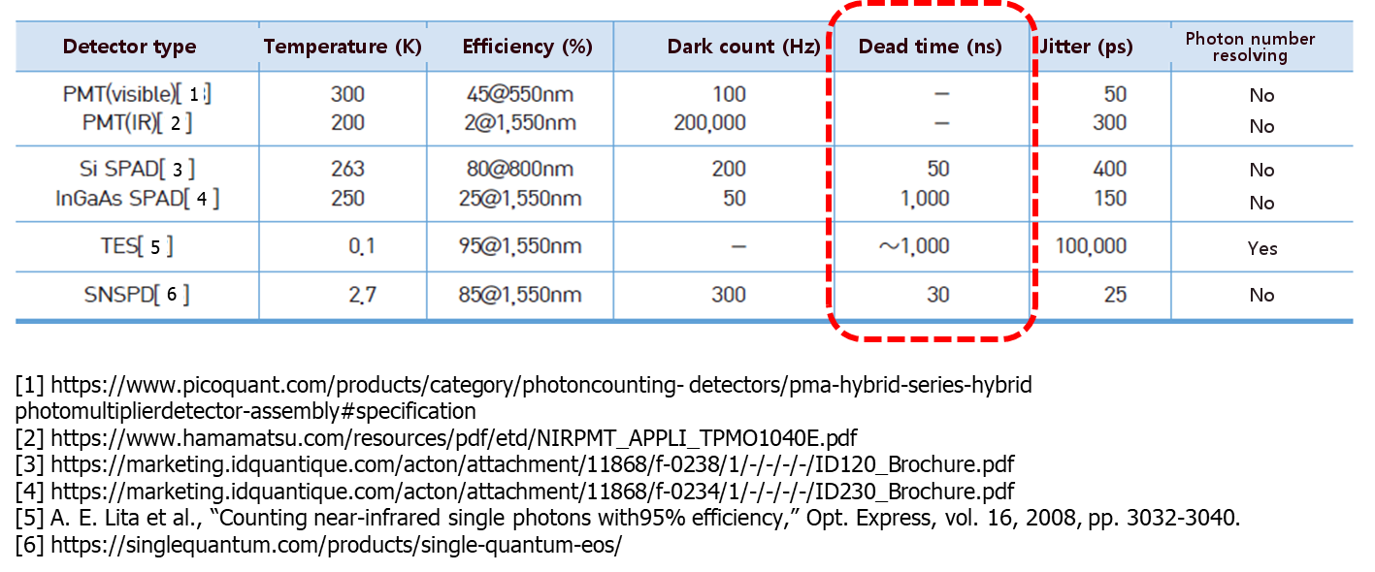
6. Appendix . Dead time comparison of commercial single-photon detectors
The concept of dead time, and a dead time comparison of commercial single-photon detectors
  Dead time
    The time the detector needs to return to the ready state, after one photon has been detected, before it can detect the next photon (µs ~ ns)
    Determined by the circuit structure of the detector and by its constituent materials
    When light arrives, a large number of electrons and holes are generated and emitted -> once avalanche breakdown has occurred, time is needed to switch the detector off and charge it again, and during that time no signal at all can be detected
  Dead time comparison of commercial single-photon detectors

Slide 14
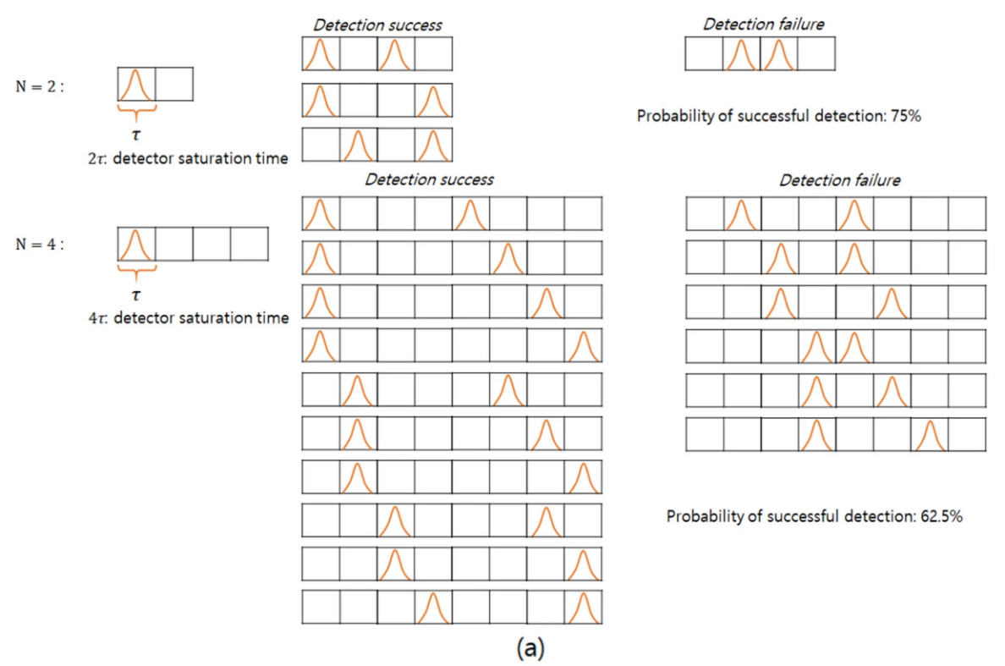
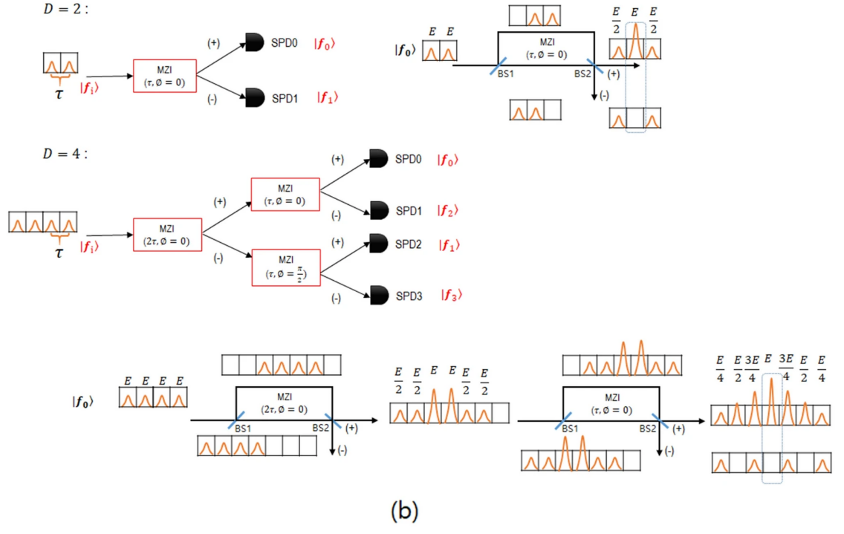
6. Appendix detection efficiency of two bases quantum states
Part 1. N-dimensional initial time and phase state generation
  Why the detection efficiency of the two initial basis states falls as the dimension increases
    Time state (a): if the next signal arrives at an interval shorter than the dead time of the SPD, that signal cannot be measured
    Phase state (b): after the MZI, the measurement has to be performed only at the position of the centre time bin, so the probabilistic detection efficiency degrades further as the dimension increases
Fig. Detection efficiency of the two- and four-dimensional time and phase states
Notes:
Measurement losses arise in both time and phase-state detection.
For time encoding, measurement loss occurs when the temporal spacing between consecutive single-photon signals is shorter than the detector dead time, preventing the detector from registering all incoming photons.
For phase encoding, measurement loss is inherent to the measurement process because only the interference outcome at the center time bin is utilized after the photon passes through the interferometer.
Furthermore, as the dimensionality of the transmitted information increases, the measurement loss rate also increases, resulting in a reduction in the overall transmission efficiency.

