Slide 1
Automation-Assisted Flow Cytometry Analysis with TASBE Flow Analytics
Jacob Beal
NIST Open Flow Cytometry Standards Consortium Meeting
November 18th, 2021

Slide 2
TASBE Flow Analytics
Free & open analysis software
  Runs in Matlab, Octave, Python
  User-friendly Excel interface
  Designed for automation
https://github.com/TASBE/TASBEFlowAnalytics

Slide 3
Calibration & Analytical Workflows
Calibration workflow components:
Model-based gating for cell populations
Background subtraction w. WT/NT
Spectral compensation w. single positives
Color remapping w. multi-color controls
MEx/ERF/Eμm units from bead calibrants
Analytical workflow components:
Per-channel statistics vs. replicate groups
GMM component separation
Comparison of condition groups
Parametric analysis
[Roederer, 2002; Wang et al., 2008; NIST/ISAC, 2012; Beal et al., 2012; Kiani et al., 2014; Beal et al., 2014; Davidsohn et al, 2014; Beal 2015]

Slide 4
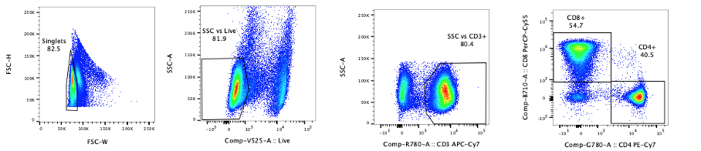
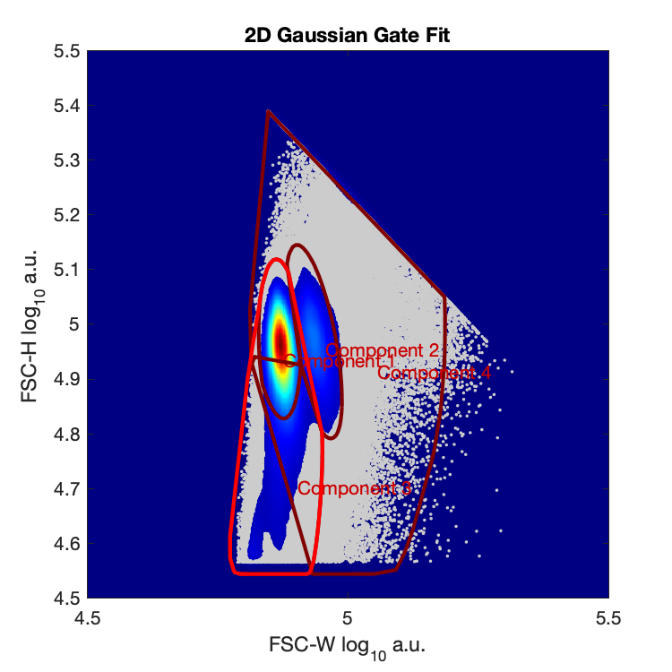
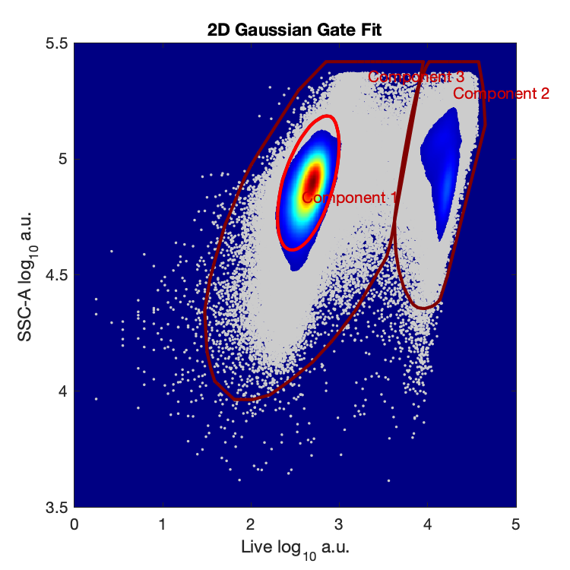
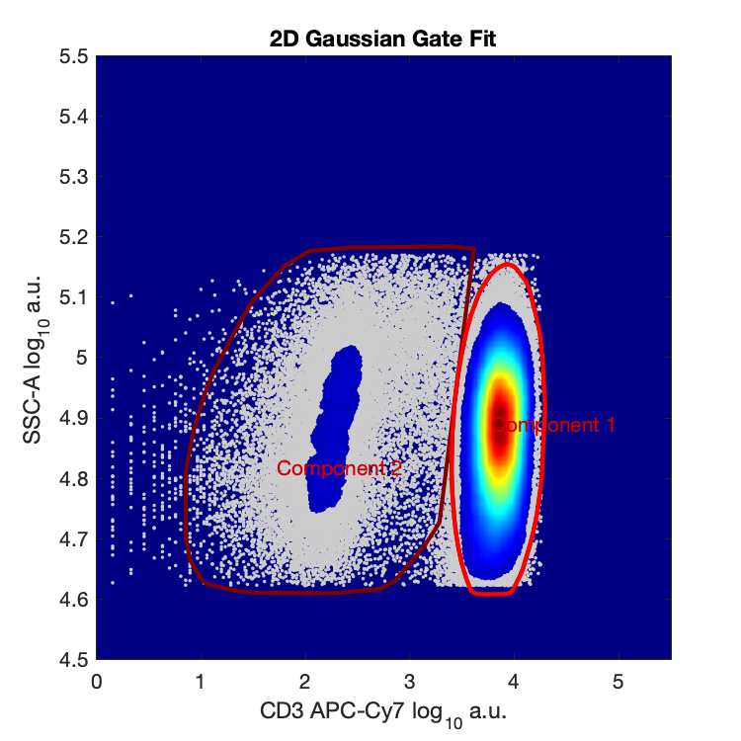
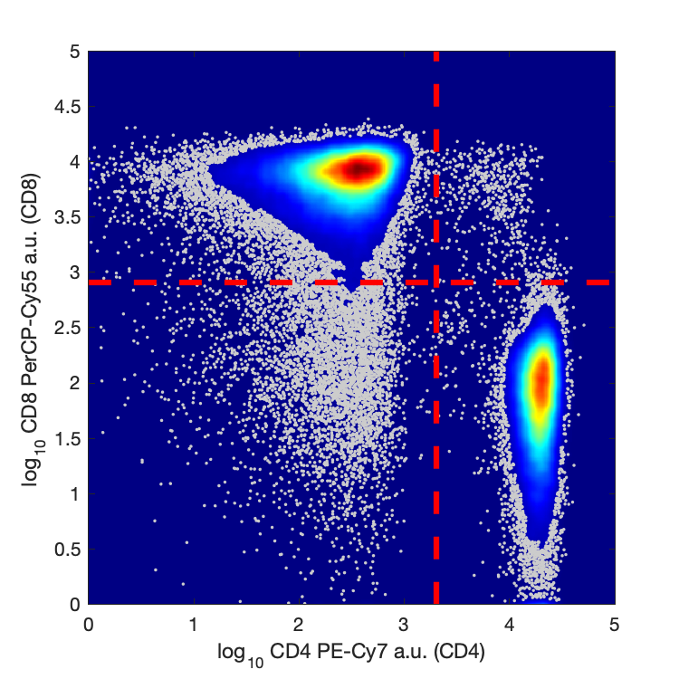
Model-based gating
Manual gating of stained blood cell assay:
TASBE model-based gating:

Slide 5
Comparing across voltage & instruments
[Beal et al., in revision]

Slide 6

Comparing across independent assays
iGEM interlab comparative analysis:
Independently transformed and cultured E. coli w. constitutive GFP expression
Equivalent-unit data across 3 years
Plate reader data from 468 teams
Flow cytometry data from 31 teams
[Beal et al., 2021]

Slide 7

Automation & quality control
TASBE workflows all include embedded diagnostics for quality control
  Quality control checks include:
    Bead peak fit quality
    Potential bead clumping
    Voltage mismatch
    High spectral overlap
    High variance in gated fraction
    Unexpectedly small event count
  Optional logging in JUnit format for pipeline integration
SD2 program automated analytics:
3 years, ~20 organizations
268 experiments
  74%: zero human intervention
  26%: diagnostic flags → adjust config & rerun
40,840 fcs files
271.9 gigabytes

Slide 8
Summary
TASBE Flow Analytics is free & open software for flow cytometry analytics
Can be controlled interactively, via Excel, or in automated pipelines
Automation-assisted workflows for gating, compensation, and unit calibration
Automated is supervised via embedded quality control
https://github.com/TASBE/TASBEFlowAnalytics

