Slide 1
Cree Power – Sept 2014 HMW Direct-Drive Motor Workshop
Jeff Casady, +001.919.308.2280 or jeffrey_casady@cree.com
John Palmour, +001.919.796.4243 or john_palmour@cree.com
Power products commercial roadmap for SiC from 2012-2020 – Jeff Casady
Power products rel data & pricing forecasts for 650V-15kV SiC power modules, MOSFETs & diodes – John Palmour

Slide 2
Power Products Commercial Roadmap from 2012-2020
Section

Slide 3
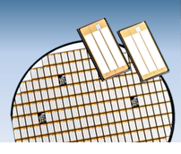
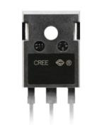
Cree SiC MOSFET Portfolio Beginning in 2011
>13 products and growing
  1200V MOSFETs (Bare Die)
    CPM2-1200-0025 (25mΩ; 60A)
    CPM2-1200-0040 (40mΩ; 40A)
    CPM2-1200-0080 (80mΩ; 20A)
    CPM2-1200-0160 (160mΩ; 10A)
  1200V MOSFETs (TO-247)
    C2M0025120D (25mΩ; 60A)
    C2M0040120D (40mΩ; 40A)
    C2M0080120D (80mΩ; 20A)
    C2M0160120D (160mΩ;10A)
    C2M0280120D (280mΩ; 7A)
  1700V MOSFETs
    C2M1000170D (1Ω, 3.0A) TO-247
    CPM2-1700-0040 (40mΩ; 50A) Bare Die
New 1700 V MOSFETs needed for PV inverters with 1.0-1.5 kV bus voltages

Slide 4
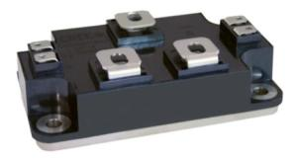
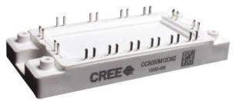
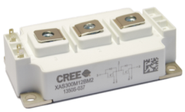
Cree All-SiC Power Module Portfolio Beginning in 2012
> 7 products and growing
  50 mm Platform Half-Bridge Configuration
    CAS100H12AM1 (1200V, 100A)
    XAS125H12AM2 (1200V, 125A)
    XAS125H17AM2 (1700V, 125A)
  45 mm Platform 6-Pack Configuration
    CCS050M12CM2 (1200V, 50A 6-pk)
    CCS020M12CM2 (1200V, 20A 6-pk)
  62 mm Platform Half-Bridge Configuration
    CAS300M12BM2 (1200V, 300A)
    CAS300M17BM2 (1700V, 250A)
1700V ½ bridge released!
Cree confidential information protected under NDA

Slide 5
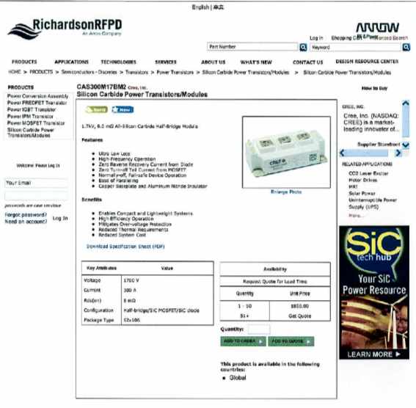
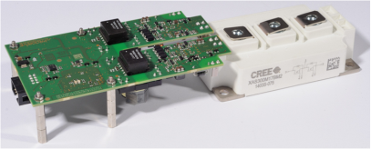

Cree 1700V, 8mΩ, ½ bridge power module available NOW
Full commercial release – September 2014
Available globally – Digikey, Mouser, Richardson/Arrow (right), … ~ $850 single unit
Gate drivers, app notes available
2 channel; 1.2/1.7 kV 62 mm module
gate driver direct mount

Slide 6
SiC MOSFET Roadmap
Section –

Slide 7
SiC current ratings are much less than Si
Si Amps are not SiC Amps
300 Amp SiC More Capable than 600 Amp Si IGBTs!
System cost reduction of 20% using 1200V SiC
  Increased frequency reduces size and weight of magnetics
  Lower losses reduce system cooling requirements
  Amperage rating for SiC less than half required for Si IGBTs
7

Slide 8
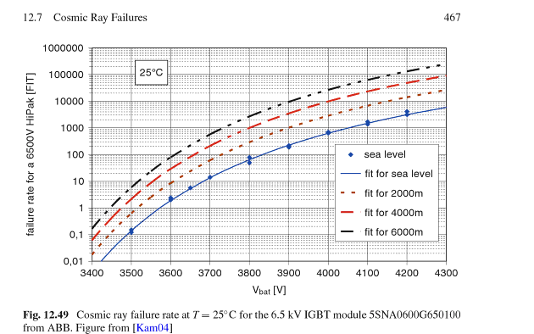
SiC voltage ratings are much less than Si?
Si Volts are not SiC Volts
6.5 kV Si IGBT used for 3.6 kV drives (100 cosmic ray FIT rate)
4.5 kV SiC MOSFET used for 3.6 kV line?
10 kV SiC MOSFET used for 7.2 kV?
Semiconductor Power Devices: Physics, Characteristics, Reliability
By Josef Lutz, Heinrich Schlangenotto, Uwe Scheuermann, Rik De Doncker
Medium Voltage SiC MOSFET roadmap must respond to application
  10X higher switching frequency, lower thermal dissipation possible
  Cosmic ray, other reliability metrics may be 100X better
  All requirements, eg. short circuit, surge must be understood
8

Slide 9
10X higher switching for SiC MOSFET than Si IGBT
Dramatic Reduction in System Weight and Complexity compared to Silicon
7.2 x 7.2 mm² Gen 3 6.5 kV
Nominally 25 A
7.2 x 7.2 mm² Gen 3 10 kV MOSFET
Nominally 15 A
10x
6.5 kV Si IGBT
(5SMX 12M6501 - ABB)

Slide 10
3rd Generation SiC MOSFETs
Smaller pitch
Optimized doping
Gen 2 DMOS
Gen 3 DMOS
Commercially released in 2013
Same high reliability DMOS Structure, but
optimized to dramatically reduce die size

Slide 11
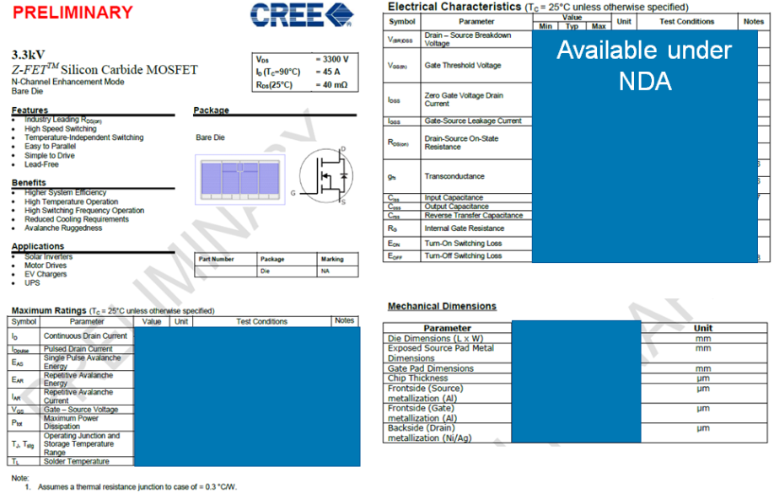
3.3 kV, 40 mΩ, “40 A” MOSFET Engineering Samples

Slide 12
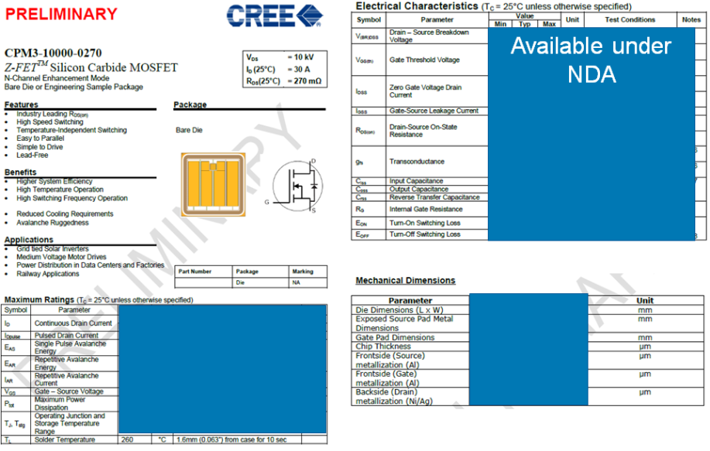
10 kV, 300 mΩ, “20 A” MOSFET Engineering Samples

Slide 13
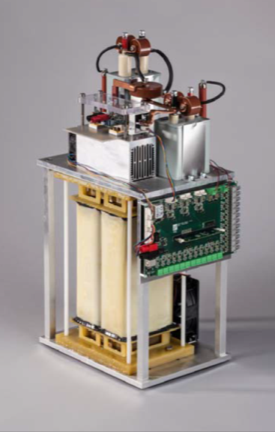

10 kV SiC MOSFETs in Boost Converter (Fraunhofer ISE)
Efficient, “transformer-less” power distribution to medium voltage grid
Fraunhofer DC-DC converter used 10kV SiC MOSFETs from Cree
30 kW DC voltage converter with 3.5 kV input voltage, 8.5 kV output voltage, 98.5% efficient
8kHz switching frequency 15X higher than possible with conventional silicon devices in the same voltage range.
Box is 36 cm x 30 cm
A Highly Efficient DC-DC-Converter for Medium-Voltage Applications
Jürgen Thoma, David Chilachava, Dirk Kranzer
ENERGYCON 2014 • May 13-16, 2014 • Dubrovnik, Croatia

Slide 14
Power products rel data & pricing forecasts for 650V-15kV SiC power modules, MOSFETs & diodes
Section

Slide 15
Power Products Reliability Data
Section

Slide 16
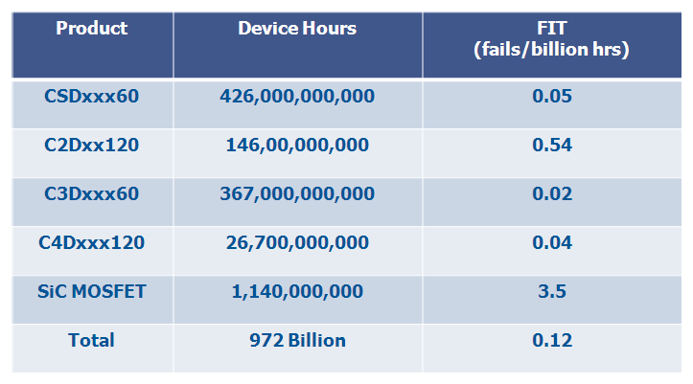
Proven Reliability with Industry-Leading Standards
Cree Field Failure Rate Data since Jan. 2004 through Mar. 2014
0.12 FIT rate is 10 times lower than the typical silicon
SiC diodes first released in 2001
SiC MOSFETs first released in 2011

Slide 17
Reliability Meets All Commercial and Military Requirements
Accelerated HTRB Testing at 150°C
Accelerated TDDB Testing at 150°C
Tested to failure at very high Drain voltages
Tested to failure at very high G-S voltages
MOSFETs have extrapolated MTTF of 30 million hours
Gate oxides have extrapolated MTTF of 8 million hours at +20V continuous

Slide 18
C2M V_{TH} Stability at High Temperature, +/- DC Bias
Positive Bias Accelerated at 175°C
Negative Bias Accelerated at -15V
V_{GS} = -15V
T = 150°C
V_{GS} = +20V
T = 175°C
Extremely stable for 1,000 hours under positive and negative bias
  Accelerated beyond data sheet to see any measurable change
  Average shift under positive bias: ΔV_{TH} = 0.06 V, ΔR_{DS-ON} = 0.1 mΩ
  Average shift under negative bias: ΔV_{TH} = 0.01 V, ΔR_{DS-ON} = 3.2 mΩ

Slide 19
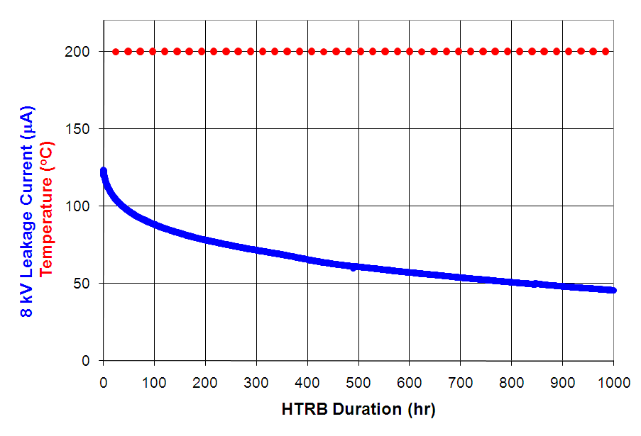

MOSFET Off-State Blocking Reliability
8 kV, 200ºC, 1000 hr HTRB of 10 kV SiC MOSFET
DUT Temperature = 200ºC
DUT 8kV Leakage Current

Slide 20
Pricing Forecasts
Section

Slide 21




Vertical integration in the power semiconductor industry
21
Global SiC Power Chip Supplier Rankings (2013)
2013 Rank | Supplier | HQ Location
1 | Cree | USA
2 | Infineon | Germany
3 | Mitsubishi | Japan
4 | ROHM | Japan
5 | ST Micro | FR-IT
Top 5 suppliers (95% of market) with US supplier (Cree) No. 1 shown on left
Global Si and SiC Power Module Market Share (2011)
2013 Rank | Supplier | HQ Location
1 | Mitsubishi (inc Powerex) | Japan
2 | Infineon | Germany
3 | Fuji | Japan
4 | Semikron | Germany
5 | Hitachi and Sanyo (tie) | Japan
Vertical, captive chip supply
Vertical, captive chip supply
Vertical, captive chip supply
Foundry module vendor
Vertical and foundry mix
Copyright © 2014, Cree, Inc. – see title page for restrictions

Slide 22


SiC Leadership – Leveraging Vertical Integration & Scale
Cree Main Campus
Durham, NC
Cree Power and RF RTP, NC
150mm wafer capability in RTP facility
> $40M invested in RTP fab capacity expansion over
3 years
Vertically integrated $1.65 B business:
  Virtually all revenue based on SiC substrates
  Unmatched command of supply chain from raw materials to finished products (including power and RF devices, LEDs, light bulbs and fixtures)
  Avoiding margin stacking in supply chain provides attractive cost structure

Slide 23
Cost reduction from volume and device refinement
600V Schottky
MOSFET
1200V Schottky
Gen 1 Schottky
Gen 2 Schottky
Gen 1
MOSFET
Gen 3 Schottky
Gen 2
MOSFET
Solid Lines = Actual
Dotted Lines = Projections
Gen 3
MOSFET
Gen 4 Schottky
Gen 5 Schottky
75 mm
100 mm
150 mm
Wafer Diameter Increases

Slide 24
1200V SiC MOSFET Projected Cost Trend
(Amps at 100C)
Released 2011 @ $5/A 1 Unit Price
2012 @ $2.50/A 1 Unit Price
@ $0.75/A
1 Unit Price
2017 @ $0.18/A
Possible in Volume

Slide 25
3.3kV SiC MOSFET Projected Cost Trend
(Amps at 100C)
2013 @ $22.50/A 1 Unit Price
2014 @ $17.50/A
1 Unit Price
2015 @ $11.75/A
1 Unit Price
2016 @ $3.60/A
Possible in Volume

Slide 26
10 kV SiC MOSFET Projected Cost Trend
(Amps at 100C)
Sampled 2012 @ $120/A Unit Price
2014 @ $60/A
1 Unit Price
2015 @ $38/A
1 Unit Price
2018 @ $10/A
Possible in Volume

Slide 27


