Slide 1
Next Generation of Electric Machines
Anant Agarwal, Steven Boyd, Ziaur Rahman
NIST/DOE Workshop on High-Megawatt (HMW) Direct-Drive Motors and Front-End Power Electronics, Sept. 4, 2014

Slide 2
Applications of High RPM Compressors
  Oil and gas transportation pumps and compressors
  Offshore gas and oil exploration (106 offshore platforms in 2012)¹
  Chemical mixers
  Petrochemical extruders
  Electrical submersible pumps (ESPs)
  Water handling and Pumping
    Desalination, waste water treatment, flood control and drainage, water purification, irrigation
  Drill motors
  Industrial desalination plants pumping systems
  HVAC systems and industrial compressors: vapor compression chiller systems
  Recycle compressors (air separation compressors)
  Marine electrified propulsion systems
  All electric underground mining vehicles
  Geothermal systems
  Refrigeration turbo compressors
1. “Petroleum and Natural Gas Systems 2012 Data Summary,” U.S. Environmental Protection Agency (2013).
“Natural Gas Demand Sustains Growth in the Mature Compressor Market,” Frost & Sullivan, June 9, 2013.
2. “Future Compressor Station Technologies and Applications”, Southwest Research Institute, Feb 9, 2012.

Slide 3
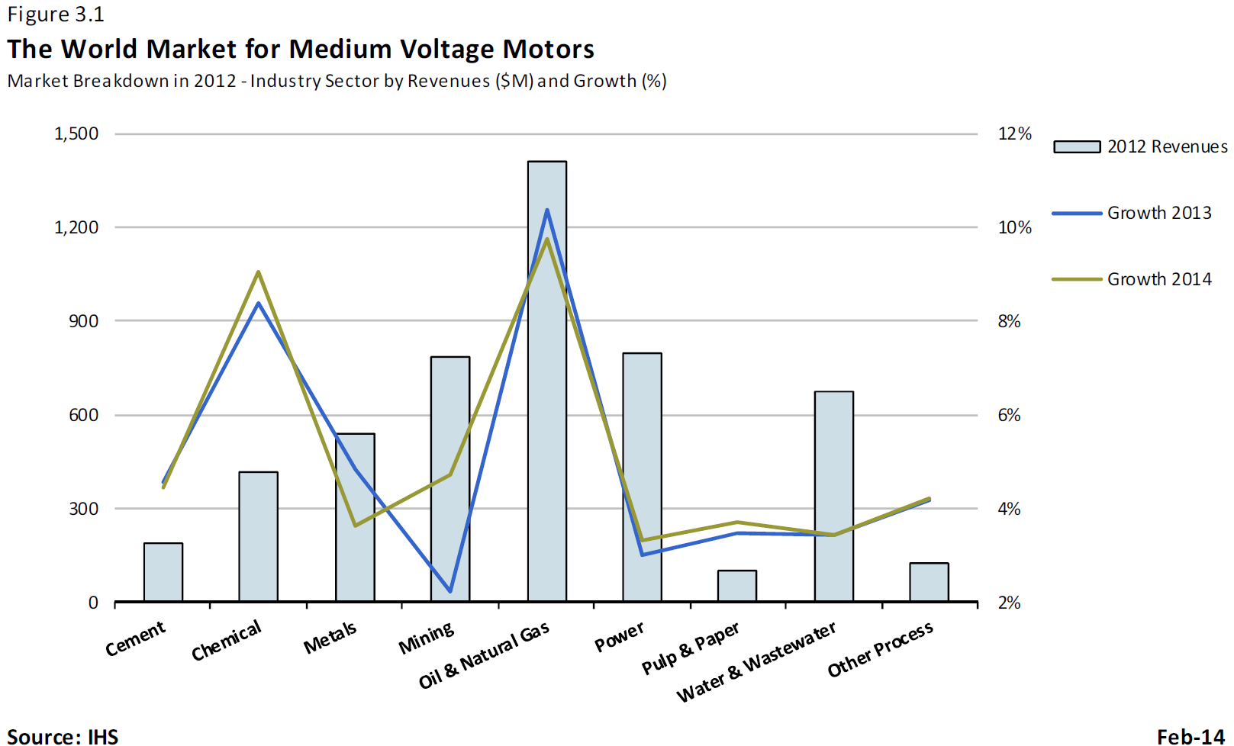
$4.5 B Worldwide Market in MV Motors
High speed, direct drive opportunities
Market breakdown in 2012. Industry Sector by Revenues ($M) and Growth (%)

Slide 4
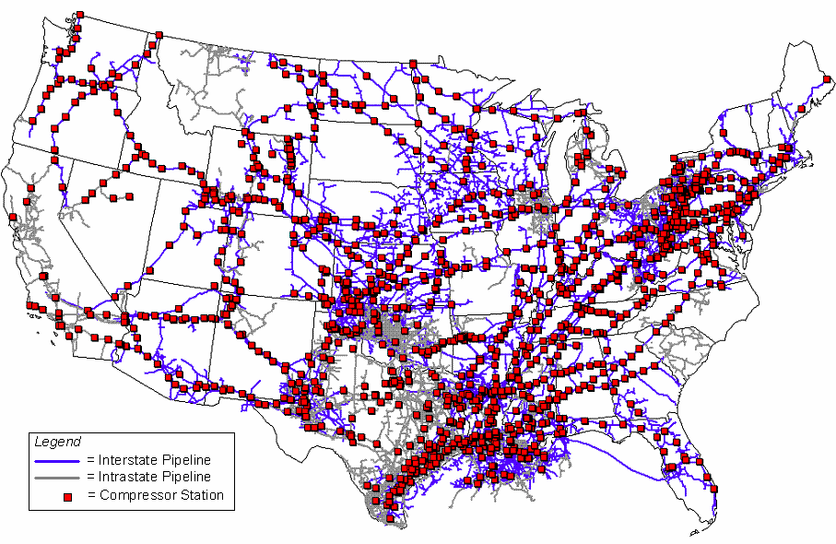
Over 900 Interstate Pipeline Compression Stations
http://www.gaselectricpartnership.com/GFuture%20Compression%20Station%20Final.pdf

Slide 5
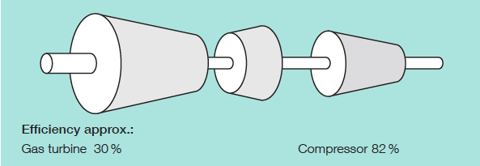
Current Solution for Pipeline Compressor Stations, LNG Plants and CO₂ Injection
Industrial Variable Speed Gas Turbine ~ 25+ MW, η ~ 30%
25 MW
Overall Efficiency ~ 25%
Håvard Devold, Tom Nestli & John Hurter, “All Electric LNG plants”
2006 ABB Process Automation Oil and Gas

Slide 6
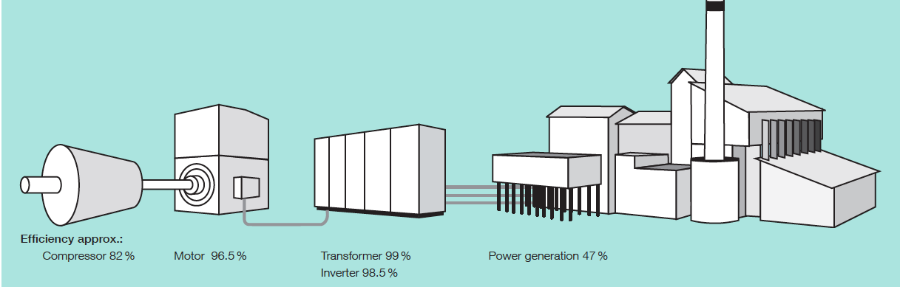
Electrification leads to higher overall efficiency
Commercial Power Generation Gas Turbine ~ 100+ MW
η ~ 47-55%
100+ MW
Overall Efficiency ~ 36 - 42%
Håvard Devold, Tom Nestli & John Hurter, “All Electric LNG plants”
2006 ABB Process Automation Oil and Gas

Slide 7
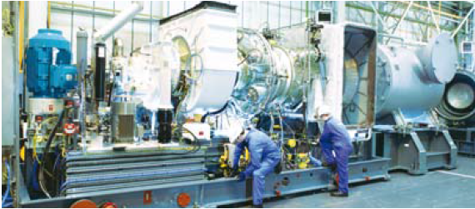

13.4 MW Gas turbine Coupled Centrifugal Compressor
Gas Turbine Unit
Output 8000 to 10000
RPM
Compressor
Starter Motor
SGT-400

Slide 8
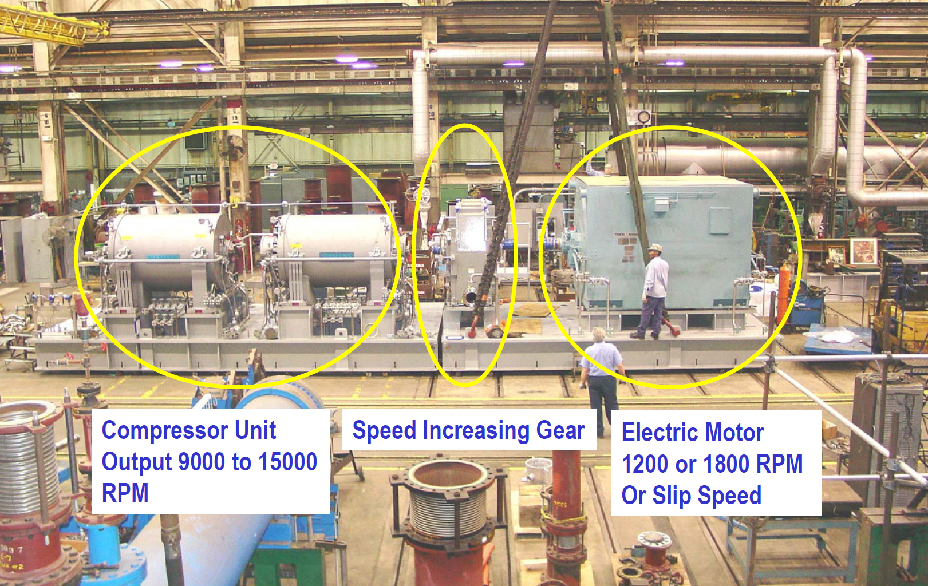
20,000 hp Centrifugal Compressor for NG

Slide 9
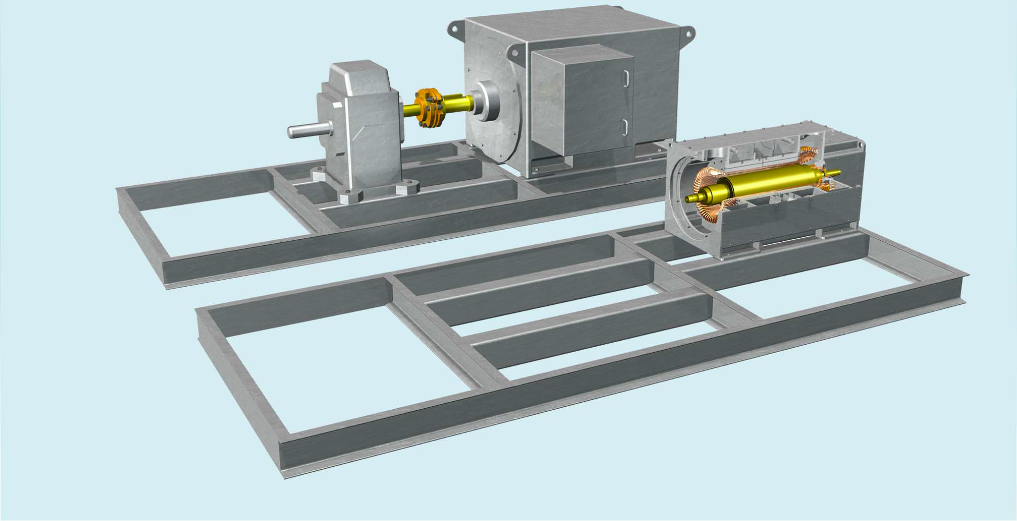
High RPM Direct Drive Motors to reduce size and cost
Size Reduction
http://www.gaselectricpartnership.com/GFuture%20Compression%20Station%20Final.pdf

Slide 10
US Manufacturing Advantage by combining Several Key Technologies in an Integrated Approach
Traditional
20-40% energy is wasted
with throttles and
other mechanical devices
Big
60 Hz
Transformer
4.16 kV
3 phase
60 Hz
1-50 MW
60 Hz Motor
1800 RPM
Gear
Box
1:G(5-10)
Compressor
Fixed Speed
9 K-18 K RPM
13.8 kV
3 phase
60 Hz
New Approach
Delivered as
one box
Variable
Speed Drive
SiC Based
1-50 MW
Gx60 Hz Motor
G x smaller
Volume
13.8 kV
3 phase
60 Hz
Compressor
Variable Speed
9 K-18 K RPM
Big 60 Hz Transformer replaced by small high frequency Transformer
Motor size reduced by 5x – cheaper, less magnets
20-40% energy per motor system is saved due to Variable Speed Drive – pay-back < 3 years
Gear Box eliminated
Smaller Foot-print (up to 5x)

Slide 11
Discussions
Applications of High RPM Motors
SST or 60 Hz Transformer
Topologies of VSD and Voltage Ratings of SiC Devices
Cost of SiC Devices
Maximum electrical frequency of Motor
PM or IM – Materials Challenges
Foot-print of the Integrated System
Power Rating of the Initial System Demonstration

Slide 12
Minimum System Requirements
13.8kV (L-L)
60Hz
3ϕ
WBG VSD:
V >2kV, f_{s} > 5 kHz
Motor:
f > 500 Hz
>1 MW
>15000 rpm
Input: > 13.8kV (L-L)
Input voltage to VSD: > 2kV (Medium Voltage Class); Use of SST for isolation and voltage step down from 13.8 kV (L-L) is optional. Standard 60Hz line transformer can be used for the demonstration.
Switching frequency: > 5 kHz
Motor fundamental electrical frequency: > 500 Hz
Speed > 15000 rpm
Output: Power > 1MW

Slide 13
Metrics: Today’s Technology
Components | Volumetric Density (MW/m³) | Footprint (m²/MW) | Efficiency (%)
Transformer | 0.178* | 3.065* | 98
VSD (Si based) | 0.125 | 3.33 | 95
Motor | 0.5 | 2.5 | 96
Gear Box | 0.38 | 1.65 | 98
Total system | 0.0548 | 10.545 | 90
Transformer integrated to VSD (Si based) | 0.11 | 3.29 | 96
System with transformer integrated VSD | 0.0729 | 7.44 | 90
1. *Transformer rated in MVA instead of MW. Data from T1008; www.energy-parts.com.
2. VSD data from T300MVi (Toshiba) & 7000-sg010 (Allen-Bradley).
3. Motor data from JH12504 (TECO-Westinghouse).
4. Gear box data from David Brown gear systems.
5. Transformer integrated VSD data; courtesy of TECO-Westinghouse.

Slide 14
Targeted Metrics
Components | Volumetric Density (MW/m³) | Footprint (m²/MW) | Efficiency (%)
Transformer integrated to VSD (SiC based) | 0.11 x 3 = 0.33 | 3.29 / 1.77 = 1.858 | 96 + 1 = 97
Motor | 0.5 x 8 = 4.00 | 2.5 / 4 = 0.625 | 96
Gear Box | 0.38 | 1.65 | 98
Total System | 0.3048 (> 4x) | 2.48 (< 1/3x) | 93 (+2)
4x improvement in volumetric power density.
3x reduction in foot print.
2% improvement in overall efficiency.

Slide 15
Targeted Metrics (Cont’d)
Overall THD <2%.
Projected cost < $1.00/Watts per system for 500 systems/yr.
Overall half load efficiency: >90%@1/2 rated torque;
>85%@1/2 rated speed.
4. Input power factor: >0.9.
5. Noise level: <85 dB @ 1 meter periphery.

