Slide 1
Analysis and Findings of the Cost Share Requirements for the Hollings Manufacturing Extension Partnership Program
Cost Share Sub-Committee of the
MEP Advisory Board
September 9, 2013

Slide 2
Today’s Agenda
Background
New Information
  9 Center Survey
  General Web Question
  ASMC Survey Summary
Key Findings
Establishing a Board Position
Next Steps

Slide 3
Background

Slide 4
COST-SHARE SUB-COMMITTEE
MEMBERSHIP
Vickie Wessel, Chair
Eileen Guarino
Ned Hill
Rich Scott
Ed Wolbert

Slide 5
Sub-Committee Process
Three Webcasts
  Cost Share 101
    July 18, 2013 and July 19, 2013 to accommodate schedules
    All Board members – not just Sub-Committee members – attended at least one of these
  Cost Share and Performance
    August 8, 2013
Materials available on Connect site (Survey, Letters, etc.) – Screen Shots next few slides
Today’s Discussion
September 23rd at 2:00 est (if needed)
Board Meeting – September 27th
Submission to Pat Gallagher – September 30th

Slide 6
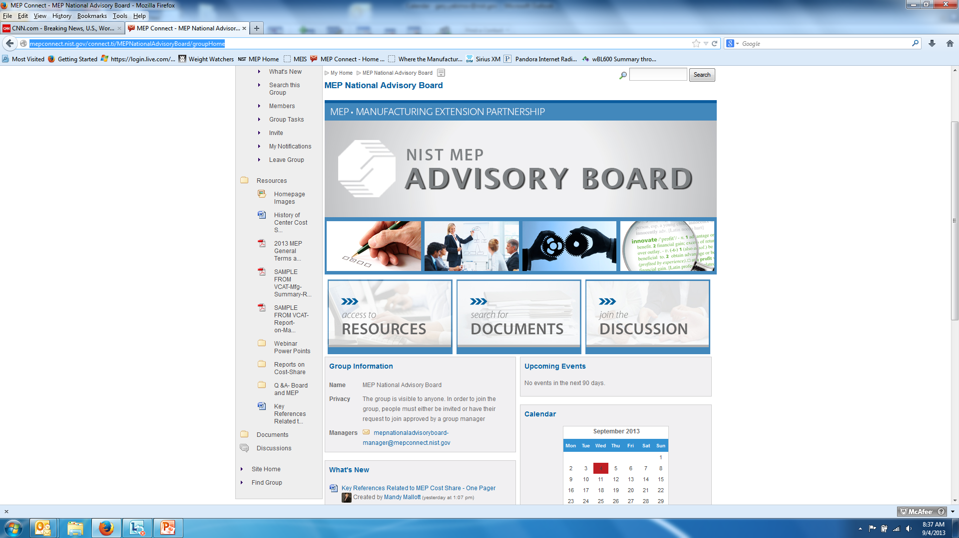

Slide 7
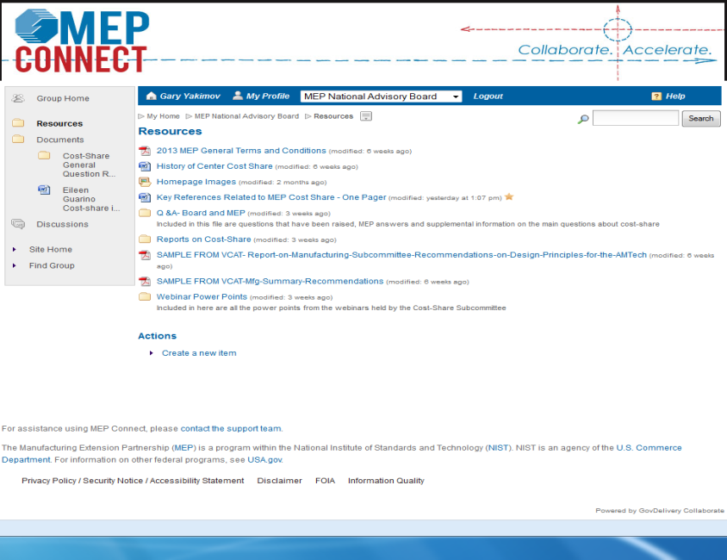

Slide 8
Board Questions
Various questions submitted by the board
  Some could be answered by national office – Connect
  Cost Share Overview – Webinars July 18/19
  Cost Share and Performance – Webinar August 8
  Narrative Answers to Other Questions
  Some needed to be answered by centers / others
  9 center survey (52 Questions)
  General question on the web site (45 responses)
  ASMC prior survey results (2009-2012)

Slide 9
MEP Program Requirements:
Statutory Requirements
TITLE 15 - COMMERCE AND TRADE
CHAPTER 7 - NATIONAL INSTITUTE OF STANDARDS AND TECHNOLOGY
Sec. 278k. Regional Centers for the Transfer of Manufacturing Technology
(c)(2)The objective of the Centers is to enhance productivity and technological performance in United States manufacturing through -
the transfer of manufacturing technology and techniques developed at the Institute to Centers and, through them, to manufacturing companies throughout the United States;
the participation of individuals from industry, universities, State governments, other Federal agencies, and, when appropriate, the Institute in cooperative technology transfer activities;
efforts to make new manufacturing technology and processes usable by United States- based small- and medium-sized companies;
the active dissemination of scientific, engineering, technical, and management information about manufacturing to industrial firms, including small- and medium-sized manufacturing companies; and
the utilization, when appropriate, of the expertise and capability that exists in Federal laboratories other than the Institute.

Slide 10
Baseline of Understanding
There is no requirement that states or manufacturers contribute cost share
The requirement of providing cost share is on the center
However, currently all centers rely on some level of program income
Centers have great variance:
  Governance/structure
  Business models
  State contributions

Slide 11
MEP Cost Share Requirements:
Statutory Requirements
Mandated to be a cost shared program between the federal government and the nonprofit entities serving as centers. [Statute, (c)]
Ratio of federal to center cost share was limited to:
  50% in the first three years of operation and may not be more than 50% at any time [Statute, (c)(3)(B) & (c)(1)]
  40% in year four of operation and 33 1/3% in years five and six. [Rule, 290.4]
Congress established a limit on the amount of federal cost share at 33 1/3%. [Statute, (c)(5)]
In-kind contributions may consist of contributions by full-time and part-time personnel, equipment, software, rental value of centrally located space and other related contributions up to a maximum of one-half of the host’s annual share. [Rule 290.4]
All contributions, including cash and third party in-kind, shall be accepted as part of the recipient’s cost sharing or matching when such contributions meet all of the following criteria are:
  verifiable from records.
  not included as contributions for any other federal program
  necessary and reasonable to accomplish program objectives.
  allowable under the applicable cost principles.
  not paid by another federal award, except where authorized
  provided for in the approved budget. [DOC Rule, 14.23]

Slide 12
History of Cost-Share
Beginning with its creation in 1988, the Hollings Manufacturing Extension Partnership (MEP) program was mandated and designed to be a cost-shared program
The program was to establish a funding profile that reduced the amount of the federal contribution in years four through six of center operation, with a prohibition of any federal funding beyond the sixth year of operation
  In 1990, through rule making, MEP set the limit on the federal contribution to be 40% in year four of operation and 33 1/3% in years five and six.
  NIST MEP developed and provided training to centers on approaches for generating revenue through fees for services provided by the centers to their manufacturing clients.
Operational experience showed that the initial concept of a center becoming financially self sufficient while serving manufacturers, particularly small and medium sized manufacturers was not feasible
In 1998, Congress passed legislation that eliminated the “Sunset” provision and established a limit on the amount of federal cost-share at 33 1/3%.
  This limit was based on the profile established by the program rule and not necessarily on the operational experience of how a center functions.
The current cost-share structure is 15 years old and is based on a funding formula that is 23 years old.

Slide 13
New Information

Slide 14
9 CENTER SURVEY (Available on Connect)
CENTER SELECTION CRITERIA
  Geography
  Structure
  Funding model
  Size
CENTER SELECTION
  Arkansas (Arkansas Manufacturing Solutions(AMS))
  Buffalo, NY (Insyte Consulting)
  Idaho (Idaho TechHelp)
  Indiana (Purdue MEP)
  Southern California (California Manufacturing Technology Consulting (CMTC))
  Southwestern PA (Catalyst Connection)
  Texas (Texas Manufacturing Assistance Center (TMAC))
  Vermont (Vermont Manufacturing Extension Center (VMEC))
  Wisconsin (Wisconsin MEP)

Slide 15
9 Center Survey:
Cost Share Policy/Requirement
The cost-share policy focuses on the reasons cost-share is a part of the MEP program, most importantly that it encourages centers to enter into agreements with private industry, universities, and State governments to accomplish program objectives, that cost-share leverages federal dollars to increase the impact of the investment, and that cost-share requirements ensure all participants share a stake in the success of the program.
The cost-share requirement refers to the condition that the centers match every $1 of federal funding with $2 of non-federal funding after 6 years of operation, the types and categories of funding that may count toward the cost-share requirement, specifically in-kind (part-time personnel, office space, equipment) and cash (fees for service, full-time personnel), and the maximum proportions of each allowed in meeting the requirement (in-kind funding may only cover up to 50% of the host’s annual share).

Slide 16
9 Center Survey - Major Results
Changing the Cost-Share Requirement
Respondents think the cost-share requirement should be changed, there should be flexibility in response to changing economic conditions, and cost-share should not be limited to only cash.
The Impact of the Current Cost-Share Requirement and Policy
The current cost-share requirement and policy results in increased administrative burden, budget uncertainty, inability to draw down federal funding, changes the types of clients centers serve….
…But has little impact of the quality, range, and quantity of the services provided.
The current cost-share policy has positive impacts.
Cost-share funding is determined by multiple factors.

Slide 17
9 Center Survey - Major Results, cont.
External Factors Impacting Centers and Cost-Share
The economic downturn and reductions in state funding have affected centers ability to meet the cost-share requirement.
Generating client fees and state/local funding are critical dimensions of their business model.
Centers agreed that they are now relying more in program income/clients fees now to meet the cost-share requirement compared to 5 years ago. In contrast, centers disagreed that there center is relying more on in-kind contributions to meet the cost share.
The Impact of Changing the Cost-Share Requirement
Centers see many positive impacts resulting from reducing the cost-share requirement including more services, more resources, and improve their performance.
Centers see few negative impacts of reducing the cost-share requirement.

Slide 18
9 Center Survey
Which of the following factors determines the level of cost-share funding your center receives from stakeholders?
Factor | % Yes | % No | % Not Sure | % Not applicable
Performance/impact of your center | 100.0 | 0 | 0 | 0
Importance of manufacturing to your local area | 88.9 | 11.1 | 0 | 0
Stakeholder Priorities | 77.8 | 11.1 | 0 | 11.1
Strategic goals of your center | 66.7 | 22.2 | 11.1 | 0
Market Size | 33.3 | 33.3 | 11.1 | 22.2
Cost-share requirement | 33.3 | 55.6 | 0 | 11.1

Slide 19
General Web Question
Posted August 9 - “The NIST MEP Advisory Board is interested in comments and thoughts on the issue of cost share. Please send all responses by email to mep@nist.gov by August 23, 2013, 5:00 p.m. Eastern Time. Please have “Cost-Share Response” as the subject of the email. The NIST MEP Advisory Board thanks you for your consideration and thoughts.”
45 Responses were received representing 35 different organizations (for some centers, both the management and members of the board sent a letter).
27 centers Responded
4 interested organizations responded
3 members of the CEO Network for Manufacturing in the Capital District, Inc. (NY) responded

Slide 20
Web Question - Overall Recommendations
All of the letters submitted supported a 1:1 cost share.
All of the letters submitted supported allowance for both in-kind and cash to be used in meeting the cost share requirement.
  Several of the letters further specified that the in-kind to cash ratio remain as it is, allowing up to 50% of the cost share requirement to be met through in-kind.
Some responses included the proposal that a portion of the non-federal share continue to come from both state and private investments to ensure that the MEP program remains a true partnership and has buy-in from all stakeholders
(Pros and Cons identified but included in later section of this presentation)

Slide 21
General Web Question - Other Comments
Recession has been one of the largest drivers of reduced funding for centers
Cost-share reduction will focus centers on client services rather than securing less valuable cost share.
Reducing the cost-share requirements could potentially reduce state support.
Current match ratio is not in line with other federal programs. Of the 96 Department of Commerce financial assistance programs, only 24 require cost share. MEP has the highest cost share of those, the next is 50/50.
Reduction in cost-share is cost-neutral to the federal government.

Slide 22
ASMC SURVEYS 2009-2012 (Available on Connect)
ASMC provided a summary of several surveys they took between 2009 and 2012. The entirety of those results are available within Connect. Specifically it is important to note that in 2012 a survey of 27 states indicated an adverse affect on services to SMEs; 7 state indicated no adverse affect. Some anecdotal effects include:
  More time on partner development, less time on SMEs
  Reduction in free/reduced service offerings
  Decline in services to rural SMEs
    Since the cost of travel and therefore sales is too high to reach these clients, centers are focusing on clients in more urban or metropolitan areas
  Decline in services to start-ups, as they can’t pay full burdened rate of services
  No center continuous improvement therefore limited service offerings
    For example, can’t train staff in sustainability and innovation services, therefore it isn’t offered to SME clients
  Reduced cost share would reduce fees for new services

Slide 23
Key Findings

Slide 24
Summary of Key Findings
Pros and Cons of Current Cost Share
Pros and Cons of Changing the Cost Share
Impact of Changing Cost Share on the Financial Size of the MEP Program
Approach of States to MEP Program Funding
Role of In-Kind Cost Share in the MEP Program
Modeling the Impact of 1:1 Cost Share
Need for the MEP Program

Slide 25
Pros and Cons of Current and Changing Cost Share – Understanding the Slides
Reviewed the following sources:
  General Accounting Office
  9 Center Survey
  General Web Question
  ASMC Surveys
Consolidated different recommendations into a single list using best judgment
Full recommendations from each source remains available on the Connect site

Slide 26
Pros of Current Cost Share Policy
Centers are encouraged to leverage resources and improve partnerships with other organizations
The need to collect client fees gives manufacturers a stake in the program
Centers emphasize services that are relevant to manufacturers
Centers avoid duplication
Cost share represents shared burden of financial investment, e.g. federal government not sole funder

Slide 27
Cons of Current Cost Share Structure
Centers spend more time and effort seeking funds at the expense of not serving clients
Centers have a significant burden/cost to obtain, manage and report on in-kind cost share for their center
Centers seek projects outside their mission
Centers shift focus to larger clients who can pay higher fees and multiple projects with repeat clients
Centers focus less on rural clients
Centers are limited in their ability to grow (i.e. only some could handle more funding under current requirements either from NIST or from other federal sources)
Centers are reluctant to invest in new services that do not immediately generate client revenue or impacts
Cost share requirement increases budget uncertainty
Cost share requirement impedes the center’s ability to participate in regional economic activities

Slide 28
Pros of Changing Cost Share
Enables centers to focus on delivering services to manufacturers
Ensures that MEP services remain affordable for the nation’s small and mid-sized manufacturers
Decreases the amount of time spent securing less valuable cost share
Better serve the needs of regional stakeholders
Better respond to the evolving needs of manufacturers
Relieves administrative burden – centers could still maintain in-kind relationships but may not need to report them all

Slide 29
Cons of Changing Cost Share
GAO Position – Reduced cost share could result in lower resources available for the program
Program Analysis – Performance of program will not be reduced
  Reduction in administrative burden (per previous slides) would result in centers allocating these resources to serve more clients,
  Financial size of program will not be reduced (see next slides)

Slide 30
Impact of Changing Cost Share on the Financial Size of the MEP Program
9 Center Survey
Centers strongly disagreed that reducing the requirement would result in:
  Less resources / lower total budget for their center
  Lower levels of funding from their stakeholders
  Focusing less on development among other organizations
  Reducing the time and effort of securing non-federal funds
General Web Question
Centers could decrease amount of time spent securing less valuable cost share and increase focus on delivering client services; in time project fee revenue could offset any “lost” cost-share from other sources
A reduction in cost-share requirement is cost-neutral for the federal government

Slide 31
Impact of Changing Cost Share on the Financial Size of the MEP Program, cont.
NIST Competition Analysis:
NIST competitions in 2010 (“e-CAR” and “t-CAR”) and multi-agency awards in 2012 (“Jobs Accelerator”) and 2013 (“Make it in America”) indicate that MEP centers and their partners are willing to provide the financial resources required to co-invest in the federal funding opportunities when these opportunities align with the goals of their regional economic systems, strategies, and priorities.
Potential reduction of programmatic cost share requirement facilitates the potential use of unallocated cost share for pursuit of other federal funding opportunities to support state and regional economic development systems, strategies, and priorities (e.g. startup firms, R&D and technology-driven firms, disadvantaged firms, etc.)

Slide 32
Modeling the Impact of 1:1 Cost Share
Analysis of center’s current ability (based on FY 2011-2012 actual budget) to meet 1:1 cost share using all forms of cash is:
Using all forms of cash:
  48 centers could meet 1:1 cost share using all forms of cash
  Of the 12 centers that do not meet 1:1 cash-only cost share in current environment:
    7 were not fully operational during the FY 11-12 year
    Of the other 5, 2 have not yet submitted a new operating plan where the data is being drawn from (and thus may actually quality at 1:1 if we had their data)
  23 centers in FY 11-12 exceed 2.00 or higher, meaning they are meeting current cost share requirements of 2:1 with cash
Using cash from program income and state and local:
  44 centers could meet 1:1 cost share
  16 centers could meet 2:1 cost share

Slide 33
Approach of States to MEP Program Funding
It is important to note that there are multiple states that created and invested in manufacturing extension services BEFORE Congress authorized and appropriated federal funds for the NIST MEP network of centers in the late 1980s and 1990s. In fact, the model for the current NIST MEP centers evolved somewhat from the state-funded extension services that pre-dated federal funding. In most (if not all) cases, the state-funded extension centers ultimately were absorbed into the NIST MEP network of centers that included federal funding.
Surveys and web responses indicated that there are many other drivers to state investment other than the cost share requirement. Important factors that seem to exert more influence on state investment decisions include:
Perceived alignment of the MEP center with the Governor's policy priorities and strategies in economic development
the state's overall budget climate / budget situation
the MEP center's reputation and quality performance
the political savvy of the MEP center in engaging and educating state stakeholders
“Precipitating event” that brings together state officials and MEP centers

Slide 34
Approach of States to MEP Program Funding, cont.
A “precipitating event” has a high degree of importance to in general either: 1) enable the state to "rediscover" the potential contribution of the MEP center, 2) enable the state and center to re-align around shared objectives, and/or 3) enabled the state to re-shape its relationship with MEP center in some important way. Some examples of recent precipitating events include:
The center has been recently re-competed;
The center has recently collaborated with other organizations and the state in a multi-agency competition (e.g., Jobs Accelerator, Make it in America, Investing in Manufacturing Communities Partnership, etc.);
The center was involved as part of the team for one of the eight participating states in the NGA Policy Academy in 2011-12.

Slide 35
Role of In-Kind Cost Share in the MEP Program
OIG Audit Findings
Across 6 centers audits found a lack of compliance with federal government accountability requirements including inadequate financial management systems, and expense reporting and management by centers and sub-recipients, among numerous other findings.
Program Perspective
It appears that the stringent 2:1 requirement has encouraged some centers to seek financial arrangements with partner organizations which have resulted in audit findings with adverse programmatic and financial impacts on the centers and on the overall program. In order to ensure the highest fiduciary standards, encourage value-added partnerships, and reduce administrative burden, greater clarity in the definition and application of in-kind contributions is required.

Slide 36
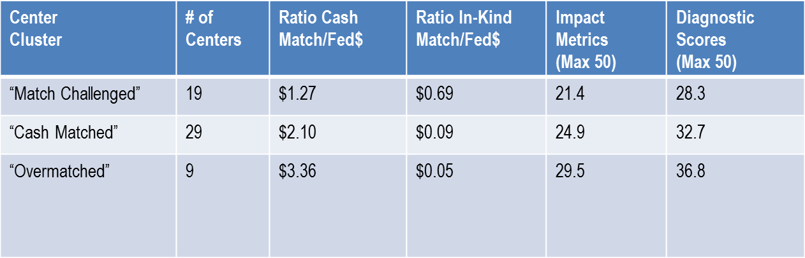
Role of In-Kind Cost Share in the MEP Program: Performance
Reliance on cash match funding is positively related to performance while reliance on in-kind match is negatively related to performance
Centers that rely more on cash perform better on the client survey and NIST assessment

Slide 37
Need for the MEP Program
GAO Report acknowledges that there is strong support in Congress for reduced cost share requirement
America COMPETES
  Identifies new responsibilities including informing on skill and training needs, innovative services, support construction and green energy industries, etc.
  Acknowledges cost share challenges through the establishment of the competitive award program that includes less restrictive cost share requirements
Presidential Initiatives including NNMI, AMTECH, M-TAC provide strong alignment with and support of the MEP mission
Multi-agency awards (Jobs Accelerator, Make it in America, etc.) recognize the need for MEP and partnering
Information Technology and Innovation Foundation identified MEP’s return on investment as the best compared to similar programs in other nations (authored by Rob Atkinson/Stephen Ezell)
Manufacturing “Feet on the Street” for other federal programs (next slide)

Slide 38
Need for Program: Manufacturing “Feet on the Street” for Other Federal Agencies
VALUE – The NIST MEP Program capability, reach, capacity and ability to measure and deliver on performance has been evidenced by the investment of other Agencies to deliver on their mission objectives.
FUNDING - Over the past 4 years (FY-2010-2013) other agencies have invested nearly $5 million in the MEP System.
Supply Chain Supplier Development via Buy America
  Department of Energy
  Department of Transportation
Supplier Development
  U.S. Navy c/o Veterans Affairs;
Environment and Sustainability Partnership and Project Support – E3/GSN
  Environmental Protection Agency;
Business Continuity Tool Development and Outreach
  Dept. of Homeland Security;
Supply Chain Product Development and Testing – Model Based Enterprise
  U.S. Air Force

Slide 39
Summary of Key Findings
Current cost share policy is positive, ensuring that beneficiaries of the program participate.
Current cost share requirement results in major negative impacts on the program limiting its ability to fulfill its public purpose.
Changing the cost share requirements would have numerous beneficial impacts, including more clients served, available cost share for other program investments, etc.
As state budgets decline and become more unpredictable, centers work more with large firms and participate in less program innovation and are less likely to serve small and/or rural manufacturers

Slide 40
Summary of Key Findings, cont.
The impact of changing the cost share on the financial size of the program is not possible to specifically determine, however there is evidence that centers will not be less motivated to secure cash resources to fulfill the mission.
There is no evidence that state contributions are driven by cost share requirements.
The impact of changing the cost share requirement is impossible to predict with scientific accuracy; however there is evidence that centers would serve more clients and benefit from reduced burden of managing in-kind cost share.

Slide 41
Establishing a Board Position

Slide 42
Factors to Consider in Establishing a Position
Cost Share Requirement – Level
  Maintaining the current cost share requirement of 2:1
  Reducing the requirement to 1:1
  Other
Composition of Cost Share – Cash/In-Kind
  All cash
  In-Kind allowance
    Level
      Maintain Current Level - 50% of cost share requirement
      Other
    What constitutes acceptable cost share (e.g. full-time equivalents, etc.)
Other Cost Share Related Items
  Balance the flexibility of a cost share requirement with need to most effectively serve the program objectives.
    Administrative Burden – Opportunity Cost
    Establish substantive relationship/administrative requirement
    Overmatch – Risk Management

Slide 43
Preliminary Position Discussion
ACTION - Does Board have enough information to establish an informed opinion at this time?
If not, what other information do you need before the Sub-Committee’s final discussion on September 23rd?
If there is current consensus on these questions, is the meeting scheduled for September 23rd still necessary?

Slide 44
Thank you for all of your time, attention, and effort!!!

