Slide 1
Cost Share Briefing MEP Advisory Board July 18/19, 2013

Slide 2
Agenda
Subcommittee Membership
Charge to Board
Background and Legislative History
Current State and Key Points
Preliminary Cost Share Data and Analysis
GAO Report
DRAFT Schedule
Actions and Next Steps
MEP Connect
Supporting References

Slide 3
Agenda
Subcommittee Membership
Charge to Board
Background and Legislative History
Current State and Key Points
Preliminary Cost Share Data and Analysis
GAO Report
DRAFT Schedule
Actions and Next Steps
MEP Connect
Supporting References

Slide 4
Subcommittee Membership
Vickie Wessel, Subcommittee Chair
Eileen Guarino
Ned Hill
Rich Scott
Ed Wolbert

Slide 5
Agenda
Subcommittee Membership
Charge to Board
Background and Legislative History
Current State and Key Points
Preliminary Cost Share Data and Analysis
GAO Report
DRAFT Schedule
Actions and Next Steps
MEP Connect
Supporting References

Slide 6
Recommendations on cost share requirements of the MEP program
In the American COMPETES Reauthorization Act of 2010, Congress directed the Comptroller General (GAO) to submit to Congress a report on cost share requirements of the MEP program with recommendations to provide for long term sustainability of the program
GAO submitted a report in April, 2011, but did not provide recommendations that would allow the Secretary of Commerce to alter the cost share structure
In the Report on the Appropriations Bill, 2012 (July 20, 2011), Congress directed the Secretary of Commerce to draft criteria for establishing specific cost share for the MEP program. A report is currently under review by the Department

Slide 7
Recommendations on cost share requirements of the MEP program
The Board is requested to immediately initiate a review of the cost share structure and by September 30, 2013 provide recommendations to the NIST Director.

Slide 8
Agenda
Subcommittee Membership
Charge to Board
Background and Legislative History
Current State and Key Points
Preliminary Cost Share Data and Analysis
GAO Report
DRAFT Schedule
Actions and Next Steps
MEP Connect
Supporting References

Slide 9
1988
Omnibus Foreign Trade and Competitiveness Act; TITLE 15 - Commerce and Trade, Chapter 7 - National Institute of Standards and Technology, Sec. 278k, Regional Centers for the Transfer of Manufacturing Technology
Created the MEP program
Mandated it to be a cost shared program between the federal government and the nonprofit entities serving as centers.
Ratio of federal to center cost share was limited to 50% in the first three years of operation.
Directed the program to establish a funding profile that reduced the amount of the federal contribution in years four through six of center operation
Prohibition of any federal funding beyond the sixth year of operation – referred to as the “Sunset” provision based on the belief that centers should/could be self-sufficient after their sixth year of operation.

Slide 10
1990
Code of Federal Regulations, Title 15--Commerce and Foreign Trade Chapter II--National Institute of Standards and Technology, Department of Commerce Part 290--Regional Centers for the Transfer of Manufacturing Technology
Set the limit on the federal contribution to be 40% in year four of operation and 33 1/3% in years five and six.
This profile was based on an arithmetic reduction of the federal share to comply with the legislation.
This was done through the program rule and not congressional legislation.
Year of center operation | Maximum NIST share
1-3 | 1/2
4 | 2/5
5-6 | 1/3

Slide 11
1998
Technology Administration Act; amendment to TITLE 15 - Commerce and Trade, Chapter 7 - National Institute of Standards and Technology, Sec. 278k
Congress passed legislation that eliminated the “Sunset” provision and established a limit on the amount of federal cost share at 33 1/3%.
Operational experience showed that the initial concept of a center becoming financially self-sufficient while serving manufacturers, particularly small and medium sized manufacturers was not feasible.

Slide 12
2007 America Competes Act
Updated the language creating and requiring cost share from the Centers to emphasize the value cost share brings to the program.
Encouraged Centers to enter into partnerships with other entities to further programmatic objective and increase ability to meet cost share requirements.
Provided clarification that these costs can be included as cost share to the program provided they are allocable and reasonable.

Slide 13
America COMPETES Reauthorization of 2010
The Comptroller General (GAO) shall submit to Congress a report on the cost share requirements under the program.
The report shall—
“(A) discuss various cost share structures, including the cost share structure in place prior to such date of enactment, and the effect of such cost share structures on individual Centers and the overall program; and
(B) include recommendations for how best to structure the cost share requirement to provide for the long-term sustainability of the program.
(C) If consistent with the recommendations in the report transmitted to Congress, the Secretary shall alter the cost structure requirements provided that the modification does not increase the cost share structure in place before the date of enactment of the America COMPETES Reauthorization Act of 2010, or allow the Secretary to provide a Center more than 50 percent of the costs incurred by that Center.”

Slide 14
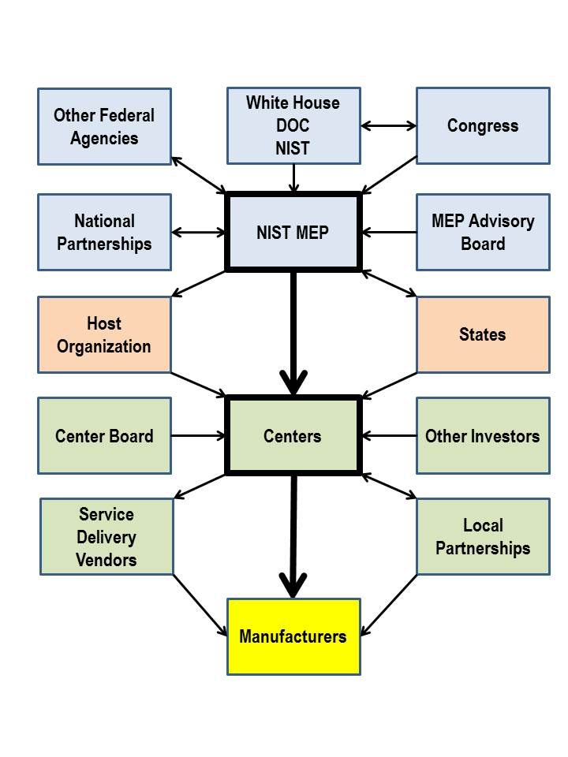
The MEP Eco-System
There are numerous other lines that can be drawn:
NIST MEP to Center Board
Other Federal Agencies to Centers
National Partnerships to Manufacturers

Slide 15
The Center Balancing Act
Client & Economic Impact
Market Penetration
Financial Stability
2 to 1 Cost Share of Expenses

Slide 16
Agenda
Subcommittee Membership
Charge to Board
Background and Legislative History
Current State and Key Points
Preliminary Cost Share Data and Analysis
GAO Report
DRAFT Schedule
Actions and Next Steps
MEP Connect
Supporting References

Slide 17
Current State
Year of Center Operation | Maximum NIST Share | Minimum Non-Federal Share
1-3 | ½ | ½
4 | 2/5 | 3/5
5 and beyond | 1/3 | 2/3
What Constitutes Cost Share:
The host organization may count as part of its share provided they are reasonable, allowable and allocable to the MEP project:
CASH
Dollar contributions (CASH) from state, county, city, industrial, or other sources;
Fees for services performed (Program Income);
Third party in-kind contributions of full-time personnel;
IN-KIND
Third party in-kind contribution of part-time personnel, equipment, software, rental value of centrally located space (office and laboratory) and other related contributions up to a maximum of one-half of the host's annual share.
Source | Cash | In-Kind
State | $150,000 | $350,000
Sub-recipient | $19,000 | $75,000
Third Party Contributor | $105,000 | $200,000

Slide 18
Diversity of Cost Share

Slide 19
Key Points
No more than 50% of the applicant’s total non-Federal cost share may be third party in-kind contributions of part-time personnel, equipment, software, rental value of centrally located space, and related contributions
Most common type of third party in-kind contribution for the MEP program is the Center’s receipt of donated or volunteered (i.e., unpaid) services by employees of another organization, which must be valued per regulation
Currently not all Centers are at the 2:1 cost share ratio

Slide 20
Agenda
Subcommittee Membership
Charge to Board
Background and Legislative History
Current State and Key Points
Preliminary Cost Share Data and Analysis
GAO Report
DRAFT Schedule
Actions and Next Steps
MEP Connect
Supporting References

Slide 21
Comparison of Cost Share: 2007 & 2012
 | 2007 | 2012 | +/-
Program Income as % of Cost Share | 40.9% | 51.8% | + 10.9
Total State Support as % of Cost Share | 33.0% | 28.7% | - 4.3
Total Third Party as % of Cost Share | 12.3% | 10.5% | - 1.8
Total Sub-Recipient as % of Cost Share | 11.5% | 8.4% | - 3.1
Other as % of Cost Share | 2.3% | 0.6% | -1.7
Non-program income cash as % of cost share has decreased from 36% in 2007 to 23% in 2012.
Notes:
“Other” includes: interest, dividends, rents, memberships and other fees, etc.

Slide 22
Total MEP center funding, including federal and non-federal contributions (dollars in millions)
Millions $

Slide 23
Center Fee for Services Revenues – Program Income

Slide 24
Change in State Support from 2007 to 2012
Notes:
Remaining centers either had no change or did not provide support in either year.

Slide 25
State Funding Priorities
Recent data generated by State Science and Technology Institute indicate that:
34 states provide some type of financial support to the MEP center
12 states provide direct line-item funding in the state budget to the MEP center
1 state provides legislative direction either for the MEP center or for funds that the MEP center can access

Slide 26
Variation Among State Cash Contributions (FY 2012)
12 centers reported no cash contribution from their state.
14 centers (23%) receive more than $1 million in state support, in aggregate, representing 60% of the total state cash contribution of $51 million.
15 centers (25%) receive state cash contributions equal to or greater than their federal funding

Slide 27
Agenda
Subcommittee Membership
Charge to Board
Background and Legislative History
Current State and Key Points
Preliminary Cost Share Data and Analysis
GAO Report
DRAFT Schedule
Actions and Next Steps
MEP Connect
Supporting References

Slide 28
GAO Report
“Factors for Evaluating the Cost Share of Manufacturing Extension Partnership Program to Assist Small and Medium-Sized Manufacturers” http://www.gao.gov/new.items/d11437r.pdf
GAO’s Research included:
NIST MEP programmatic and investment data
A survey of MEP centers
Review of legislation and regulations related to the MEP program

Slide 29
MEP Center Reported Positive Effects of the Cost Share Requirement
Centers are encouraged to leverage resources and improve partnerships with other organizations
Centers avoid duplication
The need to collect client fees gives manufacturers a stake in the program
Centers emphasize services that are relevant to manufacturers

Slide 30
MEP Center Reported Negative Effects of the Cost Share Requirement
MEP centers are spending more time and effort seeking funds
MEP centers are seeking projects outside their mission
MEP centers report shifting their focus to larger clients who can pay higher fees
MEP centers report focusing more on multiple projects with repeat clients
MEP centers report focusing less on rural clients

Slide 31
GAO Report - Recommendations
The final report does not provide any recommendations for the MEP cost share structure.
“One limitation of note is that because of the limited time the legislation provided for this review, we did not undertake a comprehensive assessment of the MEP program or cost share structures. In addition, we did not evaluate Commerce’s authority to alter the cost share structure.”
“We are unable to provide recommendations on how best to structure the cost share requirement to provide for the long-term sustainability of the program because we could not identify criteria or another basis for determining the optimal cost share structure for this program. Instead we have identified a number of factors that could be taken into account in considering modifications to the current cost share structure.”
Without recommendations, it is unclear what action the Secretary of Commerce could take to adjust the MEP cost share structure.

Slide 32
GAO Report – Principles to Consider When Setting Cost Share
All approaches involve trade-offs.
There could be trade-offs between lowering the cost share requirement and the total amount of funding available to help manufacturers. Specifically, reducing the requirements for nonfederal cost share could result in less resources being available to MEP centers…because MEP centers could have less incentive to secure nonfederal funds beyond those required to meet the reduced cost share
It is important to identify the beneficiary and allocate costs accordingly.
…cost share structures should promote equity by assigning costs to those who both use and benefit from the services…Irrespective of who benefits, it can be difficult to quantify the relative levels of benefits each entity may receive

Slide 33
GAO Report- Factors Specific to the MEP Program
The GAO identified a number of factors specific to the MEP program that could be useful in making decisions about the future of the program:
Many MEP centers, a NIST study, and a number of legislative proposals support lowering the current nonfederal cost share
Some MEP centers and a NIST study support providing more flexibility on how centers meet the nonfederal cost share
MEP centers differed on the role of in-kind contributions
Questions exist as to the need for the MEP program.

Slide 34
Congressional Response to the GAO Report
Subsequent to the GAO report issuance, Congress, in the “Report on Commerce, Justice, Science and Related Agencies Appropriations Bill, 2012” (Report 112-169, July 20, 2011) accompanying HR 2596, directed “the Secretary of Commerce to use the key factors and other findings identified by GAO in its cost-share report to draft criteria for establishing specific cost shares for the MEP program."
Revised deadline was June 7, 2013
MEP has prepared a draft report responding to the Congressional directive – the report is currently under review by the Department of Commerce, and will be transmitted to the Advisory Board when it is submitted to the Congress

Slide 35
Agenda
Subcommittee Membership
Charge to Board
Background and Legislative History
Current State and Key Points
Preliminary Cost Share Data and Analysis
GAO Report
DRAFT Schedule
Actions and Next Steps
MEP Connect
Supporting References

Slide 36
DRAFT Schedule - July
*July 18/19 – Brief Advisory Board Subcommittee - Cost share, Project Strategy
MEP Cost Share Background and History
Timing and process for collecting and communicating feedback and answers
July 26/29 – Refine questions and send to subcommittee
July 26/29 – Communicate to Centers cost share info sharing process and questions – deadline for feedback – August 23
* Meeting or Call with Subcommittee

Slide 37
DRAFT Schedule -August/September
*August 7/8 – Briefing to subcommittee on questions to national office
August – analysis of any additional information requested by subcommittee
August 26-30 – Compilation by national office staff of material submitted to subcommittee by centers
*Sept 5/6 – Subcommittee conference call to discuss information; develop draft recommendations
*September 9-13 – Refinement of draft recommendations
September 23 – DRAFT recommendation provided to Full Board
September 27 – Advisory Board meeting – morning – presentation of subcommittee recommendations
September 30 – Submission of Cost Share Recommendations to Dr. Pat Gallagher
* Meeting or Call with Subcommittee

Slide 38
Agenda
Subcommittee Membership
Charge to Board
Background and Legislative History
Current State and Key Points
Preliminary Cost Share Data and Analysis
GAO Report
DRAFT Schedule
Actions and Next Steps
MEP Connect
Supporting References

Slide 39
Actions and Next Steps
Clarify Webinar Questions as Needed
Information Collection Process – Communicate, Capture, and Present
Presentation – Format and Approach

Slide 40
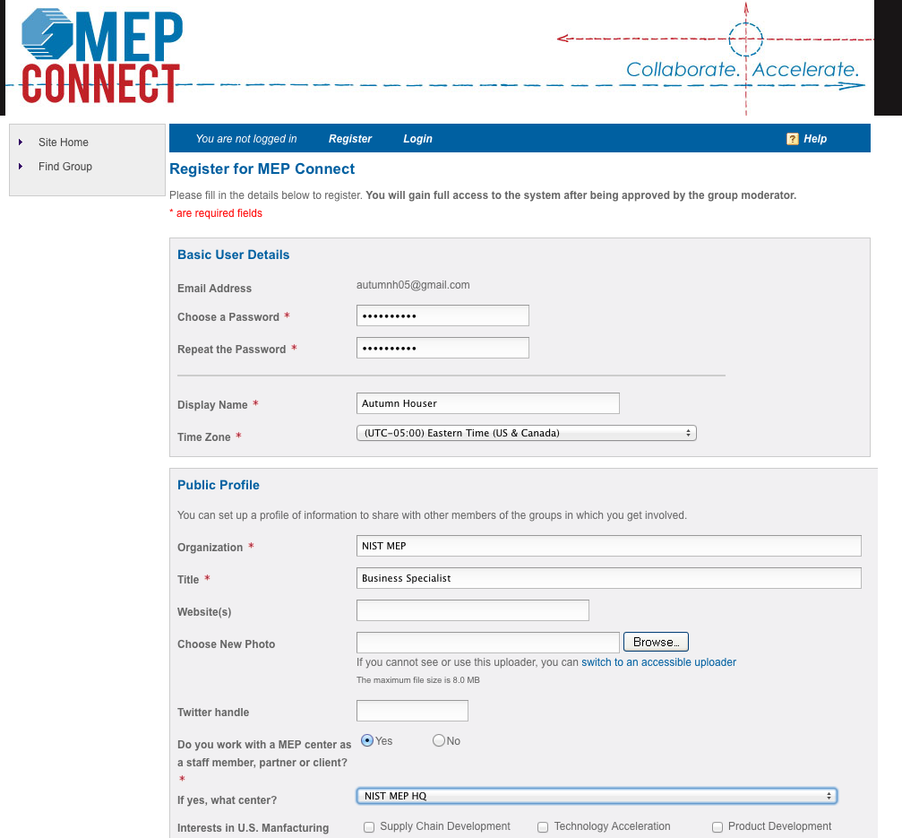

Slide 41
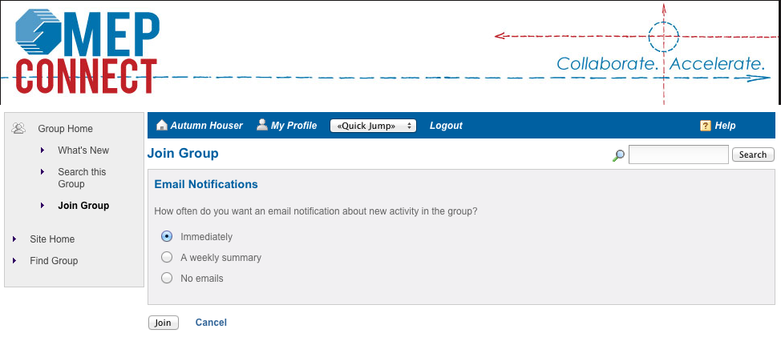

Slide 43
Supporting References
GAO Report on Cost Share - www.gao.gov/new.items/d11437r.pdf
NIST MEP General Terms and Conditions
Consolidated Board Questions
Cost Share Legislative History Document
ASMC Report
VCAT Example Presentation

