Slide 1
GenomeTrakr database: WGS network for foodborne pathogen traceback
Marc Allard, Ph.D.
Center for Food Safety and Applied Nutrition,
US Food and Drug Administration
at NIST,
Gaithersburg, MD: Aug 14, 2017

Slide 2
Current Scope of GenomeTrakr Network
Network includes labs at FDA, CDC, FSIS, 17 state health and university labs, 1 U.S. hospital lab, and 11 labs located outside the U.S.
Contributing labs are on 4 continents and in 10 countries
The network provides high resolution genomic sequences of food pathogens, ex. Salmonella, Listeria, STEC’s, others. Greater than 130,000 sequences in the database
New GenomeTrakr labs are coming on-line
Partnered with CDC in 2013 to study all clinical and environmental isolates of Listeria monocytogenes, now E. coli, (Salmonella coming)
FDA GenomeTrakr website
http://www.fda.gov/Food/FoodScienceResearch/WholeGenomeSequencingProgramWGS/ucm363134.htm

Slide 5
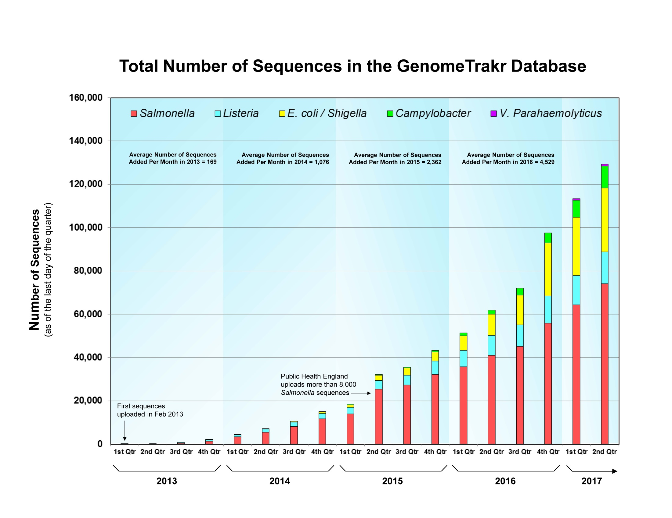

Slide 6
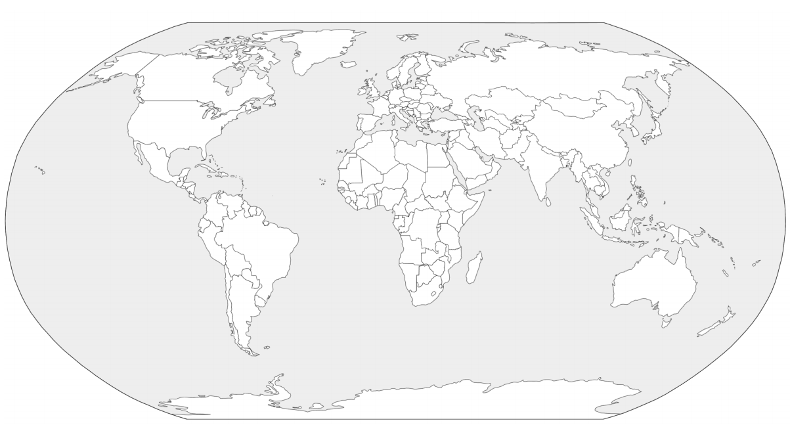
WHO-WGS Study Participating Countries
Argentina
Burkina Faso
Cambodia
Cameroon
Costa Rica
Ethiopia
Gambia
Ghana
India
Kenya
Lebanon
Paraguay
Rwanda
Senegal
Tanzania
Togo
Uruguay
Venezuela Chile
http://geology.com/world/world-map.shtml
WGS profile for 40,000 isolates: Salmonella, E. coli, Campylobacter, Listeria from humans, food animals and the environment through collaborations with Dr. Sid Thakur

Slide 8
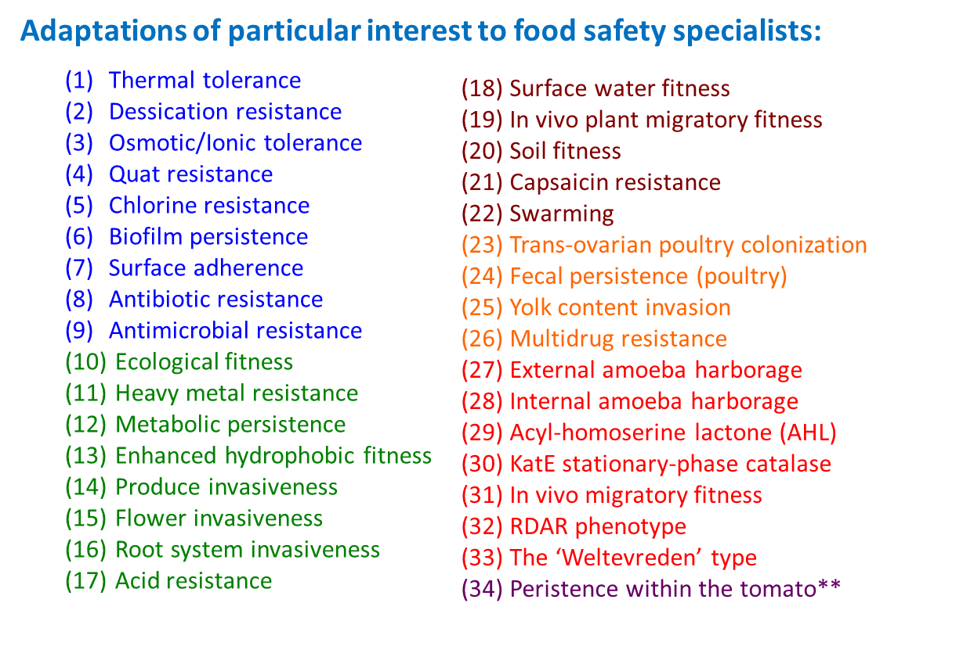

Slide 10
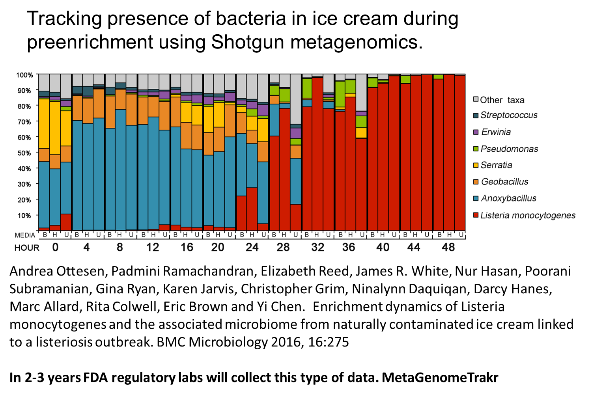

Slide 11
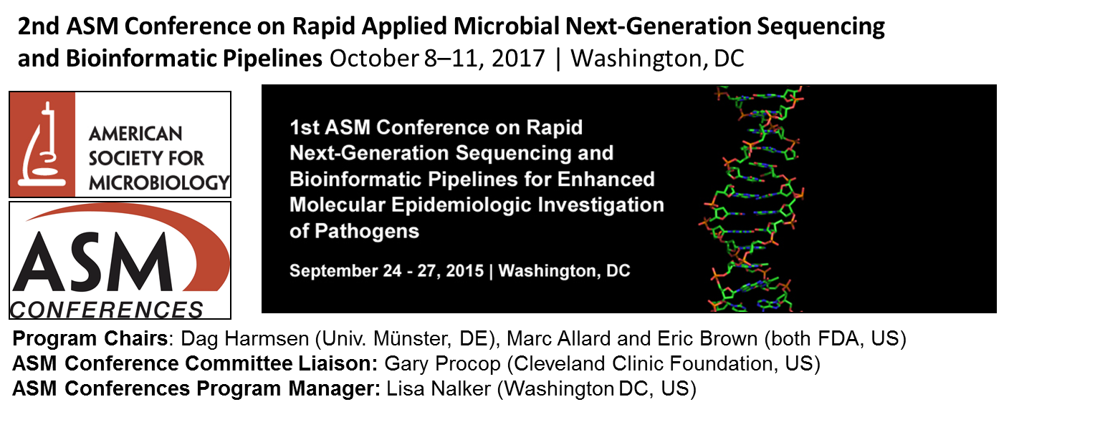

Slide 12
