Slide 1
Develop Python Scripts to Help Investigate the Structure and Interactions of Proteins
in Solution
Alex Zheng - Urbana High School, Frederick
Mentor: Yun Liu (NCNR)
Collaborators:
Christina Bergonzo (IBBR), Paul Butler(NCNR)
Jeffrey Kryzwon (NCNR)

Slide 2
Background:
Small Angle Neutron Scattering (SANS) is widely used to understand proteins in a solution
Aim a beam of neutrons at a solution of proteins and analyze how the neutrons are scattered
Various aspects of the proteins are revealed
Size and interactions between proteins are revealed by SANS
Important in cases such as pharmaceuticals
Protein-protein interactions are essential to the end result.
My project aims to understand protein behavior by calculating two values from Protein Data Bank (PDB) files:
Radius of Gyration - Size
Beta(Q) - Interaction
PDB file example

Slide 3
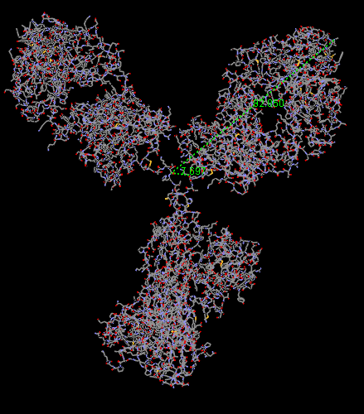
Generating PDB files from Visual Molecular Dynamics (VMD)
Used to visualize proteins and other systems
Upload a protein system and simulations
VMD visualizes the protein as it is runs through the Molecular Dynamics (MD) simulation
The simulations were provided by Dr. Christina Bergonzo
Save the simulation at specific points or ranges of time
One point in time is one frame, each frame is 1 nanosecond after the previous
In one frame, the atomic location of every atom in the protein is saved into a PDB file
Scattering patterns are revealed by analyzing the change in location of the atoms

Slide 4
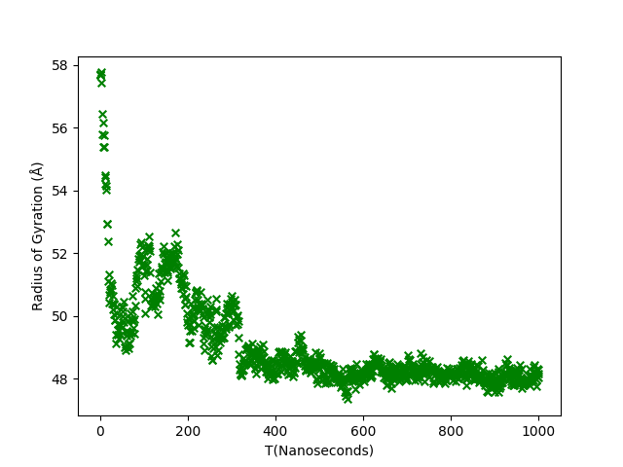
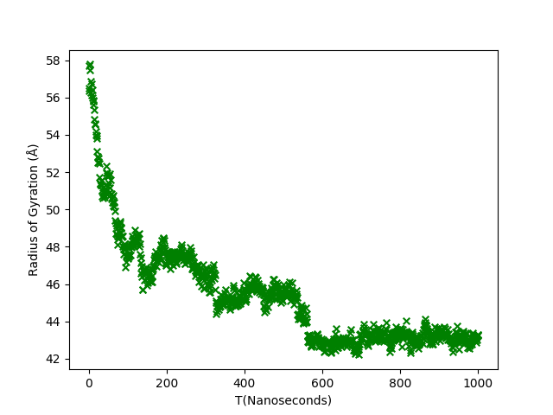
Radius of Gyration: R_{G}
TrajectoryA Visualization: Sample Size: 1000 frames
Size of the molecule (unit: Angstrom, 0.1 nanometer)
In terms of time or frames - 1 value of R_{G} per frame (1 nanosecond)
R_{G} represents the size of our protein molecule
Changes as we run it through a simulation
Generally condenses and fluctuates around one number
Known as the equilibrium structure
A smaller value of R_{G} means a more compact protein
TrajectoryD Visualization
Sample Size: 1000 frames

Slide 5
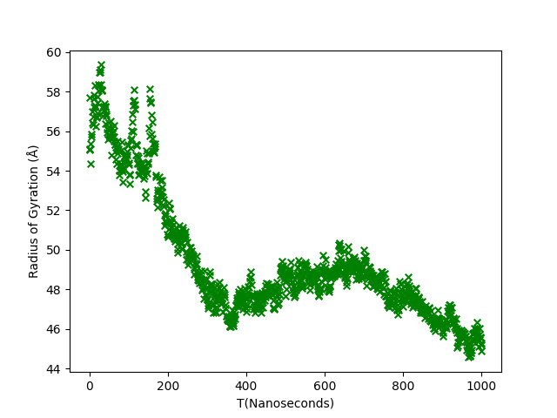
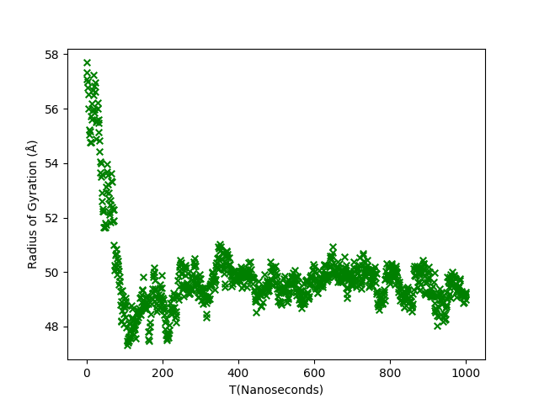
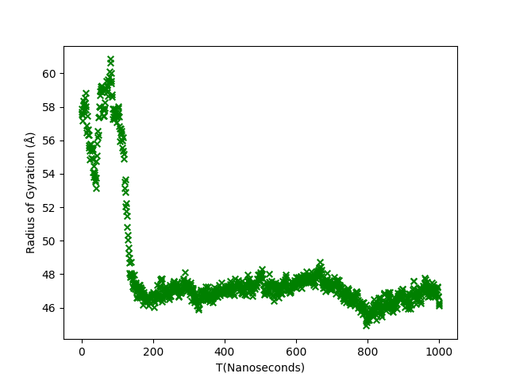
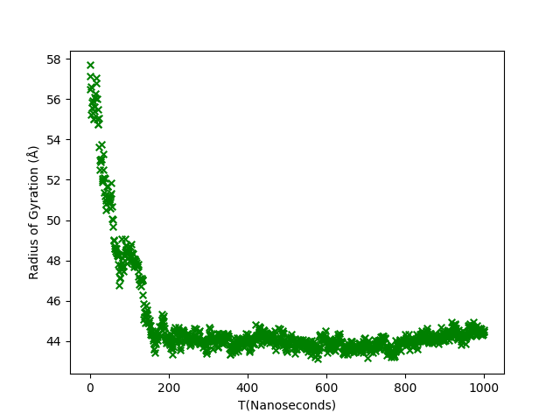
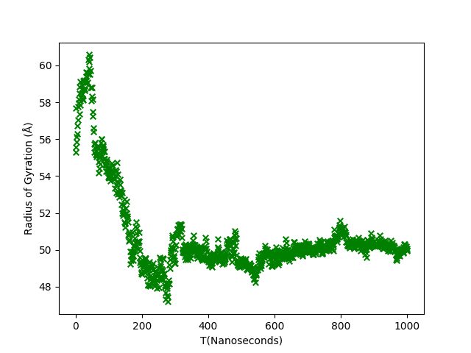
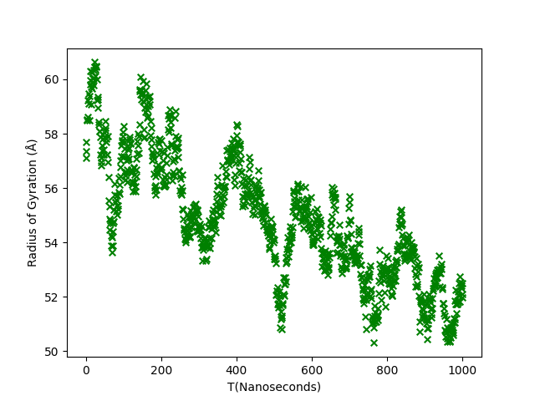
R_{G} of Different Simulations
NISTmAb Protein

Slide 6
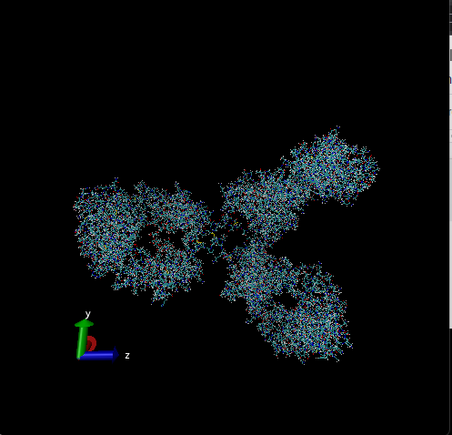
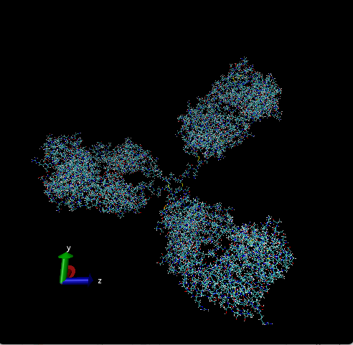
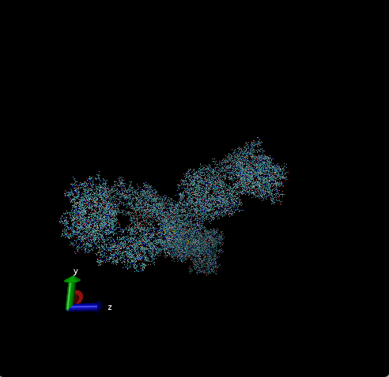
Trajectory A: Protein change over time
Frame 170: R_{G}: 51.86993545590835
Frame 1: R_{G}: 57.68932751080063
Frame 1000: R_{G}: 48.152382812019944

Slide 7
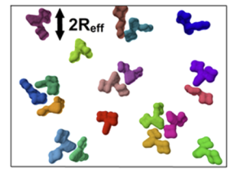
Beta Q: β(Q)
Beta(Q) is essential to understanding interactions between proteins
Scattering is still an important way to understand the interaction between proteins
To understand the interactions, we need to calculate the SANS Scattering pattern - I(Q)
P(Q) is form Factor, 𝑆 ̃(Q) is the Effective Structure Factor.
Calculate the Effective Structure factor using Beta(Q) and the True Structure factor - S(Q)
Proteins in a Solution

Slide 8
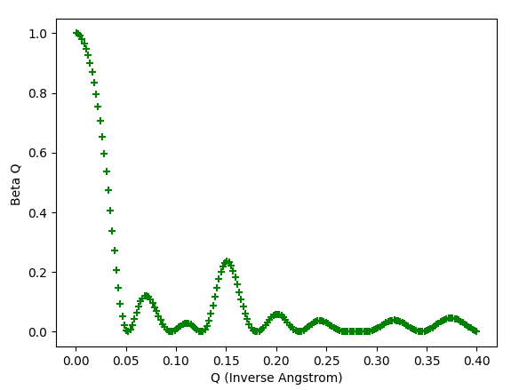
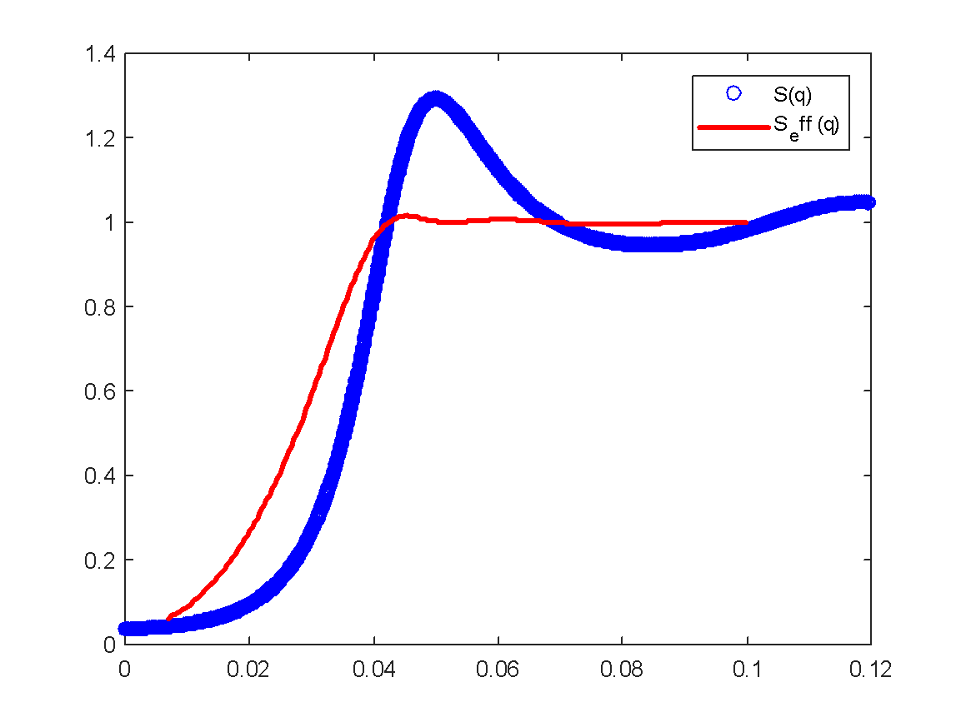
Beta Q: β(Q)
Program Beta(Q) Visualization:
Sample Size: 200
Need Beta(Q) to calculate the 𝑆 ̃(Q) (effective structure factor)
Results from the experiments is 𝑆 ̃(Q) rather than S(Q) (True Structure Factor)
It is important to calculate the Effective Structure factor to accurately obtain the Scattering patterns
Essential to understanding protein-protein interactions
The effect of the static beta approximation

Slide 9
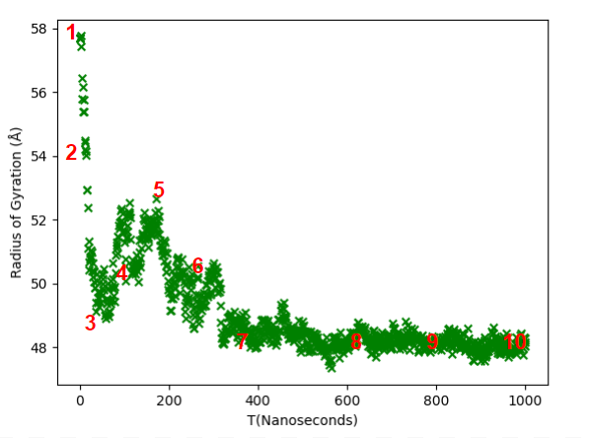
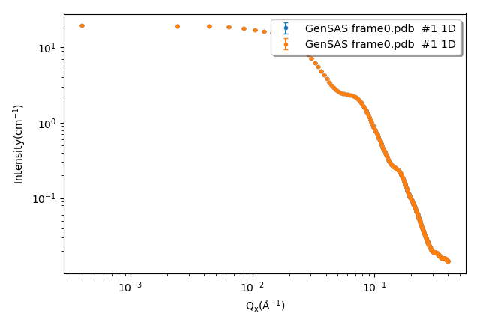
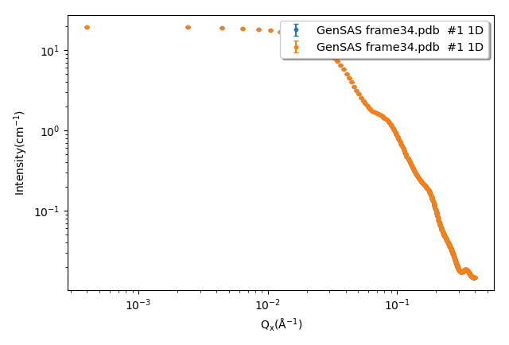
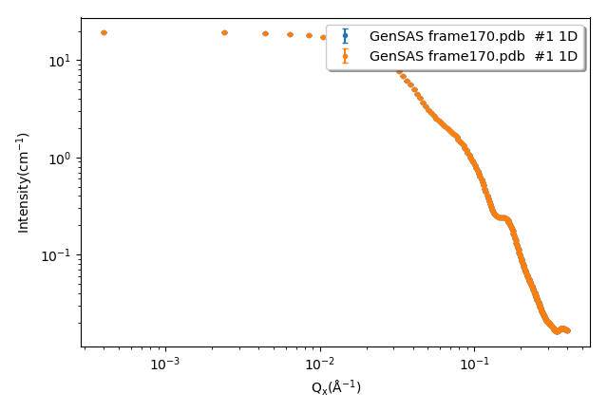
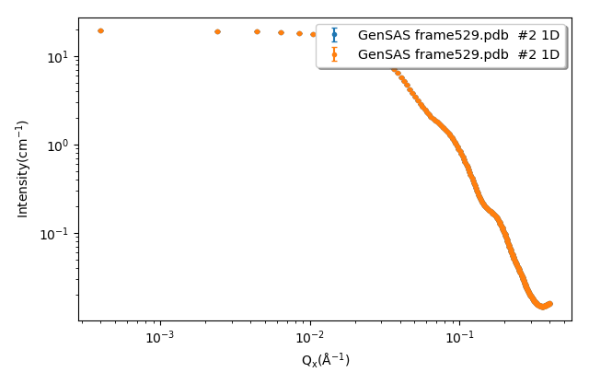
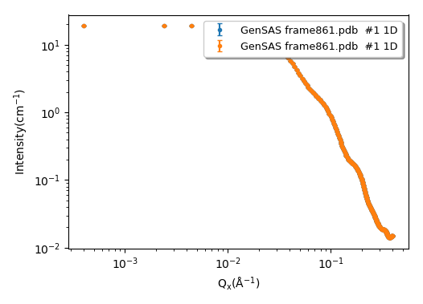
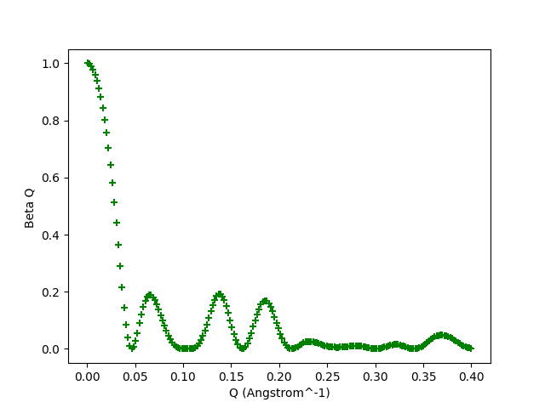
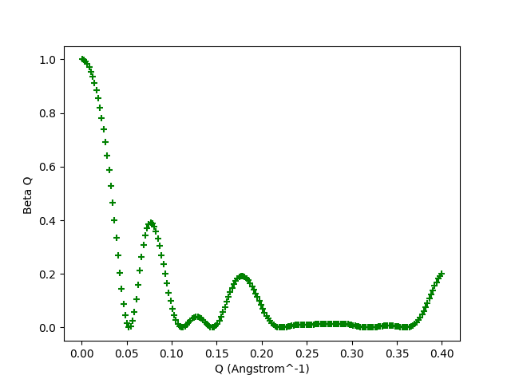
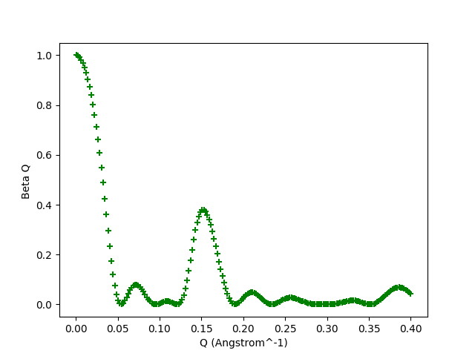
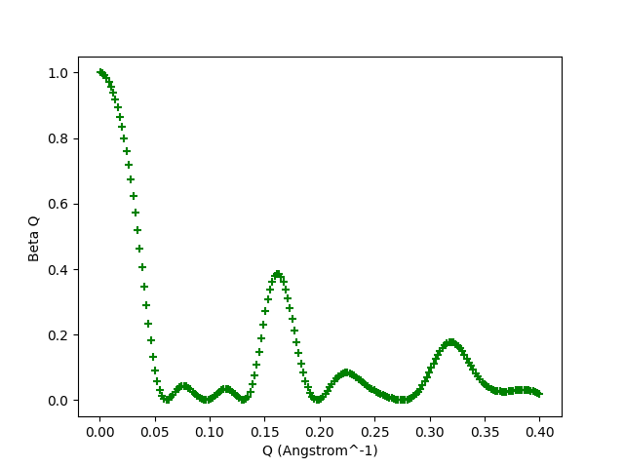
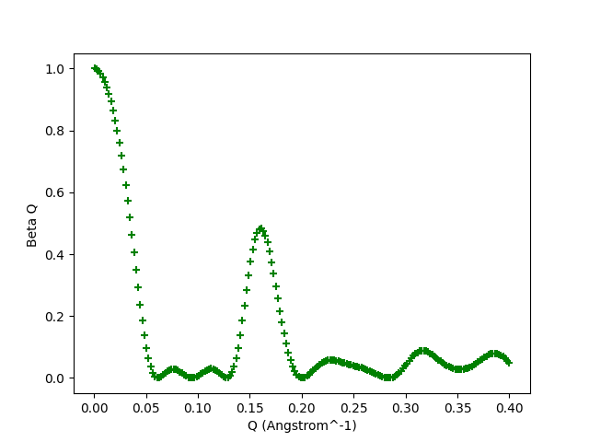
Change Over Time: Trajectory A
#1 | #3 | #5 | #7 | #9

Slide 10
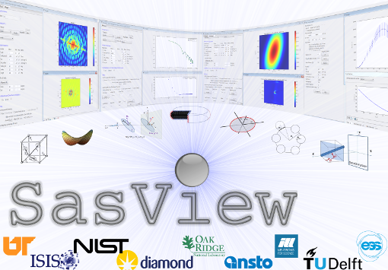
Ongoing Effort: Including Scripts into Sasview
To make the program more accessible, a secondary goal is to add the scripts into the Sasview program.
The Sasview program is a global community developed program for analyzing small angle scattering data
My main focus for this project lies in the Generic Scattering Calculator, a tool built into Sasview that computes and displays scattering data in either a 1D or 2D plot.

Slide 11
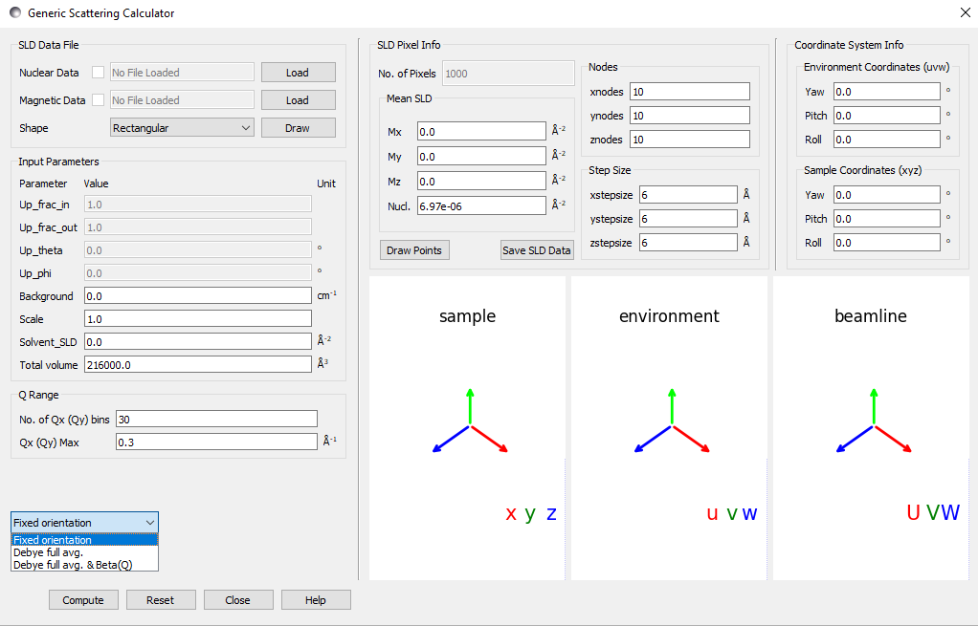
Ongoing Effort: Including Scripts into Sasview
The Generic Scattering Calculator (shown below) imports a PDB file
Calculates multiple values from the atomic data within the PDB file
Current Project also imports data from PDB files
Add the ability to calculate Beta(Q) and R_{G} into to the calculator
Makes these calculation much more accessible
No new program
Work to develop GUI and backend elements to make the feature easy to use and access.
Thanks to Paul Butler and Jeffrey Kryzwon for their help on Sasview

Slide 12
Conclusion
Develop a program to calculate Radius of Gyration and Beta(Q) of a protein in a solution using PDB files
The NISTmAb protein becomes more compact compared to its initial structure as it runs through the simulations
The R_{G} of the NISTmAb protein does not always converge to the same value across different trajectories
β(Q) and Form Factor change as R_{G} changes
Acknowledgements: CHRNS - Funding Support Julie Borchers and Joseph Dura - NCNR SHIP Directors

