Slide 1
Responding to the Challenges of Recruitment, Retention, and Succession at the NIST Information Services Office
Mary-Deirdre Coraggio
Rosa Liu
Information Services Office
June 29, 2014

Slide 2
National Institute of Standards and Technology (NIST)
Non-regulatory agency within US Department of Commerce
$850 million FY 2014 operating budget
3,000 employees
2,700 associates & facility users
NIST laboratories: Provide measurements, standards, and technology to address national priorities
Manufacturing Extension Partnership: Partnerships at 400 locations nationwide to help small manufacturers
Baldrige National Quality Award

Slide 3
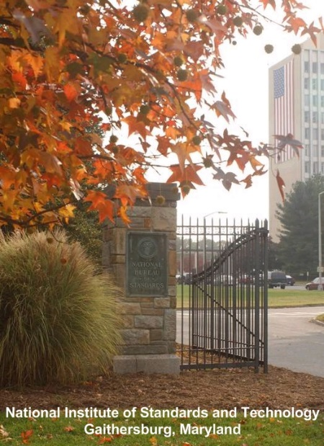
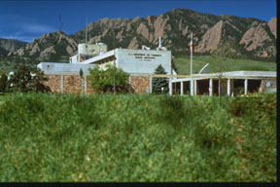
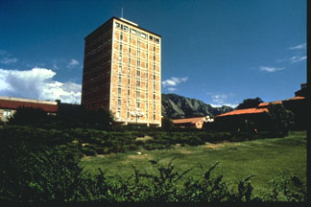
NIST Mission
To promote U.S. innovation and industrial competitiveness by advancing
measurement science, standards, and technology
in ways that enhance economic
security and improve the quality of life for all Americans.
Gaithersburg, MD
Boulder, CO

Slide 4
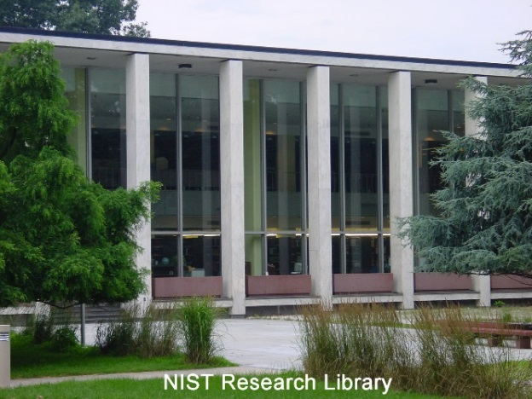
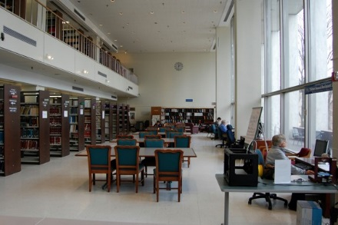
The Information Services Office (ISO) @ NIST
ISO Mission:
To support and enhance NIST research activities
Staff:
16 librarians, 9 specialists, 4 library techs
ISO programs:
Research Library
Electronic/Digital Publishing
Museum and History Program

Slide 5
NIST Alternative Performance Management System (APMS)
Major Differences Between APMS and GS:
Career Paths and Pay Bands
Set Benchmark Standards
Standardized and Shorter Position Descriptions
Easier to Create and Update
Pay-for-Performance System
Movement is by Merit and % of salary increase awarded
Flexible Hiring Salaries
Supervisory Differentials

Slide 6
NIST Alternative Performance Management System (APMS)
Benefits:
Greater Flexibility in Hiring
Manager has Classification Authority
Salary Setting
Greater Retention Options
Parallel Career Ladders

Slide 7
Career Paths and Pay Bands
CAREER PATHS | BANDS
Scientific and (ZP) Engineering | I |  |  |  |  |  | II |  |  |  | III |  | IV |  | V
S&E Technician (ZT) | I |  |  |  | II |  |  |  | III |  | IV |  | V
Administrative (ZA) Librarians 1410 Technical Information Specialists 1412 | I |  |  |  |  |  | II |  |  |  | III |  | IV |  | V
Support (ZS) Technicians 1411 | I |  | II |  | III |  | IV |  | V
Corresponding GS Grades | 1 | 2 | 3 | 4 | 5 | 6 | 7 | 8 | 9 | 10 | 11 | 12 | 13 | 14 | 15

Slide 8
Effects on Library Careers
Broadens Opportunities for Librarians
Allows Broader Use of 1412
Broadens Opportunities in Related Series
Better Grade Range
Use of Career Ladders with Education Gives Better Opportunity to Technicians

Slide 9
ISO Recruitment
Philosophy:
Focus on the Vision and Mission
Consider Each Vacancy an OPPORTUNITY
Vacancies “Belong” to the Organization

Slide 10
ISO Recruitment
Process:
Examine the Office’s Present and Future Needs
Perform Gap Analysis
Build on Strengths
Design for the Future
Choose Type of Appointment
Grade Level
Contractor/Civil Servant
Full Time/Part Time Permanent/Temporary/Term
Achieve Consensus – What’s Best for the Organization

Slide 11
ISO Recruitment
New Position:
Design New Position Description
Create Appropriate Functional Parenthetical Titles
Create Appropriate Specialty Descriptors
Describe the Principal Objective and List the Key KSAs

Slide 12
ISO Recruitment
Redefined Positions:
Determine if Opportunity for Current Staff
Reassignment
Accretion of Duties
Post Position in the Usual Method to Consider Staff
Promotion
New Path
Outside Candidates
New Hire

Slide 13
ISO Recruitment
ISO Hiring Process:
Recruitment/Interview Parameters Include
Technical Knowledge
Experience
Candidate’s Fit with ISO Culture
Narrow Candidates to Top 3-4
Pre-interviews by Phone
Check References

Slide 14
ISO Recruitment
ISO Conducts Multiple Interviews with Top Candidates:
Hiring Official
Other Group Leader
Panel of Selected Employees
Office Director Who Assesses…
Cultural Fit/Sharing Values
Candidate’s Vision and Thinking
Awareness of Technology and Business Situations
Offers Require Agreement Between Employee Panel and MT

Slide 15
Employee Retention
Tuition:
Support BS and MS programs
Support Certificate Programs
Reimburse Student Loans (MLS)
Support Specialty Training
Leadership Opportunities:
NIST Leadership Program
Federal Executive Institute
Leading ISO Teams
Participating in NIST-wide Teams

Slide 16
Employee Retention
Professional Development:
Conference Attendance
Professional Networking Opportunities
Publishing and Presentation Support
Promotion:
Accretion of Duties
New Paths

Slide 17
Employee Retention
Interesting/Engaging Projects:
Staff Proposals
Management (MT) Projects
Participation in NIST-wide Collaborations
Participation in Lab Collaborations
Encourage/Reward Risk Taking
Create Teams to Examine New Technology and Business Models

Slide 18
Employee Retention
Rewards:
Time Off and Cash-in-Account
DOC Medals
Named Awards
Federal and Other Awards
Bonuses

Slide 19
Issues and Goals
Issues:
11 Staff are Retirement Ready
Normal Attrition
Goals:
Development a Plan to Augment MT’s Approach to Hiring
Involve Employee Participation to Supplement MT Efforts

Slide 20
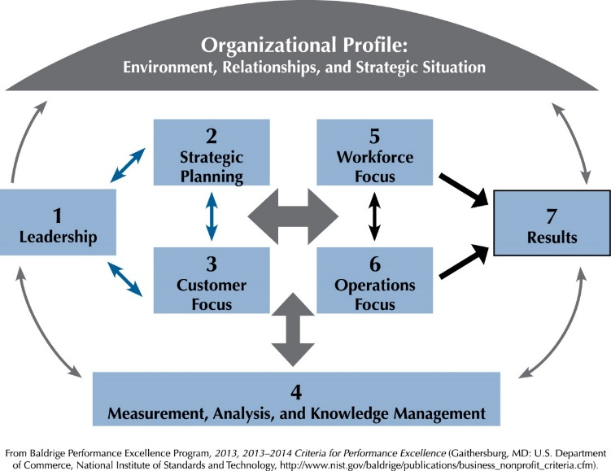
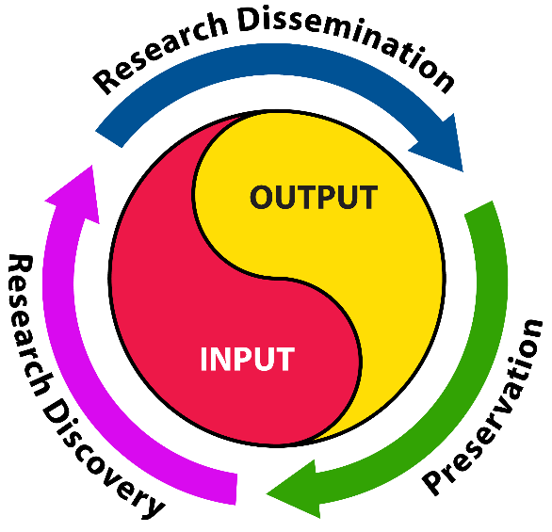
Succession Planning Approach
Establish an Employee Team to Create a Succession Plan that Aligns to ISO’s Framework:
Baldrige Criteria for Performance Excellence
Knowledge Continuum
ISO Strategic Plan
Long and Short Term Goals, Objectives, and Action Plans
Success Measures

Slide 21
Approach (continued)
Examine ISO’s Best Practices Based on Team Findings
Develop a Succession Program for ISO Staff

Slide 22
Succession Plan
Address the Competencies of Leadership:
Leading Change
Leading People
Business Acumen
Building Coalitions
Results Driven
Determine How to Develop a Deeper Bench
Identify/Develop Untapped Internal Resources
Identify Potential Candidates

Slide 23
Documentation
What Should New/Future Leaders Know About ISO?
Preserve Institutional/ Corporate Memory
Process Documentation Includes Rationale
Understand Before Changing
Create Staff Awareness of What is Required

Slide 24
Conclusion
Recruitment, Retention, and Succession are Integrated Parts of a Workforce Management Cycle:
Driven by the Vision, Mission, and Strategic Goals of the Organization
To Succeed…
All Parts Must Work Together
And Have the Buy-In of All Current and Incoming Staff

Slide 25
For more information
301-975-2784
Mary-Deirdre Coraggio, Director ISO
mary-deirdre.coraggio@nist.gov
Rosa Liu, Program Manager Research Library
rosa.liu@nist.gov

