Slide 1
WELCOME Informational Webinar – August 21, 2013 4 p.m. (EST) Federal Funding Opportunity: 2013-NIST-MEP-STEP-AK-01 National Institute of Standards and Technology (NIST) Manufacturing Extension Partnership (MEP) Tab Wilkins, Regional Manager for Strategic Transition, NIST MEP Diane Henderson, Federal Program Officer, NIST MEP

Slide 2
Information Webinar and Communication Protocols
Webinar serves as a communication vehicle to provide an overview of the funding opportunity.
No questions will be taken as part of this webinar.
All questions should be presented in writing and submitted to Diane Henderson at NIST MEP, diane.henderson@nist.gov
Provides for transparency and ensures all answers are documented.
Assures questions and answers are handled consistently.
Questions and Answers will be posted regularly on the NIST MEP Public Site, www.nist.gov/mep/

Slide 3
Information Webinar Agenda
MEP Program Overview
NIST MEP Center Creation Process
Funding Opportunity Overview
Cost Share, Funding and Eligibility
Application Package Details
Review Criteria
Application/Proposal Submission
Selection Factors
Review and Selection Process
Award Administration Information
Reporting & Audit Requirements
Agency Contacts

Slide 4
MEP Program Overview
The National Institute of Standards and Technology’s Hollings Manufacturing Extension Partnership (MEP) works with small and mid-sized U.S. manufacturers to help them create and retain jobs, increase profits, and save time and money. The nationwide network provides a variety of services, from innovation strategies to process improvements to green manufacturing. MEP also works with partners at the state and federal levels on programs that put manufacturers in position to develop new customers, expand into new markets and create new products.
The NIST MEP System has been created as a network of match funded “Centers” or non-profit organizations, universities and state agencies which employ MEP field staff to provide services to small and mid-sized manufacturers. Each “Center” has been developed in specific response to the unique opportunities, challenges and conditions in their marketplace.
MEP field staff has over 1,300 technical experts – located in every state – serving as trusted business advisors, focused on solving manufacturers’ challenges and identifying opportunities for growth. As a program of the U.S. Department of Commerce, MEP offers its clients a wealth of unique and effective resources centered on five critical areas: technology acceleration, supplier development, sustainability, workforce and continuous improvement.
http://www.nist.gov/mep/

Slide 5
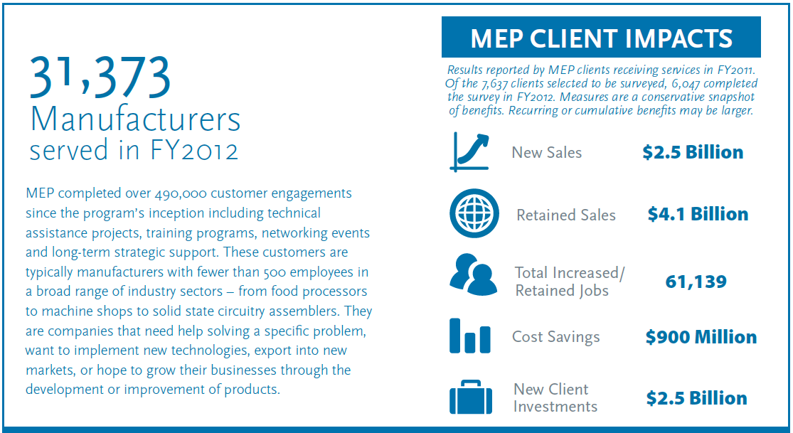
NIST MEP System Impacts

Slide 6
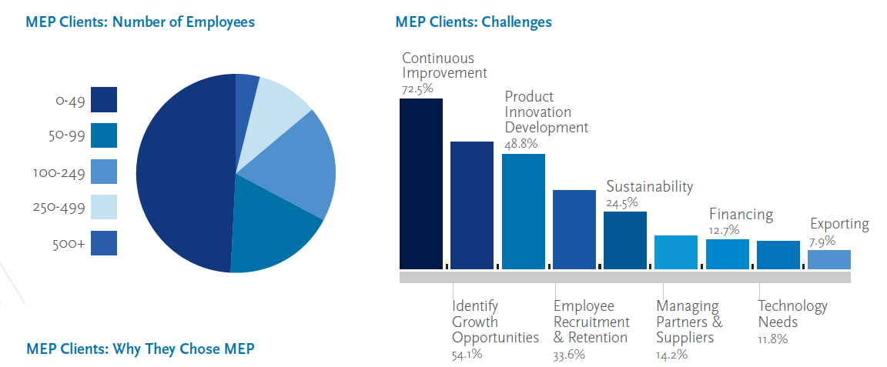
MEP System Clients and Challenges

Slide 7
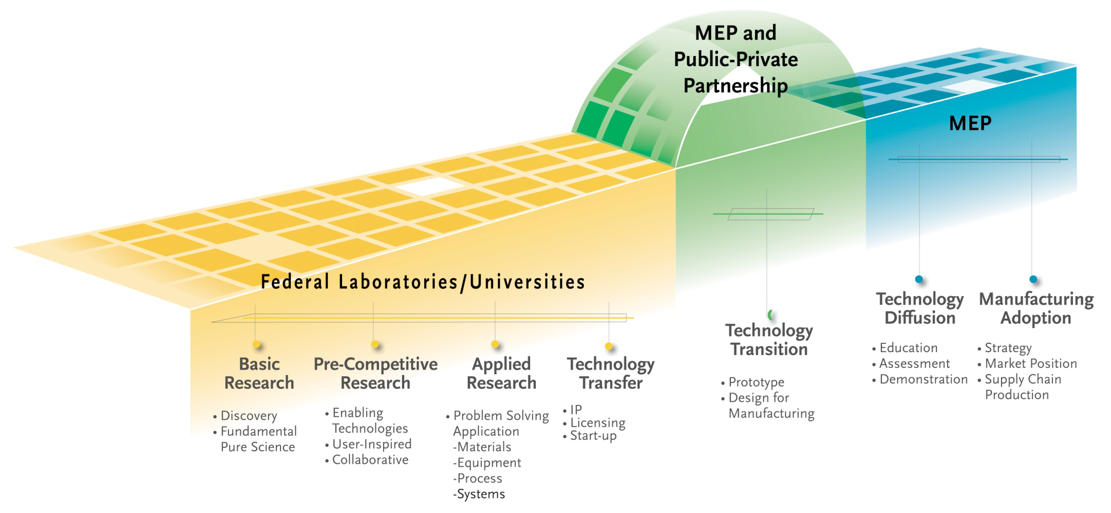
The NIST MEP Technology Continuum:
* Make the technology acceleration framework a reality
* Engage at the CEO level to transform Firms
* Partner with community leaders in regional innovation initiatives to encourage new business models/services/products, and to
commercialize technology
* A particular focus on Manufacturing Adoption and working towards Technology Diffusion and Transition

Slide 8
NIST MEP Center Creation Process
An Assistance Project seeks to understand the unique challenges, opportunities and conditions of small and mid-sized manufacturers in the region that might be addressed by creating a NIST MEP Center
Based on the planning activity a decision may be made to conduct a separate competition for a Center Designation
A Center Designation would allow an organization to apply for annual operating funding from NIST MEP, on a matching basis to provide services in the region
Once a Center Designation is made the organization becomes a NIST MEP Center

Slide 9
Funding Opportunity Overview (1)
Funding Opportunity Title: State Technology Extension Assistance Project for State of Alaska
Funding Opportunity Description:
NIST provides technical assistance to State technology extension programs throughout the United States. The purpose of this FFO is to provide NIST financial support, technical assistance and advice in understanding the technical needs of small and mid-sized manufacturers in Alaska as the state seeks to diversify their manufacturing base. This may lead to the future creation of a Manufacturing Extension Partnership (MEP) Center in the State of Alaska. This award will continue to promote increased coordination and communication within the state.
NIST invites applications from eligible applicants for a project to help the state engage the manufacturing community and potential partner and service provider communities in organizing a more effective and efficient system for supporting the global competitiveness of small and mid-sized manufacturers in the state through technical assistance services and the application of science and technology.

Slide 10
Funding Opportunity Overview (2)
Authority: The statutory authority for this program is 15 U.S.C. 272a(1), 278l and 272(b)(4)
Funding Instrument: Cooperative Agreement
The funding instrument that will be used for each award is a cooperative agreement. The nature of NIST’s “substantial involvement” will generally be collaboration between MEP and the recipient organization(s). This includes MEP collaboration with a recipient on its progress and approving changes in the statement of work.
Reference: http://www.osec.doc.gov/oam/grants_management/policy/doc_grants_manual/default.htm
In addition to financial support once the award is made NIST MEP will be available to engage in assisting the planning effort. This could include working on-site with the planning team, offering insight, advice and technical assistance regarding the experience of others across the MEP system.

Slide 11
Public Law 100-418, 15 USC Section 2781
The Secretary, through the Director and, if appropriate, through other officials, shall provide technical assistance to State technology programs throughout the United States, in order to help those programs help businesses, particularly small- and medium-sized businesses, to enhance their competitiveness through the application of science and technology.
(b) Such assistance from the Institute to State technology programs shall include, but not be limited to - (1) technical information and advice from Institute personnel; (2) workshops and seminars for State officials interested in transferring Federal technology to businesses; and (3) entering into cooperative agreements when authorized to do so under this chapter or any other Act.

Slide 12
Cost Share, Funding & Eligibility (1)
Cost Share:
Cost sharing is not required for awards under this program.
Funding Available:
NIST anticipates funding approximately one (1) application at the level of up to $150,000 for a project in the State of Alaska.
The project awarded under this FFO will have a budget and performance period of up to six (6) months.

Slide 13
Cost Share, Funding and Eligibility (2)
Eligible Applicants:
Institutions of higher education, non-profit organizations, state and local governments, and commercial organizations in the United States and its territories.
An eligible organization may work individually or include proposed subawards or contracts with others in a project proposal, effectively forming a team or consortium.

Slide 14
Application Package Details (1)
Complete applications/proposals must, at a minimum, include the following forms and documents and meet the following requirements identified in the FFO which are:
Required Forms*:
SF-424 Application for Federal Assistance
SF-424A Budget Information Non-Constructions
SF-424B Assurances Non-construction
CD-511 Certification Regarding Lobbying
SF-LLL Disclosure of Lobbying Activities (if applicable)
*Forms are available as part of the Grants.gov application kit

Slide 15
Application Package Details (2):
Proposal Requirements:
Technical Proposal. The Technical Proposal is a word-processed document not exceeding 20 pages responsive to the program description (see Section I of this FFO) and the evaluation criteria (see Section V.1 of this FFO). It should contain the following information:
Executive Summary. The executive summary should briefly describe the proposed project, consistent with the evaluation criteria (see Section V.1 of this FFO).
Project Narrative. A description of the proposed project including statement of work that should discuss the specific tasks to be carried out, including a schedule of measureable events and milestones, sufficient to permit evaluation of the application, in accordance with the evaluation criteria (see Section V.1 of this FFO). In addition to the description of the proposed project and statement of work, the project narrative should include a statement describing linkages to industry, government, non-profit organizations, and educational organizations that provide research, technical assistance, service delivery, and other services within its service region.

Slide 16
Application Package Details (3):
Qualifications. A description of the qualifications and proposed operational or management activities of key personnel who will be assigned to work on the proposed project. In addition to this description, a one (1) page resume for each key person identified should be provided (see Section IV.2.a.9 of this FFO)
Budget Narrative. There is no required format for the Budget Narrative; however, it should provide a detailed breakdown of each of the object class categories as reflected on the SF-424A. A suggested format can be found on the MEP website, www.nist.gov/mep
Indirect Cost Rate Agreement. If indirect costs are included in the proposed budget, provide a copy of the approved negotiated agreement if this rate was negotiated with a cognizant Federal audit agency. If the rate was not established by a cognizant Federal audit agency, provide a statement to this effect. The successful applicant will be required to obtain such a rate.
Resumes of Key Personnel (these do not contribute to the total number of pages). Provide a one (1) page resume for each key person identified in the proposal. Information on any pages beyond the first page of each resume will not be considered.

Slide 17
Application Package Details (4):
Proposal Format:
Page Limit. The Technical Proposals are limited to twenty (20) pages. Information on pages beyond the page limit will not be considered.
Page limit includes: Table of contents (if included), Technical Proposal with all required sections, figures, graphs, tables, images, and pictures.
Page limit excludes: SF-424, Application for Federal Assistance; SF-424A, Budget Information – Non-Construction Programs; SF-424B, Assurances – Non-Construction Programs; SF-LLL, Disclosure of Lobbying Activities; CD-511, Certification Regarding Lobbying; Budget Narrative; Indirect Cost Rate Agreement, and Resumes

Slide 18
Review Criteria:
The applications will be evaluated based on the evaluation criteria described below.
Coordination with Existing Resources in the Region (25 points)
The proposed method, breadth and depth for engaging all manufacturing sectors, major manufacturers, potential partners, as well as federal, state, regional and local entities in the analysis in order to understand current services, gaps in services and future opportunities for a coordinated effort in serving manufacturers will be evaluated.
Funding and Financial Management (10 points)
The relevancy and cost effectiveness of the applicant's financial plan for meeting the objective of this FFO will be evaluated. Does the proposed budget focus seem reasonable or cost effective for the work plan proposed?
Needs Identification Methodology (25 points)
The proposed method, breadth and depth of gathering the information necessary for understanding the types of new and existing manufacturers in the region and their barriers to global competitiveness and growth which might be assisted through extension service for manufacturers will be evaluated. This includes gathering information on key manufacturing industry needs and relevant industry initiatives, within the context of local and global challenges.

Slide 19
Review Criteria:
Resource Identification Methodology (20 points)
The applicant's methodology for collecting information about the number, size, type, skills and abilities of potential key partners in the region and relevance of existing industrial assistance and other support services that could be part of the coordination effort will be evaluated.
Qualifications of the Proposed Personnel (20 points)
How well resumes, experience, previous work and current skills demonstrate the applicant’s ability to effectively carry out the proposed project will be assessed.
NOTE: Proposers may not submit replacement pages and/or missing documents once a proposal has been submitted. Any revisions must be made by submission of a new proposal that must be received by NIST by the submission deadline.

Slide 20
Application/Proposal Submission
Dates:
Electronic applications must be received no later than 11:59 p.m. Eastern Time, Tuesday, October 1, 2013.
Paper applications must be received by NIST by 5:00 p.m. Eastern Time on Tuesday, October 1, 2013.
Applications received after the respective deadline will not be reviewed or considered.
Proposal Submission:
Electronic applications must be submitted via Grants.gov at www.grants.gov under announcement 2013-NIST-MEP-STEP-AK-01.
Paper applications must be submitted in triplicate (an original and two copies) and sent to the NIST personnel listed below:
National Institute of Standards and Technology
Manufacturing Extension Partnership
c/o Diane Henderson
100 Bureau Drive, MS 4800
Gaithersburg, MD 20899-4800

Slide 21
Selection Factors
The Selecting Official, who is the Director of the NIST MEP, shall select applications for award based upon the rank order of the applications, and may select an application out of rank based on one or more of the following selection factors:
The availability of Federal funds.
Whether the project duplicates other projects funded by DoC or by other Federal agencies.

Slide 22
Review and Selection Process (1)
Initial Administrative Review of Applications. An initial review of timely received applications will be conducted to determine eligibility, completeness, and responsiveness to this FFO and the scope of the stated program objectives. Applications determined to be ineligible, incomplete, and/or non-responsive may be eliminated from further review.
Full Review of Eligible, Complete, and Responsive Applications. Applications that are determined to be eligible, complete, and responsive will proceed for full reviews in accordance with the review and selection processes below:
Evaluation and Review. Each eligible, complete and responsive application will be reviewed by three (3) independent, objective individuals with appropriate professional and technical expertise relating to the topics covered in this FFO based on the evaluation criteria. If more than one non-Federal employee reviewer is used, the reviewers may discuss the applications with each other, but scores will be determined on an individual basis, not as a consensus. Reviewers will assign each application a score, based on the application’s responsiveness to the evaluation criteria above, with a maximum score of 100. Applications with an average score of 70 or higher out of 100 will be deemed finalists.

Slide 23
Review and Selection Process (2)
The reviewers may ask written questions of some or all finalists in order for the reviewers to gain a better understanding of the applicant’s proposal. Additionally, if deemed necessary, the reviewers may conduct a teleconference and/or site visit with each finalist, which may result in the reviewers revising their scores of the applications.
Ranking and Selection. Based on the reviewers’ final numeric scores, a rank order will be prepared and provided to the Selecting Official for further consideration. The Selecting Official, who is the Director of the NIST MEP, will then select funding recipients based upon the rank order and the selection factors (see Section V.2 of this FFO).
NIST reserves the right to negotiate the budget costs with the applicants that have been selected to receive awards, which may include requesting that the applicant remove certain costs.
Additionally, NIST may request that the applicant modify objectives or work plans and provide supplemental information required by the agency prior to award.
NIST also reserves the right to reject an application where information is uncovered that raises a reasonable doubt as to the responsibility of the applicant.
NIST may select part, some, all, or none of the applications.
The final approval of selected applications and issuance of awards will be by the NIST Grants Officer. The award decisions of the NIST Grants Officer are final.
.

Slide 24
Award Administration Information (1)
Anticipated Announcement and Award date
Review, selection, and award processing is expected to be completed in December 2013. The earliest anticipated start date for awards made under this FFO is expected to be approximately February 2014.
.
Employer/Taxpayer Identification Number (EIN/TIN), Dun and Bradstreet Data Universal Numbering System (DUNS), and System for Award Management (SAM).
All applicants for Federal financial assistance are required to obtain a universal identifier in the form of DUNS number and maintain a current registration in the Federal government’s primary registrant database, SAM (https://www.sam.gov/).
Per 2 C.F.R. Part 25, each applicant must:
Be registered in the Central Contractor Registry (CCR) before submitting an application noting the CCR now resides in SAM;
Maintain an active CCR registration, noting the CCR now resides in SAM, with current information at all times during which it has an active Federal award or an application under consideration by an agency; and
Provide its DUNS number in each application or application it submits to the agency.
Funding Availability and Limitation of Liability
Funding for the program listed in this FFO is contingent upon the availability of appropriations. I
n no event will NIST or DoC be responsible for application preparation costs if this program fails to receive funding or is cancelled because of agency priorities.
Publication of this FFO does not oblige NIST or DoC to award any specific project or to obligate any available funds.

Slide 25
Reporting & Audit Requirements (1)
In lieu of the reporting requirements described in sections A.01 Financial Reports and B.01 Performance (Technical) Reports of the DoC Financial Assistance Standard Terms and Conditions dated January 2013 (http://www.osec.doc.gov/oam/grants_management/policy/documents/DOC_Standard_Terms_and_Conditions_01_10_2013.pdf) the following reporting requirements shall apply:
Financial Reports. Each award recipient will be required to submit an SF-425, Federal Financial Report in triplicate (an original and two (2) copies), on a quarterly basis for the periods ending March 31, June 30, September 30, and December 31 of each year. Reports will be due within 30 days after the end of the reporting period.
Performance (Technical ) Reports- Each award recipient will be required to submit a technical progress report in triplicate (an original and two (2) copies), on a quarterly basis for the periods ending March 31, June 30, September 30, and December 31 of each year. (Please refer to 15 C.F.R. § 14.51 for further information and Section VI.3.(2) of the FFO)
For Example, if the start date is February 2014:
The recipient would report by April 30th for the January – March 2014 quarter
The recipient would report by July 31st for the April – June 2014 quarter
The recipient would submit last technical & financial report once award closes (approx. July 31st) or within 90 days from award close-out.

Slide 26
Reporting & Audit Requirements (2)
Federal Funding Accountability and Transparency Act of 2006. In accordance with 2 C.F.R. Part 170, all recipients of a Federal award made on or after October 1, 2010, are required to comply with reporting requirements under the Federal Funding Accountability and Transparency Act of 2006 (Pub. L. No. 109-282). In general, all recipients are responsible for reporting sub-awards of $25,000 or more. In addition, recipients that meet certain criteria are responsible for reporting executive compensation. Applicants must ensure they have the necessary processes and systems in place to comply with the reporting requirements should they receive funding.
Automated Standardized Application for Payment System (ASAP)
(For those awarded) In order to receive payments for services, recipients will be required to register to the Dept of Treasury. More information regarding ASAP can be found on-line at www.fms.treas.gov/asap/index.html.

Slide 27
Agency Contacts
Subject Area | Point of Contact
Administrative, budget, cost-sharing, eligibility questions, and other programmatic questions. | Diane Henderson Manufacturing Extension Partnership NIST Phone: 301-975-5105 Fax: 301-963-6556 E-mail: diane.henderson@nist.gov
Grants.gov - Application Submission | Christopher Hunton Grants & Agreements Management Division NIST Phone: 301–975–5718 Fax: 301–840-5976 E-mail: christopher.hunton@nist.gov
Grant rules and regulations | Calvin Mitchell Grants & Agreements Management Division NIST Phone: 301-975-4585 Fax: 301-840-5976 E-mail: calvin.mitchell@nist.gov

