Slide 1
Analysis and Findings of the Cost Share Requirements for the Hollings Manufacturing Extension Partnership Program
MEP Advisory Board
September 27, 2013
Notes:
The presentation today reflects a lot of hard work and effort:
Thank the members of the sub-committee as well as the whole board, for the time and effort they put in to this in a very short time (4 meetings over 12 weeks)
Sub-committee meetings were open to all board members and most were attended by more than just the sub-committee members
The staff for the time and effort put in to answering the board’s questions and providing research and analysis (Karen, Alex, Gary, Ken Voytek, Mandy Mallott)
The centers for taking time to respond to a 9 center survey as well as many other centers who responded to the general question posted to the website
The sub-committee does not come to its recommendation lightly, lot of good conversation and dialogue, but in the end there is very strong consensus among the group

Slide 2
Today’s Agenda
Introduction and Overview
Key Findings
Cost Share Recommendations
Background Information
Appendix A: Cost Share 101 (July Webinars)
Appendix B: Cost Share and Performance (August Webinar)
Appendix C: Center Survey and Public Comment (September Webinar)
Notes:
There were a number of background presentations developed for the Board’s consideration including an overview of cost share, and the relationship between cost share and performance as well as a review of the external responses.
We did not replicate these for the Board’s consideration, but they remain available on the Board’s intranet site

Slide 3
Introduction and Overview

Slide 4
Recent History: Need for a Cost Share Recommendation
In the American COMPETES Reauthorization Act of 2010, Congress directed the Comptroller General (GAO) to submit to Congress a report on cost share requirements of the MEP program with recommendations to provide for long term sustainability of the program
GAO submitted a report in April, 2011, but did not provide recommendations that would allow the Secretary of Commerce to alter the cost share structure
In the Report on the Appropriations Bill, 2012 (July 20, 2011), Congress directed the Secretary of Commerce to draft criteria for establishing specific cost share for the MEP program.

Slide 5
At the June 2013 National Advisory Board Meeting, the NIST Director Presented the Following Charge:
The Board is requested to immediately initiate a review of the cost share structure provide recommendations to the NIST Director by September 30, 2013.

Slide 6
Board Members
# Manufacturer
* Sub-Committee Member
Roy Church, President, Lorain Community College (OH)
# Dennis Dotson, President, The Dotson Company (MN)
#* Eileen Guarino, President/Managing Director, Greno Industries, Inc. (NY)
* Edward Hill, Vice President for Economic Development, Maxine Goodman Levin College of Urban Affairs, Cleveland State University (OH)
# Kellie Johnson, President, ACE Clearwater Enterprises (CA)
# Mark Rice, President, Maritime Applied Physics Corporation (MD)
#* Rich Scott, President, Quality Filters, Inc. (AL)
#* Vickie Wessel, President, Spirit Electronics (AZ)
# Jeffrey Wilcox, Vice President, Engineering, Lockheed Martin Corporation (MD)
#* Edward Wolbert, President & CEO, Transco Products (IL)

Slide 7
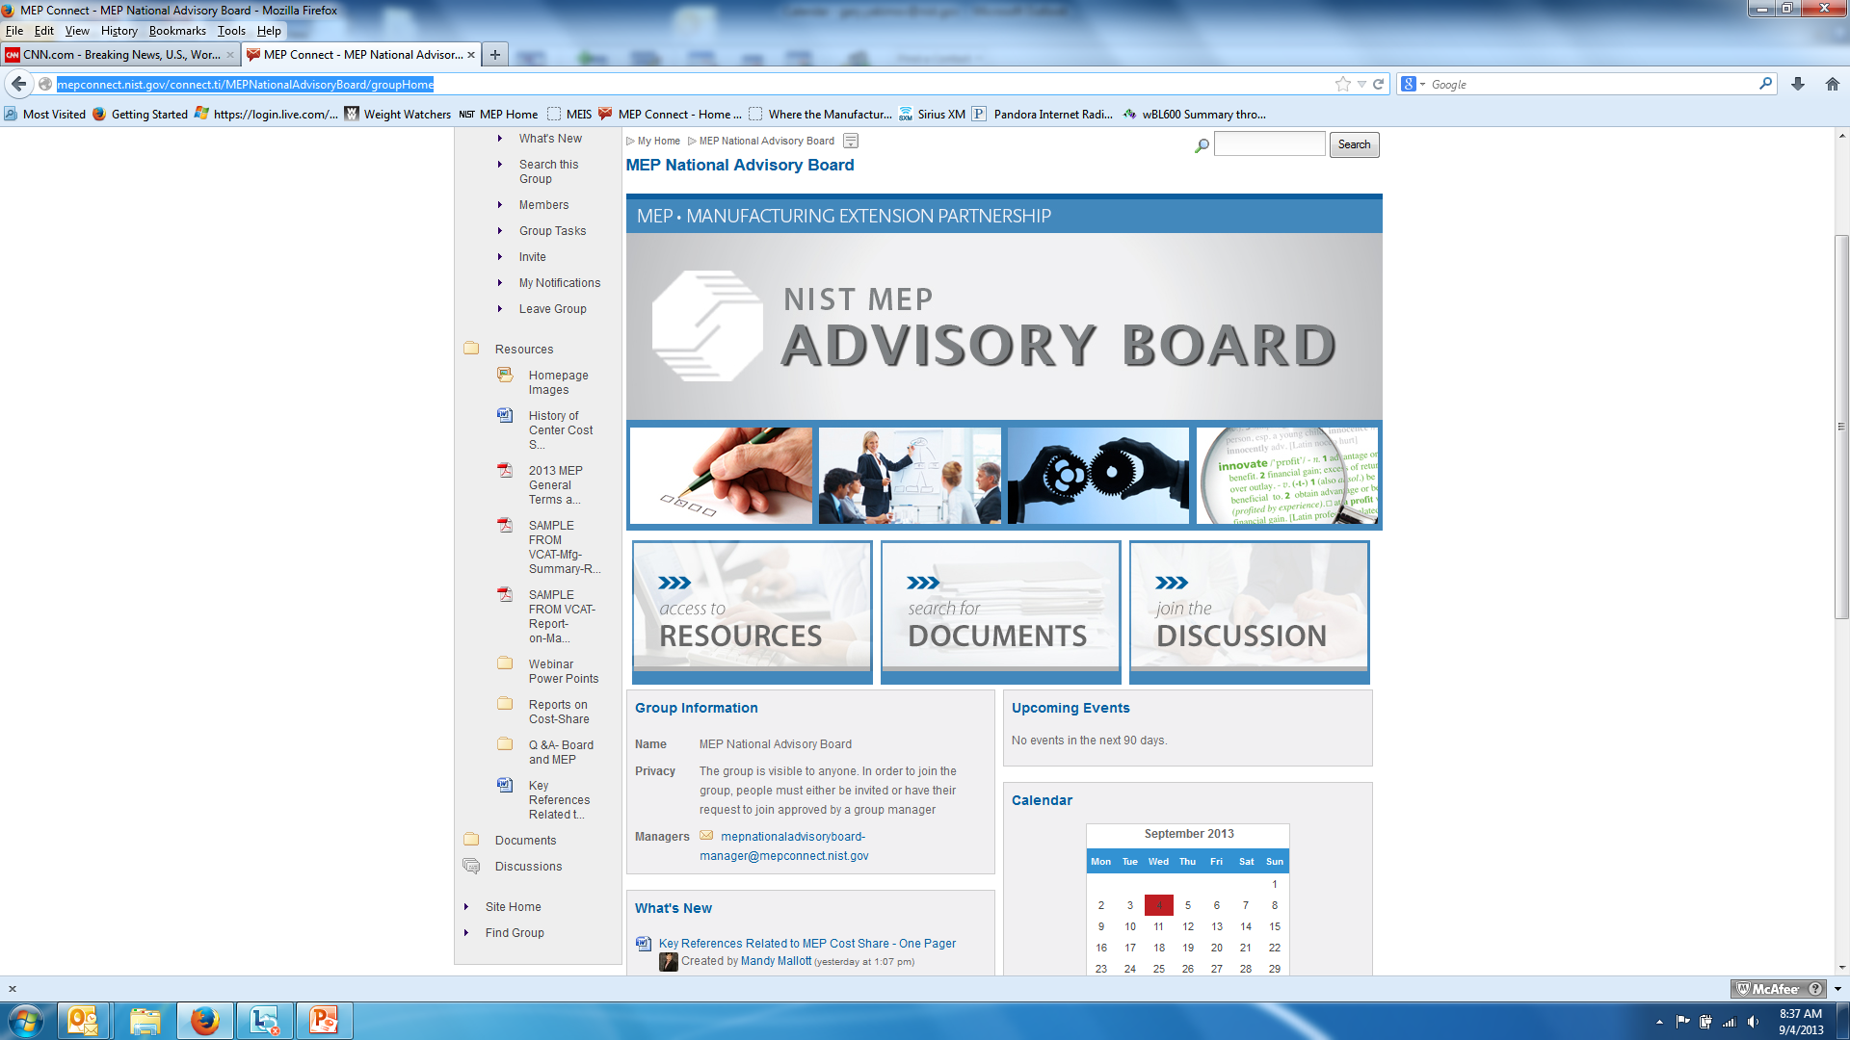
Committee Process
Board Meeting – Receive Charge from NIST Director (June 24, 2013)
Three Sub-Committee Meetings
  Cost Share 101
    July 18, 2013 and July 19, 2013 to accommodate schedules
    All Board members – not just Sub-Committee members – attended at least one of these
  Cost Share and Performance
    August 8, 2013
  Establishing a Position
    September 9 / September 23
Materials available on Connect site (Survey, Letters, etc.)
Today’s Board Meeting
Submission to NIST Director– September 30th

Slide 8
Inputs Considered
Government Accountability Office Report
9 Center Survey
General Web Question
American Small Manufacturers Coalition (ASMC) Surveys
Board Questions – Staff Research for those not answered by resources listed above
Board Sub-Committee consolidated different recommendations into a single list using best judgment
Full recommendations from each source remains available on the Connect site
Notes:
We had a lot of different inputs including the initial GAO Report, as well as three big sources of external feedback (9 Center Survey, General Web Question, ASMC surveys from prior years)
We asked the staff to examine a number of items including performance relative to cost share
Each of these sources can be examined in full, but what we’ve done here today is to synthesize those that helped drive us to our decision

Slide 9
MEP Program Requirements:
Statutory Requirements
TITLE 15 - COMMERCE AND TRADE
CHAPTER 7 - NATIONAL INSTITUTE OF STANDARDS AND TECHNOLOGY
Sec. 278k. Regional Centers for the Transfer of Manufacturing Technology
(c)(2)The objective of the Centers is to enhance productivity and technological performance in United States manufacturing through -
the transfer of manufacturing technology and techniques developed at the Institute to Centers and, through them, to manufacturing companies throughout the United States;
the participation of individuals from industry, universities, State governments, other Federal agencies, and, when appropriate, the Institute in cooperative technology transfer activities;
efforts to make new manufacturing technology and processes usable by United States- based small- and medium-sized companies;
the active dissemination of scientific, engineering, technical, and management information about manufacturing to industrial firms, including small- and medium-sized manufacturing companies; and
the utilization, when appropriate, of the expertise and capability that exists in Federal laboratories other than the Institute.
Notes:
These are the five requirements of the MEP program that are in statute

Slide 10
MEP Cost Share Requirements:
Statutory Requirements
Mandated to be a cost shared program between the federal government and the nonprofit entities serving as centers. [Statute, (c)]
Ratio of federal to center cost share was limited to:
  50% in the first three years of operation and may not be more than 50% at any time [Statute, (c)(3)(B) & (c)(1)]
  40% in year four of operation and 33 1/3% in years five and six. [Rule, 290.4]
Congress established a limit on the amount of federal cost share at 33 1/3%. [Statute, (c)(5)]
In-kind contributions may consist of contributions by full-time and part-time personnel, equipment, software, rental value of centrally located space and other related contributions up to a maximum of one-half of the host’s annual share. [Rule 290.4]
All contributions, including cash and third party in-kind, shall be accepted as part of the recipient’s cost sharing or matching when such contributions meet all of the following criteria are:
  verifiable from records.
  not included as contributions for any other federal program
  necessary and reasonable to accomplish program objectives.
  allowable under the applicable cost principles.
  not paid by another federal award, except where authorized
  provided for in the approved budget. [DOC Rule, 14.23]
Notes:
These are the cost share requirements of the program in statute

Slide 11
History of Cost-Share
Beginning with its creation in 1988, the Hollings Manufacturing Extension Partnership (MEP) program was mandated and designed to be a cost-shared program
The program was to establish a funding profile that reduced the amount of the federal contribution in years four through six of center operation, with a prohibition of any federal funding beyond the sixth year of operation
  In 1990, through rule making, MEP set the limit on the federal contribution to be 40% in year four of operation and 33 1/3% in years five and six.
  NIST MEP developed and provided training to centers on approaches for generating revenue through fees for services provided by the centers to their manufacturing clients.
Operational experience showed that the initial concept of a center becoming financially self sufficient while serving manufacturers, particularly small and medium sized manufacturers was not feasible
In 1998, Congress passed legislation that eliminated the “Sunset” provision and established a limit on the amount of federal cost-share at 33 1/3%.
  This limit was based on the profile established by the program rule and not necessarily on the operational experience of how a center functions.
The current cost-share structure is 15 years old and is based on a funding formula that is 23 years old.
Notes:
There is a long history of cost-share, but nothing more important than the last bullet. We are dealing with a cost share structure that is 15 years old and is based on a funding formula that is 23 years old.

Slide 12
Summary of Key Findings

Slide 13
Summary of Key Findings
Cost share policy is positive, ensuring that beneficiaries of the program participate.
Current cost share requirement impedes the program’s ability to: (a) serve smaller, emerging, and rural clients; (b) develop new innovative services to respond to the changing needs of small and mid-sized manufacturers; and (c) serve as a technology transfer and acceleration mechanism.
Changing the cost share requirements would have numerous beneficial impacts, including more clients served, available cost share for other program investments, etc.
Notes:
Current cost share impedes our ability to most effectively serve the small and medium manufactures and fully reach the market. It further limits the ability to most capably serve as a tech transfer mechanism. Changing the cost share increases the flexibility to respond to these impediments.

Slide 14
Summary of Key Findings, p.2
The current cost-share structure is 15 years old and is based on a funding formula that is 23 years old.
The impact of changing the cost share on the financial size of the program is not possible to precisely determine, however there is no evidence that centers will be less motivated to secure cash resources to fulfill the mission.
Notes:
Again, we are working from a structure that is 15 years old and a funding formula that is 23 years old. The world has changed significantly during that time, including: (a) the tougher economic climate of the last decade, (particularly the last half-decade), (b) the greater global competition to U.S. manufacturers, and (c ) the new focus on innovation.

Slide 15
Summary of Key Findings, p.3
There is broad evidence that state contributions are not driven by cost share requirements but rather by state priorities, economic conditions, and center performance.
There is evidence that reduced cost share requirements would result in centers serving more clients and benefit from reduced burden of managing in-kind cost share.
Notes:
It is important to stress that our evidence suggests that other factors beyond the cost-share requirement drive state contributions to the MEP program. These events include things like new funding opportunities or policy academies that bring the center and state leadership together. In addition, states were investing in programs like these before there ever was an MEP program with cost share requirements.

Slide 16
Cost Share Recommendations

Slide 17
Cost Share Recommendations
There is a need for the program to maintain a cost share policy to maximize the federal investment and encourage the participation of manufacturers:
  Readjust the cost share requirement to 1:1 to provide for the long-term sustainability of the program
  Allow local flexibility in providing in-kind cost share (up to a maximum of one-half of the Recipient’s annual cost share to continue current policy) with clearly defined, well understood, and achievable requirements that facilitate value-added local partnerships
  Optimize program performance through a balanced application of management mechanisms that appropriately includes but is not limited to cost share (e.g. center performance metrics)
Notes:
The most important part of our cost share recommendation is that we believe in cost share as an important part of the program’s effectiveness. You see that reflected in the lead bullet.
Under that guiding belief:
We feel it is very important that manufacturers have “skin in the game” whenever and wherever possible
We propose to reduce the cost share requirement to 1:1 for the long-term sustainability of the program
We propose to maintain in-kind cost share “as is” to maintain flexibility and focus centers on value-added local partnerships and to reflect the diversity among the centers’ governing structures, state legislative requirements, and rapidly changing economic conditions (i.e. we do not want to impose a “one size fits all” approach)
Finally, we believe that it is important that we have a management mechanism to optimize program performance and that right now cost share is the major driver of performance. We want to reward high performing centers including but not limited to cost share

Slide 18
Background Information
Notes:
The following slides provide additional background of the findings that drove us to our recommendation (if needed)

Slide 19
Pros of Current Cost Share Policy
Centers are encouraged to leverage resources and improve partnerships with other organizations
The need to collect client fees gives manufacturers a stake in the program
Centers emphasize services that are relevant to manufacturers
Centers avoid duplication
Cost share represents shared burden of financial investment, e.g. federal government not sole funder
Notes:
Client fees give manufacturers a stake in the program and drive centers toward services that are relevant to manufacturers

Slide 20
Cons of Current Cost Share Requirement
Centers spend more time and effort seeking funds which limits the total time they can dedicate to serving manufacturing clients
Centers have a significant burden/cost to obtain, manage and report on in-kind cost share for their center
Centers shift focus to larger clients who can pay higher fees and multiple projects with repeat clients
Notes:
Free up centers time from “chasing cost share” that is not value add
Allow them more time to build “value-added” partnerships and serve more manufacturing clients

Slide 21
Cons of Current Cost Share Requirement, cont.
Centers focus less on rural clients
Centers are limited in their ability to grow (i.e. only some could handle more funding under current requirements either from NIST or from other federal sources)
Centers are reluctant to invest in new services that do not immediately generate client revenue or impacts
Cost share requirement increases budget uncertainty
Cost share requirement impedes the center’s ability to participate in regional economic activities

Slide 22
Pros of Changing Cost Share
Enables centers to focus on delivering services to manufacturers
Ensures that MEP services remain affordable for the nation’s small and mid-sized manufacturers
Decreases the amount of time spent securing less valuable cost share
Better serve the needs of regional stakeholders
Better respond to the evolving needs of manufacturers
Relieves administrative burden – centers could still maintain in-kind relationships but may not need to report them all
Promotes innovation, technology transfer and acceleration
Notes:
Centers can more actively participate in regional collaborations including innovation, technology transfer and acceleration that may also require cost share that may otherwise have been needed to meet the needs of MEP program

Slide 23
Cons of Changing Cost Share
GAO Position – “Reduced cost share could result in lower resources available for the program because MEP centers could have less incentive to secure nonfederal funds beyond those required to meet the reduced cost share.”
Program Analysis – Performance of program will not be reduced
  Reduction in administrative burden (per previous slides) would result in centers allocating these resources to serve more clients,
  Financial size of program will not be reduced (see next slides)
Notes:
The GAO speculation about funding confuses cost share with match. Centers only get reimbursed when they expend funds – they depend upon cash to run their operations, just the like the small businesses they serve. These are not federal agencies, but independent entities. Cash is king, and centers will have to secure non-federal funds to maximize their activities

Slide 24
Impact of Changing Cost Share on the Financial Size of the MEP Program
9 Center Survey
Centers strongly disagreed that reducing the requirement would result in:
  Less resources / lower total budget for their center
  Lower levels of funding from their stakeholders
  Focusing less on development among other organizations
Centers disagreed that reducing the requirement would result in:
  Reducing the time and effort of securing non-federal funds
General Web Question
Centers could decrease amount of time spent securing less valuable cost share and increase focus on delivering client services; in time project fee revenue could offset any “lost” cost-share from other sources
A reduction in cost-share requirement is cost-neutral for the federal government
Notes:
It is important to note that the 9 centers surveyed were all successful centers, not challenged to obtain match. Their responses to the 52 item questionairre indicated that their rationale for changing the cost share is that it would enable them to better fulfill their mission.
Centers strongly agreed that the cost-share requirement results in their centers spending more time and effort seeking matching funds. Centers also agreed that they are spending more time and effort developing financial strategies to respond to the cost-share requirement and centers reported that there is a significant burden/cost to obtain, manage, and report on in-kind cost share for their center.
Centers strongly disagreed with the statement that reducing the cost-share requirement would result in less resources/lower total budget for their center. Moreover, centers strongly disagreed that reducing the cost-share requirement would results in lower levels of funding from their stakeholders or would result in them focusing less on development among other organizations.
Centers disagreed that if the cost-share requirement was reduced they would spend less time and effort securing non-federal funds.
However, centers agreed that if the cost-share requirement was reduced, they would be in a better position to achieve their goals; they would spend more time and effort delivering services to manufacturers, they would increase the number of manufacturers served as well as responding more effectively to the evolving needs of manufacturers. In addition, they agreed that if the cost-share requirement was lowered, they would better serve their regional stakeholders.

Slide 25
Impact of Changing Cost Share on the Financial Size of the MEP Program, cont.
NIST Competition Analysis:
NIST competitions in 2010 (“e-CAR” and “t-CAR”) and multi-agency awards in 2012 (“Jobs Accelerator”) and 2013 (“Make it in America”) indicate that MEP centers and their partners are willing to provide the financial resources required to co-invest in the federal funding opportunities when these opportunities align with the goals of their regional economic systems, strategies, and priorities.
Reduction of programmatic cost share requirement facilitates the potential use of unallocated cost share for pursuit of other federal funding opportunities to support state and regional economic development systems, strategies, and priorities (e.g. startup firms, R&D and technology-driven firms, disadvantaged firms, etc.)

Slide 26
Approach of States to MEP Program Funding
There are multiple states that created and invested in manufacturing extension services BEFORE Congress authorized and appropriated federal funds for the NIST MEP network of centers in the late 1980s and 1990s. In fact, the model for the current NIST MEP centers evolved from the state-funded extension services that pre-dated federal funding. The state-funded extension centers ultimately were absorbed into the NIST MEP network of centers that included federal funding.
Surveys and web responses indicated that there are many drivers to state investment other than the cost share requirement. Important factors that seem to exert more influence on state investment decisions include:
Perceived alignment of the MEP center with the Governor's policy priorities and strategies in economic development
the state's overall budget climate / budget situation
the MEP center's reputation and quality performance
the political savvy of the MEP center in engaging and educating state stakeholders
“Precipitating event” that brings together state officials and MEP centers
Notes:
States already invested in industrial extension before MEP program existed
Center’s performance, alignment with Governor’s policies and priorities, and overall budget climate in the state are primary drivers of state investment in the program

Slide 27
Approach of States to MEP Program Funding, cont.
A “precipitating event” has a high degree of importance to in general either: 1) enable the state to "rediscover" the potential contribution of the MEP center, 2) enable the state and center to re-align around shared objectives, and/or 3) enable the state to re-shape its relationship with MEP center in some important way. Some examples of recent precipitating events include:
The center has been recently re-competed;
The center has recently collaborated with other organizations and the state in a multi-agency competition (e.g., Jobs Accelerator, Make it in America, Investing in Manufacturing Communities Partnership, etc.);
The center was involved as part of the team for one of the eight participating states in the NGA Policy Academy in 2011-12.
Notes:
Note the importance off a precipitating event in bringing center and state into closer alignment and partnership

Slide 28
Which of the following factors determines the level of cost-share funding your center receives from stakeholders?
Factor | % Yes | % No | % Not Sure | % Not applicable
Performance/impact of your center | 100.0 | 0 | 0 | 0
Importance of manufacturing to your local area | 88.9 | 11.1 | 0 | 0
Stakeholder Priorities | 77.8 | 11.1 | 0 | 11.1
Strategic goals of your center | 66.7 | 22.2 | 11.1 | 0
Market Size | 33.3 | 33.3 | 11.1 | 22.2
Cost-share requirement | 33.3 | 55.6 | 0 | 11.1
Source: 9 Center Survey
Notes:
The cost share requirement was the least likely factor in determining the level of cost share funding the center receives from stakeholders (from 9 center survey)
Most likely factors were performance of center and importance of manufacturing in the local area as well as stakeholder priorities

Slide 29
Role of In-Kind Cost Share in the MEP Program
OIG Audit Findings
Across 6 centers audits found a lack of compliance with federal government accountability requirements including inadequate financial management systems, and expense reporting and management by centers and sub-recipients, among numerous other findings.
Program Analysis
It appears that the stringent 2:1 requirement has encouraged some centers to seek financial arrangements with partner organizations which have resulted in audit findings with adverse programmatic and financial impacts on the centers and on the overall program. In order to ensure the highest fiduciary standards, encourage value-added partnerships, and reduce administrative burden, greater clarity in the definition and application of in-kind contributions is required.
Notes:
Pursuit of cost share has led centers to seek financial arrangements that have resulted in audit findings.
Pursuit of value-added partnerships is likely to result in higher fiduciary standards

Slide 30
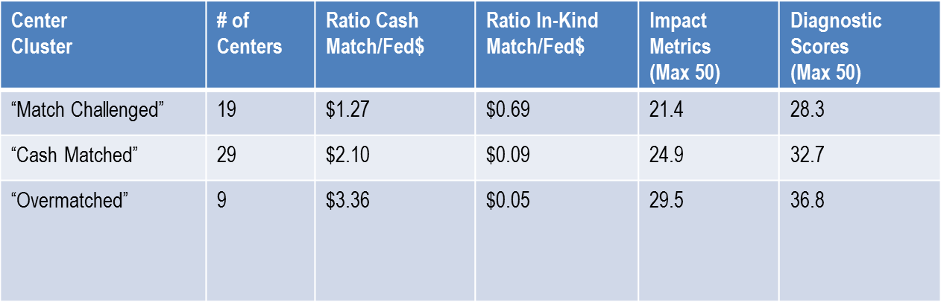
Role of In-Kind Cost Share in the MEP Program: Performance
Reliance on cash match funding is positively related to performance while reliance on in-kind match is negatively related to performance
Centers that rely more on cash perform better on the client survey and NIST assessment
Notes:
Centers who are “cash match challenged” perform less well in both impact metrics (client impact survey questions) as well as diagnostic scores (NIST MEP staff evaluation of behaviors we look for centers to exhibit)

Slide 31
Analysis of center’s current ability (based on FY 2011-2012 actual budget) to meet 1:1 cost share using all forms of cash is:
Using all forms of cash:
  48 centers could meet 1:1 cost share using all forms of cash
  Of the 12 centers that do not meet 1:1 cash-only cost share in current environment:
    7 were not fully operational during the FY 11-12 year
    Of the other 5, 2 have not yet submitted a new operating plan where the data is being drawn from (and thus may actually quality at 1:1 if we had their data)
  23 centers in FY 11-12 exceed 2.00 or higher, meaning they are meeting current cost share requirements of 2:1 with cash
Using cash from program income and state and local:
  44 centers could meet 1:1 cost share
  16 centers could meet 2:1 cost share
Using cash from just program income:
  25 centers could meet 1:1 cost share
  3 centers could meet 2:1 cost share
Notes:
The system is largely able to respond to 1:1 cash match right now. 48 can do it using all cash. Of the 12 that couldn’t, 7 weren’t fully active during the period studied.
Even using only program income cash, 25 centers could make it.

Slide 32
Next Steps
Vote on Sub-Committee Proposal (Next Slide)
Submit final recommendation by September 30, 2013

Slide 33
Hollings MEP National Advisory Board
Cost Share Recommendations
The objective of the program is to enhance productivity and technological performance in United States manufacturing. The cost share policy supports the mission of the program and its statutory requirements.
In order to optimize the federal investment and provide for the long-term sustainability of the program the National Advisory Board recommends:
  Readjusting the cost share requirement to 1:1.
  Demonstrating an appropriate and balanced industry investment.
  Allowing local flexibility in providing in-kind cost share (not to exceed one-half of the Recipient’s annual cost share) with:
    Clearly defined, well understood, and achievable criteria.
    Direct and measurable impacts consistent with program performance and evaluation.
  Maximizing program performance through a balanced application of evaluation mechanisms that appropriately include but are not limited to cost share (e.g. center performance metrics.)
  Implement the cost share recommendations in conjunction with an inclusive strategic planning process and a comprehensive review of system and center performance.
Notes:
The most important part of our cost share recommendation is that we believe in cost share as an important part of the program’s effectiveness. You see that reflected in the lead bullet.
Under that guiding belief:
We feel it is very important that manufacturers have “skin in the game” whenever and wherever possible
We propose to reduce the cost share requirement to 1:1 for the long-term sustainability of the program
We propose to maintain in-kind cost share “as is” to maintain flexibility and focus centers on value-added local partnerships and to reflect the diversity among the centers’ governing structures, state legislative requirements, and rapidly changing economic conditions (i.e. we do not want to impose a “one size fits all” approach)
Finally, we believe that it is important that we have a management mechanism to optimize program performance and that right now cost share is the major driver of performance. We want to reward high performing centers including but not limited to cost share

