Slide 1
Advancement in Bioanalytical Techniques to improve Cell Therapy Product Quantification
Heba Degheidy, MD, PhD, RAC
Division of Cellular and Gene Therapies
Office of Tissues and Advanced Therapies
Center for Biologics Evaluation and Research
U.S. Food and Drug Administration
November 18, 2021

Slide 2
FDA Organization
CBER (Center for Biologics Evaluation and Research): vaccines, blood and blood products, human tissue/tissue products for transplantation, cells, gene therapy
  Office of Tissues and Advanced Therapies (OTAT)
  (formerly Office of Cellular, Tissue, and Gene Therapies)
  Office of Vaccines Research and Review
  Office of Blood Research and Review
CDER (Center for Drug Evaluation and Research): drugs, some biological products
CDRH (Center for Devices and Radiological Health): devices for treatment, implants, diagnostic devices
CFSAN (Center for Food Safety and Applied Nutrition)
CTP (Center for Tobacco Products)
CVM (Center for Veterinary Medicine)
NCTR (National Center for Toxicological Research)
OC (Office of the Commissioner)
ORA (Office of Regulatory Affairs)

Slide 3
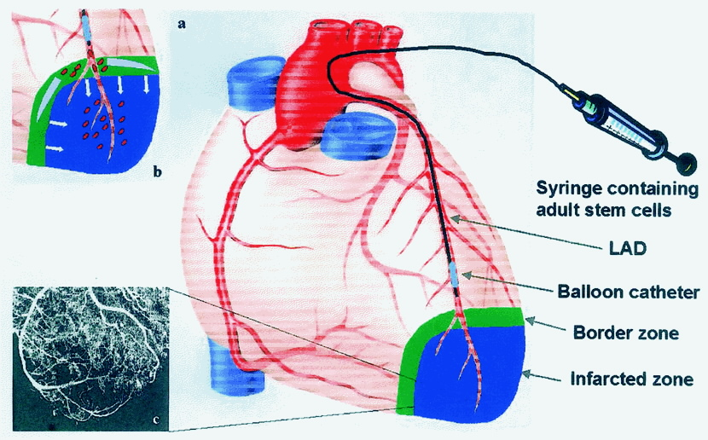
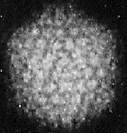
OTAT Products
  Cellular Therapies
  Cancer Vaccines and Immunotherapy
  Gene Therapies
  Xenotransplantation Products
  Tissues and Tissue-Based Products
  Combination Products
  Devices Used for Cells and Tissues

Slide 4
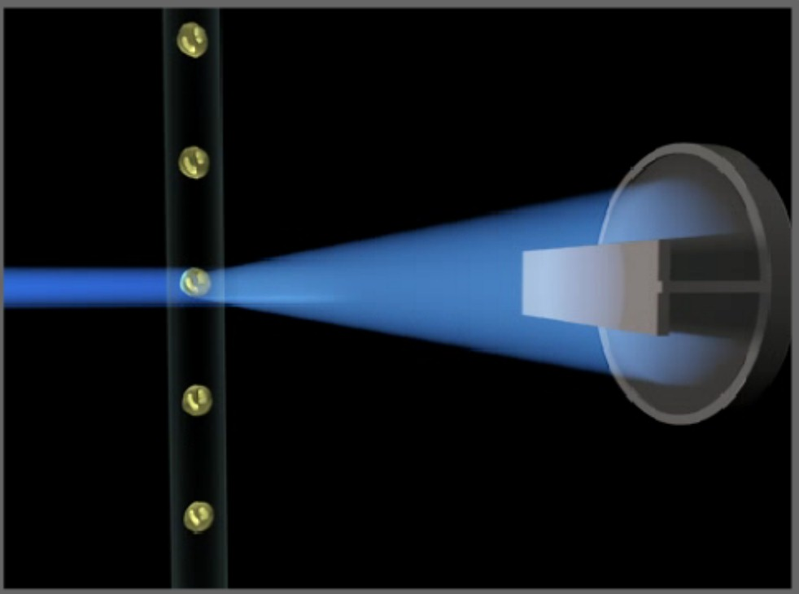
Flow Cytometry in Biologics
Product Quality
Viability
Safety
Potency
Identity
Purity
Stability
Cell Count

Slide 5
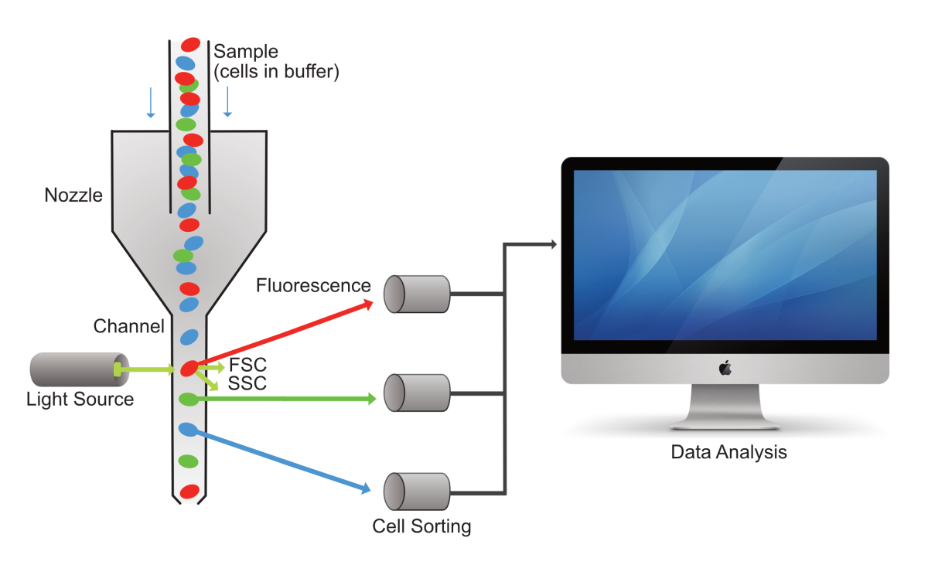
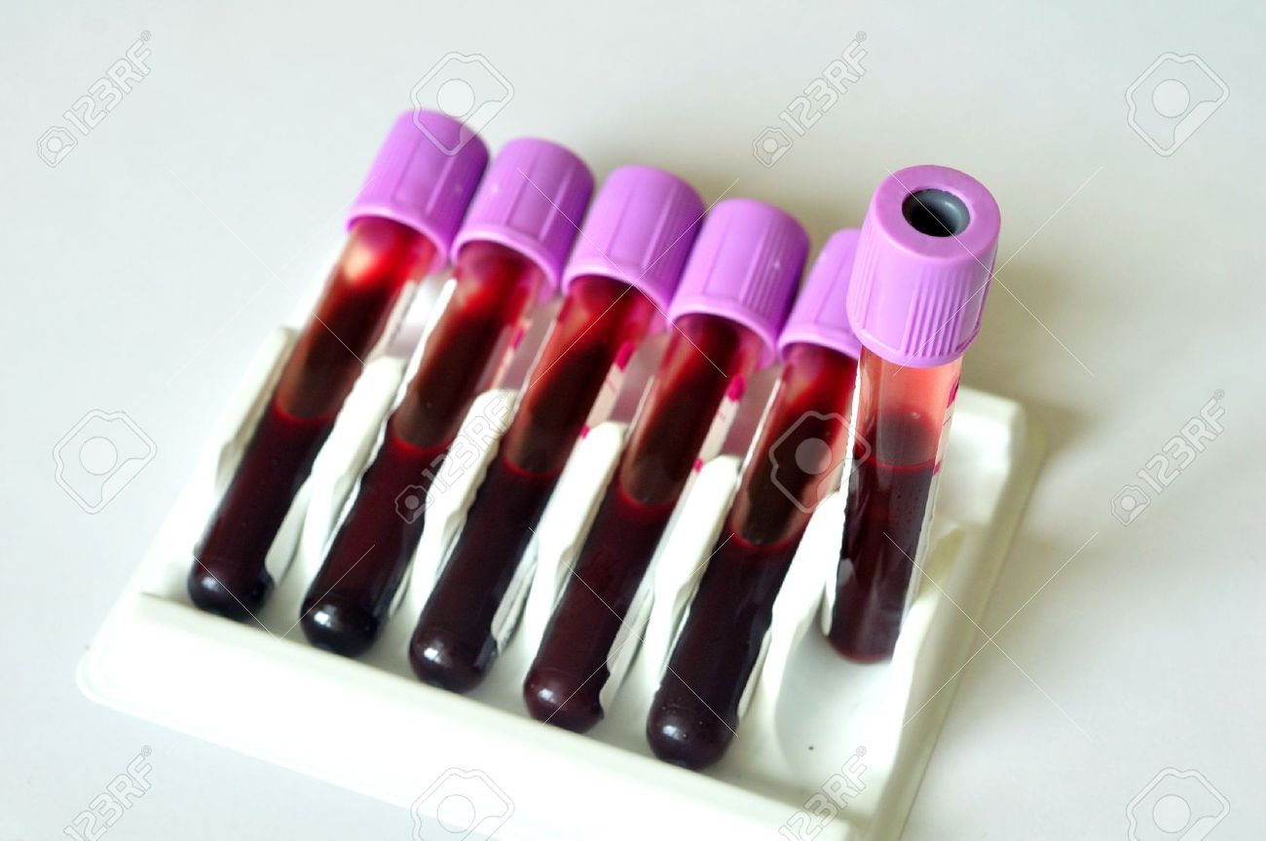
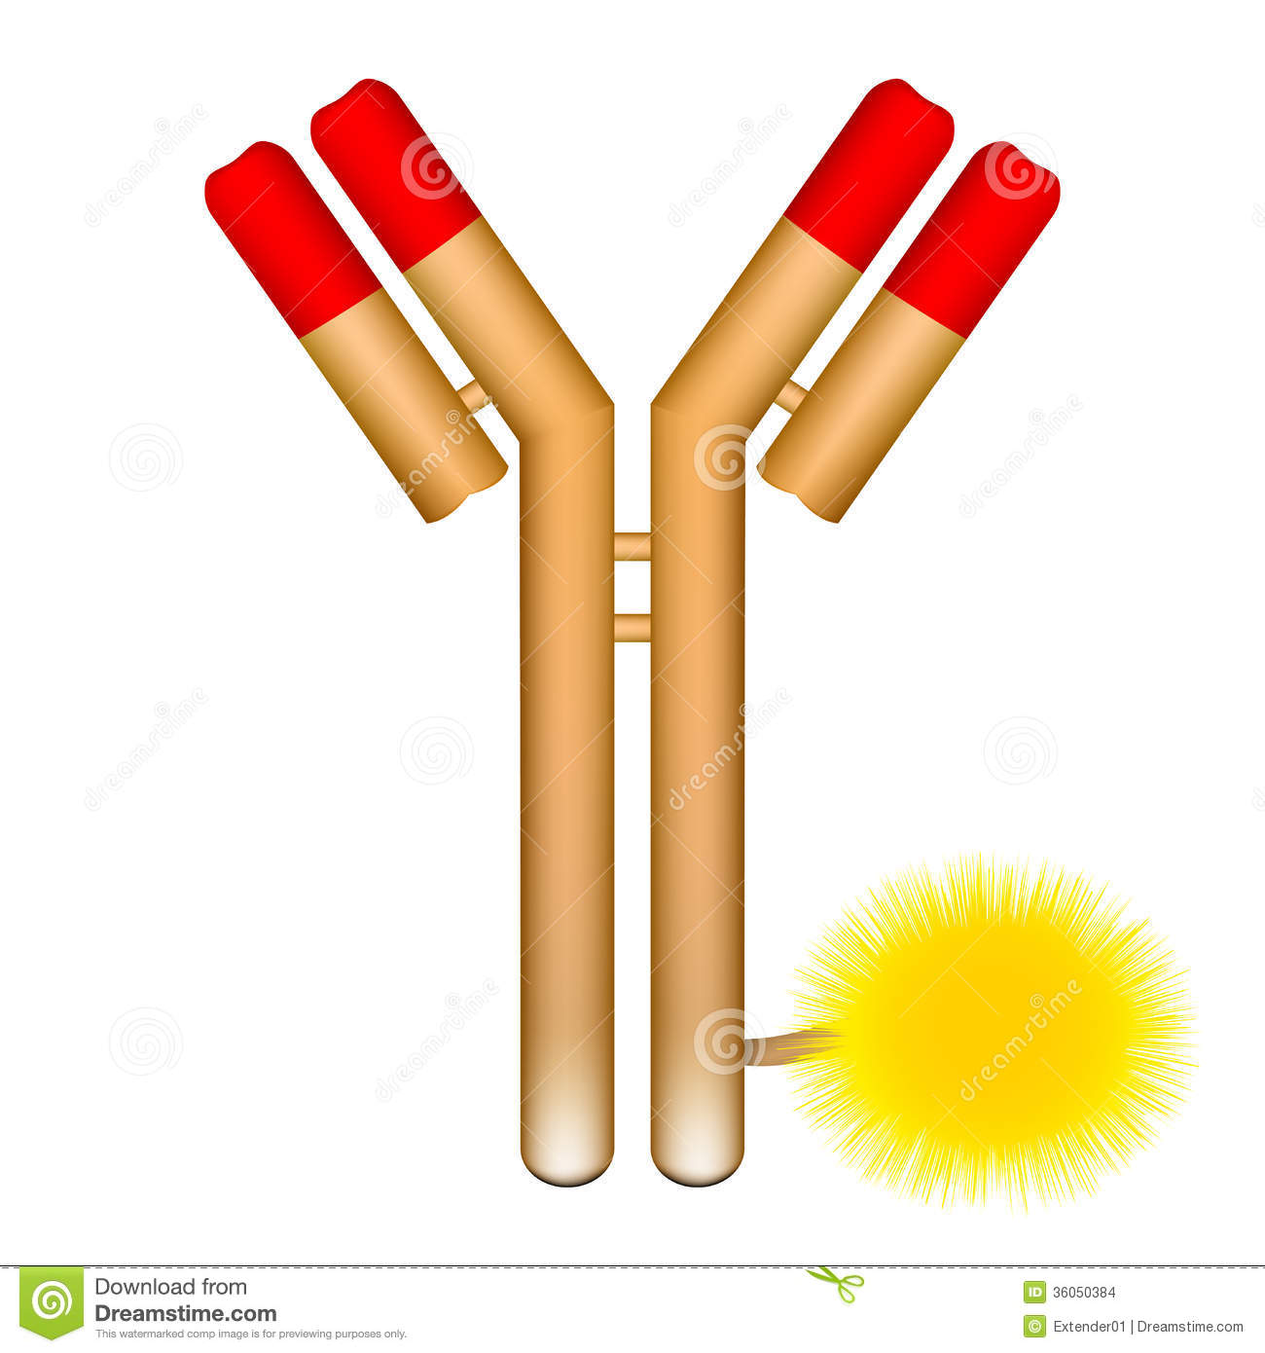
Flow cytometry Assay
Assay: Entire test system from sample collection, preparation, test results
Flow Cytometer
Clinical Sample
Assay Reagent
Antibody Titration
Antibody Cocktail Stability
Staining Protocol
Stained Sample Stability
Controls
Gating Strategy
Results/Reporting
Specimen matrix
Fresh vs. Cryopreserved
Anticoagulant(s)
Specimen Stability
Installation Qualification
Operational Qualification
Performance Qualification
Instrument Calibration

Slide 6
Sources of Uncertainty
Pre acquisition
Acquisition
Post acquisition
Samples
Antibody
Instrument
Controls
Gating Strategy
Staining Protocol
Quality Control
Procedure
Data analysis

Slide 7
Sources of Uncertainty
Pre acquisition
Acquisition
Post acquisition
Sample handling
Antibody reagent
  Stability
  Clone
  Lot
  Fluorochrome
  Affinity
Staining procedure
  Incubation time
  Volume
  Fixation
Data interpretation
Instrument calibration
Maintenance
Number of cells acquired
Controls
Standardization procedure
Operators
Gating strategy
Data interpretation must be carefully defined during validation plan design
Reference standard
% positive vs. ABC

Slide 8
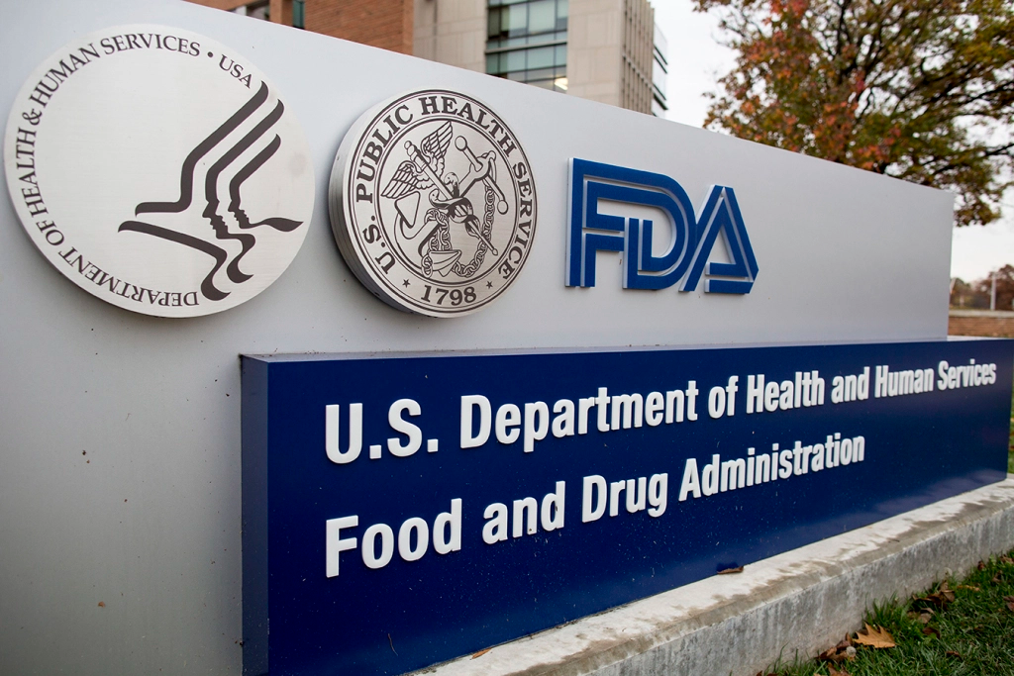
Contact Information
Heba Degheidy, MD, PhD.
Heba.Degheidy@FDA.HHS.GOV
Regulatory Questions:
OTAT Main Line – 240 402 8190
Email: OTATRPMS@fda.hhs.gov and
Lori.Tull@fda.hhs.gov
CBER website: www.fda.gov/BiologicsBloodVaccines/default.htm
Phone: 1-800-835-4709 or 240-402-8010
Consumer Affairs Branch: ocod@fda.hhs.gov
Manufacturers Assistance and Technical Training Branch: industry.biologics@fda.gov
Follow us on Twitter: https://www.twitter.com/fdacber

Slide 9

Thank you

