Slide 1

NIST ABACUS
Chemical Analysis Package
https://abacus.nist.gov/
Michael A. Nelson¹, Blaza Toman², and Lane C. Sander¹
Chemical Sciences Division¹
Statistical Engineering Division²
Material Measurement Laboratory
National Institute of Standards and Technology
Toman, B., Nelson, M. A., & Bedner, M. (2017). Rigorous evaluation of chemical measurement uncertainty: liquid chromatographic analysis methods using detector response factor calibration. Metrologia, 54(3), S16.
https://doi.org/10.1088/1681-7575/aa6404
Toman, B., Nelson, M., & Ma, Y. (2020). Optimizing experiment design for chemical measurement. Metrologia, 57(6), 064003
https://doi.org/10.1088/1681-7575/abb531
Contribution of the National Institute of Standards and Technology. Not subject to copyright. Certain commercial equipment, instruments, or materials are identified to specify adequately the experimental procedure. Such identification does not imply recommendation or endorsement by the National Institute of Standards and Technology, nor does it imply that the materials or equipment identified are the best available for the purpose.
Notes:
The NIST ABACUS application was developed to provide statistical guidance throughout a measurement process. Automated computational procedures can be implemented entirely by analysts to help them plan efficient, effective measurement experiments and conduct rigorous data analyses. This presentation provides instruction in the use of ABACUS, a computational tool developed by the Chemical Sciences Division and the Statistical Engineering Division based on statistical models described in the references listed. The App was designed to assist in the assignment of measurand levels and associated uncertainties as determined from a measurement procedure based on calibration with internal standards, although the tool applies equally well to external standard quantitation. ABACUS consists of separate modules that can be used independently or in combination to achieve these goals, and can accommodate measurement models that are based on equations for either the usual linear regression, or on averaged response factors. This presentation will demonstrate the use of these modules for a sample data set.

Slide 2
Scope and Applications
General comments:
  Single analyte / single level / single material
  Multiple samples / replicate analyses
  Linear regression or averaged response factor models
  Internal or external calibration
  Standard: pure substance or stock solution used to prepare calibrants
  Calibrant: a solution containing the analyte and internal standard, with a known concentration
  Multiple data sets, from a different series of experiments or from a different measurement procedure altogether, can be used for the calculation of the measurand concentration
Notes:
A few general comments can be made concerning the scope of ABACUS.
ABACUS applies to the estimation of a measurand level and an associated uncertainty for a single analyte at a single level in a single material.
Multiple samples of this material, and replicate analyses are employed to determine the level and uncertainty of the analyte.
In the current implementation, ABACUS can be used with linear regression or averaged response factor models, and internal standard or external standard calibration approaches.
Calibration is performed with one or more calibrants with known concentrations
The terms standard and calibrant are used to describe materials used in calibration.
“Standard” refers to either a pure substance or a stock solution with known concentration.
“Calibrant” refers to a solution prepared from the standard and internal standard solutions, with a known analyte concentration.
Finally, multiple data sets from a different series of experiments or from a different measurement procedure altogether, can be used for the calculation of the measurand concentration

Slide 3
The Modules
NIST ABACUS
“Pre-Experiment”
  Preliminary calibration to guide the experimental design
  Option to jump to “Design of Experiment”
Pre-Experiment
Background
Data entry
“Design of Experiment”
  Input variables from pre-experiment or expert judgement
  Model provides number of calibrants and samples needed to achieve a specified uncertainty
Design of Experiment
Background
Data entry
Analysis
“Analysis”
  Measurand level and uncertainty is reported for the specified calibrant and sample data
Background
Data entry
Notes:
Each of the modules can be used separately or in combination. The order is intended to provide a logical flow if all of the modules are used throughout the measurement process.
The Pre-experiment module provides a preliminary determination of the measurand level and associated uncertainty, based on exploratory data about the samples and intended approach to calibration. This information can then be used to optimize the experimental design to achieve a specified measurement uncertainty. A dialog box can be checked to run the design of experiment code without stopping the pre-experiment module and starting the design of experiment module separately.
The design of experiment module uses preliminary estimates of calibration characteristics obtained from the pre-experiment module or from expert judgement. Based on the number of available measurements (which is defined as the number of calibrants x the replicate number + the number of unknowns x the replicate number), the module provides the optimum number and levels of analyte in the calibrants that must be prepared, and the number of unknowns that must be analyzed to achieve the target uncertainty. If the target uncertainty cannot be achieved with these constraints, the estimated minimum uncertainty will be reported.
The analysis module uses all of the calibrant and unknown sample data to calculate the measurement result using a hierarchical Bayesian model. Data from calibrations performed on separate days or by different methods can be utilized in this application.

Slide 4


Slide 5
Pre-Experiment Module: Example
  3 Standards
  1 Internal Standard
  6 Calibrants
  1 Sample Material
  1 Internal Standard
  6 Samples
Standards
Internal
Sample
Internal
Standard
Material
Standard
  Day 1
Calibrants
Samples
Standards
Internal
Sample
Internal
Standard
Material
Standard
  Day 2
Calibrants
Samples
Notes:
Let’s start with a practical example to demonstrate the Pre-Experiment module.
In this example, three solutions are gravimetrically prepared with known measurand levels – these solutions are referred to as standards.
A fourth solution is prepared that contains the labeled internal standard.
Aliquots of the standards are combined with aliquots of the internal standard solution to produce six calibrants.
Six subsamples of the sample source material are combined with
aliquots of the internal standard solution
to produce the samples to be analyzed.
In this example, independently prepared samples are analyzed on each of two days (12 samples total) using separately prepared calibrants (12 calibrants total).
Let’s see how the data for the standards, calibrants, and samples are entered into ABACUS.

Slide 6
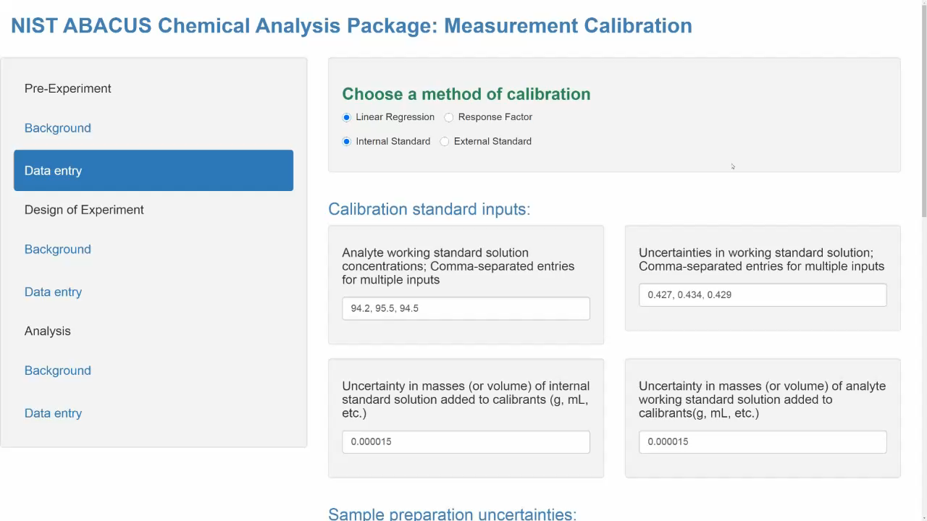
Notes:
At the top of the data entry screen, selections are indicated for the calibration model. The selection “Linear regression” fits the data to a y = mx + b model, to minimize residual errors without constraining the slope or the intercept. The selection “Response factor” assumes an y = mx model, and it averages the response factors calculated individually for each calibrant. Additionally, calibration can be based on the use of an internal standard, or an external standardization approach can be specified. Model selection should be based on knowledge of blank level response, range of calibration, and linearity of response.
Four boxes or fields are shown for entry of data related to the standard solutions. Data examples are provided in each of the fields; these values are replaced when new data is entered. In the first field, concentrations of the standards are entered, separated by commas. Since three standards were utilized, three values are entered. By convention, the first value entered corresponds to standard #1, the second, standard #2, and so on. Consistent units are used throughout the application. So, for example, if the levels of the standard are specified in units of micrograms / gram, uncertainties are specified in the same units.
In the top right-hand field, uncertainty estimates are entered for the concentration of each standard, corresponding to the entries in the previous field. These entries can be thought of as combined absolute standard uncertainties based on all available evidence. The estimate of the standard uncertainty for these inputs should be based on the standard deviation of repeat observations, balance uncertainties, volumetric glassware specifications, expertise, and any other evidence or reasonable estimates.
In the next field at the left, the estimated standard uncertainty is entered for the amount of the internal standard used to prepare the calibrants. A single value is entered here since it is assumed that the same uncertainty applies to the preparation of each calibrant. Information about the calibrants and samples are entered through data tables, which will be described in forthcoming examples.
In the field to the right, the estimated standard uncertainty is entered for the amount of the standards used to prepare the calibrants. Again, only a single value is needed to represent the uncertainty estimate for all of the calibrants.
Finally, two data entry fields are shown for data related to the preparation of the samples. These fields mirror the uncertainty estimates for the calibrants; namely, the uncertainty related to the addition of the internal standard, and the uncertainty related to the quantity of the sample.
Scrolling down on the screen, we can skip most of the fields in the section entitled MCMC Modeling Setting. The default values listed are appropriate for most data, and they can be adjusted if needed after initial data modeling.
Most of the input data for the calibrants and samples is supplied in data tables. Examples of the data tables can be downloaded from the application. Let’s look at a sample table for calibration data.

Slide 7
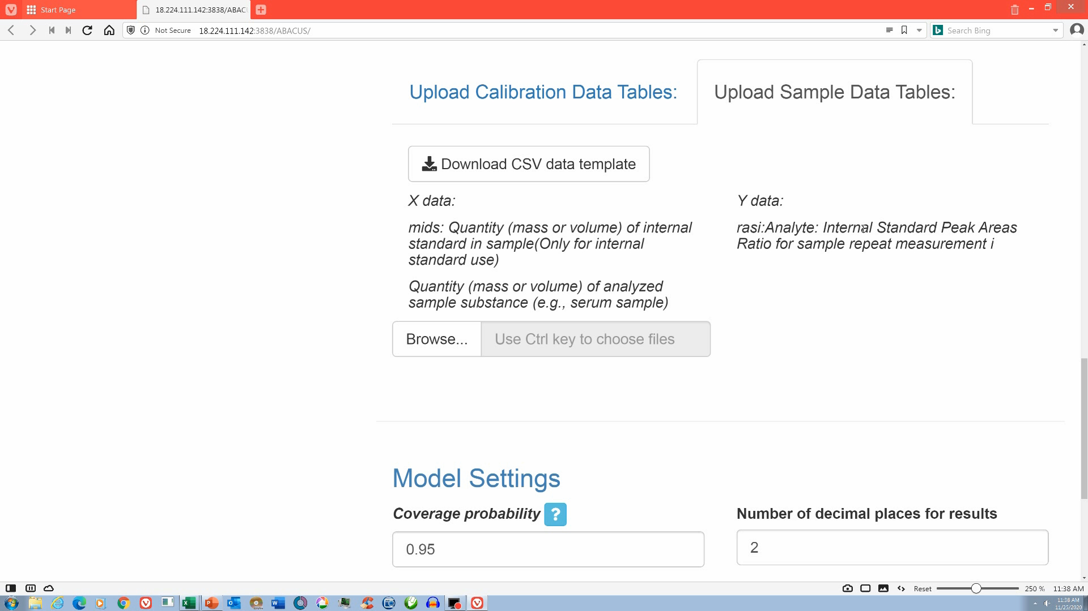
Calibration Data Tables
Notes:
Download the data template and add data that corresponds to the calibrants. Data have been copied to the clipboard from another worksheet, and are pasted onto the template. In our example, six calibrants were prepared from three standard solutions. In the corresponding calibration data table, calibrants are represented by rows of data. Columns specify the quantities of standard solutions used to prepare the calibrants, and relative instrumental responses for the measurand. Each of the headings have comments that describe the nature of the data that is to be provided. These comments can be read by hovering the mouse pointer over the cell containing the comment.
The column labeled “mid” is the quantity in units of mass or volume of the internal standard in the calibrant. If the external standard approach to quantitation is to be employed, this column is left blank.
The column labeled “mad” is the quantity of the standard solution used to prepare the calibrant.
The next column “wsol” identifies which standard was used in the preparation of the calibrant. In this example, three standard solutions numbered 1, 2, and 3 were each utilized twice by aliquoting different quantities of the standard.
Relative instrumental responses are listed in the columns labeled “rac1”, “rac2”, and so on. Each calibrant was measured twice and thus two Y-data columns are entered. Repeat analyses of each calibrant are represented by additional y-data columns which can be appended to the table. For example, if each of the calibrants were measured three times, data for the third replicate would be appended in column F. It is important to begin by adding the heading “rac3”, and then by adding the data for each of the calibrants.
Once the data table is completed in Excel, the file must be saved in the CSV format. In Excel, select the feature “save as”, and then select the file type as “CSV (comma delimited)”.
This takes care of the calibration; now let’s consider the sample data table.

Slide 8
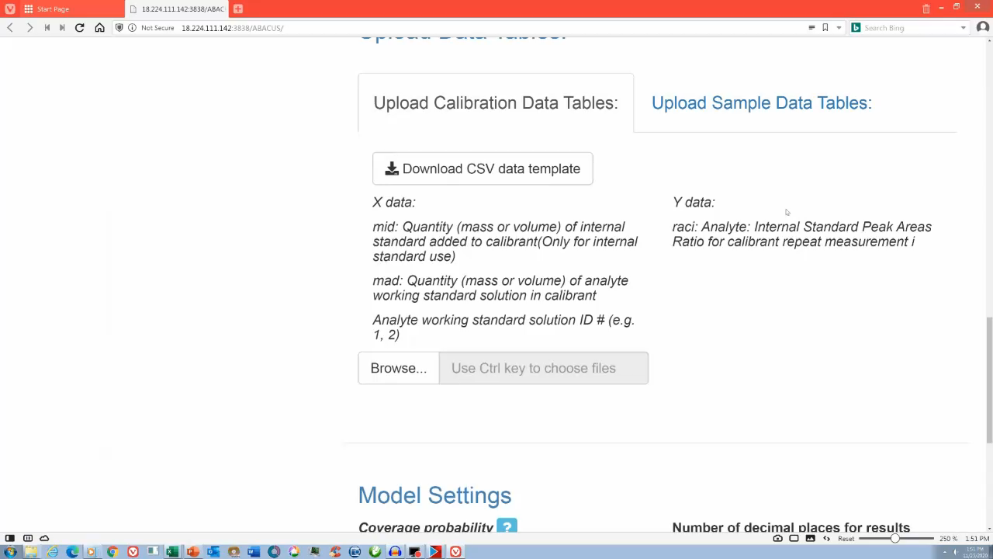
Sample Data Table
Notes:
The sample data table is analogous to the calibration data table. As with the calibration data table, download the sample data template. Be careful to select the “sample data tables” portion of the data tables screen prior to clicking on the “Download CSV data template” button to download the template corresponding to samples. Each of the column headings are commented to describe the type of data to be included in the column.
Column A labeled “mids” is the quantity of the internal standard solution that was combined with the sample substance. If the external standard approach to quantitation is to be employed, this column can be left blank.
Column B labeled “mdi” is the quantity of the sample substance combined with the internal standard.
Columns C and D identified as “ras1” and “ras2” represent replicate analyses of the same vial.
As with the example shown for the calibration data table, to append additional replicate analyses of a given sample vial, begin with the header for the appended column. Data for a third replicate analysis should be labeled “ras3”. The replicate sample analyses can then be added to the column.
Once the sample table is completed in Excel, save the file in the CSV format.
An example showing the upload of these files will be demonstrated next.

Slide 9

Notes:
Data table upload fields are located near the bottom of the data entry screen. Begin with the tab labeled “Upload Calibration Data Tables”. Select the “browse” button, and navigate to the location of the calibration table or tables. Select the table and select “open”. If more than one calibration table is to be used, select the tables by depressing the ctrl key while clicking on each table file. Repeat this process for the samples by selecting the “Upload Sample Data Tables” tab. Be sure to select the sample table files in the same order as the corresponding calibration table files so that the data for the “unknowns” are matched with the proper calibration.
After uploading the tables, compare the calibration and sample data provided onscreen to verify that the table associations are correct.
Next, check the box labeled “Run the experiment design module and specify the parameters” to jump to the design application code. Information obtained from the pre-experiment module will be automatically transferred. Leave the box unchecked if only the preliminary calibration data and analysis outputs are needed. Enter the total number of available samples (that is, calibrants + unknowns), the target standard uncertainty, and the expected minimum and maximum standard uncertainties for the calibrant concentration ratios.
At this point, sufficient information has been provided to run the model – simply click the button “Fit the model”. The application should display ‘running Bayes’ at the upper right portion of the screen to indicate that the application is performing the calculations. Modeling of the data usually takes about a minute. After the computations are complete, summary statistics and plots are provided at the bottom of the screen as indicated in the next slide.

Slide 10
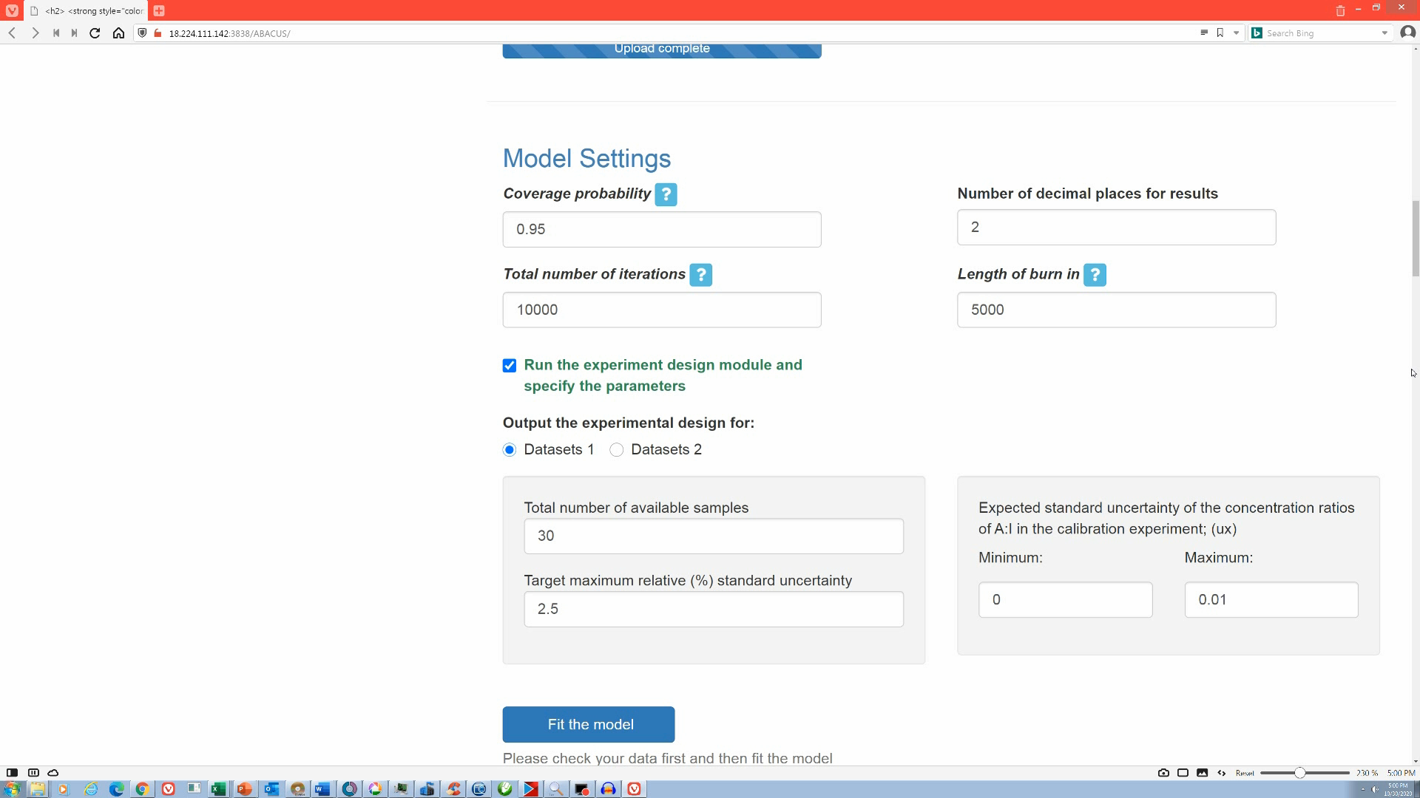
Notes:
After the Bayesian analysis is completed, Model Results are displayed that include the Experiment Design Results, and the Bayesian Posterior Estimates. The Experiment Design results include the number and concentrations of the calibrants recommended, the number of unknown samples that should be analyzed, and the relative uncertainty in percent that will be realized. After the Experiment Design results, summary statistics, calibration plots, and other descriptive information related to the preliminary calibration is presented. The Model Results include the posterior mean, standard uncertainty, posterior median, and credible interval ranges. Calibration plots are also provided. In this example, separate calibrations were performed on different days, so calibration plot 1 is for day 1, and calibration plot 2 is for day 2. These calibration plots correspond to the separate calibration tables that were uploaded. The y axis represents the response ratios for calibrants, and the x axis represents the concentration ratios of the calibrants. The red and green data points provide a distinction between replicate calibrant sets prepared with the three standard solutions, whereas replicate analysis of the same calibrant vial are indicated by separate points plotted at the same x-axis concentration. Numerical values are also provided for these plots; namely, the R squared value, the mean intercept, and the mean slope. Also shown is the posterior distribution, which shows how the data were modeled by Bayesian statistics. The posterior distribution is a representation of our knowledge of the measurand after the experiment. The plot shows the probability distribution across a range of values that likely contains the true value of the measurand.

Slide 11
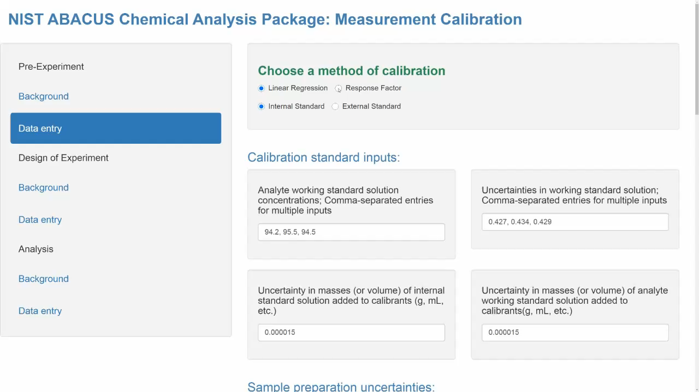
Notes:
The same data can be fit to an averaged response factor model. Select the type of model at the top of the page, either before or after entering data. In this example, the model selection will be changed after initial analysis with the linear regression model. After initiating “Fit the model” and the Bayesian analysis is completed, the Model results are displayed.
Similar summary statistics are displayed for the averaged response factor model, such as the posterior mean, standard uncertainty, posterior median, and 95% credible interval range. The calibration plots are qualitatively similar; however, for the averaged response factor model, the calibration line necessarily passes through the origin.

Slide 12
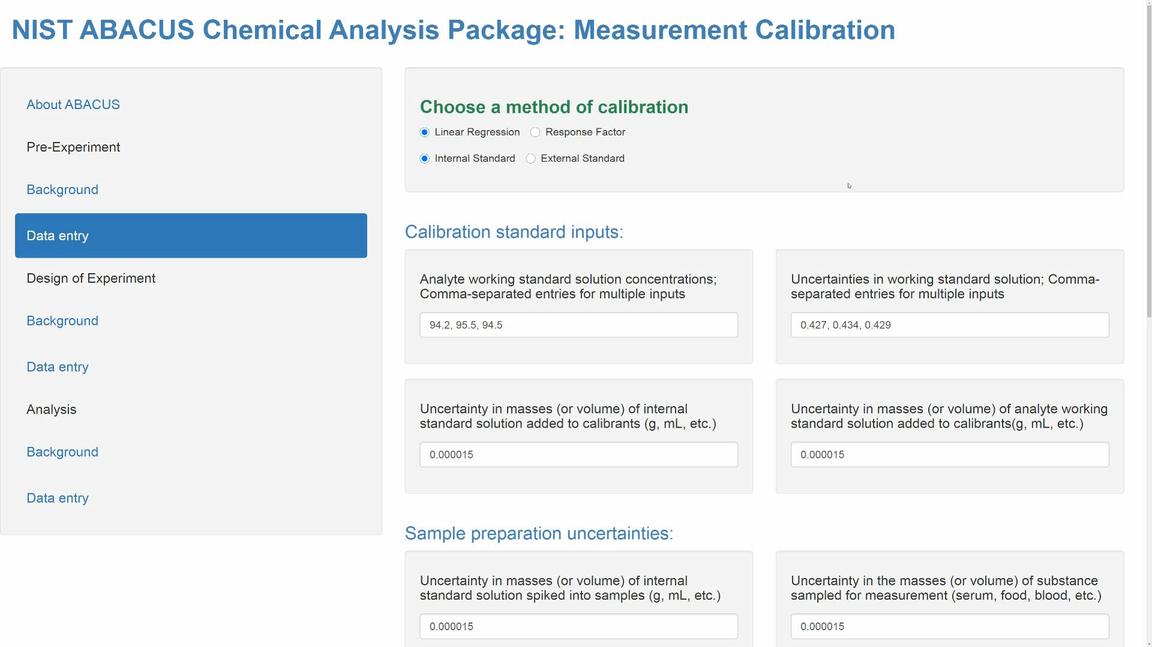
“Design of Experiment” App
Notes:
The Design of Experiment module discussed in conjunction with the pre-experiment module can be accessed without running the pre-experiment module. This can be useful for advanced users that wish to manually explore the influence of different variables on experiment design. The Design of Experiment module provides recommendations for the number and concentrations of calibrants to be used and the number of samples to be run, to achieve a target measurement uncertainty. The obvious application for this program is the certification of a reference material, with a desired expanded uncertainty. For cases in which the target measurement uncertainty cannot be achieved based on the preliminary data, the design of experiment module will provide an experimental design with the lowest uncertainty based on the information that is available.
The Design of Experiment module requires estimates to be entered for a number of parameters associated with calibration and measurement uncertainty. These parameters are described in detail in the Background link for this module. Many of these parameters can be obtained in the pre-experiment module, or estimates can be entered based on judgement. This module provides more control over the experimental design, and permits the user to study the influence of specific parameters on measurement uncertainty. After this data is entered into the screen fields, the selection “Fit the Model” is made, and calculations are started. Depending on the constraints entered, recommendations are returned by the application about the concentrations of the calibrants and the number of replicate analyses of calibrants and samples required to minimize measurement uncertainty. These recommendations are just that; they are intended to inform the analyst of a possible experimental design that can be employed for an analysis. The actual experimental design used by the analyst, and resulting data, are then input into the Analysis module to obtain a summary of the measurement results based on Bayesian statistics, such as might be required for the certification of a reference material.

Slide 13

“Analysis” App
Similar to Pre-Experiment App
No link to Design of Experiment
Simplified Reporting
Notes:
The data entry procedure and execution of the Analysis module are similar to those of the Pre-Experiment module. However, unlike in the pre-experiment, the analysis module simply provides results for a single estimate of the measurand level and associated uncertainty calculated using all available data. This includes summary statistics and a probability plot of the posterior distribution, as well as characteristics of the calibrations.

Slide 14

ABACUS – https://abacus.nist.gov/
For additional information
about ABACUS, contact:
michael.nelson@nist.gov
blaza.toman@nist.gov
www.nist.gov
Notes:
For additional information about ABACUS, contact Michael.nelson@nist.gov or blaza.toman@nist.gov

Slide 15
Pre-Experiment App: Example
Response
Factor
y = mx
y
y = measurand response
x = measurand amount
slope = m
x

Slide 16
Pre-Experiment App: Example
Linear
Regression
y = mx + b
y
slope = m
y = measurand response
x = measurand amount
intercept = b
x

