Slide 1
Discussion on Challenges, Quantitation, Gating, and Best Practices and Strategies

Slide 2
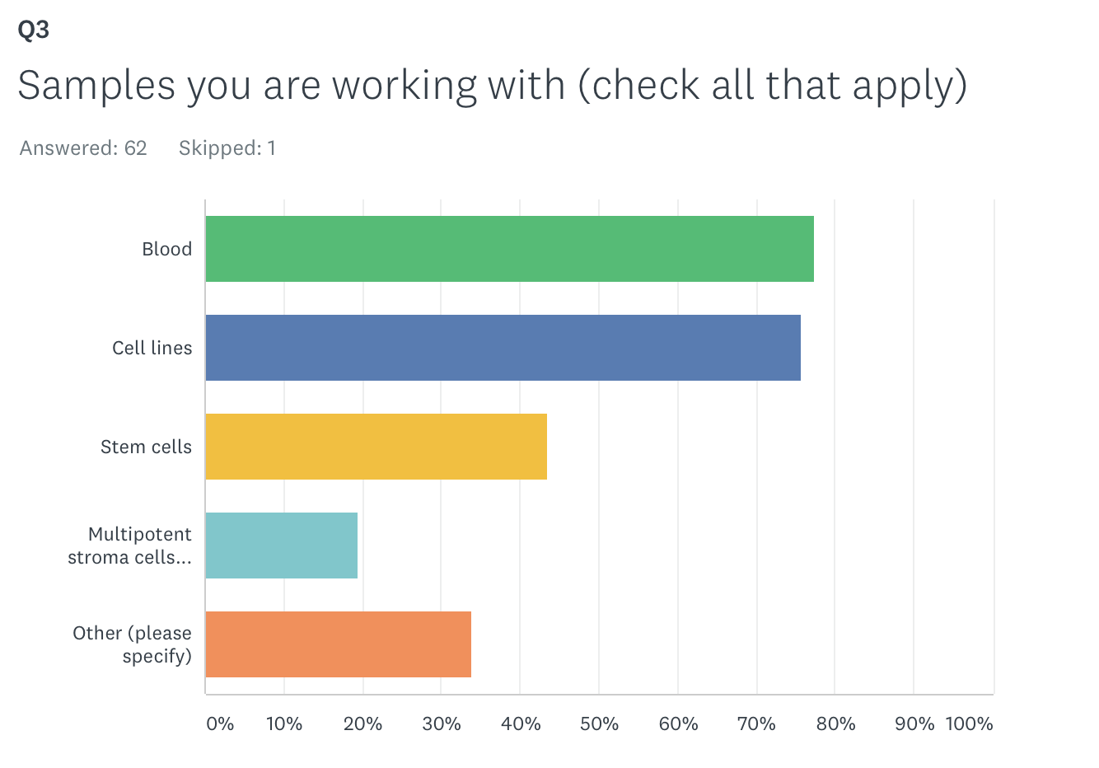
Various samples are measured by flow cytometry in cell therapy applications

Slide 3
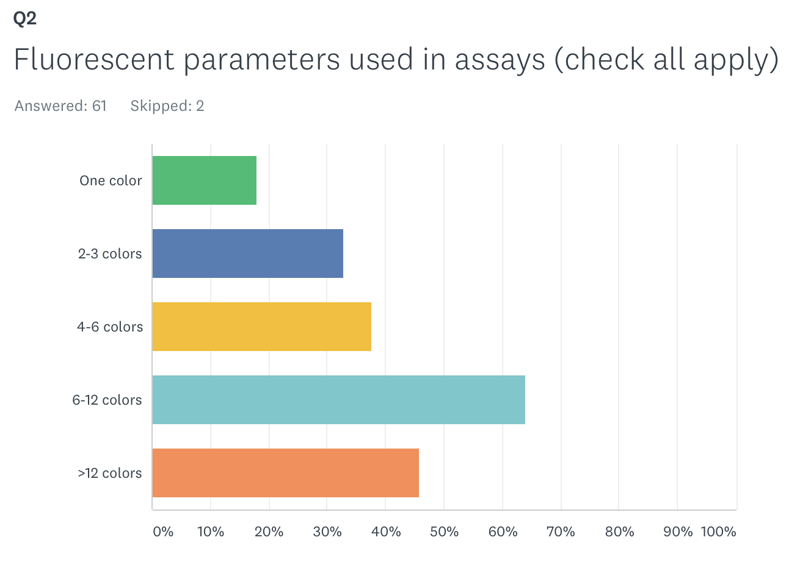
Wide range of fluorescent parameter is used

Slide 4
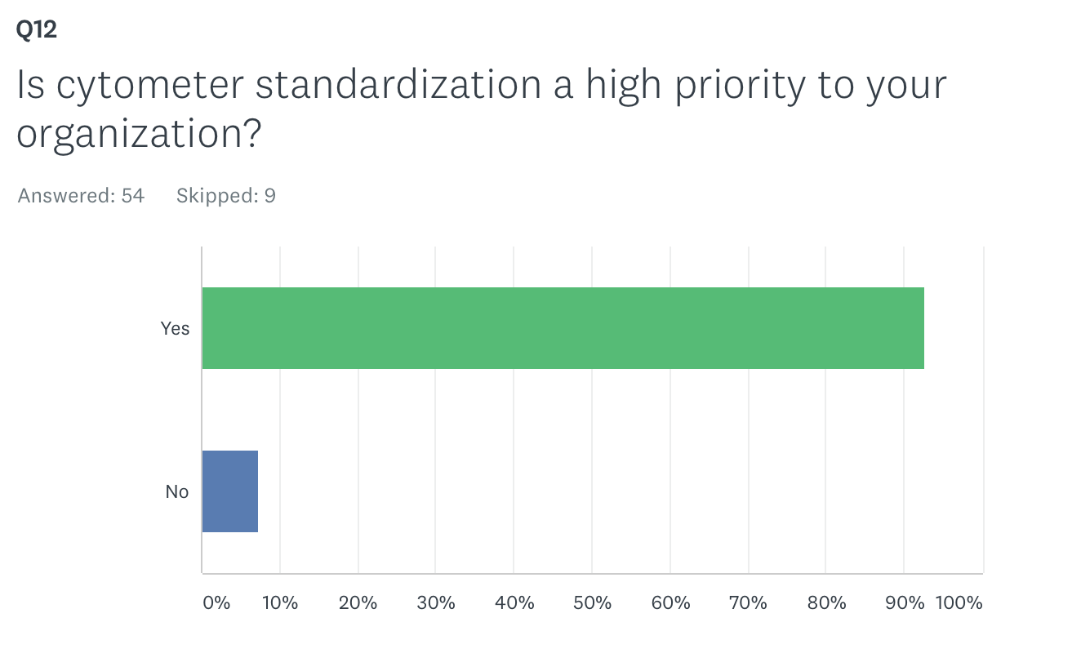
Cytometer standardization is generally a high priority for their organization

Slide 5
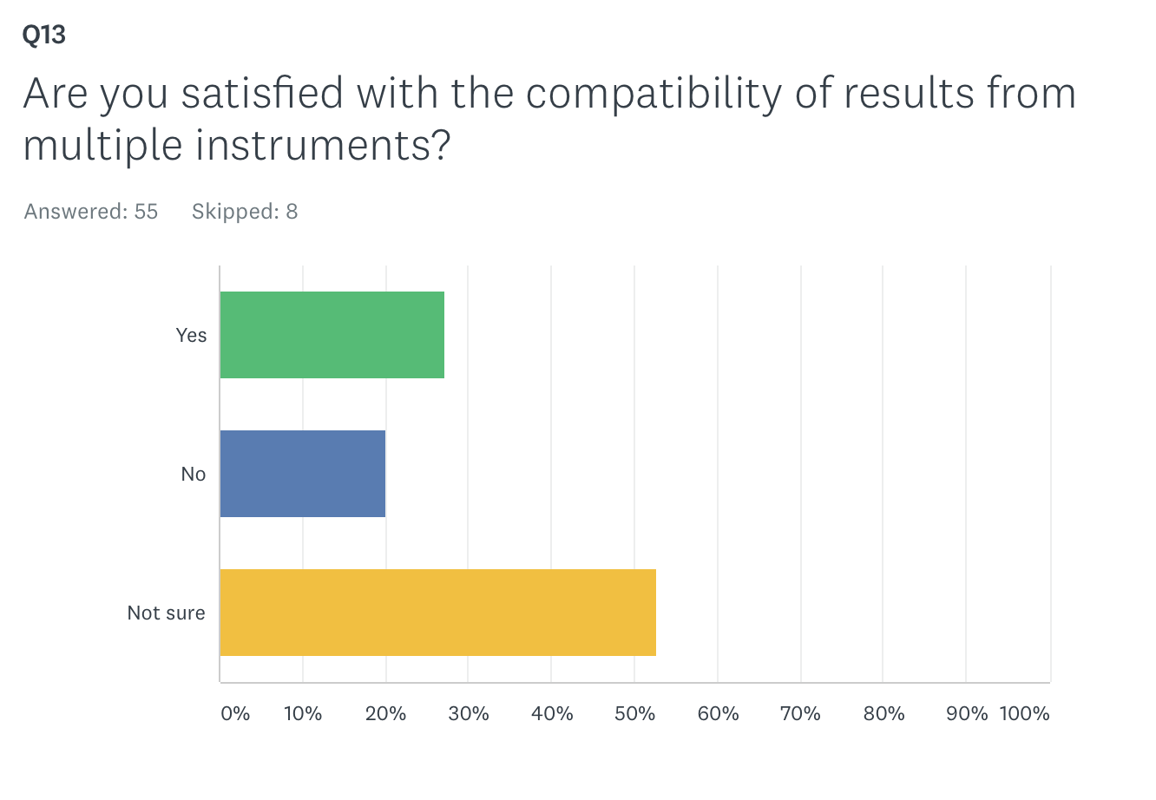
No consensus about the compatibility/comparability of results from flow

Slide 6
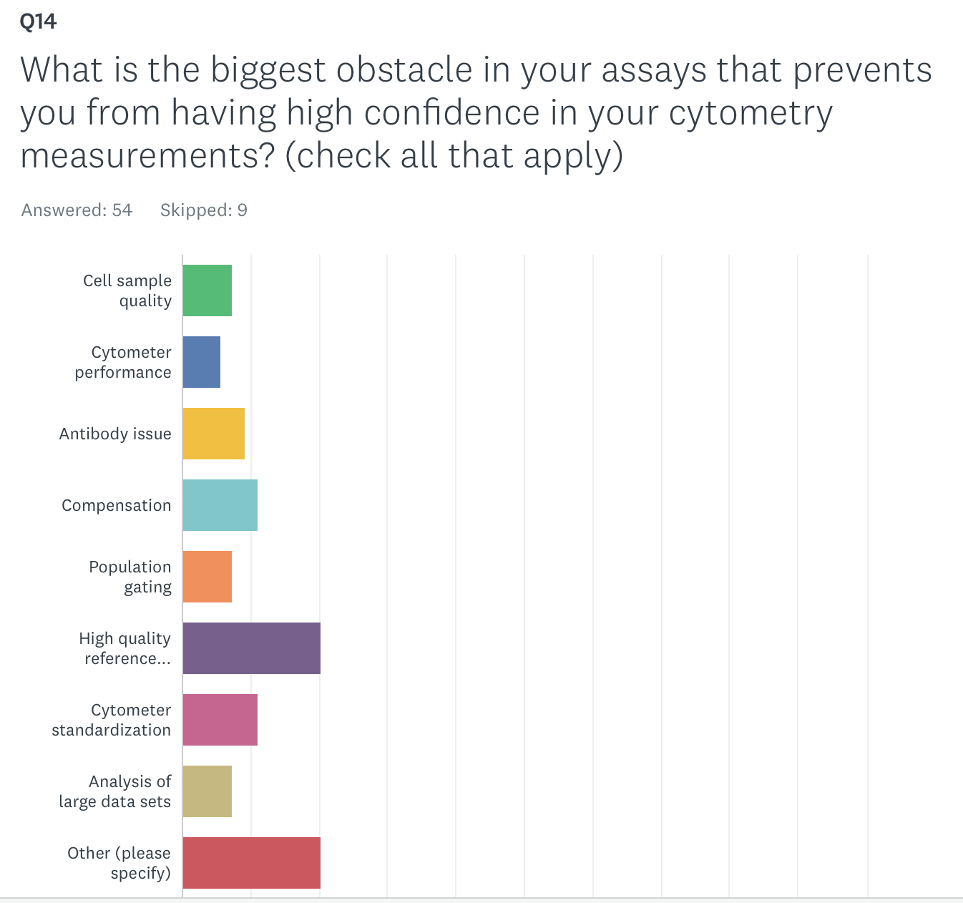
Many obstacles for achieve high confidence in flow measurements

Slide 7
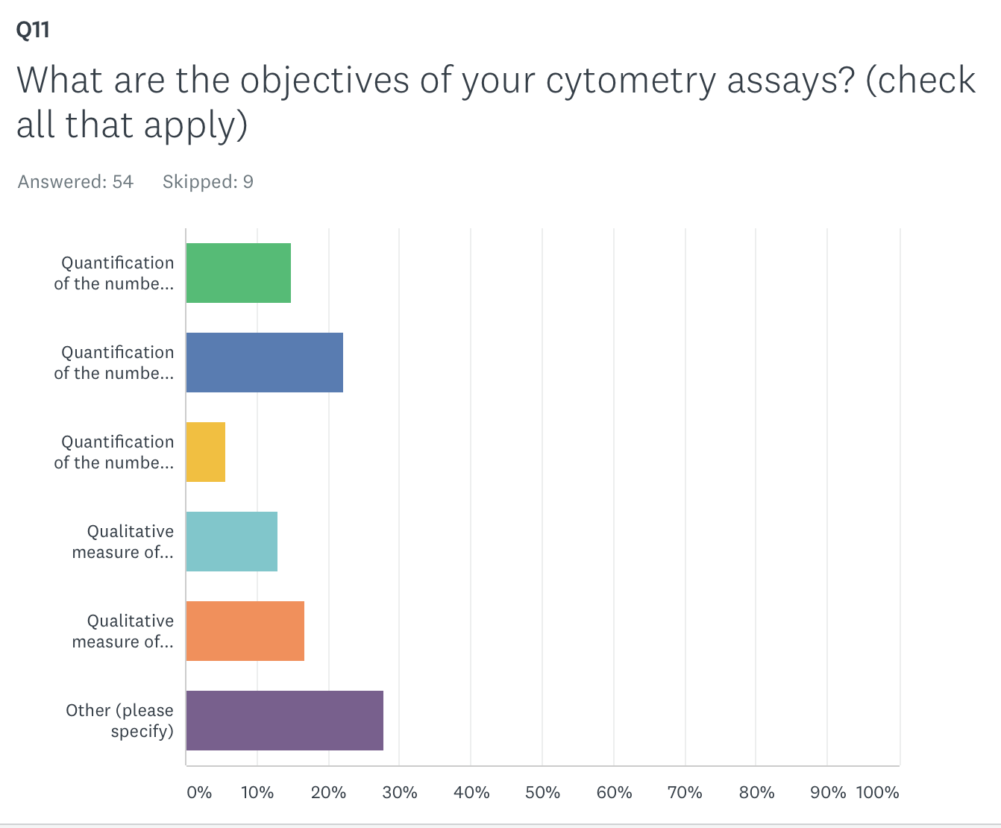
Importance of fit for purpose as objective of flow assay can vary: quantitation of cell count and biomarker expression is important

Slide 8
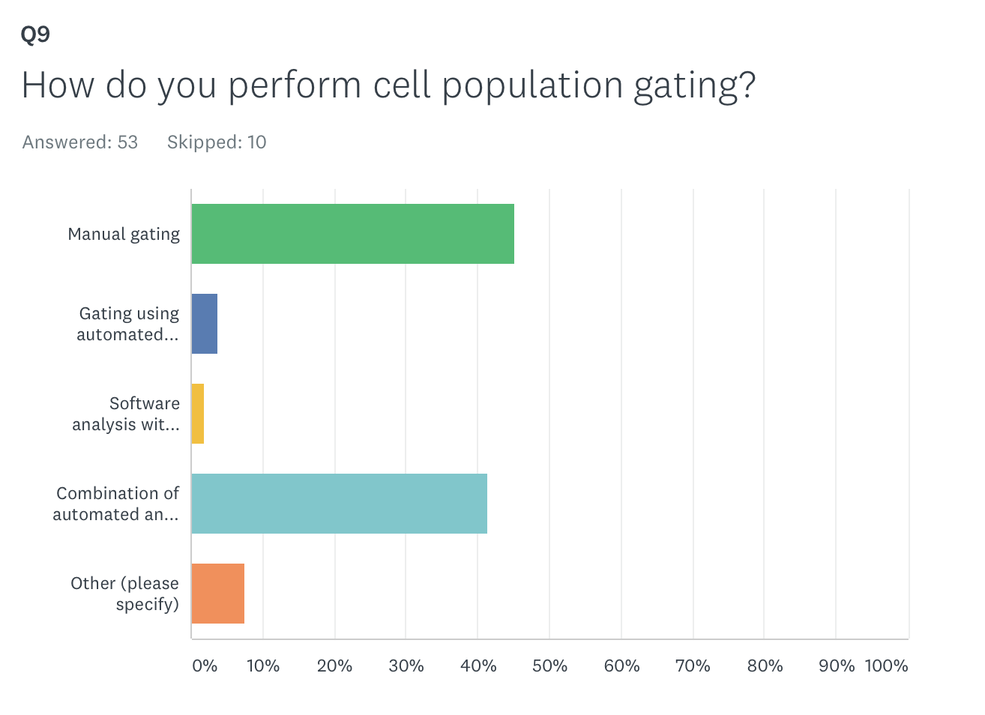
Consensus on gating strategies

Slide 9
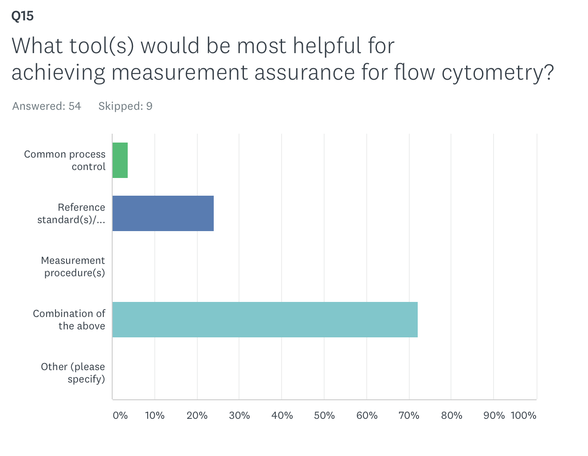
Some agreement on tools for achieving measurement assurance

Slide 10
(1) Reference Standards to Aid Measurement Assurance and
(2) Best Practices/Strategies to Enhance Result Comparability across Multiple Flow Cytometers

