Slide 1
Biological and Non-biological Reference Materials for Flow Cytometry
Lili Wang
Biosytems and Biomaterials Division

Slide 2
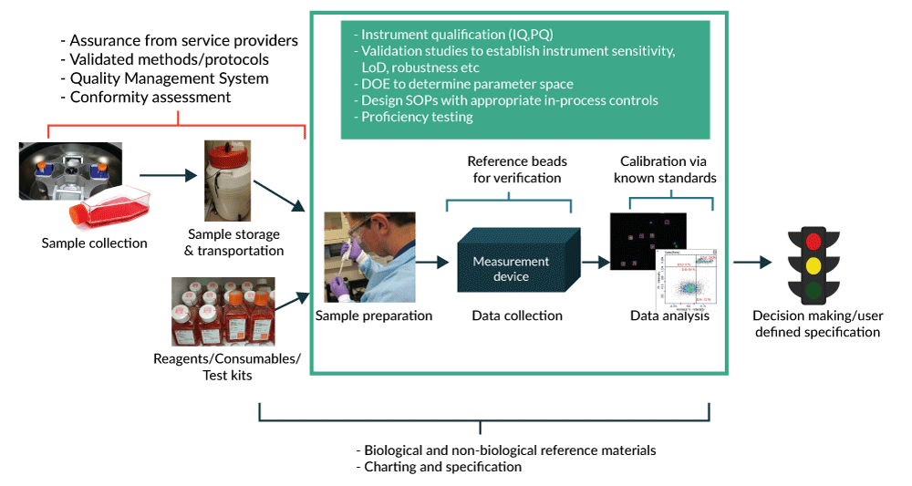
Understanding and Managing Sources of Variability in Measurement Process
Cell Gene Therapy Insights 2016;2(6),663-673.

Slide 3
Use of Reference Materials for Quantitative
Flow Cytometry
Reference materials
controls
Sources of variability
Cell reference
materials
QC & calibration beads
Sample Collection
Fixed vs. fresh
Anticoagulant
Cell count& Viability
Cell debris detection
Compensation bead/
reference cell controls
Cell processing/staining
Antibody quality
Cell debris detection
Reference cell materials
Reference cell/sample FMO controls
Flow cytometer QC/calibration
Linearity/sensitivity/resolution
Instrument settings
Flow cytometry compensation
Linearity scale/range
Labeling fluorophore choice
Quantitative measurement
Reference cell materials
Data analysis/reporting
Population gating
Notes:
The major point is that reference materials can be used for a lot of things, consider what evidence they are providing or what aspect of measurement they are being used for.

Slide 4
Benchmarking Flow Cytometric Scale
Two step process:
1. Establish linear range in fluorescence scale using beads assigned with “Equivalent number of Reference Fluorophores (ERF) values
Aim: Provides evidence of linear range/proportionality and resolution, provides evidence of comparability within experiment and between experiments on single instrument
Benchmark scale
2. Anchor the fluorescence scale (FS) to a benchmark cell material with a known protein expression in the unit of Antibodies Bound per Cell (ABC)
Aim: Transforms fluorescence scale to ABC scale, provides reasonable instrument independent transferable scale
Cytometry Part A ● 73A: 279-288, 2008; Flow Cytometry Protocols: Third Edition, p53-65, 2011
Current Protocols in Cytometry, 75:1.29.1-14, 2016; Flow Cytometry Protocols: Fourth Edition (in press)
Notes:
This is a generalized scheme that enables clear understanding what the reference materials are giving you in terms of measurement assurance evidence. There are ways to do this in a one step process, but in that case more specialized ERF beads and more characterization would be required.

Slide 5
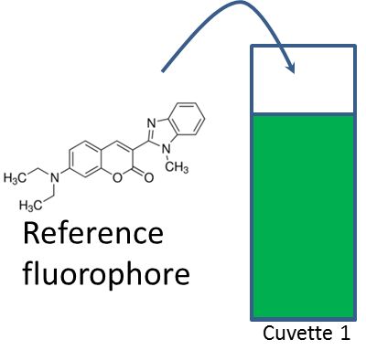
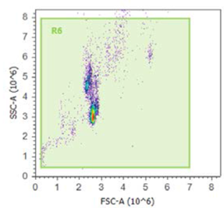
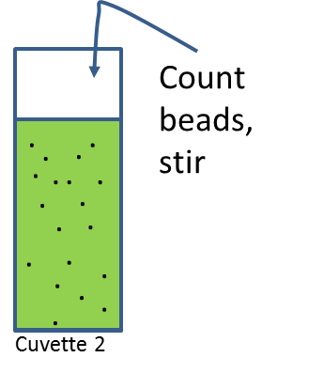
Traceable ERF Value Assignment to Calibration Beads
Emission of RF
NIST SRM 1934
Fluorescein
Nile red
Allophycocyanin (APC)
Coumarin 30
Calibrated fluorometer
Different manufacturers’
relative intensity beads
ERF/bead
Calibrated fluorometer
Light obscuration and flow cytometry methods
for accurate microsphere concentration, fraction of fluorescence signal in single spheres
Emission of bead
Flow Cytometry Quantitation Consortium
81 Federal Register 136 (15 July 2016), pp. 46054-46055
ERF Value Assignment to Cytometer Calibration Beads Submitted by Consortium Members

Slide 6
Traceable ERF Value Assignment to Commercial Microparticles
FC Bead | Ex Laser (nm) | SRM 1934
FITC | 488 | Fluorescein
PE | 488 | Fluorescein
BB515 | 488 | Fluorescein
PerCP | 488 | Nile Red
PerCP-Cy5.5 | 488 | Nile Red
PE-Cy7 | 488 | Nile Red
APC | 633 | APC
APC-R700 | 633 | APC
APC-H7 | 633 | APC
APC-Cy7 | 633 | APC
V450 | 405 | Coumarin 30
BV421 | 405 | Coumarin 30
V500-C | 405 | Coumarin 30
BV510 | 405 | Coumarin 30
BV605 | 405 | Coumarin 30
Six Peak Hard Dyed Micro-particles | Ex Laser (nm) | SRM 1934
Intensity 2-6 | 488 | Fluorescein
Intensity 2-6 | 488 | Nile Red
Intensity 2-6 | 633 | APC
Intensity 2-6 | 405 | Coumarin 30

Slide 7
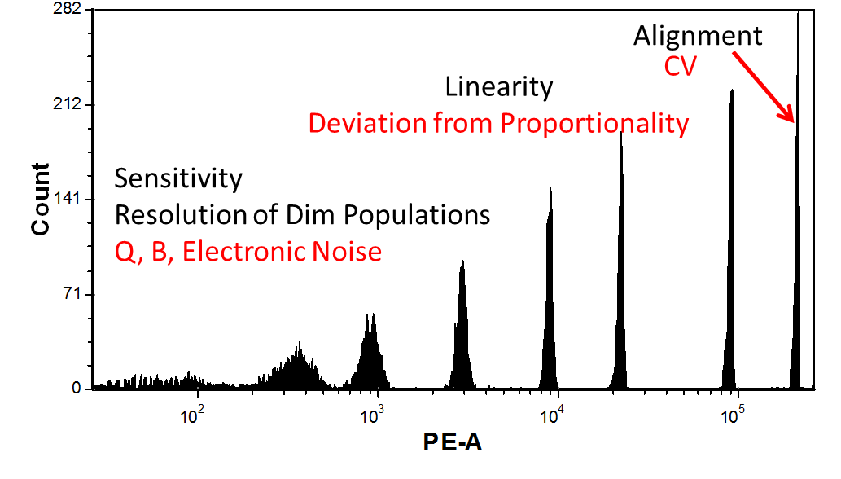
Flow Cytometer Performance Characterization
Cytometry 33A:260-266, 1998
Cytometry 33A:267-279, 1998
Current Protocols in Cytometry, 40:1.20.1-1.20.18, 2007
Single Cell Analysis (edited book), p171-199, 2017
Flow Cytometry Protocols: Fourth Edition (in press)

Slide 8
Cellular Assays on Flow Cytometry Devices Cleared by CDRH
Purpose | Measurand | ‘quantitative’, ‘qualitative’ or ‘semi-quantitative’ | Standard used
Assessment of CMV-specific immune status and risk of CMV reactivation in immunosuppressed stem cell transplant recipients. | CMV specific CD8 MHC tetramer or dextramers | Quantitative | Beads
Immunologic assessment of patients having or suspected of having immune deficiency. | CD3+, CD3+CD4+, CD3+CD8+ | Quantitative and Qualitative | Beads
monitor forms of immunodeficiency | CD3+CD4+, CD3+CD8+ | Quantitative | Beads
Immunologic assessment of patients having or suspected of having immune deficiency. | CD3+CD4+, CD3+CD8+, CD3+, CD19+ and CD3-CD56+ | Quantitative | Beads or on a dual platform
Immunologic assessment of patients having, or suspected of having, immune deficiency. | CD3+, CD3+CD4+, CD3+CD8+, CD3-CD19+, CD3-CD56+ and/or CD16+, CD45+ Low SS, and CD45+ | Qualitative and quantitative | Beads or on a dual platform
HIV positive patients | CD4/Hgb | Quantitative | CD4 count/volume of the imaged field of views
multiparameter immunophenotyping aid in the differential diagnosis of hematopoietic neoplasms | T1: CD2, CD56, CD7, CD5, CD45 T2: CD8, CD4, CD3, CD45 B1: Kappa, Lambda, CD19, CD5, CD45 B2: CD20, CD10, CD19, CD38, CD45 M: CD7, CD13, CD34, CD33, CD45 | Qualitative | None

Slide 9
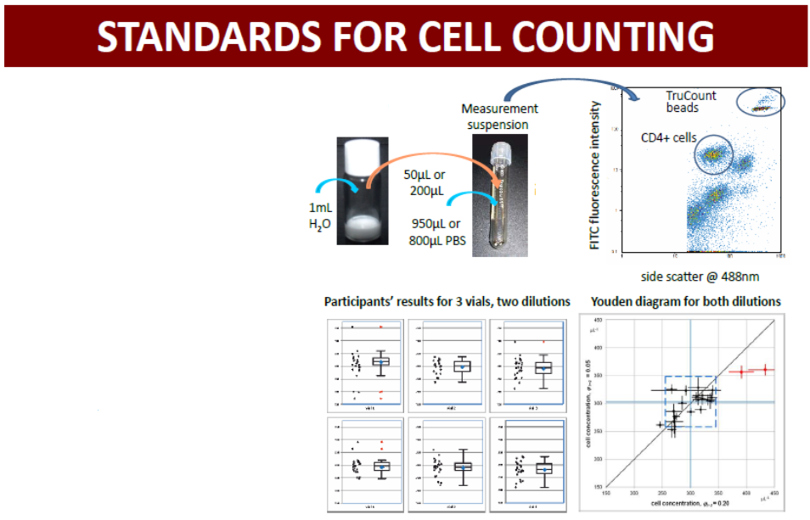
CD4+ Cell Counting Standard
(WHO BS/10.2153)
(http://www.nibsc.org/documents/ifu/SS-319-20.pdf)
The first international reference standard for CD4+ cell counting for HIV/AIDS diagnosis and restricting access to anti-retroviral treatment (ART).
A round-robin international comparative study has demonstrated equivalence in capability in flow cytometric measurement of CD4+ cell concentrations and documented the associated measurement uncertainty.
Mean CD4+ lymphocyte concentration:
300.4 ± 28.3 µL⁻¹ for 1 to 5 dilution
302.9 ± 28.3 µL⁻¹ for 1 to 20 dilution
Cytometry Part A ● 87A: 244-253, 2015
Cytometry Part A ● 87A: 254-261, 2015

Slide 10
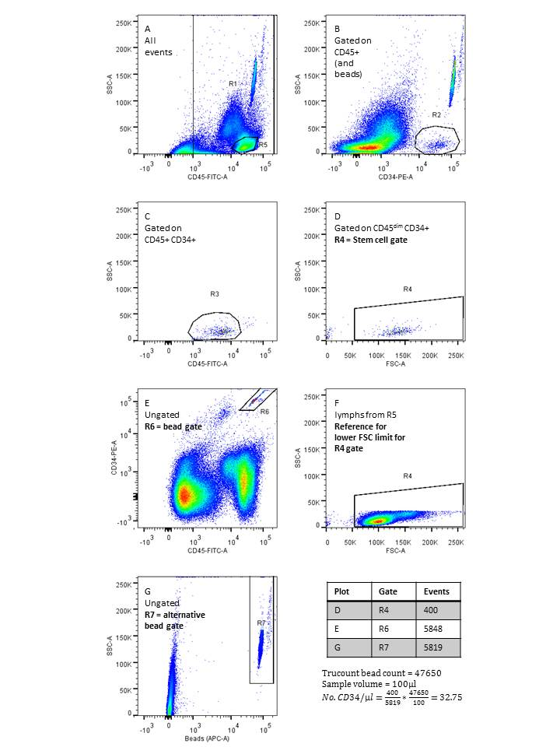
CD34+ Cell Counting Reference Material
http://www.nibsc.org/science_and_research/biotherapeutics/flow_cytometry_reference_materials.aspx
CD45+ cells → CD34+ cells → CD45^{dim} cells → Blast morphology
Internal reference counting beads
Reference lymphocyte plot

Slide 11
Source of Variability for Cell Counting and Expression Analysis Using Flow Cytometry
Sample Collection
TruCount Bead Standard
Data Analysis
Anticoagulant
Effect of
Temperature
Tube-to-Tube
Variability
Number of Events
Collected
Cell count and
viability
Dot or Density
Plots
Population
Gating
Cell debris
Channel for
Bead Detection
Source of
Variability
Different
Manufacturers
Volume Calibration
Linearity/sensitivity/
resolution calibration
Different
Clones and
Binding Affinities
Threshold and
PMT setting
Reagent
Titration
Cytometer
Compensation
Single tube/separate
tube assay
Antibody Reagents
Flow Cytometer Platforms
Choice of reference
cell materials
Quantitation

Slide 12
Need for Biological Cell Reference Materials
Stabilized Samples Diagnostic for ALL, AML, CLL,
MM, and MRD
CVID: B cell panel; better standardization of memory B cells (both switched and unswitched). IgG expressing B cells - both percentage and expression.
PNH (Paroxysmal Nocturnal Hemoglobinuria), CAR T Cell Manufacturing

Slide 13
Characterization of Human CD4+ Lymphocyte
Candidate Reference Materials
Obtaining ABC (antibodies bound per cell) values for CD4 receptors on
T-cells:
    Flow cytometry using QuantiBrite PE beads and unimolar CD4
    PE conjugate
    ii) Mass cytometry (CyTOFTM)
    iii) Single photon counting based technique (under development)
Quantifying CD4 receptor density using multiple reaction monitoring mass
spectrometry (MRM MS) combined with N15, C13 labeled recombinant CD4
protein as an internal standard
Quantifying RNA of CD4 per cell (under development)
Cytometry Part A ● 81A: 567-575, 2012;
Analytical Chemistry ● 85: 1773-1777, 2013;
Clinical Proteomics ● 11: 43, 2014

Slide 14
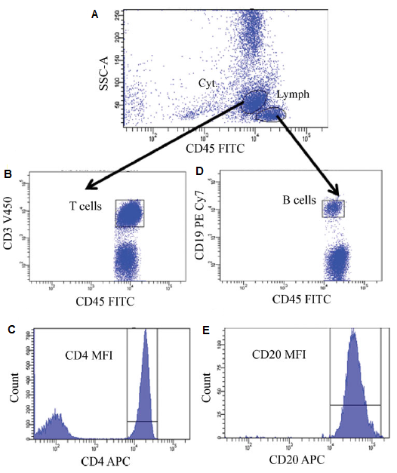
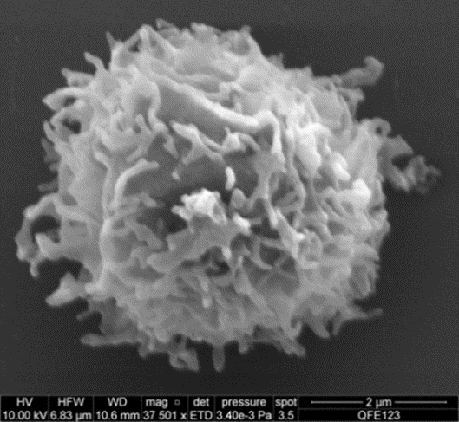
Procedure for Obtaining ABC Values of Biomarkers Based on Human PBMC Reference Controls
Cyto-Trol showing a consistent ABC
value of CD4 reference marker on T
cells using quantitative flow cytometry (41000, CV of 3.1%), CyTOF (38000, CV of 4.9%), and quantitative mass spectrometry (42500, CV of 12.8%)
Current Protocols in Cytometry, 75:1.29.1-14, 2016
Cytometry Part B (Clinical Cytometry) 90B:159-167, 2016
Flow Cytometry Protocols: Fourth Edition (in press)

Slide 15
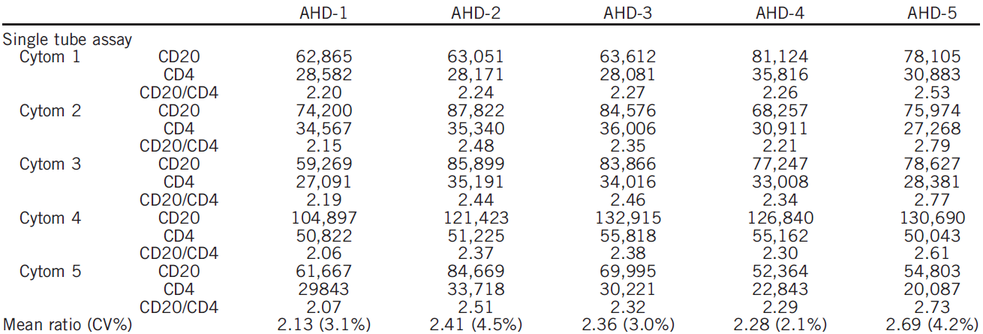
Quantifying CD20 Expression Based on CD4 Reference

Slide 16
CYTO 2016 Workshop on Biological
Cell Reference Materials
Biolegend’s Veri-CellsTM PBMC
BD Biosciences’ PBMC Dried Down CTT
Beckman Coulter’s Cyto-Trol Control CellsTM
NIST, FDA, and a company are jointly characterizing these human blood cell preparations using conventional flow cytometry and CyTOF.
A round-robin study afterward with user communities to test their utilities/usefulness. The study allows for assay protocol development and serves a training purpose.

Slide 17
Characterization of Human CD4+ and CD19+ Lymphocytes from Different Cell Preparations as Candidate Biological Cell Reference Materials for Quantitative Multiparameter Flow Cytometry and CyTOF
Three commercially available human PBMCs:
Veri-Cells PBMC
Cyto-Trol Control Cells
PBMC Dried Down CTT
Anonymized whole blood samples
Activity by using flow cytometry and CyTOF:
Quantifying CD4 expression on T lymphocytes
Quantifying CD19 expression on B lymphocytes
Characterize PBMC cell subsets
Characterize differential states of T lymphocytes
Apply an agreed gating strategy and analyze data

Slide 18
Building Measurement Assurance with the Use of Reference Materials
Reference materials
controls
Sources of variability
Cell reference
materials
QC & calibration beads
Sample Collection
Fixed vs. fresh
Anticoagulant
Cell count& Viability
Cell debris detection
Compensation bead/
reference cell controls
Cell processing/staining
Antibody quality
Cell debris detection
Reference cell materials
Reference cell/sample FMO controls
Flow cytometer QC/calibration
Linearity/sensitivity/resolution
Instrument settings
Flow cytometry compensation
Linearity scale/range
Labeling fluorophore choice
Quantitative measurement
Reference cell materials
Data analysis/reporting
Population gating
Notes:
The major point is that reference materials can be used for a lot of things, consider what evidence they are providing or what aspect of measurement they are being used for.

Slide 19



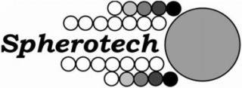



Acknowledgements
NIST: P. DeRose, E. Stein, A.K. Gaigalas, H. He, K.D. Cole, M.
Misakian, P. Bajcsy, M. Wang, I.V. Turko, A. Plant
: : R.A. Hoffman, M. Bigos, J.P. Nolan and the Standardization
Task Force and Study Participants
: H. Degheidy, H. Mostowski, F. Abbasi, G.E. Marti and S. Bauer
Univ. of Toronto/DVS Sciences/Fluidigm: O. Ornatsky and S. Tanner
Flow Cytometry Quantitation Consortium:
CCQM Comparative Study Participants: 20 organizations across 10 countries

