Slide 1
Survey Snippets: Calibration and Reference Materials for Cytometer Measurement “Standardization”
NIST-FDA Flow Cytometry Workshop: Building Measurement Assurance in Flow Cytometry

Slide 2
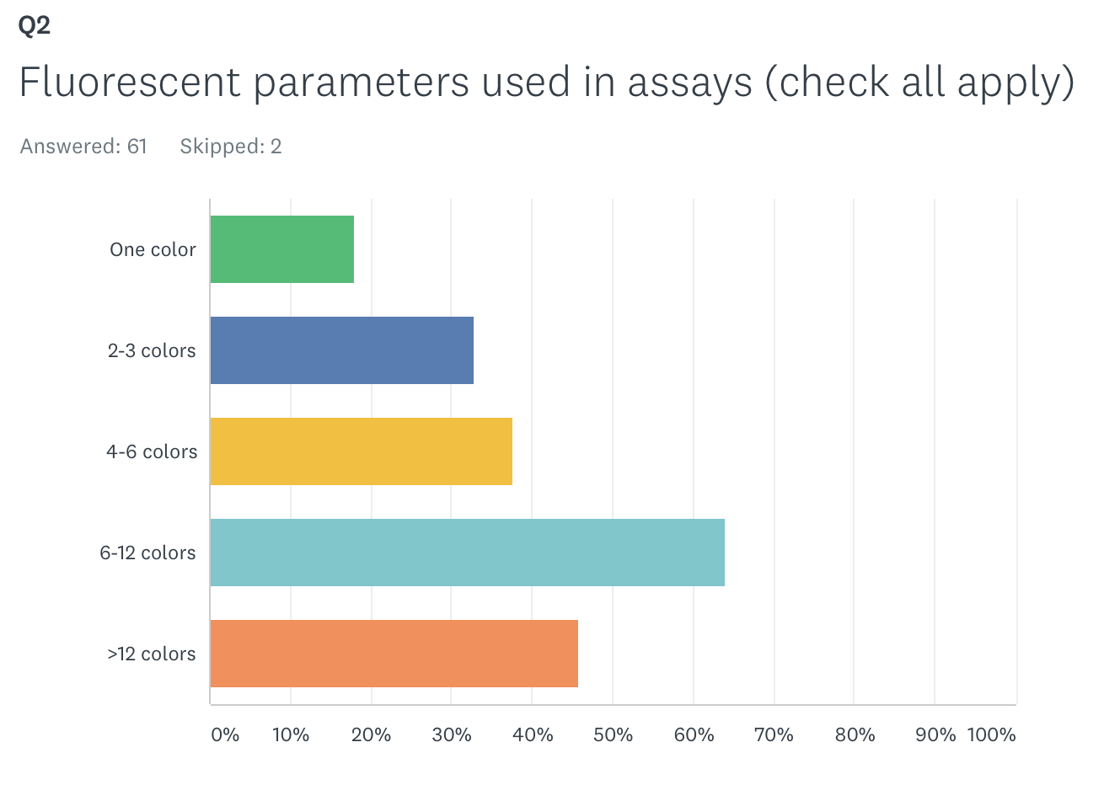
Wide range of fluorescent parameter is used

Slide 3
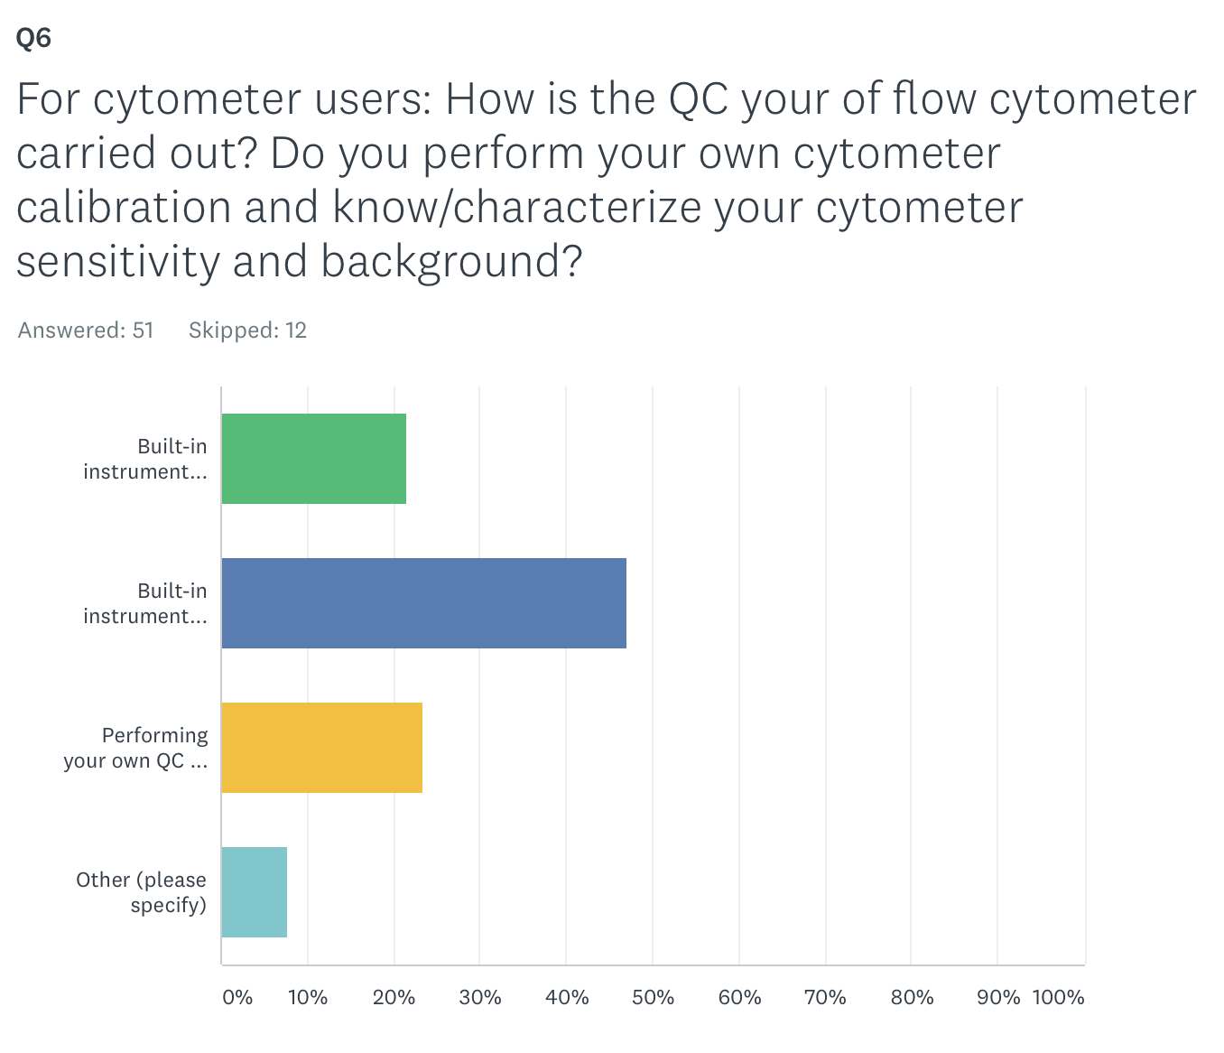
Several approaches to QC the flow cytometer
(w/o further calibration/characterization)
(w further calibration/characterization)

Slide 4
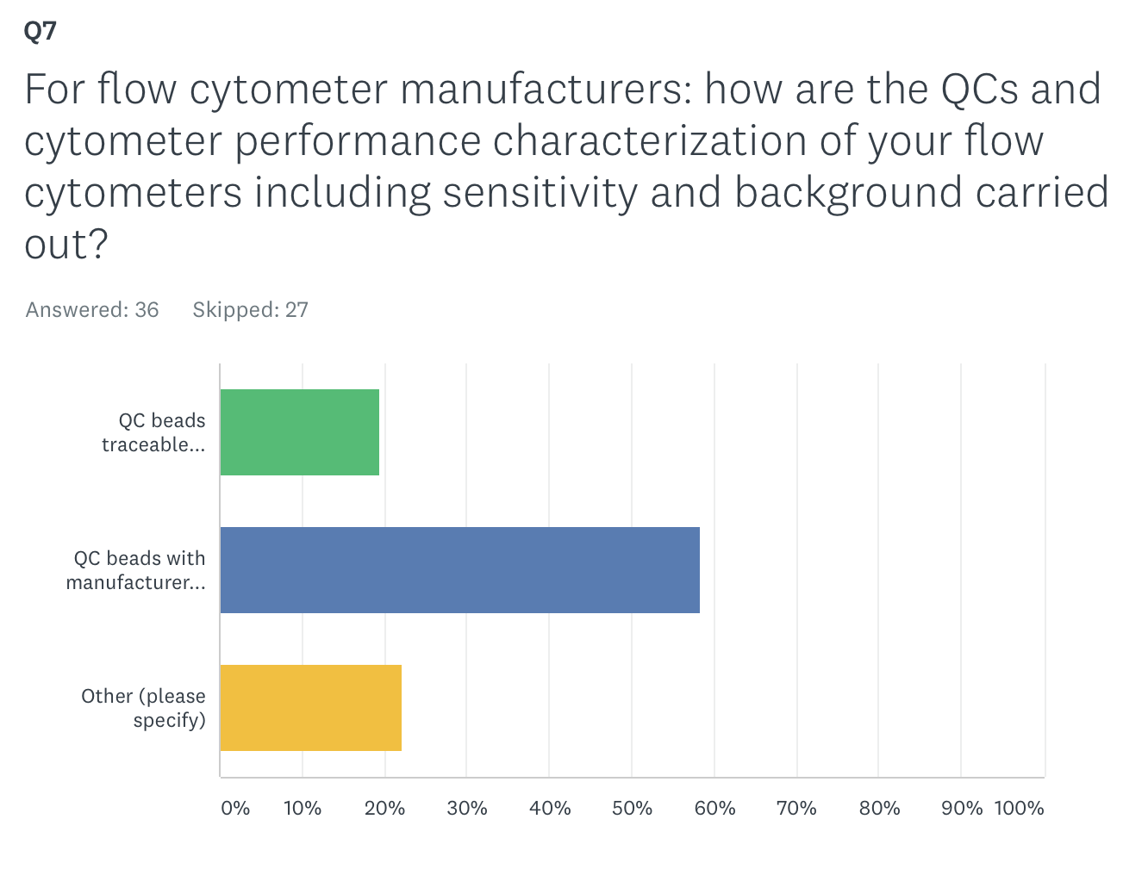
No consensus approach for QC and performance characterization
(to NIST standards)
(to mfg assigned intensities)

Slide 5
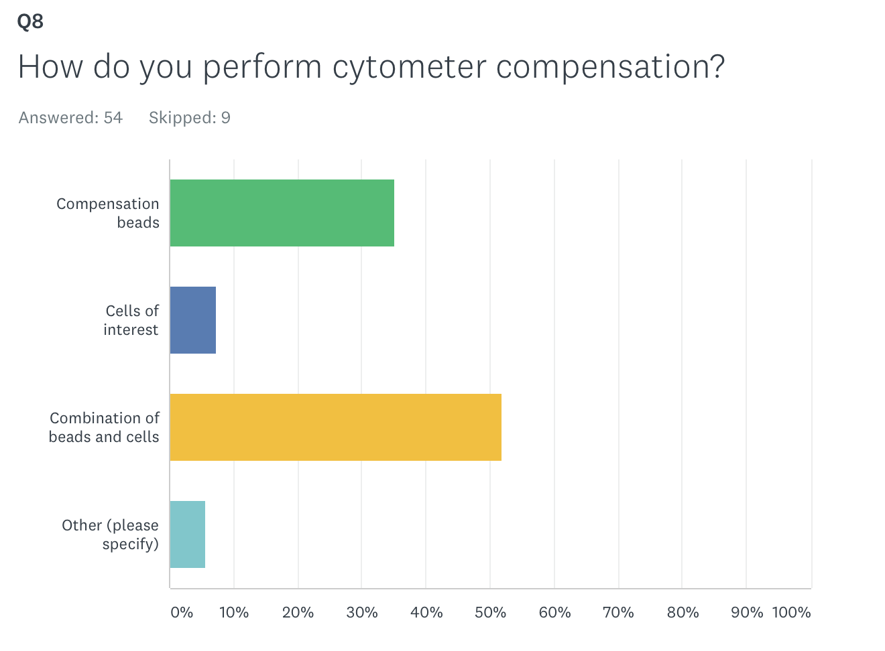
No consensus on how to perform cytometer compensation

Slide 6
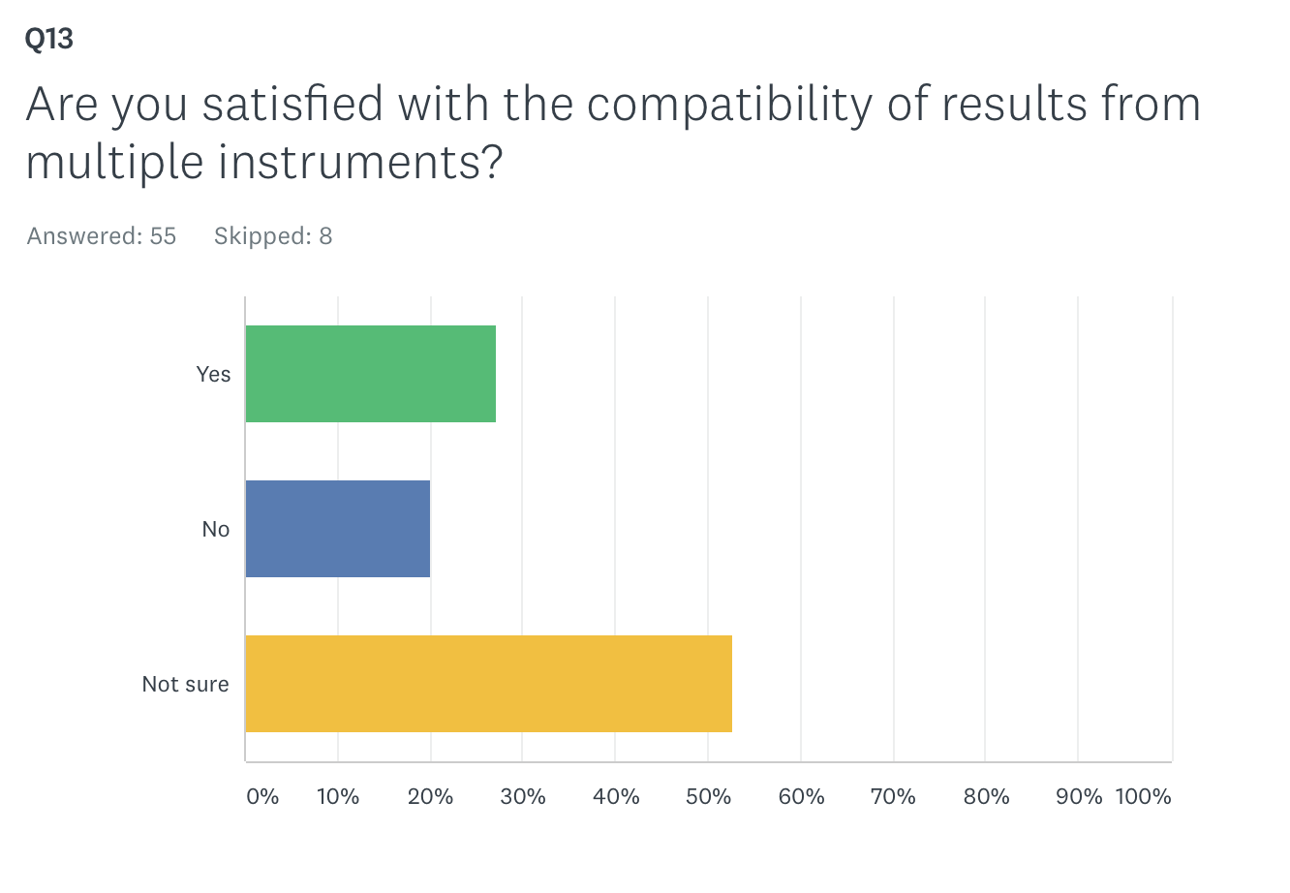
No consensus about the compatibility/comparability of results from flow

Slide 7
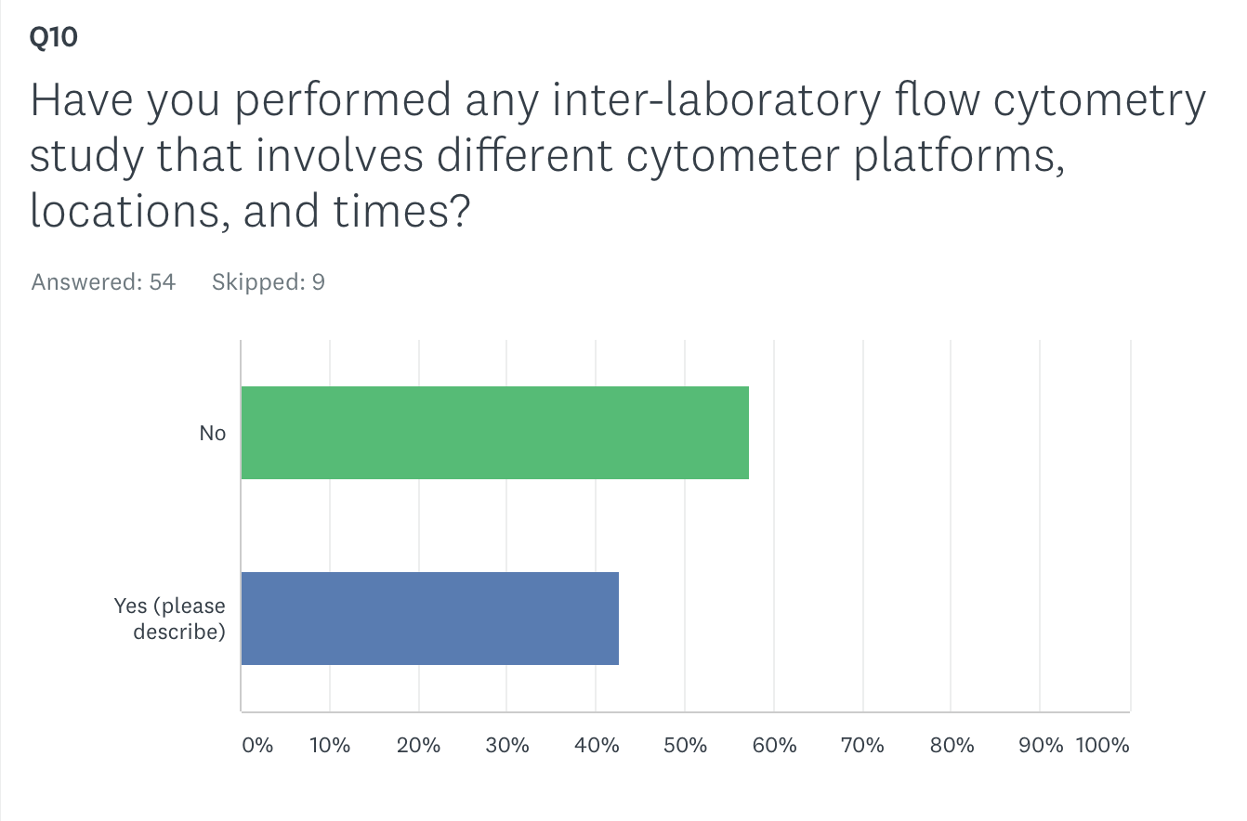
Some efforts to perform inter-laboratory flow cytometry studies

Slide 8
Discussion topics
Reference materials for 12 color flow (calibration/compensation)?
Comparability between instruments?
Reliance on MFG calibration?
What are home-built protocols/materials based on?

