Slide 1

Likelihood Ratio as Weight of Forensic Evidence: A Closer Look
Steve Lund and Hari Iyer
November 8, 2018

Slide 2
Disclaimer
Viewpoints expressed are our own and are not intended to reflect the viewpoints of anyone else at NIST
We are only discussing what makes sense to us and are not trying to claim that these are new perspectives

Slide 3
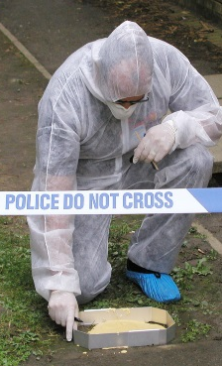


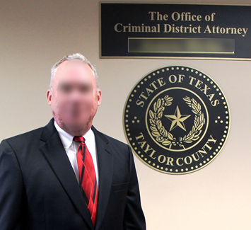
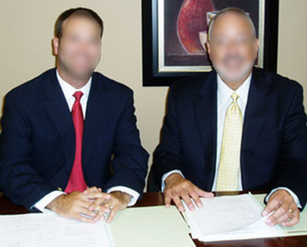
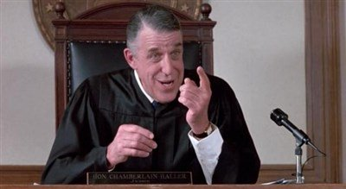
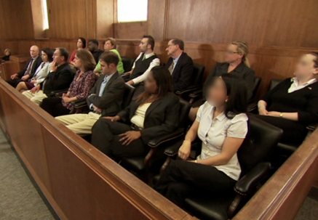
Crime Scenes (Experts)
  Observations and Evidence Collection
Investigation
  Construction of narratives
  Person(s) of interest
  Comparison with crime scene evidence in context of considered narratives
  Report
Legal Proceedings (+ Attorneys)
  Drop case or press charges
  Plea Bargain or…
Trial (+ Judge and jurors)
  Verdict

Slide 4

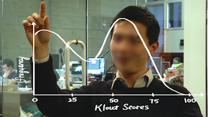


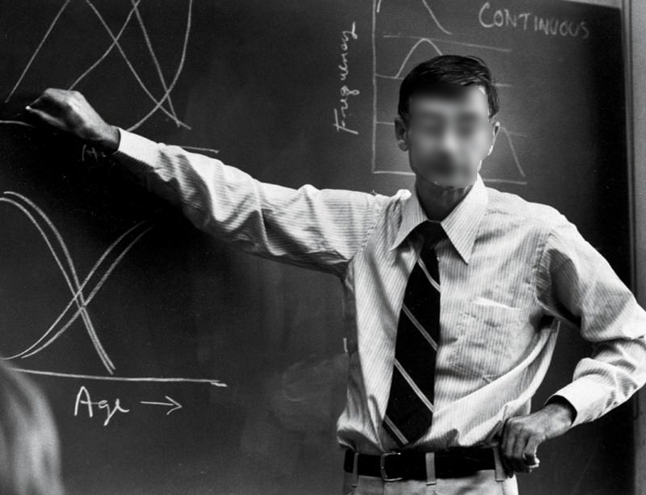
Statistician
Use likelihood ratios instead
  Report/Testimony
  Conclusion
  (ID, exclusion, inconclusive)
Evidence
Observations
Broader Scientific Community
Notes:
A major component of the Judicial system is the communication between the trained forensic professionals who gather and evaluate evidence and the defendants, plaintiffs, attorneys, judges and jurors who decide the case outcomes.
For many years, categorical conclusions were accepted as the punchline of expert communication. For instance in matters of source identification, one might have used a three point scale.

Slide 5

What is a Likelihood Ratio (LR)?
How strongly the considered evidence, E, affects your perception regarding which of two competing propositions (hypotheses) are true
  Example: Police responded to a report of a suspicious individual entering a house through a side window. A few minutes later, Hari was found walking two blocks away. Hari denied ever approaching the house.
  Proposition 1: Hari entered the home
  Proposition 2: Hari did not enter the home
  What is your initial perception regarding the truth of Proposition 1?

Slide 6
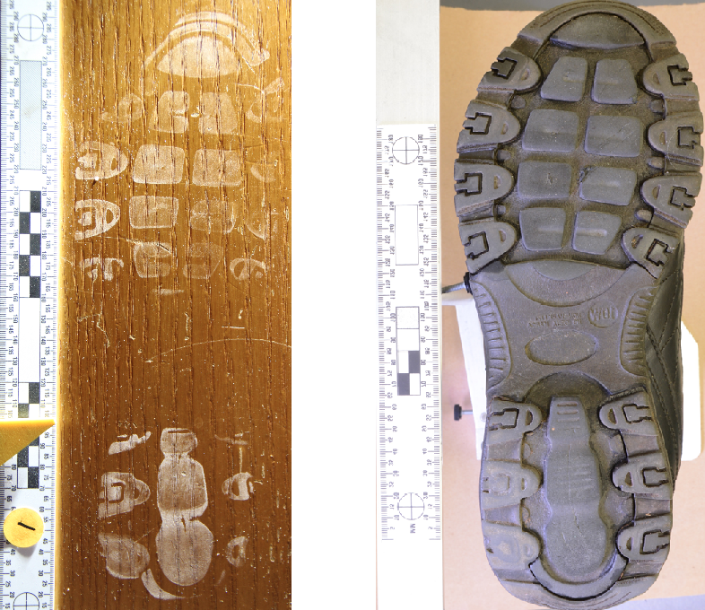
What is a Likelihood Ratio (LR)?
Evidence (E): Officers noticed Hari wearing shoes with an outsole design that looked similar to an impression left inside the open window.
  How does considering E change your perception regarding the truth of proposition 1?
  Chance of encountering E if proposition 1 were correct
Chance of encountering E if proposition 2 were correct
LR =

Slide 7
What is a Likelihood Ratio (LR)?
Chance of encountering E if proposition 1 were correct
Chance of encountering E if proposition 2 were correct
LR =
0
∞
1
Observed evidence could not have occurred if proposition 1 were correct
Observed evidence equally likely under either narrative
Observed evidence could not have occurred if proposition 2 were correct

Slide 8
Bayes’ Formula
Prior Odds * Likelihood Ratio = Posterior Odds
What you believed before
How what you learned impacted your belief
What you believe now

Slide 9

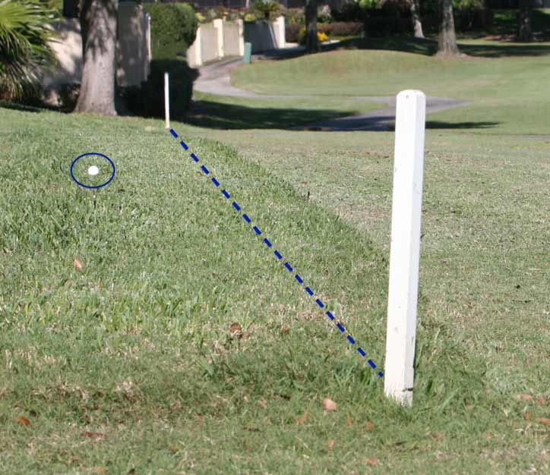
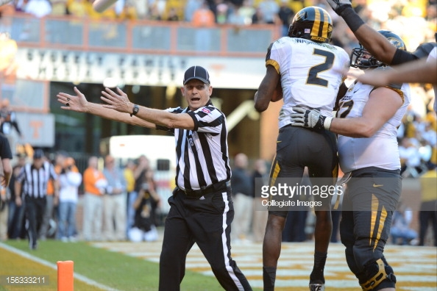
Statistician
  Decision Making Under Uncertainty
Evidence
Observations
Prior belief
Value of Evidence
Likelihood Ratio
Assumptions
Modelling Choices
Posterior belief
Perceived costs
Decision

Slide 10
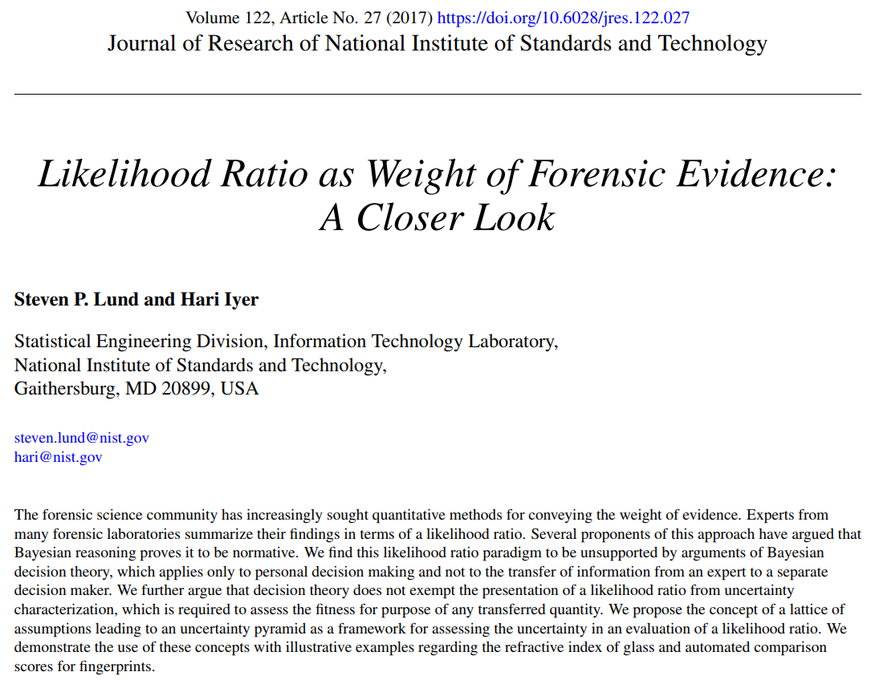
Notes:
Following a process that involved 7 internal and 4 external reviewers, we published a paper that identified some potential concerns and suggested solutions regarding the widespread use of likelihood ratios.
Talk about reviewers: No fewer than
14 reviewers
7 Internal: John Butler, Antonio Possolo, Martin Herman, Will Guthrie, Adam Pintar, Ron Goldberg, Chuck Romine
3 Informal: Jaquelyn Spiers, John Buckleton, Simone Gittleson
4 External: David Kaye, Jay Kadane, Hal Stern, Karen Kafadar

Slide 11
Statistician
  Decision Making Under Uncertainty
Evidence
Observations
Prior belief
Value of Evidence
Likelihood Ratio
Assumptions
Modelling Choices
Posterior belief
Perceived costs
Decision
Notes:
In particular, we focused on how forming an LR requires making assumptions and modelling choices that are beyond consideration of whatever data is available.

Slide 12



Uncertainty Pyramid
Validation Test
Model
Evidence
Data
Model
Likelihood Ratio
Model
Model
Model
Kinda
Pretty
Very
Strictness
Notes:
You might say that the available data has to travel through a model in order to become an LR.
We emphasized that even experts must resort to personal preference and familiarity when choosing what models and assumptions to use.
We further emphasized that any validation test does not uniquely support any one model. There is a range of models that, if considered, would also pass the same validation test with the same data.
Of course there are a variety of validation tests, some stricter than others, and each will have it’s own associated range of LRs for the set of considered models.
The range of reasonable LRs depends on what data you have, what models you’re willing to consider, and what test you choose to run. We called the exploration of these factors an Uncertainty Pyramid.

Slide 13

Statistician
  Decision Making Under Uncertainty
Evidence
Observations
Prior belief
Value of Evidence
Likelihood Ratio
Assumptions
Modelling Choices
Posterior belief
Perceived costs
Decision
Notes:
… and suggested that any report of LR include a description of how these factors have been investigated so that the audience may understand the range of reasonable LRs and decide how best to utilize that information.
For those who don’t want to examine an uncertainty pyramid, we pointed out that there is no statistical argument requiring experts to communicate using a probabilistic assessment such as an LR. Instead, they could stick to the facts…

Slide 14
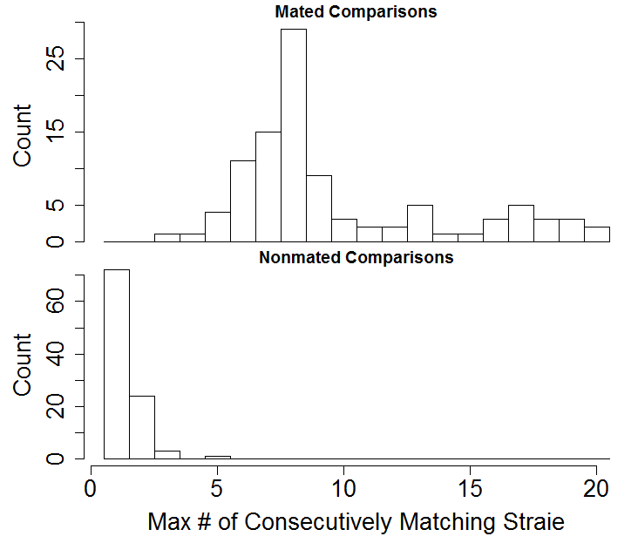
Results Obtained from Scenarios
Made to Represent Proposition 1
Examination Result
Results Obtained from Scenarios
Made to Represent Proposition 2
4
Result Obtained
Notes:
by describing the results of evidence evaluation as a black box score and provide any data they are aware of that may help others better understand the meaning of that result (E.g., black box studies) in the context of the current considerations.

Slide 15
Our Suggestions:
Option A: Stick to the facts (if an LR algorithm was used, treat its result as data rather than a probabilistic interpretation)
Option B: If presenting a probabilistic interpretation, seek to convey the influence of assumptions on the interpretation. We suggested considering an uncertainty pyramid
Notes:
Simply summarized:
If you’re going to provide an LR, carefully examine and convey the influence of your assumptions and modelling choices. If you don’t want to do that, stick to presenting results as data rather than probabilistic interpretations.

Slide 16

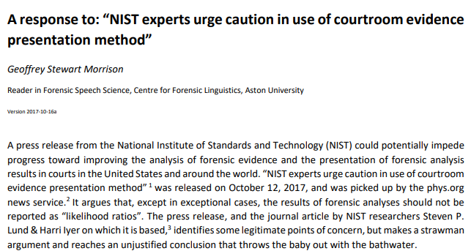
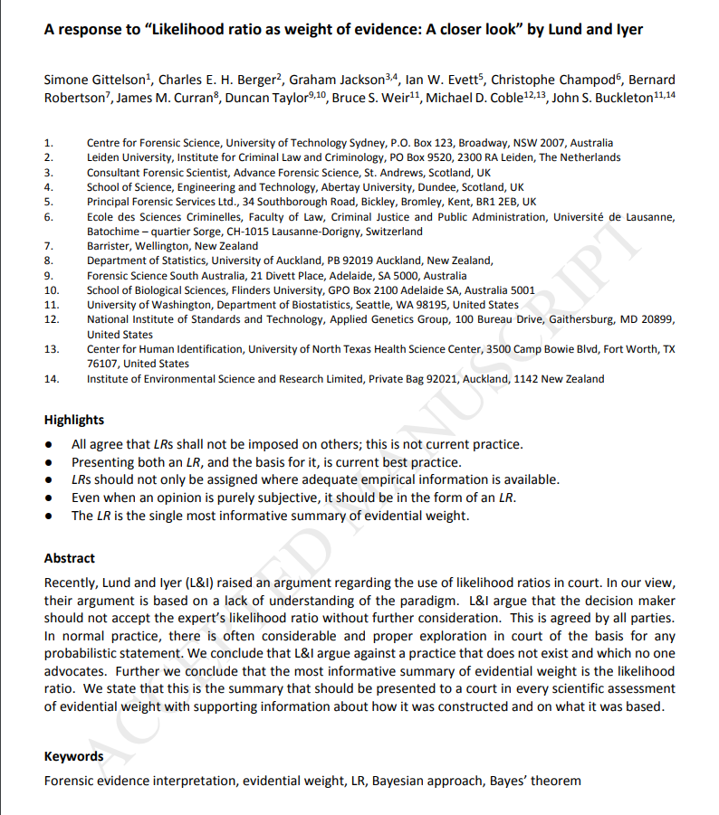
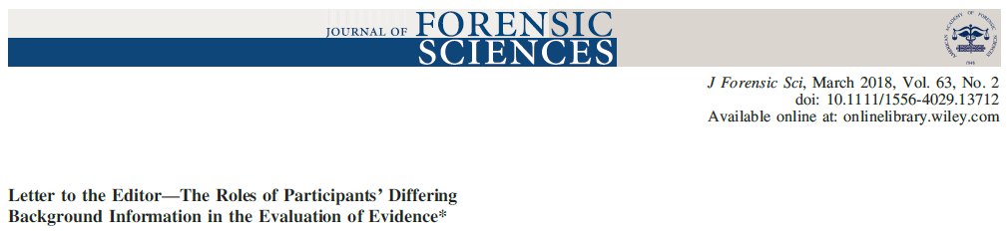

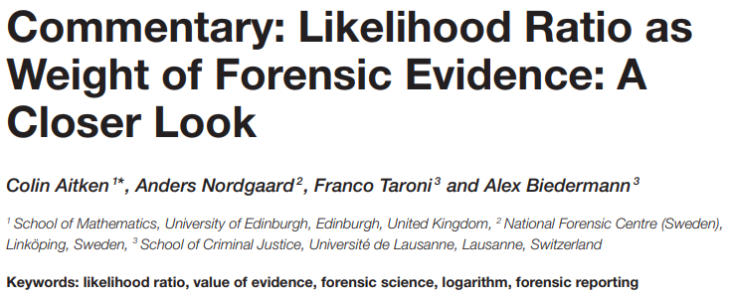
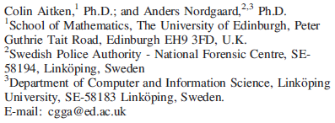
Published Responses
Commentary: Likelihood Ratio as Weight of Forensic Evidence: A Closer Look
Notes:
We are aware of four published responses to our paper. Today I’ll be discussing the response from Simone Gittelson et.al and the response from Geoffrey Morrison.

Slide 17
Our Suggestions:
This is not what the court is asking for, and jurors won’t understand it!
Option A: Stick to the facts (if an LR algorithm was used, treat it as a score rather than a probabilistic interpretation)
Option B: If translating data to probabilistic interpretation, seek to convey the influence of assumptions on the interpretation. We suggested considering an uncertainty pyramid
This is unnecessary. Jurors can modify an expert’s LR value themselves, or the adversarial system can sort it out!
Notes:
Notes of Advisory Committee on Proposed Rules for Federal Rule of Evidence 702: “Most of the literature assumes that experts testify only in the form of opinions. The assumption is logically unfounded.” It goes on to clearly state that expert opinion is not abolished, but the use of expert testimony in non-opinion form is encouraged.
If juror’s are not in a position to understand the available information, how are they expected to correct the expert’s offered LR?
We agree that assessing the influence of assumptions should be a standard part of the adversarial system, and thought the best way to ensure that it is, was to suggest that standard practice be for anyone providing an LR to report what is known about the influence of their assumptions
Among the four responses, regarding our main points we found :
no arguments against the claim that other reasonable models exist
no arguments against the fact that they’d give different answers (Everyone agrees!)
no arguments against the claim that you cannot understand how different the results could reasonably be without examining multiple models, regardless of how extensive validation efforts are.
no arguments against the claim this information is of direct interest to decision makers within the judicial system.

Slide 18
You presented a straw man argument!
These are the people we were writing about. We do not believe this negates the need for considering an uncertainty pyramid.
Morrison (page 4-5):
“Although there are some advocates of the use of the likelihood ratio framework who also take the view that likelihood ratio values can be assigned entirely on the basis of the forensic scientist’s untested subjective judgment (Lund & Iyer’s strawman), it is not true that likelihood ratios must be based on untested subjective judgment. Many forensic statisticians argue for a rigorous calculation of likelihood ratios based on relevant data, quantitative measurements, and statistical models.“
Notes:
We did not claim that all likelihoods ratios must be based on untested subjective judgement. We said that producing an LR, even when relevant data and quantitative measurements are available, requires modeling choices that influence the result.
We are not asking if you have tested your LR system. We are asking how wide is the range of LRs that pass your test? (If its not been tested, then the answer is anything from 0 to infinity)

Slide 19
You presented a straw man argument!
We agree with this “argument,” but did not attempt to make this point.
Gittleson et al (abstract):
“L&I argue that the decision maker should not accept the expert’s likelihood ratio without further consideration. This is agreed by all parties. In normal practice, there is often considerable and proper exploration in court of the basis for any probabilistic statement. We conclude that L&I argue against a practice that does not exist and which no one advocates. Further we conclude that the most informative summary of evidential weight is the likelihood ratio. We state that this is the summary that should be presented to a court in every scientific assessment of evidential weight with supporting information about how it was constructed and on what it was based.“
Gittleson et al (abstract):
“L&I argue that the decision maker should not accept the expert’s likelihood ratio without further consideration. This is agreed by all parties. In normal practice, there is often considerable and proper exploration in court of the basis for any probabilistic statement. We conclude that L&I argue against a practice that does not exist and which no one advocates. Further we conclude that the most informative summary of evidential weight is the likelihood ratio. We state that this is the summary that should be presented to a court in every scientific assessment of evidential weight with supporting information about how it was constructed and on what it was based.“
Gittleson et al (abstract):
“L&I argue that the decision maker should not accept the expert’s likelihood ratio without further consideration. This is agreed by all parties. In normal practice, there is often considerable and proper exploration in court of the basis for any probabilistic statement. We conclude that L&I argue against a practice that does not exist and which no one advocates. Further we conclude that the most informative summary of evidential weight is the likelihood ratio. We state that this is the summary that should be presented to a court in every scientific assessment of evidential weight with supporting information about how it was constructed and on what it was based.“
This is exactly what we are concerned about.

Slide 20
Validation Test
Evidence
Data
Likelihood Ratio
Model
Kinda
Pretty
Very
Notes:
Describing our data, our assumptions and model, and our validation efforts without referring to an uncertainty pyramid fails to convey the range of reasonable values and risks giving recipients a potentially unwarranted impression that any reasonable assessment of the evidence would differ only negligibly from the offered result.

Slide 21
Your reported LR
Your chosen validation test or plausibility criteria
#

Slide 22
LR framework is logically what’s required
Agree, broadly
  Likelihood of evidence should be assessed under each of an exhaustive set of plausible explanations
Points of potential disagreement:
  Framework does not imply an expert should provide opinion in the form of a numerical LR
  “CASE framework” (Consider All Sensible Explanations)
  Some situations not conducive to a pair of propositions

Slide 23
You say a model has to be theoretical best before being used. The theoretical best is not even relevant to the court
We did not suggest this, and agree it’s not relevant because it’s unattainable.

Slide 24
You say a model has to be theoretical best before being used. The theoretical best is not even relevant to the court
We said an offered model can only be shown to be reasonable, not uniquely best, and argue it’s essential to discuss what results are produced by other reasonable models

Slide 25
Your concerns apply to any probabilistic assessment or interpretation (including categorical conclusions), not just likelihood ratios.
We agree! Any uncertainty that affects LRs is a part of the uncertainty that would need to be considered for posteriors or categorical conclusions

Slide 26
Your suggestions are already the status quo!
That has not been our perception based on conversations, presentations, and readings we’ve encountered, including the responses
If true, we would have expected the rebuttal to simply point to ample reports and transcripts across many disciplines that stick to the facts or illustrate uncertainty pyramid
We’re not the ones experiencing day-to-day usage, so based on your own practices, judge for yourself!

Slide 27
Demonstrating how well system has performed on case-like instances warrants use of LR (3rd page of Morrison)
Warrants treatment as a score, rather than an interpretation

Slide 28
Reliance on adversarial system to flesh out uncertainty (4th page of Morrison, and Gittelson)
Our point was to make this Leads to an imbalance of justice. Those who can identify and afford effective experts, in addition to attorneys who can navigate the technical details.

Slide 29
Why we wrote the paper
Our perception based on papers, presentations and conversations with leading forensic statisticians
In particular, “The Dismissal of the Illusion…”
  Personal and accounts for all uncertainty
  “However, even if it were sensible to determine an interval, it is not clear how such an interval should act as a multiplication factor for the prior odds in favour of a prosecution proposition, held by a recipient of expert information.”
  “Instead, scientists should devote their efforts to the elicitation and communication of results that they can present—within a personal and decision-theoretic perspective—as their best representation of the value of the issue under consideration; i.e. as a probability or a likelihood ratio.”

Slide 30
Responses from Authors of Taroni 2015
Commentary: Likelihood Ratio as Weight of Forensic Evidence: A Closer Look

Slide 31
Commentary: Likelihood Ratio as Weight of Forensic Evidence: A Closer Look
If you have evidence (E), prosecution hypothesis (H_{p}), defense hypothesis (H_{d}), and background information (I), and Pr(E|H_{p}, I) and Pr(E| H_{d}, I) are available, the LR is the only logically admissible evaluation (whether considering Bayesian decision theory or not)
Additionally, LR is value and log(LR) is weight

Slide 32
Fact finders’ I “is formally independent of E and has no effect on the probability of E”
Forensic scientist’s I “is formally independent of the propositions H_{p} and H_{d} and has no effect on the probability of H_{p} or H_{d}”
Then evaluating evidence in light of everyone’s background information is equivalent to asking fact finder to form prior odds and forensic scientist to form LR

