Slide 1
Standardization Strategies in Flow Cytometry
Heba Degheidy, MD,PhD
OTAT/CBER/FDA

Slide 2
Flow Cytometry Applications
Immunophenotyping
Cell subsets are measured by labeling population specific proteins with a fluorescent tag on the cell surface.
^{Cell Sorting}
The cell sorter is a specialized flow cytometer with the ability to physically isolate cells of interest into separate collection tubes.
Cell Proliferation
Proliferation can be measured by labeling resting cells with a cell membrane fluorescent dye e.g. (CFSE) and measuring the reduction of the fluorescence signal.
DNA Content
Fluorescent dyes, such as propidium iodide, intercalates into the DNA helical structure. The fluorescent signal is directly proportional to the amount of DNA in the nucleus.
Apoptosis
The two distinct types of cell death, apoptosis and necrosis, can be assessed by flow cytometry.
Cell Cycle Analysis
Flow cytometry can analyze replication states using fluorescent dyes to measure the four distinct phases of the cell cycle.

Slide 3
Cell Therapy Product
  Ensure consistency and improve characterization of cell
  therapy products
  Methods to monitor manufacturing
  Product quality
  Scientific basis for:
      Policy development
      Guidance for sponsors

Slide 4
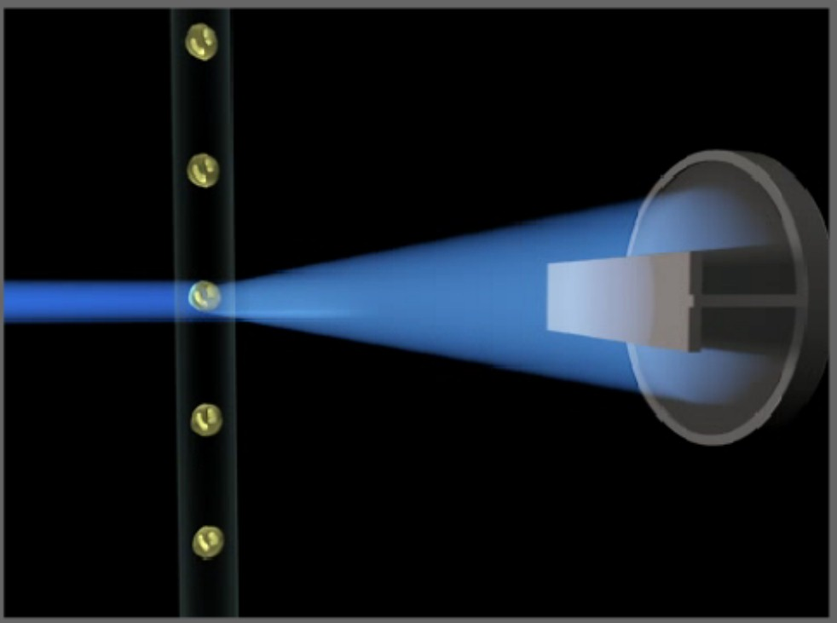
Cell Therapy Product Release Testing
Quality
Safety
Viability
Potency
Identity
Purity
Stability
Cell count

Slide 5

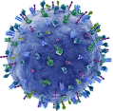
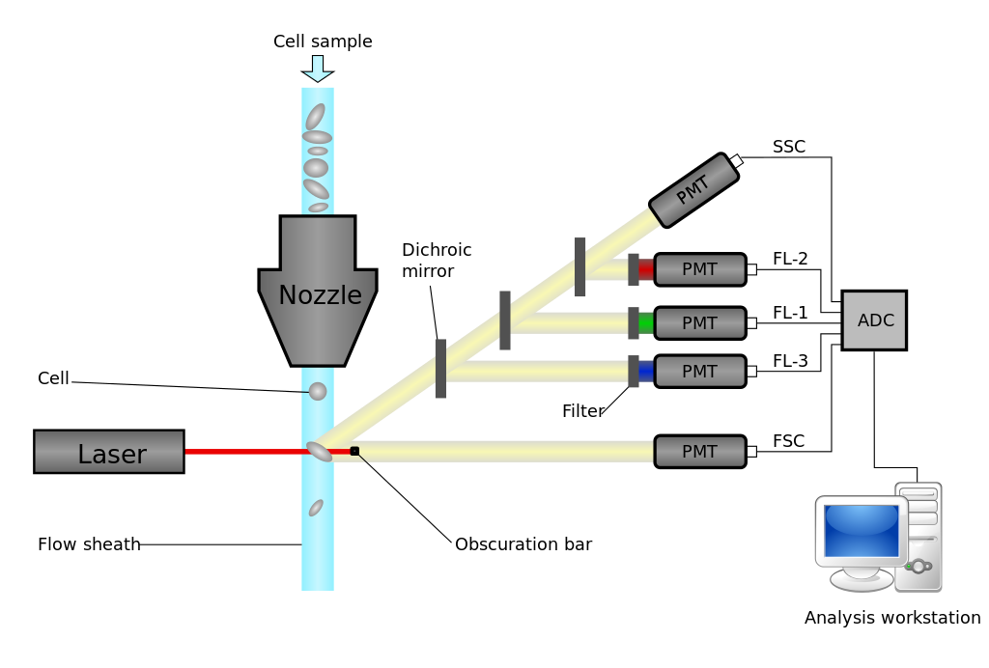
Flow Cytometry: Measure Identity and Purity of a Cell Product
Input = mixture of unlabeled and
labeled cells
Output = number of
labelled cells/ total cells (%)

Slide 6
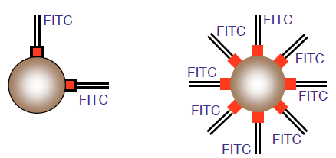
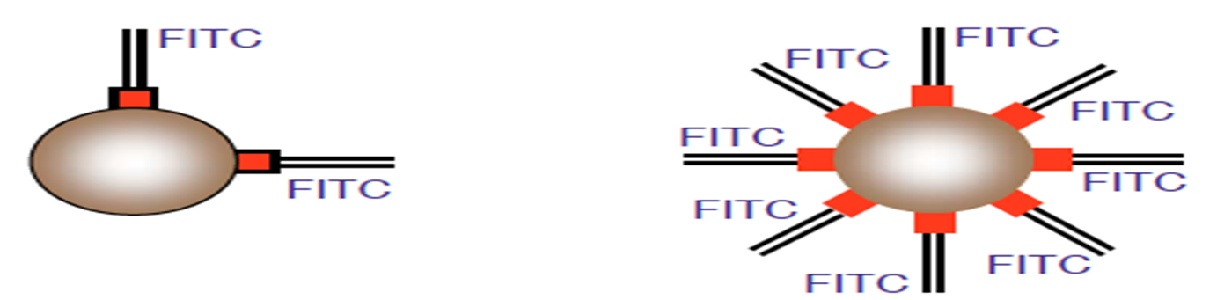
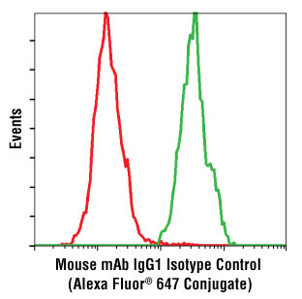
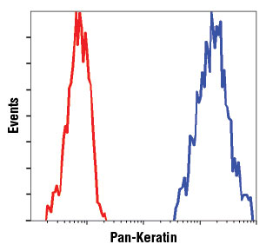
Percentage (%) vs. MFI
59%
60 %
FITC

Slide 7
Sources of Variability in Flow Cytometry
Flow cytometry experiment
Pre-Acquisition
Acquisition
Post- Acquisition
Cell Viability
Cell Preparation
Antibody panel
Fluorochrome selection
Staining Procedure
Controls
Instrument configuration
Instrument PM
Instrument QC/QA
Instrument monitoring
Instrument Calibration
Proper PMT setting
Proper controls
Gating template
Proper gating
Controls
Data reporting

Slide 8
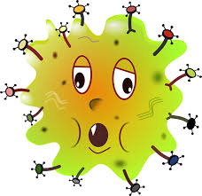
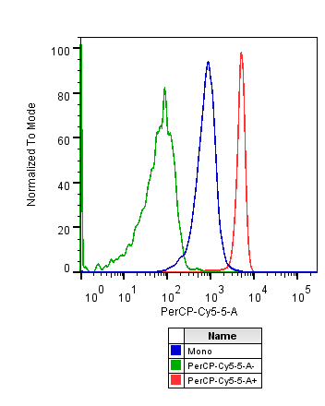
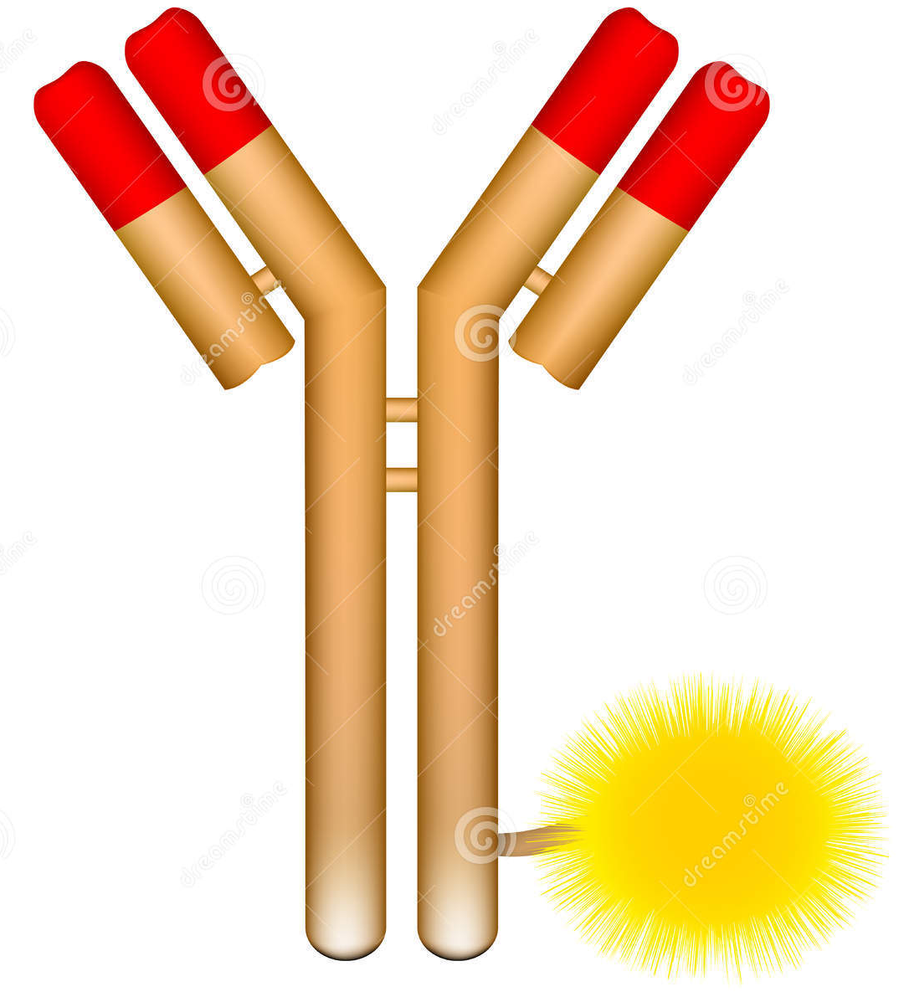

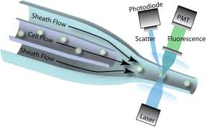
Positive Fluorescent Signal
PerCP-Cy5.5
Auto fluorescence
Antigen density
Antibody clone
Flour chrome
F/P
PMT voltage
Electronic noise
Fluorescence detection efficiency

Slide 9
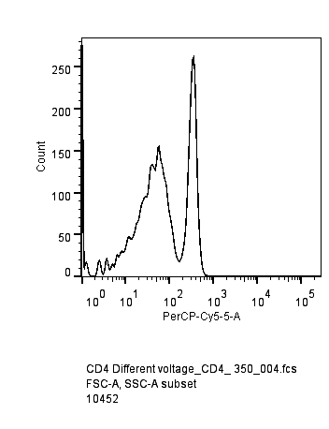
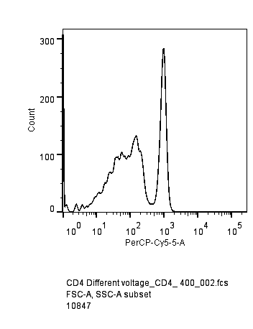
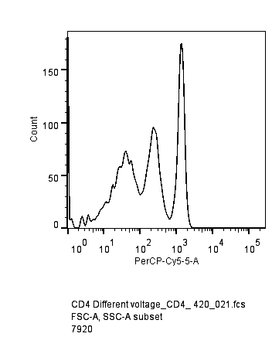

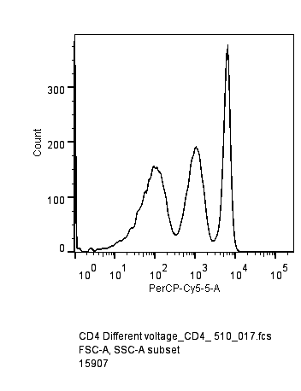
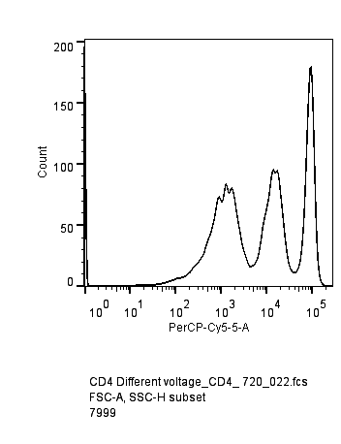
PMT Voltage Optimization
PMT=350
PMT=400
PMT=420
DP
HP
N
P
P
N
N
PMT=497
PMT=510
PMT=720
DP
HP
DP
HP
HP
N
N
DP
N

Slide 10
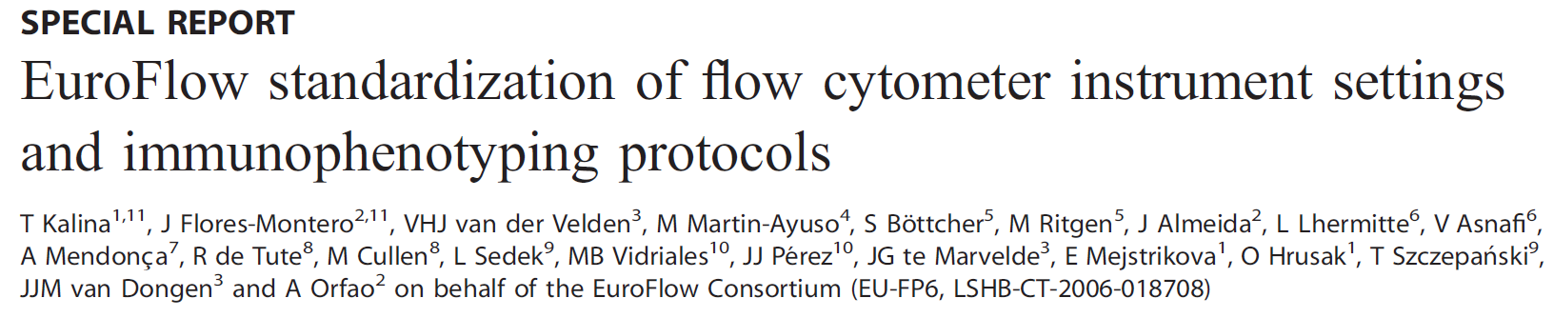
The EuroFlow setting of photomultiplier tube (PMT) voltages for a fluorescence detector is established at a voltage above the electronic noise in such a way that the least auto fluorescent cell type to be measured is placed at the left side of the scale, as ‘negative’ events clearly distinguishable from debris in the multidimensional space generated, dim fluorescent events can be discriminated from the negative, and no cell- or bead- associated fluorescence measurement reaches the upper limit of the scale. Each PMT is characterized by a response of accuracy to PMT voltage measured, as the robust coefficient of variation (rCV) of a dim particle. Optimal PMT voltage is set at the beginning of the plateau of a rCV versus PMT voltage curve. In this way, the electronic noise contribution to the signal is minimal whereas maximal dynamic range is left for the measurement of fluorescence
Leukemia (2012) 26, 1986–2010

Slide 11
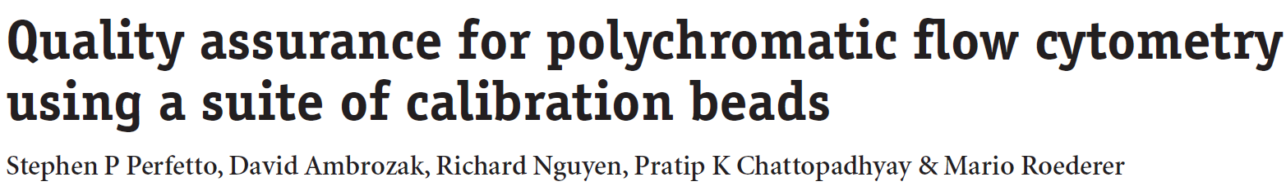
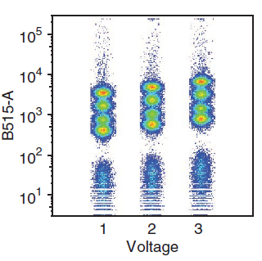
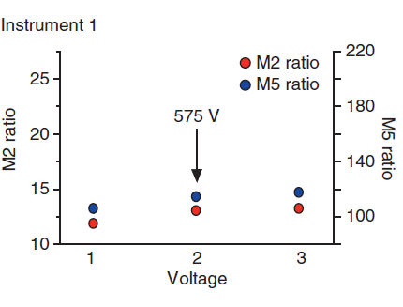
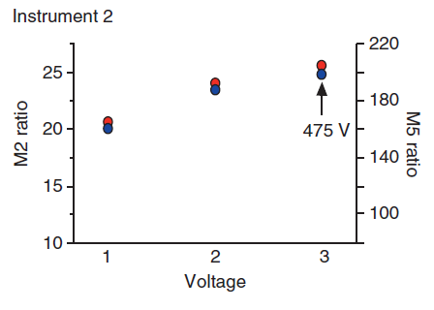
Determining the optimal PMT voltage using QCSBs
Using Quantum Simply Cellular Beads , QCSBs (an antibody-capture beads with four different intensities and a negative bead)
Identify M1-M5
  M1= negative bead population and M5 = brightest bead population.
  M2 ratio (dimmest bead separation) = MFI of the M2 bead/90th percentile of the M1 bead
  M5 ratio (brightest bead separation) = MFI of M3 bead/90th percentile of the M1 bead.
If these ratios are unchanged over the voltage range, as in instrument 1, then the middle voltage is selected (e.g., 575 V).
If these ratios continue to increase, as in instrument 2 , then the highest voltage in the range is selected (e.g., 475 V).
Nature protocols , VOL.7, 2012

Slide 12
Concept of Flow cytometry Standardization
Identify the minimum acceptable voltage for each channel to ensure:
  Negative’ events are clearly distinguishable from the debris
  Dim fluorescent events can be discriminated from the negative and are not dominated by electronic noise.
  The high positive populations are within the linear range for each detector

Slide 13
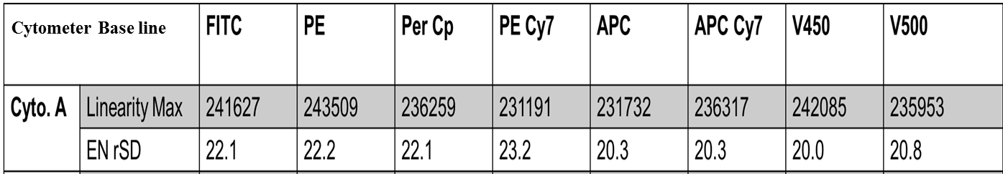
Instrument Standardization
Steps:
1- Define base line and establish cytometer specific reference settings
2- Run daily performance Characteristic QC/QA of instrument.
2- Determine ENrSD, Lin Max for each detector.

Slide 14
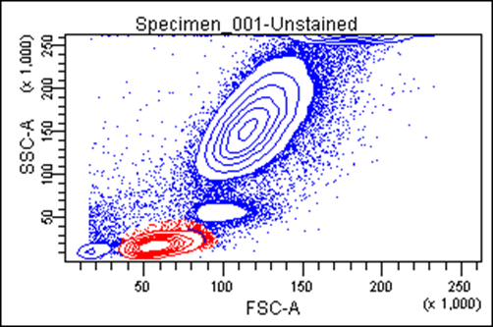
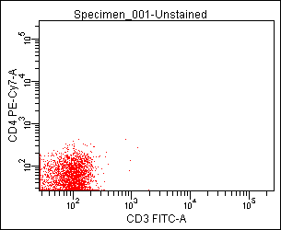
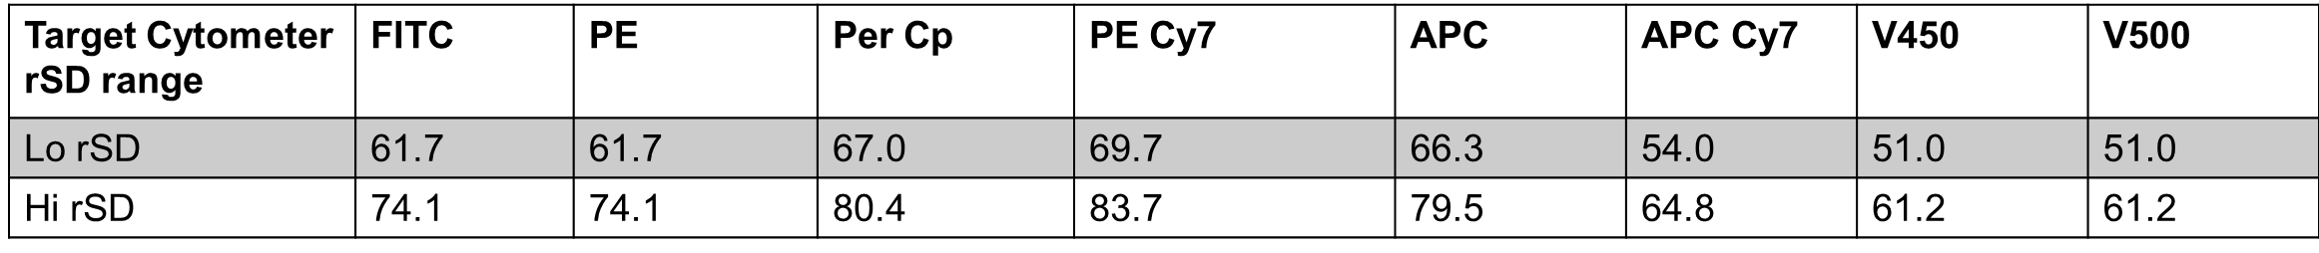
Instrument Standardization
4- Use unstained control to optimize the voltage and adjust the unstained background within 2.5 times the ENrSD
2.5. ENrSD

Slide 15
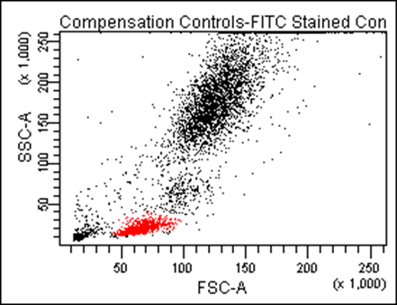
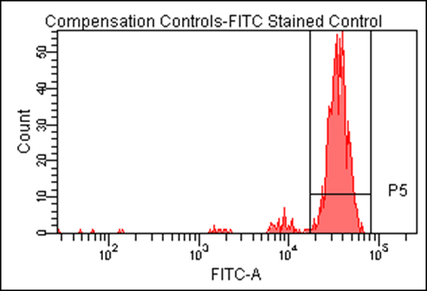
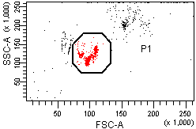
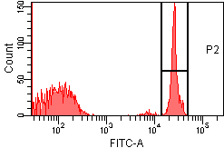
Instrument Standardization
5. Check the PMT voltage ( The bright positive peaks are within the linear scale for each detector.
Biological
Control
Beads
Control

Slide 16
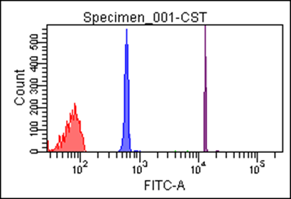
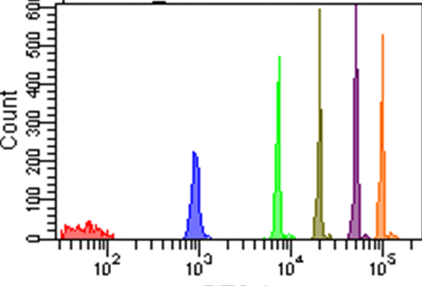
Instrument Standardization
6-Run Compensation controls (Comp beads or biological control) using the same PMT voltage compensation calculation.
7- Identify the MFI of one target peak ( 3 beaks, or 6 beaks beads) and save it.
8- Record instrument target MFI over time to define instrument performance.
9- Run stained biological control tube e.g. normal donor T,B,NK and B-cell subsets tube.
MFI
MFI
FITC
FITC

Slide 17
Standardization of One Instrument vs. Multiple Instruments
Transfer target MFI values
Optimize PMT voltages
0ptimize voltages of 2nd cytometer using these target values
Identify Target values
Compare multi color stained biological control tube between Standardized Cytometers
Monitor instruments performance over time using beads

Slide 18
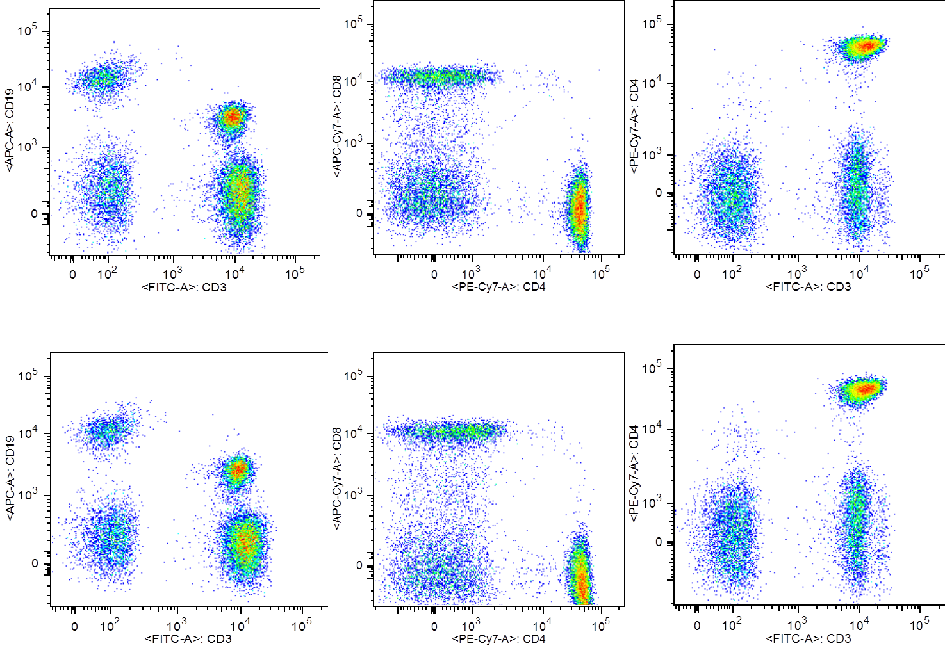
Two Flow cytometry Instruments at same location
CD3, CD4 and CD8 stained tube acquired on two flow cytometers and analyzed using the same gating template
Cyto. A
Cyto. B

Slide 19
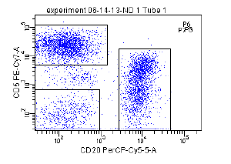
Four Flow cytometers at two laboratory locations
Instrument #1
Instrument #2
Instrument #3
Instrument #4
CD20
CD3
CD5
CD20

Slide 20
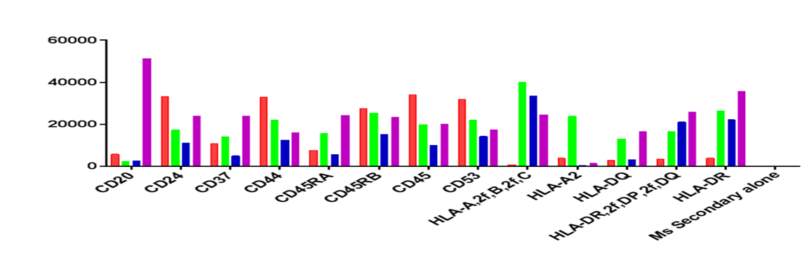
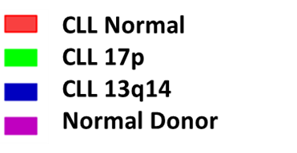
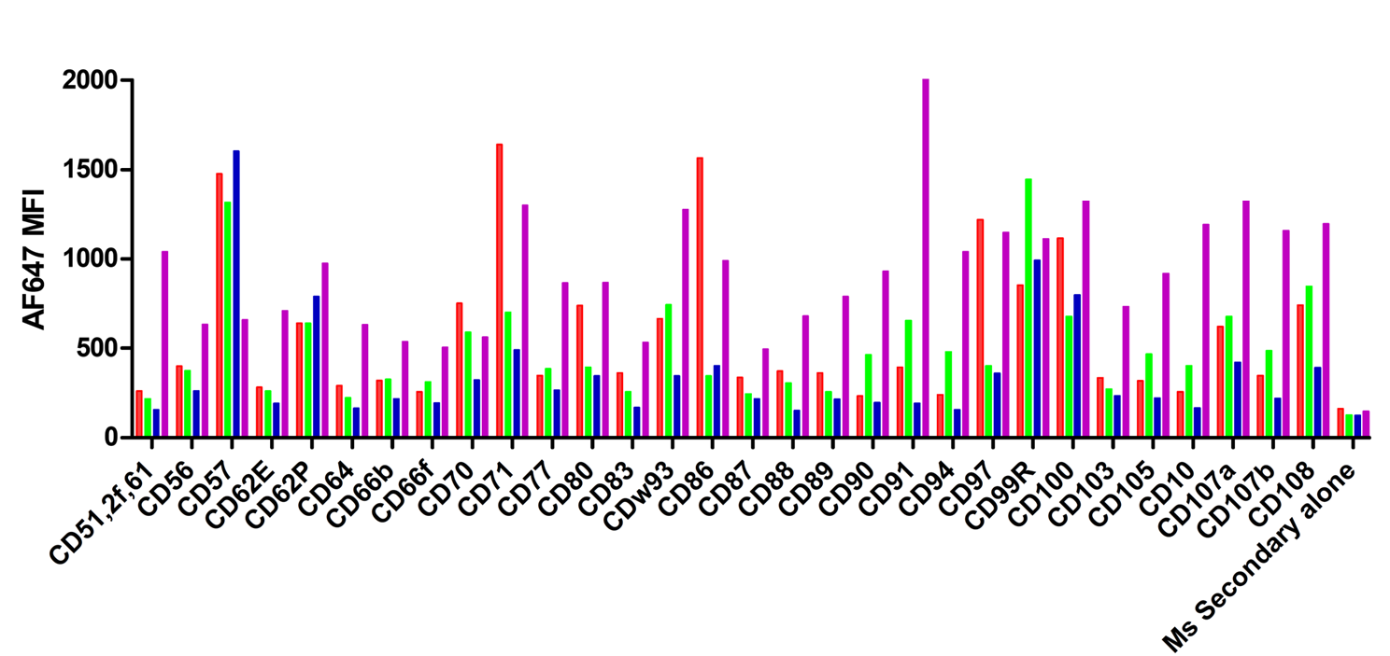
Percentage (%) Does Not Inform Us About Inherited Changes within the Cell !
Gated on CD19+ve
CD20
19
Notes:
All lines capable of tri-lineage differentiation

Slide 21
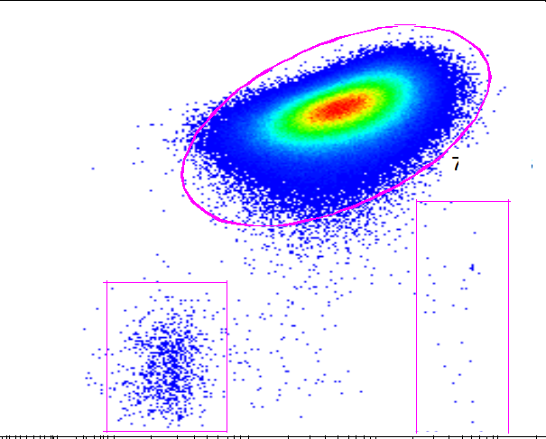
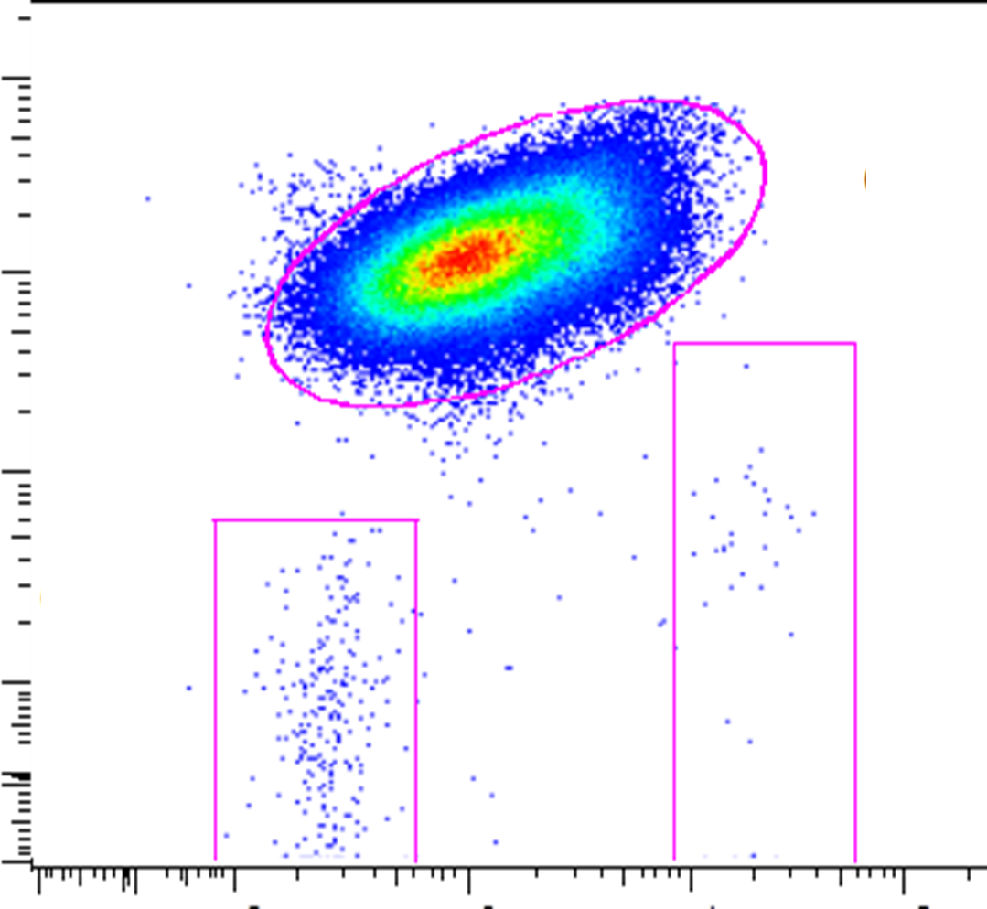

Percentage (%) Does Not Inform Us About Inherited Changes within the Cell
99.6%
99.4%
CD20 dim/CD19+/ CD5+/CD3-
CD5
CD5
Non del 13q14
del 13q14
CD20
CD20
% of Max
BCL-2
Degheidy et al., Cytometry B Clin Cytom. 2013;84(4):237-47
20
Notes:
All lines capable of tri-lineage differentiation

Slide 22
Changes in BCL-2 Level with Leukemia Progression
Diagnosis
1 year after diagnosis
Overlay
Del 13q14
Mono-allelic
Del 13q14
Bi-allelic
Del 13q14
Bi-allelic
Count
BCL-2
Importance of using the same cytometer settings to predicts changes in MFI
over time
Degheidy et al. 2013. Cytometry B Clin Cytom. Jul-Aug;84(4):237-47
21

Slide 23
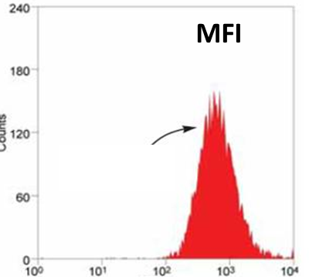
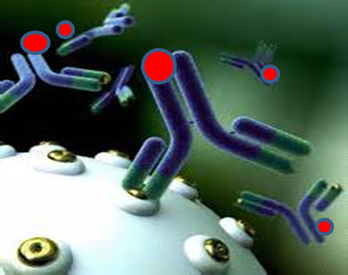
Principle of Marker Quantification
Antibodies bound per cell (ABC)
Biomarker Quantification
ABC
Count
PE
Antibody Bound per Cell (ABC) value

Slide 24
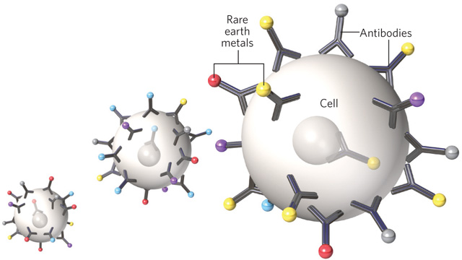
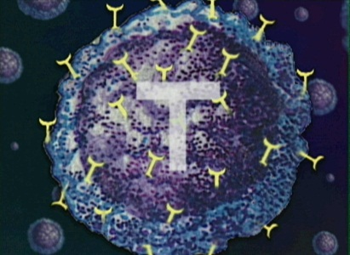
Development of Cell Reference Materials for Flow Cytometry Based Quantification
National Institute of Standards and Technology (NIST)
Application setting
MFI of known ABC
Known ABC value
ABC for CD4= 40,000
(Based on Flow Cytom. and Mass Spec.)
Same settings
MFI to calculate ABC
Unknown ABC value
Wang et al. Cytometry Part A 2012, 81A:567
Wang et al. Clinical Proteomics 2014, 11:43
23

Slide 25
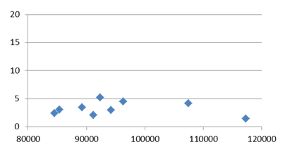
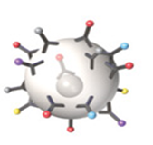
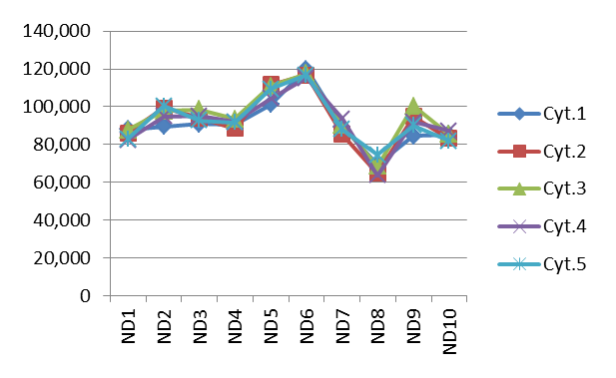
Consistent Measurements of CD20 ABC Values
10 Donors/ 5 instruments/ 2 laboratories
APC CD20
CV %
ABC CD20
Degheidy et al.,2014. J. Biomedical Science and Engineering; 7: 756-768.
Degheidy et al.,2016. Cytometry. Part B, Clinical cytometry ;90:159–167

Slide 26
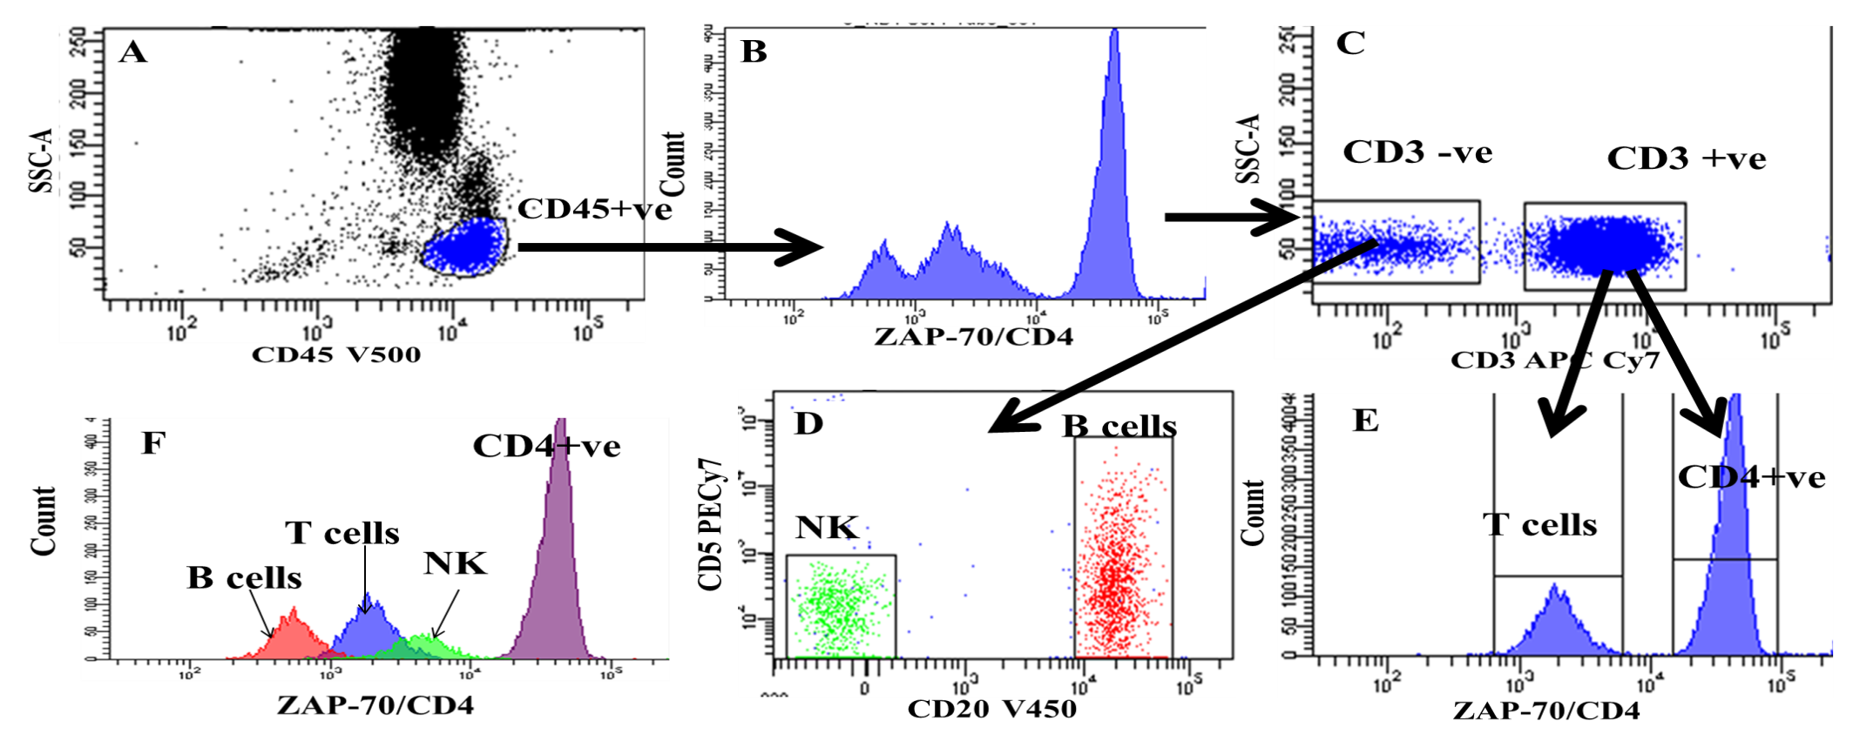
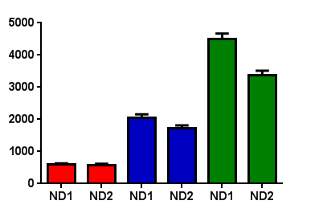
ZAP70 Expression in B- T-and NK- Cells
NK cells
ABC ZAP70
T cells
B cells
Degheidy et al., 2011. Cytometry B Clin Cytom. Sep;80( 5):300-8
Degheidy et al., 2011. Cytometry B Clin Cytom. Sep;80(5):309-17
Degheidy et al., 2012. Cytometry B Clin Cytom. 82B:67–77

Slide 27
Acknowledgements
NIST: Lili Wang, A.K. Gaigalas
FDA: Howard Mostowski, Fatima Abbasi, Gerald Marti, Steven Bauer, Flow cytometry working group
NIH: Adrian Wiestner, NIH Blood Bank

Slide 28

Thank You

