Slide 1
NIST-FDA Flow Cytometry Workshop
Steven R. Bauer, Ph.D.
US Food and Drug Administration
Center for Biologics Evaluation and Research
Office of Tissues and Advanced Therapies
1

Slide 2
Outline
Introduction
Challenges in Flow Cytometry
Importance of Standards
Workshop Goals
2

Slide 3
Flow Cytometry is Crucial for
Products in Multiple FDA Centers
CBER: many cell-based products, cell-based assays
CDRH: devices for counting cells, diagnostics
CVM: many cell-based products
CDER: stem-cell based screening assays for drug development, cell-based production of biologics
My focus: CBER- regulated cell-based products and regenerative medicine
    Generally applicable to other FDA-regulated products
3
Notes:
Combination products across Centers

Slide 4
21st Century Cures Act:
Title III, Section 3036
Regenerative medicine provision:
  Section 3036: Directs HHS, in consultation with NIST and stakeholders, to facilitate efforts around development of standards for regenerative medicine therapies and regenerative medicine advanced therapies
  Standards for flow cytometry will be beneficial for many FDA-regulated product types
4

Slide 5
Areas for Flow Cytometry Standards
Instrument variability
Threshold and Gate settings
Cell preparation
Operator training
Reagents
Quantitation
Others
5

Slide 6
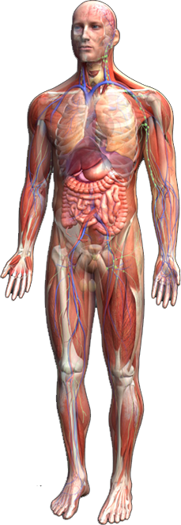
Therapeutic Promise of
Regenerative Medicine
Dental repair
Stroke
Heart repair
Bone marrow
transplantation
Lung repair
Diabetes
Spinal cord repair
Crohn’s disease
Graft Vs. Host disease
Arthritis
6

Slide 7

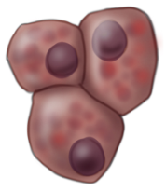
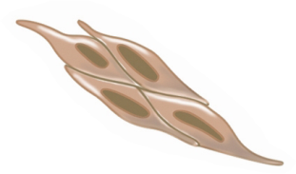

How Can We Help Fulfill the Tremendous Promise?
Self-
renewal
Terminal
Differentiation
Commitment
Differentiation
Developmental Stages
Environmental Influences
Can we develop ways to identify and
confidently measure
Quality Attributes that
predict safety and effectiveness?
Quality Attributes depend on
Quality Measurements!!!
(Purity, Identity, Potency)
7

Slide 8
Flow Cytometry
Crucial for measurements of purity, identity, potency
Methods vary and depend on the product
Validation of flow cytometry procedure required for licensure
  Expected by Phase III, required for BLA
Pre-IND
IND
BLA
Development
Preclinical
Phase I
Phase II
Phase III
Marketing
8

Slide 9
Flow Cytometry Measurement
Reproducibility
  Day-to-day
  Instrument to instrument
  Between platforms
  Within a facility
  Between facilities
What to measure
9

Slide 10
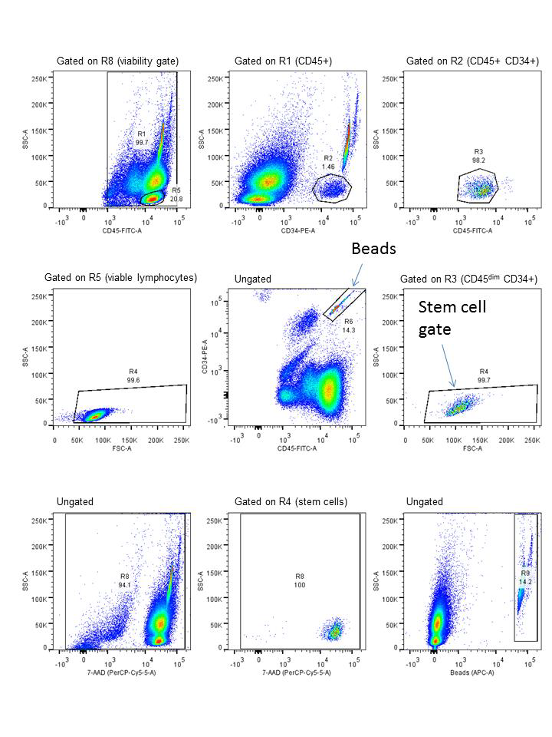
Examples of Flow Cytometry Use
Enumeration of CD34⁺ cells
Characterization of MSCs
Lo Surdo JL et al., Cytotherapy, 2013
http://www.nibsc.org/science_and_research/biotherapeutics/flow_cytometry_reference_materials.aspx
10

Slide 11
Additional Considerations for
Cell-based Products
Flow cytometry often established for one product by one manufacturer in one site
Other considerations
  Multiple manufacturing sites
  Technology Transfer (new site, scale out, etc.)
Standards (written, physical) would be beneficial
11

Slide 12
Benefits of Standards
(Written, Physical)
Confidence/comparison
Basic and Translational Research
  Academic labs
  R&D labs
  Within context of one sponsor
  Within community of developers
Facilitate development of safe and effective cell-based products
  Precise and Accurate Flow Cytometry
12

Slide 13
Cell Product Characterization
  Purity
    Free of extraneous materials
    Identity
    Specific test to distinguish it from others
    Potency
    Assay for biological function
Sponsor determined methods
Flow cytometry often used for these Quality Attributes
13

Slide 14
Outcomes
Discussions with Expert Stakeholders
Clarification of Challenges
Identification of Possible Solutions
Identification of Standards Development Opportunities
Publication of a White Paper
14

Slide 15
OTAT Contact Information
Steven R. Bauer, Ph.D.
steven.bauer@fda.hhs.gov
240-402-9385
Regulatory Questions:
Contact the Regulatory Management Staff in OTAT at OTATRPMS@fda.hhs.gov
or Lori.Tull@fda.hhs.gov
or by calling (240) 402-8361
OCTGT Learn Webinar Series: http://www.fda.gov/BiologicsBloodVaccines/NewsEvents/ucm232821.htm
15

Slide 16
Public Access to CBER
CBER website:
http://www.fda.gov/BiologicsBloodVaccines/default.htm
Phone: 1-800-835-4709 or 240-402-8010
Consumer Affairs Branch (CAB)
Email: ocod@fda.hhs.gov
Phone: 240-402-8010
Manufacturers Assistance and Technical Training Branch (MATTB)
Email: industry.biologics@fda.gov
Phone: 240-402-8010
Follow us on Twitter
https://www.twitter.com/fdacber
16

