Slide 1

Baldrige Performance Excellence Program | 2020
Self-Assessing Your Organization with the
Baldrige Excellence Framework
Notes:
Self-Assessing Your Organization with the Baldrige Excellence Framework. Baldrige Performance Excellence Program 2020.

Slide 2
What Is a Baldrige Self-Assessment?
The first step toward organizational
improvement and performance excellence
A “results-oriented” review
Adaptable to the needs of your organization
Notes:
The Baldrige Excellence Framework is a systems approach to improving your organization. Whether your organization is large or small, and no matter your industry or sector, you can use the Baldrige framework and its Criteria for Performance Excellence for improvement.
The Baldrige framework provides a way to evaluate how well your organization is meeting its goals and objectives. You can use the Baldrige framework to evaluate your processes and their impact on results.
Most organizations begin their improvement journeys by using the Criteria for self-assessment. Self-assessments are flexible. You can
engage all workforce members in the process or select participants from a cross section of functions and levels—or appoint a small group to represent all colleagues
use a questionnaire approach
use only the Organizational Profile for a first self-assessment
use a selected group of questions from the seven Criteria categories
do a full self-assessment

Slide 3
Why Conduct a Self-Assessment?
Your customers, competitors, or budget are driving the need to change.
Your environment is changing.
Your organization is among the best, and you want to keep it that way.
Notes:
Many reasons can underlie the need for a Baldrige self-assessment.
Your customers, competitors, or budget are driving the need to change.
Your environment is changing.
Your organization is among the best, and you want to keep it that way.
Your self-assessment can reveal strengths for you to build on and opportunities for to improve, and help you implement appropriate action plans.

Slide 4
Benefits
Identify successes and opportunities for improvement
Jump-start a change initiative
Energize improvement initiatives
Energize the workforce
Focus your organization on common goals
Assess performance against the competition
Align resources with strategic objectives
Notes:
You can realize on one or more of these benefits when your organization conducts a self-assessment and uses the results to create and carry out action plans for improvement: Identify successes and opportunities for improvement
Jump-start a change initiative
Energize improvement initiatives
Energize the workforce
Focus your organization on common goals
Assess performance against the competition
Align resources with strategic objectives

Slide 5
Tools and Approaches
Surveys
Are We Making Progress?
Are We Making Progress as Leaders?
easyInsight
Self-Assessments
Organizational Profile
Criteria item title questions
Baldrige Excellence Builder
Full self-assessment
Are You a Role-Model Leader?
Boards of Directors’ Responsibilities
Notes:
Here are some tools and approaches that you can use to introduce the Baldrige framework to your organization and begin a self-assessment. Your organization’s experience with the Baldrige framework will help you decide where to begin.
Are We Making Progress? and Are We Making Progress as Leaders? are two questionnaires that introduce the seven Baldrige Criteria categories to your organization and help you quickly identify strengths and opportunities for improvement.
2. easyInsight: Take a First Step toward a Baldrige Self-Assessment is an online survey that helps you identify gaps in your understanding of your organization and allows you to compare your organization to others.
3. Completing the Organizational Profile is the first step in a full self-assessment against the Baldrige Criteria.
4. Answering the 17 Criteria item title questions helps you understand the full dimensions of the Criteria and your organization.
5. You can conduct an intermediate self-assessment against the most important Criteria questions using the Baldrige Excellence Builder.
6. Finally, you can conduct a full self-assessment using the seven categories of the Baldrige Criteria.

Slide 6
Are We Making Progress?
Notes:
Learn what your employees and senior leaders think. Try Are We Making Progress? and Are We Making Progress as Leaders?, available free from the Baldrige website. Organized by the seven Baldrige Criteria categories, these questionnaires help you check your progress on organizational goals and improve communication among your workforce members and leadership team. Learn whether
your leadership team and employees understand the values, vision, mission, and plans
workforce members trust your organization’s leadership
your communication is effective
your message is being well received

Slide 7
For Your Workforce
For Your Leaders
Notes:
The questionnaires each contain 40 statements, use a 5-point scale for responses, and take about 10 minutes to complete. They are written in simple language that helps you understand the intent of the seven Criteria categories.
The questionnaire can be used with all levels of employees. Depending on your organization’s needs, you can distribute the questionnaire to a subset of employees or to all employees.
Are We Making Progress as Leaders? asks questions similar to those in Are We Making Progress? but its target audience is the organization’s leaders.
You can modify the 40 questions in either questionnaire to address the specific needs or language of your organization. They can help you focus your improvement and communication efforts on areas needing the most attention.

Slide 8

easyInsight
Is my organization ready for a more thorough self-assessment?
Are there gaps in our knowledge about our organization?
How does my organization compare to others?
What plans can we make for improvement or for a more complete self-assessment?
Notes:
Identify gaps in your understanding of your organization and compare your organization with others with easyInsight: Take a First Step toward a Baldrige Self-Assessment, an online self-assessment tool based on the Organizational Profile. You can complete easyInsight free on the Baldrige website.
Completing easyInsight can
help you determine your organization’s readiness for a more thorough self-assessment
reveal gaps in information and opportunities for improvement
allow you to compare your organization to others who already have completed the easyInsight self-assessment
help you develop an action plan for improvement or prepare for a more complete self-assessment

Slide 9
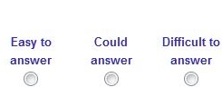
To Complete easyInsight
Notes:
To complete easyInsight, you read and consider each question in the Organizational Profile within the context of your organization, and then determine the level of difficulty of answering each question: “Easy to answer,” “Could answer,” or “Difficult to answer.”
Doing this helps you identify gaps in your understanding of your organization.
When you have completed the online assessment, you can compare your answers to those of others who have completed easyInsight.
You can then develop an action plan to address gaps and issues.

Slide 10
Organizational Profile Questions
What are my organization’s key characteristics?
What are the key influences on my organization?
What key challenges does my organization face?
Notes:
When you have completed easyInsight and addressed your gaps or issues, you may be ready to move on to responding to the questions in the Organizational Profile.
The Organizational Profile sets the context for evaluating your organization. It is what makes the Criteria for Performance Excellence applicable to any type of organization—business, education, health care, nonprofit, or government; large or small; single-site or with locations around the world.
Specifically, the Organizational Profile is a series of questions that helps you better understand your organization. It creates a snapshot of your organization so you can examine its key influences, challenges, and advantages: What are my organization’s key characteristics?
What are the key influences on my organization?
What key challenges does my organization face?
The Organizational Profile is available free as a standalone document on the Baldrige website, as part of the free Baldrige Excellence Builder (discussed later in this presentation), and in the full Baldrige Excellence Framework booklet, available for sale on the Baldrige website.

Slide 11
Complete the Organizational Profile
Describe what is relevant and important
Ensure common understanding
Guide selection of information/data
Identify gaps/lack of deployment
Notes:
By answering the questions in the Organizational Profile, your organization can gain a common understanding of what is important to you, and this understanding will then guide data collection and selection of information as the process continues. The Organizational Profile also guides the assessment of approaches used by your organization, the extent of deployment of those approaches, and the results you achieve.
Many organizations start with the Organizational Profile and progress gradually to more detailed levels of self-assessment and action. If you identify topics for which you have conflicting, little, or no information, you can use these topics for action planning.

Slide 12
Organizational Profile
Notes:
The requirements for the Organizational Profile are basically the same for all three versions of the Baldrige framework—Business/Nonprofit, Health Care, and Education—with some variation in vocabulary.
There are two major sections with subparts under each.
The first section is the basic description of your organization.
This includes your organizational environment (product offerings; mission, vision, and values; core competencies; workforce profile; technologies, equipment, and facilities; and regulatory environment). It also includes your organizational relationships (governance system, key customer groups, stakeholder groups, and market segments; key product and customer-support service requirements; and key suppliers and partners).

Slide 13
Organizational Situation
Notes:
The second section focuses on your organizational situation.
This includes your organization’s competitive environment (including your relative size and growth and number of competitors). It also includes your strategic context (key business, operational, societal responsibility, and workforce strategic challenges and advantages) and your performance improvement system (including your approach to evaluation and improvement).

Slide 14
Next step
Notes:
As a next step in self-assessment, you might answer the questions in the titles of the 17 Criteria items. The sample shown here is from Category 3, Customers. This will give you a basic understanding of the Criteria and your organization’s performance in each area. You might do this yourself, at a leadership retreat, or as a whole organization.
These title questions are part of the Baldrige Excellence Builder (discussed later) and the full Baldrige Excellence Framework booklet.

Slide 15
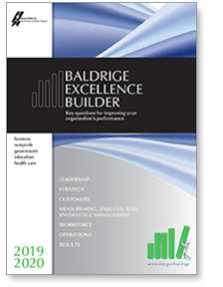
Intermediate Self-Assessment
Baldrige Excellence Builder:
Key questions for improving your organization’s performance
Notes:
If your organization has some experience with the Baldrige Criteria or has completed smaller-scale assessments, you may be ready to assess your organization against the most important features of organizational performance excellence, using the questions in the Baldrige Excellence Builder.

Slide 16
Sample
Notes:
The booklet includes instructions for doing this type of assessment, as well as a scoring rubric and a glossary of key terms.
You might use the champion-and-team approach described later in this presentation, or have your senior leaders perform the assessment.

Slide 17
Full Self-Assessment: Six Steps
Identify the scope.
Select champions.
Select category teams/collect data & information.
Share answers.
Create & communicate an action plan.
Notes:
If your organization has some experience with the Baldrige framework or has completed smaller-scale assessments, you may be ready to use the complete set of Criteria to conduct a full self-assessment. Here are six basic steps for conducting a full self-assessment. We encourage you to modify this process to meet your own organizational needs.

Slide 18
Steps 1-3
1. Scope: the whole organization, or one part?
2. Champions: one for each Criteria or Excellence Builder category
Select category teams; answer the Criteria or Excellence Builder questions
Notes:
First, identify whether the whole organization or a specific part of it will be assessed. Determine if the self-assessment will cover the entire organization, a subunit, a division, or a department.
Then select champions for each of the Baldrige categories. These champions will participate in preparing responses to the item questions in the Criteria categories—either the full set of Criteria questions or the questions in the Baldrige Excellence Builder. If they have not already done so, champions should prepare an Organizational Profile describing your organization and its challenges.
The champions select category teams, which collect information and data for responding to the questions in their respective categories.

Slide 19
Steps 4-5
4. Share answers to the questions
among category teams.
5. Create and communicate an action plan
for improvement.
Criteria category | Importance: High, medium, low | For High-Importance Areas Stretch (strength) or improvement (OFI) goal What action is planned? By when? Who is responsible?
1 Leadership
Strength
1.
2.
OFI
1.
2.
Notes:
4. Category teams share their answers to the Excellence Builder or Criteria questions with other category teams. The teams identify common themes in their answers. If you choose, you could have the teams score their answers using the basic rubric in the Excellence Builder or the full rubric in the Baldrige Excellence Framework booklet.
5. Each category team creates and communicates an action plan for improvement based on the team’s answers and organizational priorities. The Self-Analysis Worksheet, available online at www.nist.gov/baldrige/publications/business_nonprofit_criteria.cfm, can help your category teams identify strengths and opportunities, set priorities, and develop action plans.

Slide 20
Step 6
6. Evaluate the self-assessment process
for future improvements.
Notes:
6. In the final step, senior leaders, champions, and teams evaluate what has been done and think about ways to improve the self-assessment process in the future.
Your organization’s experience with and prior use of the Baldrige framework may determine whether you use an informal self-assessment or a formal approach that includes developing a written report. If you decide on an informal assessment—which many organizations have found to be a good way to start—you can complete the exercise in a one- or two-day meeting.

Slide 21
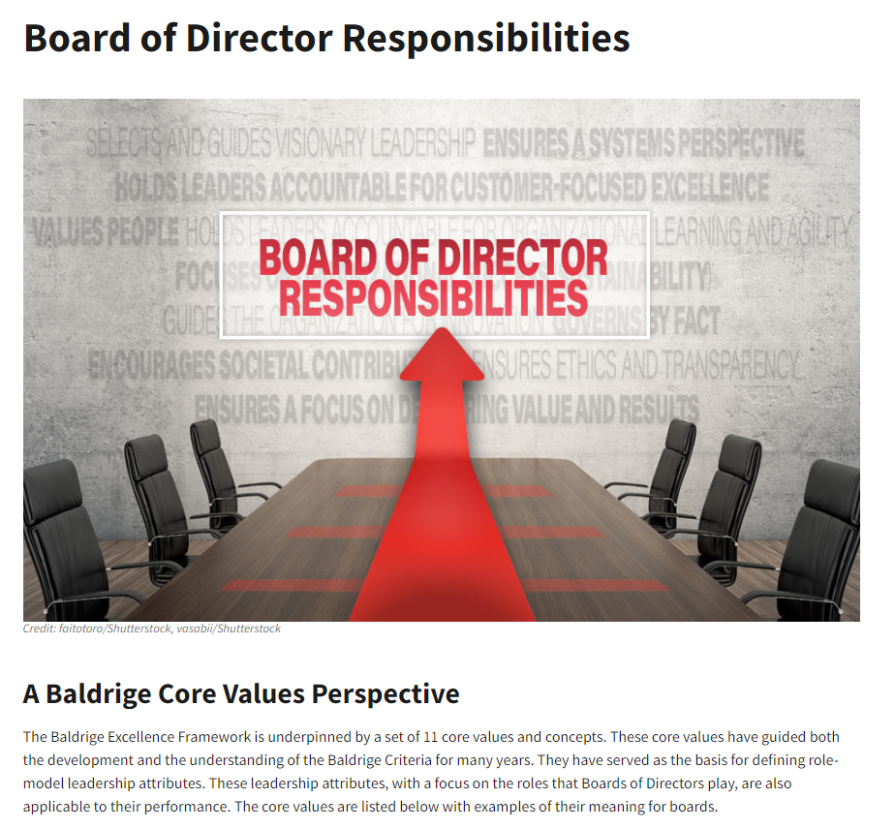
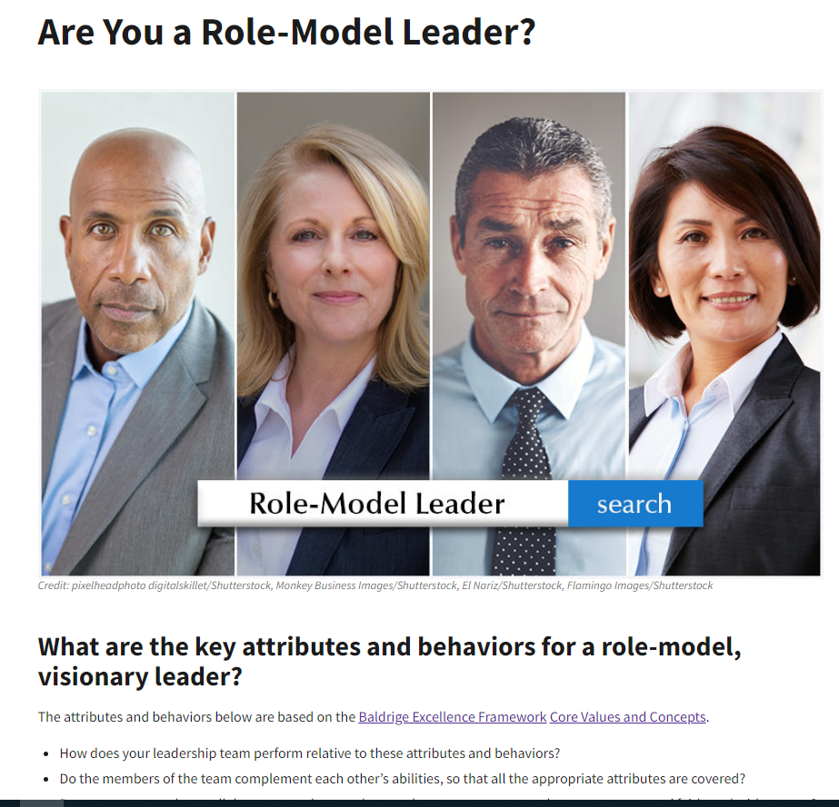
“Board of Director Responsibilities” and “Are You a Role-Model Leader?”
Notes:
Use “Are You a Role-Model Leader?” to assess your leaders against the attributes and behaviors of role-model organizational leaders in the context of the Baldrige core values.
See “Board of Director Responsibilities” for role-model board attributes and examples.

Slide 22
For more information
For more information
Baldrige Excellence Framework booklets
Self-assessment tools
Training, conferences, and executive education
Organizational assessments
Award recipient profiles
Case studies
Connections to the Baldrige community
www.nist.gov/baldrige
baldrige@nist.gov
(301) 975-2036
Baldrige Performance Excellence Program | www.nist.gov/baldrige
Notes:
For more information:
Baldrige Excellence Framework booklets
Self-assessment tools
Training, conferences, and executive education
Organizational assessments
Award recipient profiles
Case studies
Connections to the Baldrige community
www.nist.gov/baldrige
baldrige@nist.gov
301-975-2036

