Slide 1
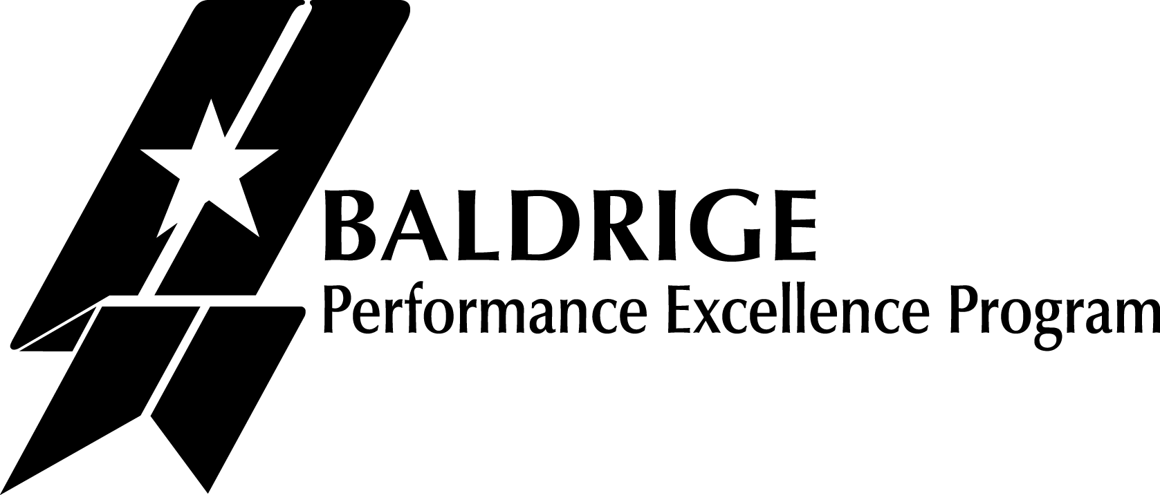
Baldrige Performance Excellence Program | 2020
Performance Excellence:
A Systems Approach and Tools
Baldrige Performance Excellence Program | www.nist.gov/baldrige
Notes:
Performance Excellence: A Systems Approach and Tools. Baldrige Performance Excellence Program 2020.

Slide 2
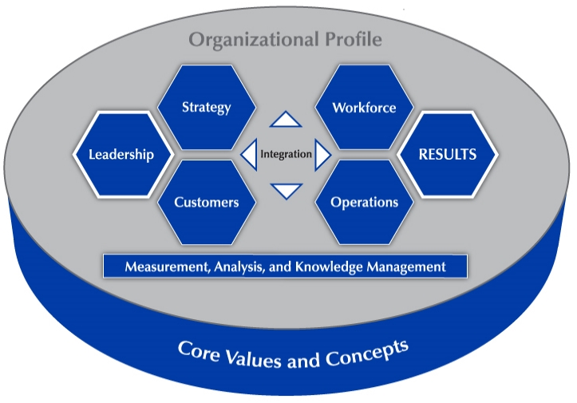
Baldrige Excellence Framework and Criteria for Performance Excellence
Baldrige Excellence Framework and Criteria for Performance Excellence
Higher productivity
Greater customer loyalty
Increased market share
Improved profitability
Better employee relations
Notes:
The Baldrige Excellence Framework and its Criteria for Performance Excellence are nationally and internationally renowned as a comprehensive performance excellence framework that any organization can use to improve. The Baldrige framework focuses on business results as well as organizational improvement and innovation systems. For many organizations, using the Baldrige framework results in the benefits shown here: higher productivity, greater customer loyalty, increased market share, improved profitability, better employee relations
The seven categories you see in the diagram make up the Criteria for Performance Excellence: Leadership; Strategy; Customers; Measurement, Analysis, and Knowledge Management; Workforce; Operations; and Results.

Slide 3
Quote from Larry Potterfield
  Our sales are up over 20% per year over the last five years. Our profits are up over 40% per year for that same time. Customer satisfaction, at 93%, is at an all-time high. Employee satisfaction, at 82%, is at an all-time high also.
  All the winds are blowing in the right direction at MidwayUSA, and it’s all because of our efforts in engaging the Baldrige Criteria.
  —Larry Potterfield, CEO
  Two-time Baldrige Award winner MidwayUSA
Notes:
Thousands of organizations of all kinds use the Baldrige Excellence Framework and its Criteria for Performance Excellence for self-assessment and training and as a tool to develop and improve performance and business processes, resulting in significant growth in revenue and jobs creation, among other results.
Quote from Samuel Liang, president and CEO, two-time Baldrige Award winner MEDRAD: “It’s all about continuous improvement. . . . By embracing all of the key dimensions of Baldrige, the company has doubled in size this as a business of Bayer Health Care.”
Alternate quotation:
MidwayUSA has benefited tremendously from the Baldrige Criteria: Our sales are up over 20% per year over the last five years. Our profits are up over 40% per year for that same time. Customer satisfaction, at 93%, is at an all-time high. Employee satisfaction, at 82%, is at an all-time high also. All the winds are blowing in the right direction at MidwayUSA, and it’s all because of our efforts in engaging the Baldrige Criteria.
—Larry Potterfield, CEO, Baldrige Award winner MidwayUSA

Slide 4
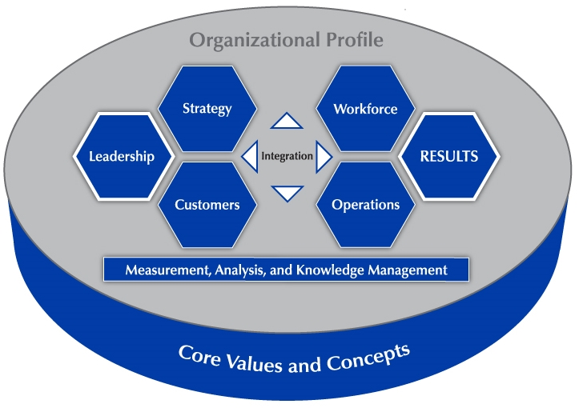
Baldrige / Six Sigma / Lean / ISO 9001
Baldrige
Business results Organizational improvement and innovation systems
Six Sigma, Lean, & ISO 9001
Organizational improvement and innovation processes
Six Sigma & Lean
Drive waste and inefficiencies from processes
Notes:
As many organizations have discovered, the Baldrige framework and its Criteria can be used effectively as an umbrella or systemic model for organizational performance excellence. The Baldrige framework helps organizations of all types pinpoint their strengths and opportunities for improvement—and they allow the organizations to choose the tools best suited for them to implement those improvements. In addition to using the Baldrige framework as a roadmap to organizational excellence, you might use Six Sigma, Lean, or a variety of other performance improvement tools to help improve processes identified by thoughtful application of Baldrige.
The Baldrige framework focuses on organizational improvement and innovation systems. Six Sigma and Lean methodologies drive waste and inefficiencies out of processes that users of the Baldrige framework identify for improvement. Six Sigma, Lean, and ISO 9001 focus on organizational improvement and innovation processes.
The Baldrige systems approach includes all the components of the 9001 Quality Management System. It also extends into dozens of other organizational systems.

Slide 5
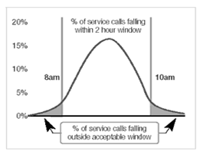
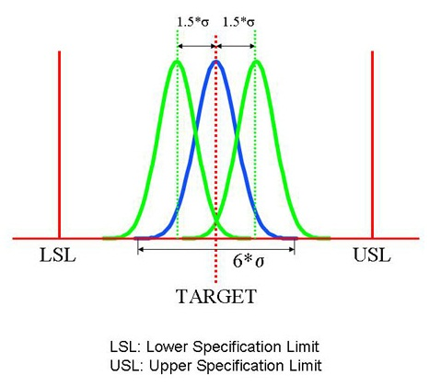
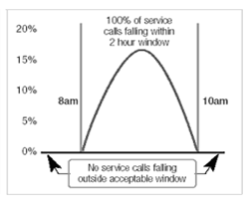
Six Sigma
Six Sigma
Reduce variation; lower defect rates
< 3.4 defects/million opportunities
Notes:
Let’s look at two commonly used improvement tools: Six Sigma and Lean.
The aim of Six Sigma is to reduce variation by using statistical methods to lower process defect rates to the “six sigma” level: fewer than 3.4 defects per million opportunities.
The focus is on establishing measurement systems for work processes and, through Six Sigma projects, identifying areas for reducing variation and improving processes.
These projects may include anything from improving the processes involved in mass-producing component piece parts, to completely redesigning, for example, an aircraft completion process so that the aircraft requires less maintenance, or to (as you see on the left) improving processes around service calls so that all calls fall within the required two-hour window.

Slide 6
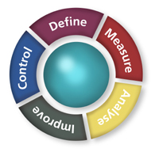
Six Sigma Methodologies
Six Sigma
Methodologies
DMAIC
Define, measure, analyze, improve, and control
DMADV
Define, measure, analyze, design, and verify
Notes:
The Six Sigma DMAIC methodology (define, measure, analyze, improve, and control) is the system for improving existing processes that fall below specifications and need incremental improvement.
DMADV (define, measure, analyze, design, and verify)—sometimes referred to as Design for Six Sigma, or DFSS—is used to develop new processes or products at Six-Sigma-quality levels.

Slide 7
Lean
Eliminate non-value-added activities and waste
Transportation
Inventory
Redundant motion
Waiting
Overprocessing
Overproduction
Defects
Waste
Anything a final customer wouldn’t want to pay for
Notes:
Lean is a series of tools and techniques for managing an organization’s processes.
Specifically, Lean focuses on eliminating all non-value-added activities and waste from processes. Waste is defined as anything a final customer would not want to pay for. Some of the sources of waste are shown here: transportation, inventory, redundant motion, waiting, overprocessing, overproduction, and defects.

Slide 8
Lean continued
Lean
Map and
understand
value stream
Goals
Increase productivity
Eliminate waste
Maximize resource utilization
Customer-
defined value
Make value
stream flow
Continuously improve processes
Notes:
The Lean tools used differ from application to application, but all are used for both incremental and breakthrough improvements.
Organizations that use Lean extend the concepts of waste elimination and value-adding processes to suppliers, partners, and customers. A Lean organization is said not to reach full potential until all aspects of its value chain have eliminated waste and are operating at full value-added potential.

Slide 9
ISO
ISO
Standards for quality management systems
ACT
Take action to improve
PLAN
Set objectives and processes to deliver products that meet customer requirements
DO
Implement processes
CHECK
Monitor/measure processes and products against objectives and requirements
Notes:
ISO 9000 is a series of international standards published by the International Organization for Standardization (ISO), in Geneva, Switzerland.
Companies use the standards to help determine what they need to maintain an efficient quality conformance system.
ISO 9000 registration validates that an organization’s quality management system complies with the ISO standard.
The standard defines minimum requirements for quality assurance systems that directly influence product quality and customer satisfaction without suggesting tools for analysis, prioritization, and evaluation.
The most recent version is ISO 9001:2015. A key tool in ISO:2015 is the Plan-Do-Check-Act (PDCA) cycle, which is used to define, implement, and control corrective actions and improvements to processes. Some of the key updates in ISO 9001:2015 include the introduction of an emphasis on the strategic environment for risk-based thinking, improved applicability for services, and increased leadership requirements.
While ISO:2015 has expanded its perspective, it still focuses on the “quality management system” (QMS). The QMS is process based, not system based.

Slide 10
Baldrige Framework, Lean, ISO, Six Sigma
Notes:
The Baldrige Excellence Framework, Lean, ISO, Six Sigma … how do you know which performance improvement tools are right for your organization?
These improvement tools are complementary, not mutually exclusive. For example, Baldrige, Lean, and Six Sigma all
focus on results
use a team approach
require management by fact
are customer- and market-focused
require strong leadership for long-term effectiveness
The continuous improvement focus in the Baldrige framework is also an integral part of the cyclical steps of Six Sigma and Lean.

Slide 11
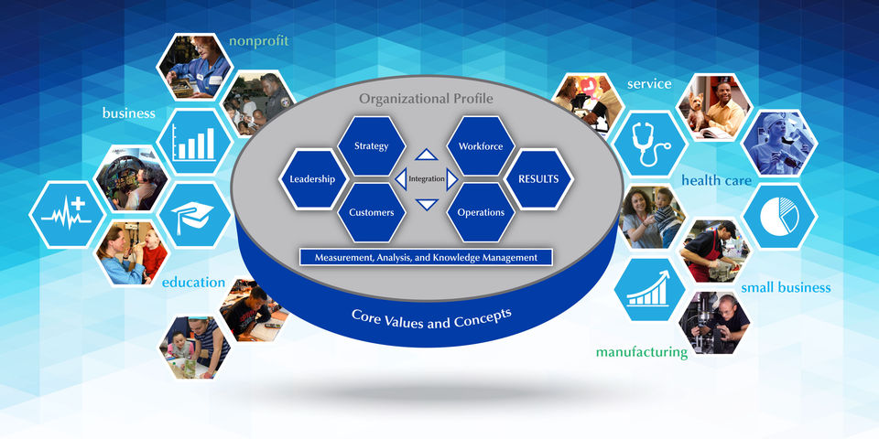
Baldrige Excellence Framework
Integrated management framework
Emphasis on
Integration
  Innovation
  Results
  Sustainability
  Nonprescriptive
  Holistic
  Inclusive
  Adaptable
Notes:
In the Baldrige framework, the emphasis is on integrating all parts of your management model and improving processes while keeping the whole organization in mind.
The Baldrige framework can be used by large and small businesses, education and health care organizations, government and nonprofit organizations, and organizations with one site or worldwide locations.
The Baldrige framework can be adapted to fit your challenges and culture and help you evaluate performance, assess where improvements or innovation are most needed, get results, and ensure sustainability.
The Baldrige framework doesn’t prescribe how your organization should be structured. For example, the Baldrige framework doesn’t recommend that you should or should not have departments for quality, planning, or other functions or that different units in your organization should be managed in the same way.

Slide 12
Quote from Robert Galvin
While other approaches focus on a single aspect, such as leadership or process management, the Baldrige Criteria provide an integrated management framework that addresses all the factors that define an organization’s operations and results. And the process is compatible with Lean and Six Sigma strategies as well as ISO 9000.
—Robert W. Galvin, chairman, Baldrige Award winner
Motorola Commercial, Government & Industrial Solutions Sector
Notes:
Here’s one difference: the Baldrige Excellence Framework serves as a comprehensive framework for performance excellence. It focuses on business results as well as organizational improvement and innovation systems. The Baldrige systems approach includes all the components of the ISO 9001 Quality Management System but extends into dozens of other organizational systems designed to supports high performance and sustainability.
Lean and Six Sigma methodologies drive waste and inefficiencies out of processes, and ISO 9001 is a series of standards for an efficient quality conformance system.
Any organization—no matter its sector, size, or level of maturity—can use the Baldrige Excellence Framework as a roadmap for performance excellence. Six Sigma, Lean, or a variety of other performance improvement tools can be used to help improve core processes identified by thoughtful application of the Baldrige framework .
Quote from Robert W. Galvin, chairman, Baldrige Award winner, Motorola Commercial, Government & Industrial Solutions Sector: While other approaches focus on a single aspect, such as leadership or process management, the Baldrige Criteria provide an integrated management framework that addresses all the factors that define an organization’s operations and results. And the process is compatible with Lean and Six Sigma strategies as well as ISO 9000.”

Slide 13
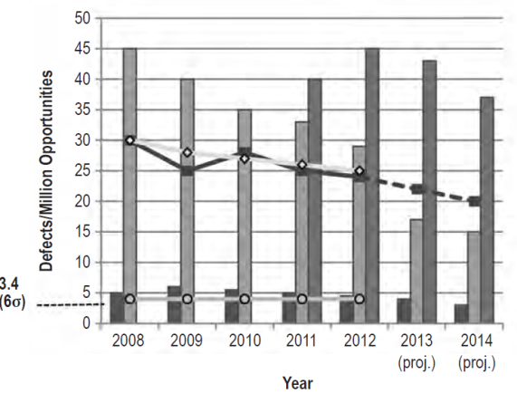
Six Sigma, Lean, and Baldrige
Six Sigma, Lean, and Baldrige
Notes:
In fact, many organizations begin their improvement efforts by using the Baldrige Excellence Framework for self-assessment. Through the questions in the Baldrige Criteria, you pinpoint strengths and opportunities for improvement. The you can use Six Sigma, Lean, or a variety of other performance improvement tools to help improve core processes. The Baldrige Excellence Framework allows you to choose the most suitable tools for carrying out improvements. For example, you might
use Baldrige to develop an overall, systemwide performance map, identify areas for improvement, and track results
use Six Sigma, Lean, or other tools to design operations or improve processes within the organization
For example, in the control stage of a Six Sigma project, data are generated on an ongoing basis, and they are monitored continuously to identify needs for further improvement. Similarly, in a Lean environment, continuous work is done to identify and eliminate waste-generating processes.

Slide 14
1 Leadership
 | Baldrige | Six Sigma | Lean
Address the overall leadership system | ■
Benefit from leaders who
Align financial and human resources | ■
Communicate cultural norms | ■ | ■ | ■
Encourage and provide resources | ■ | ■ | ■
Solidify a culture of organizational excellence | ■ | ■ | ■
Notes:
The first category in the Baldrige Criteria is Leadership, reflecting the critical role of committed senior leaders in an organization.
The Baldrige Criteria address the entire leadership system. By responding to the questions in the Leadership category, you can, for example, identify any gaps in
setting and deploying your vision and values
addressing fiscal accountability and transparency in operations
recognizing disconnects between your mission and your processes for achieving that mission.
At that point, you might allocate financial and human resources to carry out Six Sigma, Lean, or other enterprise-critical initiatives.
What do Baldrige, Six Sigma, and Lean share?
In the use of all three, senior leaders may need to communicate new cultural norms to employees, such as fact-based decision making and process measurement. To sustain success with process improvement activities and projects over the long term—and solidify a culture of organizational excellence—senior leaders must also encourage and provide resources.

Slide 15
2 Strategy
2 Strategy
Baldrige
Identify organizational objectives
Measure progress
Coordinate use of assets toward objectives
Six Sigma
Measure progress
Six Sigma, Lean
Coordinate use of assets toward objectives
Notes:
The Strategy category examines
how you develop your strategy,
how you implement that strategy,
how you make changes if necessary
how you measure progress
Your organization’s performance depends on the actions you take and on the totality of your operating environment. Every organization has resources that it uses to accomplish its mission, vision, and values. The coordinated use of these assets toward some set of objectives and goals is the organization’s strategy.
Lean, Six Sigma, and other tools can be methodologies for coordinating the use of assets toward organizational objectives. As an organization defines and deploys its business strategies, these techniques help leaders analyze performance gaps and respond by setting strategic improvement goals to close those gaps.

Slide 16
3 Customers
3 Customers
Customer- defined value
Map and
understand
value stream
Make value
stream flow
Continuously improve processes
Baldrige | Baldrige, Six Sigma | Lean
Build customer engagement and loyalty | Use the voice of the customer to identify areas for improvement | Make all process steps something the customer is willing to pay for
Notes:
In the Baldrige Criteria, the Customers category asks how you engage customers for long-term marketplace success. This includes how your organization
listens to the voice of the customer
serve customers’ needs to engage them and build relationships
ISO 9001:2015 also has customer requirements as one of its key elements. The ISO 9001 process approach focuses on enhancing customer satisfaction by consistently meeting customer requirements. Defining customer requirements and monitoring customer satisfaction are critical to the approach.
One of Lean’s main principles is a focus on customer requirements. In a Lean environment, all process steps should add value. Value-added process steps are those that the customer is willing to pay for, that are done right the first time, and that change the product or service in some way. To know what a customer is willing to pay for, an organization needs a customer and market focus.
Six Sigma focuses improvement projects on what is important to internal product recipients and to final customers. Within Six Sigma, the voice of the customer is often used to identify areas that need improvement and gather a variety of customer and market data through such mechanisms as surveys, focus groups, industry research, and competitive analyses.

Slide 17
4 Measurement, Analysis and Knowledge Management
4 Measurement, Analysis, and
Knowledge Management
Baldrige | ISO 9001 | Six Sigma | Lean
Measure and improve processes business results overall organizational performance | Monitor and measure process performance | Use specific metrics Collect data Analyze data Collect control data | Measure, analyze, and reduce wait time inventory batch size process time rework
Notes:
The Measurement, Analysis, and Knowledge Management category is the system foundation of the Baldrige framework. The Criteria ask how you
select, gather, analyze, and improve your organization’s data, information, and knowledge assets
manage organizational knowledge, information, and information technology
ISO 9001 relies on monitoring and measuring process performance. This information is used to assess whether the process is in compliance or not.
The use of data and metrics is an integral part of Six Sigma. For example, decision making must be data-driven to allow the measure, analyze, and control phases of the DMAIC process to function. Organizations that use Six Sigma have specific metrics, as well as data collection and analysis tools, built into the various steps of both DMAIC and DMADV projects.
Lean focuses on developing processes with zero waiting time, zero inventory, pull-based scheduling, reduction of batch sizes, work balancing, and process time reduction. Within Lean systems, quantitative measures and metrics are used to monitor processes and make decisions on the health of a process and its place within the continual process improvement cycle.
Organizations select Six Sigma and Lean projects based on process knowledge and potential benefit to the organization. Some of the factors used to select these projects are the potential cost savings, increased sales, reduced cycle time, and improved customer service and satisfaction.
Six Sigma and Lean complement the Baldrige foundation of measurement, analysis, and prioritization to improve overall organizational performance.

Slide 18
5 Workforce
5 Workforce
Baldrige
Manage workforce capability and capacity Foster a high-performance environment Engage, manage, and develop the workforce
Employee Engagement
Six Sigma, Lean, ISO
Require Leadership development Training Compensation alignment Culture shift
2015
2016
2017
2018
2019
Notes:
The Workforce category examines
your ability to build an effective and supportive workforce environment
how you engage, manage, and develop your workforce to use its full potential in alignment with your overall mission, strategy, and action plans.
Adoption of Six Sigma, Lean, and/or ISO 9001:2015 methodologies requires some of the elements emphasized by this Baldrige category, such as workforce assets in areas of project leadership, training, and compensation alignment.
To launch and sustain successful improvement projects, organizations need leadership and training programs. Key individuals need to be identified and trained to serve as initiative and project champions and as process owners and project facilitators. Six Sigma, Lean, and ISO 9001 expertise must be instilled in project leaders before they begin their project tasks.
To keep the momentum going in Lean and Six Sigma, reward and recognition systems need to be developed to drive behaviors of both process owners and personnel. In Six Sigma, Lean, and ISO 9001, performance assessment tools are data-driven and results-oriented.

Slide 19
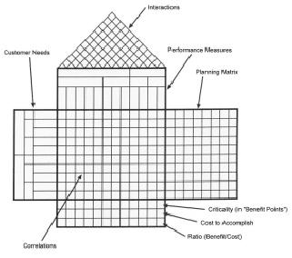
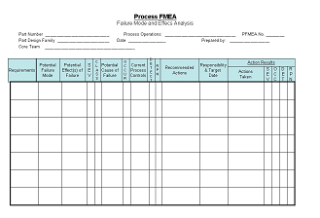
6 Operations
6 Operations
Baldrige
Processes: interrelated, interdependent steps along the path to customer engagement and organizational sustainability
Six Sigma, Lean, ISO 9001
Generate standard operating procedures Set specification and control limits Identify explicit corrective actions Optimize processes
Notes:
The Operations category examines
how you design, manage, and improve your products and work processes
how you ensure effective management of your operations
Six Sigma, Lean, and ISO 9001 all focus deeply on processes, so this is the Baldrige Criteria category that Six Sigma, Lean, and ISO 9001 most closely address.
Like the Baldrige Criteria, all three methodologies view processes as interrelated and interdependent steps on the path to customer satisfaction and achievement of the organization’s core mission, vision, and values. For example, Six Sigma, Lean, and ISO 9001 are particularly useful in improving the efficiency and effectiveness of repetitive processes, such as manufacturing cars or billing.
The drive for the kind of sustainable, transformational change in operations called for by Six Sigma, Lean, and ISO 9001 can be effective only if change itself becomes part of the organization’s processes and all processes become better at fulfilling customer needs.
Six Sigma, Lean, or any of the other process improvement tool sets or standards might be used as an organization’s methodology for improving key value-creating processes.

Slide 20
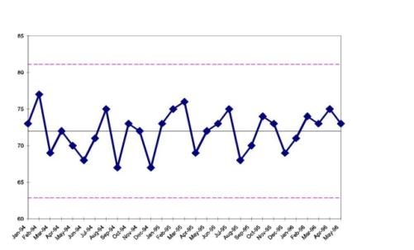
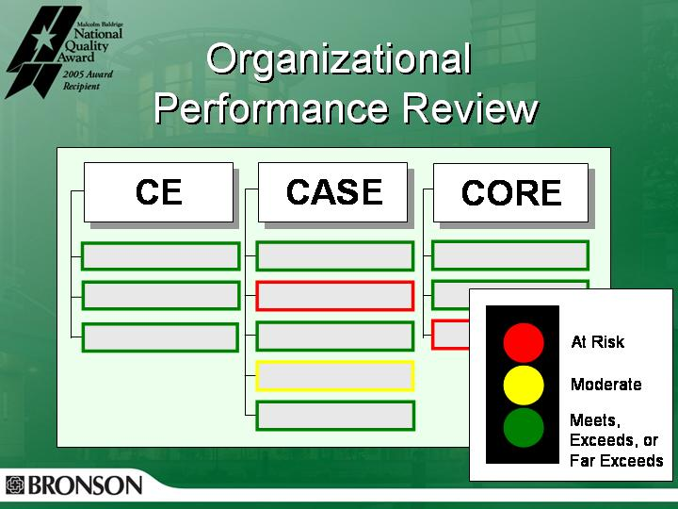
7 Results
7 Results
Baldrige
Addresses all results: Product and process Customer Workforce Leadership and governance Financial and market
Six Sigma, Lean, ISO 9001
Data-driven and results-oriented, leading to tracking systems (e.g., control charts, scorecards, rolled throughput yield charts) monitoring of functional or operational results
Notes:
In the Baldrige framework, everything points toward the final category, Results. This category asks about your organization’s performance and improvement in all areas:
product and process outcomes
customer-focused outcomes
workforce-focused outcomes
leadership and governance outcomes
financial and market outcomes
The category also asks how your results compare with those of other organizations with similar offerings.
The goals of Six Sigma, Lean, and ISO 9001, which are process enhancement tools, are not to create management scorecards. However, since all three are data-driven and results-oriented, their use leads naturally to systems for tracking systems and the monitoring of results in the areas where the methodologies are applied. These include the use of performance scorecards and customer dashboards to measure and monitor process performance.
Both Lean and Six Sigma are at their core focused on achieving and reporting specific performance goals, applying metrics to meeting customer requirements, monitoring and sustaining high performance levels, and using performance measures to monitor operations. The development of robust processes leads to the ability to review and report process measures and to roll results from individual processes into divisional or organizational outcomes so that you can assess organizational and process performance against benchmarks.

Slide 21
In conclusion
Baldrige
Business results Organizational improvement and innovation systems
Six Sigma, Lean, & ISO 9001
Organizational improvement and innovation processes
Six Sigma & Lean
Drive waste and inefficiencies from processes
Notes:
In conclusion, the Baldrige Excellence Framework can be used effectively as an umbrella or systemic model for organizational performance excellence. In addition to using the Baldrige framework as a roadmap to organizational excellence, you might use Six Sigma, Lean, or a variety of other performance improvement tools to help improve processes identified by thoughtful application of the Criteria.
The Baldrige Excellence Framework focuses on organizational improvement and innovation systems. Six Sigma and Lean methodologies drive waste and inefficiencies out of processes that users of Baldrige identify for improvement. Six Sigma, Lean, and ISO 9001 focus on organizational improvement and innovation processes.

Slide 22
For more information
For more information
Baldrige Excellence Framework booklets and free content
Self-assessment tools
Organizational assessments
Training, conferences, and executive education
Award recipient profiles
Case studies
Connections to the Baldrige community
www.nist.gov/baldrige
baldrige@nist.gov
(301) 975-2036
Baldrige Performance Excellence Program | www.nist.gov/baldrige
Notes:
For more information: Baldrige Excellence Framework booklets and free content
Self-assessment tools
Organizational assessments
Training, conferences, and executive education
Award recipient profiles
Case studies
Connections to the Baldrige community
www.nist.gov/baldrige
baldrige@nist.gov
(301) 975-2036

