Slide 1

Baldrige Performance Excellence Program | 2020
Introduction to the
Baldrige Program
Baldrige Performance Excellence Program | www.nist.gov/baldrige
Notes:
Introduction to the Baldrige Program: Baldrige Performance Excellence Program 2020.

Slide 2

For more than 30 years
  For more than 30 years:
  Defining performance excellence
  Recognizing performance excellence
  Sharing best practices
  Helping organizations improve in areas of national need
Public-private partnership
Presidential education and award program
Notes:
The Baldrige Program is the only public-private partnership and Presidential award and education program dedicated to improving U.S. organizations. Its mission is to define, recognize, and foster organizational performance excellence in every sector; sharing best practices, and helping organizations improve in areas of national need.

Slide 3
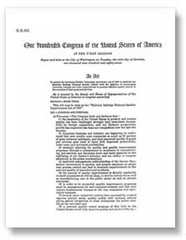
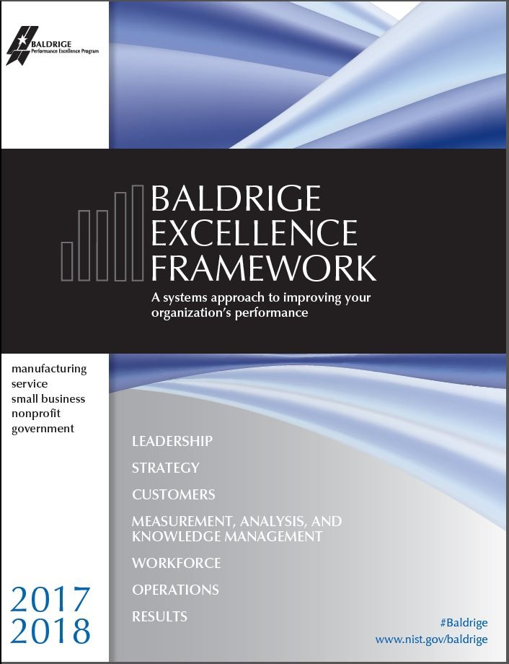


The Baldrige Program has existed for 30+ years
A 30+-year-old public-private partnership to improve the performance and competitiveness of businesses in the US
Establish the standard of excellence
Identify role-model organizations
Foster use of the standard and share best practices
Notes:
The Baldrige Program has existed for 30+ years. The program has an interesting history.
The program was originally named after Malcolm Baldrige, who was the 26th Secretary of Commerce. Malcolm Baldrige died in July1987 in a rodeo accident, but his service as Secretary of Commerce was one of the longest in history. In the mid-1980s, U.S. leaders realized that American companies needed to focus on quality in order to compete in an ever-expanding, demanding global market.
Malcolm Baldrige was an advocate of quality management as a key to U.S. prosperity and sustainability and after his death, Congress named the Award in recognition of his contributions.
The goal of the Malcolm Baldrige National Quality Improvement Act of 1987 was to enhance the competitiveness of U.S. businesses. Its scope has since been expanded to health care and education organizations (in 1999) and to nonprofit/government organizations (in 2007).
The key three purposes of the program are shown here:
Establish the standard of excellence
Identify role model organizations
Foster use of the standard and share best practices.

Slide 4
The Baldrige Program . . .
Authors the Baldrige Excellence Framework and its Criteria for Performance Excellence
Offers organizational assessments and self-assessment tools
Provides training, executive development, and conferences
Manages the Malcolm Baldrige National Quality Award
Shares organizational best practices
Offers approaches to cybersecurity risk management and community excellence
Notes:
In carrying out its mission, the Baldrige Program
authors the Baldrige Excellence Framework and its Criteria for Performance Excellence, an integrated management framework that serves as the basis for state, regional, sector, local, and many international performance excellence and business excellence awards and programs
offers Baldrige Award evaluations and Baldrige Collaborative Assessments of organizational strengths and opportunities for improvement by teams of trained experts
provides self-assessment tools for organizations
provides executive development, training, educational presentations, conferences, and workshops on proven best management practices and on using the Baldrige Criteria to improve
manages the Malcolm Baldrige National Quality Award, the highest award for performance excellence that a U.S. organization can receive, designed to recognize role model organizations
shares these role models’ best practices for the benefit of other U.S. organizations
Offers Baldrige-based approaches to cybersecurity risk management and community excellence

Slide 5
Baldrige Community
Baldrige Community
Foundation for the
Malcolm Baldrige
National Quality Award
Board of
Overseers
Department of Commerce
Alliance for
Performance
Excellence
National
Institute of
Standards and
Technology
CV
Baldrige
Award
Recipients
Cooperating Organizations
Communities of Excellence 2026
Professional Societies
Trade Associations
Board of Examiners
Judges
Examiners
ASQ
(Contractor)
Notes:
The public-private partnership is fundamental to the program’s success. The program is managed by the National Institute of Standards and Technology, an agency of the U.S. Department of Commerce. It is funded by product and service fees and by a gift to the Department of Commerce from the Foundation for the Malcolm Baldrige National Quality Award.
The following are the program’s key partners.
The Baldrige Foundation, composed of leaders from prominent U.S. organizations, is responsible for raising funds to endow the program permanently, overseeing the investment of endowed funds, and disbursing funds to the National Institute of Standards and Technology (NIST).
The Alliance for Performance Excellence is a nonprofit national network of local, state, regional, and sector Baldrige-based programs. Alliance member programs serve as a feeder system for the national Baldrige Award.
ASQ provides logistical support to the program in administering the award process under a contract with NIST.
The Board of Overseers, composed of distinguished leaders from all sectors of the U.S. economy, is appointed by the U.S. Secretary of Commerce to evaluate the program, provide policy guidance, and assess how well the award is serving the national interest.
The Board of Examiners is a group of about 500 recognized experts who volunteer to assess award applications and assist in the program’s outreach and educational activities.
Baldrige Award recipients share information on their best management practices and performance results.

Slide 6
Performance Excellence
An integrated approach to organizational performance management that results in
Delivery of ever-improving value to customers and stakeholders, contributing to organizational sustainability
Improvement of overall organizational effectiveness and capabilities
Organizational and personal learning
Notes:
As mentioned, the Baldrige Program aims to identify and recognize organizations that demonstrate performance excellence, to disseminate best practices, and to help organizations achieve performance excellence.
Performance excellence refers to an integrated approach to organizational performance management. This approach results in (1) delivery of ever-improving value to customers and stakeholders, contributing to organizational sustainability and marketplace success (an external focus); (2) improvement of overall organizational effectiveness and capabilities (an operational focus); and (3) organizational and personal learning (a learning focus).

Slide 7
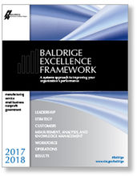
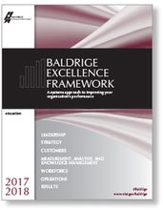
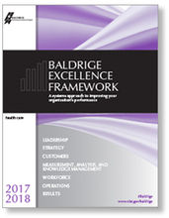
Baldrige Excellence Framework and Criteria for Performance Excellence
Define performance excellence
Organizational Profile and seven categories—an integrated management framework
Used by diverse organizations in all
sectors of the economy
Used to identify award recipients
Updated every two years
Notes:
The Baldrige Excellence Framework has two uses: (1) to help organizations improve and (2) to identify Baldrige Award recipients to serve as role models of performance excellence. The Criteria are a de facto definition of performance excellence. They are a set of questions that focus on critical factors contributing to performance excellence. The questions are organized into an Organizational Profile and seven categories. The questions in the Organizational Profile focus on the key influences on how your organization operates and the key challenges it faces. The remaining questions ask about an organization’s processes relating to leadership, strategic planning, customers and the workforce, operations, information systems, and results. The seven categories are designed to work as an integrated framework for managing an organization.
In keeping with the continuous improvement philosophy of the Baldrige Program, the Baldrige framework is updated every two years through a consensus process to stay at the leading edge of validated leadership and performance practice.
Three versions of the Baldrige framework represent each of the Baldrige Program’s main customer groups: business/nonprofit, education, and health care organizations. The primary differences are the use of language appropriate for each sector and integration of sector-specific themes. For education, these themes focus on student learning. For health care, the themes include a focus on patient care and patient health care outcomes.
Since their inception in 1988, the Baldrige framework and the Criteria for Performance Excellence have accelerated in acceptance and importance. Organizations of all sizes and types use the Criteria for improvement and self-assessment, including large and small manufacturers; banks and other service providers; small businesses from consulting firms to fast-food restaurants; K–12 school systems, universities, and proprietary education organizations; hospitals, long-term care facilities, and other health care organizations; nonprofit organizations, and local, state, and federal government agencies.

Slide 8
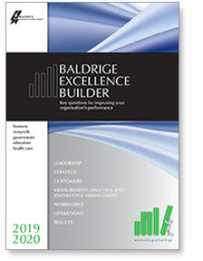
Baldrige Excellence Builder
Assess your organization against the most important features of organizational performance excellence
Organizational Profile and seven categories—abbreviated
Notes:
The Baldrige Excellence Builder is based on the Baldrige Excellence Framework and its Criteria for Performance Excellence. Use the Excellence Builder to
Assess your organization against the most important features of organizational performance excellence
Key Questions
The Baldrige Excellence Builder helps you understand how well you are accomplishing what is important to your organization:
Are your processes consistently effective?
Do your approaches address your organization's needs?
How good are your results?
Is your organization learning and improving?

Slide 9
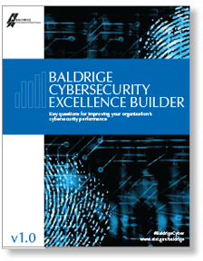
Baldrige Cybersecurity Excellence Builder
Voluntary self-assessment tool
Blends the Baldrige Excellence Framework’s systems perspective with NIST Cybersecurity Framework concepts
Assess the effectiveness and efficiency of cybersecurity-related processes and the results they achieve
Notes:
What is the Baldrige Cybersecurity Excellence Builder?
The Baldrige Cybersecurity Excellence Builder is a voluntary self-assessment tool that enables organizations to better understand and improve the effectiveness of their cybersecurity risk management efforts. It helps leaders of organizations to identify opportunities for improvement based on their cybersecurity risks, needs, and objectives, as well as their larger organizational environment, relationships, and outcomes.
Does the Baldrige Cybersecurity Excellence Builder prescribe cybersecurity best practices or standards?
No. Use of the Baldrige Cybersecurity Excellence Builder is completely voluntary. Like the Framework for Improving Critical Infrastructure Cybersecurity PDF(Cybersecurity Framework) and the Baldrige Excellence Framework, it is not a one-size-fits-all approach. It is adaptable and scalable to an organization’s needs, goals, capabilities, and environment. It does not prescribe how an organization should structure its cybersecurity policies and operations.
What is the relationship between the Baldrige Cybersecurity Excellence Builder and the Framework for Improving Critical Infrastructure Cybersecurity?
The Baldrige Cybersecurity Excellence Builder blends the systems perspective and business practices of the Baldrige Excellence Framework with the concepts of the Cybersecurity Framework.
Why should my organization use the Baldrige Cybersecurity Excellence Builder?
Using this self-assessment, your organization can
determine cybersecurity-related activities that are important to your business strategy and critical service delivery;
prioritize your investments in managing cybersecurity risk;
determine how best to enable your workforce, customers, suppliers, partners, and collaborators to be risk conscious and security aware, and to fulfill their cybersecurity roles and responsibilities;
assess the effectiveness and efficiency of your use of cybersecurity standards, guidelines, and practices;
assess the cybersecurity results you achieve; and
identify priorities for improvement.

Slide 10

Communities of Excellence 2026
Using a Baldrige-Based Framework to Lead Transformation
A Systematic Approach to Excellence in Communities
In partnership with the Baldrige Performance Excellence Program
Notes:
Communities of Excellence 2026: A Systematic Approach to Excellence in Communities. Using a Baldrige-Based Framework to Lead Transformation. In partnership with the Baldrige Performance Excellence Program 2019.
The mission of Communities of Excellence 2026 (COE) is to improve the quality of life for our nation’s residents by assisting communities in implementing the Baldrige-based Communities of Excellence Framework.
In collaboration with the Baldrige Program, COE
Adapted the Baldrige Framework to develop the Communities of Excellence Framework
Educates individuals and organizations on the framework
Encourages community assessments against the framework
Shares best practices identified through assessments

Slide 11
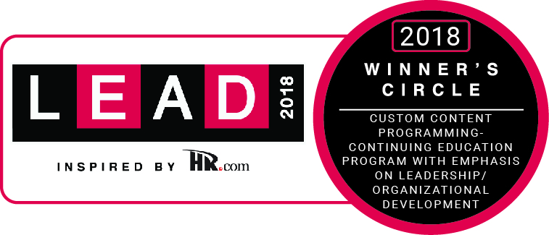
Baldrige Executive Fellows Program
Hands-On Leadership Development
Peer network of fellow executives
Best practices and solutions to drive organizational improvement
Capstone project for an organizational strategic challenge or opportunity
Deeper understanding of strategy; sustainability; integration of processes, plans, resources, and goals; and measurement
In-depth learning from world-class organizations and their senior executives
Notes:
Join a Community of Visionary Leaders
The Baldrige Executive Fellows Program is a one-year, nationally ranked leadership development experience for direct reports to the most senior leader in the organization or business unit leaders. The program prepares this elite group of rising senior executives for impactful leadership and helps them emerge with a broader perspective on how to achieve performance excellence for their own organizations, stimulate innovation, and build the knowledge and capabilities necessary for organizational sustainability. Featured in Leadership Excellence, "Peer Learning" (PDF) explains how Fellows learn and share leadership solutions with national role models and other executives.
Senior Executive Development
As a Baldrige Fellow, you’ll be part of a cohort of senior decision makers who learn from each other and from winners of the Malcolm Baldrige National Quality Award, the nation’s highest award for organizational performance excellence. From personal visits to these role-model organizations and their senior executives and from interactions with your cohort, you’ll establish relationships that will benefit you and your organization now and in the future.
PROGRAM BENEFITS
In-depth learning from world-class organizations and their senior executives
A peer network of fellow executives to tap into now and in the future
Best practices and solutions to drive improvement in your organization’s results
A capstone project to address a unique strategic challenge or opportunity facing your organization
A deeper understanding of strategy; sustainability; integration of processes, plans, resources, and goals; and measuring the right things

Slide 12
Become a Baldrige Examiner
Network with peers
Attend award-winning training
Learn about the Baldrige Excellence Framework and Criteria
Evaluate and provide feedback to Baldrige Award applicant organizations
Gain experience in organizational assessment
Develop analytical and consensus-building skills
Be recognized for service by the Secretary of Commerce and the NIST Director
Notes:
Enrich Your Career and Improve Organizational Performance
If you are looking for a one-of-a-kind professional development and networking opportunity, and the chance to make a meaningful contribution to organizational improvement and U.S. competitiveness, apply to serve as a volunteer on the Baldrige Board of Examiners.
Baldrige Examiners attend Award winning training and learn about the Baldrige Excellence Framework and Criteria. Using the Baldrige Criteria, examiners evaluate and provide feedback to organizations across the United States. The feedback report is a key reason why organizations apply for the Baldrige Award.
Who Should Apply
U.S. citizen or permanent resident of the United States
Leadership, Strategy, Customers, Measurement, Analysis & Knowledge Management, Workforce, and Operations Category Experts
Manufacturing, Service, Health Care, Education, and Nonprofit (including Government) Industry Experts
Quality and Performance Excellence Experts
EXAMINER BENEFITS
Strengthen your ability to use the Baldrige Excellence Framework within your organization
Network with peers and enhance personal growth
Gain experience in organizational assessment by reviewing applications from U.S. organizations
Be recognized for service by the Secretary of Commerce and the NIST Director
Attend ceremony for the Malcolm Baldrige National Quality Award Recipients
Receive award-winning Examiner Preparation Course training
Gain experience in understanding the Baldrige Excellence Framework and Criteria
Develop analytical and consensus-building skills and a systems perspective that can be applied within your organization
Members of the Board of Examiners are not compensated for their time; they serve on a voluntary basis.

Slide 13
Program Achievements
Created a national and international standard for performance excellence
Produced role models
Shared best management practices
Generated award programs
Raised U.S. competitiveness
Established outreach and education systems
Created assessment tools in areas of national need (community excellence and cybersecurity)
Notes:
Accomplishments:
The Baldrige Excellence Framework and its Criteria for Performance Excellence are accepted in the United States and worldwide as the primary standard for performance excellence. In addition to U.S. organizations that apply for the award, thousands more use the Baldrige framework for internal assessments.
Award recipients serve as role models. They actively share information and effectively demonstrate the importance of engaging in a continuous improvement process and of using assessment to gain a better understanding of customers, internal processes, and corporate culture.
State and local Baldrige-based award programs have grown from 8 in 1991 to around 30 today, covering nearly every U.S. state and territory.
Award recipients and other organizations that have used the Criteria see the benefits, such as increased customer engagement, improved cycle time, and increased sales/market share. Although the program is small, it has leveraged its influence to make a nationwide (and even global) impact and has promoted nationwide learning about the value of performance excellence.

Slide 14
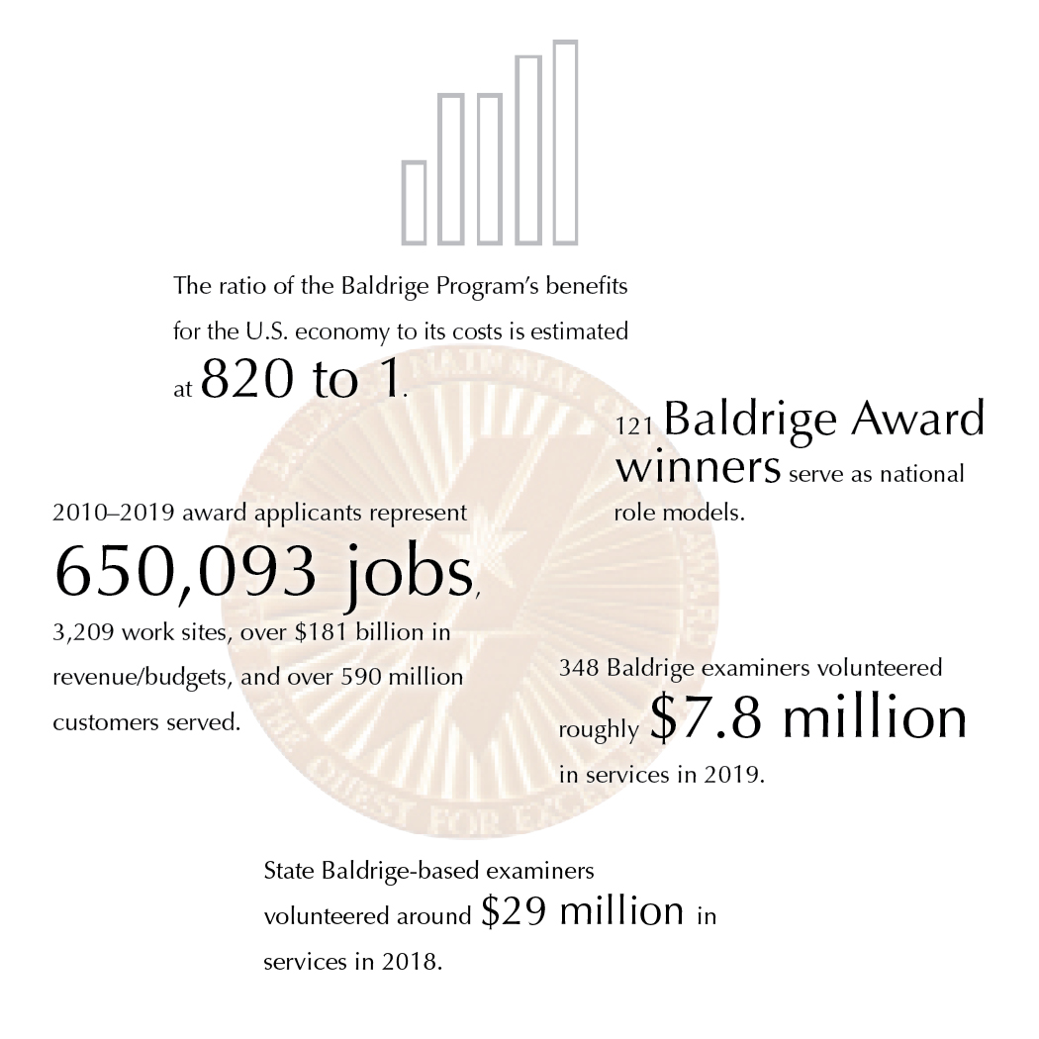

Baldrige Impacts
Baldrige Performance Excellence Program | www.nist.gov/baldrige
Notes:
The ratio of the Baldrige Program’s benefits for the U.S. economy to its costs has been estimated at 820 to 1.
121 Baldrige Award winners serve as national role models.
2010-–2019 award applicants represent 650,093 jobs, 3,209 work sites, over $181 billion in revenue/budgets, and over 590 million customers served.
348 Baldrige examiners volunteered roughly $7.9 million in services in 2019.
State Baldrige-based examiners volunteered around $29 million in services in 2018.

Slide 15
Start Improving Your Organization (1)
Purchase the Baldrige Excellence Framework or download free content.
Become a Baldrige examiner, or
attend examiner training.
Attend a national or regional Baldrige conference.
Do a Baldrige self-assessment.
Notes:
You can take a number of steps to start using Baldrige to improve your organization’s performance.
Visit the Baldrige website for Baldrige Excellence Framework booklets and free content.
Become an examiner. Examiners at the state/local and the national levels receive valuable training and experience in understanding and applying the Criteria, and they strengthen their ability to use the Criteria within their own organizations. For a fee, you can also attend examiner training without serving as an examiner.
Attend a conference. Annually, Baldrige sponsors The Quest for Excellence® conference in Washington, D.C., every spring, as well as regional conferences, to showcase the award recipients. Conferences give you an opportunity to learn about recipients’ best practices and to network with other organizations.
Consider self-assessing your organization against the Baldrige Criteria. See the Baldrige website for tools and information.

Slide 16



Start Improving Your Organization (2)
Contact your state or local Baldrige-based program: www.baldrigealliance.org.
Consider the Baldrige Executive Fellows Program for a senior leader.
Contact a Baldrige Award recipient.
Apply for a Baldrige-based award, or
consider a Baldrige Collaborative Assessment.
Notes:
Contact your state or local Baldrige-based program. These programs’ training and assessment offerings are a good way to begin learning about the Baldrige framework. Information on these programs is linked from the Baldrige website.
Ask your CEO or another senior leader to consider the Baldrige Executive Fellows Program. This executive development program centers on forming relationships with and learning from Baldrige Award recipients and their senior executives.
Most Baldrige Award recipients offer events focused on sharing role-model practices with other U.S. organizations. See the Baldrige website for contact information.
Consider applying for a Baldrige-based award. If you are not ready to apply at the national level, consider contacting your state, regional, or sector Baldrige-based program. Or consider a Baldrige Collaborative Assessment, in which team of Baldrige examiners works with your staff to assess your organization.

Slide 17
For More Information
Baldrige Excellence Framework booklets and
free content
Self-assessment tools
Organizational assessments
Training, conferences, and executive education
Award recipient profiles
Case studies
Connections to the Baldrige community
www.nist.gov/baldrige
baldrige@nist.gov
(301) 975-2036
Baldrige Performance Excellence Program | www.nist.gov/baldrige
Notes:
For more information: Baldrige Excellence Framework booklets and
free content:
Self-assessment tools
Organizational assessments
Training, conferences, and executive education
Award recipient profiles
Case studies
Connections to the Baldrige community
www.nist.gov/baldrige; baldrige@nist.gov; 301-975-2036

