Slide 1

Baldrige Performance Excellence Program | 2020
Baldrige Program Impacts
Baldrige Performance Excellence Program | www.nist.gov/baldrige

Slide 2
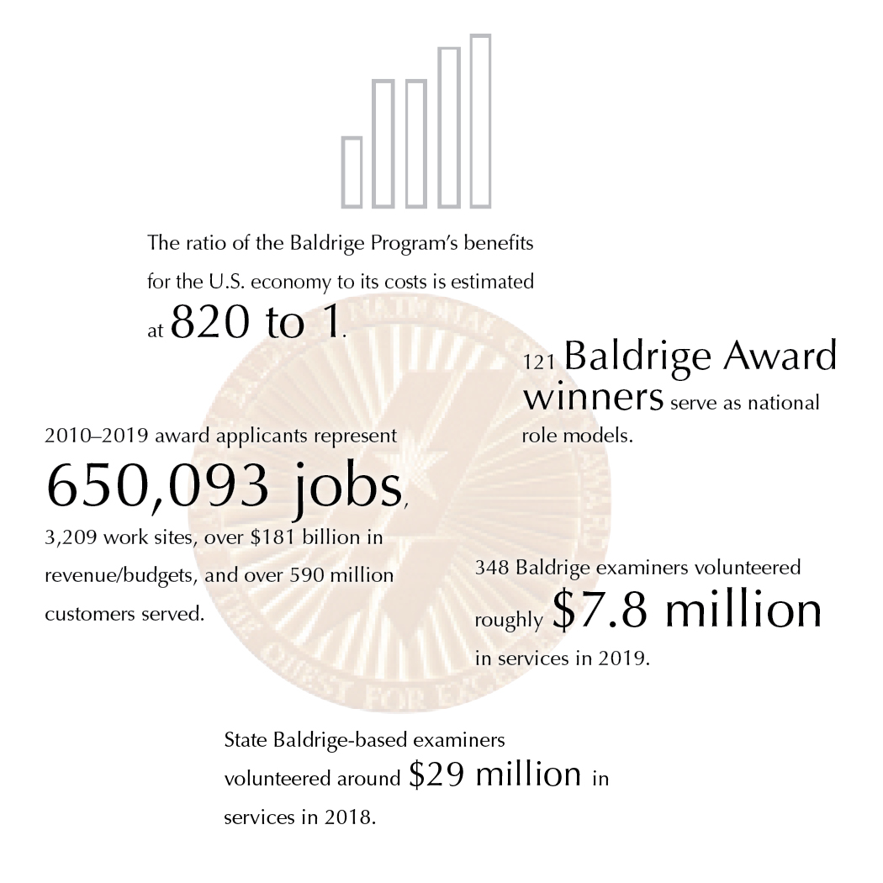

Baldrige Impacts
Baldrige Performance Excellence Program | www.nist.gov/baldrige
Notes:
The ratio of the Baldrige Program’s benefits for the U.S. economy to its costs has been estimated at 820 to 1.
121 Baldrige Award winners serve as national role models.
2010-–2019 award applicants represent 650,093 jobs, 3,209 work sites, over $181 billion in revenue/budgets, and over 590 million customers served.
348 Baldrige examiners volunteered roughly $7.9 million in services in 2019.
State Baldrige-based examiners volunteered around $29 million in services in 2018.

Slide 3
Nationwide
Nationwide
Improve organizational practices, capabilities, and results
Communicate and share best practices (Baldrige Award recipients)
Tool for understanding and managing organizational performance
Notes:
Since 1987, the Baldrige Excellence Framework and its Criteria for Performance Excellence have played three roles in strengthening U.S. competitiveness:
They help improve organizational performance practices, capabilities, and results.
As the basis of the Baldrige Award, which recognizes the achievements of role-model organizations, they facilitate communication and sharing of best practices among U.S. organizations.
They also serve as a working tool for understanding and managing organizational performance, for guiding your strategic plan, and for providing opportunities to learn.

Slide 4
Ratio of 820 to 1
820:1
Ratio of Baldrige Program benefits for the U.S. economy to program costs
Source: Albert N. Link and John T. Scott, Economic Evaluation of the Baldrige Performance Excellence Program, December 2011, http://www.nist.gov/baldrige/publications/economic_evaluation_2011.cfm.
Notes:
Source for 820-to-1 ratio: Albert N. Link and John T. Scott, Economic Evaluation of the Baldrige Performance Excellence Program, December 2011, http://www.nist.gov/baldrige/publications/economic_evaluation_2011.cfm.
To arrive at this ratio, they compared the benefits received by the 273 Baldrige Award applicants from 2007 to 2010 with the cost of operating the Baldrige Program.
The 820-to-1 ratio represents only the benefits for the surveyed applicants, but it represents all of the Baldrige Program's social costs. Link and Scott note that the benefit-to-cost ratio would be much higher if program costs were compared with the benefits for the entire U.S. economy.
Three types of social benefit were measured:
the applicants’ cost savings from using the Baldrige Criteria instead of a higher-priced alternative
gains to U.S. consumers, who had greater satisfaction with higher-quality products
gains to the U.S. economy from saving scarce resources, since the Baldrige Criteria were used instead of a higher-cost alternative

Slide 5
Impact of Baldrige Framework Use
Impact of Baldrige Framework Use
Notes:
For data on the impact of using Baldrige within an organization, we looked at organizations that we know were using the Criteria for at least a 5-year period: the seven two-time Baldrige Award winners. These growth rates are for the period between awards. Comparative data on job growth are from the U.S. Bureau of Economic Analysis and U.S. Bureau of Labor Statistics.

Slide 6
Reach and Impact of Baldrige
Reach and Impact of Baldrige
Baldrige Program NIST
12,000+ Baldrige Examiners
~50 Business Excellence Programs Worldwide
130 Baldrige Executive Fellows
30 Regional/ Sector Baldrige-Based Programs
Corporate Baldrige-Based Excellence Programs
Federal Baldrige-Based Programs
Baldrige Performance Excellence Groups
Commun-ities of Excellence
129 Baldrige Award Recipients
Association Baldrige-Based Programs
College/
University Business Courses
Baldrige-Based Accredita-tions
1,700+ Baldrige Award Applicants
Baldrige Cybersecurity Excellence Builder
Rated #1 Leadership Development Program
50,000+ presentations
Improved: operations, engagement, outcomes;
820:1
10,000 applications
20,000 examiners
40,000 conference attendees
Notes:
Reach and Impact of Baldrige: Baldrige Executive Fellows rated number 1 Leadership Development Program; 121 Baldrige Award Recipients with 50,000+ presentations; 1700+ Baldrige Award Applicants have improved operations, engagement, outcomes; 30 Regional / Sector Baldrige-Based Programs have had 13,000 applications, 20,000 examiners, and 40,000 conference attendees.

Slide 7
Widespread U.S. Participation
Large and small organizations
Internal business excellence programs
College and university courses
Accreditation
Consultants
Private-sector support
Notes:
Organizations of all sizes and types use the Baldrige framework for improvement and self-assessment, including large and small manufacturers; banks and other service providers; small businesses from consulting firms to fast-food restaurants; K–12 school systems, universities, and other education organizations; hospitals, long-term care facilities, and other health care organizations; nonprofit organizations, and local, state, and federal government agencies.
Several large national and international organizations, such as Tata Industries and Infosys, base their internal performance excellence programs on the Baldrige Criteria.
Colleges and universities, such as Ferris State University, Loyola University of New Orleans, and the College of Engineering at the University of Missouri, offer MBA programs, certificates, or courses on the Baldrige framework.
The North Central Association’s Commission on Accreditation and School Improvement has adopted Baldrige-compatible criteria as the basis of its district and school accreditation frameworks. The Accreditation Council for Business Schools and Programs bases its accreditations on the Baldrige Criteria. And the National Housing Quality Award (NHQA) for home builders is modeled after the Malcolm Baldrige National Quality Award.
An informal community of Baldrige-based consultants helps organizations learn about and use the Baldrige framework.
63 small business development centers, with a total of 1,100 offices in the United States, have adopted aspects of the Baldrige Competitiveness Program begun by the Puerto Rico Small Business Technology and Development Center, which, since 2011, has trained more than 125 businesses, including 250 top-management executives, on Baldrige principles. The Puerto Rico small business graduates have seen improvements in the areas of leadership, sales, metrics, operations, human resources, workplace environment, financial results, and client satisfaction. In addition, SBDCs in Central America, including El Salvador, have begun adopting Baldrige.

Slide 8
Lower Health Care Costs, Improved Quality
Baldrige Hospitals
Faster five-year performance improvement than peers
83% more likely to be among Thomson Reuters’ 100 Top Hospitals®
Outperformed non-Baldrige hospitals on 6 of 7 100 Top Hospitals measures
Lower Health Care Costs,
Improved Quality
Source: Foster, D. A., and Chenoweth, J. 2011, October. Comparison of Baldrige Award Applicants and Recipients with Peer Hospitals on a National Balanced Scorecard. Thomson Reuters. http://www.nist.gov/baldrige/upload/baldrige-hospital-research-paper.pdf.
Notes:
An independent study has documented that use of the Baldrige Health Care Criteria for Performance Excellence has a direct impact on both reducing health care costs and improving quality. The study was completed by Thomson Reuters in October 2011. Key findings include the following:
Baldrige hospitals (award winners and those that received a site visit) demonstrated faster five-year performance improvement than their peers.
Baldrige hospitals, as a group, were about 83% more likely than non-Baldrige hospitals to be awarded Thomson Reuters 100 Top Hospitals® national recognition for excellence in organization-wide performance.
Baldrige hospitals outperformed non-Baldrige hospitals on six of seven individual measures of performance used in the 100 Top Hospitals composite score, including the Centers for Medicare and Medicaid Services’ (CMS) Core Measures and adjusted operating profit margin.
Foster, D. A., and Chenoweth, J. 2011, October. Comparison of Baldrige Award Applicants and Recipients with Peer Hospitals on a National Balanced Scorecard. Thomson Reuters. http://www.nist.gov/baldrige/upload/baldrige-hospital-research-paper.pdf.

Slide 9
Higher Health Care Quality, Better Patient Experience
34 Baldrige Award recipients in health care:
Matched or exceeded geographic competitors on 23 health care process measures and 6 outcome measures
Exceeded these competitors on 10 measures of patient experience
Higher Health Care Quality,
Better Patient Experience
Source: R. C. Schulingkamp and J. R. Latham. Healthcare Performance Excellence: A Comparison of Baldrige Award Recipients and Competitors. Quality Management Journal, Vol. 22, No. 3 (2015).
Notes:
A 2015 study compared 34 U.S. health care organizations that received the Baldrige Award with their 153 geographically closest competitors. The study found that the award recipients matched or exceeded their competitors’ measures of health care quality and outperformed them in measures of favorable patient experience.
The authors examined results data for 39 measures that U.S. hospitals publicly report to the Centers for Medicare and Medicaid Services (CMS). The 39 measures included 23 for health care processes, 10 for patient experience, and 6 for health care outcomes. The patient-experience results data come from Hospital Consumer Assessment of Healthcare Providers and Services (HCAHPS) surveys of patients.
The study included all organizations in the health care sector that received the Baldrige Award, the nation’s highest honor recognizing organizational performance excellence and innovation, between 2002 and 2011. The study’s comparison group included all competing hospitals within a 25- to 50-mile radius of the Baldrige Award winners.
Hospitals that used the Baldrige Health Care Criteria had higher means and lower standard deviations [indicating a measurable positive patient experience] than those that didn’t in all 10 measures. The differences were statistically significant for 9 of those 10 measures, showing that there is a definite positive impact on patient experience with use of the Criteria.

Slide 10
Health Care: Adoption of Baldrige Practices
Health Care:
Adoption of Baldrige Practices
Highest formal use: Teaching hospitals
(nearly 70%)
100 Top Hospitals winners extensively use Baldrige practices (80%)
Source: Shook, J., and Chenoweth, J. 2012, October. 100 Top Hospitals CEO Insights: Adoption Rates of Select Baldrige Award Practices and Processes. Truven Health Analytics. http://www.nist.gov/baldrige/upload/100-Top-Hosp-CEO-Insights-RB-final.pdf.
Notes:
Another study looked at the current adoption of Baldrige practices among Top 100 Hospitals winners. The study conducted by Truven Health Analytics (formerly known as the health care business of Thomson Reuters) was completed in October 2012.
Overall, the 100 Top Hospitals winners have extensively adopted Baldrige practices, even though 63% reported they did not intentionally use the Baldrige Criteria to develop organizational goals and/or process improvement initiatives. More than 80% of the respondents agreed or strongly agreed that they have implemented the Baldrige practices listed on the survey, with the exception of alignment of results across all areas (68%).
Teaching hospitals reported the highest formal use of the Baldrige Criteria. Nearly 70% of these hospitals noted that their teams have used the Criteria to develop organizational goals and process improvement initiatives.
Shook, J., and Chenoweth, J. 2012, October. 100 Top Hospitals CEO Insights: Adoption Rates of Select Baldrige Award Practices and Processes. Truven Health Analytics. http://www.nist.gov/baldrige/upload/100-Top-Hosp-CEO-Insights-RB-final.pdf

Slide 11
Health Care: Adoption of Baldrige Criteria
Health Care:
Adoption of Baldrige Criteria
By 2018, hospitals likely to
  Use the Baldrige Criteria for improvement or assessment: 65%
  Apply for the Baldrige Award or a state-level Baldrige-based award: 41%
Source: Futurescan 2013: Healthcare Trends and Implications 2013-2018. American Hospital Association, Society for Healthcare Strategy & Market Development. http://www.nist.gov/baldrige/upload/Futurescan-2013-p44-2.pdf.
Notes:
Another study asked about the use of the Baldrige Health Care Criteria. This study was based on a survey of CEO members of the American College of Health Care Executives and senior, provider-based members of the Society for Healthcare Strategy and Market Development, as part of Futurescan 2013. Key findings include these:
65% of hospitals are likely to “use the Baldrige Criteria for Performance Excellence as a systematic framework for performance improvement or as an internal assessment tool” by 2018.
41% are likely to submit an application for the Baldrige Award or a state-level Baldrige-based award by 2018.
Futurescan 2013: Healthcare Trends and Implications 2013-2018. American Hospital Association, Society for Healthcare Strategy & Market Development. http://www.nist.gov/baldrige/upload/Futurescan-2013-p44-2.pdf.

Slide 12
Editorial Quotes
“What frameworks or process improvement approaches are being used by hospitals and health systems to transform their organizations and maximize positive outcomes?”
“The Baldrige Performance Excellence Program provides organizations with one such framework to identify improvement opportunities, develop best practices, and attain and sustain top performance."
Source: Frontiers of Health Services Management, Fall 2015 (a publication of the American College of Healthcare Executives).
Notes:
The Fall 2015 issue of Frontiers of Health Services Management, a publication of the American College of Healthcare Executives (ACHE), featured accounts and commentary by leaders of several U.S. health care organizations that had received the Baldrige Award in recent years.
An editorial placed the Baldrige coverage in the context of "healthcare reform’s directives that hospitals and health systems develop more effective and efficient ways of delivering care."

Slide 13
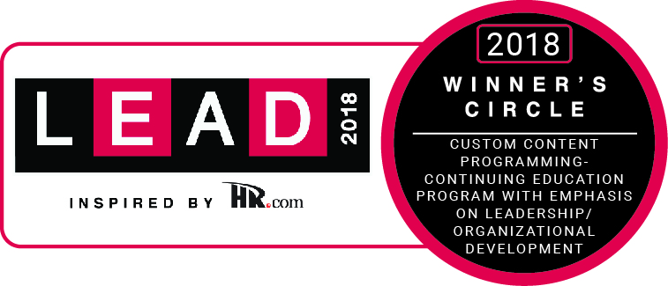
Baldrige Training:
Top-Tier Leadership Development
Baldrige Examiner Training:1st place, 2018
Baldrige Executive Fellows Program: 4th place, 2018
for emphasis on human resources and leadership/ organizational development
Top-10 ranking, 2016–2017, in this area
Among government/military leadership development programs:
Top-10 ranking 5 times, 2010–2015
—Leadership Excellence magazine
Notes:
Leadership Excellence magazine has consistently ranked the Baldrige Program among the best leadership development programs in the United States. The ranking recognizes Baldrige Examiner Training as well as the Baldrige Executive Fellows Program.
From 2010 to 2015, the program ranked in the top 10 government/military leadership development programs.
In 2016, the program began competing against a much larger pool of programs: continuing education programs with an emphasis on leadership. The program retained its top-10 ranking.
The ranking is based on survey responses, interviews, and site visits around seven criteria: vision/mission, involvement/participation, accountability/measurement, design/content/curriculum, presenters/presentations/delivery, take-home value, and outreach.

Slide 14
Factors behind the Impact
Acceptance of the Baldrige framework nationally and globally
Program participants
Notes:
The Baldrige Program and the Baldrige Award have successfully promoted performance excellence across the country and around the world. The program’s success can be attributed to a number of factors, including these:
the network of state, regional, and sector-specific Baldrige-based award programs
the growth of international interest in the Baldrige Program
the efforts of award recipients and other program participants

Slide 15
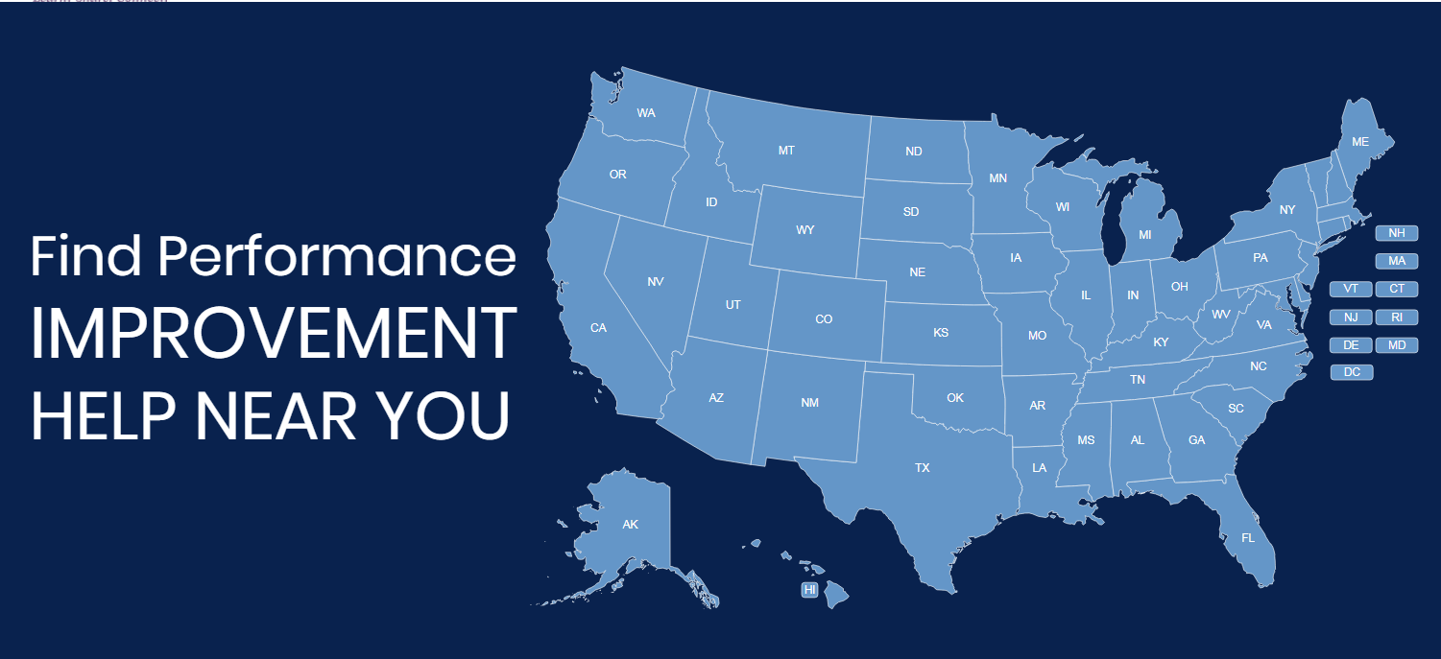
Alliance for Performance Excellence
A National Network
https://www.baldrigealliance.org
Notes:
The Alliance for Performance Excellence, a nonprofit network, serves as an umbrella organization for local, state, regional, and industry Baldrige-based programs. Around 30 state, regional, local, and industry-based performance excellence programs throughout the country base their programs and awards on the Baldrige Excellence Framework, which has extended the reach of the national program and the Baldrige framework. These programs offer tools, resources, and expertise to assist organizations in improving their performance. They also serve as a feeder system for the national Baldrige Award.
The number of state and local, regional, and sector-specific Baldrige-based award programs has grown from 8 in 1991 to around 30 today. These programs cover nearly all U.S. states and territories.
Other Baldrige-based programs cover long-term care and assisted living organizations, for example.
The Alliance for Performance Excellence noted the following for 2018:
1,241 application reports were received.
1,660 examiners were trained.
Over the past 20 years, state and local programs have trained more than 50,000 examiners.

Slide 16
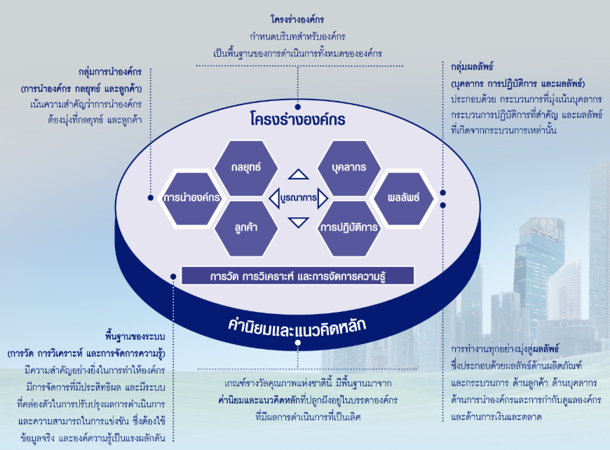

International Adoption
International Adoption
  About 80 performance excellence programs worldwide
Notes:
The Baldrige framework and the Criteria are a globally recognized model of performance excellence. Approximately 80 performance or business excellence programs around the world use the Baldrige Criteria or criteria similar to Baldrige as their performance excellence models.

Slide 17
Baldrige Award Participants
121 Baldrige Award recipients
(129 awards)
1,747 award applications
More than 12,000 examiners trained
Notes:
Baldrige Program participants include a wide variety of individuals and organizations, such as Baldrige framework-using organizations; Baldrige Award applicants and recipients; and members of the Board of Examiners, who evaluate the award applications and prepare feedback reports.
From the program’s inception through 2019, 129 of the 1,747 applications have resulted in a Baldrige Award: 31 in manufacturing, 16 in service, 29 in small business, 14 in education, 27 in health care, and 12 in the nonprofit sector. Eight organizations (MEDRAD; MESA; MidwayUSA; The Ritz-Carlton Hotel Company, L.L.C.; Solectron; Cargill Kitchen Solutions [formerly Sunny Fresh Foods, Inc.]; Southcentral Foundation; and Texas Nameplate, Inc.) have received the award twice, making the total number of award recipients 121.
Through 2019, the Baldrige Performance Excellence Program had trained more than 12,000 examiners in the Baldrige framework and processes. State and regional programs that are members of the nonprofit Alliance for Performance Excellence, which serves as a feeder system for the national Baldrige Award, have trained more than 50,000 examiners. Examiners often take knowledge from the program to their own organizations and teach others about the Baldrige process.
There have been examiners and award recipients in nearly every state and the District of Columbia.

Slide 18

Baldrige Award Recipients
Baldrige Award Recipients
Presentations to all sectors
Quest for Excellence® and regional conferences
Influence on customers/suppliers
Seminars and workshops
Articles
Notes:
Through the sharing of best practices and knowledge of the Baldrige framework, award recipients have helped increase the competitiveness of U.S. organizations. For example, award recipients often host seminars and workshops to help other organizations understand and use the Criteria.
Collectively, Baldrige Award recipients have given thousands of presentations. Audiences have included businesses, education and health care organizations, and government agencies and other nonprofit groups.
Award recipients also share best practices at the annual Quest for Excellence Conference® and at regional conferences. Regional conferences are held at various U.S. locations each year.
The use of the Baldrige framework by award recipients has had a positive influence in several ways on these organizations’ customers and suppliers. First, the use of the Baldrige framework has helped the organizations improve their processes related to customers and suppliers and their relationships with these groups. In addition, some organizations, through such mechanisms as Baldrige-based awards for their suppliers, have encouraged their supplier organizations to use the Baldrige framework .
Many award recipients have also written and published articles on the Baldrige framework and the Baldrige Program.

Slide 19
The Bottom Line: Results
The Bottom Line: Results
Improved outcomes for products, services, and processes
Notes:
Besides results such as increased self-knowledge, more workforce participation, and integrated operations, the Baldrige framework has helped organizations to improve bottom-line results and competitiveness. Following are some examples:
Lockheed Martin Missiles and Fire Control (MFC) has attained a leading market share and sustained growth over the past four years: return on investment, a strategic measure for MFC, has grown at a 23% compound annual rate, faster than the industry-best competitor at 13.7%; operating margin has had a compound annual growth rate of 6.2% over 11 years, better than the Standard & Poor’s (S&P) 500 Capital Goods Manufacturing Index at 1.5% and the industry-best competitor at 0.2%; from 2006 to 2011, annual orders from repeat customers increased by 32%, and international orders increased by almost 400%; and time reductions as a result of process and performance improvement programs yielded an estimated saving of $225 million annually.
Since 2006, MESA more than doubled in size while transforming itself from a manufacturing company to a full-service provider of corrosion control and integrity solutions to the pipeline industry. MESA's growth rate during this period exceeded its closest competitor by almost 40%; MESA's entry into new markets, including expansion into the asset integrity market for pipelines, has created more than $26 million of annual revenue over a nine-year period; profitability as a percentage of revenue has increased from 5% in 2006 to greater than 10% projected for 2012; customer retention rates consistently exceeded 95% in both materials and service between 2006 and 2011, and revenue from existing customers increased over the same period; and the customer satisfaction increased from 87% in 2006 to over 90% since 2009; these levels are consistently better than competitors (ranging from 72 to 83%) and the American Customer Satisfaction Index (ranging from 72 to 76%).
North Mississippi Health Services’ (NMHS’) outpatient management of diabetes has met or exceeded the National Committee for Quality Assurance (NCQA) top-decile benchmark since 2008; colorectal cancer screenings have increased since 2009 and consistently exceed the standard set by the state’s Medicare quality improvement organization; for 2012, the system’s flagship hospital performed at the 100% level for Joint Commission-accredited hospitals in 26 of 30 Surgical Care Improvement Project core measures; a strong focus on patient safety has led to no central line-associated blood stream infections in the intensive care unit for two years; employee retention has been at or above 90% since fiscal year 2007, exceeding the Bureau of Labor Statistics’ benchmark for health care organizations by 10%; and NMHS leads its primary competitor in market share by 13% and all other hospitals combined by 8%.
The City of Irving is one of five cities in the state and 89 in the nation with a AAA rating from both Standard and Poor’s and Moody’s—ratings that it has maintained since 2007; the tax rate is the second lowest in the Dallas-Fort Worth Metropolitan area. Since 2007, its overall cost of service has been better than four comparable cities in the area; the rating for overall quality of service in Irving (74%) is higher than the state of Texas (46%), county government (37%), and the U.S. government (38%); since 2006, the%age of residents rating many of the city’s key services—including police, code enforcement, libraries, and recreational—as good or excellent has increased by double digits; and Irving’s focus on process efficiency has resulted in more than $44 million in cost savings and efficiencies since 2008.
Montgomery County Public Schools (2010 Baldrige Award recipient) elementary school students’ reading performance used to determine Adequate Yearly Progress (AYP) increased for all subgroups, including improvements of 10.2 percentage points for Limited English Proficient students, 8.3 percentage points for students receiving free and reduced-priced meals, 7.1 percentage points for African Americans, and 7.6 percentage points for Hispanics..
Advocate Good Samaritan Hospital (2010 Baldrige Award recipient) demonstrates high levels of performance in many process measures for clinical outcomes. For example, risk-adjusted mortality (overall mortality divided by expected mortality where 1 is the standard) decreased from 0.55 in 2007 to 0.42 in 2010, exceeding the six-county top-decile level as measured by Thomson Reuters.
Lean manufacturing concepts have helped MESA Products, Inc. (2006 Baldrige Award recipient) achieve cycle time and productivity improvements. For example, throughput time in the magnesium assembly area improved by 82%, output in the instrumentation equipment assembly area increased by 60%, lead time for the sales-order-entry process decreased by 30%, and error rates dropped 50%. In addition, on-time shipments improved to 97.2%.
Hurricane Katrina caused DynMcDermott Petroleum Operations Company (2005 Baldrige Award recipient) to relocate operations from New Orleans, Louisiana, to Beaumont, Texas. Within five days, the Strategic Petroleum Reserve, which DynMcDermott manages as a contractor for the U.S. Department of Energy, began delivering oil to refineries in the Gulf Coast region that normally get oil from the Gulf of Mexico.

Slide 20
Returns on Investment in
Performance Excellence:
2019 Baldrige Award Recipients
Notes:
The following slides show some of the achievements of the current award recipients.

Slide 21

Adventist Health White Memorial
Zero emergency department returns after outpatient surgery since 2014, in the 2018 national top decile
Complication rates better than the national top decile
Net Promoter Score almost 25% higher than competing hospitals
Standard & Poor’s AA+ rating for days-cash-on-hand
Notes:
Adventist Health White Memorial is a private, faith-based, nonprofit teaching hospital that provides a full range of inpatient, ambulatory, emergency, and diagnostic services. Six service lines include general medicine, cardiovascular, surgical, orthopedic, women’s services, and emergency services. The hospital, which is deeply committed to its East Los Angeles community, is the only “safety-net” hospital serving more than 2 million people in a densely populated area where most residents live below the Federal poverty level. The hospital’s service area is a federally designated medically underserved area; the payor mix is 97% Medicaid and Medicare.
Highlights
Zero emergency department returns after outpatient surgery since 2014, in the national top decile in 2018
Complication rates better than the national top decile
Net Promoter Score almost 25% higher than competing hospitals
Standard & Poor's AA+ rating for days-cash-on-hand

Slide 22

Center for Organ Recovery & Education
In the top 10% of the nation’s OPOs from 2014 through 2019
Satisfaction levels above 90% for all four key customer groups
Cost savings of over $300,000 in 2014, $600,000 in 2018, over $2.6 million in 2019 as the result of managing operational costs, efficiency, and effectiveness
Notes:
Located in Pittsburgh, PA, CORE is a nonprofit organ procurement organization (OPO) with a federally designated service area encompassing a population of 5.5 million in western Pennsylvania, West Virginia, and one county in New York. One of 58 independent, nonprofit OPOs designated by the Centers for Medicare and Medicaid Services, CORE’s mission is to save and heal lives through donation.
Highlights
Performance among the top 10% of the nation’s OPOs from 2014 through 2019
Satisfaction levels above 90% for all four of CORE’s key customer groups—donor families, transplant centers, corneal transplant surgeons, and tissue processors
Cost savings of over $300,000 in 2014, over $600,000 in 2018, and over $2.6 million in 2019 as the result of managing operational costs, efficiency, and effectiveness

Slide 23
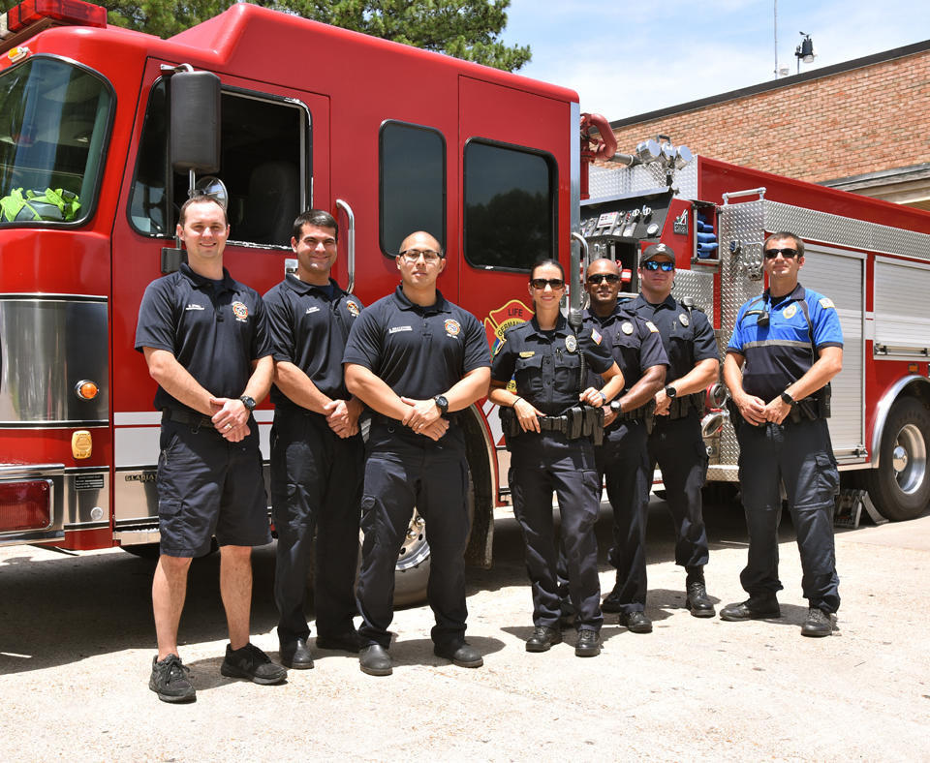
City of Germantown, Tennessee
Since 1994, highest possible credit rating from Standard & Poor's and Moody’s
Unemployment rate of ~2.6% in 2018, better than the current U.S. rate of 3.7%
71 Net Promoter Score in customer engagement, better than the “excellent” and “world-class” benchmarks of 50 and 70
Close to 80% overall satisfaction rating since 2015, better than the 2019 FEVS benchmark of 60%
Notes:
Located near the Mississippi River along the historic trails of the Chickasaw Indians and established in 1841, the City of Germantown operates under a mayor-council form of government. With a certified population of 40,123, the City has one defining mission—Excellence, Every day. The philosophy guides staff commitment to align performance excellence with the City’s vision and long-range strategy, represented in the Germantown Forward 2030 Plan. The City comprises 19.8 square miles and its key product offerings include education, economic development, public safety, sanitation, and utilities (water and sewer).
Highlights
Since 1994, the highest possible credit rating from Standard & Poor's and Moody’s
Unemployment rate of about 2.6% in 2018, better than the current U.S. rate of 3.7%
Net Promoter Score of 71 in customer engagement in 2018, better than the “excellent” benchmark of 50 and the “world-class” benchmark of 70
Close to 80% overall satisfaction rating since 2015, better than the 2019 FEVS benchmark of 60%

Slide 24

Howard Community College
By more than 200%, outperforms local and national comparators for attainment of associate degrees and certificates
Tripled graduation rates for Black/African American and Hispanic/Latino first-time-to-college students within two years of entry
100% graduate placement rate for health sciences students from 7 of 8 health sciences programs
Best in the state for full-time-equivalent enrollment growth over 10 years
Notes:
Howard Community College is an open-access, public community college offering associate degrees and certificates, as well as workforce development training and continuing education classes, that help students attain new skills, and prepare for careers or transfer to four-year institutions. With 2,724 employees, the college educates about 30,000 students annually through a main campus in Columbia, Maryland, in addition to two other locations.
Highlights
Outperforms local and national comparators for attainment of associate degrees and certificates by more than 200%
Tripled graduation rates for Black/African American and Hispanic/Latino first-time-to-college students within two years of entry
100% graduate placement rate for health sciences students from seven out of eight of health sciences programs
Best in the state for full-time-equivalent enrollment growth over the past 10 years

Slide 25

Illinois Municipal Retirement Fund
Standard & Poor’s “strong” rating since 2017
90% funded, 1 of only 16 of the 100 largest U.S. public pension plans at this level
Over 10 years, 9.47% gross annualized rate of return, better than the actuarial assumption of 7.5% and total portfolio benchmark of 8.78%
97% member and 96% employer satisfaction with transactions
Notes:
With a workforce of 210, the Illinois Municipal Retirement Fund is a public-defined benefit pension plan providing services to local government and school district employees throughout Illinois (except for the City of Chicago and Cook County). It serves 3,010 employers and has $42.7 billion in assets. IMRF has 176,517 active members, 119,939 inactive members, and 133,261 benefit recipients. It has main and satellite offices, respectively, in Oak Brook and Springfield, IL, as well as eight Illinois regional home offices.
Highlights
Standard & Poor’s “strong” rating since 2017
90% funded, 1 of only 16 of the 100 largest U.S. public pension plans at this level
Over 10 years, 9.47% gross annualized rate of return, better than the actuarial assumption of 7.5% and total portfolio benchmark of 8.78%
97% member and 96% employer satisfaction with transactions

Slide 26

Mary Greeley Medical Center
CMS top decile for 30-day readmissions, 30-day mortality for heart attack patients, and preventable blood clots
Top-decile inpatient satisfaction since 2016
More than 75% of inpatients/outpatients recommending the medical center
Dominant leader in primary market share
Notes:
Opened in 1916 and now the largest independent medical center in its primary and secondary markets, Mary Greeley Medical Center is a public, nonprofit, 220-bed hospital offering inpatient, outpatient, emergency department, home health care, and hospice services. The hospital, which was gifted to the city of Ames by a Union Army officer in the Civil War in memory of his beloved wife, provides health care to the residents of a 14-county area in central Iowa. Inpatient and outpatient services support a continuum of care for patients, including surgery, cancer care, cardiac care, diabetes and nutrition care, orthopedics, obstetrics and gynecology, gastroenterology, mental health services, palliative care, home health care, hospice care, rehabilitation, and more.
Highlights
Center for Medicare and Medicaid Services top decile for 30-day readmissions, 30-day mortality for heart attack patients, incidence of preventable blood clots, compliance with sepsis practices, influenza vaccinations, stroke bundle compliance, and outpatient imaging measures
Top-decile inpatient satisfaction since 2016
More than 75% of inpatients and outpatients recommending the medical center
Dominant leader in primary market share overall and for inpatient (43%) and outpatient (48%) care since 2015, in spite of being one quarter to one third the size of two of its closest competitors

Slide 27
For more information
For more information
Baldrige framework booklets and free content
Self-assessment tools
Organizational assessments
Training, conferences, and executive education
Award recipient profiles
Case studies
Connections to the Baldrige community
www.nist.gov/baldrige
baldrige@nist.gov
(301) 975-2036
Baldrige Performance Excellence Program | www.nist.gov/baldrige

