Slide 1
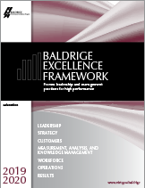

Baldrige Performance Excellence Program | 2020
Baldrige Excellence Framework (Education)
Proven leadership and management practices for high performance

Slide 2
Quote from Dr. JoAnn Sternke
Why Baldrige? Because before we used [the Baldrige Criteria], we were hard-working, but now we’re more effective and efficient.
Because [Baldrige] allowed us to leverage our strength in planning and get better to reach new heights of achievement.
Because [Baldrige] allows us to make sure that we are using results to drive improvement.
Because by using a systematic approach, we became more innovative.
—JoAnn Sternke, Superintendent,
Pewaukee School District
Notes:
More quotes:
What [Baldrige] does is give you an open field to think differently, to be more creative, to take risks but to planfully do them, study them, act upon them, evaluate them, and then redo them to attain your goal.
—Dr. Jerry Weast, (former) superintendent of Baldrige Award recipient Montgomery County Public Schools, Maryland
We’ve seen student achievement go up in ways that we never thought imaginable. We’ve become more efficient and more effective. And these successes aren’t just figures and statistics; they do change lives. And in the process, we’ve become an innovative force in education. For those pondering whether or not to pursue this Baldrige process, I say boldly, Why wouldn’t you?
—JoAnn Sternke, Superintendent, Pewaukee School District

Slide 3
Quote from Dr. Jerry Weast
What we've done [with Baldrige] is put together a string of wins based on continuous improvement, … and it’s changed the way we look at children, changed our expectations, changed the way that we look at outcomes, helped us look higher, changed the way that we keep track of data. It's not testing; it's measurement, measurement to improvement.
—Dr. Jerry Weast, Former Superintendent,
Montgomery County (Maryland) Public Schools
Notes:
More quotes:
The great thing about Baldrige—we’re already getting applications from outside of the state, from people who want to come work in a Baldrige-winning school system.
—Dr. Terry Holliday, (former) superintendent of Baldrige Award recipient Iredell-Statesville Schools, North Carolina
I see the Baldrige process as a powerful set of mechanisms for disciplined people engaged in disciplined thought and taking disciplined action to create great organizations that produce exceptional results.
—Jim Collins, author of Good to Great: Why Some Companies Make the Leap . . . and Others Don’t

Slide 4
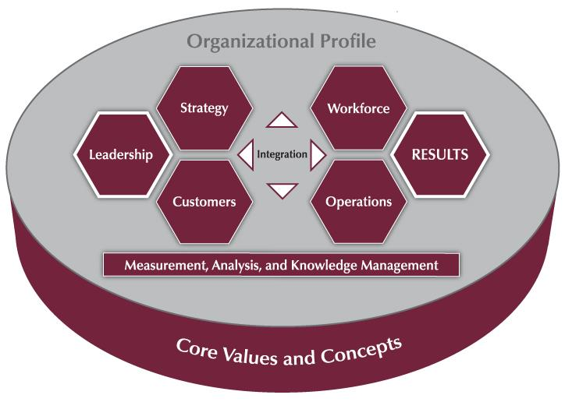
The Baldrige Approach in 3 Questions
Is your organization doing as well as it could?
How do you know?
What and how should your organization improve or change?
Notes:
These three questions sum up what using the Baldrige framework can tell you about your organization.

Slide 5
Baldrige Systems Perspective
A systems perspective
Core values and concepts
Education Criteria for Performance Excellence
Scoring system
Notes:
The Baldrige Excellence Framework promotes a systems perspective. It helps you see your organization as a system with interdependent parts.
The framework consists of a set of core values and concepts, the Education Criteria for Performance Excellence, and a scoring system to use in evaluating your organization.

Slide 6
Systems Perspective
Notes:
This overview shows how the Education Criteria provide a systems perspective for managing your organization. The Organizational Profile sets the context for your organization. It serves as the background for all you do.
The performance system consists of the six categories in the center of the figure. These categories define your processes and the results you achieve.
Performance excellence requires strong Leadership and is demonstrated through outstanding Results. Those categories are highlighted in the figure. The word “integration” at the center of the figure shows that all the elements of the system are interrelated.
The center horizontal arrowheads show the critical linkage between the leadership triad and the results triad and the central relationship between the Leadership and Results categories.
The center vertical arrowheads point to and from the system foundation, which provides information on and feedback to key processes and the organizational environment.
The leadership triad (Leadership, Strategy, and Customers) emphasizes the importance of a leadership focus on strategy and on students and other customers.
The results triad (Workforce, Operations, and Results) includes your workforce-focused processes, your key operational processes, and the performance results they yield.
The system foundation (Measurement, Analysis, and Knowledge Management) is critical to effective management and to a fact-based, knowledge-driven, agile system for improving performance and competitiveness.
As mentioned, the Core Values and Concepts are the foundation of the Criteria.
All actions lead to Results—a composite of educational program and service, process, customer-focused, workforce-focused, leadership and governance, and financial and market results.

Slide 7
Criteria Categories
Leadership
Strategy
Customers
Measurement, Analysis, and Knowledge Management
Workforce
Operations
Results
Notes:
The Baldrige Education Criteria for Performance Excellence are a set of questions divided into an Organizational Profile and the seven categories in the diagram on the previous slide. Each category represents a critical aspect of managing and performing as an organization.
Each category is subdivided into items. There are 17 items, each focusing on an aspect of your organization.

Slide 8
The Role of Core Values and Concepts
Notes:
The Education Criteria are built on 11 interrelated core values and concepts. These are beliefs and behaviors found in high-performing organizations.
The Education Criteria encourage you to take a systems perspective on your organization, the value at center of the figure. The next layer shows the core values and concepts that are embedded in Education Criteria categories 1 through 6. These categories are the next layer in the figure. Systematic processes in those areas yield the performance results found in Education Criteria category 7, represented by the outermost layer.
Let’s take a closer look at these core values and concepts.

Slide 9
Core Values and Concepts
Core Values and Concepts
Student-centered excellence
Valuing people
Organizational learning and agility
Focus on success
Managing for innovation
Management by fact
Societal contributions
Systems perspective
Visionary leadership
Ethics and transparency
Delivering value and results
Notes:
The Baldrige Criteria are built on these interrelated core values and concepts. They represent beliefs and behaviors that are found in high-performing organizations
First and foremost, Baldrige provides a systems perspective that requires visionary leadership—the first two core values.
The next seven core values are the hows of an effective system: student-centered excellence, valuing people, organizational learning and agility, focus on success, managing for innovation, management by fact, and societal contributions.
The final two core values, ethics and transparency and delivering value and results, are the outcome of using Baldrige as a guide.

Slide 10
Core Values and Concepts 2
Student-centered excellence
Valuing people
Organizational learning and agility
Focus on success
Managing for innovation
Management by fact
Societal contributions
Systems perspective
Visionary leadership
Ethics and transparency
Delivering value and results
Notes:
Systems perspective: A systems perspective means managing all the parts of your organization as a unified whole to achieve your mission, in the context of your business ecosystem. It means ensuring that your plans, processes, measures, and actions are consistent. And it means ensuring that the individual parts of your organization’s management system work together in a fully interconnected, unified, and mutually beneficial manner.
Visionary leadership: Your organization’s senior leaders should set a vision for the organization, create a customer focus, demonstrate clear and visible organizational values and ethics, and set high expectations for the workforce. The vision, values, and expectations should balance the needs of all your stakeholders.
Student-centered excellence: Your students and other customers are the ultimate judges of performance and quality. Thus, your organization must take into account all educational program and service features and support that contribute value to your students and other customers. .
Valuing people: A successful organization values all people who have a stake in the organization, including students, other customers, community members, stockholders, and other people affected by the organization’s actions. Your organization’s success depends on an engaged workforce that benefits from meaningful work, clear organizational direction, the opportunity to learn, and accountability for performance. That engaged workforce must also have a safe, trusting, and cooperative environment.

Slide 11
Core Values and Concepts 3
Student-centered excellence
Valuing people
Organizational learning and agility
Focus on success
Managing for innovation
Management by fact
Societal contributions
Systems perspective
Visionary leadership
Ethics and transparency
Delivering value and results
Notes:
Organizational learning and agility: Success in today’s ever-changing, globally competitive environment demands continual organizational learning and agility. Agility requires a capacity for rapid change and for flexibility in operations. Organizational learning includes both continuous improvement of existing approaches and significant change or innovation, leading to new goals, approaches, educational programs and services, and markets.
Focus on success: Ensuring your organization’s success now and in the future requires an understanding of the short- and longer-term factors that affect your organization and its marketplace. Ensuring this ongoing success requires managing uncertainty in the environment, as well as balancing some stakeholders’ short-term demands with the organization’s and stakeholders’ needs to invest in long-term success.
Managing for innovation: Innovation is no longer strictly the purview of research and development departments. Organizations should be led and managed so that innovation becomes part of the learning culture, is integrated into daily work, and reaches across the entire organization. Innovation should lead the organization to new dimensions of performance
Management by fact: Performance improvement requires measurement and analysis. The measures selected should best represent the factors that lead to improved student, other customer, operational, societal, and financial performance. Analysis supports a variety of purposes, such as planning, reviewing your overall performance, improving operations, managing change, and comparing your performance with competitors’ or with best-practice benchmarks.

Slide 12
Core Values and Concepts 4
Student-centered excellence
Valuing people
Organizational learning and agility
Focus on success
Managing for innovation
Management by fact
Societal contributions
Systems perspective
Visionary leadership
Ethics and transparency
Delivering value and results
Notes:
Societal contributions: Leaders should stress contributions to the public, ethical behavior, and the need to consider societal well-being and benefit, which refers to leadership in and support—within the limits of an organization’s resources—of the environmental, social, and economic systems in the organization’s sphere of influence.
Ethics and transparency: Ethical behavior and transparency build trust in the organization and a belief in its fairness and integrity that is valued by all key stakeholders. Your organization should stress ethical behavior in all stakeholder transactions and interactions. Transparency is characterized by consistently candid and open communication on the part of leadership and management and by the sharing of clear and accurate information.
Delivering value and results: By delivering value to key stakeholders, your organization builds loyalty, contributes to growing the economy, and contributes to society. Results should be used to deliver and balance value for your key stakeholders—your students, other customers, workforce, stockholders, suppliers, and partners; the public; and the community. Thus results need to be a composite of measures that include not just financial results, but also educational program and service results, process results; student, other customer, and workforce satisfaction and engagement results; and leadership, strategy, and societal performance.

Slide 13
Item Format
Item Format
Notes:
There are 17 Criteria items (plus 2 in the Organizational Profile), each with a particular focus.
Let’s take a look at what an item looks like in the Baldrige Excellence Framework booklet. In this graphic of item 3.1, Customer Expectations, you can see that the basic question is in the item title (“How do you listen to your students and other customers … ?”).
Each item includes one or more areas to address (labeled a, b, c, and so on).
There are three levels of item questions:
Basic questions are expressed in the title question.
Overall questions are expressed in boldface in the shaded box. These leading questions are the starting point for responding.
Multiple questions are the individual questions under each area to address, including the one in boldface. That first question expresses the most important one in that group.
Terms in small caps are defined in the Glossary of Key Terms.
Item notes serve three purposes: (1) to clarify key terms or questions, (2) to give instructions and examples for responding to the item questions, and (3) to indicate key linkages to other items.
Notes also provide additional guidance specifically for nonprofit organizations. These nonprofit-specific notes are shown in italics.
At the end of each item is a link to additional examples and guidance (free on the Baldrige website).

Slide 14
Organizational Profile
P.1 Organizational Description
P.2 Organizational Situation
Starting point for self-assessment
and application preparation
Basis for early action planning
Notes:
The Organizational Profile provides a snapshot of your organization, the key influences on how it operates, and the key challenges it faces. Your responses set the context for responding to the Criteria items. The Organizational Profile helps everyone (e.g., organizations using the Criteria for self-assessment, application writers, and reviewers) understand what is most relevant and important to the your business and to performance.
The Organizational Profile is the best starting point for assessment. If you identify topics for which conflicting, little, or no information is available, you can use these topics for action planning. By addressing the questions in the Organizational Profile, you can identify potential gaps in key information and bring into focus areas that affect key performance requirements and results.
P.1, Organizational Description, asks, “What are your key organizational characteristics?” It asks you to describe your organization’s operating environment, including identifying its core competencies, and its key relationships with customers, stakeholders, suppliers, and partners. It also asks for a description of your governance system.
P.2, Organizational Situation, asks, “What is your organization’s strategic situation?” It asks you to describe your competitive environment, key strategic challenges and advantages, and system for performance improvement. It includes a request to identify available sources of comparative and competitive data to emphasize the need for these sources and to provide a context for later responses.

Slide 15
1. Leadership (120 pts.)
1. Leadership (120 pts.)
1.1 Senior Leadership (70 pts.)
1.2 Governance and Societal Contributions (50 pts.)
Senior leaders’ actions
Organizational governance
Societal contributions
Notes:
Category 1 (Leadership) asks how senior leaders’ personal actions and your governance system guide and sustain your organization.
1.1, Senior Leadership, asks about the key aspects of your senior leaders’ responsibilities, with the aim of creating an organization that is successful now and in the future.
1.2, Governance and Societal Contributions, asks about key aspects of your organization’s governance system, including the improvement of leadership. It also asks how your organization ensures that everyone in the organization behaves legally and ethically and how it makes societal contributions.

Slide 16
2. Strategy (85 pts.)
2. Strategy (85 pts.)
2.1 Strategy Development (45 pts.)
Strategic and action planning
2.2 Strategy Implementation (40 pts.)
Implementation of plans
Notes:
Category 2 (Strategy) asks how your organization develops strategic objectives and action plans, implements them, changes them if circumstances require, and measures progress.
The category stresses that your organization’s long‐term success and competitive environment are key strategic issues that need to be integral parts of your overall planning. Making decisions about your organization’s core competencies and work systems is an integral part of ensuring your organization’s success now and in the future, and these decisions are therefore key strategic decisions.
2.1, Strategy Development, asks how your organization establishes a strategy to address its challenges and leverage its advantages and how it makes decisions about key work systems and core competencies. It also asks about your key strategic objectives and their related goals. The aim is to strengthen your overall performance, competitiveness, and future success.
2.2, Strategy Implementation, asks how your organization converts your strategic objectives into action plans to accomplish the objectives and how your organization assesses progress relative to these action plans. The aim is to ensure that you deploy your strategies successfully and achieve your goals.

Slide 17
3. Customers (85 pts.)
3. Customers (85 pts.)
3.1 Customer Expectations (40 pts.)
Listening to students and other customers; determining programs and services for them
3.2 Customer Engagement (45 pts.)
Engaging students and other customers; determining their satisfaction and engagement
Notes:
Category 3 (Customers) asks how your organization listens to the voice of the customer, builds relationships with students and other customers, and uses student and other customer information to improve and to identify opportunities for innovation.
The category stresses student and other customer engagement as an important outcome of an overall learning and performance excellence strategy..
3.1, Customer Expectations, asks about your organization’s processes for listening to your students and other customers, and determining and customizing educational programs and services to meet their needs. The aim is to capture meaningful information in order to exceed your students’ and other customers’ expectations.
3.2, Customer Engagement, asks about your organization’s processes for enabling students and other customers to seek information and support. The item also asks how you build relationships with your students and other customers and manage complaints. The aim of these efforts is to improve marketing, build a more student- and other customer‐focused culture, and enhance student and other customer loyalty.

Slide 18
4. Measurement, Analysis, Knowledge Management (90 pts.)
4. Measurement, Analysis, and Knowledge Management (90 pts.)
4.1 Measurement, Analysis, and Improvement of Organizational Performance (45 pts.)
4.2 Information and Knowledge Management (45 pts.)
Analysis, review, and improvement of organizational performance
Information and knowledge management
Notes:
Category 4 (Measurement, Analysis, and Knowledge Management) is the main point within the Criteria for all key information about effectively measuring, analyzing, and improving performance and managing organizational knowledge to drive improvement, innovation, and organizational competitiveness. In the simplest terms, category 4 is the “brain center” for aligning your organization’s operations with its strategic objectives.
4.1, Measurement, Analysis, and Improvement of Organizational Performance, asks how your organization selects and uses data and information for performance measurement, analysis, and review in support of organizational planning and performance improvement. The aim is to guide your organization’s process management toward the achievement of key organizational results and strategic objectives, to anticipate and respond to rapid or unexpected organizational or external changes, and to identify best practices to share.
4.2, Information and Knowledge Management asks how your organization builds and manages its knowledge assets and how it ensures the quality and availability of data and information.

Slide 19
5. Workforce (85 pts.)
5. Workforce (85 pts.)
5.1 Workforce Environment (40 pts.)
5.2 Workforce Engagement (45 pts.)
Building an effective workforce environment
Engaging and developing your workforce
Notes:
Category 5 (Workforce) addresses key workforce practices—those directed toward creating and maintaining a high‐performance work environment and toward engaging your workforce to enable it and your organization to adapt to change and to succeed.
5.1, Workforce Environment, asks about your workforce capability and capacity needs, how you meet those needs to accomplish your organization’s work, and how you ensure a supportive work climate. The aim is to build an effective environment for accomplishing your work and supporting your workforce.
5.2, Workforce Engagement, asks about your organization’s systems for developing workforce performance among your workforce members to enable and encouraging all workforce members to contribute effectively and to the best of their ability. These systems are intended to foster high performance and to help accomplish your action plans and ensure organizational success now and in the future

Slide 20
6. Operations (85 pts.)
6. Operations (85 pts.)
6.1 Work Processes (45 pts.)
6.2 Operational Effectiveness (40 pts.)
Designing, managing, and improving programs, services, and work processes
Improving operational effectiveness
Notes:
Category 6 (Operations) This category asks how your organization designs, manages, and improves its educational programs and services and its work process. It also asks how you improve operational effectiveness.
Item 6.1, Work Processes, asks about the management of your key educational programs and services and work processes, with the aim of creating value for your students and other customers and achieving organizational success now and in the future. It also asks how you manage your supply chain.
Item 6.2, Operational Effectiveness, asks how you ensure efficient and effective operations in order to have a safe workplace environment and deliver value to your students and other customers. It also asks how you manage security and cybersecurity.

Slide 21
Results (450 pts.)
7. Results (450 pts.)
7.1 Student Learning and Process Results (120 pts.)
7.2 Customer Results (80 pts.)
7.3 Workforce Results (80 pts.)
7.4 Leadership and Governance Results (80 pts.)
7.5 Budgetary, Financial, Market, and Strategy Results (90 pts.)
Performance and improvement in all key areas
Performance levels, trends, and comparative data
Notes:
Category 7 (Results) provides a systems focus that encompasses all results necessary to sustaining an enterprise: your key student learning and process results, your student- and other customer‐focused results, your workforce results, your leadership and governance system results, and your overall financial and market performance.
Category 7 provides “real‐time” information (measures of progress) for evaluating, improving, and innovating of processes and educational programs and services, in alignment with your overall organizational strategy.
7.1, Student Learning and Process Results, asks about your organization’s key educational program and service and operational performance results, which demonstrate program and service quality and value that lead to student and other customer satisfaction and engagement.
7.2, Customer Results, asks about your organization’s customer‐focused performance results, which demonstrate how well your organization has been satisfying your students and other customers and engaging them in loyalty‐building relationships.
7.3, Workforce Results, asks about your organization’s workforce‐focused performance results, which demonstrate how well your organization has been creating and maintaining a productive, caring, engaging, and learning environment for your workforce.
7.4, Leadership and Governance Results, asks about your key results that demonstrate the extent to which your organization is fiscally sound, ethical, and socially responsible.
7.5, Budgetary, Financial, Market, and Strategy Results, asks about results that demonstrate your financial sustainability, your marketplace achievements, and the achievement of your strategy.

Slide 22
Scoring System
Scoring guidelines
Importance to your organization
Two dimensions: process and results
Notes:
Once you have answered the questions in the Criteria for Performance Excellence, the scoring guidelines allow you (in a self-assessment) or outside assessors (such as Baldrige examiners) to evaluate your processes and your results and gauge your organizational maturity.
In doing this evaluation, a major consideration is what is important to your organization, as described in the Organizational Profile.
In a Baldrige assessment, your organization is evaluated on two dimensions: process and results.

Slide 23
Category Point Values
1 Leadership 120
2 Strategy 85
3 Customers 85
4 Measurement, Analysis, and
Knowledge Management 90
5 Workforce 85
6 Operations 85
7 Results 450
Total 1,000
Notes:
All the questions in the items within the boxed categories (1 through 6) ask about your organization’s processes.
The results items (category 7) ask about trends, performance levels, and comparisons, as well as the breadth and importance of your results. Because the bottom line for any organization is results, almost half of the application points are for results.
Results should be supported by linkages to the appropriate process items to show cause and effect.
Results may be the bottom line, but they are accomplished through a successful performance management system that is guided from the top.

Slide 24
Evaluating Processes
Approach
Deployment
Learning
Integration
How do you accomplish your organization’s work? How systematic are your key processes?
How consistently are your key processes used?
How well have you evaluated and improved your key processes? How well have improvements been shared?
How well do your processes address organizational needs?
Notes:
Your processes are evaluated based on these four factors:
Approach: How do you accomplish the work of your organization? How systematic are the key processes you use?
Deployment: How consistently are your key processes used throughout your organization?
Learning: How well have you evaluated and improved your key processes? How well have improvements been shared within your organization?
Integration: How well do your processes address your current and future organizational needs?

Slide 25
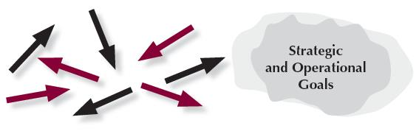
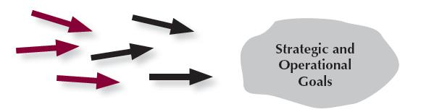


Steps toward Mature Processes
Steps toward Mature Processes
Reacting to Problems (0–25%)
Early Systematic Approaches (30–45%)
Aligned Approaches (50–65%)
Integrated Approaches (70–100%)
Notes:
This graphic is an aid for assessing process items (categories 1 through 6). In each case, the arrows indicate the degree of consistency and coordination among organizational units. The circular shapes shown next to the arrows depict the relative clarity or definition of an organization’s goals. The steps are as follows:
Reacting to Problems: Here operations are characterized by activities rather than by processes, and they are largely responsive to immediate needs or problems.
Early Systematic Approaches: Here the organization is at the beginning stages of conducting operations by processes with repeatability, evaluation and improvement, and some early coordination among organizational units.
Aligned Approaches occur in the third step toward a mature process. At this stage, operations are repeatable and are regularly evaluated for improvement, with learnings shared and with coordination among organizational units.
Integrated Approaches occur at the final stage of a mature process. The arrows indicate the evolution of the organization into an interconnected unit. At this stage, not only are processes repeatable, but also, in collaboration with other affected units, they are regularly evaluated for change and improvement. This collaboration and interconnection help organizations achieve efficiencies across units.

Slide 26
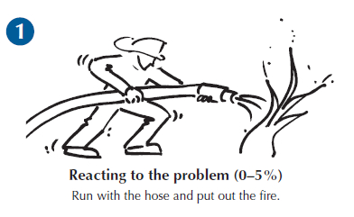
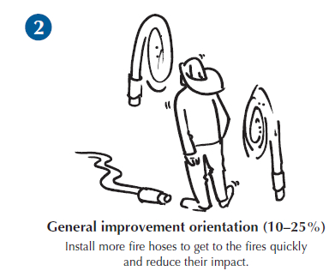
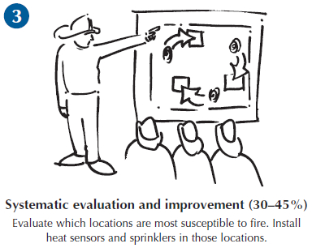
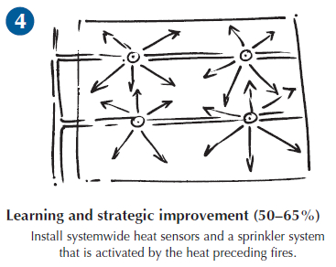
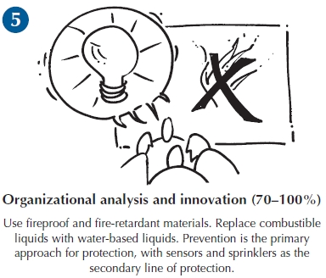
From Fighting Fires to Innovation: An Analogy for Learning
From Fighting Fires to Innovation:
An Analogy for Learning
Notes:
Learning is an essential attribute of high-performing organizations and, therefore, a critical concept in performance excellence. It is a key term used throughout the Baldrige Excellence Framework booklet and is one of the four scoring factors used to assess the maturity of an organization’s processes.
Effective, well-deployed organizational learning can help an organization improve from the early stages of reacting to problems to the highest levels of organization-wide improvement, refinement, and innovation. The firefighting analogy illustrated here shows a progression through the levels of maturity for this scoring dimension: reacting to the problem, general improvement orientation, systematic evaluation and improvement, learning and strategic improvement, and organizational analysis and innovation.

Slide 27
Evaluating Results
Levels
Trends
Comparisons
Integration
What is your current performance?
Are the results improving, staying the same, or getting worse?
How does your performance compare with others?
Are you tracking important results? Are you using the results in decision making?
Notes:
Your results are evaluated based on these four factors:
Levels: What is your current performance?
Trends: Are the results improving, staying the same, or getting worse?
Comparisons: How does your performance compare with that of other organizations and competitors, or with benchmarks?
Integration: Are you tracking results that are important to your organization? Are you using the results in organizational decision making?

Slide 28
For more information
For more information
Baldrige Excellence Framework booklets and free content
Self-assessment tools
Organizational assessments
Training, conferences, executive education
Award recipient profiles
Case studies
Connections to the Baldrige community
www.nist.gov/baldrige
301-975-2036
baldrige@nist.gov
Baldrige Performance Excellence Program | www.nist.gov/baldrige

