Slide 1
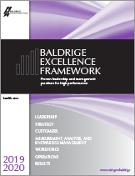

Baldrige Performance Excellence Program | 2019
Baldrige Excellence Framework (Health Care)
Proven leadership and management practices for high performance

Slide 2
For those considering the Baldrige framework, I want to testify to the magnitude of the results you can achieve. . . . It was the use of the Baldrige framework that had boosted our ability to deliver better care to our patients. And, in the end, that is the most important thing.
—Nancy Schlichting, CEO,
Henry Ford Health System
Notes:
More quotes:
“The Baldrige journey for us has really never been about winning the crystal. It’s about being worthy, . . . accelerating our performance, . . .. transforming our organization, making it a better place for our physicians to practice, achieving stronger clinical outcomes, . . . creating a great work environment, and eventually getting to this vision of ours of building healthy communities.”
—David Tilton, president and CEO of Baldrige Award recipient AtlantiCare
“I honestly in my heart believe that because we participated in the Baldrige program and because it gave us that consistent feedback, there are people who are alive today who wouldn’t have been had we not been so committed to the Baldrige process.”
—Rulon Stacey, president of Baldrige Award recipient Poudre Valley Health System
“I see the Baldrige process as a powerful set of mechanisms for disciplined people engaged in disciplined thought and taking disciplined action to create great organizations that produce exceptional results.”
—Jim Collins, author of Good to Great: Why Some Companies Make the Leap . . . and Others Don’t
“Baldrige is a commitment to excellence that never ends. . . . We want to learn every day, we want to be better every day, and Baldrige gave us the framework . . . to pursue that journey of excellence.”
—Mark Laney, president and CEO of 2009 Baldrige Award recipient Heartland Health

Slide 3
Using the program as an improvement road map . . ., we improved patient satisfaction for 10 straight years.
Our risk-adjusted mortality rate improved to rank among the top 10% nationally. . . .
While driving these improvements, we also created efficiencies, freeing up resources to further reinvest in our clinical care and services.
—Rulon Stacey, Former President/CEO,
Poudre Valley Health System

Slide 4
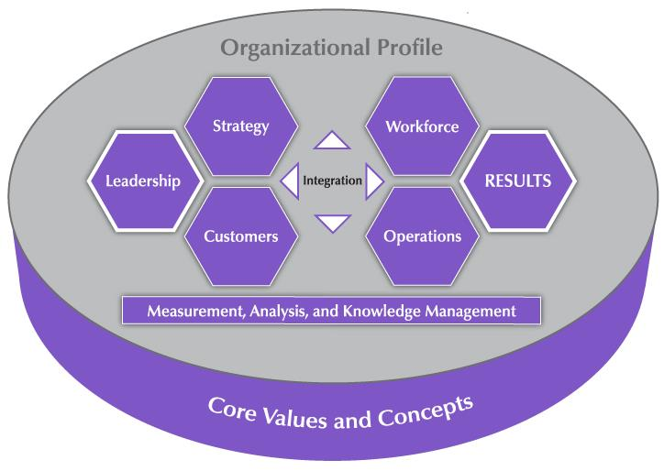
The Baldrige Approach in 3 Questions
Is your organization doing as well as it could?
How do you know?
What and how should your organization improve or change?
Notes:
These three questions sum up what using the Baldrige framework can tell you about your organization.

Slide 5
A systems perspective
Core values and concepts
Health Care Criteria for Performance Excellence
Scoring system
Notes:
The Baldrige Excellence Framework promotes a systems perspective. It helps you see your organization as a system with interdependent parts.
The framework includes the Health Care Criteria for Performance Excellence, a set of core values and concepts, and a scoring system to use in evaluating your organization’s processes and results.

Slide 6
A Systems Perspective
Notes:
This overview shows how the Criteria provide a systems perspective for managing your organization. The Organizational Profile sets the context for your organization. It serves as the background for all you do.
The performance system consists of the six categories in the center of the figure. These categories define your processes and the results you achieve.
Performance excellence requires strong Leadership and is demonstrated through outstanding Results. Those categories are highlighted in the figure. The word “integration” at the center of the figure shows that all the elements of the system are interrelated.
The center horizontal arrowheads show the critical linkage between the leadership triad and the results triad and the central relationship between the Leadership and Results categories.
The center vertical arrowheads point to and from the system foundation, which provides information on and feedback to key processes and the organizational environment.
The leadership triad (Leadership, Strategy, and Customers) emphasizes the importance of a leadership focus on strategy and on patients and other customers.
The results triad (Workforce, Operations, and Results) includes your workforce-focused processes, your key operational processes, and the performance results they yield.
The system foundation (Measurement, Analysis, and Knowledge Management) is critical to effective management and to a fact-based, knowledge-driven, agile system for improving performance and competitiveness.
As mentioned, the Core Values and Concepts are the foundation of the Criteria.
All actions lead to Results—a composite of health care and process, customer-focused, workforce-focused, leadership and governance, and financial and market results.

Slide 7
Health Care Criteria Categories
Leadership
Strategy
Customers
Measurement, Analysis, and Knowledge Management
Workforce
Operations
Results
Notes:
The Baldrige Health Care Criteria for Performance Excellence are a set of questions divided into an Organizational Profile and the seven categories in the diagram on the previous slide. Each category represents a critical aspect of managing and performing as an organization.
Each category is subdivided into items. There are 17 items, each focusing on an aspect of your organization.

Slide 8
The Role of Core Values and Concepts
Notes:
The Health Care Criteria are built on 11 interrelated core values and concepts. These are beliefs and behaviors found in high-performing organizations.
Systems perspective is at the center of the figure. The next layer shows the other core values and concepts that are embedded in Health Care Criteria categories 1 through 6. These categories are the next layer in the figure. Systematic processes in those areas yield the performance results found in Health Care Criteria category 7, represented by the outermost layer.
Let’s take a closer look at these core values and concepts.

Slide 9
Core Values and Concepts
Patient-focused excellence
Valuing people
Organizational learning and agility
Focus on success
Managing for innovation
Management by fact
Societal contributions
Systems perspective
Visionary leadership
Ethics and transparency
Delivering value and results
Notes:
First and foremost, Baldrige provides a systems perspective that requires visionary leadership—the first two core values.
The next seven core values are the hows of an effective system.
The final two core values, ethics and transparency and delivering value and results, are the outcome of using Baldrige as a guide.

Slide 10
Patient-focused excellence
Valuing people
Organizational learning and agility
Focus on success
Managing for innovation
Management by fact
Societal contributions
Systems perspective
Visionary leadership
Ethics and transparency
Delivering value and results
Notes:
Systems perspective: A systems perspective means managing all the parts of your organization as a unified whole to achieve your mission, in the context of your business ecosystem. It means ensuring that your plans, processes, measures, and actions are consistent. And it means ensuring that the individual parts of your organization’s management system work together in a fully interconnected, unified, and mutually beneficial manner.
Visionary leadership: Your organization’s senior leaders should set a vision for the organization, create a customer focus, demonstrate clear and visible organizational values and ethics, and set high expectations for the workforce. The vision, values, and expectations should balance the needs of all your stakeholders.
Patient-focused excellence: Your patients and other customers are the ultimate judges of your performance and the quality of your health care services. Thus, your organization must consider all features and characteristics of patient care delivery (including those not directly related to medical, clinical, and health services) and all modes of customer access and support that contribute value to your patients and other customers.
Valuing people: A successful organization values all people who have a stake in the organization, including customers, community members, and other people affected by the organization’s actions. Your organization’s success depends on an engaged workforce that benefits from meaningful work, clear organizational direction, the opportunity to learn, and accountability for performance. That engaged workforce must also have a safe, trusting, and cooperative environment.

Slide 11
Patient-focused excellence
Valuing people
Organizational learning and agility
Focus on success
Managing for innovation
Management by fact
Societal contributions
Systems perspective
Visionary leadership
Ethics and transparency
Delivering value and results
Notes:
Organizational learning and agility: Success in today’s ever-changing, globally competitive environment demands continual organizational learning and agility. Agility requires a capacity for rapid change and for flexibility in operations. Organizational learning includes both continuous improvement of existing approaches and significant change or innovation, leading to new goals, approaches, health care services, and markets.
Focus on success: Ensuring your organization’s success now and in the future requires an understanding of the short- and longer-term factors that affect your organization and its marketplace. Ensuring this ongoing success requires managing uncertainty in the environment, as well as balancing some stakeholders’ short-term demands with the organization’s and stakeholders’ needs to invest in long-term success.
Managing for innovation: Innovation is no longer strictly the purview of research and development departments. Organizations should be led and managed so that innovation becomes part of the learning culture, is integrated into daily work, and reaches across the entire organization. Innovation should lead the organization to new dimensions of performance
Management by fact: Performance improvement requires measurement and analysis. The measures selected should best represent the factors that lead to improved health care, patient and other customer, operational, societal, and financial performance. Analysis supports a variety of purposes, such as planning, reviewing your overall performance, improving operations, managing change, and comparing your performance with competitors’ or with best-practice benchmarks.

Slide 12
Patient-focused excellence
Valuing people
Organizational learning and agility
Focus on success
Managing for innovation
Management by fact
Societal contributions and community health
Systems perspective
Visionary leadership
Ethics and transparency
Delivering value and results
Notes:
Societal contributions and community health: Leaders should stress contributions to the public, ethical behavior, the need to consider societal well-being and benefit, and the need to foster community health. This involves to leadership in and support—within the limits of an organization’s resources—of the environmental, social, and economic systems in the organization’s sphere of influence.
Ethics and transparency: Ethical behavior and transparency build trust in the organization and a belief in its fairness and integrity that is valued by all key stakeholders. Your organization should stress ethical behavior in all stakeholder transactions and interactions. Transparency is characterized by consistently candid and open communication on the part of leadership and management and by the sharing of clear and accurate information.
Delivering value and results: By delivering value to key stakeholders, your organization builds loyalty, contributes to growing the economy, and contributes to society. Results should be used to deliver and balance value for your key stakeholders—your patients, other customers, workforce, suppliers, and partners; the public; and the community. Thus results need to be a composite of measures that include not just financial results, but also health care and process results; customer and workforce satisfaction and engagement results; and leadership, strategy, and societal performance.

Slide 13
Item Format
Notes:
There are 17 Criteria items (plus 2 in the Organizational Profile), each with a particular focus.
Let’s take a look at what an item looks like in the Baldrige Excellence Framework booklet. In this graphic of item 3.1, Customer Expectations, you can see that the basic question is in the item title (“How do you listen to your patients and other customers … ?”).
Each item includes one or more areas to address (labeled a, b, c, and so on).
Items include questions on three levels:
Basic questions are expressed in the title question.
Overall questions are expressed in the questions in boldface in the shaded box. These leading questions are the starting point for responding.
Multiple questions are the individual questions under each area to address, including the one in boldface. That first question expresses the most important one in that group.
Terms in small caps are defined in the Glossary of Key Terms.
Item notes serve three purposes: (1) to clarify key terms or questions, (2) to give instructions and examples for responding to the item questions, and (3) to indicate key linkages to other items.
At the end of each item is a link to additional examples and guidance (free on the Baldrige website).
12

Slide 14
Organizational Profile
P.1 Organizational Description
P.2 Organizational Situation
Starting point for self-assessment
and application preparation
Basis for early action planning
Notes:
The Organizational Profile provides a snapshot of your organization, the key influences on how it operates, and the key challenges it faces. Your responses set the context for responding to the Criteria items. The Organizational Profile helps everyone (e.g., organizations using the Criteria for self-assessment, application writers, and reviewers) understand what is most relevant and important to the your business and to performance.
The Organizational Profile is the best starting point for assessment. If you identify topics for which conflicting, little, or no information is available, you can use these topics for action planning. By addressing the questions in the Organizational Profile, you can identify potential gaps in key information and bring into focus areas that affect key performance requirements and results.
P.1, Organizational Description, asks, “What are your key organizational characteristics?” It asks you to describe your organization’s operating environment, including identifying its core competencies, and its key relationships with patients, other customers, stakeholders, suppliers, and partners. It also asks for a description of your governance system.
P.2, Organizational Situation, asks, “What is your organization’s strategic situation?” It asks you to describe your competitive environment, key strategic challenges and advantages, and system for performance improvement. It includes a request to identify available sources of comparative and competitive data to emphasize the need for these sources and to provide a context for later responses.

Slide 15
1. Leadership (120 pts.)
1.1 Senior Leadership (70 pts.)
1.2 Governance and Societal Contributions (50 pts.)
Senior leaders’ actions
Organizational governance
Societal contributions
Notes:
Category 1 (Leadership) asks how senior leaders’ personal actions and your governance system guide and sustain your organization.
1.1, Senior Leadership, asks about the key aspects of your senior leaders’ responsibilities, with the aim of creating an organization that is successful now and in the future.
1.2, Governance and Societal Contributions, asks about key aspects of your organization’s governance system, including the improvement of leadership. It also asks how your organization ensures that everyone in the organization behaves legally and ethically and how it makes societal contributions.

Slide 16
2. Strategy (85 pts.)
2.1 Strategy Development (45 pts.)
Strategic and action planning
2.2 Strategy Implementation (40 pts.)
Implementation of plans
Notes:
Category 2 (Strategy) asks how your organization develops strategic objectives and action plans, implements them, changes them if circumstances require, and measures progress.
The category stresses that your organization’s long‐term success and competitive environment are key strategic issues that need to be integral parts of your overall planning. Making decisions about your organization’s core competencies and work systems is an integral part of ensuring your organization’s success now and in the future, and these decisions are therefore key strategic decisions.
2.1, Strategy Development, asks how your organization establishes a strategy to address its challenges and leverage its advantages and how it makes decisions about key work systems and core competencies. It also asks about your key strategic objectives and their related goals. The aim is to strengthen your overall performance, competitiveness, and future success.
2.2, Strategy Implementation, asks how your organization converts your strategic objectives into action plans to accomplish the objectives and how your organization assesses progress relative to these action plans. The aim is to ensure that you deploy your strategies successfully and achieve your goals.

Slide 17
3. Customers (85 pts.)
3.1 Customer Expectations (40 pts.)
Listening to patients and other customers; determining health care services for them
3.2 Customer Engagement (45 pts.)
Engaging them; determining their satisfaction and engagement
Notes:
Category 3 (Customers) asks how your organization listens to the voice of the customer, builds relationships with patients and other customers, and uses patient and other customer information to improve and to identify opportunities for innovation.
The category stresses patient and other customer engagement as an important outcome of an overall learning and performance excellence strategy.
3.1, Customer Expectations, asks about your organization’s processes for listening to your patients and other customers and determining and customizing health care services to meet their needs. The aim is to capture meaningful information in order to exceed your patients’ and other customers’ expectations.
3.2, Customer Engagement, asks about your organization’s processes for enabling patients and other customers to seek information and support. The item also asks how you build relationships with your patients and other customers and manage complaints. The aim of these efforts is to improve marketing, build a more patient- and other customer-focused culture, and enhance patient and other customer loyalty.

Slide 18
4. Measurement, Analysis, and Knowledge Management (90 pts.)
4.1 Measurement, Analysis, and Improvement of Organizational Performance (45 pts.)
4.2 Information and Knowledge Management (45 pts.)
Analysis, review, and improvement of organizational performance
Information and knowledge management
Notes:
Category 4 (Measurement, Analysis, and Knowledge Management) is the main point within the Criteria for all key information about effectively measuring, analyzing, and improving performance and managing organizational knowledge to drive improvement, innovation, and organizational competitiveness. In the simplest terms, category 4 is the “brain center” for aligning your organization’s operations with its strategic objectives.
4.1, Measurement, Analysis, and Improvement of Organizational Performance, asks how your organization selects and uses data and information for performance measurement, analysis, and review in support of organizational planning and performance improvement. The aim is to guide your organization’s process management toward the achievement of key organizational results and strategic objectives, to anticipate and respond to rapid or unexpected organizational or external changes, and to identify best practices to share.
4.2, Information and Knowledge Management asks how your organization builds and manages its knowledge assets and how it ensures the quality and availability of data and information.

Slide 19
5. Workforce (85 pts.)
5.1 Workforce Environment (40 pts.)
5.2 Workforce Engagement (45 pts.)
Building an effective workforce environment
Engaging and developing your workforce
Notes:
Category 5 (Workforce) addresses key workforce practices—those directed toward creating and maintaining a high‐performance work environment and toward engaging your workforce to enable it and your organization to adapt to change and to succeed.
5.1, Workforce Environment, asks about your workforce capability and capacity needs, how you meet those needs to accomplish your organization’s work, and how you ensure a supportive work climate. The aim is to build an effective environment for accomplishing your work and supporting your workforce.
5.2, Workforce Engagement, asks about your organization’s systems for developing workforce performance among your workforce members to enable and encouraging all workforce members to contribute effectively and to the best of their ability. These systems are intended to foster high performance and to help accomplish your action plans and ensure organizational success now and in the future.

Slide 20
6. Operations (85 pts.)
6.1 Work Processes (45 pts.)
6.2 Operational Effectiveness (40 pts.)
Designing, managing, and improving health care services and work processes
Improving operational effectiveness
Notes:
Category 6 (Operations) This category asks how your organization designs, manages, and improves its health care services and work processes. It also asks how you improve operational effectiveness.
Item 6.1, Work Processes, asks about the management of your key health care services and work care processes, with the aim of creating value for your patients and other customers and achieving organizational success now and in the future. It also asks how you manage your supply network.
Item 6.2, Operational Effectiveness, asks how you ensure efficient and effective operations in order to have a safe workplace environment and deliver value to your patients and other customers. It also asks how you manage security and cybersecurity.

Slide 21
7. Results (450 pts.)
7.1 Health Care and Process Results (120 pts.)
7.2 Customer Results (80 pts.)
7.3 Workforce Results (80 pts.)
7.4 Leadership and Governance Results (80 pts.)
7.5 Financial, Market, and Strategy Results (90 pts.)
Performance and improvement in all key areas
Performance levels, trends, and comparative data
Notes:
Category 7 (Results) provides a systems focus that encompasses all results necessary to sustaining an enterprise: your key health care and process results, your patient- and other customer‐focused results, your workforce results, your leadership and governance system results, and your overall financial and market performance.
Category 7 provides “real‐time” information (measures of progress) for evaluating, improving, and innovating processes in alignment with your overall organizational strategy.
7.1, Health Care and Process Results, asks about your organization’s key health care and operational performance results, which demonstrate health care service quality and value that lead to patient and other customer satisfaction and engagement.
7.2, Customer Results, asks about your organization’s patient- and other customer‐focused performance results, which demonstrate how well your organization has been satisfying your patients and other customers and engaging them in loyalty‐building relationships.
7.3, Workforce Results, asks about your organization’s workforce‐focused performance results, which demonstrate how well your organization has been creating and maintaining a productive, caring, engaging, and learning environment for your workforce.
7.4, Leadership and Governance Results, asks about your key results that demonstrate the extent to which your organization is fiscally sound, ethical, and socially responsible.
7.5, Financial, Market, and Strategy Results, asks about results that demonstrate your financial sustainability, your marketplace achievements, and the achievement of your strategy.

Slide 22
Scoring System
Scoring guidelines
Importance to your organization
Two dimensions: process and results
Notes:
Once you have answered the questions in the Criteria for Performance Excellence, the scoring guidelines allow you (in a self-assessment) or outside assessors (such as Baldrige examiners) to evaluate your processes and your results and gauge your organizational maturity.
In doing this evaluation, a major consideration is what is important to your organization, as described in the Organizational Profile.
In a Baldrige assessment, your organization is evaluated on two dimensions: process and results.

Slide 23
Category Point Values
1 Leadership 120
2 Strategy 85
3 Customers 85
4 Measurement, Analysis, and
Knowledge Management 90
5 Workforce 85
6 Operations 85
7 Results 450
Total 1,000
Notes:
All the questions in the items within the boxed categories (1 through 6) ask about your organization’s processes.
The results items (category 7) ask about trends, performance levels, and comparisons, as well as the breadth and importance of your results. Because the bottom line for any organization is results, almost half of the application points are for results.
Results should be supported by linkages to the appropriate process items to show cause and effect.
Results may be the bottom line, but they are accomplished through a successful performance management system that is guided from the top.

Slide 24
Evaluating Processes
Approach
Deployment
Learning
Integration
How do you accomplish your organization’s work? How systematic are your key processes?
How consistently are your key processes used?
How well have you evaluated and improved your key processes? How well have improvements been shared?
How well do your processes address organizational needs?
Notes:
Your processes are evaluated based on these four factors:
Approach: How do you accomplish the work of your organization? How systematic are the key processes you use?
Deployment: How consistently are your key processes used throughout your organization?
Learning: How well have you evaluated and improved your key processes? How well have improvements been shared within your organization?
Integration: How well do your processes address your current and future organizational needs?

Slide 25
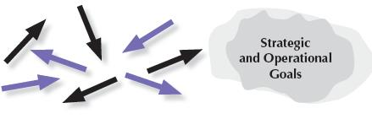
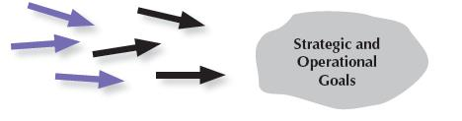

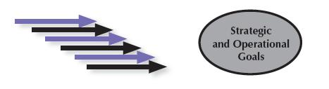
Steps toward Mature Processes
Reacting to Problems (0–25%)
Early Systematic Approaches (30–45%)
Aligned Approaches (50–65%)
Integrated Approaches (70–100%)
Notes:
This graphic is an aid for understanding how to assess process items (categories 1 through 6). In each case, the arrows indicate the degree of consistency and coordination among organizational units. The circular shapes shown next to the arrows depict the relative clarity or definition of an organization’s goals. The steps are as follows:
Reacting to Problems: Here operations are characterized by activities rather than by processes, and they are largely responsive to immediate needs or problems.
Early Systematic Approaches: Here the organization is at the beginning stages of conducting operations by processes with repeatability, evaluation and improvement, and some early coordination among organizational units.
Aligned Approaches occur in the third step toward a mature process. At this stage, operations are repeatable and are regularly evaluated for improvement, with learnings shared and with coordination among organizational units.
Integrated Approaches occur at the final stage of a mature process. The arrows indicate the evolution of the organization into an interconnected unit. At this stage, not only are processes repeatable, but also, in collaboration with other affected units, they are regularly evaluated for change and improvement. This collaboration and interconnection help organizations achieve efficiencies across units.

Slide 26
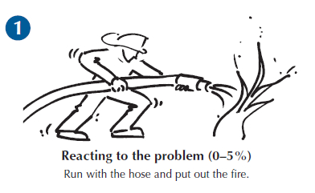
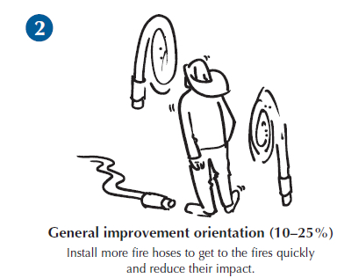
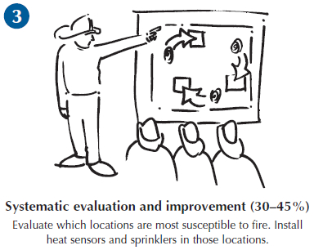
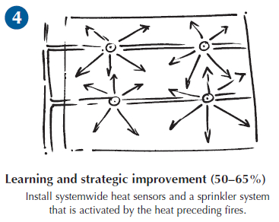
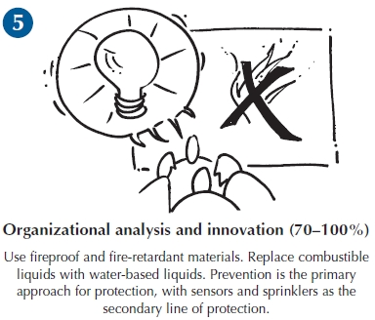
From Fighting Fires to Innovation:
An Analogy for Learning
Notes:
Learning is an essential attribute of high-performing organizations and, therefore, a critical concept in performance excellence. It is a key term used throughout the Baldrige Excellence Framework booklet and is one of the four scoring factors used to assess the maturity of an organization’s processes.
Effective, well-deployed organizational learning can help an organization improve from the early stages of reacting to problems to the highest levels of organization-wide improvement, refinement, and innovation. The firefighting analogy illustrated here shows a progression through the levels of maturity for this scoring dimension: reacting to the problem, general improvement orientation, systematic evaluation and improvement, learning and strategic improvement, and organizational analysis and innovation.

Slide 27
Evaluating Results
Levels
Trends
Comparisons
Integration
What is your current performance?
Are the results improving, staying the same, or getting worse?
How does your performance compare with others?
Are you tracking important results? Are you using the results in decision making?
Notes:
Your results are evaluated based on these four factors:
Levels: What is your current performance?
Trends: Are the results improving, staying the same, or getting worse?
Comparisons: How does your performance compare with that of other organizations and competitors, or with benchmarks?
Integration: Are you tracking results that are important to your organization? Are you using the results in organizational decision making?

Slide 28
For more information
Baldrige Excellence Framework booklets and free content
Self-assessment tools
Organizational assessments
Training, conferences, executive education
Award recipient profiles
Case studies
Connections to the Baldrige community
www.nist.gov/baldrige
301-975-2036
baldrige@nist.gov
Baldrige Performance Excellence Program | www.nist.gov/baldrige

