Slide 1

Baldrige Performance Excellence Program | 2019
Baldrige Cybersecurity Excellence Builder
Baldrige Performance Excellence Program | www.nist.gov/baldrige

Slide 2

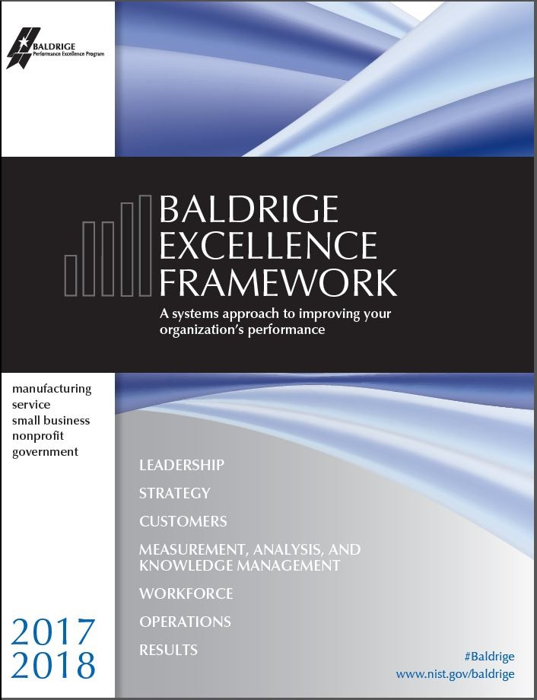


Baldrige Performance Excellence Program
A 30-year-old public-private partnership to improve the performance and competitiveness of businesses in the US
Establish the standard of excellence
Identify role-model organizations
Foster use of the standard and share best practices
Notes:
The Baldrige Program has existed for 30 years. The program has an interesting history.
The program was originally named after Malcolm Baldrige, who was the 26th Secretary of Commerce. Malcolm Baldrige died in July1987 in a rodeo accident, but his service as Secretary of Commerce was one of the longest in history. In the mid-1980s, U.S. leaders realized that American companies needed to focus on quality in order to compete in an ever-expanding, demanding global market.
Malcolm Baldrige was an advocate of quality management as a key to U.S. prosperity and sustainability and after his death, Congress named the Award in recognition of his contributions.
The goal of the Malcolm Baldrige National Quality Improvement Act of 1987 was to enhance the competitiveness of U.S. businesses. Its scope has since been expanded to health care and education organizations (in 1999) and to nonprofit/government organizations (in 2007).
The key three purposes of the program are shown here:
Establish the standard of excellence
Identify role model organizations
Foster use of the standard and share best practices.

Slide 3
Baldrige Cybersecurity Initiative
Promotes excellence in cybersecurity through a systems thinking approach to continuous improvement
Aligns with Baldrige Program’s purpose, and complements our work to promote excellence within other sectors
Voluntary and supported by private sector
Notes:
The Baldrige Cyber Program concept was initiated in 2016 by Tony Scott, then the Federal Chief Information Officer (CIO), who asked NIST to request that its Baldrige Program and Applied Cybersecurity Division (ACD) to consider establishing an award that would recognize excellence in cybersecurity based on the voluntary NIST Cybersecurity Framework.
Tony Scott had prior knowledge about Baldrige and was aware of its success. He was a strong advocate of the Baldrige approach and believed that Baldrige concepts held promise to inspiring greater use of best practices for cybersecurity risk management.
This initiative was not a proposal for a new category of the Malcolm Baldrige Award, but rather a separate, voluntary initiative to recognize excellence in cybersecurity and to encourage best practice sharing.
The key objective of the initiative is to promote excellence in cybersecurity.
This aligns with and complements the Baldrige Program’s promotion of excellence and attention to national needs (it was founded when there was a perceived quality crisis).
Participation in the initiative is completely voluntary. From the start, the Baldrige Program relied on the advice and support of industry in shaping the initiative.

Slide 4
Progress to Date
Listening and learning events, with input used to design and improve efforts
Two-phase approach
  1: Voluntary self-assessment tool based on Cybersecurity Framework and Baldrige concepts—Complete
  2: Voluntary assessments, recognition and best-practice sharing—Pending funding
Notes:
From this request, a working group was established to explore the feasibility of a voluntary Baldrige Cyber initiative/effort. The working group included representatives from the NIST Applied Cybersecurity Division, and the Baldrige Program.
The working group also included cybersecurity representatives from manufacturing, telecommunications, information technology, health care, management consulting, US Chamber of Commerce, and industry associations. The industry representatives were very familiar with the Cybersecurity Framework because their organizations are using it and have been involved in providing input into the development of the Cyber Framework.
Informal working group established, October 2015, which includes the Baldrige Program, NIST Applied Cybersecurity Division, OMB, and industry cybersecurity and Baldrige-award representatives
Two key concerns were identified and received a good amount of discussion. The first concern being the potential for a target on the back of an organization because it would be recognized as having a superior cybersecurity risk management program and this could possibly challenge hackers, and secondly, a major concern about the possibility of government regulations being imposed.
A proposal was developed and input from the discussions with the working group helped to inform the components of the proposal.
In addition, we gathered input on the proposal from various outreach activities and other meetings that were attended by members of the working group.
In the end, the working group agreed on a two phase approach
Phase 1: develop and distribute a voluntary self-assessment tool, the Baldrige Cybersecurity Excellence Builder. Public and private sector partners reviewed, used, and commented on the initial draft.
Phase 2, also voluntary, will be based on what is learned from phase one and if there is interest, support, and adequate funding, we will implement this phase.

Slide 5
Notes:
What is the Baldrige Cybersecurity Excellence Builder (BCEB)? What is it not?
The BCEB was developed by the Baldrige Program and NIST’s Applied Cybersecurity Division (part of the Information Technology Laboratory) with the input of an industry group that included representatives of all sectors. A draft was released for comment in September 2016. Version 1 was released in April 2017.
The BCEB is a self-assessment tool intended to help organizations better understand the effectiveness of their cybersecurity risk management efforts and identity improvement opportunities in the context of their overall organizational performance. This self-assessment tool blends organizational assessment approaches from the Baldrige Program with the concepts and principles of the Cybersecurity Framework developed by NIST’s Applied Cybersecurity Division (ACD).
It is not a replacement for the Baldrige framework or the Cybersecurity framework. It combines concepts of both into a self-assessment tool---a “helper” for using the Cybersecurity Framework and assessing how well you’re using it.
Baldrige focuses on performance excellence, improvement, and a systems approach that represents the leading edge of validated leadership and performance practice.
The Cybersecurity Framework includes cybersecurity standards, guidelines, practices, and informative references.

Slide 6
Builder Goals
Help organizations understand the robustness and effectiveness of their cybersecurity programs and practices
Help organizations gauge how cybersecurity efforts align to organizational strategy
Emphasize the tracking and use of performance metrics to drive decision making
Spread effective use of NIST’s Cybersecurity Framework
Improve organizations’ performance and sustainability/competitiveness (BPEP’s mission)
Notes:
The Baldrige Cybersecurity Excellence Builder provides a self-assessment tool that:
Leverages the concepts and content of the NIST cybersecurity framework and the organizational assessment and performance management concepts of the Baldrige Excellence Framework
Encourages integration of cybersecurity into governance, strategy, and planning; workforce hiring, development, and engagement; customer satisfaction and engagement; results and outcomes tracked as a part of organizational performance review and management
Enables better prioritization of investments in cybersecurity risk management
Enhances alignment of cybersecurity policies, programs, and practices with strategy, organizational goals and objectives, and stakeholder needs and expectations
Increases the awareness and utilization of the NIST cybersecurity framework
Fosters increased sharing of best practices in cybersecurity risk management across industry sectors

Slide 7
NIST Cybersecurity Framework Components
    Aligns industry standards and best practices to the Framework Core in a particular implementation scenario
    Supports prioritization and measurement while
    factoring in business
    needs
    Cybersecurity activities and informative references, organized around particular outcomes
    Enables communication of cyber risk across an organization
Core
Implementation
Tiers
Profile
    Describes how cybersecurity
    risk is managed by an organization
    and to what degree the risk management practices exhibit key characteristics
Notes:
The voluntary Framework for Improving Critical Infrastructure Cybersecurity consists of standards, guidelines, and best practices to manage cybersecurity-related risk. The Cybersecurity Framework’s prioritized, flexible, and cost-effective approach helps to promote the protection and resilience of critical infrastructure and other sectors important to the economy and national security.
The Cybersecurity Framework has three components:
The Core includes cybersecurity activities and informative references, organized around particular outcomes.
Tiers describe how cybersecurity risk is managed by an organization and to what degree the risk management practices exhibit key characteristics.
Profiles align industry standards and best practices to the Framework Core in a particular implementation scenario. This supports prioritization and measurement while factoring in business needs.

Slide 8
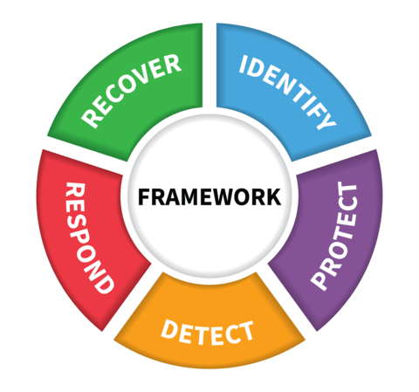
Cybersecurity Framework Core
What techniques can restore capabilities?
What processes and assets need protection?
What techniques can contain the impacts of incidents?
What safeguards are available?
What techniques can identify incidents?
Notes:
The Core includes five functions representing cybersecurity activities at their highest level.
Within these functions, activities are presented in more detail as categories, subcategories, and informative references.

Slide 9
A Systems Perspective
Notes:
The BCEB reflects the Baldrige systems perspective, shown in this diagram. A systems perspective means that you manage your cybersecurity efforts like a set of interconnected parts, with all the parts working in harmony.
The parts, in this perspective, are key areas that affect and are affected by your organization’s cybersecurity efforts—shown in the blue hexagons and rectangle. The background for all these areas is the Organizational Context, where you describe your organization and its strategic situation.
The BCEB does not prescribe how you should structure your cybersecurity policies or operations or what your mission and goals should be. Instead, in the Organizational Context, you define what is most relevant and important to your organization’s mission and performance.
The BCEB includes seven categories:
The leadership triad, on the left, includes the Leadership, Strategy, and Customers categories. This emphasizes the importance of a leadership focus on cybersecurity strategy and on the needs of customers.
The results triad, on the right, includes your workforce processes, the processes used in your key cybersecurity operations, and the performance results they yield.
The system foundation is Measurement, Analysis, and Knowledge Management. This is the “brain center” for the aligning your cybersecurity operations with your objectives. It is the main point for the key information you need to effectively measure, analyze, and improve your organization’s cybersecurity performance.
The word “integration” at the center of the figure shows that all the elements of the system are interrelated.

Slide 10
The BCEB and the Cybersecurity Framework
BCEB: How well are you achieving this scenario? Where do you need to improve?
Core
Implementation
Tiers
Profile
How effective and efficient are your cybersecurity-related processes? How good are your results?
Notes:
If you’re not currently using the Cybersecurity Framework, the BCEB can serve as a “door” to its use. By answering the questions in the BCEB and assessing your answers, you will identify topics to explore in the Cybersecurity Framework, including references to industry-specific standards and guidelines.
If you are using the Cybersecurity Framework, the BCEB can help you assess how well you are implementing it.
With the BCEB, you can assess how well you’re achieving the Cybersecurity Framework profile you choose and determine what your strengths and opportunities for improvement are.
For the Core and the Implementation tiers, the BCEB helps you assess the efficiency and effectiveness of the processes you use to manage cybersecurity risk within the five Cybersecurity Framework functions and the goodness of the results you are achieving through those processes. What you find can help you determine the your organization’s implementation tier.

Slide 11
    Cybersecurity activities and informative references, organized around particular outcomes
    Enables communication of cyber risk across an organization
Framework Core
Notes:
The Framework Core organizes cybersecurity activities around the functions of Identify, Protect, Detect, Respond, and Recover.
The BCEB pulls these activities into a set of questions organized by the categories of the Baldrige Excellence Framework. This reinforces the organization-wide view of cybersecurity in the Cybersecurity Framework. It helps you integrate cybersecurity risk management into your organization-wide policies and operations so that they work together smoothly. Helps you see how cybersecurity fits into your organization as a system, with considerations in every part of the system that are interdependent.

Slide 12
Understand business factors & organizational priorities underlying your cybersecurity program.
Hire & retain the cybersecurity workforce you need. Engage & empower your workforce to achieve objectives.
Set clear strategic priorities/objectives related to cybersecurity.
Understand how leaders’ actions guide & sustain cyber risk management.
Track results and use them to evaluate & improve policies & operations.
Design and manage effective and efficient cybersecurity operations.
Understand patients’ & other customers’ requirements & expectations for cybersecurity.
Measure & analyze cybersecurity outcomes that matter.
Notes:
How does this work? The BCEB asks questions that help you improve your cyber risk management program in the areas you see here.
The parts of the system making up your organization are shown in the hexagons and in the bar below them, against the background of your organization’s key characteristics. Here’s how the system works.
How does the Baldrige systems approach relate to cybersecurity risk management?
Answering the questions in the Organizational Context section helps you understand the business factors and organizational priorities underlying your cybersecurity risk management.
The questions in the Leadership section help you understand how your leaders’ actions guide and sustain your cybersecurity risk management.
The questions in the Strategy section guide you to create clear strategic priorities for your cybersecurity program.
The questions in the Customers section help you understand and exceed the cybersecurity-related requirements and expectations of your customers and stakeholders.
The questions in the Measurement, Analysis, and Knowledge Management section guide you to align cybersecurity policies and operations with your objectives through measurement and analysis. They also guide you to manage your organization’s cybersecurity-related knowledge.
The questions in the Workforce section guide you to engage and empower your entire workforce to achieve your cybersecurity-related objectives.
The questions in the Operations section guide you to design, manage, and improve your cybersecurity operations for effectiveness and efficiency.
The questions in the RESULTS section lead you to use data and information to evaluate and improve cybersecurity-related policies and operations in alignment with your strategy.

Slide 13
Start Here!
Most appropriate starting point for self-assessment
Helps identify potential gaps, focus on key cybersecurity requirements and results
Shows what is important to your organization’s cybersecurity needs
Customizes the self-assessment by stating unique situation and challenges
May be an initial self-assessment
Terms in small caps: Glossary
Many questions relate to “Identify” in the Cybersecurity Framework Core.
Notes:
The Organizational Context is the most appropriate starting point for a self-assessment because:
Having a clear understanding of your organization, why it exists, where your senior leaders want to take it in the future, who your key stakeholders are, what their expectations are, and what resources support critical functions will enable you to make and implement strategic decisions about cybersecurity risks, policies, and operations.
It helps you identify potential gaps in what you know about your organization and its cybersecurity policies and operations.
It helps you and focus on key cybersecurity requirements and results, once you’ve identified them.
It also may be used by itself for an initial self-assessment. If you identify topics for which conflicting, little, or no information is available, the Organizational Context may serve as your first complete assessment, and you can use these topics for action planning.
It customizes the self-assessment by identifying your organization’s unique situation and challenges.
The questions in the Organizational Context section reflects mainly the “Identify” function in the Cybersecurity Framework.

Slide 14
C Organizational Context: Example
C.1 Organizational Description
a. Organizational Environment
. . .
Workforce Profile What is your overall workforce profile? What is your cybersecurity workforce profile? What recent changes have you experienced in the composition of your overall and your cybersecurity workforce or in your needs for them? . . .
(4) Assets What are your organization’s major physical and virtual assets, including its data, knowledge, devices, systems, and facilities? What are your priorities for protecting these assets, based on their criticality and business value?
. . .
Notes:
Questions like these set the background for your organization. For example, who does the cybersecurity work in your organization? What assets need to be protected?
.

Slide 15
Process Questions “How” “Key” Nonprescriptive Category 6: Cyber Framework Core functions of Protect, Detect, Respond, Recover
Notes:
The process questions are in categories 1-6. The purpose of process questions is to allow you to articulate and assess the processes that are most important to your organization’s cybersecurity risk management.
Each category includes two items.
Category 1, Leadership, includes two items: 1.1 asks how your leaders’ personal actions guide your cybersecurity policies and operations. 1.2 asks how you govern you cyber policies and operations. It also asks about societal responsibilities with regard to cybersecurity.
Category 2, Strategy, asks how you include cybersecurity in your strategic planning (in 2.1) and then how you implement cybersecurity-related action plans (in 2.2).
Category 3, Customers, asks (in 3.1) how you listen to the voice of your customers with regard to cybersecurity and then (3.2) how you serve customers’ needs and build relationships with them.
Category 4, Measurement, Analysis, and Knowledge Management asks (4.1) how you measure, analyze, and improve your cybersecurity performance, and then (4.2) how you manage your organization’s cybersecurity knowledge.
Category 5, Workforce, asks (5.1) how you build an effective environment for your cybersecurity workforce. 5.2 then asks how you engage your entire workforce, with the purpose of supporting your cybersecurity policies and operations.
Category 6, Operations, asks about your cybersecurity work processes (6.1). The parts of this item correspond to 4 of the 5 functions in the Cyber Framework (Protect, Detect, Respond, and Recover). 6.2 asks about effective management of your cybersecurity operations.
Many process questions begin with “how.” These are asking for descriptions of processes and how they work. Many questions include the word “key.” These ask for your organization’s most important or critical processes, measures, or outcomes. The purpose is to identify most important processes, measures, etc.
The questions are nonprescriptive—they don’t say how you should develop their cybersecurity strategy, or what an organization’s key measures should be. That will depend on your organization’s situation and priorities (in the Organizational Context and in answers to other questions).

Slide 16
Example: Category 5, Workforce
5.1 Workforce Environment
(1) How do you assess your cybersecurity workforce capability and capacity needs?
…
(4) How do you organize and manage your cybersecurity workforce to establish roles and responsibilities?
…
5.2 Workforce Engagement
…
(2) How do you foster an organizational culture that is characterized by open communication, high performance, and engagement in cybersecurity matters?
(3) How does your workforce performance management system support high performance in fulfilling cybersecurity roles and responsibilities?
Notes:
Here is an example of a process category.
Item 5.1 asks about the workforce environment for your cybersecurity workforce. It helps you explore whether you have the cybersecurity workforce you need, and how you retain and support that workforce.
5.2, Workforce Engagement, asks whether the members of your entire workforce understand their role in ensuring cybersecurity, and asks how you are supporting those workforce members in their roles.

Slide 17
Example: Category 6, Operations
6.1 Work Processes
Cybersecurity Process Design, Management, and Improvement
…
b. Protection
…
c. Detection
How do you detect anomalies …?
How do you monitor information systems …?
How do you maintain and test detection processes …?
d. Response
…
e. Recovery
…
Notes:
Here is another example of a process item. In 6.1, Work Processes, parts b, c, d, and e relate to the Cybersecurity Framework core functions of Protect, Detect, Respond, and Recover. The questions here draw directly from the Cybersecurity Framework.

Slide 18
7.1 Cybersecurity Process Results 7.2 Customer Results 7.3 Workforce Results 7.4 Leadership and Governance Results 7.5 Financial and Strategy Results “Key,” most important results Linked to process items
Notes:
Category 7 includes 5 items asking for your key cybersecurity results. As in the process items, they ask for your key results—those that are most important to your organization. The results relate to the process areas represented in categories 1-6.

Slide 19
Linkages: Context, Processes, and Results (Example 1)
Organizational Context, C.1b(2): What are your key internal and external customer groups …? What are their key requirements and expectations for your cybersecurity policies and operations?
Process Item 3.1, Q2: How do you determine internal and external customers’ satisfaction and dissatisfaction with your cybersecurity policies and operations?
Results Item 7.2, Q1: What are your results for your internal and external customers’ satisfaction with your cybersecurity policies and operations?
Notes:
A key strength of the BCEB is the linkage among its three parts: Organizational Context, processes, and results. These linkages help you manage your cybersecurity risk management as a system.
The example here involves customers. Many more are found throughout the BCEB.

Slide 20
Linkages: Context, Processes, and Results (Example 2)
Organizational Context, C.1a(4): What re your organization’s major physical and virtual assets, including its data, knowledge, devices, systems, facilities, and equipment? What are your priorities for protecting …?
Process Item 6.1c: Detection of Cybersecurity Events: (1) How do you detect anomalies … ? (2) How do you monitor information systems …? (3) How do you maintain and test detection processes …?
Results Item 7.1, Q2: What are your results for the detection of cybersecurity events?
Notes:
Here’s another example involving the Detect function.

Slide 21
Process and Results Maturity Model
Results
(L) Levels, (T) Trends, (C) Comparisons, (I) Integration
Processes
(A) Approach, (D) Deployment, (L) Learning, (I) Integration
Reactive
Early
Developing
Mature
Leading
Exemplary
Notes:
In assessing your cybersecurity processes and results, the BCEB uses the maturity model you see here. It shows maturity from reactive to exemplary on two dimensions: processes and results. Each dimension involves four evaluation factors for measuring the effectiveness and efficiency of processes and how good your results are. These are reflected in the BCEB assessment rubric.

Slide 22
Approach
Deployment
Learning
Integration
Do you have a process for accomplishing this?
How consistently are your key processes used where they should be used in your organization?
Do you improve the process regularly, and share the improvements?
How do your processes reflect your organizations needs and goals?
Is the process well-ordered and repeatable?
Process Assessment Rubric
(Categories 1 – 6)
Notes:
The process categories (1-6) are assessed based on these four factors:
Approach: How do you accomplish your organization’s cybersecurity work? How well-ordered and repeatable are the processes you use?
Deployment: How consistently are your key cybersecurity-related processes used where they should be used throughout your organization?
Learning: Have you evaluated and improved your key cybersecurity-related processes? Have improvements been shared within your organization?
Integration: How do your cybersecurity-related processes address your organization’s cybersecurity and overall needs and goals?

Slide 23
Evaluating Results: “LeTCI”
Levels
Trends
Comparisons
Integration
What is your current performance?
Are the results improving, staying the same, or getting worse?
How does your performance compare with that of others?
Are you tracking important results?
Are you using the results in to make decisions?
Notes:
Your results are evaluated based on these four factors:
Levels: What is your current cybersecurity-related performance?
Trends: Are the results improving, staying the same, or getting worse?
Comparisons: How does your cybersecurity-related performance compare with that of other organizations and competitors, or with benchmarks?
Integration: Are you tracking cybersecurity-related results that are important to your organization? Are you using the results in organizational decision making?

Slide 24
Steps in a Self-Assessment
Notes:
This approach shown in this slide guides you through a process for using the BCEB as a self-assessment and action tool. The BCEB suggests seven steps in a full self-assessment:
Scope: whole organization, or just a part?
Answer the Organizational Context questions (What):
Answer the Process questions (How and What)
Answer the Results questions (Outputs/Outcomes)
Apply the Assessment Rubric -Helps to assess the maturity of the cybersecurity risk management program
Prioritize: you can’t do everything at once; create an Action plan
Measure and evaluate your progress.
Using the BCEB is not an “all or nothing” effort. The steps are iterative. Depending on its situation and goals, an organization might spend a fair amount of time on a particular step. It might realize that it needs to go back and redefine the scope, or concentrate on one or more of the process and results items.

Slide 25
For more information
Baldrige Cybersecurity Excellence Builder booklets and downloads
Other Baldrige Program products and services
Connections to the Baldrige community
https://www.nist.gov/baldrige/products-services/
baldrige-cybersecurity-initiative
baldrige@nist.gov
(301) 975-2036
Baldrige Performance Excellence Program | www.nist.gov/baldrige
Notes:
For more information, visit the Baldrige website.

