Slide 1
Next up! Cybersecurity Framework Webinar: Helping Small & Medium-sized Businesses
to Manage Cybersecurity Risk

Slide 2
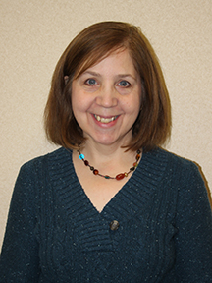
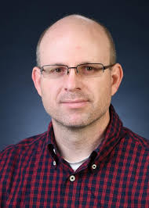
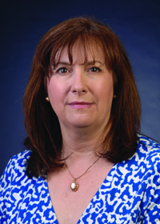
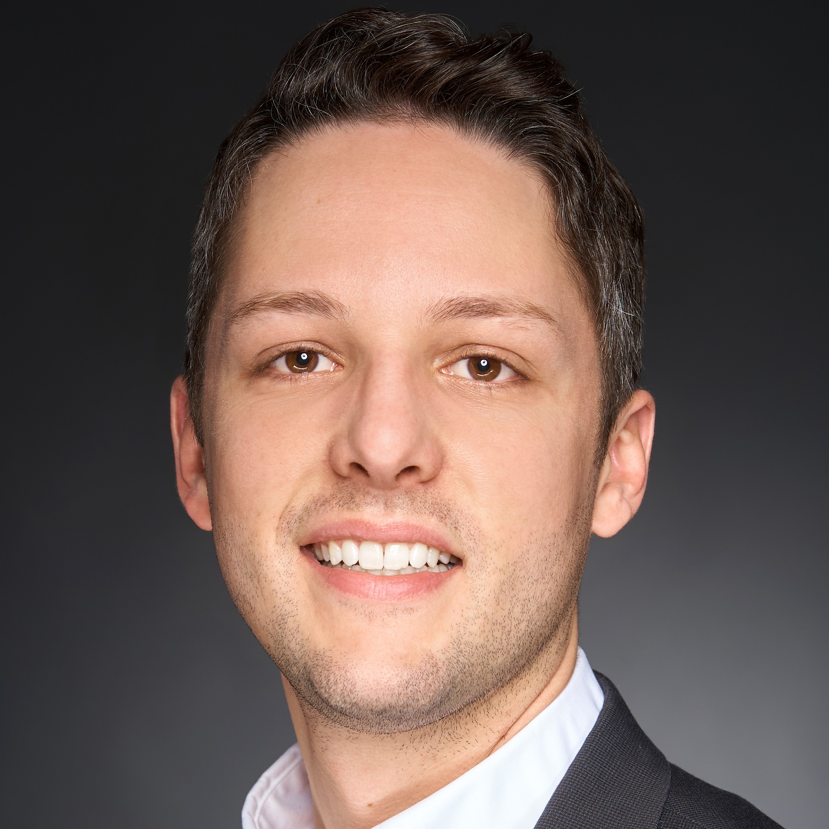
Introducing:
Moderator: Jeff Marron,
NIST
Panelist: Daniel Eliot,
NCSA
Panelist: Mary Smith,
L’Anse Manuf.
Panelist: Pat Toth, NIST

Slide 3
