Slide 1


Keynote Address
Roger Severino, Director
Office for Civil Rights
U.S. Department of Health and Human Services
October 18, 2018

Slide 2
I didn’t know

Slide 3

Proposed HIPAA Policy Activity
Notice of Proposed Rulemaking on Good Faith Disclosures by Health Care Providers to Address Opioid Crisis
Request for Information on Improving Care Coordination and Reducing Regulatory Burden
  Notice of Privacy Practices
  Required Provider to Provider Information Sharing
  Accounting of Disclosures
Request for Information on Civil Monetary Penalties or Monetary Settlements to Harmed Individuals
HIPAA/FERPA

Slide 4
Recent HIPAA Enforcement Highlights
2/16/2017 | Memorial Healthcare System | $5,500,000
5/10/2017 | Memorial Hermann Health System | $2,400,000
5/23/2017 | St. Luke's-Roosevelt Hospital Center | $387,200
2/1/2018 | Fresenius Medical Care North America | $3,500,000
2/13/2018 | Filefax | $100,000
6/18/2018 | MD Anderson Cancer Center | $4,348,000 ALJ Judgement
9/20/2018 | ABC Cases | $999,000
10/15/2018 | Anthem | $16,000,000

Slide 5
HIPAA Enforcement January 1, 2017 – October 15, 2018
Total $45,360,383*
*BJE

Slide 6
500+ Breaches by Type
September 23, 2009 through December 31, 2017
January 1, 2018 through September 30, 2018

Slide 7
500+ Breaches by Location
September 23, 2009 through December 31, 2017

Slide 8
Phase 2 Audit Program
Purpose: Identify best practices; uncover risks and vulnerabilities not identified through other enforcement tools; encourage consistent attention to compliance
Phase 2 (2016-2017): 166 covered entity and 41 business associate desk audits were completed in December 2017
Summary findings will be published in 2018

Slide 9
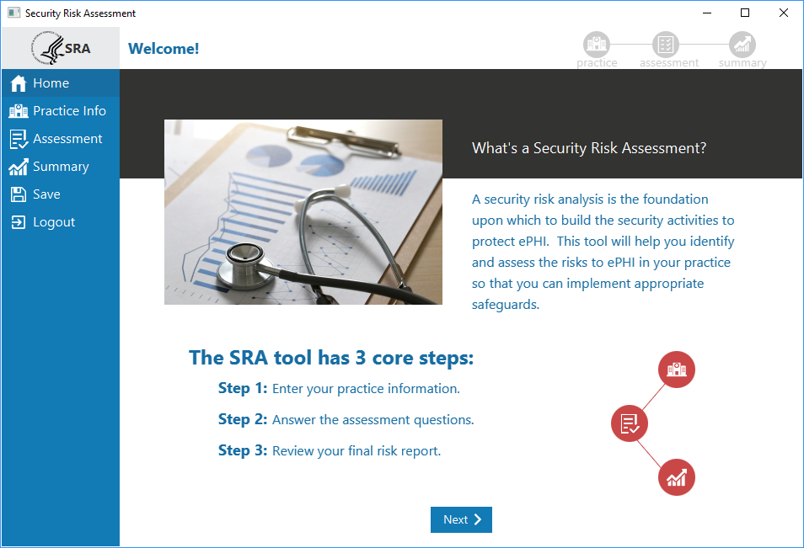
ONC/OCR Security Risk Assessment Tool v3

Slide 10
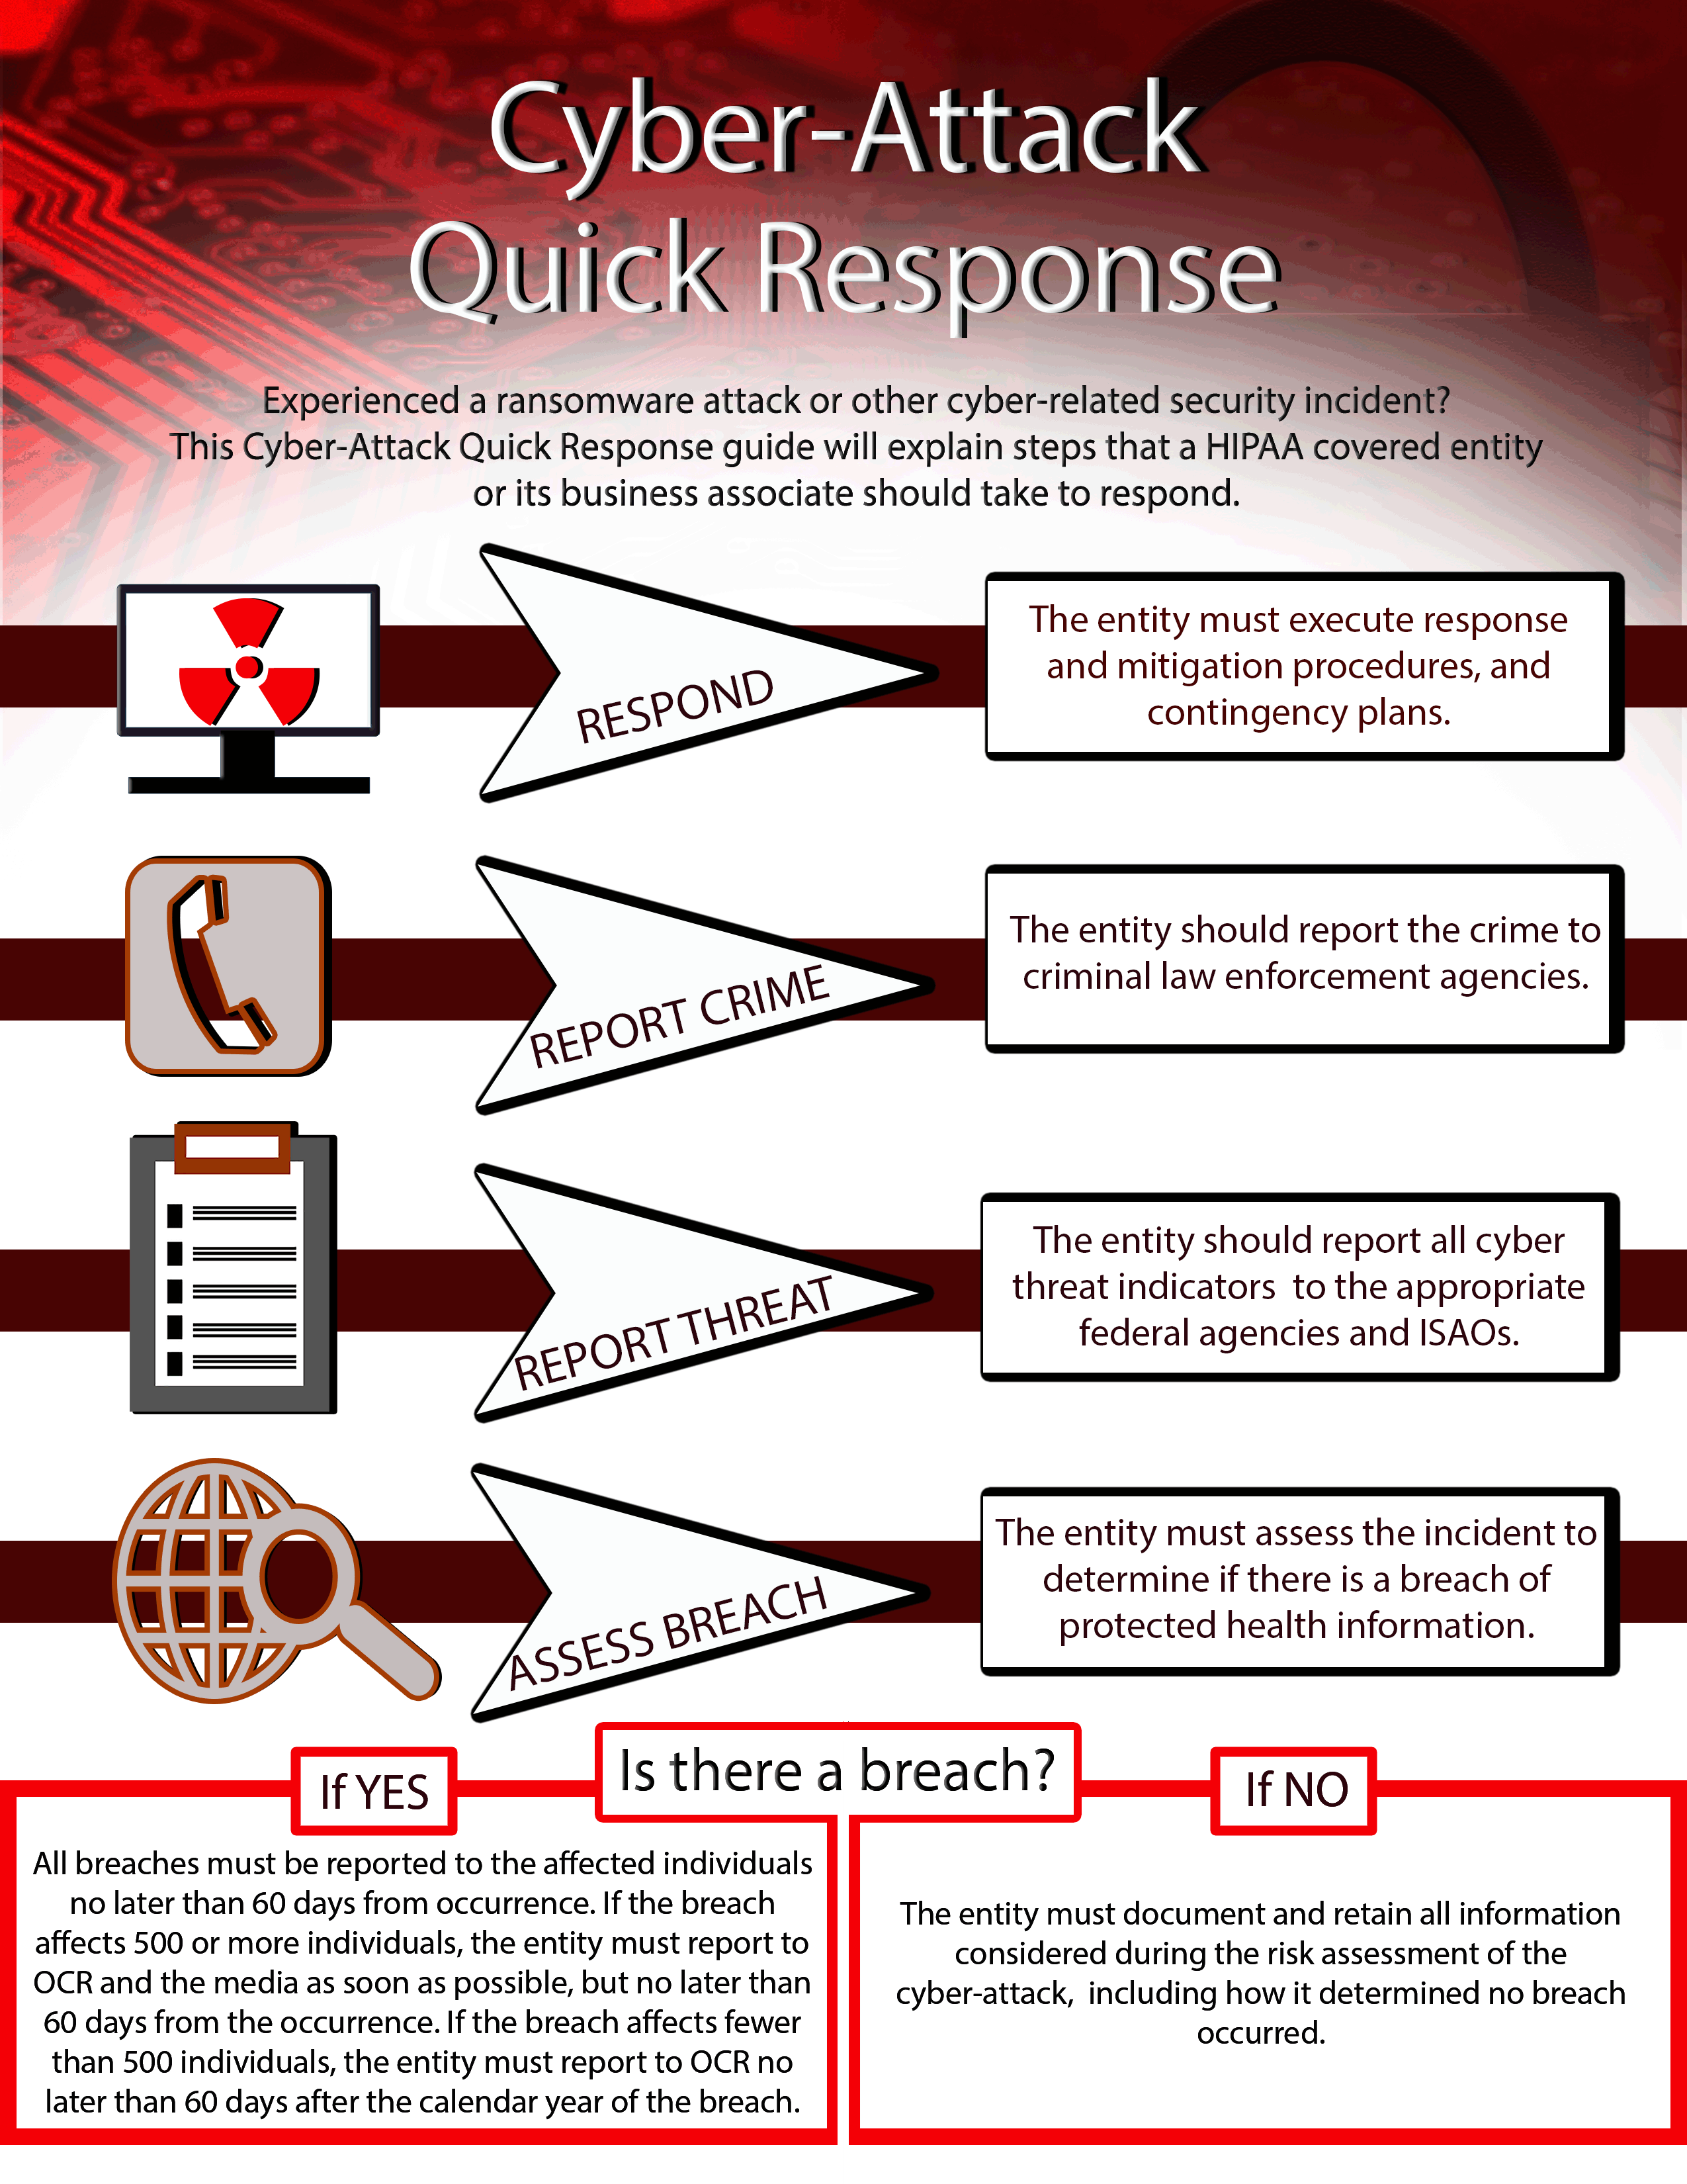
OCR Cybersecurity Guidance
Ransomware Guidance
Cyber Security Checklist and Infographic
Monthly Cybersecurity Newsletters
  April 2018: Risk Analyses vs. Gap Analyses
  May 2018: Workstation Security
  June 2018: Software Vulnerabilities and Patching
  July 2018: Guidance on Disposing of Electronic Devices and Media
  August 2018: Securing Electronic Media and Devices

