Slide 1

Baldrige Performance Excellence Program | 2017
Baldrige Program Impacts
Baldrige Performance Excellence Program | www.nist.gov/baldrige

Slide 2
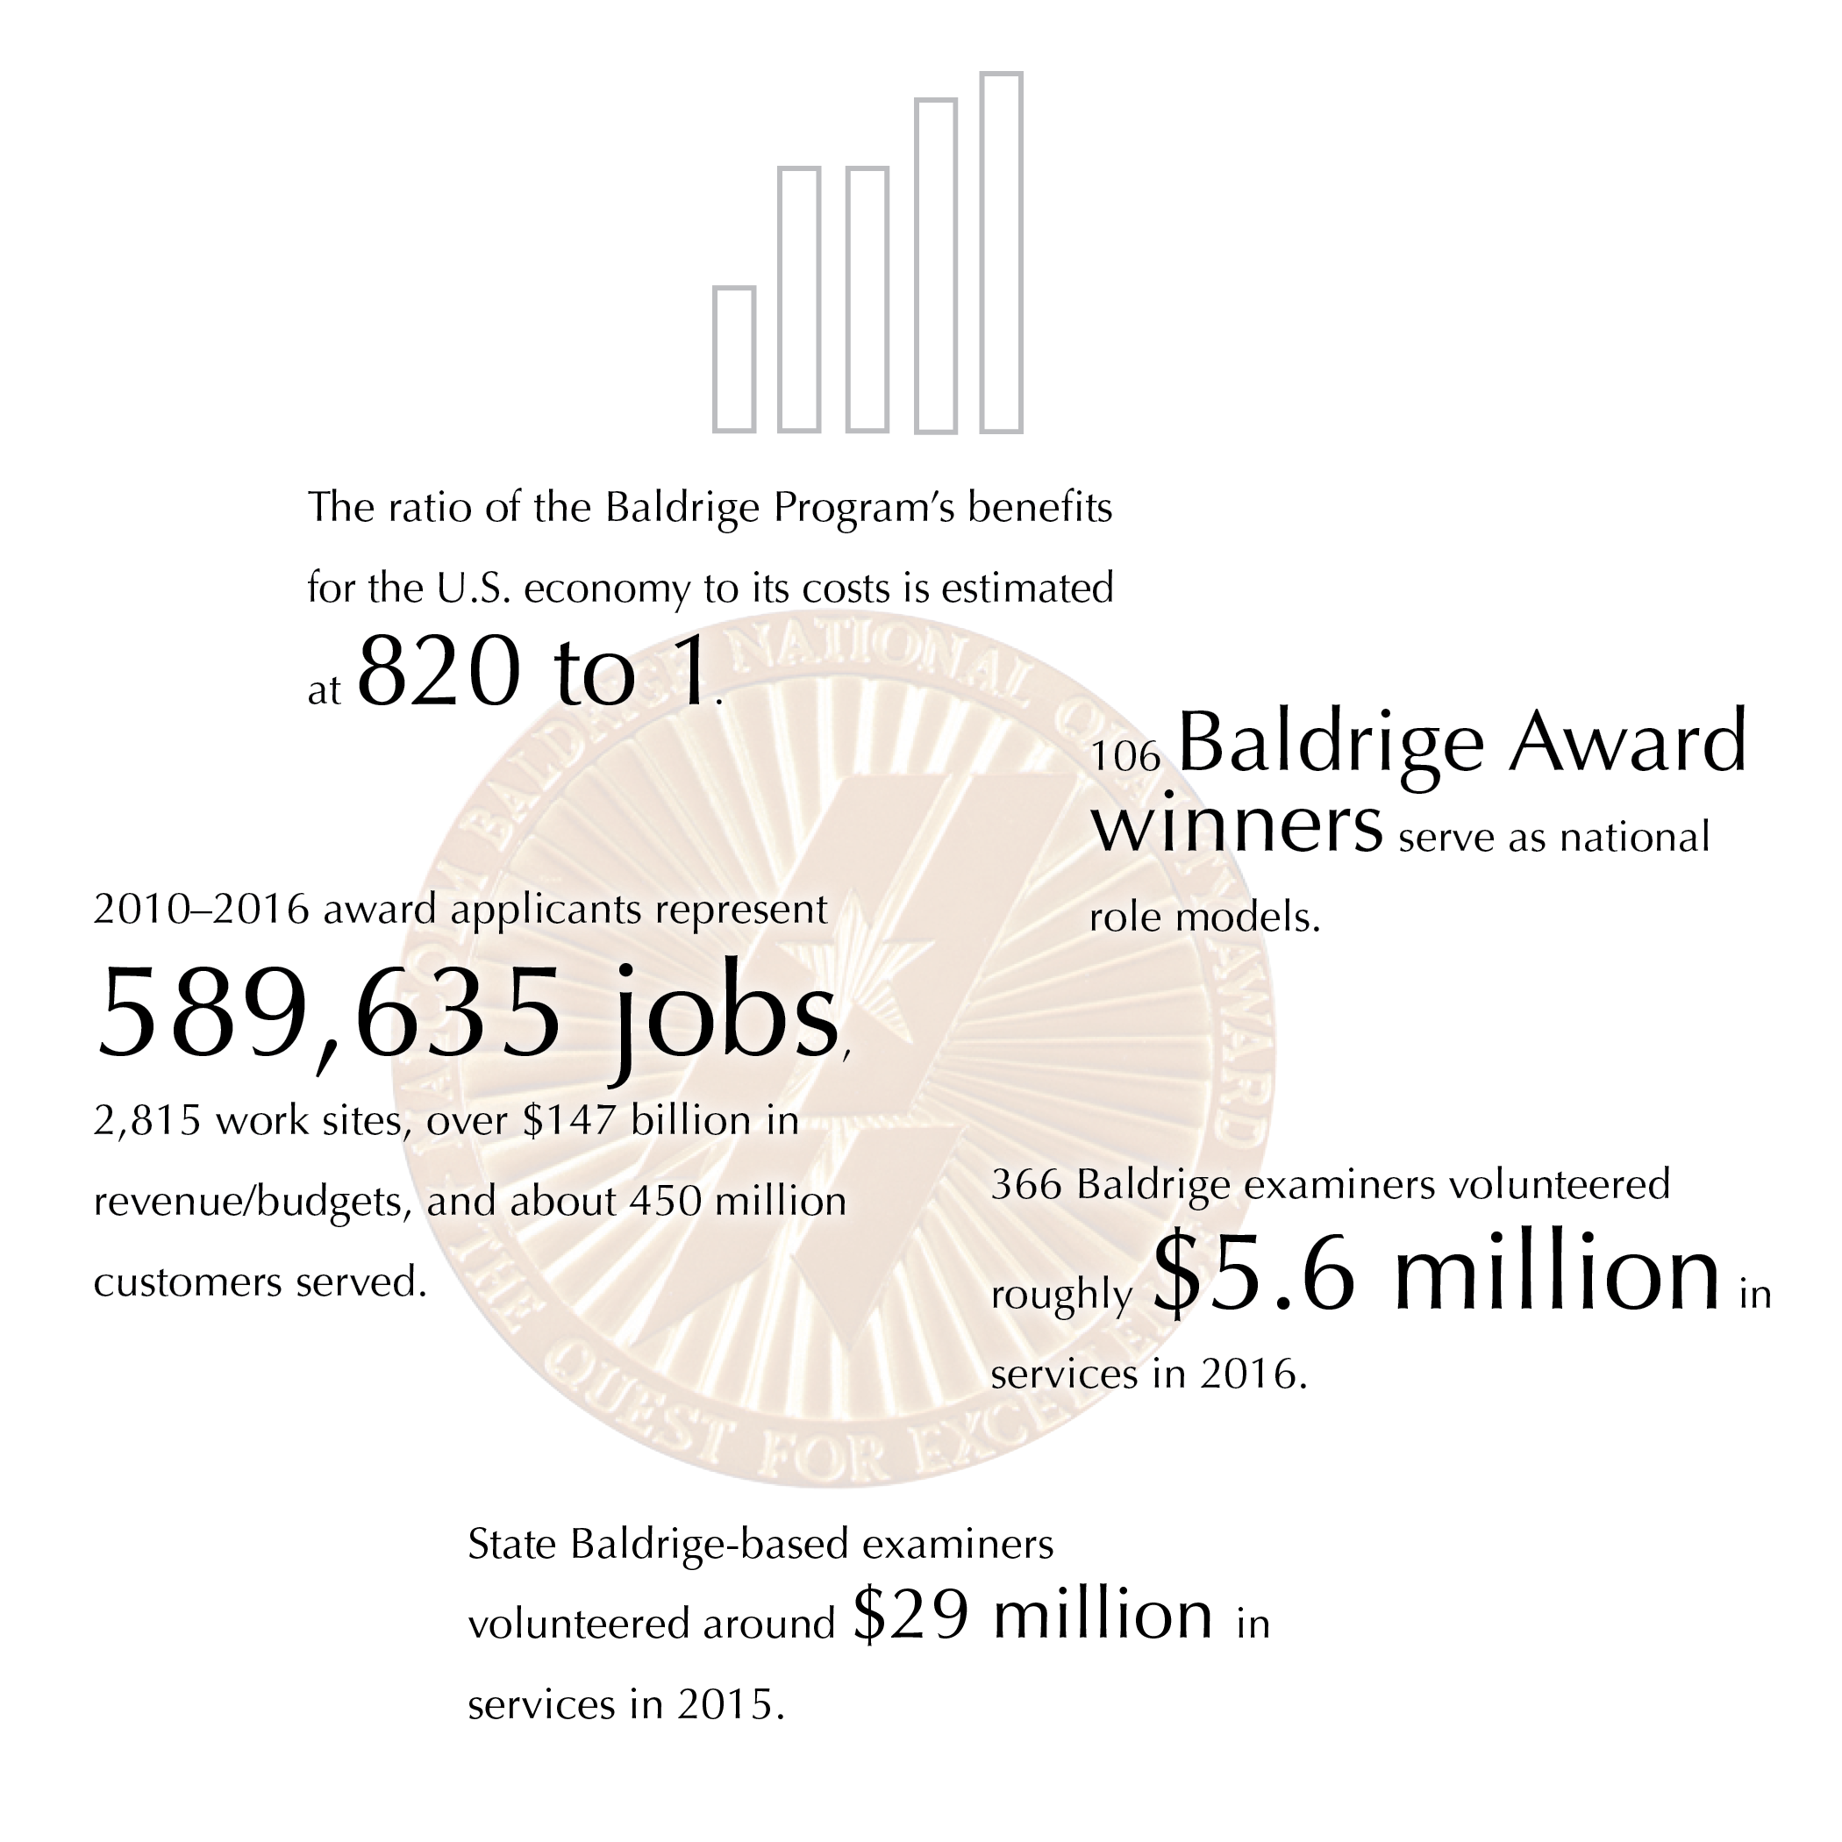

Baldrige Performance Excellence Program | www.nist.gov/baldrige
Notes:
The ratio of the Baldrige Program’s benefits for the U.S. economy to its costs is estimated at 820 to 1.
106 Baldrige Award winners serve as national role models.
2010-–2016 award applicants represent 589,635 jobs, 2,815 work sites, over $147 billion in revenue/budgets, and about 450 million customers served.
366 Baldrige examiners volunteered roughly $5.6 million in services in 2016.
State Baldrige-based examiners volunteered around $29 million in services in 2015.

Slide 3
Nationwide
  Improve organizational practices, capabilities, and results
  Communicate and share best practices (Baldrige Award recipients)
  Tool for understanding and managing organizational performance
Notes:
Since 1987, the Baldrige Excellence Framework and its Criteria for Performance Excellence have played three roles in strengthening U.S. competitiveness:
They help improve organizational performance practices, capabilities, and results.
As the basis of the Baldrige Award, which recognizes the achievements of role-model organizations, they facilitate communication and sharing of best practices among U.S. organizations.
They also serve as a working tool for understanding and managing organizational performance, for guiding your strategic plan, and for providing opportunities to learn.

Slide 4
820:1
Ratio of Baldrige Program benefits for the U.S. economy to program costs
Source: Albert N. Link and John T. Scott, Economic Evaluation of the Baldrige Performance Excellence Program, December 2011, http://www.nist.gov/baldrige/publications/economic_evaluation_2011.cfm.
Notes:
Source for 820-to-1 ratio: Albert N. Link and John T. Scott, Economic Evaluation of the Baldrige Performance Excellence Program, December 2011, http://www.nist.gov/baldrige/publications/economic_evaluation_2011.cfm.
To arrive at this ratio, they compared the benefits received by the 273 Baldrige Award applicants from 2007 to 2010 with the cost of operating the Baldrige Program.
The 820-to-1 ratio represents only the benefits for the surveyed applicants, but it represents all of the Baldrige Program's social costs. Link and Scott note that the benefit-to-cost ratio would be much higher if program costs were compared with the benefits for the entire U.S. economy.
Three types of social benefit were measured:
the applicants’ cost savings from using the Baldrige Criteria instead of a higher-priced alternative
gains to U.S. consumers, who had greater satisfaction with higher-quality products
gains to the U.S. economy from saving scarce resources, since the Baldrige Criteria were used instead of a higher-cost alternative

Slide 5
Impact of Baldrige Framework Use
Notes:
For data on the impact of using Baldrige within an organization, we looked at organizations that we know were using the Criteria for at least a 5-year period: the seven two-time Baldrige Award winners. These growth rates are for the period between awards. Comparative data on job growth are from the U.S. Bureau of Economic Analysis and U.S. Bureau of Labor Statistics.

Slide 6
Reach and Impact of Baldrige
Baldrige Program NIST
10,000+ Baldrige Examiners
~100 Business Excellence Programs Worldwide
Baldrige Executive Fellows
30+ Regional/ Sector Baldrige-Based Programs
Corporate Baldrige-Based Excellence Programs
Federal Baldrige-Based Programs
Baldrige Performance Excellence Groups
Commun-ities of Excellence
102 Baldrige Award Recipients
Association Baldrige-Based Programs
College/
University Business Courses
Baldrige-Based Accredita-tions
1,600+ Baldrige Award Applicants
Baldrige Cybersecurity Excellence Builder
Rated #1 Leadership Development Program
50,000+ presentations
Improved: operations, engagement, outcomes;
820:1
10,000 applications
20,000 examiners
40,000 conference attendees

Slide 7
Widespread U.S. Participation
Large and small organizations
Internal business excellence programs
College and university courses
Accreditation
Consultants
Private-sector support
Notes:
Organizations of all sizes and types use the Baldrige framework for improvement and self-assessment, including large and small manufacturers; banks and other service providers; small businesses from consulting firms to fast-food restaurants; K–12 school systems, universities, and other education organizations; hospitals, long-term care facilities, and other health care organizations; nonprofit organizations, and local, state, and federal government agencies.
Several large national and international organizations, such as Tata Industries and Infosys, base their internal performance excellence programs on the Baldrige Criteria.
Colleges and universities, such as Ferris State University, Loyola University of New Orleans, and the College of Engineering at the University of Missouri, offer MBA programs, certificates, or courses on the Baldrige framework.
The North Central Association’s Commission on Accreditation and School Improvement has adopted Baldrige-compatible criteria as the basis of its district and school accreditation frameworks. The Accreditation Council for Business Schools and Programs bases its accreditations on the Baldrige Criteria. And the National Housing Quality Award (NHQA) for home builders is modeled after the Malcolm Baldrige National Quality Award.
An informal community of Baldrige-based consultants helps organizations learn about and use the Baldrige framework.
Before 2011, over 90% of program support, including in-kind contributions, came from the private sector. This includes the volunteer time of members of the Board of Examiners. (Currently, the Baldrige Program is funded partly through a gift from the private Baldrige Foundation and partly through product and service fees.)
63 small business development centers, with a total of 1,100 offices in the United States, have adopted aspects of the Baldrige Competitiveness Program begun by the Puerto Rico Small Business Technology and Development Center, which, since 2011, has trained more than 125 businesses, including 250 top-management executives, on Baldrige principles. The Puerto Rico small business graduates have seen improvements in the areas of leadership, sales, metrics, operations, human resources, workplace environment, financial results, and client satisfaction. In addition, SBDCs in Central America, including El Salvador, have begun adopting Baldrige.

Slide 8
Lower Health Care Costs,
Improved Quality
Baldrige hospitals:
Faster five-year performance improvement than peers
83% more likely to be among Thomson Reuters’ 100 Top Hospitals®
Outperformed non-Baldrige hospitals on 6 of 7
100 Top Hospitals measures
Source: Foster, D. A., and Chenoweth, J. 2011, October. Comparison of Baldrige Award Applicants and Recipients with Peer Hospitals on a National Balanced Scorecard. Thomson Reuters. http://www.nist.gov/baldrige/upload/baldrige-hospital-research-paper.pdf.
Notes:
An independent study has documented that use of the Baldrige Health Care Criteria for Performance Excellence has a direct impact on both reducing health care costs and improving quality. The study was completed by Thomson Reuters in October 2011. Key findings include the following:
Baldrige hospitals (award winners and those that received a site visit) demonstrated faster five-year performance improvement than their peers.
Baldrige hospitals, as a group, were about 83% more likely than non-Baldrige hospitals to be awarded Thomson Reuters 100 Top Hospitals® national recognition for excellence in organization-wide performance.
Baldrige hospitals outperformed non-Baldrige hospitals on six of seven individual measures of performance used in the 100 Top Hospitals composite score, including the Centers for Medicare and Medicaid Services’ (CMS) Core Measures and adjusted operating profit margin.
Foster, D. A., and Chenoweth, J. 2011, October. Comparison of Baldrige Award Applicants and Recipients with Peer Hospitals on a National Balanced Scorecard. Thomson Reuters. http://www.nist.gov/baldrige/upload/baldrige-hospital-research-paper.pdf.

Slide 9
Higher Health Care Quality,
Better Patient Experience
34 Baldrige Award winners
Matched or exceeded geographic competitors on 23 health care process measures and 6 outcome measures
Exceeded these competitors on 10 measures of patient experience
Source: R. C. Schulingkamp and J. R. Latham. Healthcare Performance Excellence: A Comparison of Baldrige Award Recipients and Competitors. Quality Management Journal, Vol. 22, No. 3 (2015).
Notes:
A 2015 study compared 34 U.S. health care organizations that received the Baldrige Award with their 153 geographically closest competitors. The study found that the award recipients matched or exceeded their competitors’ measures of health care quality and outperformed them in measures of favorable patient experience.
The authors examined results data for 39 measures that U.S. hospitals publicly report to the Centers for Medicare and Medicaid Services (CMS). The 39 measures included 23 for health care processes, 10 for patient experience, and 6 for health care outcomes. The patient-experience results data come from Hospital Consumer Assessment of Healthcare Providers and Services (HCAHPS) surveys of patients.
The study included all organizations in the health care sector that received the Baldrige Award, the nation’s highest honor recognizing organizational performance excellence and innovation, between 2002 and 2011. The study’s comparison group included all competing hospitals within a 25- to 50-mile radius of the Baldrige Award winners.
Hospitals that used the Baldrige Health Care Criteria had higher means and lower standard deviations [indicating a measurable positive patient experience] than those that didn’t in all 10 measures. The differences were statistically significant for 9 of those 10 measures, showing that there is a definite positive impact on patient experience with use of the Criteria.

Slide 10
Health Care:
Adoption of Baldrige Practices
100 Top Hospitals winners extensively use Baldrige practices (80%)
Highest formal use: Teaching hospitals
(nearly 70%)
Source: Shook, J., and Chenoweth, J. 2012, October. 100 Top Hospitals CEO Insights: Adoption Rates of Select Baldrige Award Practices and Processes. Truven Health Analytics. http://www.nist.gov/baldrige/upload/100-Top-Hosp-CEO-Insights-RB-final.pdf.
Notes:
Another study looked at the current adoption of Baldrige practices among Top 100 Hospitals winners. The study conducted by Truven Health Analytics (formerly known as the health care business of Thomson Reuters) was completed in October 2012.
Overall, the 100 Top Hospitals winners have extensively adopted Baldrige practices, even though 63% reported they did not intentionally use the Baldrige Criteria to develop organizational goals and/or process improvement initiatives. More than 80% of the respondents agreed or strongly agreed that they have implemented the Baldrige practices listed on the survey, with the exception of alignment of results across all areas (68%).
Teaching hospitals reported the highest formal use of the Baldrige Criteria. Nearly 70% of these hospitals noted that their teams have used the Criteria to develop organizational goals and process improvement initiatives.
Shook, J., and Chenoweth, J. 2012, October. 100 Top Hospitals CEO Insights: Adoption Rates of Select Baldrige Award Practices and Processes. Truven Health Analytics. http://www.nist.gov/baldrige/upload/100-Top-Hosp-CEO-Insights-RB-final.pdf

Slide 11
Health Care:
Adoption of Baldrige Criteria
By 2018, hospitals likely to
Use the Baldrige Criteria for improvement or assessment: 65%
Apply for the Baldrige Award or a state-level Baldrige-based award: 41%
Source: Futurescan 2013: Healthcare Trends and Implications 2013-2018. American Hospital Association, Society for Healthcare Strategy & Market Development. http://www.nist.gov/baldrige/upload/Futurescan-2013-p44-2.pdf.
Notes:
Another study asked about the use of the Baldrige Health Care Criteria. This study was based on a survey of CEO members of the American College of Health Care Executives and senior, provider-based members of the Society for Healthcare Strategy and Market Development, as part of Futurescan 2013. Key findings include these:
65% of hospitals are likely to “use the Baldrige Criteria for Performance Excellence as a systematic framework for performance improvement or as an internal assessment tool” by 2018.
41% are likely to submit an application for the Baldrige Award or a state-level Baldrige-based award by 2018.
Futurescan 2013: Healthcare Trends and Implications 2013-2018. American Hospital Association, Society for Healthcare Strategy & Market Development. http://www.nist.gov/baldrige/upload/Futurescan-2013-p44-2.pdf.

Slide 12
“What frameworks or process improvement approaches are being used by hospitals and health systems to transform their organizations and maximize positive outcomes?”
“The Baldrige Performance Excellence Program provides organizations with one such framework to identify improvement opportunities, develop best practices, and attain and sustain top performance."
Source: Frontiers of Health Services Management, Fall 2015 (a publication of the American College of Healthcare Executives).
Notes:
The Fall 2015 issue of Frontiers of Health Services Management, a publication of the American College of Healthcare Executives (ACHE), featured accounts and commentary by leaders of several U.S. health care organizations that had received the Baldrige Award in recent years.
An editorial placed the Baldrige coverage in the context of "healthcare reform’s directives that hospitals and health systems develop more effective and efficient ways of delivering care."

Slide 13
Baldrige Training:
Top-Tier Leadership Development
In 2017: Three offerings in the top 10: Examiner training, Baldrige Executive Fellows Program, and Baldrige Award process
Among continuing education programs with emphasis on leadership:
Top-10 ranking, 2016
Among government/military leadership development programs:
Top-10 ranking 5 times, 2010–2015
—Leadership Excellence magazine
Notes:
Leadership Excellence magazine has consistently ranked the Baldrige Program among the best leadership development programs in the United States. The ranking recognizes Baldrige Examiner Training as well as the Baldrige Executive Fellows Program.
From 2010 to 2015, the program ranked in the top 10 government/military leadership development programs.
In 2016, the program competed against a much larger pool of programs: continuing education programs with an emphasis on leadership. The program retained its top-10 ranking.
The ranking is based on survey responses, interviews, and site visits around seven criteria: vision/mission, involvement/participation, accountability/measurement, design/content/curriculum, presenters/presentations/delivery, take-home value, and outreach.

Slide 14
Factors behind the Impact
Acceptance of the Baldrige framework nationally and globally
Program participants
Notes:
The Baldrige Program and the Baldrige Award have successfully promoted performance excellence across the country and around the world. The program’s success can be attributed to a number of factors, including these:
the network of state, regional, and sector-specific Baldrige-based award programs
the growth of international interest in the Baldrige Program
the efforts of award recipients and other program participants

Slide 15
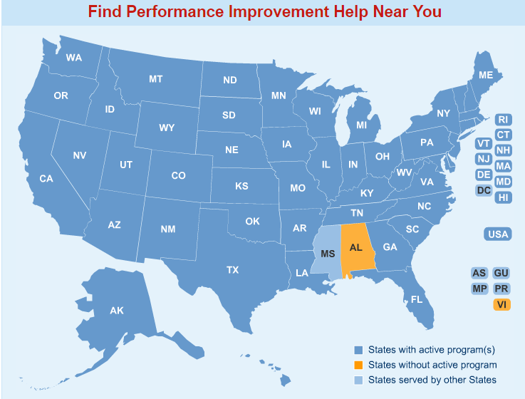
Alliance for Performance Excellence
A National Network
www.baldrigepe.org/alliance
Notes:
The Alliance for Performance Excellence, a nonprofit network, serves as an umbrella organization for local, state, regional, and industry Baldrige-based programs. Around 30 state, regional, local, and industry-based performance excellence programs throughout the country base their programs and awards on the Baldrige Excellence Framework, which has extended the reach of the national program and the Baldrige framework. These programs offer tools, resources, and expertise to assist organizations in improving their performance. They also serve as a feeder system for the national Baldrige Award.
The number of state and local, regional, and sector-specific Baldrige-based award programs has grown from 8 in 1991 to around 30 today. These programs cover nearly all U.S. states and territories.
Other Baldrige-based programs cover long-term care and assisted living organizations and Army National Guard units, for example.
The Alliance for Performance Excellence noted the following for 2015:
1,262 application reports were received.
1,921 examiners were trained.
Over the past 20 years, state and local programs have trained more than 30,000 examiners.

Slide 16
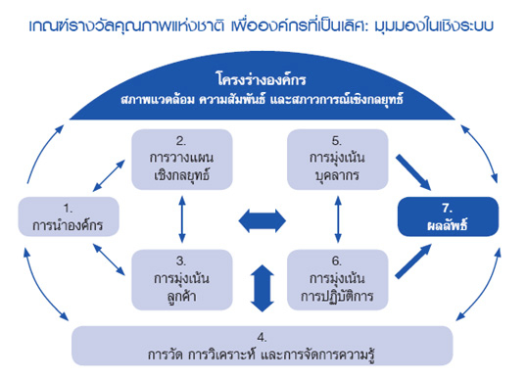

International Adoption
  About 100 performance excellence programs worldwide
Notes:
The Baldrige framework and the Criteria are a globally recognized model of performance excellence. Of the approximately 100 performance or business excellence programs around the world, most use the Baldrige Criteria or criteria similar to Baldrige as their performance excellence models.

Slide 17
Baldrige Award Participants
106 Baldrige Award recipients
(113 awards)
1,673 award applications
More than 10,000 examiners trained
Notes:
Baldrige Program participants include a wide variety of individuals and organizations, such as Baldrige framework-using organizations; Baldrige Award applicants and recipients; and members of the Board of Examiners, who evaluate the award applications and prepare feedback reports.
From the program’s inception through 2015, 109 of the more than 1,600 applications have resulted in a Baldrige Award: 31 in manufacturing, 16 in service, 26 in small business, 11 in education, 22 in health care, and 7 in the nonprofit sector. Seven organizations (MEDRAD; MESA; MidwayUSA; The Ritz-Carlton Hotel Company, L.L.C.; Solectron; Cargill Kitchen Solutions [formerly Sunny Fresh Foods, Inc.]; and Texas Nameplate, Inc.) have received the award twice, making the total number of award recipients 106.
Through 2016, the Baldrige Performance Excellence Program had trained more than 10,000 examiners in the Baldrige framework and processes. State and regional programs that are members of the nonprofit Alliance for Performance Excellence, which serves as a feeder system for the national Baldrige Award, have trained more than 30,000 examiners over the past 20 years. Examiners often take knowledge from the program to their own organizations and teach others about the Baldrige process.
There have been examiners and award recipients in nearly every state and the District of Columbia.

Slide 18

Baldrige Award Recipients
Presentations to all sectors
Quest for Excellence® and regional conferences
Influence on customers/suppliers
Seminars and workshops
Articles
Notes:
Through the sharing of best practices and knowledge of the Baldrige framework , award recipients have helped increase the competitiveness of U.S. organizations. For example, award recipients often host seminars and workshops to help other organizations understand and use the Criteria.
Collectively, Baldrige Award recipients have given thousands of presentations. Audiences have included businesses, education and health care organizations, and government agencies and other nonprofit groups.
Award recipients also share best practices at the annual Quest for Excellence Conference® and at regional conferences. Regional conferences are held at various U.S. locations each year.
The use of the Baldrige framework by award recipients has had a positive influence in several ways on these organizations’ customers and suppliers. First, the use of the Baldrige framework has helped the organizations improve their processes related to customers and suppliers and their relationships with these groups. In addition, some organizations, through such mechanisms as Baldrige-based awards for their suppliers, have encouraged their supplier organizations to use the Baldrige framework .
Many award recipients have also written and published articles on the Baldrige framework and the Baldrige Program.

Slide 19
The Bottom Line: Results
Improved outcomes for products, services, and processes
Notes:
Besides results such as increased self-knowledge, more workforce participation, and integrated operations, the Baldrige framework has helped organizations to improve bottom-line results and competitiveness. Following are some examples:
Lockheed Martin Missiles and Fire Control (MFC) has attained a leading market share and sustained growth over the past four years: return on investment, a strategic measure for MFC, has grown at a 23% compound annual rate, faster than the industry-best competitor at 13.7%; operating margin has had a compound annual growth rate of 6.2% over 11 years, better than the Standard & Poor’s (S&P) 500 Capital Goods Manufacturing Index at 1.5% and the industry-best competitor at 0.2%; from 2006 to 2011, annual orders from repeat customers increased by 32%, and international orders increased by almost 400%; and time reductions as a result of process and performance improvement programs yielded an estimated saving of $225 million annually.
Since 2006, MESA more than doubled in size while transforming itself from a manufacturing company to a full-service provider of corrosion control and integrity solutions to the pipeline industry. MESA's growth rate during this period exceeded its closest competitor by almost 40%; MESA's entry into new markets, including expansion into the asset integrity market for pipelines, has created more than $26 million of annual revenue over a nine-year period; profitability as a percentage of revenue has increased from 5% in 2006 to greater than 10% projected for 2012; customer retention rates consistently exceeded 95% in both materials and service between 2006 and 2011, and revenue from existing customers increased over the same period; and the customer satisfaction increased from 87% in 2006 to over 90% since 2009; these levels are consistently better than competitors (ranging from 72 to 83%) and the American Customer Satisfaction Index (ranging from 72 to 76%).
North Mississippi Health Services’ (NMHS’) outpatient management of diabetes has met or exceeded the National Committee for Quality Assurance (NCQA) top-decile benchmark since 2008; colorectal cancer screenings have increased since 2009 and consistently exceed the standard set by the state’s Medicare quality improvement organization; for 2012, the system’s flagship hospital performed at the 100% level for Joint Commission-accredited hospitals in 26 of 30 Surgical Care Improvement Project core measures; a strong focus on patient safety has led to no central line-associated blood stream infections in the intensive care unit for two years; employee retention has been at or above 90% since fiscal year 2007, exceeding the Bureau of Labor Statistics’ benchmark for health care organizations by 10%; and NMHS leads its primary competitor in market share by 13% and all other hospitals combined by 8%.
The City of Irving is one of five cities in the state and 89 in the nation with a AAA rating from both Standard and Poor’s and Moody’s—ratings that it has maintained since 2007; the tax rate is the second lowest in the Dallas-Fort Worth Metropolitan area. Since 2007, its overall cost of service has been better than four comparable cities in the area; the rating for overall quality of service in Irving (74%) is higher than the state of Texas (46%), county government (37%), and the U.S. government (38%); since 2006, the%age of residents rating many of the city’s key services—including police, code enforcement, libraries, and recreational—as good or excellent has increased by double digits; and Irving’s focus on process efficiency has resulted in more than $44 million in cost savings and efficiencies since 2008.
Montgomery County Public Schools (2010 Baldrige Award recipient) elementary school students’ reading performance used to determine Adequate Yearly Progress (AYP) increased for all subgroups, including improvements of 10.2 percentage points for Limited English Proficient students, 8.3 percentage points for students receiving free and reduced-priced meals, 7.1 percentage points for African Americans, and 7.6 percentage points for Hispanics..
Advocate Good Samaritan Hospital (2010 Baldrige Award recipient) demonstrates high levels of performance in many process measures for clinical outcomes. For example, risk-adjusted mortality (overall mortality divided by expected mortality where 1 is the standard) decreased from 0.55 in 2007 to 0.42 in 2010, exceeding the six-county top-decile level as measured by Thomson Reuters.
Lean manufacturing concepts have helped MESA Products, Inc. (2006 Baldrige Award recipient) achieve cycle time and productivity improvements. For example, throughput time in the magnesium assembly area improved by 82%, output in the instrumentation equipment assembly area increased by 60%, lead time for the sales-order-entry process decreased by 30%, and error rates dropped 50%. In addition, on-time shipments improved to 97.2%.
Hurricane Katrina caused DynMcDermott Petroleum Operations Company (2005 Baldrige Award recipient) to relocate operations from New Orleans, Louisiana, to Beaumont, Texas. Within five days, the Strategic Petroleum Reserve, which DynMcDermott manages as a contractor for the U.S. Department of Energy, began delivering oil to refineries in the Gulf Coast region that normally get oil from the Gulf of Mexico.

Slide 20
Returns on Investment in
Performance Excellence:
2016 Baldrige Award Recipients
Notes:
The following slides show some of the achievements of the current award recipients.

Slide 21

Don Chalmers Ford
13 times in 17 years: Highest national Ford dealership recognition for customer satisfaction and market share
Sales volume increase: $109 million to $126 million over 4 years
90% or higher customer rating of new vehicle sales
96% of customers willing to recommend the dealership
Notes:
Don Chalmers Ford is an independent business franchised to represent the Ford Motor Company in vehicle sales and service in Rio Rancho, New Mexico, a city of 94,000 just outside Albuquerque. The company motto, “Real Value, Real People, Real Simple,” is brought to life by Don Chalmers Ford’s commitment to “customers, quality, and community.” Providing customers with an innovative, non-traditional dealership experience is key; for example, visitors are always welcomed by a greeter when entering the showroom, which is designed to surround them with a relaxed, “art gallery” atmosphere. The company has a workforce of 182 employees and recorded $126 million in gross sales in 2015.
Selected Results
Highest national recognition for customer satisfaction and market share available to Ford dealerships 13 times over the last 17 years. This feat has only been accomplished by 4 percent of domestic Ford dealerships.
Total sales volume increased from $109 million in 2012 to $126 million in 2015. Total dealership gross profit increased by 13 percent during the same period, with the percentage of gross profit growth in 2015 exceeding Ford's national benchmark level by 8.4%.
Retention rate of sales consultants increased from 56.3% in 2011 to 71.4% in 2015, significantly higher than the national average of 26% for non-luxury brand dealerships.
Don Chalmers Ford’s customer engagement and satisfaction have achieved benchmark levels in each market segment and exceed regional benchmarks for service locations, according to Ford Motor Company’s Consumer Experience Index (CEI)/Net Promoter Score. Overall customer satisfaction for new vehicle sales and for maintenance and repair (CEI score of 88) surpassed the ratings for Ford dealers of similar size in the region (average CEI score of 81) in 2015.
Customers have rated the dealership’s new vehicle sales at 90 or higher for engagement and satisfaction from 2013 to 2016. Ninety-six percent of customers who bought used vehicles from Don Chalmers Ford report that they are willing to recommend the dealership to family and friends.
Retention rate of sales consultants increased from 56.3% in 2011 to 71.4% in 2015, significantly higher than the national average of 26 percent for non-luxury brand dealerships.

Slide 22

Momentum Group
Sales growth of more than 400%; outperformed the industry for 19 years of its 22 in business
Reduced sample production time by 50%; improved sample yield per yard by 20%
Average employee tenure: more than 10 years; 73% of current managers promoted from within
Notes:
Momentum Group, headquartered in Irvine, California, started in 1994 as one of the smallest contract textile distributors in the United States. Today, the company is a recognized leader in the commercial interiors industry, creating exclusive, design-focused fabrics for customers that include architectural and design firms, and commercial furniture manufacturers. In just over two decades, Momentum Group’s sales have grown more than 400% and have outperformed the industry for 19 years out of the 22 that the firm has been in business. Momentum Group employs a workforce of 150 at its corporate offices in Irvine; design center and warehouse in North Carolina; warehouses in Michigan and California; showrooms in Illinois, New York, and Texas; and individual sales and remote employee offices across the nation.
Selected results
Sales growth of more than 400%; outperformed the industry for 19 years out of the 22 that the firm has been in business.
Invested in process upgrades that have reduced sample production time by 50% and improved sample yield per yard by 20%.
Named a “Best Place to Work” by both California’s Orange County Business Journal and Business North Carolina. The company also has been recognized by the Orange County Register as one of its “Top Workplaces.”
Average employee tenure of more than 10 years; 73% of current managers promoted from within.

Slide 23

Kindred Nursing and Rehabilitation Center—Mountain Valley
5-Star quality rating—the highest possible—for 7 consecutive years
100% of residents and family members either “very” or “extremely” satisfied
90% employee retention rate
Since 2014, best possible performance for pain management for long-term residents
Notes:
Providing hope and promoting healing and recovery: that is the mission of Kindred Nursing and Rehabilitation Center - Mountain Valley, a 68-bed skilled nursing center in Kellogg, Idaho, a rural community set in the foothills of the Rocky Mountains. Kindred - Mountain Valley is operated by Kindred Healthcare Inc., a for-profit corporation with approximately 90 centers across the nation. Kindred - Mountain Valley provides skilled nursing and rehabilitation services for patients who require short-term (six months or less) and long-term (longer than six months) care. The center has 92 employees on staff and reports a total net revenue of $6.4 million.
Selected Results
For seven consecutive years, achieved a five-star quality rating—the highest possible—from the Centers for Medicare and Medicaid Services. Less than 1% of 15,600 skilled nursing facilities nationwide achieved the five-star rating over that period of time.
One-hundred% of residents and family members surveyed have expressed either “very” or “extreme” overall satisfaction levels since 2013, which is above the national industry average by 20% for residents and by 10% for families.
90% employee retention rate, which is more than 20% above the national industry average.
Occupancy rate of 89 to 90% has exceeded national and state benchmarks from 2010 to 2016.
Based on an analysis of Centers for Medicare and Medicaid Services data comparing nursing homes, demonstrates the “best possible results” for several long- and short-term resident outcomes. For example, since 2014, the center has achieved the best possible performance for pain management for long-term residents and outperformed state and national benchmarks by 10–20% for short-term residents.
100% of residents and family members surveyed have expressed either “very” or “extreme” overall satisfaction levels since 2013, which is above the national industry average by 20% for residents and by 10% for families.
90% employee retention rate, which is more than 20% above the national industry average.
Nursing staff turnover of 22% compared to the 50% or higher levels typically seen nationally for nursing homes.

Slide 24

Memorial Hermann Sugar Land Hospital
Since 2011, zero patient safety “never events” in key areas
90th percentile for patients “likely to recommend” day surgery, emergency care, gynecology, orthopedics, and women’s health
90% retention for employee partners; 100% for physician partners
Notes:
Memorial Hermann Sugar Land Hospital is part of the Memorial Hermann Health System, the largest not-for-profit health system in Southeast Texas. Memorial Hermann Sugar Land is a 149-bed, full-service acute care community hospital located in Sugar Land, Texas, and serves Fort Bend County, a populous region of nearly 700,000 just southwest of Houston. The organization excels by “bringing together quality, safety, and a family-caring-for-family approach” that “sets the pace for the hospital of tomorrow.” Memorial Hermann Sugar Land also is the anchor for more than 20 associated care centers in the Sugar Land area that provide primary and specialty care services in cardiology, diagnostics, emergency care, imaging, occupational therapy, oncology, physical therapy, rehabilitation, sleep disorders, speech therapy, sports medicine, surgery, and urgent care. Staffed by 641 employees, Memorial Hermann Sugar Land operates with a revenue of $135 million.
Selected Results
Top 10% nationally for a emergency center arrival-to-discharge time, compliance with regulations to reduce medication errors, bed turnaround times, radiology and laboratory result turnaround times, and the use of computerized physician order entry.
Retention for FY2016 is at 90% for employee partners, 100% for physician partners, and 90% for volunteer partners, all comparable to or exceeding national benchmarks.
Patients “likely to recommend” several service lines and departments—including day surgery, emergency care, gynecology, orthopedics, and women’s health—at levels that put Memorial Hermann Sugar Land in the Press Ganey Associates 90th%ile for this measure.
Operating earnings (before interest, depreciation, and amortization) since 2014 have exceeded Standard and Poor’s (S&P) national median for AA-rated nonprofit hospitals. Operating margin has met or exceeded the S&P benchmarks for the same group since 2013.
Since 2011, zero patient safety “never events” (medical errors that should never occur) related to pressure ulcers, ventilator-associated pneumonia, transfusion reactions, and deaths from normally low mortality conditions.
.

Slide 25
For more information
Baldrige framework booklets and free content
Self-assessment tools
Organizational assessments
Training, conferences, and executive education
Award recipient profiles
Case studies
Connections to the Baldrige community
www.nist.gov/baldrige
baldrige@nist.gov
(301) 975-2036
Baldrige Performance Excellence Program | www.nist.gov/baldrige

