Slide 1
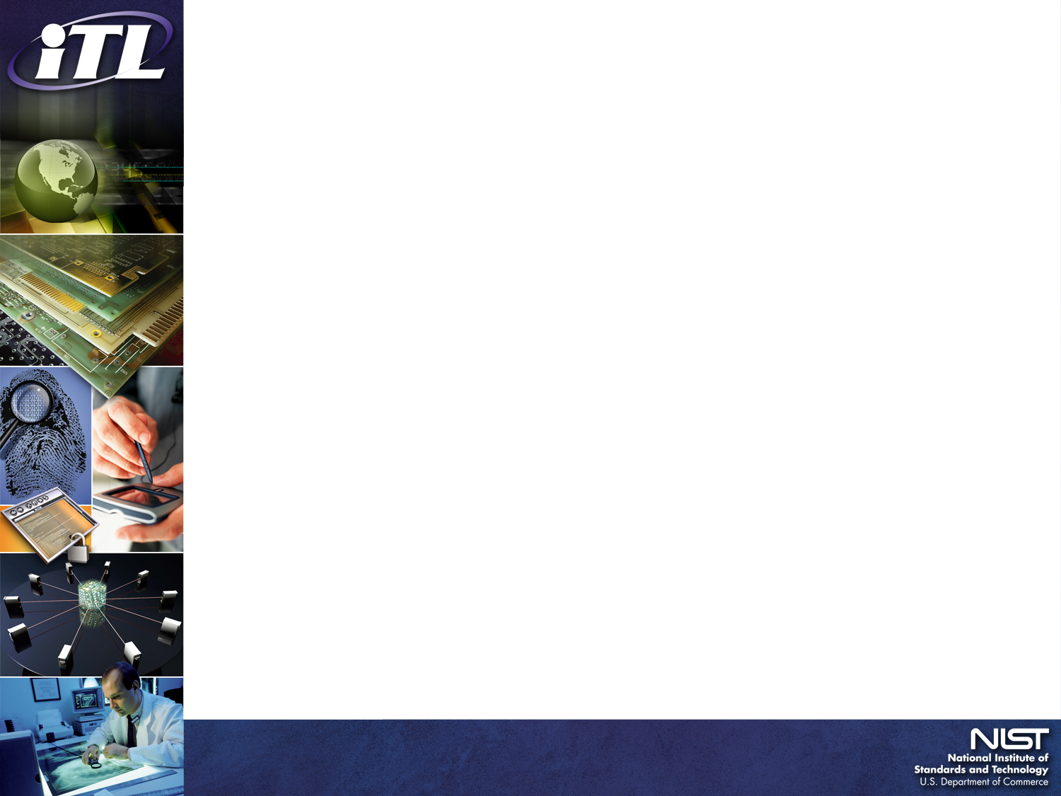
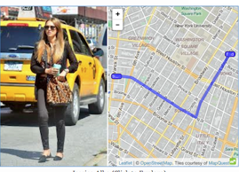
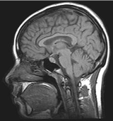

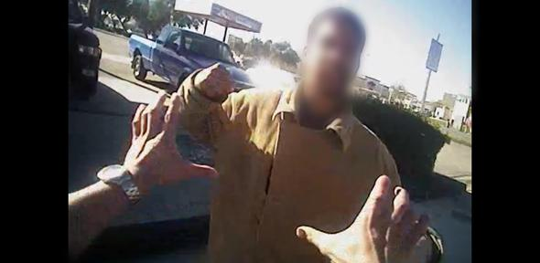
There is privacy risk in de-identified data — what can we do about it?
Sweeney, 2000
Today:
How do we balance
Utility vs. Risk?
How does risk
change over time?
New data types
to de-identify.
NYC Taxi drivers
Re-identified
Field Suppression, Swapping, Generalization
Ethnicity
Visit date
Diagnosis
…
Birth date
Sex
ZIP Code
Name
Address
Medical Data
Voter List
Bikeshare riders re-identified?
HIPAA “Safe Harbor” standard.
k-anonymity, l-diversity, t-closeness
Differential Privacy
Options moving forward:
Better de-identification
Synthetic data
Data use agreements
Privacy remediation
Community harms without re-identification
NIST FY2016 GOALS:
Develop guidance
Gov De-ID Stakeholder meeting
Pilot de-identification evaluation
Tabular
Geospatial
Social Media
Medical
DNA
Bodycams/Surveillance
Simson L. Garfinkel, Ph.D., Senior Advisor, Information Access Division, simson.garfinkel@nist.gov
DISCLAIMER: Specific products and organizations identified in this report were used in order to perform the evaluations described. In no case does such identification imply recommendation or endorsement by the National Institute of Standards and Technology, nor does it imply that identified are necessarily the best available for the purpose.

