Slide 1



Self-Assessing
Your Organization
with the Baldrige Criteria
Baldrige Performance Excellence Program | www.nist.gov/baldrige

Slide 2
What Is a Baldrige Self-Assessment?
The first step toward organizational
improvement and performance excellence
A “results-oriented” review
Adaptable to the needs of your organization
Notes:
Whether your organization is large or small, and no matter your industry or sector, you can use the Baldrige Criteria for improvement. The most visible users of the Baldrige Criteria are Baldrige Award recipients, but many more organizations nationwide use the Criteria internally for improvement.
The Baldrige Criteria provide a framework for evaluating how well your organization is doing in meeting its goals and objectives. Use the Criteria to examine both your processes and their impact on results.
Most organizations begin their improvement journeys by using the Criteria for self-assessment. Self-assessments are flexible. You can
engage all workforce members in the process or select participants from a cross section of functions and levels—or appoint a small group to represent all colleagues
use a questionnaire approach
use only the Organizational Profile in the Criteria booklet for a first
self-assessment
focus on a single Criteria category or look at all seven categories simultaneously
benchmark other organizations in key areas to identify best practices and results

Slide 3
Why Conduct a Self-Assessment?
Your customers, competitors, or budget are driving the need to change.
Your environment is changing.
Your organization is among the best, and you want to keep it that way.
Notes:
Many reasons can underlie the need for a Baldrige self-assessment.
Your customers, competitors, or budget are driving the need to change.
Your environment is changing.
Your organization is among the best, and you want to keep it that way.
Your self-assessment can reveal opportunities for your organization’s improvement and help you implement appropriate action plans.

Slide 4
Benefits
Identify successes and
opportunities for improvement
Jump-start a change initiative
Energize improvement initiatives
Energize the workforce
Focus your organization on common goals
Assess performance against the competition
Align resources with strategic objectives
Notes:
You can realize on one or more of these benefits when your organization conducts a self-assessment and implements action plans for improvement.

Slide 5
Tools and Approaches
Are We Making Progress? and
Are We Making Progress as Leaders?
easyInsight
Organizational Profile
Criteria item title questions
Intermediate self-assessment
Full self-assessment
Notes:
Here are some tools and approaches that you can use to introduce the Baldrige Criteria to your organization and begin a self-assessment. Your organization’s experience with the Baldrige Criteria will help you decide where to begin.
Are We Making Progress? and Are We Making Progress as Leaders? are two questionnaires that will introduce the seven Criteria categories to your organization and help you quickly identify strengths and opportunities for improvement.
2. Easy Insight: Take a First Step toward a Baldrige Self-Assessment is an online assessment tool that helps you identify gaps in your understanding of your organization and allows you to compare your organization to others.
3. Completing the Organizational Profile is the first step in a full self-assessment the Baldrige Criteria.
4. Answering the 17 Criteria item title questions helps you understand the full dimensions of the Criteria and your organization.
5. You can conduct an intermediate self-assessment using the Criteria item title question and the outline provided by the subsequent headings and subheadings.
6. Finally, you can conduct a full self-assessment using the seven categories of the Baldrige Criteria.

Slide 6

If You Are Just Learning about the Baldrige Criteria . . .
Your Reference Guide to Performance Excellence
Notes:
The brochure Your Reference Guide to Performance Excellence, available free from or Web site or on request from Customer Service, offers details about self-assessment tools, steps in the performance excellence journey, and information on state and local quality programs.

Slide 7
Do leaders/employees know and understand our values, vision, mission, and plans?
Does the workforce trust my organization’s leadership?
Is my communication effective?
Is my message being well received?
Notes:
Learn what your employees and senior leaders think. Try Are We Making Progress? and Are We Making Progress as Leaders?, available free from the Baldrige Web site. Organized by the seven Baldrige Criteria categories, these questionnaires help you check your progress on organizational goals and improve communication among your workforce members and leadership team. Learn whether
your leadership team and employees understand the values, vision, mission, and plans
workforce members trust your organization’s leadership
your communication is effective
your message is being well received

Slide 8
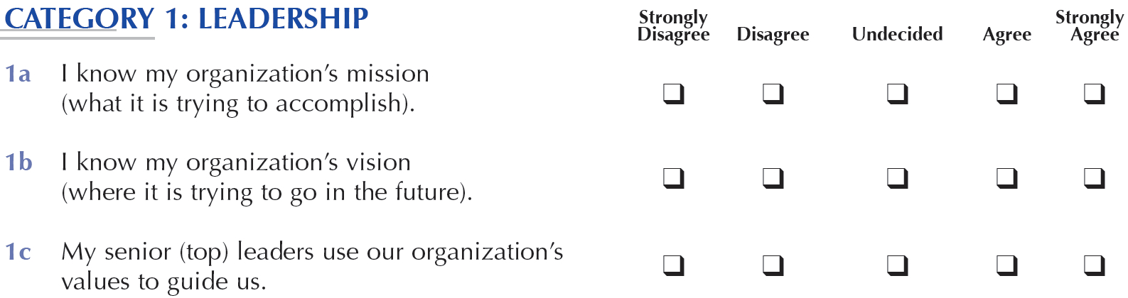
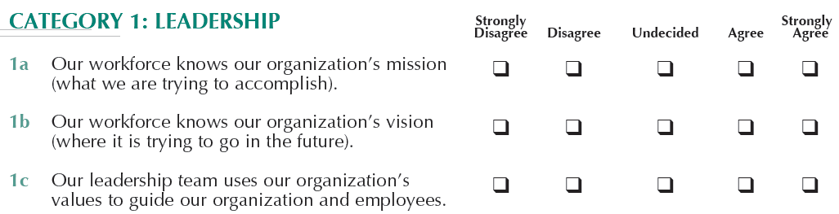
For Your Workforce
For Your Leaders
Notes:
The questionnaires each contain 40 statements, use a five-point scale for responses, and take about 10 minutes to complete. They are written in simple language that helps you understand the intent of the seven Criteria categories.
The questionnaire can be used with all levels of employees. Depending on your organization’s needs, you can distribute the questionnaire to a subset of employees or to all employees.
Are We Making Progress as Leaders? asks questions similar to those in Are We Making Progress? but its target audience is the organization’s leaders.
You can modify the 40 questions in either questionnaire to address the specific needs or language of your organization. They can help you focus your improvement and communication efforts on areas needing the most attention.
When you have completed the survey in your organization, you can compare your results with those of other organizations by visiting the Baldrige Program’s Web site.

Slide 9
Organizational Profile
  What are my organization’s key characteristics?
  What are the key influences on my organization?
  What key challenges does my organization face?
Notes:
The Organizational Profile sets the context for evaluating your organization. It is what makes the Criteria for Performance Excellence applicable to any type of organization—business, education, health care, nonprofit, or government; large or small; single-site or with locations around the world.
Specifically, the Organizational Profile is a series of questions that helps you better understand your organization. It creates a snapshot of your organization so you can examine its key influences, challenges, and advantages.

Slide 10

Is my organization ready for a more thorough self-assessment?
Are there gaps in our knowledge about our organization?
How does my organization compare to others?
What plans can we make for improvement or for a more complete self-assessment?
Notes:
Identify gaps in your understanding of your organization and compare your organization with others with easyInsight: Take a First Step toward a Baldrige Self-Assessment, an online self-assessment tool based on the Organizational Profile. You can complete easyInsight free on the Baldrige Web site.
Completing easyInsight can
help you determine your organization’s readiness for a more thorough self-assessment
reveal gaps in information and opportunities for improvement
allow you to compare your organization to others who already have completed the easyInsight self-assessment
help you develop an action plan for improvement or prepare for a more complete self-assessment

Slide 11
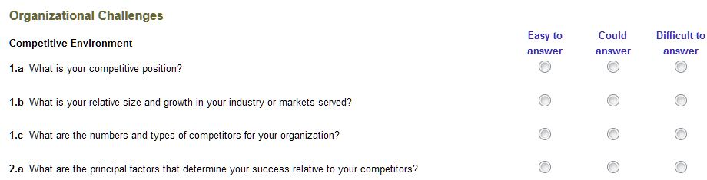
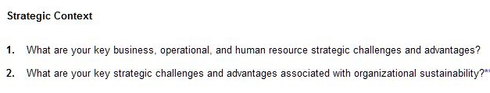
Notes:
To complete easyInsight, you read and consider each question in the Organizational Profile within the context of your organization, and then determine the level of difficulty of answering each question: “Easy to answer,” “Could answer,” or “Difficult to answer.”
Doing this helps you identify gaps in your understanding of your organization.
When you have completed the online assessment, you can compare your answers to those of others who have completed easyInsight.
You can then develop an action plan to address gaps and issues.

Slide 12
Complete the Organizational Profile
Describe what is relevant and important
Ensure common understanding
Guide selection of information/data
Identify gaps/lack of deployment
Notes:
When you have completed easyInsight and addressed your gaps or issues, you may be ready to move on to actually responding to the questions in the Organizational Profile, available free on the Baldrige Web site.
By preparing the Organizational Profile, your organization can gain a common understanding of what is important to you, and this understanding will then guide data collection and selection of information as the process continues. The Organizational Profile also guides the assessment of approaches used by your organization, the extent of deployment of those approaches, and the results you achieve.
Many organizations start with the Organizational Profile and progress gradually to more detailed levels of self-assessment and action. If you identify topics for which you have conflicting, little, or no information, you can use these topics for action planning. For many organizations, this approach serves as a first Baldrige self-assessment.

Slide 13
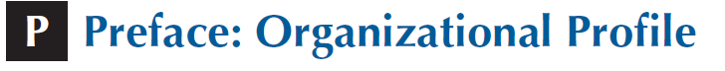
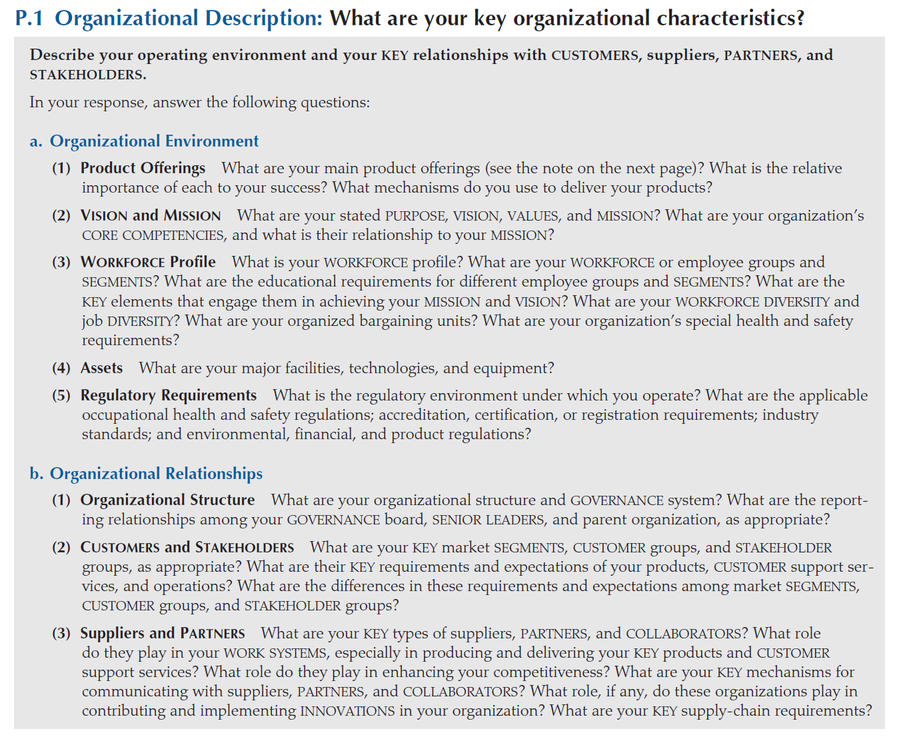
Notes:
The requirements for the Organizational Profile are basically the same for all three versions of Criteria that we produce—Business/Nonprofit, Health Care, and Education—with some variation in vocabulary.
There are two major sections with subparts under each.
The first section is the basic description of your organization.
This includes your organizational environment (product offerings; mission, vision, and values; core competencies; workforce profile; technologies, equipment, and facilities; and regulatory environment). It also includes your organizational relationships (governance system, key customer groups, stakeholder groups, and market segments; key product and customer-support service requirements; and key suppliers and partners).

Slide 14
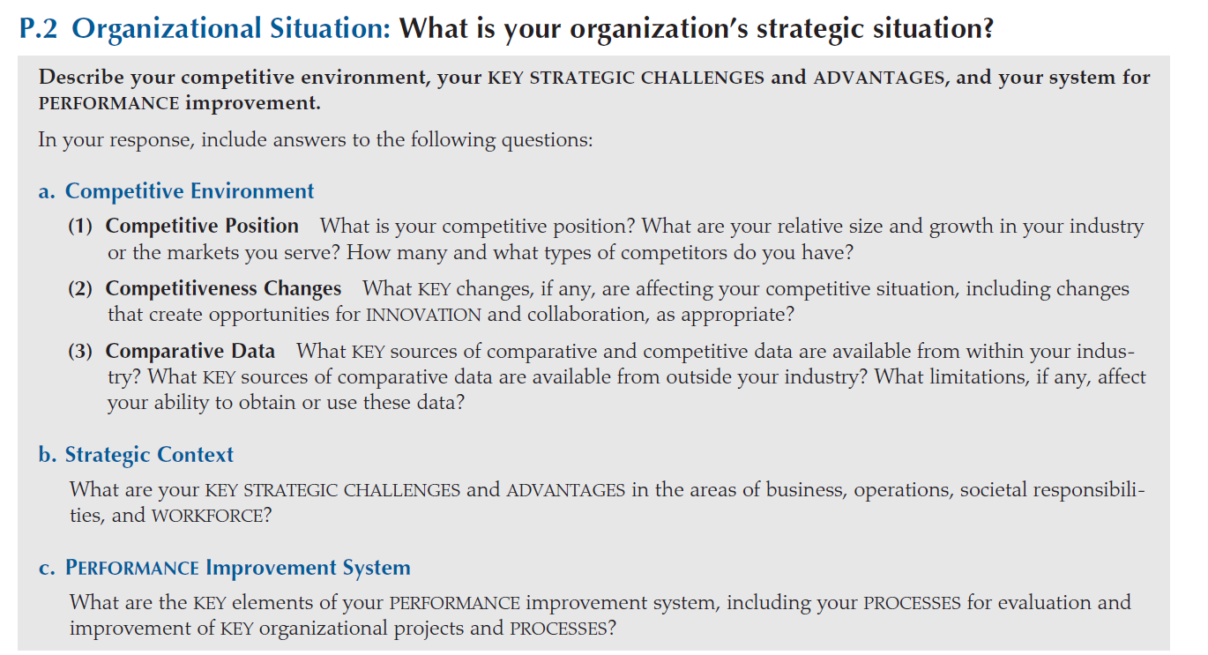
Notes:
The second section focuses on your organizational situation.
This includes your organization’s competitive environment (including your relative size and growth and number of competitors). It also includes your strategic context (key business, operational, societal responsibility, and workforce strategic challenges and advantages) and yourperformance improvement system (including your approach to evaluation and improvement).

Slide 15

Notes:
As a next step in self-assessment, you might purchase a Criteria booklet and answer the questions in the titles of the 17 Criteria items. The sample shown here is from Category 3, Customer Focus This will give you a basic understanding of the Criteria and your organization’s performance in each area. You might do this yourself, at a leadership retreat, or as a whole organization

Slide 16


Notes:
Then look at the Criteria category titles, item titles, and area-to-address headings to see a simple outline of a holistic performance management system. See if you are considering all of these dimensions in establishing your leadership system and measuring performance.

Slide 17
Full Self-Assessment: Six Steps
Identify the scope.
Select champions.
Select category teams/collect data and information.
Share answers.
Create and communicate an action plan.
Evaluate.
Notes:
If your organization has some experience with the Baldrige Criteria or has completed smaller-scale assessments, you may be ready to use the complete set of Criteria to conduct a full self-assessment. Here are six basic steps for conducting a full self-assessment, although we encourage you to modify this process to meet your own organizational needs.

Slide 18
1. Scope: the whole organization, or one part?
2. Champions: one for each Criteria category
Select category teams; answer the Criteria questions
Notes:
First, identify whether the whole organization or a specific part of it will be assessed. Determine if the self-assessment will cover the entire organization, a subunit, a division, or a department.
Then select champions for each of the Baldrige categories. These champions will participate in preparing responses to the item questions in the Criteria categories. If they have not already done so, champions should prepare an Organizational Profile describing your organization and its challenges.
The champions select category teams, which collect information and data for responding to the Criteria questions in their respective categories.

Slide 19
4. Share answers to Criteria questions
among category teams.
5. Create and communicate an action plan
for improvement.
Criteria category | Importance: High, medium, low | For High-Importance Areas
 |  | Stretch (strength) or improvement (OFI) goal | What action is planned? | By when? | Who is responsible?
1 Leadership
Strength
1.
2.
OFI
1.
2.
Notes:
4. Category teams share their answers to Criteria questions with other category teams. The teams identify common themes in their answers.
5. Each category team creates and communicates an action plan for improvement based on the team’s answers and organizational priorities. The Self-Analysis Worksheet, available online at www.nist.gov/baldrige/publications/business_nonprofit_criteria.cfm, can help your category teams identify strengths and opportunities, set priorities, and develop action plans.

Slide 20
6. Evaluate the self-assessment process
for future improvements.
Notes:
6. In the final step, senior leaders, champions, and teams evaluate what has been done and think about ways to improve the self-assessment process in the future.
Your organization’s experience with and prior use of the Baldrige Criteria may determine whether you use an informal self-assessment or a formal approach that includes developing a written report. If you decide on an informal assessment—which many organizations have found to be a good way to start—you can complete the exercise in a one- or two-day meeting.

Slide 21
For More Information
Criteria booklets
Self-assessment tools
Training, conferences, and executive education
Organizational assessments
Award recipient profiles
Case studies
Connections to the Baldrige community
www.nist.gov/baldrige
baldrige@nist.gov
(301) 975-2036
Baldrige Performance Excellence Program | www.nist.gov/baldrige
Notes:
Visit the Baldrige Web site for self-assessment resources.
The Criteria for Performance Excellence booklets provide the blueprint for an effective self-assessment.
The Baldrige Program holds one national and two regional conferences each year to share the role-model approaches of its award winners. These conferences provide insights into the practices of numerous organizations that have used the Criteria to improve and innovate. Workshops on self-assessment are often offered in conjunction with these conferences.
Baldrige Award winners honor their responsibility to serve as performance improvement advocates, share their strategies, and serve as role models. Many undertake ongoing self-assessments of their organizations and can share their experiences with you.
Numerous state and local Baldrige-based award programs provide helpful services in the area of self-assessment and action in addition to their award program functions. There are programs in most states.

