Slide 1
Ensuring Quality Feedback Reports: The Tech Editing Process for 2014
Briefing for Senior and Alumni Examiners

Slide 2
Our Objectives
Review steps of the two phases (Part 1 and Part 2) of the tech editing process, as revised in 2013.
Share process improvements based on your input.
Point you to resources for tech editing.

Slide 3
2014 Tech Editing Process: Part 1
Before the consensus call,
  tech editors will review the team’s draft work (focusing on 3 areas: comment conflicts, comment/scoring alignment, and tone based on the applicant’s view);
  tech editors will give direct feedback to the team leader; and
  team leaders will share the feedback with the team, as appropriate.
Notes:
The tech editor’s role used to be conducted by staff members and alumni examiners only after an examiner team completed its work in BOSS.
Beginning last year, tech editors are asked to
Conduct a higher-level review of the scorebook before it is finalized by the examiner team in BOSS and provide feedback to the team leader before the first consensus call. (part 1)
Complete a more comprehensive review of the content of the final scorebook after the team finalizes its work in BOSS. (part 2)
The key aim of both phases of tech editing is to advance the quality of the final feedback report. Communication between the tech editor and the team leader helps the tech editor understand why the examiner team might have made certain decisions in comments, and the feedback provided by the tech editor enables the team to improve the quality of the feedback before the scorebook is finalized.

Slide 4
2014 Tech Editing Process: Part 2
After the scorebook is finalized in BOSS,
  tech editors will help Baldrige staff review the quality of scorebooks (completing five comprehensive editing tasks);
  team leaders may be contacted again by tech editors with questions (e.g., to clarify comments); and
  team leaders may share additional feedback with the team, as appropriate.
Notes:
Note that there are two places when the tech editor will help us review the feedback: (1) right before the consensus call and (2) after the scorebook is submitted as final. This means there are two times when team leaders may be queried about something in the feedback.
But this also means that (1) team leaders will know how their work is being received, and (2) tech editors will save time because they can question the team leader directly if something is not clear.
There also may be opportunities for the team leader to explain a comment to the editor based on the team’s consensus discussion; in this case, the editor may be able to help clarify the comment for the applicant.
We all learn, and we all improve the feedback for the applicant.
And we should note that team leaders of site-visited applicants have always received feedback directly from the judges and site visit monitors on their scorebooks before they are submitted to applicants. We hope this process might be a way for team leaders of non-site-visited applicants to receive real-time feedback, too.

Slide 5
Additional Improvements Based on Your Input (Thank you!)
Send applications to tech editors several weeks before R-3 review.
Give tech editors access to BOSS.
Allow some flexibility in tech editor/team leader communications (e.g., feedback can be posted in BOSS if agreed upon).
Be sure team leaders are aware of two-part tech editing process.
Try to keep the same tech editor with team for both phases.
Focus on fewer tasks in part 1 tech editing (2014: comment conflicts, comment/scoring alignment, tone from applicant view).
Notes:
Listed on this slide are a few key improvements that we have made to the process based on your feedback. We gathered these suggestions from alumni and seniors at last year’s process briefings as well as from end-of-process e-mail surveys of tech editors and team leaders last year. Here are notes corresponding to each numbered change:
1. In 2014, tech editors will only be asked to read the Organizational Profile during Part 1 (though we recognize that they may wish to read and need to reference the entire application).
2. Tech editors will have access to BOSS in Part 1 only (If an applicant is chosen for site visit, then the Baldrige staff member who travels with the examiner team will be the Part 2 tech editor, so tech editors whose applicants do not go on to a site visit no longer need/use BOSS.)
3. Tech editors and team leaders can also use e-mail to communicate some feedback if no applicant-specific information is included.
4. In addition to including all team leaders in the training briefings, we are adding notes in the award process communications that team leaders receive.
5. In 2013, there were only a few cases where a new tech editor had to be assigned to a scorebook in Part 2 (due to the tech editor’s schedule constraints).
6. These three focus areas have been frequently identified as key to quality in feedback reports and are issues that the tech editor is especially well-positioned to observe. (Additional note to seniors/team leaders: although the tech editor’s work is more focused in Part 1, they will still need 7-10 days/at least a week, including a weekend, for sufficient review and feedback—please keep that in mind in creating team schedules for the interval between the posting date of the R-3 and the first consensus call.)

Slide 6
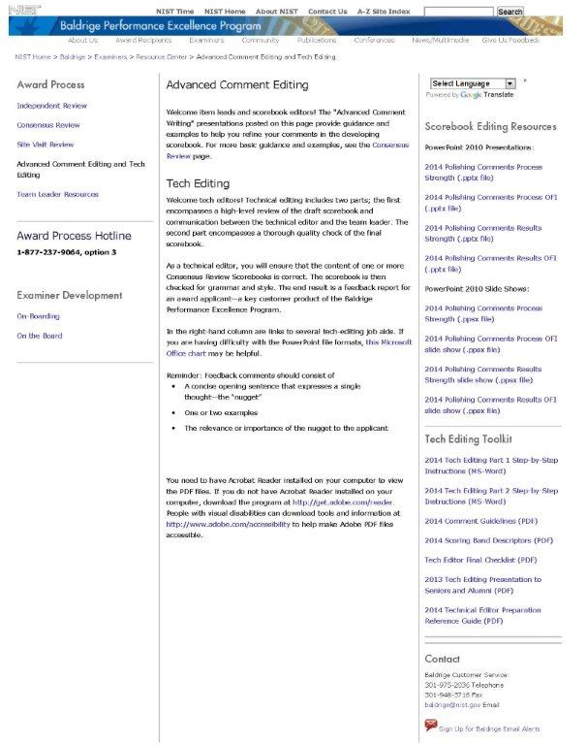
Where Can You Find Tech Edit Resources?
Notes:
Note that the key information and resources needed for tech editing are posted online in the Examiner Resource Center on this “Advanced Comment Editing and Tech Editing” page.

Slide 7
Benefits of the Two-Part Process
Applicant: Best-quality feedback
Team Leader: Feedback to improve and feedback to celebrate team’s work
Tech Editor: Time saved by noting concerns earlier in the process

Slide 8
Call to Action
Alumni: Please let us know if you are interested in serving as a tech editor this year. (Sign up today or e-mail us before June.)
Seniors: Please consider the tech editor’s role in your team’s planning to maximize this support (e.g., be sure to communicate scheduling that may impact the tech editor’s R-3 review, share feedback with team members to help them improve comments).
Thank you!
Notes:
Traditionally we have only asked Alumni examiners to serve as tech editors; that remains our preference, but if you are an interested senior, we may consider you for a reserve/swing pool in case unexpected opportunities arise.
Keep in mind that we may have more volunteers than needed based on our number of applicants. If you are not initially given a Part 1 assignment, however, we will keep your name in a reserve/swing pool in case opportunities arise unexpectedly during Part 1 (in the summertime) or at Part 2 (in the fall).

