Slide 1

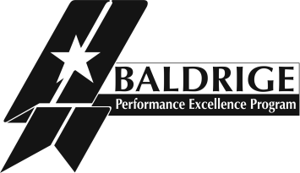

Introduction to the Baldrige Criteria
Baldrige Performance Excellence Program | www.nist.gov/baldrige

Slide 2
  It amazes me that U.S. businesses spend so much money on “how-to” books and course work to teach leaders how to build successful organizations.
  My recommendation: implement the Baldrige-based Criteria in your business. No other single document can help build a long-term successful organization.
  —Jerry Rose, Vice President, Cargill, Inc.
Notes:
Other quotations:
Baldrige … isn’t a program; it’s an embedded lifestyle of how to do things in a continuous way, how to take calculated risk to get great rewards.
—Dr. Jerry Weast, Superintendent, Baldrige Award winner
Montgomery County Public Schools, Maryland
I see the Baldrige process as a powerful set of mechanisms for disciplined people engaged in disciplined thought and taking disciplined action to create great organizations that produce exceptional results.
— Jim Collins, author of Good to Great:
Why Some Companies Make the Leap ... and Others Don’t
The use of the Baldrige framework boosted our ability to deliver better care to our patients. And, in the end, that is the most important thing.
—Nancy Schlichting, CEO, Baldrige Award winner Henry Ford Health System

Slide 3
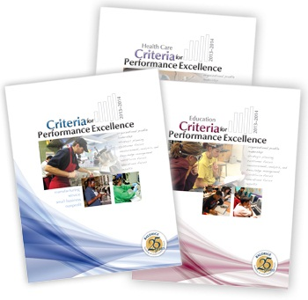
The Criteria . . .
  Empower your organization to reach your goals, improve results, and become more competitive
  Help you assess where your organization is and where it needs to be
  Give you the tools you need to examine your management system
Notes:
For 25 years, the Baldrige Criteria have empowered organizations—no matter their size, sector, or industry—to reach their goals, improve results, and become more competitive by aligning your plans, processes, decisions, people, actions, and results.
The Criteria are a de facto definition of performance excellence. They are updated biennially to ensure that they remain at the “leading edge of validated management practice.”
Using the Criteria gives you a holistic assessment of where your organization is and where it needs to be.
The Criteria give you the tools you need to examine all parts of your management system and improve processes and results while keeping the whole organization in mind.
The Criteria are available in three versions: Business/Nonprofit (for manufacturing, service, nonprofit, and government organizations), Education, and Health Care.

Slide 4

Nationwide
  Help improve organizational practices, capabilities, and results
  Facilitate communication and sharing of best practices among organizations (Baldrige Award)
  Are a tool for understanding and managing organizational performance
Notes:
Since 1987, the Baldrige Criteria have played three roles in strengthening U.S. competitiveness:
They help improve organizational performance practices, capabilities, and results.
As the basis of the Malcolm Baldrige National Quality Award, which recognizes the achievements of role-model organizations, the Criteria facilitate communication and sharing of best practices among U.S. organizations.
They also serve as a working tool for understanding and managing organizational performance, for guiding your strategic plan, and for providing opportunities to learn.

Slide 5
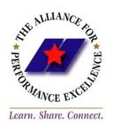
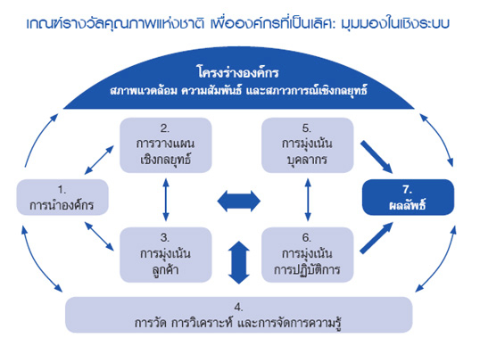
The Criteria Are the Basis for . . .
  State, local, and industry-based performance excellence programs
  Many of the nearly 100 performance excellence programs around the globe
Notes:
The Criteria are a nationally and globally recognized model of performance excellence. Around 30 active state, regional, and local performance excellence programs (covering most of the 50 states as well as U.S. territories) throughout the country base their programs and awards on the Baldrige Criteria. Additionally, about 100 countries, including Japan, have quality programs based on the Baldrige Criteria.

Slide 6
What Are the Criteria?
A set of expectations or requirements
A structured approach to performance improvement
A framework for a systems view of performance management
Notes:
Expectations
The Criteria are a set of expectations or requirements that a phrased as a series of questions.
They define the critical factors that drive organizational success.
Structured Approach
The Criteria are made up of seven categories.
Distributed across the categories are 17 items, each focusing on a major requirement.
Within each item, one or more area(s) to address contain specific requirements related to the item.
Framework
The Criteria constitute a framework for understanding
a systems view of performance management
the key components of a performance management system
the relationships among the components
The Criteria emphasize the alignment of key components of the performance management system.

Slide 7
The Criteria Help You . . .
Align your resources
Identify strengths and opportunities for improvement
Improve communication, productivity,
and effectiveness
Achieve your strategic goals
Notes:
The Criteria requirements work together as a unique, integrated performance management framework. Answering the questions helps you align your resources; identify strengths and opportunities for improvement; improve communication, productivity, and effectiveness; and achieve your strategic goals.

Slide 8
Performance Excellence Is the Goal
Ever-improving value to customers and stakeholders, which contributes to sustainability
Improved overall effectiveness and capability
Organizational learning
Personal learning
Notes:
As a result, you progress toward performance excellence:
You deliver ever-improving value to your customers and stakeholders, which contributes to organizational sustainability.
You improve your organization’s overall effectiveness and capability.
Your organization improves and learns.
Your workforce members learn and grow.
By value, we mean the perceived worth of a product, process, asset, or function relative to its cost and possible alternatives
By performance, we mean outputs and their outcomes obtained from processes, products, and customers that permit you to evaluate and compare your organization’s results to performance projections, standards, past results, goals, and other organizations’ results. Performance can be expressed in nonfinancial and financial terms.
The Baldrige Criteria address five types of organizational performance: (1) product and process outcomes, (2) customer-focused outcomes, (3) workforce-focused outcomes, (4) leadership and governance outcomes, and (5) financial and market outcomes.
The Education and Health Care Criteria focus on parallel sector-related results, with a primary focus on student learning and health care outcomes, respectively.
Organizational learning refers to both continuous improvement of existing approaches and significant change or innovation, leading to new goals, approaches, products, and markets.
Personal learning comes from education, training, and developmental opportunities that further your individual workforce members’ growth. It can result in (1) a more engaged, satisfied, and versatile workforce that stays with your organization; (2) cross-functional learning for your organization; (3) the building of your organization’s knowledge assets; and (4) an improved environment for innovation.

Slide 9
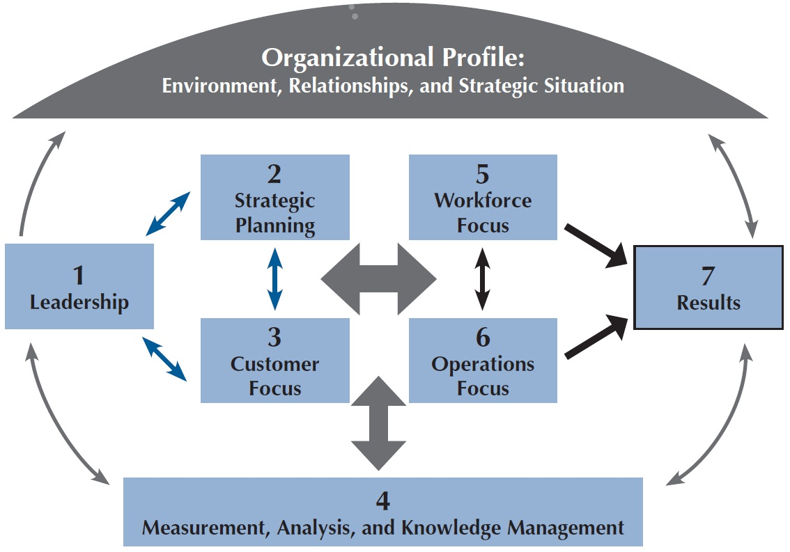
Criteria Framework:
A Systems Perspective
Notes:
The framework provides a high-level overview of the Baldrige Criteria for Performance Excellence and shows how the Criteria provide a systems perspective for managing your organization. From top to bottom, the framework has three basic elements—the Organizational Profile, the system operations, and the system foundation (Measurement, Analysis, and Knowledge Management).
The Organizational Profile (the umbrella at the top of the figure) sets the context for the way your organization operates. Your environment, key working relationships, and strategic challenges and advantages serve as an overarching guide for your organizational performance management system.
The performance system (middle of the figure) consists of two linked triads, formed by the six Baldrige process categories, that define your operations and the results you achieve.
The leadership triad—Leadership, Strategic Planning, and Customer Focus—emphasizes the importance of a leadership focus on strategy and customers. Senior leaders set your organizational direction and seek future opportunities for your organization.
The results triad—Workforce Focus, Operations Focus, and Results—focuses on your workforce and key processes that accomplish the work of the organization, which yields your overall performance results.
ALL actions point toward results.
The horizontal arrow in the center of the framework links the two triads—a linkage critical to organizational success—and indicates the importance of feedback in an effective performance management system.
The system foundation (bottom of the figure) is composed of Measurement, Analysis, and Knowledge Management, which are critical to a fact-based, knowledge-driven system for improving performance and competitiveness.

Slide 10
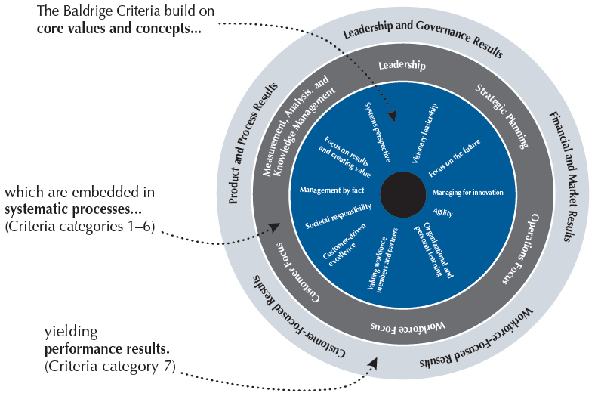
Core Values and Concepts
Notes:
The Criteria are built on a number of interrelated core values and concepts.
These values and concepts are embedded beliefs and behaviors found in high-performing organizations. They are the foundation for integrating key performance and operational requirements within a results-oriented framework that creates a basis for action and feedback.
This figure shows the role of the core values and concepts on which the Criteria are built. Core values and concepts are embedded in the systematic processes addressed in Criteria categories 1 through 6. These systematic processes yield the performance results found in Criteria category 7.
The Baldrige core values and concepts are visionary leadership, customer-driven excellence, organizational and personal learning, valuing workforce members and partners, agility, focus on the future, managing for innovation, management by fact, societal responsibility, focus on results and creating value, and systems perspective. The Education Criteria and Health Care Criteria each include an additional core value (student-centered learning and patient-centered excellence, respectively).

Slide 11
Background and History
Created in a consensus-building process with the community
Reviewed and updated regularly
Validated
Notes:
Creation: The Criteria were created in 1987 with significant input from a diverse group of experts and practitioners. The development process included a review of state-of-the-art practices within private- and public-sector organizations that were working on continuous improvement and organizational excellence.
Review and Modification: In 1995, legislation was authorized to add Criteria for education and health care organizations. In 2006, with similar legislation passed and an appropriation in place, the Criteria were revised to include nonprofit organizations.
The Criteria are updated with input from all sectors, including all participants in the Baldrige Program: current and former members of the Board of Examiners, award applicants and recipients, and members of the Panel of Judges and the Board of Overseers.
The Criteria are improved regularly to enhance coverage of strategy-driven performance, address the needs of all stakeholders, accommodate important changes in organizational needs and practices, and respond to evolving challenges for defining excellence.
An open-door policy exists for Criteria input at any time from any stakeholder.
Validation: Award recipients and other Criteria users validate the effectiveness of the framework by showing the correlation among use of the Criteria, scoring, and performance results.

Slide 12
Evolution
The Criteria are continually improved to
focus on key areas of performance
best stimulate competitive success
emphasize and improve linkages
increase ease of use and broaden the user base
Notes:
The Criteria have evolved through changes in content, emphasis, detail, and core values and concepts. To improve the Criteria, we continually
update the key requirements to reflect the “leading edge of validated management practice”
tighten and synthesize the key requirements
emphasize and strengthen the linkages among the Organizational Profile, process items, and results items
streamline the Criteria to focus on the key areas of organizational performance, including sustainability
clarify and simplify the language to increase applicability to all sectors

Slide 13
The Criteria . . .
Focus on results
Are nonprescriptive and adaptable
Support a systems perspective
Support goal-based diagnosis
Notes:
Focus on Key Results: An organization’s performance measurements need to focus on key results. The Business/Nonprofit Criteria focus on five key areas: (1) product and process outcomes, (2) customer-focused outcomes, (3) workforce-focused outcomes, (4) leadership and governance outcomes, and (5) financial and market outcomes.
The Education and Health Criteria focus on parallel sector-related results.
Nonprescriptive: The Criteria do not prescribe
that an organization should or should not have departments for quality, planning, or other functions
how the organization should be structured
that different units in an organization should be managed in the same way
The focus is on results, not on procedures, tools, or organizational structure. Organizations are encouraged to develop and demonstrate creative, adaptive, and flexible approaches for meeting basic requirements.
Systems Perspective: The systems perspective to goal alignment is embedded in the integrated structure of the core values and concepts, the Organizational Profile, the Criteria, and the results-oriented, cause-effect linkages among the Criteria items. Using a systems perspective means managing the entire enterprise, as well as its key processes, to achieve results.
Goal-Based Diagnosis: The Criteria and Scoring Guidelines form a two-part diagnostic (assessment) system. The Criteria are a set of 17 performance-oriented requirements. The Scoring Guidelines spell out the assessment dimensions (process and results) and the key factors used to assess each dimension. Assessments provide a profile of strengths and opportunities for improvement relative to the 17 basic requirements.

Slide 14
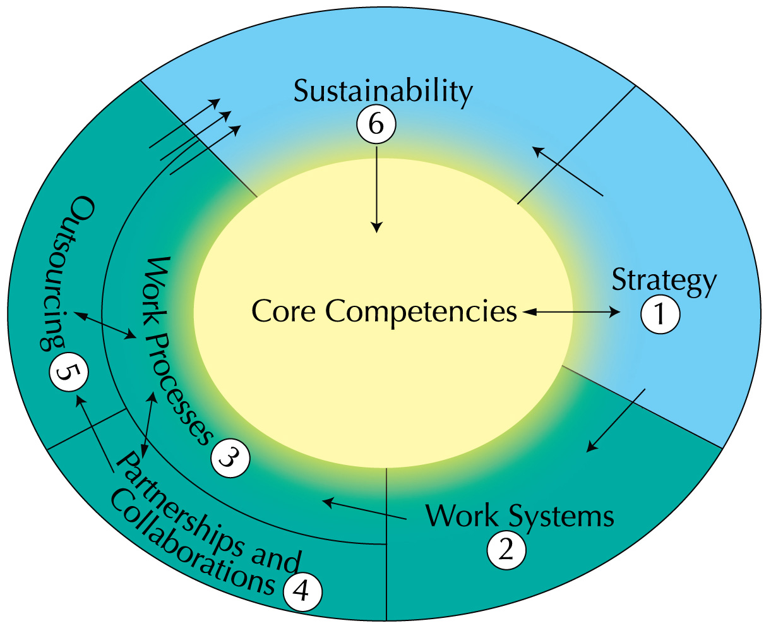
Role of
Core
Competencies
Notes:
The Criteria help your organization focus on its core competencies and how they relate to your mission. The term “core competencies” refers to your organization’s areas of greatest expertise. Your organization’s core competencies are those strategically important capabilities that are central to fulfilling your mission or provide an advantage in your marketplace or service environment.
Core competencies frequently are challenging for competitors or suppliers and partners to imitate, and they may provide a sustainable competitive advantage. They may involve technology expertise, unique service offerings, a marketplace niche, or a particular business acumen (e.g., business acquisitions).
This graphic demonstrates that core competencies are central to an organization’s strategy development process. To sustain its capabilities, an organization needs to relate to and capitalize on its core competencies in its work systems and work processes. Leveraging its core competencies and identifying what capabilities might be outsourced are part of an organization’s decision making when considering partnerships and collaborations. Understanding and capitalizing on its core competencies then helps an organization remain sustainable. It is able to adapt and change its core competencies based on opportunities and challenges. This knowledge feeds back into its strategic planning.

Slide 15
Baldrige Scoring System
Scoring Guidelines
Importance to the organization
Two dimensions: Process and results
Notes:
The Scoring Guidelines, which are an anchored rating scale, allow you (in a self-assessment) or outside assessors (such as Baldrige examiners) to consider what is important to your organization and to assess it on two evaluation dimensions: process and results.
Baldrige evaluations, scoring, and feedback consider your responses to the Baldrige Criteria in light of your organization’s environment, key working relationships, and strategic context.

Slide 16
Category Point Values
1 Leadership 120
2 Strategic Planning 85
3 Customer Focus 85
4 Measurement, Analysis, and
Knowledge Management 90
5 Workforce Focus 85
6 Operations Focus 85
7 Results 450
Total points 1,000
Notes:
All responses to the items within the boxed categories (1 through 6) should address your organization’s processes.
Responses to the results items (category 7) should address trends, performance levels, and comparisons, as well as the breadth and importance of the results. Because the bottom line for any organization is results, almost half of the application points are for results.
Results must be supported by linkages to the appropriate process items to show cause and effect.
Results may be the bottom line, but they are accomplished through a successful performance management system that is guided from the top.

Slide 17
Evaluating Process
Process: Methods used and improved to address categories 1–6
Evaluation factors
  Approach
  Deployment
  Learning
  Integration
Notes:
The scoring of responses to Criteria items, as well as award applicant feedback, is based on two evaluation dimensions: (1) process and (2) results. Criteria users need to furnish information on both. A closer look at the two dimensions follows.
Approach refers to the
methods used to accomplish the process
appropriateness of the methods to the item requirements and your operating environment
effectiveness of your use of the methods
degree to which the approach is repeatable and based on reliable data and information (i.e., systematic)
Deployment refers to the extent to which your approach is
applied in addressing item requirements relevant and important to your organization
applied consistently
used by all appropriate work units
Learning refers to
refining your approach through cycles of evaluation and improvement
encouraging breakthrough change to your approach through innovation
sharing refinements and innovation with other relevant work units and processes
Integration refers to the extent to which your
approach is aligned with your organizational needs identified in the Organizational Profile and other Criteria items
measures, information, and improvement systems are complementary across processes and work units
plans, processes, results, analyses, learning, and actions are harmonized across processes and work units to support organization-wide goals

Slide 18
Evaluating Results
Results: Outputs and outcomes in achieving the requirements in items 7.1–7.5
Evaluation factors
Levels
Trends
Comparisons
Integration
Notes:
The four factors used to evaluate results are
Levels: your current level of performance
Trends: the rate of your performance improvements or the sustainability of good performance (i.e., the slope of data point over time) and the breadth (i.e., the extent of deployment) of your performance results
Comparisons: your performance relative to appropriate comparisons, industry leaders, and/or benchmarks
Integration: the extent to which
your results measures (often through segmentation) address important customer, product, market, process, and action plan performance requirements identified in the Organizational Profile and process items
your results include valid indicators of future performance
your results are harmonized across processes and work units to support organization-wide goals

Slide 19
What Can the Criteria Do for
Your Organization?
Jump-start change initiatives
Energize improvement initiatives
Focus on common goals
Assess performance against the competition
Align resources with strategic objectives
Notes:
You can realize one or more of these benefits when your organization uses the Criteria as a management framework, conducts a self-assessment or has an external assessment, and implements action plans for improvement.

Slide 20
Baldrige and Other Performance Management Systems
ISO 9001:2008
Health care accreditation, such as the
Joint Commission
Education accreditation, such as the North Central Association of Colleges and Schools
Basic difference: Excellent performance versus minimum required performance
Notes:
Should your organization use the Baldrige Criteria or pursue other performance management systems? In fact, not only are the Criteria compatible with these systems, but recent iterations of many standards and accreditations have become more similar to the Baldrige Criteria. Some now include systems perspectives, self-assessment, process management, a focus on results, and expanding procedures to become more performance-based and systematic in evaluations. In some cases, a Baldrige application may be substituted for these other assessments.
— ISO’s (International Organization for Standardization’s) purpose is to facilitate international trade by providing a single set of conformity standards.
— The Joint Commission certifies health care providers’ processes.
— The North Central Association (NCA) of Colleges and Schools conducts evaluations of K-12 school districts and higher education institutions for accreditation purposes.
The basic difference between a Baldrige assessment and these other evaluation systems is that Baldrige focuses on achieving performance excellence rather than on achieving required performance levels. Baldrige feedback focuses on key challenges for the future and opportunities for improvement; accreditation feedback focuses on deficiencies.

Slide 21
Baldrige, ISO 9001:2008, and Six Sigma
ISO 9001:2008 and Six Sigma represent a fraction of the performance management system in the Baldrige Criteria.
May compete for the same resources
Serve different but compatible purposes
Notes:
Some organizations may believe that to become more competitive they must complete ISO registration and/or implement Six Sigma, as well as implementing the Baldrige Criteria, but they may find they are unable to do all three at the same time. The choice of which to do first is a business decision that only the organization can make.
ISO 9001:2008 registration and Six Sigma could be tools for or subsets to the Baldrige process, given the shared emphases in many areas.

Slide 22
How Is Baldrige Different?
Offers an overall systems framework
Focuses on results in all areas
Focuses on the future—a strategic view
Includes organizational and personal learning and knowledge sharing
Includes corporate governance, ethics, societal responsibility, and sustainability
Provides a public service in the national interest
Notes:
The Baldrige Criteria provide a systems perspective for achieving performance excellence for the entire organization, whereas ISO focuses on product/service conformity systems and Six Sigma concentrates on product quality and process engineering, for example.
Category 7 of the Baldrige Criteria requires identifying and tracking key results in all areas of importance to an organization: product and process outcomes, customer-focused outcomes, workforce-focused outcomes, leadership and governance outcomes, and financial and market outcomes.
One of the core values of the Baldrige Criteria is a focus on the future for sustainable performance and market leadership. This requires an understanding of the short- and longer-term factors that affect an organization.
The Baldrige Criteria also emphasize the importance of organizational and personal learning and knowledge sharing, which includes continuous improvement as well as adaptation to change, best-practice sharing, benchmarking, and investments in the workforce’s personal learning and growth. Thus learning is directed not only toward better products but also toward being more responsive, adaptive, and efficient.
The Baldrige Criteria include an increased focus on governance, sustainability, societal responsibility, ethics, and strategy―issues not addressed by ISO or Six Sigma.
Baldrige has a unique mission and legislative mandate. The Baldrige Program is the first and only organization that focuses on performance excellence as well as America’s competitiveness.

Slide 23
Baldrige and Joint Commission Similarities
Focus on continuous improvement
Are based on a set of core values
Offer a means for self-assessment
Notes:
The Joint Commission standards and the Baldrige Criteria for Performance Excellence do not compete or conflict with one another.
Both
—focus on continuous improvement
—are based on a set of core values
—offer a means for self-assessment

Slide 24
Baldrige and Joint Commission Differences
Joint Commission
Focuses on patient care
Establishes minimum standards for accreditation
Considers individual factors
Baldrige
Overall organizational focus, including focus on patients
Role-model performance
Focuses on individual factors and strategic challenges and advantages
Notes:
How are they different?
—The Joint Commission’s focus is on the care of patients. Baldrige’s focus is more comprehensive, including a focus on organizational systems, management, the workforce, and other stakeholders, but it doesn’t include the specific patient safety requirements spelled out by the Joint Commission.
—The Joint Commission’s qualifications for institutions are intended to be inclusive, allowing all acceptable institutions to qualify. Baldrige encourages organizations to achieve excellence and recognizes leading-edge practices and world-class, role-model levels of performance.
—The Joint Commission’s review process looks for the same things in every institution, serving as an audit. The Joint Commission considers some individual factors. However, in a Baldrige assessment, examiners review award applicants’ processes and results relative to each applicant’s key environmental and organizational factors and strategic challenges and advantages.

Slide 25
Start Your Baldrige Journey
Purchase the Criteria, or
download free Criteria content.
Contact your state or local
Baldrige-based program.
Attend a national or regional conference.
Contact a Baldrige Award recipient.
Notes:
You can take a number of steps to start using the Criteria to improve your organization’s performance.
Visit the Baldrige Web site for Criteria booklets and free Criteria content.
Contact your state or local Baldrige-based program. These programs’ lower-tier award applications are a good way to begin learning about the Baldrige Criteria. Information on these programs is linked from the Baldrige Web site.
Attend a conference. Annually, Baldrige sponsors The Quest for Excellence® conference in Washington, D.C., every spring, as well as regional conferences, to showcase the award recipients. Conferences give you an opportunity to learn about recipients’ best practices and to network with other organizations.
Most Baldrige Award recipients offer events focused on sharing role-model practices with other U.S. organizations. See the Baldrige Web site for contact information.

Slide 26
Start Your Baldrige Journey
Become a Baldrige examiner, or
attend examiner training.
Consider the Baldrige Executive Fellows Program for a senior leader.
Do a Baldrige self-assessment.
Apply for a Baldrige-based award, or
consider a Baldrige Collaborative Assessment.
Notes:
Consider self-assessing your organization against the Baldrige Criteria. See the Baldrige Web site for tools and information.
Consider applying for a Baldrige-based award. If you are not ready to apply at the national level, consider submitting an application to your state or local program. Or consider a Baldrige Collaborative assessment, in which team of Baldrige examiners works with your staff to assess your organization.
Become an examiner. Examiners at both the state/local and the national levels receive valuable training and experience in understanding and applying the Criteria, and they strengthen their ability to use the Criteria within their own organizations.
Ask your CEO or another senior leader to consider the Baldrige Executive Fellows Program. This executive development program centers on forming relationships with and learning from Baldrige Award recipients and their senior executives.

Slide 27

For More Information
Criteria booklets and free Criteria content
Self-assessment tools
Training, conferences, and executive education
Organizational assessments
Award recipient profiles
Case studies
Connections to the Baldrige community
www.nist.gov/baldrige
baldrige@nist.gov
(301) 975-2036
Baldrige Performance Excellence Program | www.nist.gov/baldrige

