Slide 1
NOAA’s National Climatic
Data Center
Climate Archives in NOAA: Challenges and Opportunities
Thomas R. Karl, L.H.D.
Director, NOAA’s National Climatic Data Center
Chair, U.S. Subcommittee on Global Change Research
March 4, 2014

Slide 2
Challenges and Opportunities
Reprocessing Radar Data: a classic big data challenge
Computing the Global Temperature: quality analysis and robust science on big data
Climate Normals: building useful products with big data
Climate Data Records: ensuring long-term consistency and continuity
Merging data: satellite, in-situ, radar
Cloud computing; international challenges
Naming conventions
Discovery, metadata, and access

Slide 3
NCDC’s Mission
To Steward the Nation’s Climate Information
NCDC is responsible for preserving, monitoring, assessing, and providing public access to the Nation’s treasure of climate and historical weather data and information.
ACQUIRE
ARCHIVE
ACCESS
ASSESS
Notes:
NCDC Headquarters in Asheville, NC
Co-located with Air Force Weather Agency’s 14th Weather Squadron
NCDC’s Federal presence extends to:
Asheville, NC
Boulder, CO
Honolulu, HI
Silver Spring, MD and
WI, NY, TX, UT, MO, and AK
Our vision: to be the most comprehensive, accessible, and trusted source of state-of-the-art climate and historical weather data and information
Acquire and ingest data
Archive and scientific stewardship of the Nation’s meteorological data – national and international
Provide access to data, metadata (information about the data), and products
Monitor and describe the national and global climate

Slide 4
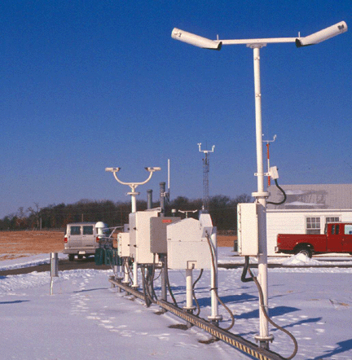
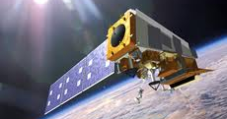
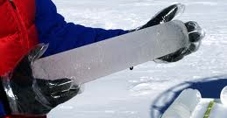
Data Received from Many Sources
Notes:
Such as:
Forecast Warning Analysis
Voluntary U.S. Observers
Global Weather Reports
Weather Charts & Models
Ship, Buoy Reports
Rocketsonde
Weather Balloons
Storm Data
Doppler Radar
Polar and Geostationary Satellites
Aircraft Observations
Wind Profiler
Airport Weather Reports (ASOS)
U.S. Climate Reference Network
Reanalysis & Climate Models
U.S. Regional Climate Reference Network (USRCRN)

Slide 5
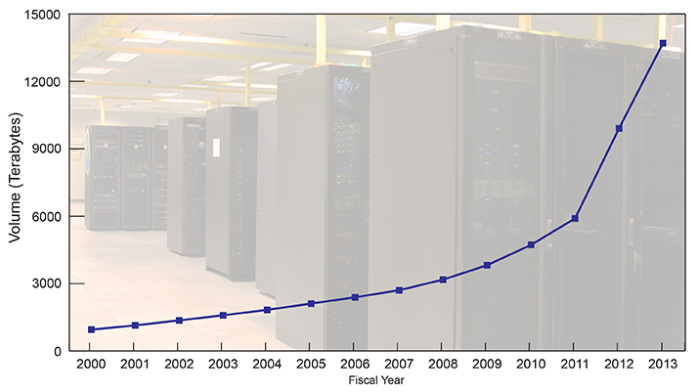
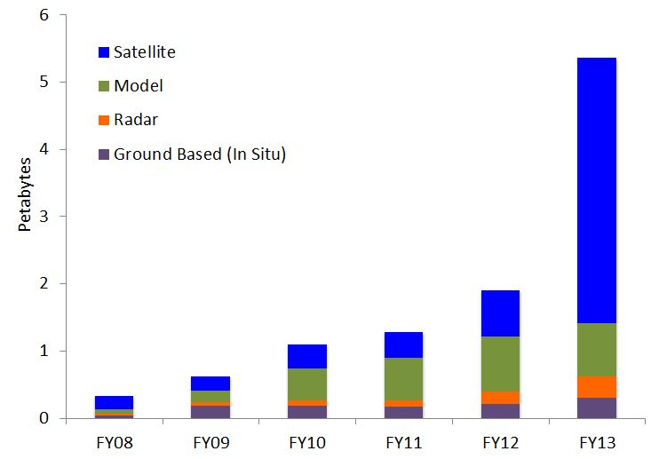
Archive and Access
Amazon
Kindle Fire
Total Archive Volume: 13.4 Petabytes
NCDC provides safe storage of 13.4 PB
= 13.4 Billion Kindle Fire e-Books
= 2.2 Million Kindle Fire e-Readers
Total Data Delivered
Users download ~5 PB per year
= 5 Billion Kindle Fire e-Books/year
= 2,300 Kindle Fire e-Readers/day
Note: all data types are vital for climate science, e.g. Paleoclimate data
*
*Huge increase in outgoing NCDC satellite data from Boulder
Notes:
Update:
--Bar chart columns need to be reordered to (top to bottom): Satellite, Model, Radar, In Situ
--Legend order similarly changed, to in situ on last label
Kindle Fire: 8GB internal (approximately 6GB available for user content). That's enough for 80 apps, plus 10 movies or 800 songs or 6,000 books.
User Downloads = 5PB download / 6GB storage per device = 833,333 devices * 6,000 books = 5 billion books per year
833,333 devices per year / 365 days per year = ~2,300 devices per day
Volume (in books): Each book = 1 MB; Each device = 6 GB

Slide 6
Future Projections
Cumulative
Satellite
Model
Ocean
Geophysical
Radar
By 2019, NOAA will hold over 40 Petabytes of environmental data.

Slide 7
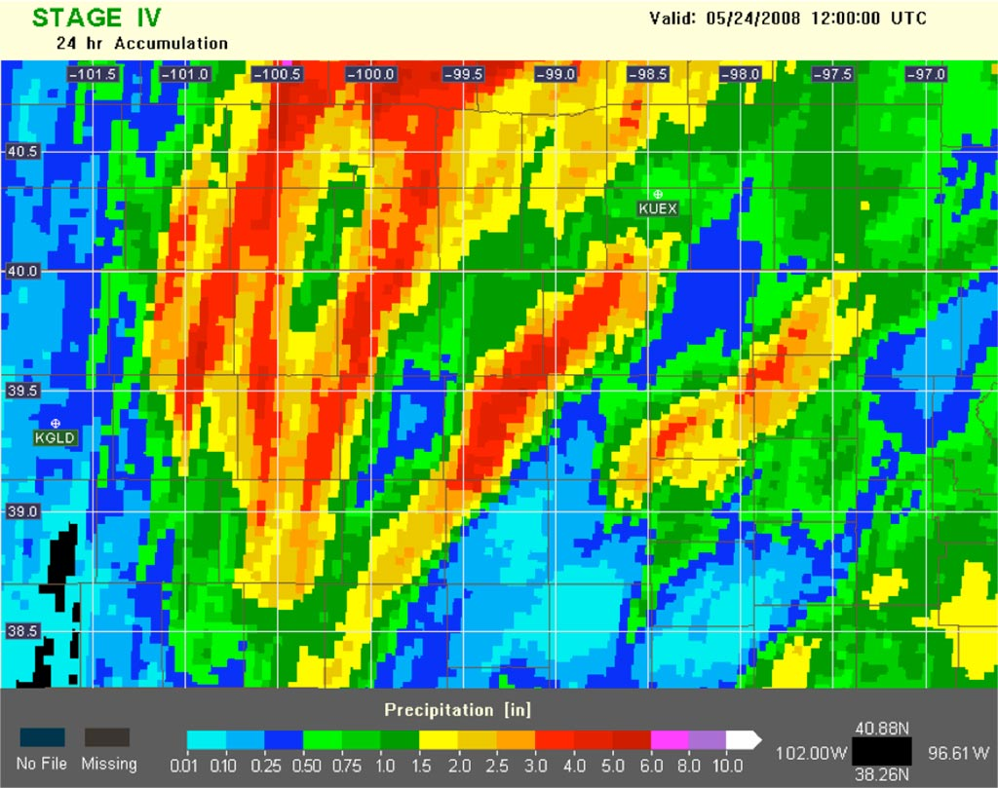
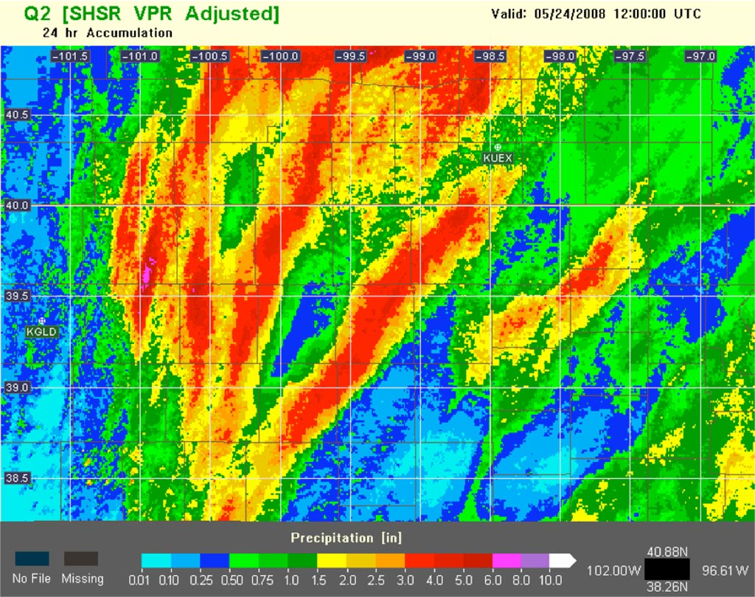
Reprocessing Radar Data
Thunderstorm from 5/24/2008 over Northwest Kansas
Original
Reprocessed
Higher spatial resolution, reduction of artifacts and problems introduced in operational processing
Much higher volume of data. Limited by I/O versus computational speed.

Slide 8
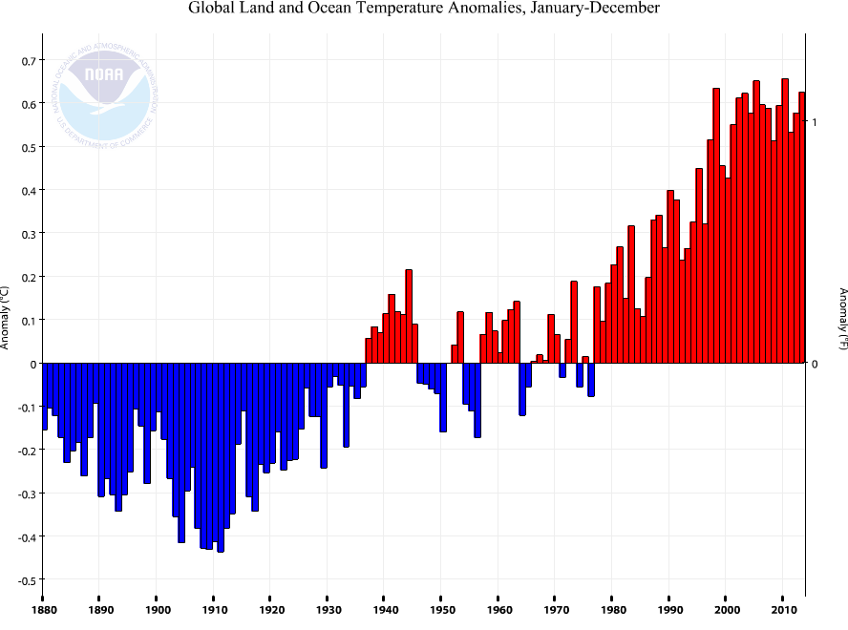
Computing the Global Temperature
The challenge of robust science on big data, e.g.,
Quality control
Integrating multiple data sources
Homogeneity adjustments
Spatial interpolation
Operational monitoring requirements
Configuration management and version control

Slide 9
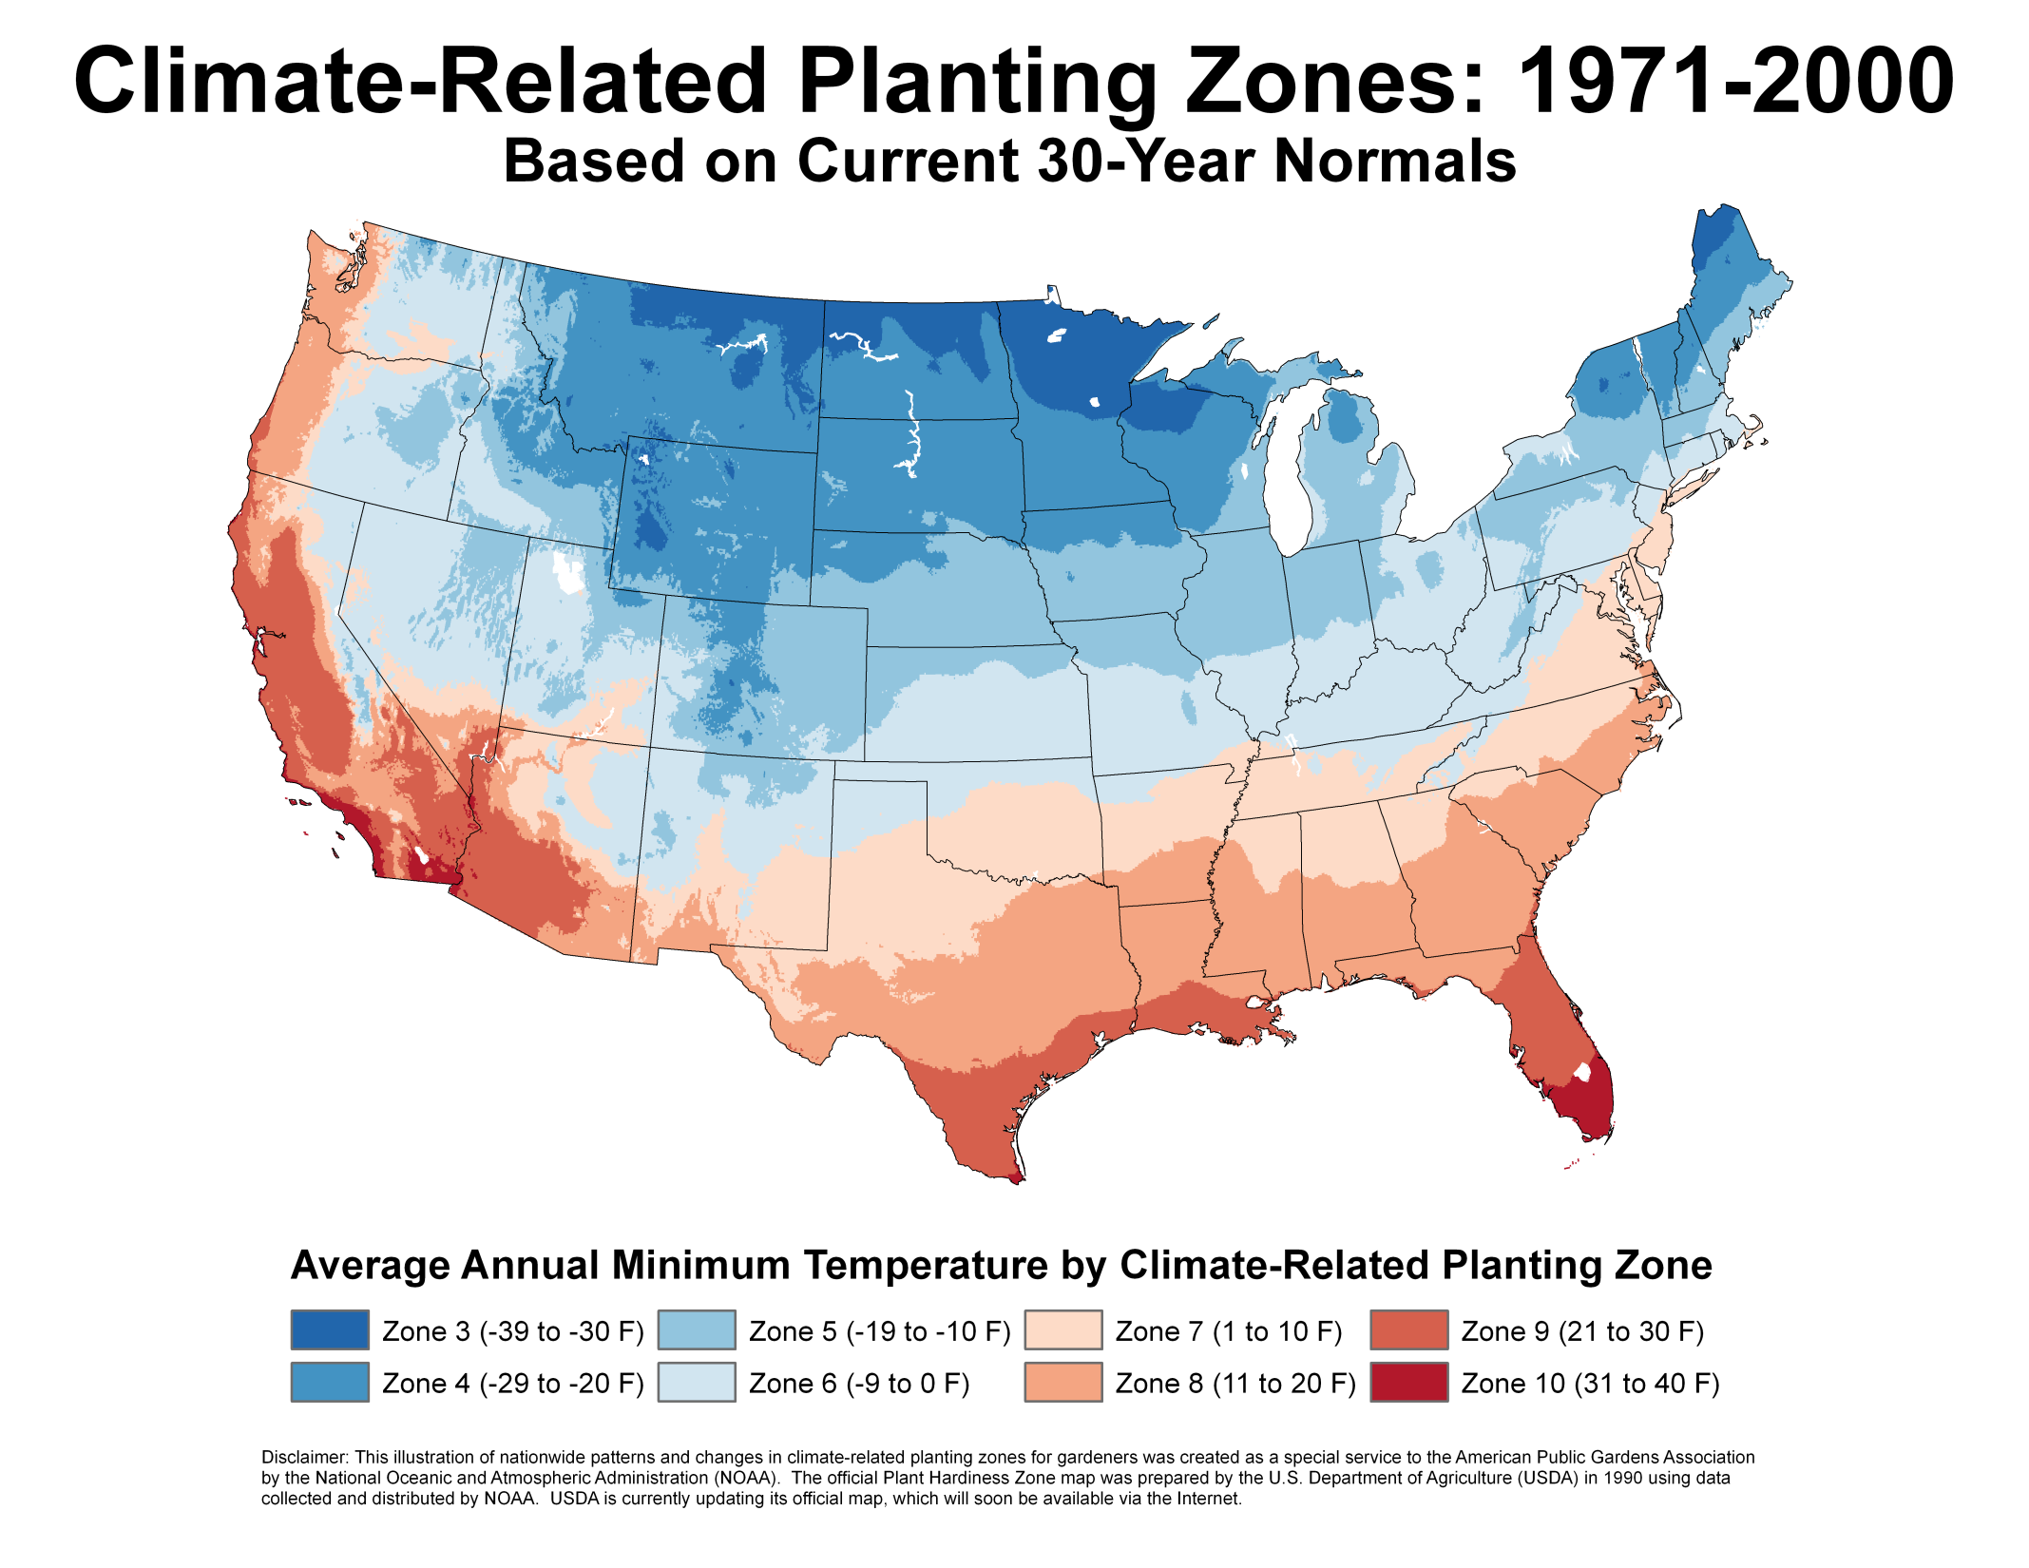
9

Slide 10
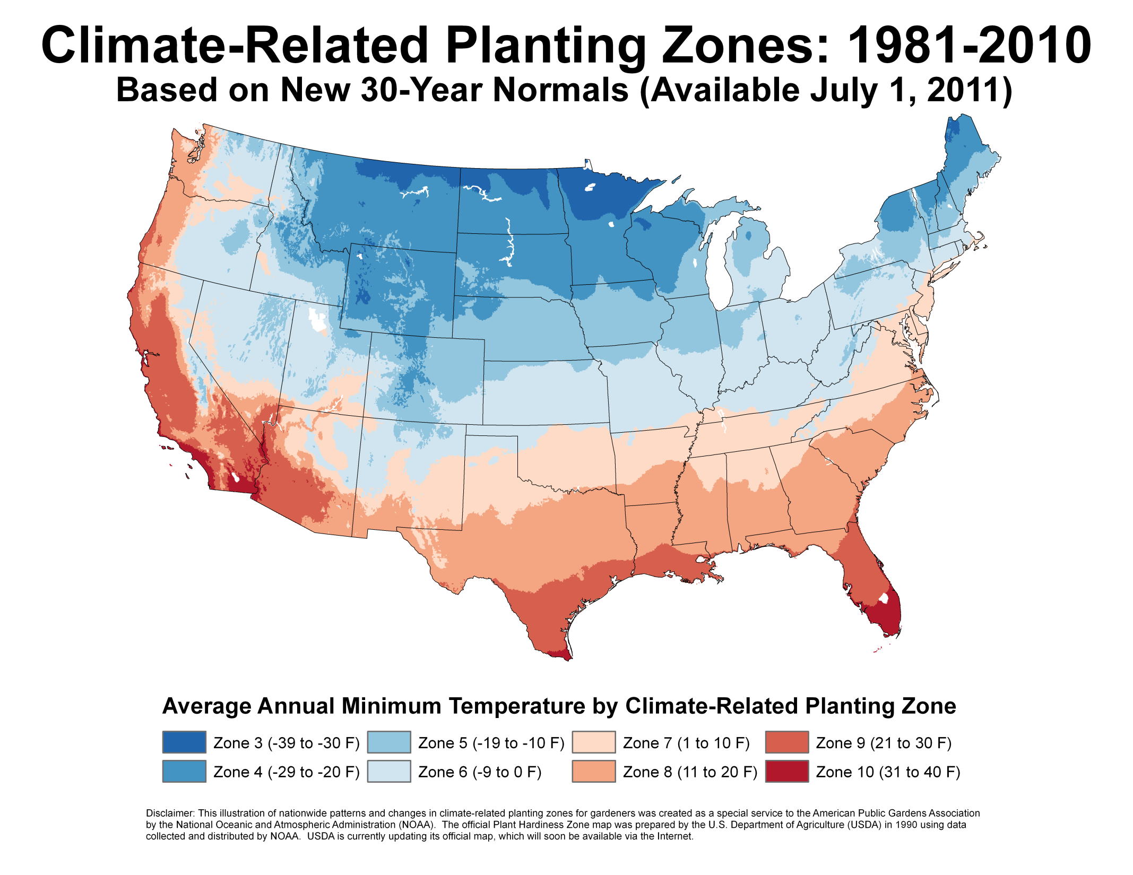

Slide 11
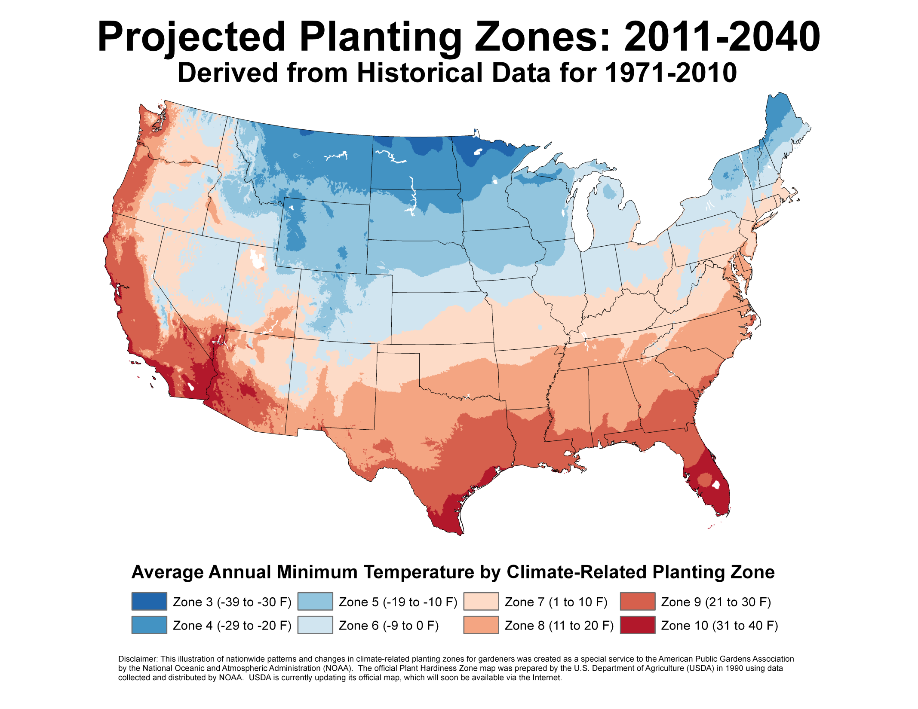
11

Slide 12
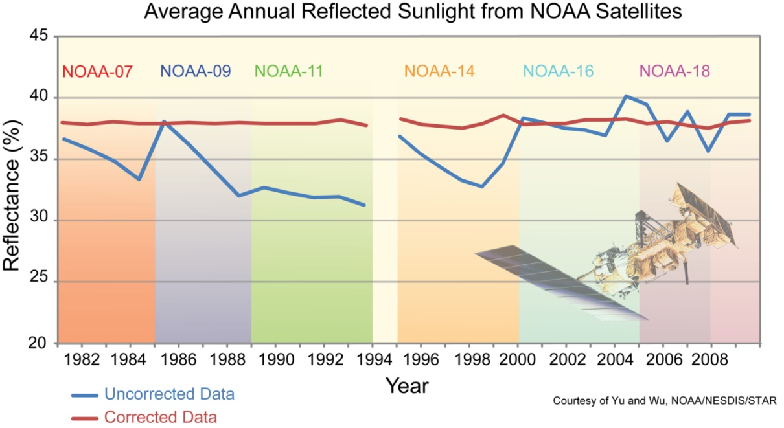
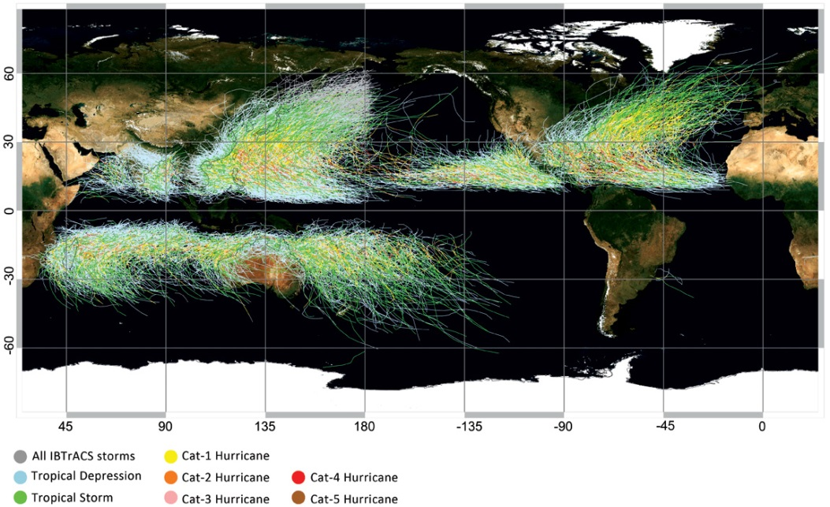
Climate Data Records
Reliable records of Earth’s weather and climate
Merge data from surface, atmosphere, and space-based systems across decades
Reveal Earth’s short- and longer-term environmental changes and variations
Uncorrected versus corrected reflected sunlight satellite measurements

Slide 13
Cloud Computing
Cloud not appropriate for all activities
Need cost effective solution
Cost is dependent on utilization and capacity
Need adequate performance
Need a mix of private and public cloud services
Migration requires significant changes in systems and organization
Significant security questions remain

Slide 14
International Challenges
Some countries are charging for data or restricting the flow
But more data yields better model output & outlook products that benefit all countries
Analog climate data worldwide
Needs rescue and digitization before they’re lost
Global climate observing systems
If systems are allowed to continue to degrade, the data coverage and quality will degrade also

Slide 15
Metadata Challenges
Opportunity: adopt common metadata standards
Enable discovery and access in a platform-independent fashion
Support the Administration’s Open Data Initiatives (e.g., data.gov and climate.gov)
Modern, self-describing format standards (e.g. netCDF) bundle metadata with the data
Examples of key pieces of information in the metadata:
Observation details (what, how) and Geospatial information (where, when)
Dataset provenance, including quality control information
Data discovery end points, such as websites, FTP sites, GIS services, etc
Challenge: implementation is a very large effort
NCDC alone has over 700 different data collections
Each collection may have hundreds to millions of granules, all of which have to be properly described with appropriate metadata.

Slide 16
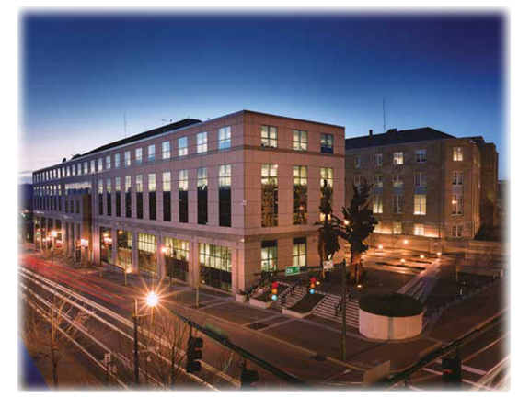
NOAA’s National Climatic
Data Center
www.ncdc.noaa.gov
www.climate.gov
www.twitter.com/NOAANCDC
www.facebook.com/NOAANationalClimaticDataCenter

