Slide 1
NIST-FDA Flow Cytometry Workshop: Building Measurement Assurance in Flow Cytometry
NIST Organizers:
Lili Wang
John Elliott
Sheng Lin-Gibson
FDA Organizers:
Steven Bauer
Heba Degheidy
Judy Arcidiacono

Slide 2
Meeting Logistics
Safety
Lunch and coffee: NIST cafeteria
Group dinner: Dog Fish
Meeting presentation/discussion format
Permission to post of meeting materials
Post meeting comments/ideas (to be announced)

Slide 3
In case of emergency
  Turn left toward Red Auditorium Exits
  Proceed to Visitor Assembly Area in the 101 parking lot

Slide 4
NIST-FDA Flow Cytometry Workshop: Building Measurement Assurance in Flow Cytometry
Sheng Lin-Gibson, Ph.D.
Acting Chief, Biosystems and Biomaterials Division
Director, Regenerative Medicine and Advanced Therapy Programs
NIST Materials Measurement Laboratory
Phone: 301-975-6765
slgibson@nist.gov

Slide 5
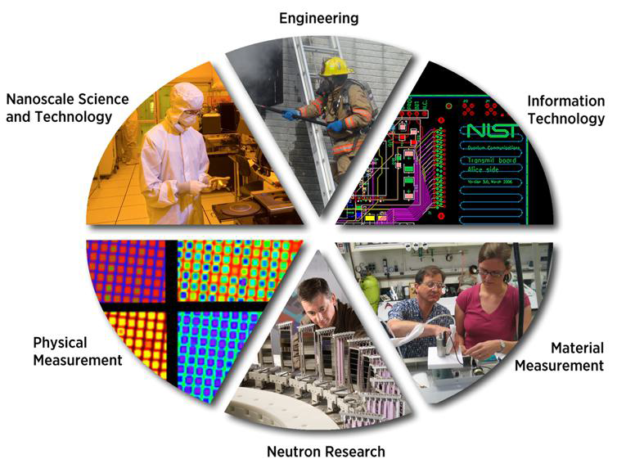
NIST – Who we are today
The National Metrology Institute
global harmonization of measurement and traceability to the SI
“Industry’s National Laboratory”
Non-regulatory agency partnering/serving industry to help maintain US leadership in science and technology products
Department of Commerce
developing standards to support international trade and commerce
Notes:
NIST is a relative new comer in biosciences
We have been … more than 100 years
More recently, we have been referred to…
For these reasons, we are a part of ..

Slide 6


Bio at NIST
  Develop measurement science, standards, data & technology to support development, manufacturing, & regulatory approval of biologics (proteins, cell-based therapeutics products, gene therapy products) and devices
  Works closely with stakeholders (biopharma industry, FDA, equipment vendors) to identify key measurement problems and solutions
  Draws from a broad array of unique, cutting-edge expertise, resources, and facilities available at NIST
  Is a scientifically trusted, impartial 3rd party that works to promote cross-industry collaboration & open data sharing
Notes:
The NIST biomanufacturing program develops measurement science, standards, reference data and tools to support the development, manufacturing, and regulatory approval of biologic medicines with the initial focus primarily on protein therapeutics.
A guiding principle of program is engagement and outreach to customers which are primarily the biopharmaceutical industry, bioprocess instrument vendors, and the FDA.
This program was developed through extensive outreach and interaction with stakeholders including the biopharmaceutical industry, FDA, and other organizations (USP, NIBSC) in the biopharma community.
NIST has held since 2012 an annual Biopharmaceutical Measurement Roundtable which is attended by ~10 members from the biopharma industry. NIST activities are presented at this meeting and NIST receives feedback from roundtable members on the relevance of these activities to industry, and also learns of current and emerging measurement needs in the biopharma industry.

Slide 7
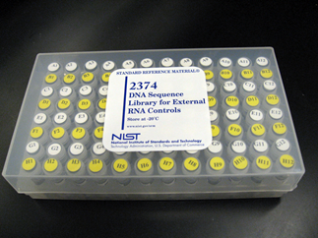

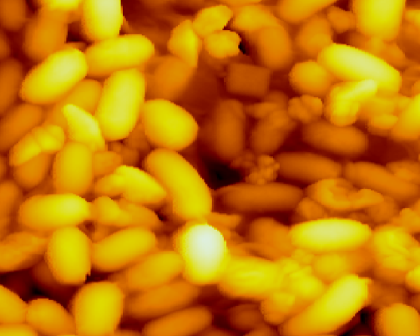
NIST Practices
Measurements and Technology
  Develop advanced measurement capabilities
  Improve measurement quality and assurance
  Reference Materials (Reference Standards)
  Develop and certify NIST SRMs and RMs
  Generate reference data (e.g., chemical spectra)
Standards (Documentary Standards)
  Lead and contribute to documentary standards development through SDOs (e.g., ISO, IEC, ASTM, etc.)
  Conformity assessment
  Standards education
  Convening
NIST synthetic RNA controls used in sequencing of Ebola virus genomes
U.S. national prototype kilogram
NIST Monoclonal Antibody Reference Material 8671
Yeast Cells as a Reference Material
Notes:
The results of this study were published in the August issue of Science. In this work, the Ebola virus genomes from about 100 patients were sequenced to observe the accumulation of interhost and intrahost variation, allowing the scientists to characterize patterns of viral transmission. Synthetic RNA controls, prepared by and donated from NIST, were spiked-in to each individual sample so that the sequencing process could be tracked and any cross-contamination could be identified. The scientists hoped that this study will help with ongoing epidemiological and genomic surveillance, the development of therapeutics, and strategic planning for health organizations. (Citation: Stephen K. Gire et al., Genomic surveillance elucidated Ebola virus origin and transmission during the 2014 outbreak,Science, 345, 1369(2014)
DOI: 10.1126/science.1259657)
Measurements and Standards to Support Nutrition Labeling
The Chemical Sciences Division is working to provide food-matrix reference materials to facilitate compliance with nutritional labeling laws, provide traceability for food exports, improve the accuracy of label information for packaged foods, and contribute to studies of human nutritional status. Approximately 30 food-matrix SRMs and RMs are available to support these measurement needs; examples include infant formula, baby food, meat homogenate, fish tissue, baking chocolate, peanut butter, spinach, and food oils.
Standard Reference Material (SRM) 2387, a peanut butter sample that has been characterized with state-of-the-art measurement methods to provide values for the amount of fat, protein, vitamins, minerals and other analytes it contains. It is one of a series of food-matrix SRMs that can be used by food manufacturers to validate production and quality control procedures as well as ensure accurate labeling of product content.

Slide 8
Broader NIST Efforts
NIST Laboratory Programs
Standards Leadership
Coordination & Communication
Industry engagement
USG coordination
Convene workshops
ISO/TC 276 leadership
ASTM F04 leadership
Expert contributions to SDOs
Innovative measurement solutions
Industry collaborations
Notes:
One of our strategic priority is bioscience, including one growing program in cell therapy…
It has 3 components that works in concert to advance measurements and standards
The largest piece is our laboratory program that underpin our standard development effort
Another important piece is bridging the communication gap with industry stakeholders as well as our other agency partners.

Slide 9
NIST Programs in Quantitative Flow Cytometry Measurements
Quantitative flow cytometry measurement solutions will help researchers to produce reliable data, develop better drugs, and delivery of better treatment.
Objective: develop reference materials, methodology, and procedures to enable quantitative measurements of biological substances (cells, proteins, and NAs).
  Flow Cytometry Quantitation Consortium
  Quantification of Cells with Specific Phenotypic Characteristics
  Characterization of Commercially Available Human Peripheral Blood Mononuclear Cell (PBMC) Preparations for Quantitative Flow Cytometry
  Fluorescently Labeled Monoclonal Antibody Metrology for Quantitative Flow Cytometry
  Quantitative Measurements of Cell Functional Markers and Disease Biomarkers
  Genomic Material Measurements Using Flow Cytometry

Slide 10




Bridging the Communication Gap
NIST Meetings, Workshops, and Commentaries
Oct 25, 2017 | NIST-FDA Flow Cytometry Workshop | Whitepaper expected
April 2017 | NIST-FDA Cell Counting Workshop | Whitepaper expected
July 2016 | Cytotherapy Commentary: “Defining quality attributes to enable measurement assurance for cell therapy products” | Sheng Lin-Gibson and Sumona Sarkar et al., Cytotherapy, Volume 18 (10), October 2016, Pages 1241-1244
May 2016 | Genome Editing Standards Workshop | http://www.nist.gov/mml/bbd/genes.cfm
Feb 2016 | NIST CAR-T Biomanufacturing Symposium | Lin-Gibson et al. DOI: 10.1089/humc.2016.29014.com https://www.ibbr.umd.edu/NISTCART
May 2015 | NIST Workshop: Strategies to Achieve Measurement Assurance for Cell Therapy Products | Simon et al. Stem Cells Translational Medicine 5, 705-708. http://www.nist.gov/mml/bbd/biomaterials/measurement-assurance-for-cell-therapy-products.cfm
NIST Participation/Contribution
Forum on Regenerative Medicine
MATES -
Multi-Agency Tissue Engineering Science
Notes:
In our many discussions with stakeholders, we realized that we have a unique role in facilitate the communications, not to share the greatly and newest achievements, but dig deep in common challenges that are holding us back.
We are increasingly holding meetings and workshops
We held 3 workshops within the past year or so
We have plans to host additional meetings in the coming year

Slide 11
FDA-NIST Collaborations on Standards
Leveraging unique expertise
Standards Development
Workshops and Public Meetings
Research Collaborations
NIST engages in discussions and collaborates with industry and others on pre-competitive technologies
NIST expertise in measurement sciences address specific analytical challenges
FDA scientific and regulatory expertise ensure that standards
- do not conflict with FDA regulation and policy
- address significant regulatory challenges that recur across the field
Arcidiacono, Lin-Gibson, et al. Cytotherapy. Submitted

Slide 12
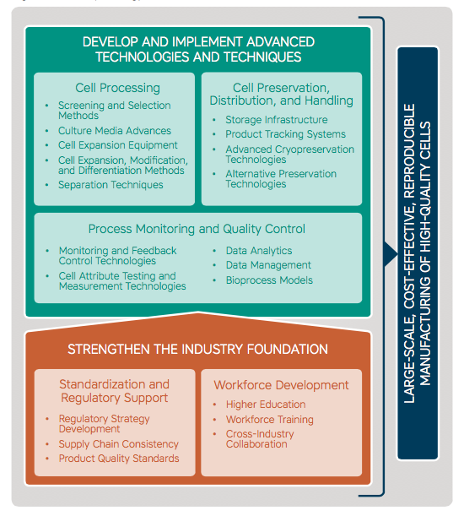
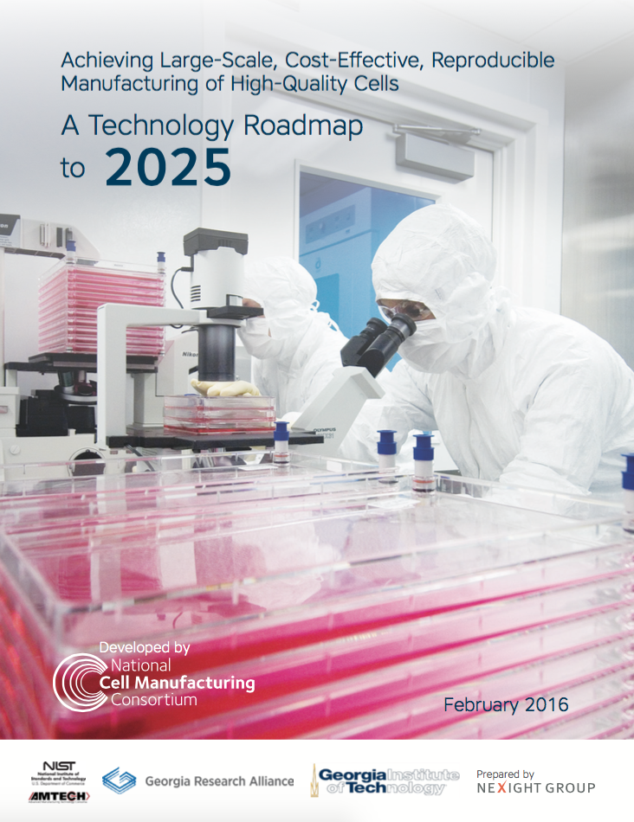
NIST/AMTech funded industry-driven technology consortia that establishes technology roadmaps to address long-term U.S. industrial research needs.
http://cellmanufacturingusa.org
Notes:
“Advanced Manufacturing” AMTech is an industry driven technology consortia that establishes technology roadmaps to address long-term U.S. industrial needs.
In order to achieve large-scale cost effective, reproducible manufacturing of high quality cells, the industry foundation needs to be strong enough to support the development of advanced technologies. Standardization is an important support for this foundation.

Slide 13
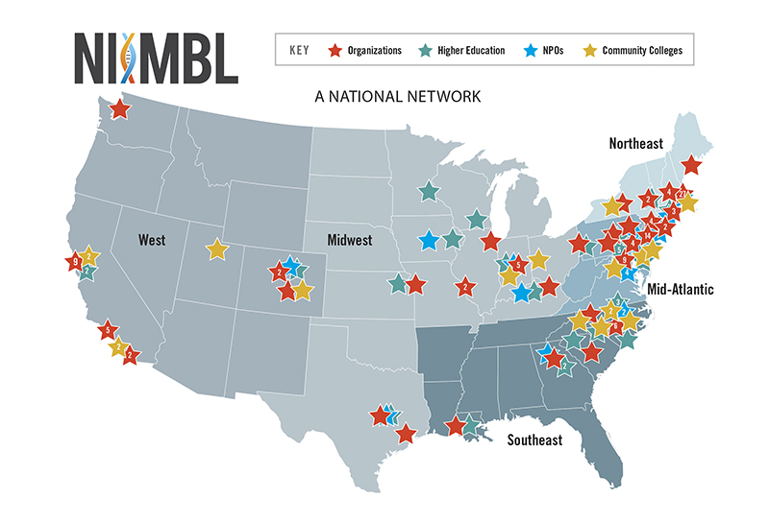


Dec 16, 2016: U.S. Secretary of Commerce Penny Pritzker Announces Biopharmaceutical Manufacturing Institute Joining Manufacturing USA Network

Slide 14
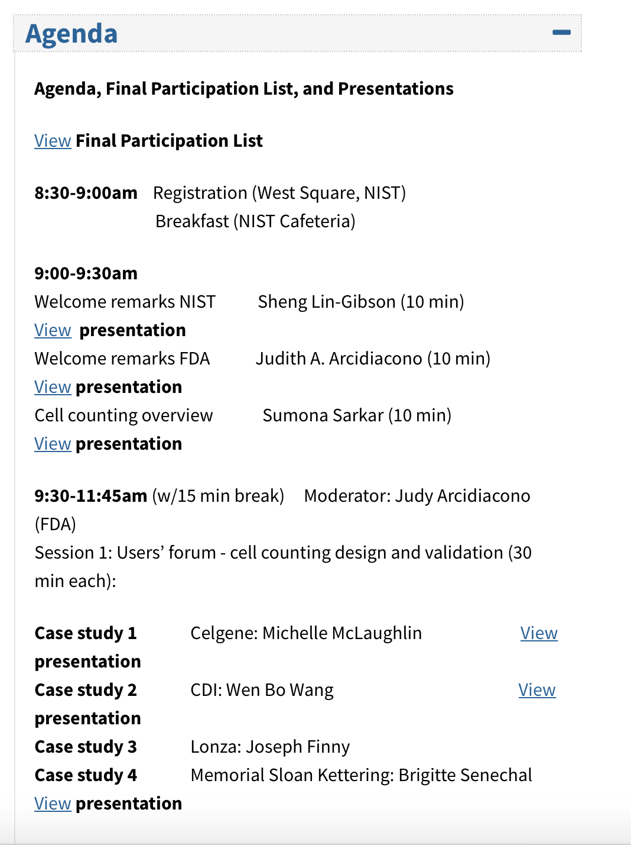
NIST-FDA Cell Counting Workshop: Sharing practices in cell counting measurements
Most presentation slides are available online
Workshop findings informed the development of ISO standards (ISO TC/276)
Whitepaper under development

Slide 15
Workshop Goals
Raise awareness of the importance and challenges associated with flow cytometry measurements
Develop and document best practices for flow cytometry
Discuss options to address measurement challenges through collaborative studies (NIIMBL, BioFabUSA, others)
Workshop outcomes to support the development of international standards

Slide 16
Additional information
ISO/TC 276: Biotechnology https://www.iso.org/committee/4514241.html
US TAG to ISO/TC 276 https://www.nist.gov/programs-projects/us-tag-isotc276-biotechnology
NIST Flow Cytometry Program https://www.nist.gov/programs-projects/quantitative-flow-cytometry-measurements
NIIMBL http://niimbl.org
BioFabUSA https://www.armiusa.org
NIST-FDA Cell Counting Workshop https://www.nist.gov/news-events/events/2017/04/nist-fda-cell-counting-workshop-sharing-practices-cell-counting
NIST-FDA Flow Cytometry Workshop https://www.nist.gov/news-events/events/2017/10/nist-fda-flow-cytometry-workshop-building-measurement-assurance-flow

