Slide 1
OECD Sustainable Manufacturing Metrics Toolkit and Sustainable Manufacturing 101 Module
Morgan Barr
Department of Commerce
January 25, 2012

Slide 2

What is the OECD?
The OECD is an intergovernmental organization with 30 member countries
“a setting where governments compare policy experiences, seek answers to common problems, identify good practice and coordinate domestic and international policies.”
Made up of several “Directorates” and numerous committees organized by issue with government and business representation
The OECD is one of the largest sources of international economic and social statistics and data

Slide 3
OECD Sustainable Manufacturing Toolkit
U.S. proposed study in 2006 in the Committee for Industry, Innovation and Entrepreneurship (CIIE)
Responding to industry demand with the goal of creating a useful toolkit for companies to help them start measuring their environmental performance
Work began in early 2008

Slide 4
Goals
Simplified metrics
Limited in number and scope. It is very difficult to start measuring your impact, and improvement is impossible without measurement. Needed to be SME-friendly
Internationally accepted
OECD worked with companies and experts from many member states.
Commonly used
Based on existing sets of metrics and the indicators that are most commonly used by companies
Picture of environmental sustainability
Comparable
Voluntary reporting initiatives (GRI, EMAS and ISO 14031) are flexible frameworks with a choice of indicators and methodologies, and the indicators are usually not normalized
Can be used by non-experts
More detailed and sophisticated indicators and methodologies (LCA, MFA, environmental accounting) require extra time and specialized expertise.
Internal decision making
Indicators, as a group, give a holistic picture of the facility or product’s environmental impacts over the life cycle
Many metrics sets are used for external reporting, not improvement, and most don’t focus on the materials, processes and products

Slide 5

Phase 1 Results
The report, Eco-Innovation in Industry: Enabling Green Growth, was published in January 2010
It included chapters on:
  Concept of sustainable manufacturing
  Eco-innovation examples
  Background on indicators for sustainable manufacturing
  Measuring eco-innovation
  Strategies for promoting eco-innovation

Slide 6
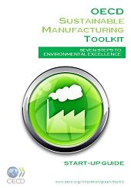
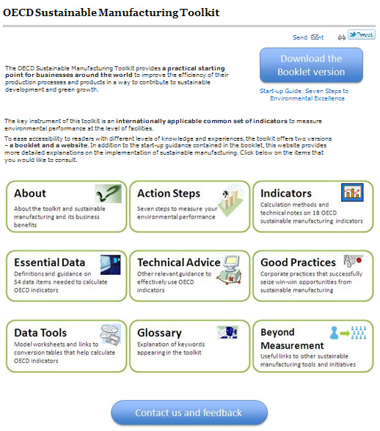
Phase 2 Results
Start-up Guide
  Step by step guide on how to measure
  Why measurement is important
  Benefits of sustainability
  Deals with issues of data availability, priorities, alternative sources of data
  Making decisions
  Going beyond the toolkit
Online portal
  In-depth information on how to calculate the indicators (forthcoming)
  Other advice and tools

Slide 7
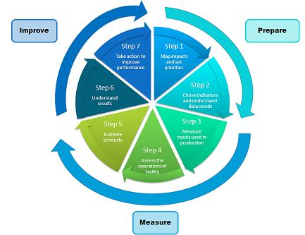
Measurement Process
The quick-start guide describes a seven step process
Map impacts and set priorities
Choose indicators and understand data needs
Measure inputs used in production
Assess the operations of your facility
Evaluate your products
Understand your Results
Take action to improve your performance

Slide 8
Indicators Overview
18 indicators
54 data points
Facility level (can be aggregated)
Inputs, processes, products
Many are normalized
Can be tracked over time

Slide 9
Relationship With Other Metrics Sets
Product | process | facility | corporation | sector | country | global
Measurement unit
LCA
High
GRI
MFA
Technical Detail
OECD
Toolkit
Medium
IPCC
PRTRs
EMAS
EF
Low

Slide 10
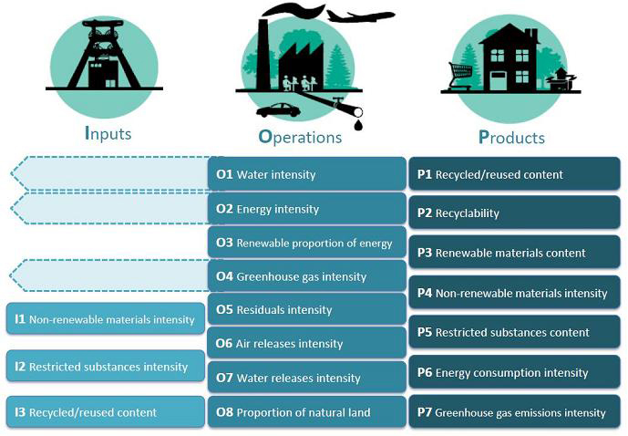
Indicators Overview

Slide 11

Inputs
I1. Non-renewable Materials Intensity
I2. Restricted Substances Intensity
I3. Recycled/Reused Content of Material Inputs

Slide 12

Operations
O1. Water Intensity
O2. Energy Intensity
O3. Renewable Proportion of Energy Consumed

Slide 13
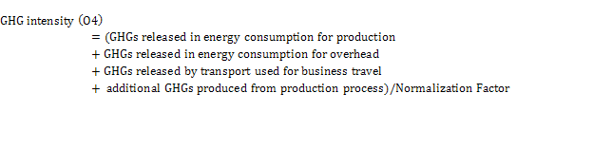

Operations
O4. Greenhouse Gas Intensity
O5. Residuals Intensity
  Mass Balance Approach

Slide 14
Operations
O5. Residuals Intensity
  Total Waste Approach
  R_{a} = weight of releases to air
  R_{sw} = weight of releases to surface water
  R_{l} = weight of releases to land
  R_{lf} = weight of releases to landfills
  T_{d} = weight of transfers to disposal
  T_{t} = weight of transfers for treatment
  T_{r} = weight of transfers to recycling
  T_{er} = weight of transfers for energy recovery
  T_{s} = weight of transfers to sewage
  GHG_{p} = weight of additional GHGs produced from production process
  GHG_{o} = Weight of additional GHGs produced from overhead
  C_{e} = Carbon content of direct energy use

Slide 15


Operations
O6. Intensity of Residual Releases to Air
O7. Intensity of Residual Releases to Water
O8. Percent of Land Occupied that is “Natural Cover”

Slide 16

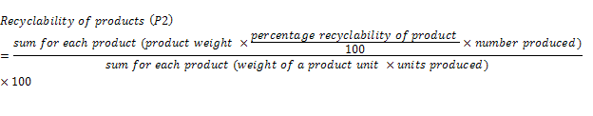
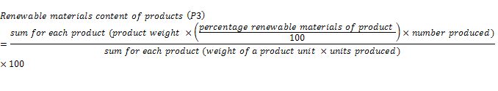
Products
P1. Recycled/Reused Content of Products
P2. Recyclability of Products
P3. Renewable Materials Content of Products

Slide 17
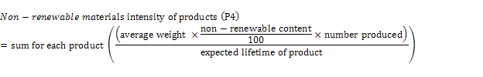
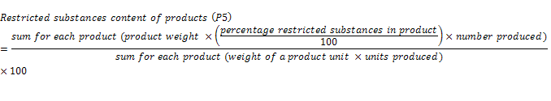


Products
P4. Non-Renewable Materials Intensity Over Product Lifetime
P5. Restricted Substances Content of Products
P6. Energy Consumption Intensity
P7. Greenhouse Gas Emissions Intensity

Slide 18
Sustainable Manufacturing 101 Module
Goals:
  Provide non-experts with an introduction to sustainability topics and guidance on how to begin implementing more sustainable practices
  Gather information from disparate sources into one place
  Can be used by people with a variety of training needs (specific sustainability topics to financing and decision making)
  Connect users to more in depth sources of information

Slide 19





How to use this training
If you haven’t yet, first start the slide show. Click the at the bottom of the screen
Click on the arrows and other indicated buttons to move through the lesson.
Click the house button to take you back to the beginning of the lesson
Look for these icons to learn about:
New or related terms
Examples from real companies
Terms to look for in the Sustainable Business Clearinghouse in order to find information and resources to help you.
Advanced concepts
Checklists with guidance to follow
Tools and resources to pursue for help

Slide 20

Lessons
Introduction to Sustainable Manufacturing Concepts
The Business Case for Sustainable Manufacturing
Getting Started and Understanding Your Impact
Finding Opportunities for Improvement
Deciding on, Financing, and Implementing Projects
Foreign and Domestic Regulations

Slide 21
What is Sustainability?
A common definition of sustainable development is that of the UN Brundtland Commission:
“Sustainable development is development that meets the needs of the present without compromising the ability of future generations to meet their own needs.”¹
You will also hear about the Triple Bottom Line²
This concept suggests that, in addition to its economic performance, a company must also account for and focus on its environmental and social performance to be truly sustainable.
Another common way of saying this is “people, planet, profit”² Sustainability is the intersection of these three concepts.
Environmental
(Planet)
Economic
(Profit)
Social
(People)
Sustainability
¹ Brundtland Commission of the United Nations
² John Elkington, Cannibals with Forks: the Triple Bottom Line of 21st Century business

Slide 22

How do you Implement Sustainable Manufacturing?
It can be overwhelming to think about all the work that would be required to make your company more sustainable.
However, there is a spectrum of efforts you can make towards sustainable manufacturing. Some involve more effort and investment than others.¹
Raw Material Substitution
Shifting to more environmentally sound inputs
Process OptimizationMaking adjustments to processes to increase efficiency
New Technologies
Enable lower resource consumption, waste generation, emissions
Housekeeping
Improvements in work practices and maintenance
New Product Design
Minimize impacts throughout product lifecycle
Click on each of the boxes to learn more
Generally easier
More Difficult
¹ “Government Strategies and Policies for Cleaner Production.” United Nations Environmental Programme and “Eco-Innovation in Industry: Enabling Green Growth” OECD

Slide 23
Economic Benefits: A Closer Look
Sustainability can have a positive effect on a number of business areas.
Click on each item to learn more.
Resource and Production Costs
Regulatory Compliance Costs
Sales and Brand Reputation
Financing and Capital
Employee Hiring and Retention

Slide 24
Resource and Production Costs
Forty-four percent of CEOs from the Accenture survey reported that revenue growth or cost reduction was a major motivation for their sustainability efforts.¹
Sustainable manufacturing practices increase production efficiency, primarily through increased resource efficiency. Resource efficiency includes things like energy, water, and material efficiency. Increasing your resource efficiency will lower your material and input costs.²
Sustainable manufacturing can also lower the cost of waste removal, as you produce less waste and byproducts, and reduce transportation costs through lower product weight and more efficient transportation.³
Some Ways Sustainable Practices can Lower Production Expenses³
Efficiency - Using fewer materials, energy, water and other inputs to produce each product.
Waste – Reducing or reusing scrap or wasted energy. Recycling materials
Substitution – Use cheaper and more sustainable materials and energy sources
¹ Accenture and the United Nations Global Compact “A New Era of Sustainability: UN Global Compact-Accenture CEO Study 2010.”
² UNEP Life Cycle Initiative “Life Cycle Management”
³ “The Sustainability Advantage.” Bob Willard.

Slide 25

What is Your Company’s Footprint?
When beginning to think about where you should focus your efforts, it’s tempting to start with the impacts within your operations or just within your facility. But the effect of your product or service doesn’t stop at the factory gate.
You need to think about the entire Life Cycle of your product, taking a cradle to grave approach from the inputs used to make your product to the impact it has when it is disposed of at the end of its life.
Basic Product Life Cycle
Materials and inputs
Manufacturing
Product Use
End of Life
Cradle
Grave
  Let’s discuss how you would think about impacts across the life cycle.

Slide 26



The Manufacturing and Product Life Cycle
Pollution
Waste
Byproducts
Inputs and Procurement
Raw Materials
Processing
Manufacturing
Product Design
Remanufacturing
Recycling
Transportation and Distribution
Distribution
Product End-of-Life
Retailing
Consumer Use
Click on the green boxes for more information
Product Reuse
Disposal

Slide 27
Manufacturing
For each topic, you will learn:
  Why it is an important sustainability issue
  Important terms and concepts
  An introduction to approaching the issue
  Typical opportunities for improvement
  Examples from real companies
  A checklist to help with implementation
  Search terms for the Sustainable Business Clearinghouse
  Additional resources to help you
Click here to learn about common manufacturing processes that often have environmental opportunities
Click on each of the topics to learn more
Water
Energy
Materials and Waste
Greenhouse Gases
Air Quality
Packaging
Buildings and Infrastructure

Slide 28
Basic Project Assessment Process
Collect all relevant cost data to understand the full costs¹
Identify cost generators
Detailed costs after project
Analyze Projects using profitability measure
Prepare a justification package
Payback Period
Net Present Value (NPV)
Internal Rate of Return (IRR)
Detailed current costs by process
Proposed costs of implementing the project
Make the case for your project
Provide supporting information and data
present the project to company decision makers²
Link the project to company mission and goals
1
2
3
¹Ohio EPA “Financial Analysis of Pollution Prevention Projects”
² NEWMOA “Improving Your Competitive Position: Strategic and Financial Assessment of Pollution Prevention Investments

Slide 29
1: Types of Costs to Include in Analysis¹
In order to understand how a project would affect your costs, you need to compare the full cost before and after the project.
Direct or Visible
Hidden or Indirect
Contingent Liability
Less Tangible
Initial²
Let’s take a look at each of these costs in more detail.
¹ GEMI “Finding Cost-Effective Pollution Prevention Initiatives: Incorporating Environmental Costs Into Business Decision Making”
² NEWMOA “Improving Your Competitive Position: Strategic and Financial Assessment of Pollution Prevention Investments

Slide 30
Hidden Costs
Types of Costs¹
Costs included in Overhead aren’t allocated to specific processes or products or are allocated using a generic proxy, so they are “hidden”. It can, therefore, be difficult to determine the true costs of a specific process or product.
Cost Pool | Description
Direct Labor | Workers involved directly in the production process
Direct Materials | Materials that are part of the product
Overhead
Indirect Labor | Any other work that's not production
Indirect Materials | Materials not in the finished product
Facility Costs | For the building, such as rent, heating, lighting
Corporate Expenses | Administration costs, including things like marketing and sales expenses
¹ NEWMOA “Improving Your Competitive Position: Strategic and Financial Assessment of Pollution Prevention Investments

Slide 31

Hidden Environmental Costs
Many times, environmental costs should be allocated to a specific process, but aren’t because they are “hidden” in the overhead. In such cases, you could underestimate the costs or benefits of changing that process.
Traditionally, company decision making processes have not taken into account all environmental costs or savings. This can lead to the rejection of sustainability projects that have merit.¹
Environmental Costs Typically Included in Overhead²
Monitoring and Reporting
Waste Management and Disposal
Capital Depreciation
Employee Training
Utilities (electricity and water)
Permits and Fees
Equipment
Fines and Penalties
Equipment Cleaning
Legal support¹
Sampling and Testing¹
Utilities can be a major cost, but it can be hard to allocate your utilities costs to your different processes accurately. The next lesson will give you more advice on how to do this for specific utilities.
¹ GEMI “Finding Cost-Effective Pollution Prevention Initiatives: Incorporating Environmental Costs Into Business Decision Making”
² NEWMOA “Improving Your Competitive Position: Strategic and Financial Assessment of Pollution Prevention Investments

Slide 32
“Hidden” Costs Example¹
Imagine a facility with two processes, welding and surface coating.
Only the surface coating process uses hazardous materials and produces hazardous waste.
Overhead costs for resulting from the hazardous materials could be allocated to both processes using a proxy (such as labor hours), resulting in the costs shown in the red boxes.
In reality, the surface coating process is really responsible for the costs, resulting in the cost allocation in the blue box.
Welding
Overhead Costs: $10,000
Hazardous Material Training
Labeling and Manifesting
Waste Disposal
Permits and Fees
Protective Gear
Welding Materials
Energy
Surface Coating
Air Emissions
Coatings
Solvents
Energy
$5,500
Hazardous Waste
Solid Waste
$4,500
$10,000
Result: If you were considering a project to remove all hazardous materials from surface coating, using this overhead allocation would underestimate the true benefits of the project.
More accurate allocation
¹ NEWMOA “Improving Your Competitive Position: Strategic and Financial Assessment of Pollution Prevention Investments

Slide 33
Process Costs Example
Here we see some of the potential types of costs to be included when analyzing the change to the surface coating process.
On the next slide, we will see how some of these costs would be quantified.
Initial Costs
Purchase of new equipment
Installation
Training
Hidden Costs
Cost of energy in process
Compliance costs (permitting, documentation, training, protective gear)
Waste Management
Direct or Visible Costs
Materials like coatings and solvents
Labor
Wasted materials
Surface Coating
Coatings
Solvents
Energy
Hazardous Waste
Solid Waste
Contingent Liability
Risk of hazmat spill
Exposure to workers
Less Tangible Costs
Employee health and safety from hazardous materials
Company reputation
Productivity increase from new process

Slide 34
Hypothetical Project Cost Example
Cost | Before Project | After Project | Incremental Change
Initial Costs (New Equipment acquisition, installation, training, etc.) | n/a | $75,500 | ($75,500)
Operating Cash Flows (one year) | Before Project | After Project | Savings
Raw Materials (Change type of coating) | $65,600 | $46,800 | $18,800
Solvents (No longer Needed) | $12,500 | $0 | $12,500
Energy (New Process requires more energy) | $5,000 | $8,500 | ($3,500)
Hazardous Materials Management and Waste Removal (No longer needed for this process) | $6,500 | $0 | $6,500
Other Costs | $6,500 | $2,800 | $3,700
Total Operating Cash Flows | $96,100 | $58,100 | $38,000
Initial Cost
*Tradeoffs: for this project, many costs fall, but energy costs increase. You will need to decide if the tradeoffs are worth undertaking.
Annual Savings
So we’ve identified an initial cost of $75,500 and annual savings of $38,000.
In a few slides, we will use these numbers to conduct a project profitability assessment to determine whether the project should be implemented.
Adapted from: NEWMOA “Improving Your Competitive Position: Strategic and Financial Assessment of Pollution Prevention Investments, “Lean and Clean Value Stream Mapping,” Green Suppliers Network, and “The Lean and Environment Toolkit,” EPA.

Slide 35
2: Project Profitability Assessment
There are several common ways to assess the profitability of a project.¹ These methods will help you determine whether a proposed project will add economic value to the company.
Click on the boxes below to learn about each type of profitability assessment.
Payback Period
Net Present Value (NPV)
Internal Rate of Return (IRR)
These methods involve looking at the cash flow generated by your project. In the case of sustainability projects, this is usually through cost savings. The result is a single number that allows you to understand how profitable the project is.
Your company may have a method that it typically applies when analyzing investments.²
¹ Ohio EPA “Financial Analysis of Pollution Prevention Projects”
2 EnergyStar Building Manual Chapter 3 Investment Analysis

Slide 36
Net Present Value Example
The easiest way to calculate NPV is through the use of a spreadsheet or calculator that can calculate NPV.¹
Going back to our surface coating example, let’s assume a cost of capital here of 10%, a project lifetime of 5 years, and constant annual savings.
Present Value¹
= Future Value
(1+r)T
r= discount rate
T=number of periods in which interest is earned
NPV =
Present Value of all Cash Inflows -
Present Value of Cash Outflows
Year | Cash Flow | PV of Cash Flows
0 | ($75,500) | ($75,500)
1 | $38,000 | $34,546
2 | $38,000 | $31,403
3 | $38,000 | $28,549
4 | $38,000 | $25,954
5 | $38,000 | $23,594
 |  | $68,546
Positive NPV
¹ NEWMOA “Improving Your Competitive Position: Strategic and Financial Assessment of Pollution Prevention Investments

Slide 37
Financing Environmental Investments
Once you’ve decided on a project, you may be able to finance it using retained earnings, but you may also need to look outside the company for financing. When considering financing for your project, it’s important to find the appropriate financing vehicle for your specific situation.¹
You should consider things like the size of your company, the kind of project you need to fund, your cash flow, other financial considerations. It is important to start with a cash flow projection to help you determine whether you need to seek outside financing. It will also be required for any loan.²
Click on each of the types of financing for more information
Commercial Loans
Federal or State Assistance
Leasing/ Vendor Financing
Utility Incentives and Rebates
Equity and Venture Capital
Energy Service Companies
(ESCOs)
Tax Incentives
¹ NIST MEP “Quick Reference Guide to Growth Financing”
² Department of Energy “Financing Options, Techniques, and Strategies”

Slide 38
Toolkit and Sustainable Manufacturing 101 Modules can be found at www.trade.gov/green
Contact information:
  Morgan Barr, 202-482-3704, morgan.barr@trade.gov
  Bill McElnea, 202-482-2831 , bill.mcelnea@trade.gov

