Slide 1

Introduction to Communities of Excellence and the Communities of Excellence Framework
Introduction to Communities of Excellence and the Communities of Excellence Framework
_______________________________
Stephanie Norling
Executive Director
March 2024

Slide 2

Who We Are
A nonprofit organization committed to improving the quality of life for all residents at the community level
by assisting communities in implementing the Baldrige-based Communities of Excellence Framework as a roadmap for addressing the most pressing community challenges and opportunities with systematic thinking and action, inclusivity, collaboration, and a commitment to performance excellence.
2

Slide 3
Who We Are (cont.)
Our Foundation Statement: For America to sustain its vitality, promote opportunity, and ensure a more equitable society during its second 250 years of existence, we must improve the performance of communities and the people who lead and live in them.
Why We Exist: To ensure that every person in America has the opportunity to live their best life in communities that are thriving.
Envisioned Future: Communities that adopt the Baldrige-based Communities of Excellence Framework are recognized as the top-performing in the nation and are catalysts for our country to again lead the world in educational attainment, economic prosperity, health and wellness, and quality of life.
3

Slide 4
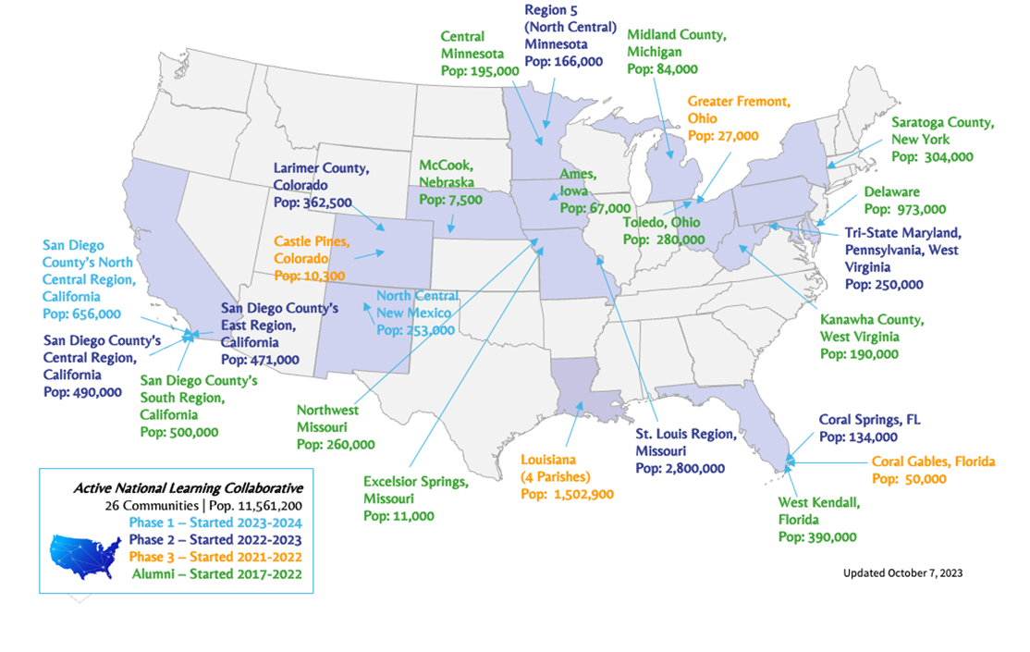
Who’s Involved
Who’s Involved

Slide 5
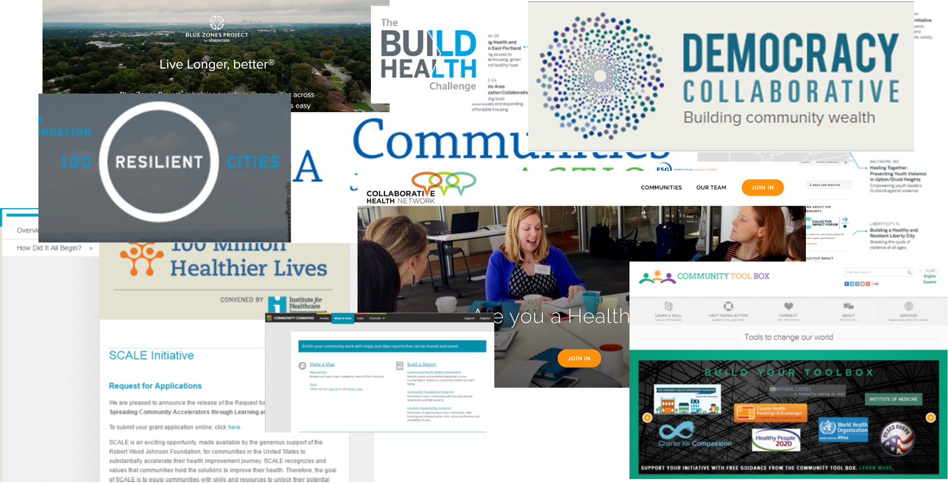
What is Being Done to Address our Many Challenges?
What is Being Done to Address our Many Challenges?
5

Slide 6
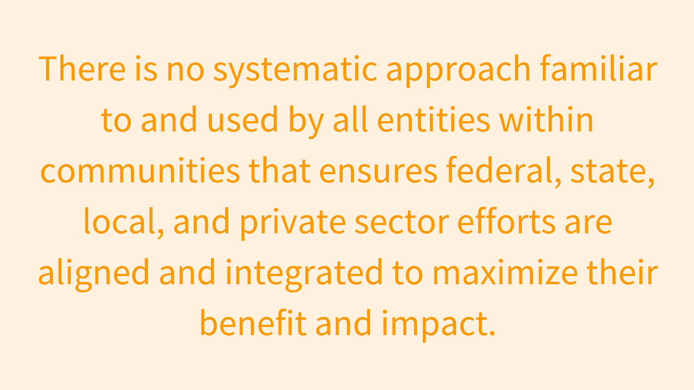
No Systematic Approach

Slide 7
Our Belief
Our Belief
That a systems framework proven to drive performance excellence in companies and organizations – the Baldrige Framework - can be modified to achieve performance excellence in communities to benefit the health and wellbeing of all residents.
7

Slide 8
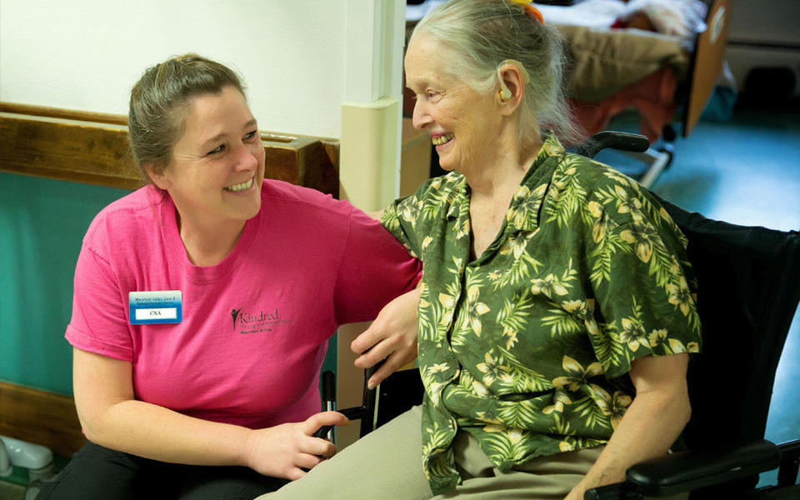
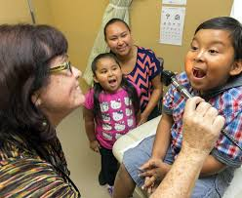


Why Base this on Baldrige?
Why Base this on Baldrige?
Three Important Questions:
  Are we doing as well as we could?
  How do we know?
  What and how could we improve or change?
8

Slide 9

Our Guiding Question
Our Guiding Question…
Could we envision a community that works
like a well-run organization, that creates a
strategic plan, has a disciplined decision-making processes with clear authority, and can measure and articulate results clearly and continually?

Slide 10
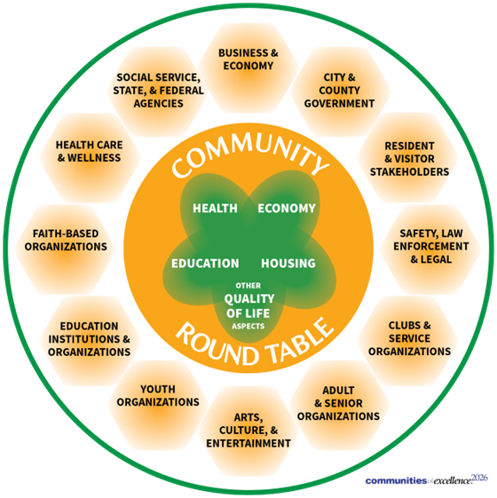
Communities are Collaborative Systems or Networks
Communities are Collaborative Systems or Networks…
Every System Within a Community is Inter-Connected
10

Slide 11
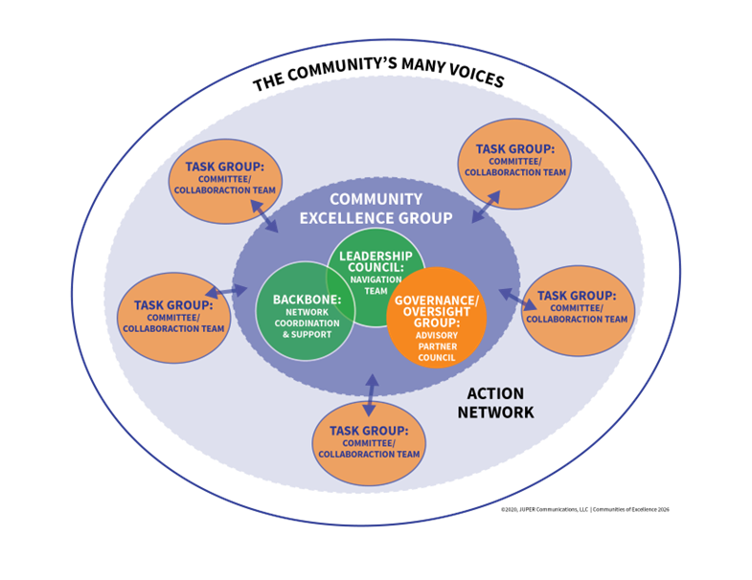
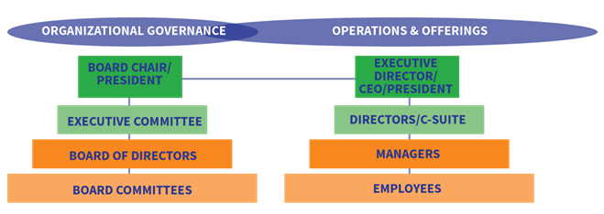
Community Leadership is Different from Organizational Leadership
DISTRIBUTED STRUCTURE SAMPLE
Key Roles:
Backbone
Governance Council
Leadership Council
Task Groups
HIERARCHY STRUCTURE SAMPLE
Key Roles:
Board of Directors
Executive Director/CEO/President
Departments (Manager/Employees)
11

Slide 12
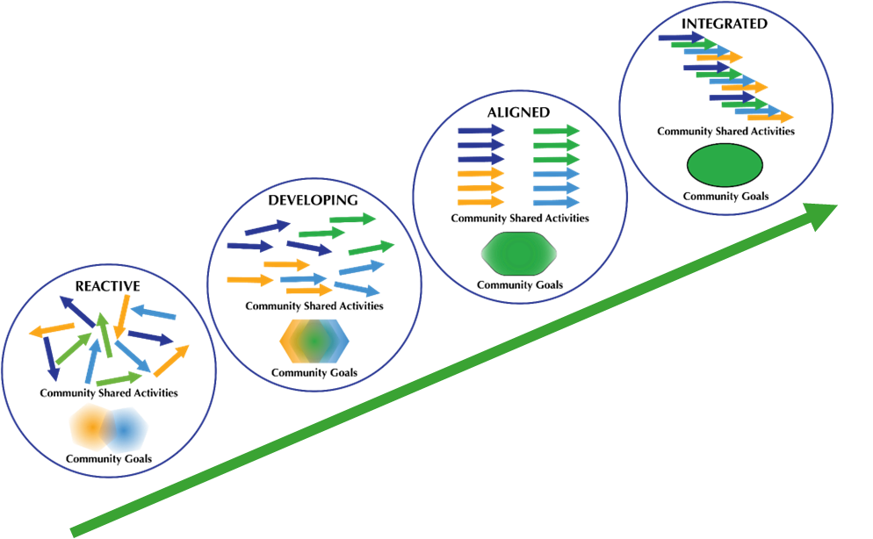
Most Communities are Here
Most Communities are Here
12

Slide 13
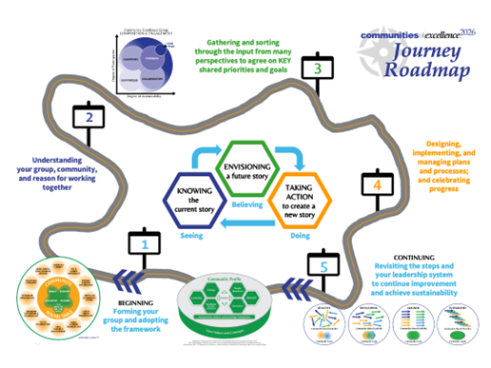
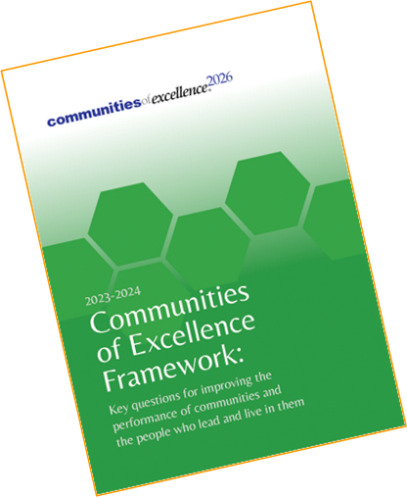
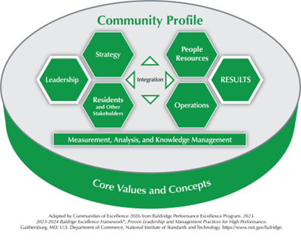
Communities, like Organizations, Need Support…
13

Slide 14
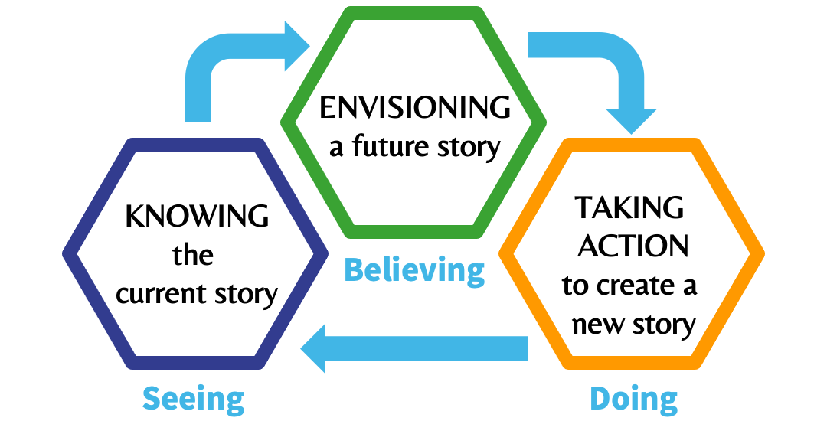
A Proven Systems Approach in Communities
A PROVEN
SYSTEMS APPROACH
IN COMMUNITIES
Engaging and supporting leaders
through a journey
by learning together
from each other
14
14

Slide 15
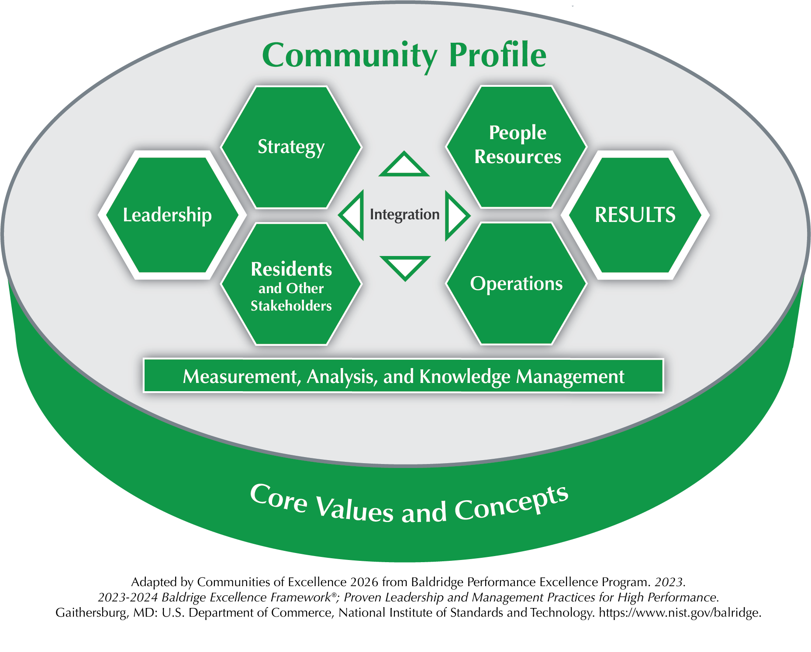

Communities of Excellence Framework
Communities of Excellence Framework:
THE CRITERIA FOR COMMUNITY PERFORMANCE EXCELLENCE
15
15

Slide 16
The Interconnected Activities of the Journey Guided by The COE Framework
The Interconnected Activities of the
Journey Guided by The COE Framework
Community Values and Culture
How We Think and Act Together
Community Profile
How We Get To Know Ourselves Better
Category 1: Leadership
How We Lead
Category 2: Strategy
How We Plan
Category 3: Residents and
Other Stakeholders
How We Listen
Category 4: Measurement, Analysis,
and Knowledge
Management
How We Measure and Learn
Category 5: People Resources
How We Build Our Team(s)
Category 6: Operations
How We Do Things
Category 7: Results
How We Track and Share Progress
16

Slide 17
2023-2024 Communities of Excellence Framework
2023-2024 Communities of Excellence Framework
  4th and most comprehensive revision to the framework since 2013.
  Six-month effort with over 100 voices contributing
  Alignment to Baldrige Framework 2022-2023 Revision
  Equity Task Force – Six national DEIA leaders

Slide 18
Initial Input – Some Examples
Initial Input – Some Examples
  “Make a clear distinction between the community leadership group, the community agencies/groups, and the community at large.”
  “Limited mention of elected officials and community governance.”
  “One item that I have found missing in customer engagement is “Involve customers and residents in the design and improvement of programs and services to the community.”
  “Safety has become an essential issue in today’s communities. There are areas of the framework where safety could be addressed.”
  “Need additional clarity around who we should be comparing ourselves against.”

Slide 19
Equity Task Force
Equity Task Force
Purpose:
Provide specific recommendations to the next revision of the Communities of Excellence Framework to ensure that it is methodically integrating diversity, equity, and inclusion (DEI) into its criteria to ensure every resident can thrive.
Ensure that equity and excellence are one and the same.
Some of the Key Contributions:
Definitions: Diversity, Equity, Inclusion, Accessibility
Addition of Housing to Core Elements
Safety – Physical, Psychological, Emotional, Social
Residents and Other “Stakeholders”
Key Segments Defined and Questions Added in All Categories

Slide 20
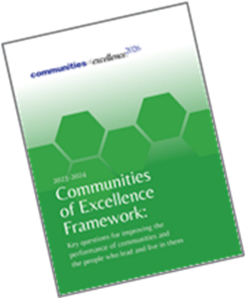
Segmentation in the COE Framework
Segmentation in the COE Framework
SEGMENT. A part of your community’s base of residents, other stakeholders, community offerings, or people resources. Your residents and other stakeholders should be segmented by key protected classes appropriate to your federal, state, and your community improvement efforts. At a minimum, your segments should include race/color, religion, sex, national origin, age, disability, and genetic information.
The U.S. Equal Employment Opportunity Commission references these protected classes, as does the U.S. Department of Housing and Urban Development, the U.S. Department of Health and Human Services, the U.S. Department of Justice, and more.

Slide 21
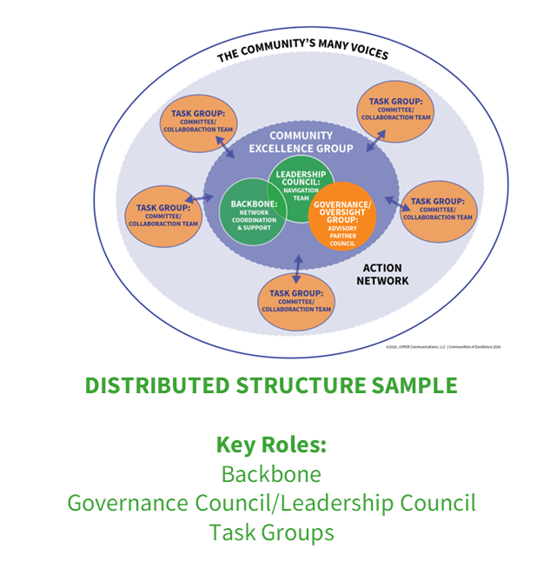
Key Concepts – Community and the Community Excellence Group
Key Concepts – Community and the Community Excellence Group
Community - Geographic region you define in the Community Profile.
Community Excellence Group - Specific individuals, organizations, and groups that have come together for your community excellence efforts.

Slide 22
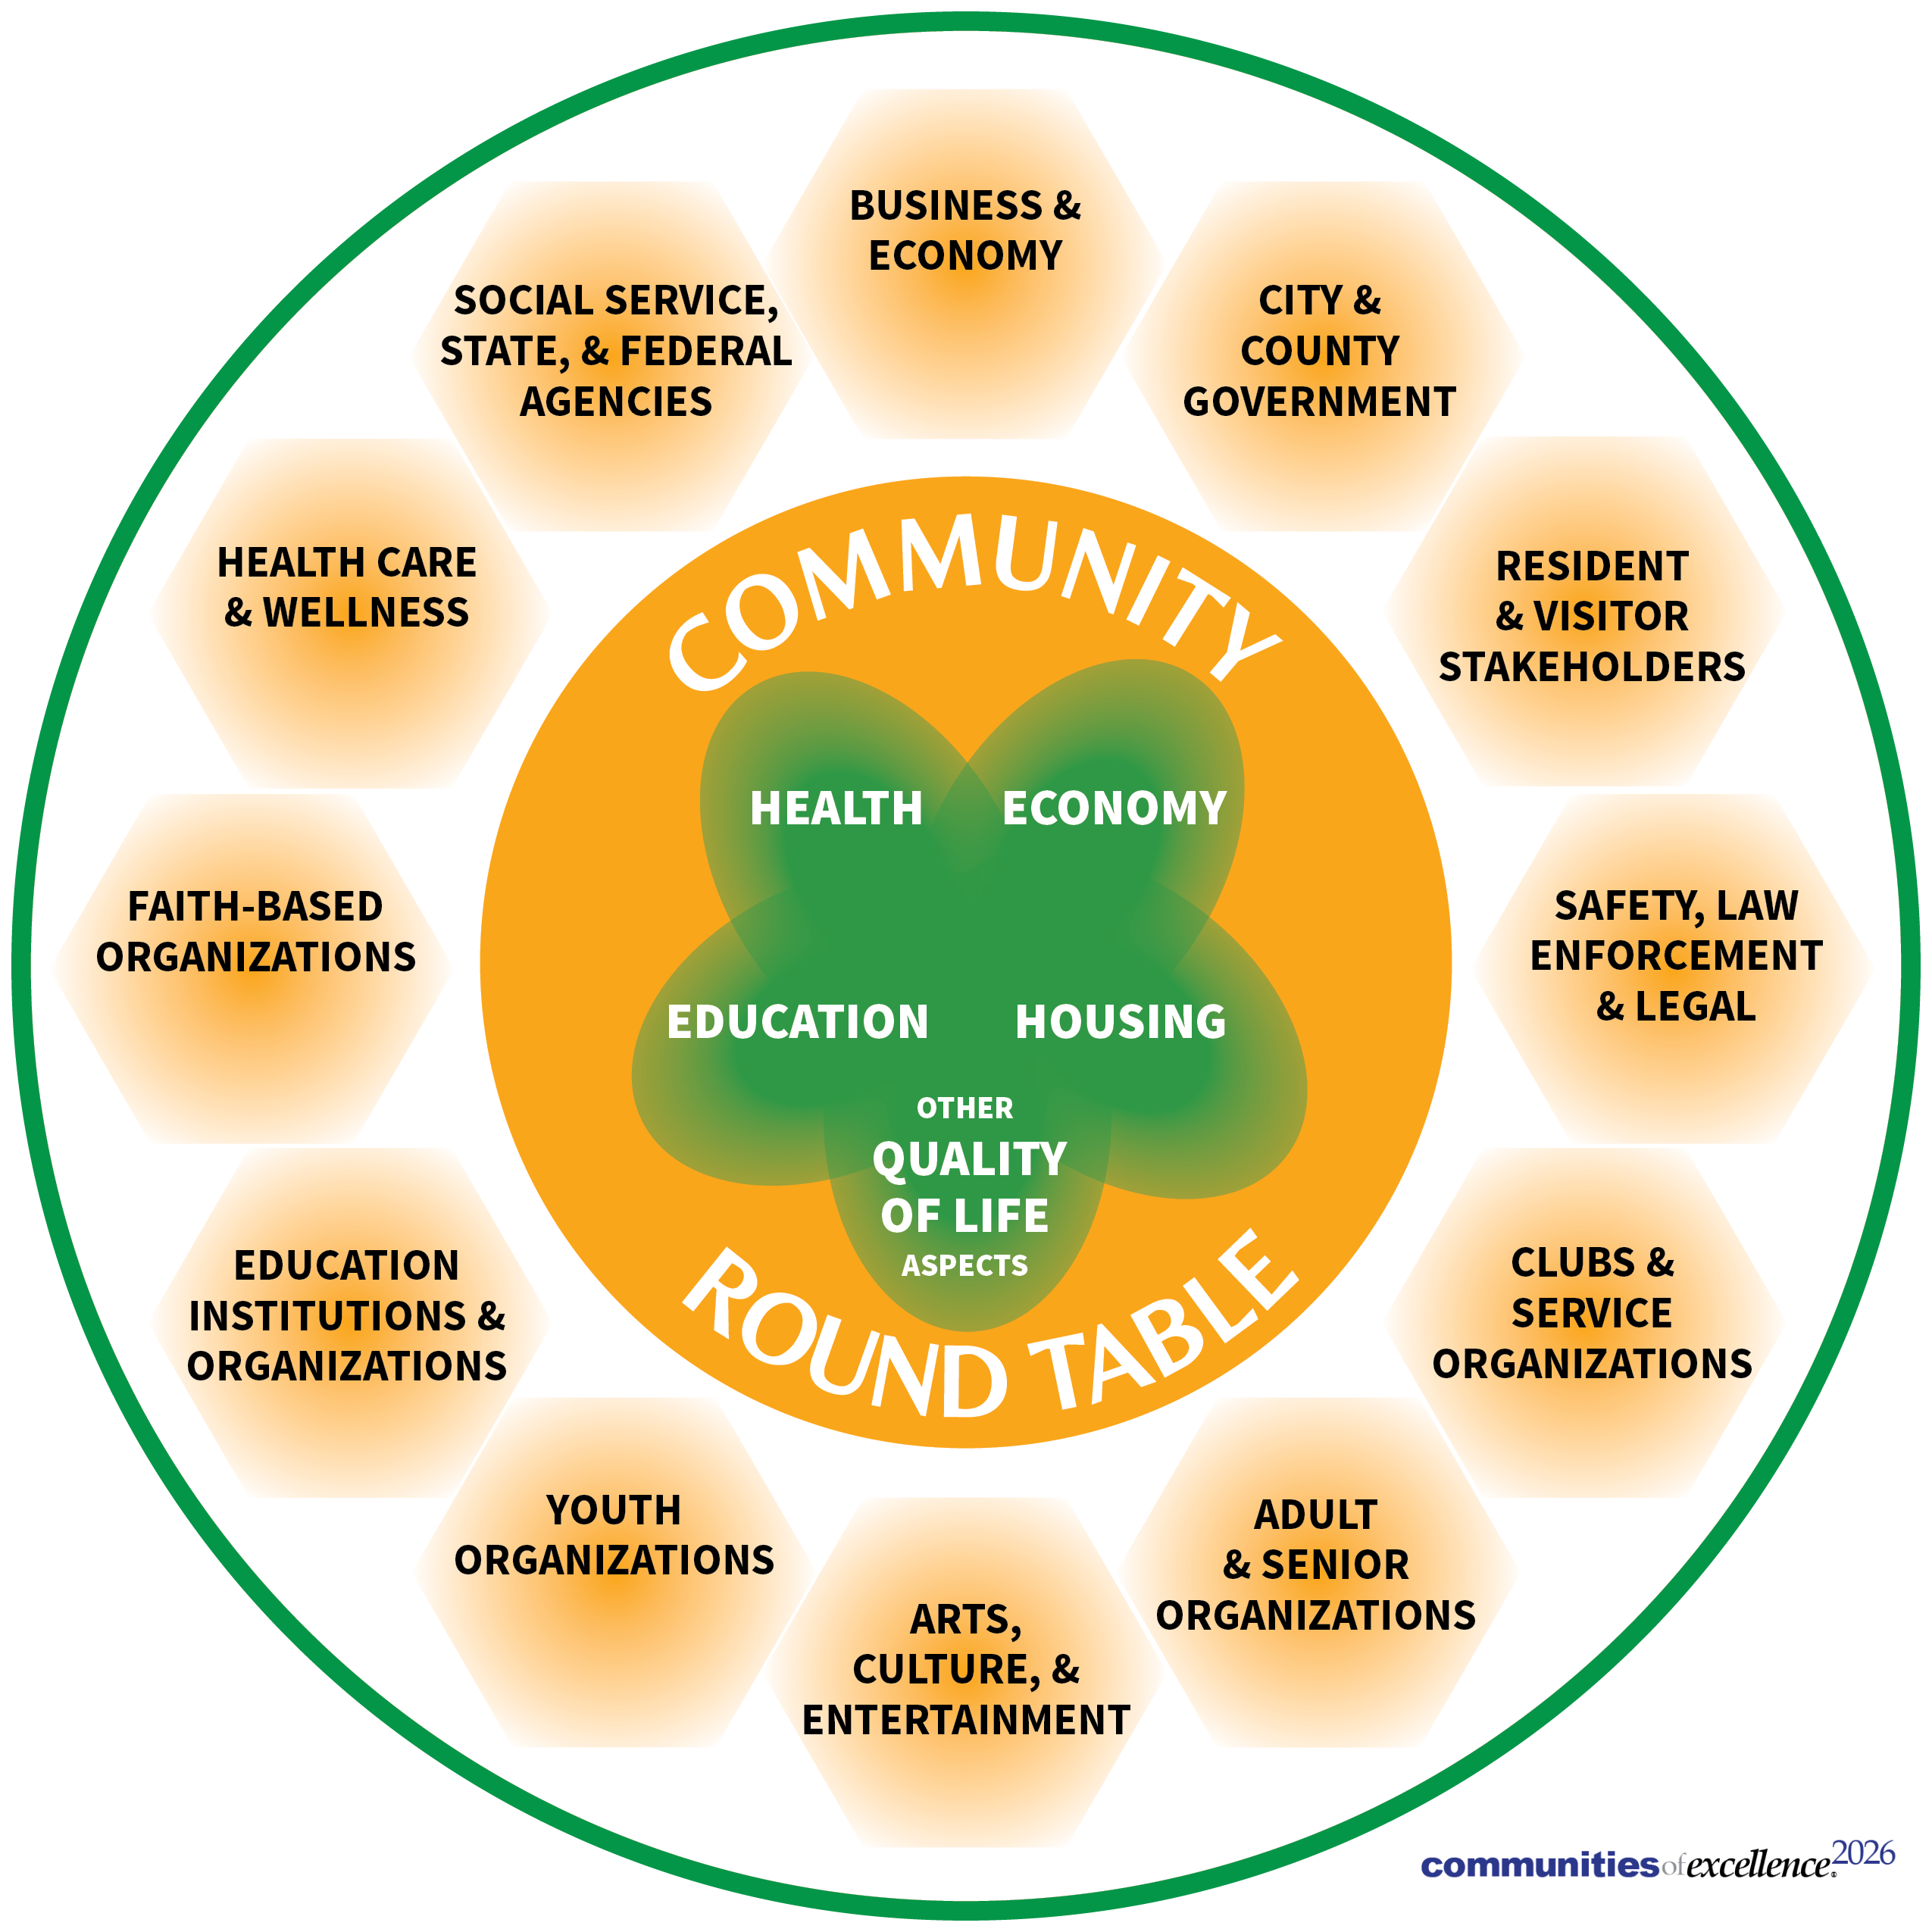
Key Concepts – Quality of Life
Key Concepts – Quality of Life
Quality of Life refers to the overall satisfaction and well-being experienced by individuals within a community and its natural environment, encompassing various aspects such as physical health, mental well-being, social connections, financial/economic security, and access to essential services.

Slide 23
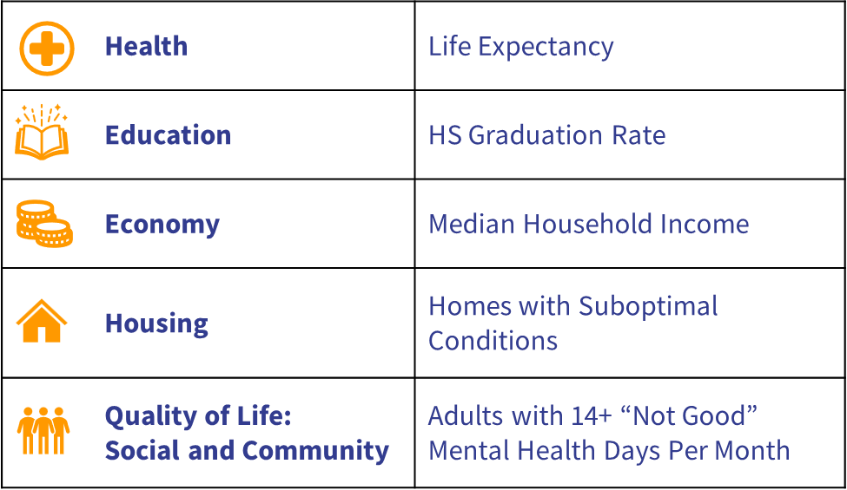
COE Common Community Scorecard
COE Common Community Scorecard
THE INDICATORS (a.k.a. Primary or KEY Metrics)
23
23

Slide 24
The Common Community Scorecard Toolkit
The Common Community Scorecard Toolkit
Quantitative Measures
INTENDED OUTCOMES:
Empower community excellence groups with the necessary information to engage with residents, other stakeholders, partners, and collaborators on specific outcomes.
Provide updated, relevant, timely tools, resources and information (data) to support ongoing awareness, education, and engagement across various communities.
Drive progress towards the COE Common Community Scorecard indicators and shared community-specific strategic objectives.
24

Slide 25
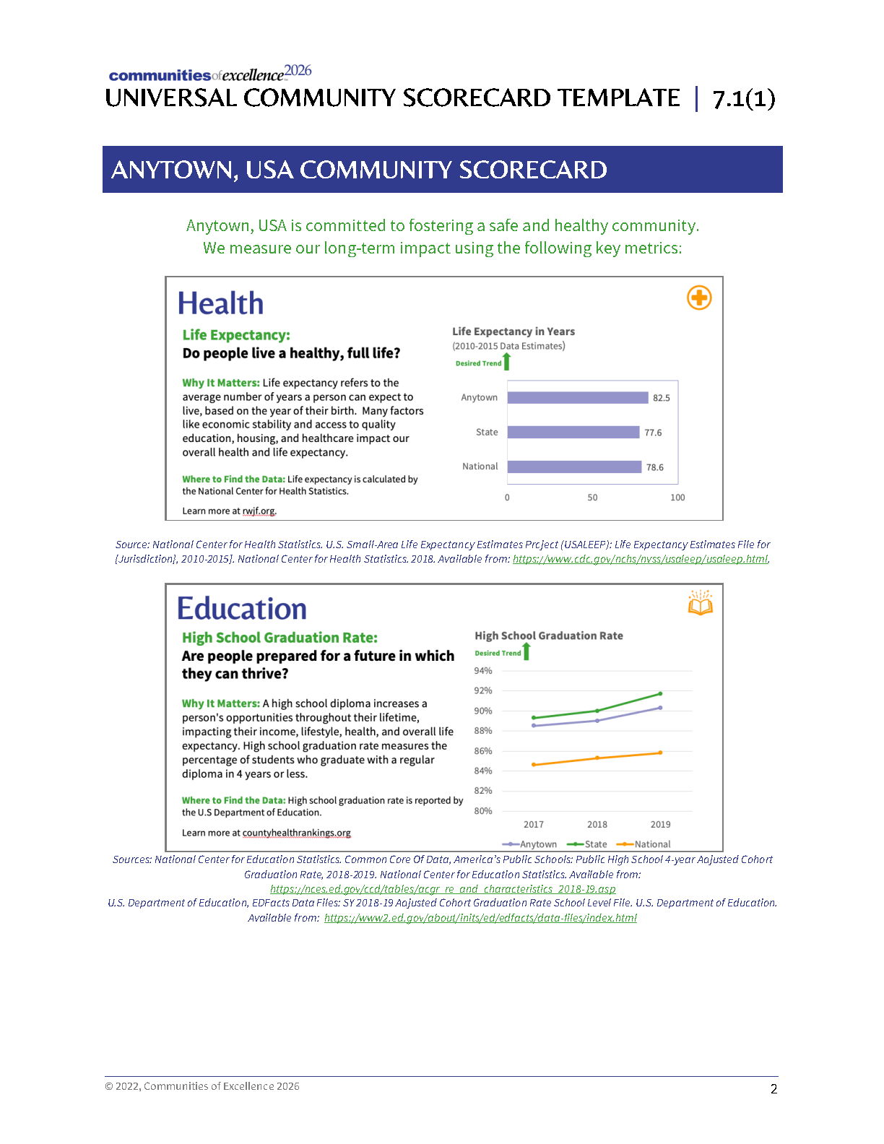
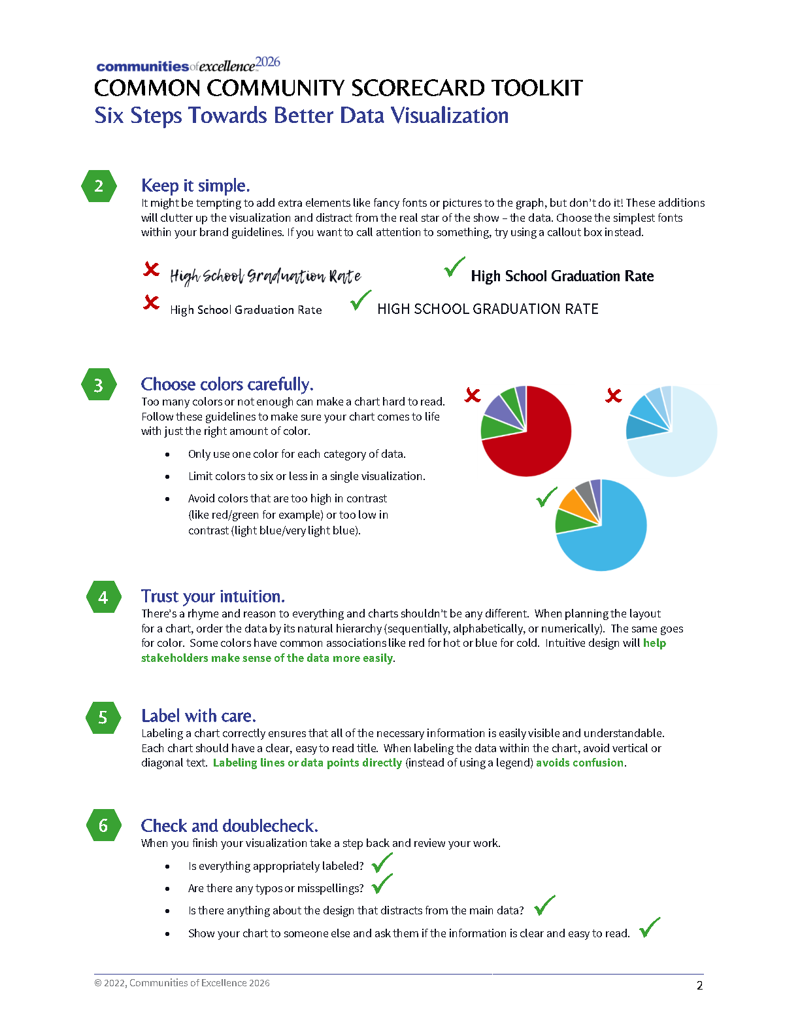
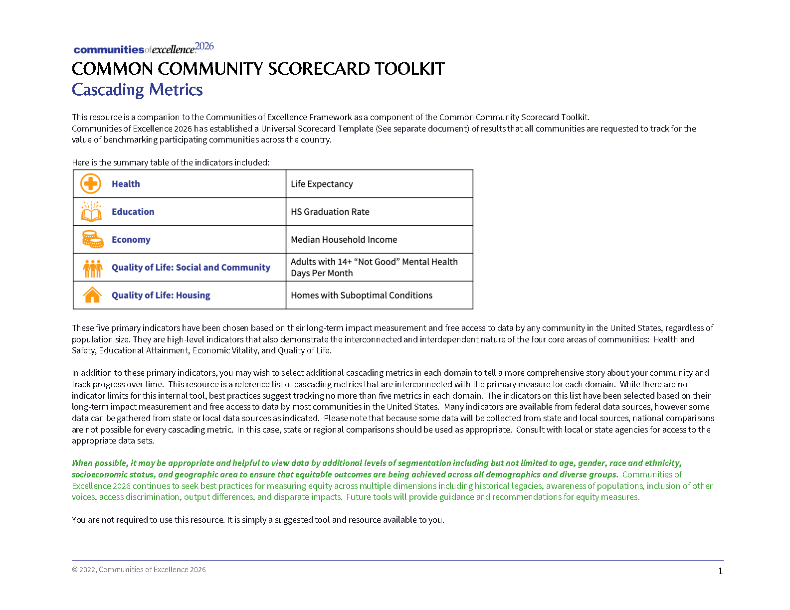
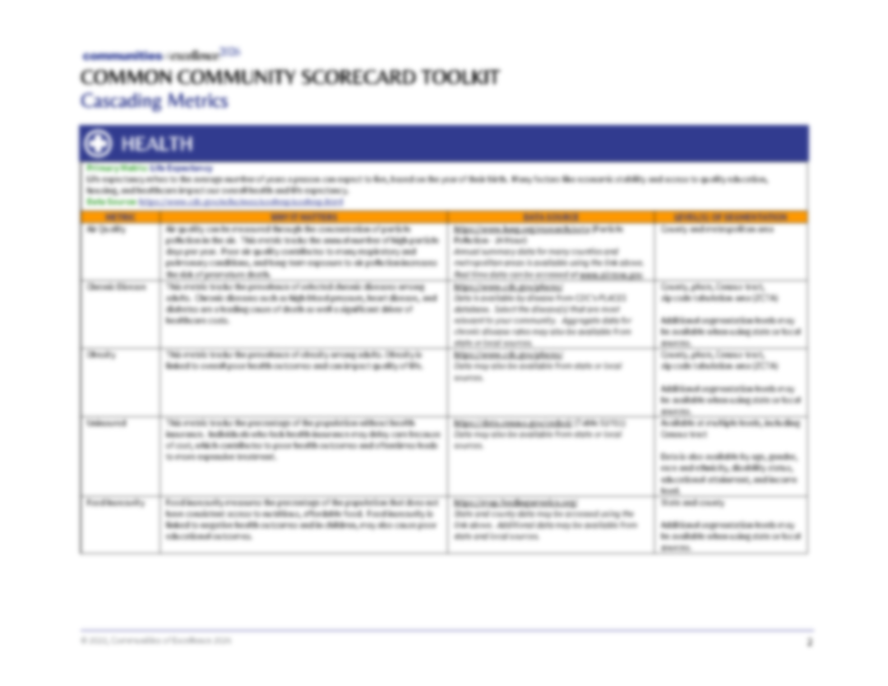
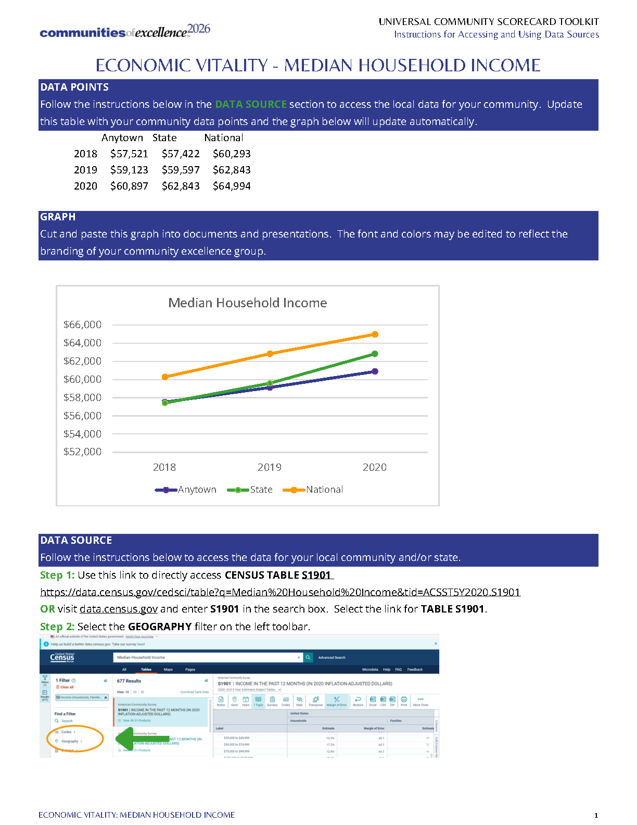
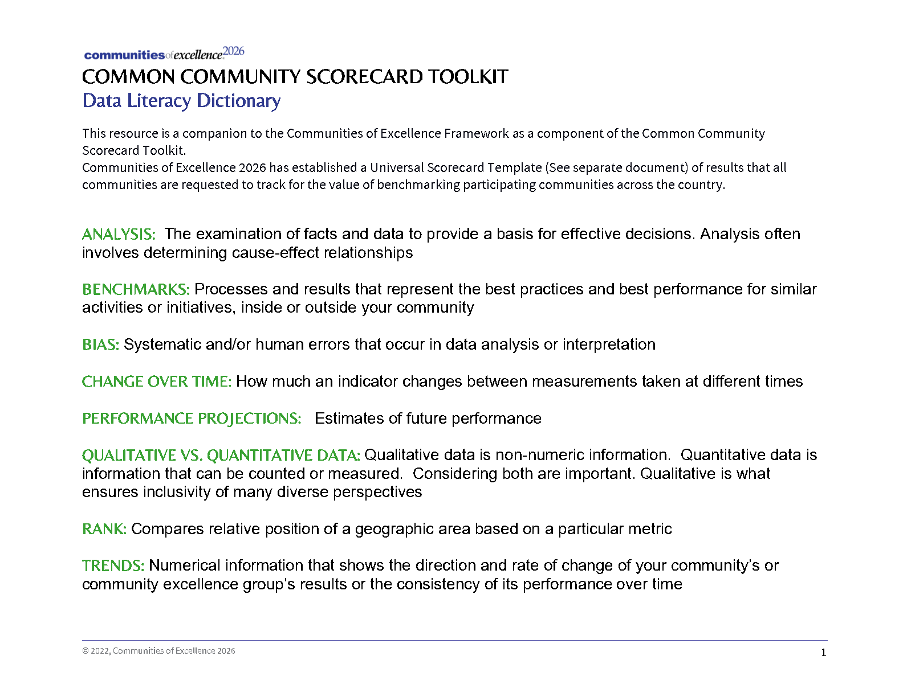

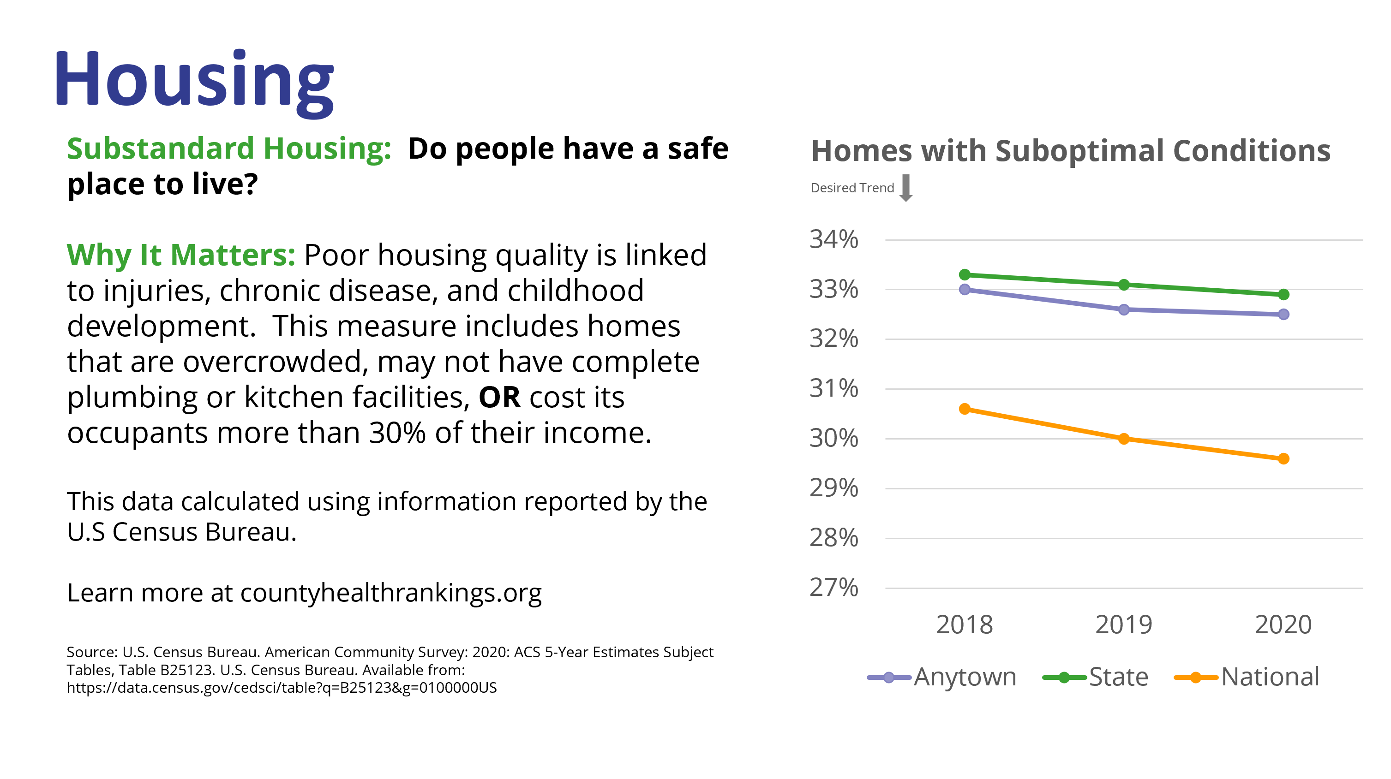
The Common Community Scorecard Toolkit (cont.)
The Common Community Scorecard Toolkit
Quantitative Measures
25

Slide 26
How Do You Get Started in a Community?
Look at the data
Listen to your residents and stakeholders
Identify a call to action
Start the conversations
Find common interests
Grow partnerships
Begin the journey

Slide 27
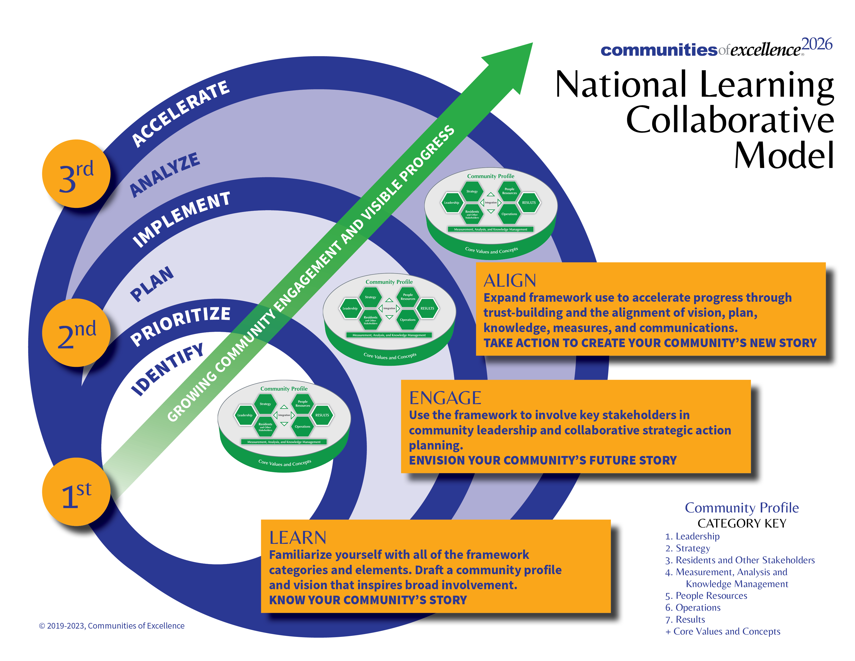

Communities of Excellence 2026 National Learning Collaborative
We believe communities can achieve . . .
EDUCATIONAL SUCCESS
HEALTH AND WELLNESS
EQUITABLE OUTCOMES
OVERALL IMPROVED
COMMUNITY LIFE
This three-phase experience is designed for communities to align and strengthen their collaborative efforts while learning how to identify, prioritize, and act on strategic advantages, challenges, and opportunities. Multi-sector groups learn in cohorts of several communities that have committed to participate in each phase facilitated over 12 months.
27

Slide 28

Thank you
Thank you!
For More Information:
www.communitiesofexcellence2026.org
snorling@communitiesofexcellence2026.org

