Slide 1
SEaRching for Entailed QUestions revealing NOVel nuggets of Answers
UT Dallas HLTRI @TAC 2020 EPIDEMIC QUESTION Answering
Maxwell Weinzierl,
Dr. Sanda Harabagiu
Notes:
Human Language Technology Research Institute at The University of Texas at Dallas
Maxwell Weinzierl
Dr. Sanda Harabagiu

Slide 2
GoaL
Novelty in factual content Across answers (NugGets)

Slide 3
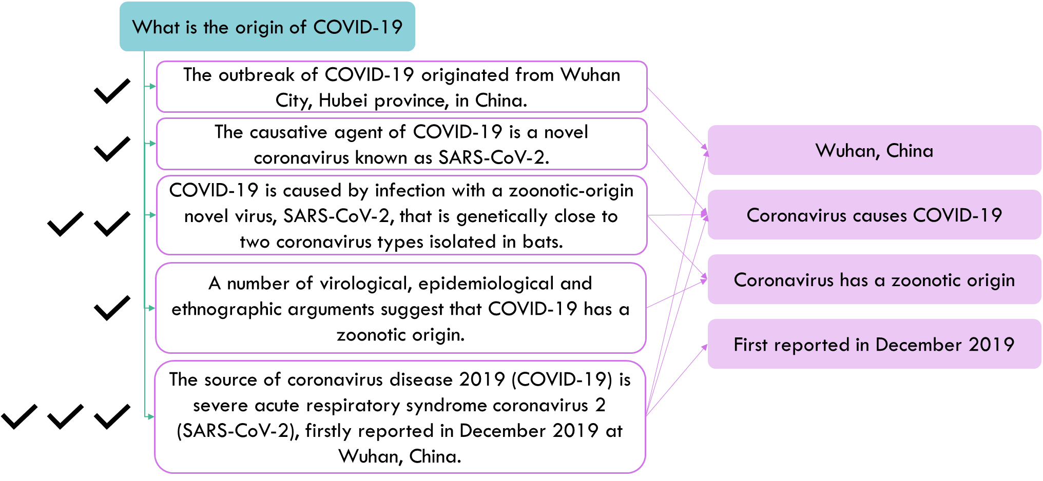
Example of Novel “Nuggets” in Answers

Slide 4
Example of Novel “Nuggets” in Answers

Slide 5
Idea
combine Recognizing Question Entailment (RQE) with Document Expansion by Query Prediction

Slide 6
Recognizing Question Entailment (RQE)
Question A entails question B if every answer to B is also a correct answer to A
Question A can be considered a “superquestion” and question B a “subquestion”

Slide 7
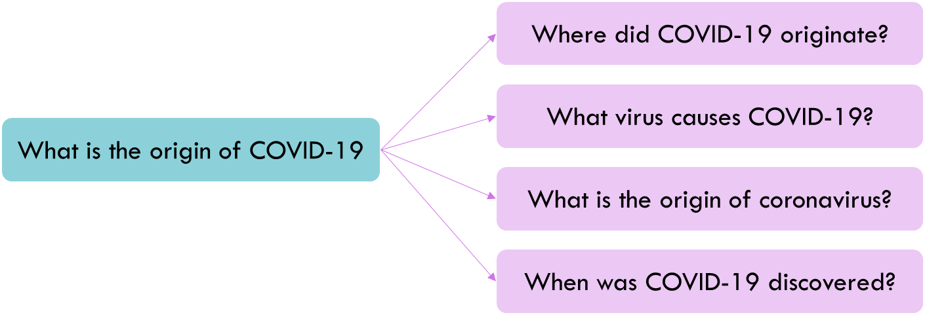
RQE Example

Slide 8
Document Expansion by Query Prediction
Predict possible questions for a document
Append those predicted questions to the document during indexing to improve search results
Typically used with classical term-based retrieval techniques such as BM25

Slide 9
Doc Expansion by Query Prediction Example

Slide 10
SER4EQUNOVA
SEaRching for Entailed QUestions revealing NOVel nuggets of Answers
Notes:
SIR! For EQUNOVA
Safari qnova

Slide 11
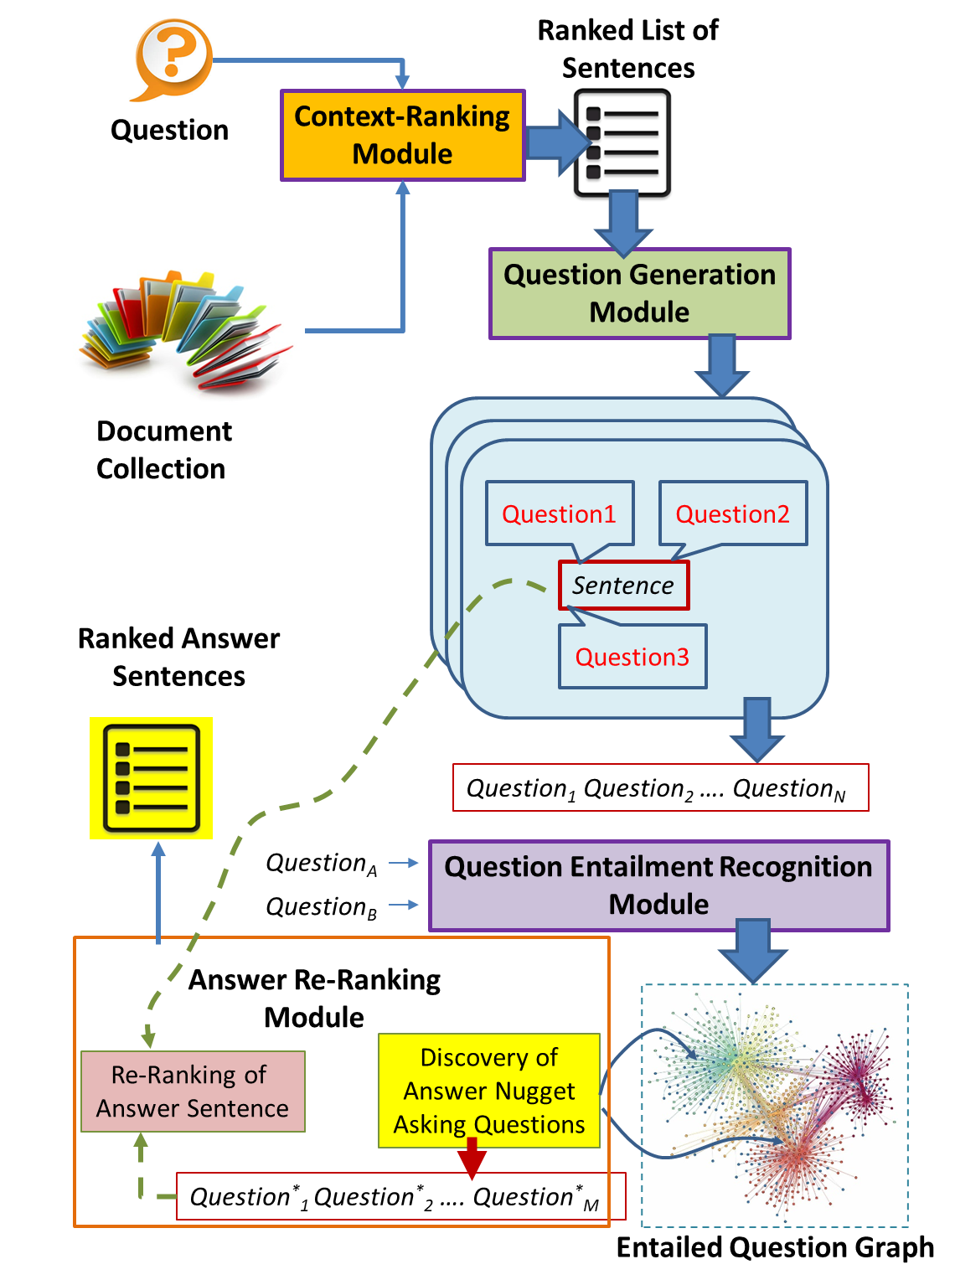
SER4EQUNOVA
Architecture

Slide 12
SER4EQUNOVA
Architecture

Slide 13
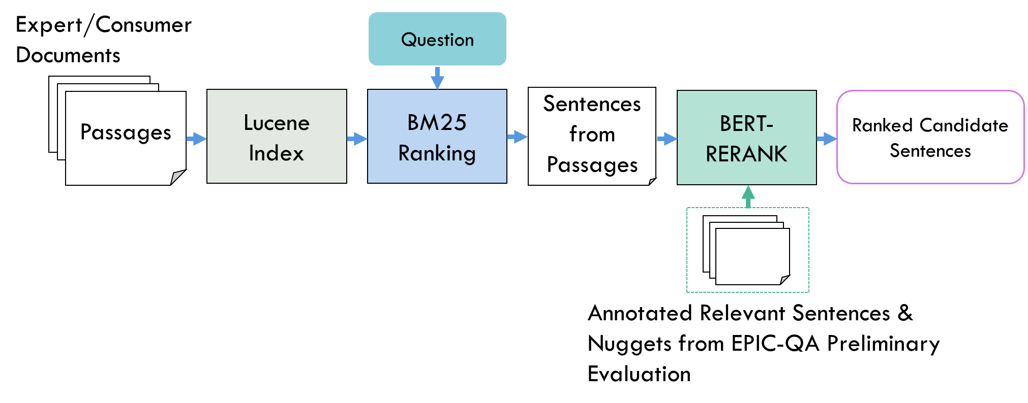
Context-Ranking Module

Slide 14
SER4EQUNOVA
Architecture

Slide 15
Question Generation Module
T5 model (docTTTTTquery) trained on MSMARCO to generate questions from answers
K questions are generated for every answer provided by the context-ranking module

Slide 16
Example
from EPIC-QA Expert Task

Slide 17
SER4EQUNOVA
Architecture

Slide 18
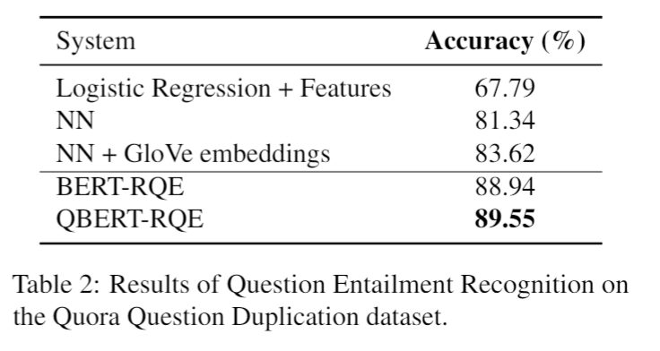
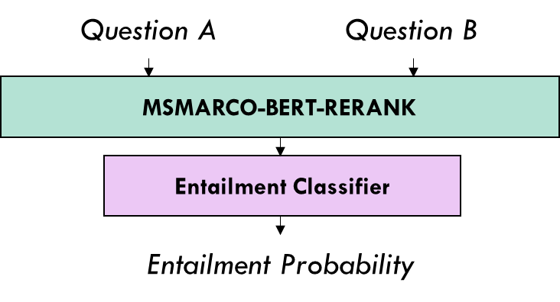
Question Entailment Recognition Module
QBERT-RQE

Slide 19
SER4EQUNOVA
Architecture

Slide 20
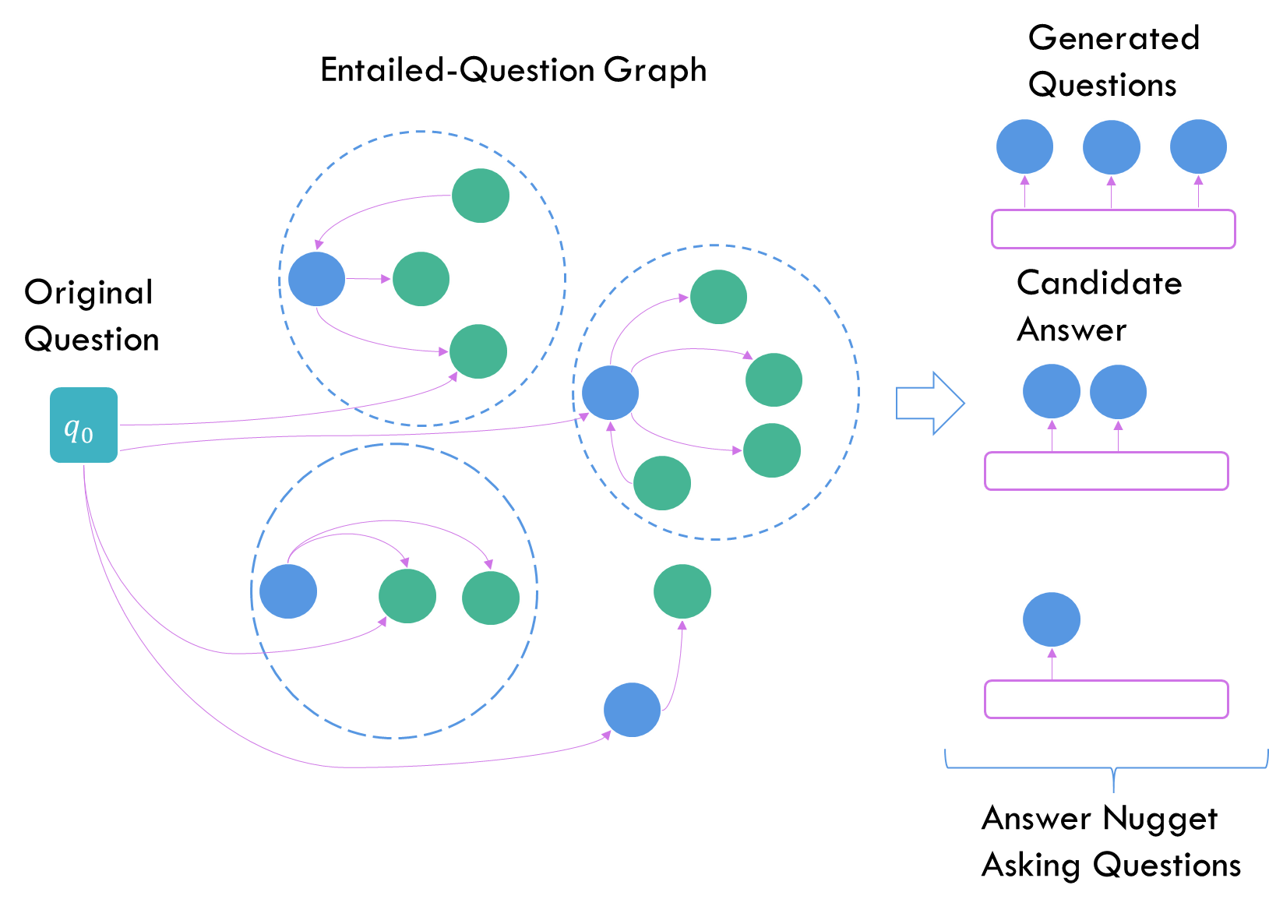

Slide 21
Answer Re-Ranking Module
Infer presence of nuggets from Answer Nugget Asking Questions produced by the Entailed Question Graph
Nugget presence or absence indicates novel quality of answers
Re-rank answers using Normalized Discount Novelty Score (NDNS) algorithm using inferred nuggets

Slide 22
Re-Ranking Example

Slide 23
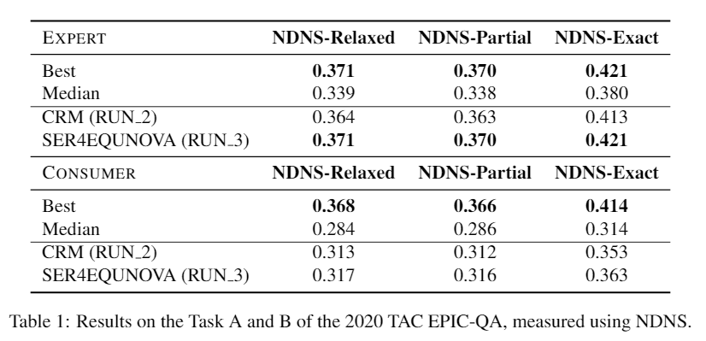
Results

Slide 24
Thanks!
Questions?

