Slide 1

Cross-media Structured Common Space for Multimedia Event Extraction
Manling Li, Alireza Zareian, Qi Zeng, Heng Ji and Shih-Fu Chang
UIUC and Columbia

Slide 2
Information Overload: Multimedia Multilingual Data
Notes:
Nowadays, the practice of journalism often distributes news content via multimedia.

Slide 3
Text Information Extraction: turn unstructured data to structured information
  Relation Extraction
  Event Extraction (Trigger Labeling + Argument Role Labeling)
Notes:
Application is to do IE. Nodes. edges

Slide 4
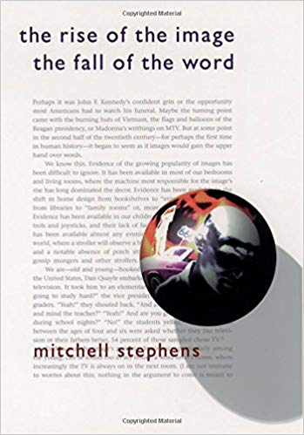
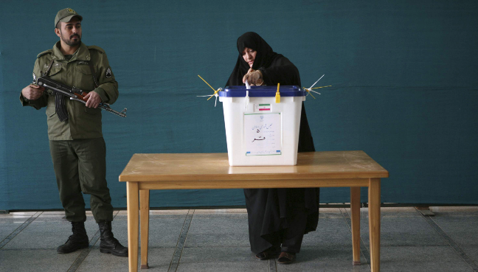
Let’s watch out of the well
We produce and consume news content simultaneously through different media
By randomly checking 100 multimedia documents from Voice of America, 34% images contain visual objects that serve as event arguments which are not mentioned in surrounding texts
Vote_? = soldier
TransportPerson_Instrument = stretcher
Notes:
Improve the corss media common space using more high level structures.
Further Explore cross linugal event structure #transfer learning for event argument labeling
and extend memory network to other extraction tasks.

Slide 5
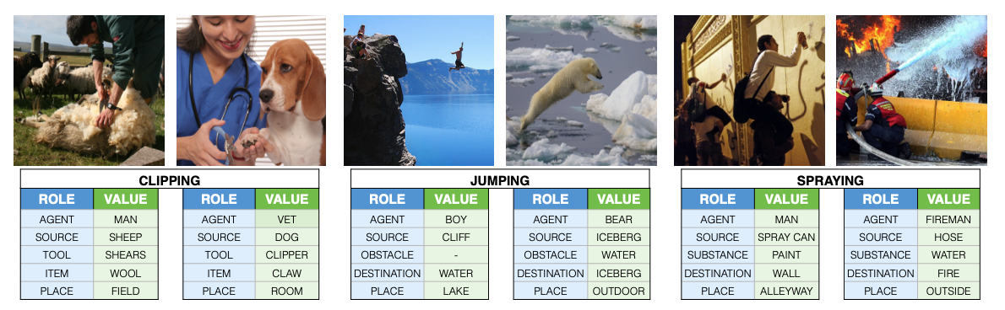
Vision is a bit behind NLP on Newsworthy Complex Event Extraction
  Visual Event Extraction mainly focuses on peaceful daily life scenarios including sports, cooking and fashion
  The closest task is visual situation recognition (Yatskar et al., 2016)
    Classify an image as one of 500+ verbs instead of event type (verbs are from FrameNet)
    Classify a region as one of 192 generic semantic roles instead of event argument roles
Notes:
All of these cool things are about english. But foreign languages are very important. E.g.. Burmese.

Slide 6
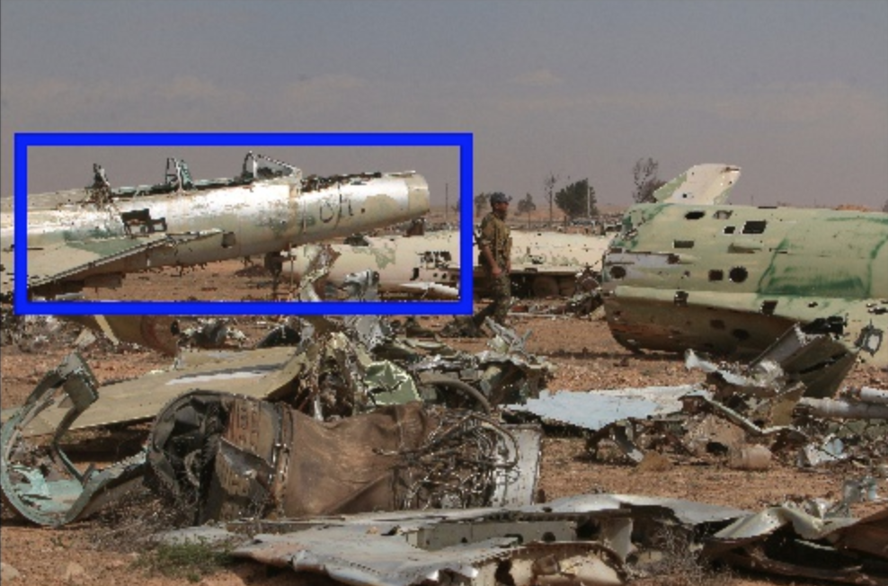
A New Task: Multimedia Event Extraction
Thanks to AIDA Event Ontology - Many events and argument roles are visually displayable
Input: News Article & Events
Input: Image & Visual Objects
In March , Turkish forces escalated attacks [Conflict.Attack] on the YPG in northern Syria , forcing U.S. to deploy [Movement.TransportPerson] a small number of forces in and around the town of Manbij to the northwest of Raqqa to “deter” Turkish - SDF clashes and ensure the focus remains on Islamic State. Meanwhile, Raqqa is being pummeled by airstrikes [Conflict.Attack] mounted by U.S.-led coalition forces and Syrian warplanes. Local anti-IS activists say the air raids [Conflict.Attack] fail to distinguish between military and non-military targets …
airplane
vehicle
Output: Image-related Events & Visual Argument Roles
Visual Events | airstrikes [Conflict.Attack] raids [Conflict.Attack]
Visual Arguments | Target | airplane
 | Target | vehicle

Slide 7
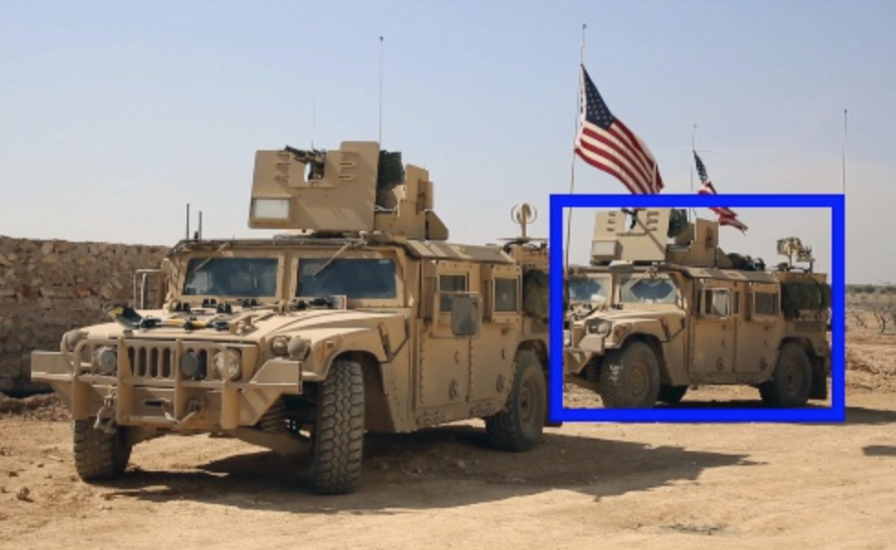
A New Task: Multimedia Event Extraction
Input: News article text
Input: Image
Last week , U.S . Secretary of State Rex Tillerson
visited [Movement.TransportPerson] Ankara, the first senior administration official to visit [Movement.TransportPerson] Turkey, to try to seal a deal about the battle [Conflict.Attack] for Raqqa and to overcome President Recep Tayyip Erdogan's strong objections to Washington's backing of the Kurdish Democratic Union Party (PYD) militias. Turkish forces have attacked SDF forces in the past around Manbij, west of Raqqa, forcing the United States to deploy [Movement.TransportPerson] dozens of soldiers on the outskirts of the town in a mission to prevent a repeat of clashes, which risk derailing an assault on Raqqa .
land_vehicle
land_vehicle
Output: Events & Arguments
Visual Events | deploy [Movement.TransportPerson]
Visual Arguments | Vehicle | land_vehicle
 | Vehicle | land_vehicle

Slide 8
A New Data Set on Multimedia Event Extraction
Ontology: overlapped set between ACE and imSitu
  Event Types:
    Manually map verbs in imSitu to ACE to obtain the overlapped event types
  Argument Roles:
    Based on ACE argument roles, add additional detectable visual roles (marked in red)
Event Type | Argument Roles
Life.Die | Agent, Victim, Instrument, Place, Time
Transaction.TransferMoney | Giver, Recipient, Beneficiary, Money, Instrument, Place, Time
Conflict.Attack | Attacker, Instrument, Place, Target, Time
Conflict.Demonstrate | Demonstrator, Instrument, Police, Place, Time
Contact.Phone-Write | Participant, Instrument, Place, Time
Contact.Meet | Participant, Place, Time
Justice.ArrestJail | Agent, Person, Instrument, Place, Time
Movement.Transport | Agent, Artifact/Person, Instrument, Destination, Origin, Time

Slide 9
A New Data Set on Multimedia Event Extraction
Event type annotation
  Text: Event Type & Trigger
  Image: Event Type
Argument role annotation
  Text: Argument Role & Entity
  Image: Argument Role & Bounding Box (except time and place)
Cross-media event coreference resolution
Two independent annotations + expert annotator adjudication

Slide 10
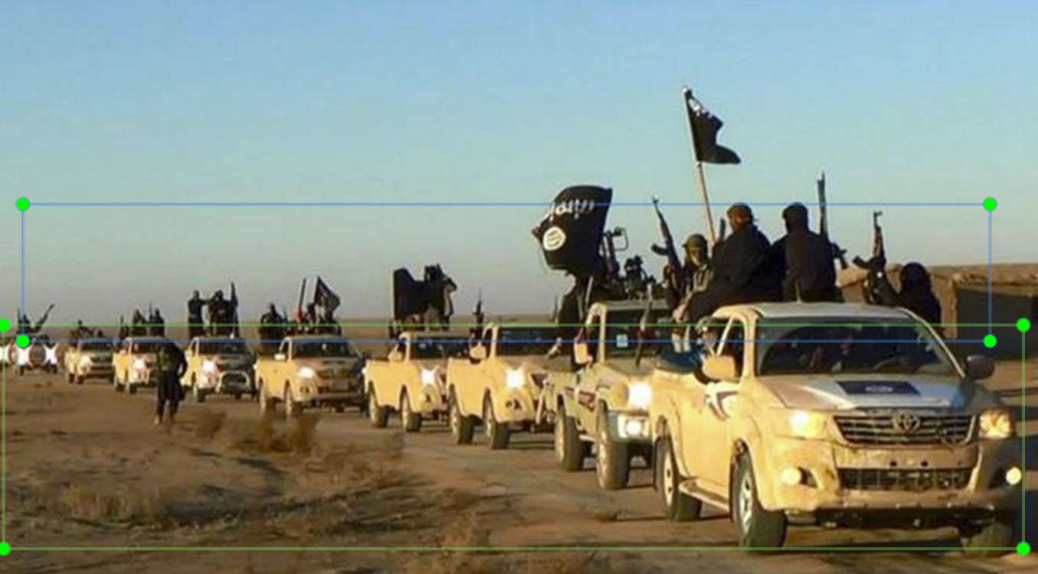
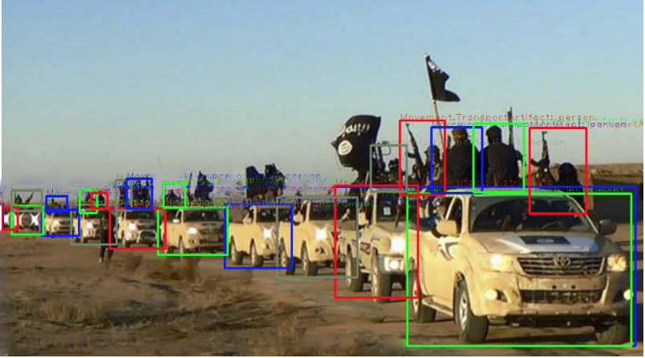
A New Data Set on Multimedia Event Extraction
Bounding box annotation:
  Union bounding box:
    For each role, annotate the smallest bounding box covering all the arguments
  Instance bounding box:
    For each role, annotate multiple bounding boxes, where each bounding box is the smallest region that covers one argument
    Follows VOC2011 Annotation Guidelines (http://host.robots.ox.ac.uk/pascal/VOC/voc2011/guidelines.html)
Union bounding box
Instance bounding box

Slide 11
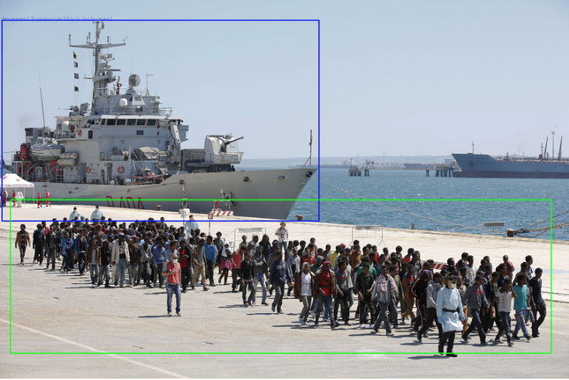
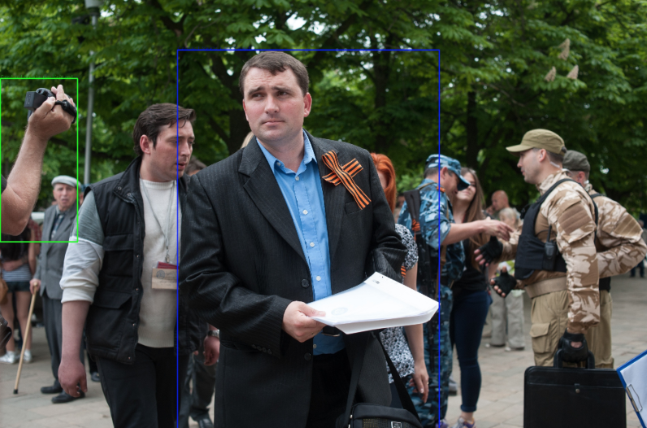
A New Data Set on Multimedia Event Extraction
Each image is annotated by checking the caption as reference context
  E.g. can not determine Transport.Transportation event and Contact.Meet event without captions:
Image Caption:
Migrants are disembarked from the Italian navy ship 'Vega' in the Sicilian harbour of Augusta, southern Italy, May 4, 2015.
Image Caption:
Secessionist referendum official Alexander Malyhin holds a document as he speaks to journalists in the eastern Ukrainian city of Luhansk May 12, 2014.

Slide 12
A New Data Set on Multimedia Event Extraction
Data Source: VOA news from 2006-2017
  Informative: Select documents with the most images and extracted events
  Diversity: Collect more images that have low-frequent event types in captions by running AIDA text event extraction system
Data Statistics:
  Target by Nov 30, 2019: ~300 news articles, ~1000 images, ~40 images for each event type
  Complete:
    115 news articles, 612 images
    497 textual events, 1532 textual arguments
    178 visual events, 771 visual arguments
Will be released through LDC (thanks to Stephanie’s team’s help in advance)
  Need ideas to share image annotations legally

Slide 13
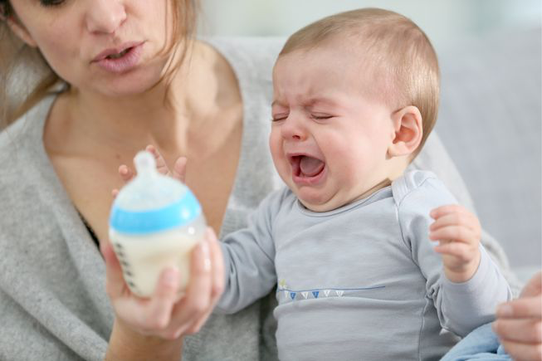


Solution for Low-resource Setting: Share and Transfer
Enhance Quality with deep knowledge acquisition and reasoning
Transfer knowledge across domain/genre/language/data modality
Notes:
Enhance english capability. then help others. Milk training data. Grow then help other kids.

Slide 14
Cross-media Structured Common Space Construction
  Treat Image/Video as a foreign language

Slide 15
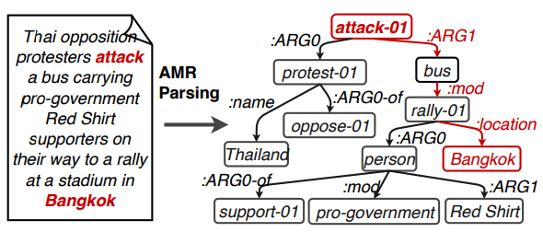
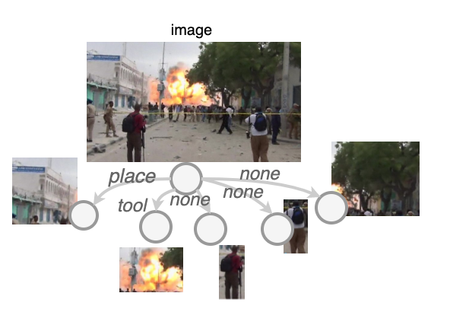
Cross-media Structured Common Space Construction
Graph 1: Object-based Graph
  Use the the bounding boxes of object detection system (no labels)
  Pros: good localization quality
  Cons: some object types are not covered, such as stone, stretcher, etc.
  Cons: imbalanced number of objects in each image, such as crowd vs one person

Slide 16
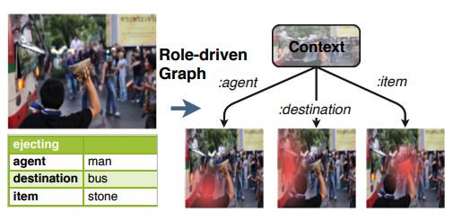
Cross-media Structured Common Space Construction
Graph 2: Role-attentive Graph
  “Role”: situation recognition roles (192 roles)
  Pros: semantic graph structure is similar to AMR graph
  Cons: bounding boxes generated by attention are not precise

Slide 17
Cross-media Structured Common Space Construction
Situation Recognition Encoder Training:
  Graph 1: Object-based Graph Training
  Learn to project image embedding to verb embedding
  Learn a role classifier to obtain edge types based on situation recognition annotation

Slide 18
Cross-media Structured Common Space Construction
Situation Recognition Encoder Training:
  Graph 2: Role-driven Attention Graph
    Learn to project image embedding to verb embedding
    Learn to project role attention heatmap to noun embedding

Slide 19
Weakly Aligned Structured Embedding (WASE)
-- Training Phase (Common Space Construction)

Slide 20
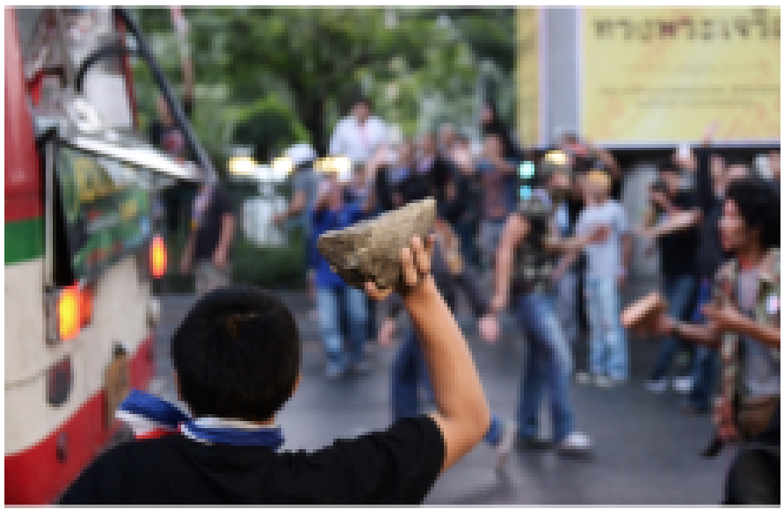
Weakly Aligned Structured Embedding (WASE)
-- Training Phase (Common Space Construction)
Thai opposition protesters attack a bus carrying pro-government Red Shirt supporters on their way to a rally at a stadium in Bangkok
WASE
(text)
Event argument candidates
Event trigger candidates
Co-Attention
WASE
(img)
Event argument candidates
Event trigger candidate

Slide 21
Weakly Aligned Structured Embedding (WASE)
-- Training Phase (Common Space Construction)
Thai opposition protesters attack a bus carrying pro-government Red Shirt supporters on their way to a rally at a stadium in Bangkok
WASE
(text)
Event argument candidates
Event trigger candidates
Co-Attention
WASE
(img)
Event argument candidates
Event trigger candidate

Slide 22
Weakly Aligned Structured Embedding (WASE)
-- Training Phase (Common Space Construction)
Thai opposition protesters attack a bus carrying pro-government Red Shirt supporters on their way to a rally at a stadium in Bangkok
WASE
(text)
Event argument candidates
Event trigger candidates
WASE
(img)
Event argument candidates
Event trigger candidate

Slide 23
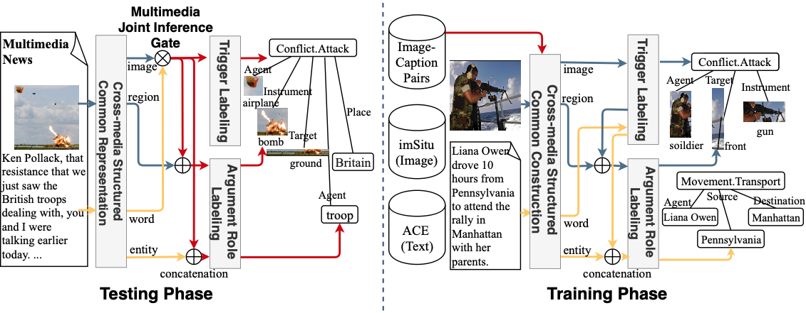
Weakly Aligned Structured Embedding (WASE)
-- Testing & Training Phase
Notes:
Image help text: (1) resistence
text help image: (1) attacker, (what kind of image info is helping text event extraction?)
(2) new roles

Slide 24
Experiments on Text Data
Compare with text-only extraction
  ACE dataset
  Input: Text
  Output: ACE Events & Roles
Method | Event Trigger Extraction |  |  | Argument Role Extraction
 | P(%) | R(%) | F₁(%) | P(%) | R(%) | F₁(%)
JMEE (Text-only) [1] | 49.12 | 72.64 | 58.61 | 31.63 | 38.63 | 34.78
Multimedia Flat Embedding | 56.08 | 62.03 | 58.91 | 26.28 | 39.71 | 29.53
WASE | 59.55 | 66.43 | 62.80 | 33.75 | 31.47 | 36.37
[1] Xiao Liu, Zhunchen Luo, and Heyan Huang. 2018a. Jointly multiple events extraction via attention-based graph information aggregation. EMNLP 2018

Slide 25
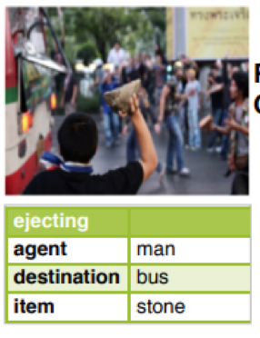
Experiments on Image Data
Compare with image-only extraction (Situation Recognition)
  imSitu dataset
  Input: Image
  Output: Situation Recognition Verbs & Roles & Nouns
Method | Event Type Detection |  |  | Argument Role Extraction
 | P(%) | R(%) | F₁(%) | P(%) | R(%) | F₁(%)
FC_Graph(Vision-only) [2] | 36.75 | 36.75 | 36.75 | 19.15 | 19.15 | 19.15
Multimedia Flat Embedding | 35.39 | 35.39 | 35.39 | 32.48 | 34.24 | 33.34
WASE (role-attentive graph) | 33.23 | 33.23 | 33.23 | 35.67 | 37.26 | 36.45
WASE (object-based graph) | 48.17 | 48.17 | 48.17 | 31.23 | 13.31 | 18.66
[2] Ruiyu Li, Makarand Tapaswi, Renjie Liao, Jiaya Jia, Raquel Urtasun, and Sanja Fidler. 2017. Situation recognition with graph neural networks. ICCV 2017

Slide 26
Experiments on New Multimedia Data
Evaluation: correctness of localization
  Attention based methods, compared with ground truth union bounding box:
    Attention Pointing Game[3]: correct if the attention peak falls into the ground truth union bounding box
    Attention Correctness[3]: correct if at least 50% of the attention heatmap falls into the ground truth union bounding box
    Attention Bounding Box IoU (Intersection over Union): correct if IoU larger than 0.5
  Object based methods, compared with ground truth instance bounding box:
    Object Bounding Box IoU (Intersection over Union): correct if IoU larger than 0.5
Method | Event Type Detection |  |  | Argument Role Extraction
 | P(%) | R(%) | F₁(%) | P(%) | R(%) | F₁(%)
Multimedia Flat Embedding | 12.71 | 52.14 | 20.43 | 13.35 | 20.87 | 16.28
WASE (attention pointing game) | 13.40 | 54.25 | 30.74 | 16.02 | 22.64 | 18.76
[1] Akbari, H., Karaman, S., Bhargava, S., Chen, B., Vondrick, C., & Chang, S. F. (2019). Multi-level Multimodal Common Semantic Space for Image-Phrase Grounding. CVPR 2019 (pp. 12476-12486).

Slide 27
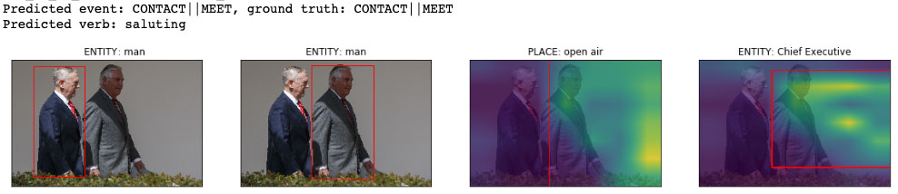
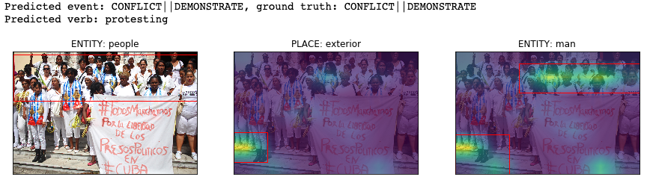
Visual Role Extraction Output Example

Slide 28
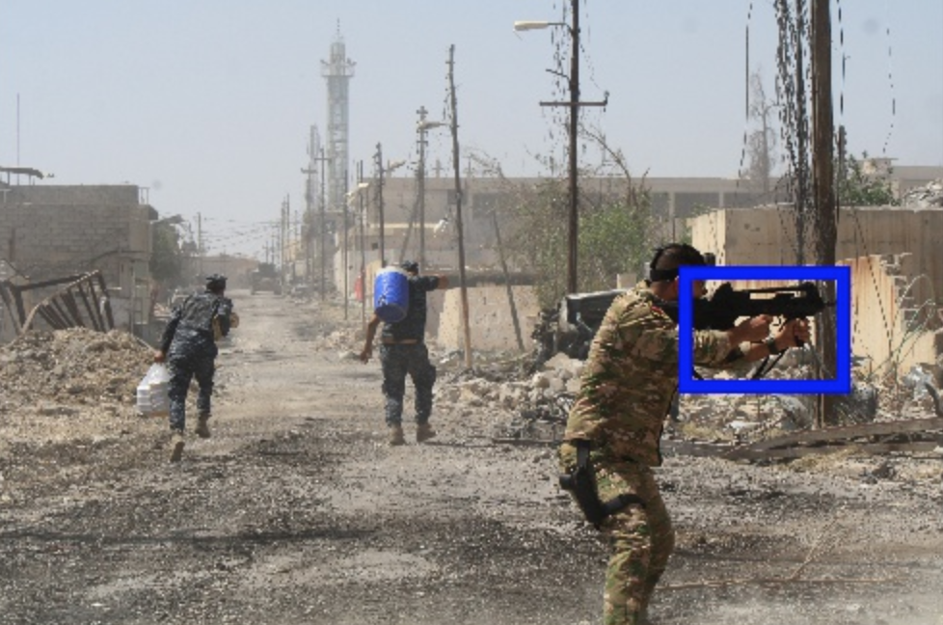
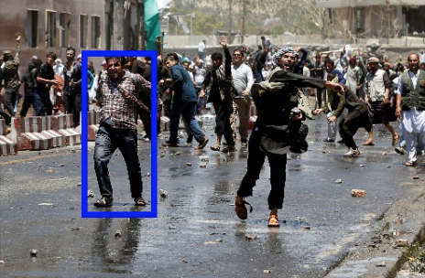
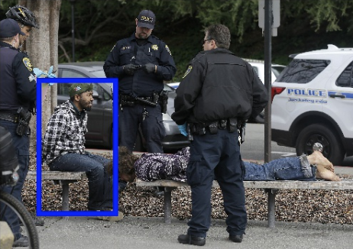
Compare to State-of-the-art Cross-media Flat Representation
  Baseline:
    Event: Justice:Arrest-Jail
    Roles:
      None
  Our Approach:
    Event: Conflict.Attack
    Roles:
      Instrument = weapon
  Baseline:
    Event: Justice:Arrest-Jail
    Roles:
      Entity = man
  Our Approach:
    Event: Conflict:Demonstrate
    Roles:
      Entity = man
  Baseline:
    Event: Justice:Arrest-Jail
    Roles:
      Agent = man
  Our Approach:
    Event: Justice:Arrest-Jail
    Roles:
      Person = man

Slide 29
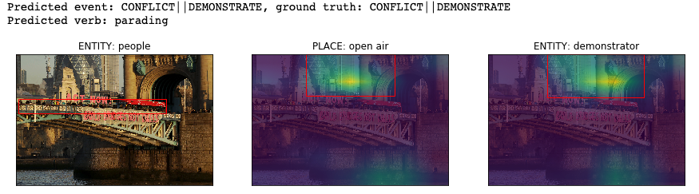
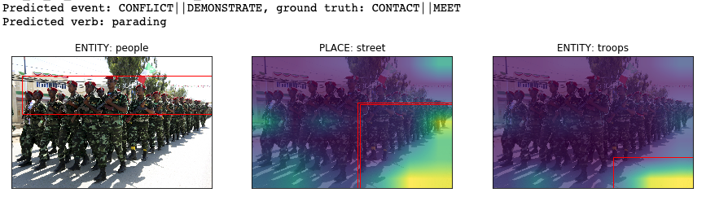
Remaining Challenges: correct entity name but wrong localization

Slide 30
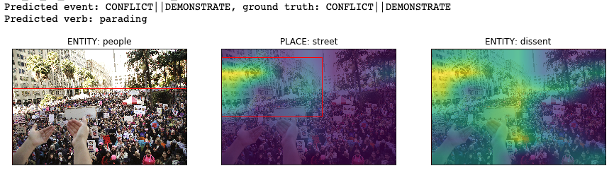
Remaining Challenges: too many instances

Slide 31
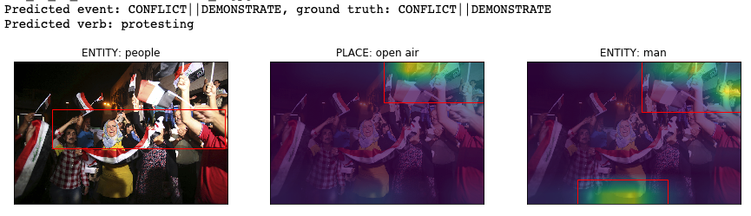
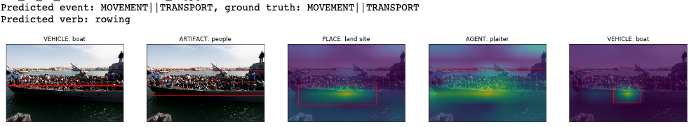
Remaining Challenges: similar attention heatmap for different roles

Slide 32
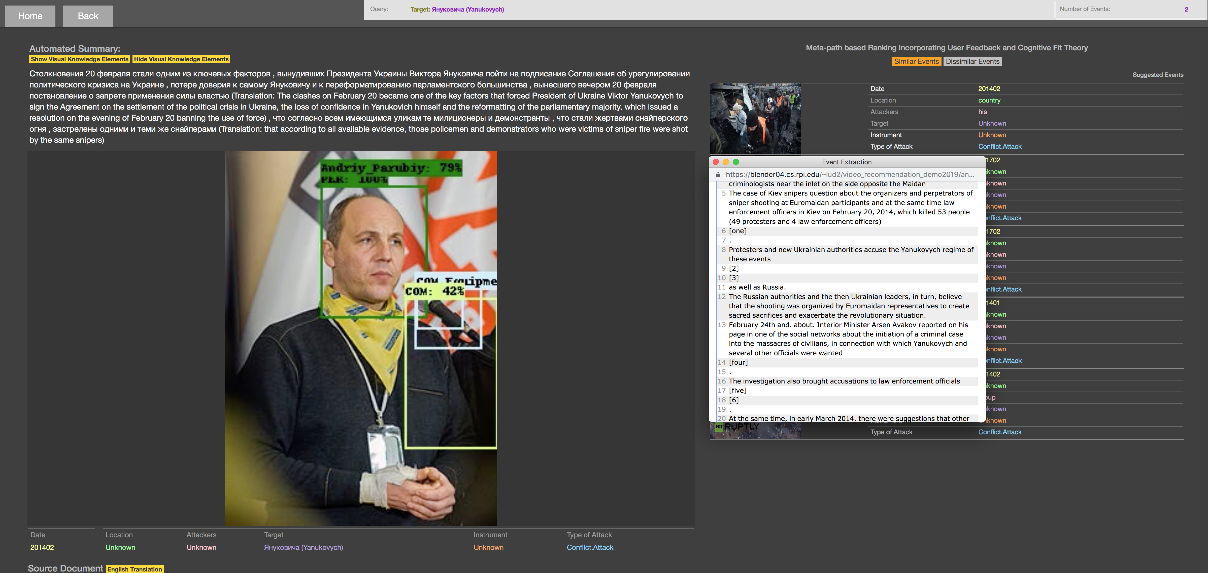
Application: Multimedia Event Recommendation
https://blender04.cs.rpi.edu/~lud2/video_recommendation_demo2019/navigation_dark.html

Slide 33
Application: Let’s Write a History Book!
History is written by the victors
Entity-centric knowledge base is much easier to construct than event-centric one
  Who is Barack Obama’s wife?
Requires exhaustive search and information aggregation
  How many people died in 911? Who are they?
Multi-view verification
  What happened in 1989 Tiananmen Square?
  What happened in Hong Kong Protest 2019?
It’s international human right to know
what happened in the history
We aim to create a history book automatically
so it can be more complete and authentic
than human created ones
33
Notes:
Change low resource IL to a language which is not in wikipedia
Word-level: from bi-lingual dicts and alignment; structure-level comes from wals; multi-level alignment

Slide 34
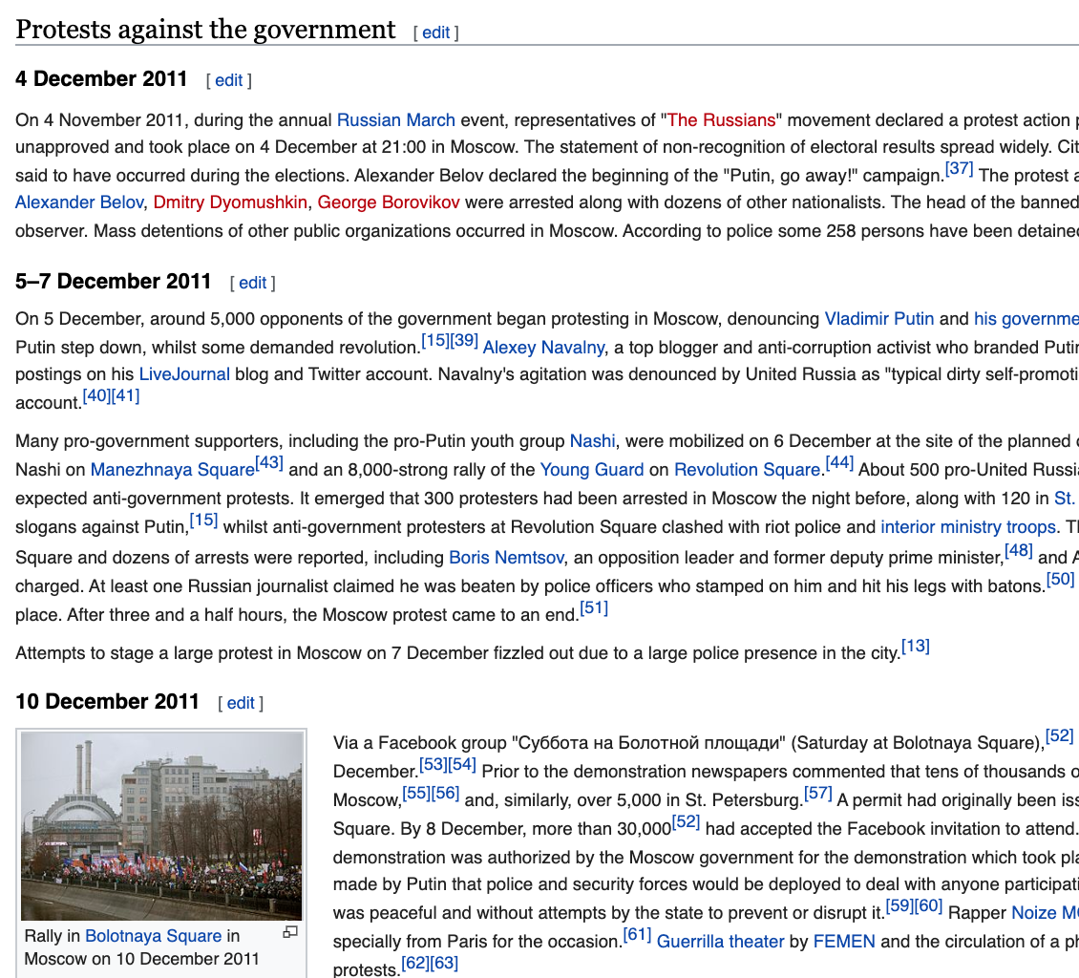
What will such a History Book look like?
Each chapter looks like a Wikipedia page
  The description is organized by multimedia timeline with detailed source and evidence information, links to original news articles
  Detailed participants (arguments) and their roles, and their connections and relations
  Infobox shows event-event relations: temporal,
  causal and hierarchical
Building blocks
  Open-domain Multilingual Multimedia Event Extraction
  Cross-document Event Coreference Resolution and Ranking
  Event Schema Induction and Event-Event Relation Extraction
  Cross-source Information Verification and Truth Finding
  Abstract Summarization for Event Description
Never-ending updated over time; put up to the
wild for human editing and curation
34
Notes:
Change low resource IL to a language which is not in wikipedia
Word-level: from bi-lingual dicts and alignment; structure-level comes from wals; multi-level alignment

Slide 35
Thank You
35

