Slide 1
Overview of TAC-KBP2019
Fine-grained Entity Extraction
Heng Ji (UIUC), Avirup Sil (IBM), Hoa Trang Dang (NIST), Ian Soboroff (NIST) and Joel Nothman (Sydney Informatics Hub)

Slide 2
What are “entities”?
[Main meaning]
- unique world bodies with (non-unique) names, such as
people, organizations, locations
e.g. Washington County
[Extended meaning – information extraction]
- unique identifiers, such as URLs, email addresses, tracking numbers, hashtags
- expressions of time, quantities, monetary values
Concepts (e.g. county)
But, everything is ambiguous

Slide 3
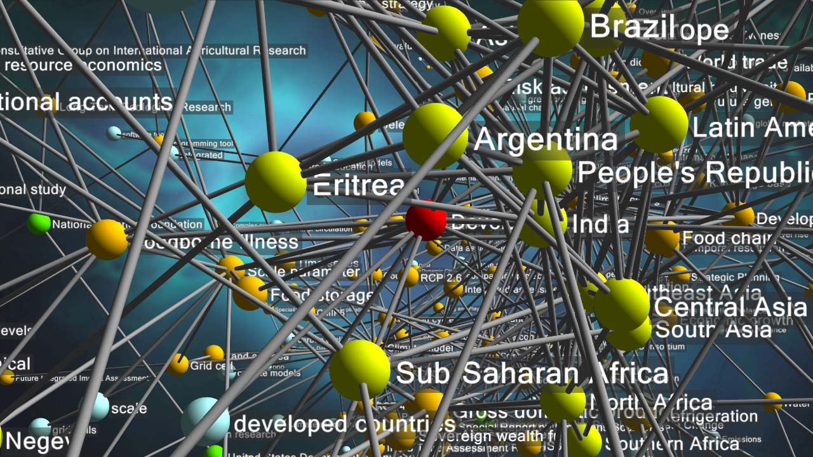

Why Are Entities Important?

Slide 4
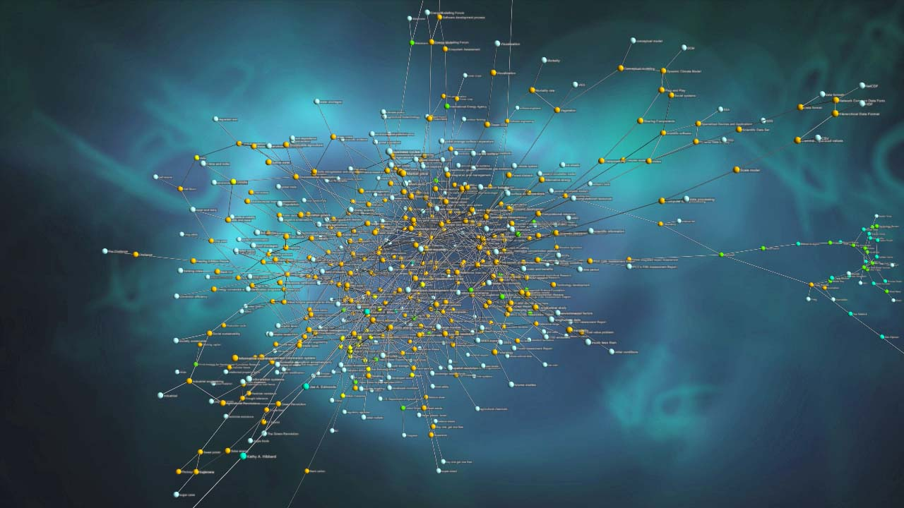
How Many Entities Are There?
Named places on Earth:
  ~ 10 million
Books written:
  ~ 130 million
People:
  ~ 8 billion
Species on Earth:
  ~ 1 trillion (of which ~10 million catalogued)
Stars in the Universe:
  ~ 1 billion trillion (1,000,000,000,000,000,000,000)
How Many Attributes?
How Many Relationships?
How Many Mentions?

Slide 5
Toward Fine-grained Entity Extraction
Real-world applications in scenarios such as disaster relief and technical support require us to significantly extend EDL capabilities to a wider variety of fine-grained entity types (e.g., technical terms, lawsuits, disease, crisis, vehicles, food, biomedical entities)
  e.g., the most frequent questions people ask Amazon's Alexa often involve new products, movies and actors
What’s New
  Low-resource setting: some silver-standard annotation but limited gold-standard annotation for training
  Human-in-the-loop: provide limited “feedback” on system output, which should be used to improve each system. The feedback will be provided based on a user model of how analysts might interact with the system while giving feedback on system output
  A new benchmark for both identification and classification of fine-grained entity types
5
Notes:
Change low resource IL to a language which is not in wikipedia
Word-level: from bi-lingual dicts and alignment; structure-level comes from wals; multi-level alignment

Slide 6
Task

Slide 7
Human Feedback
Simulate how analysts might interact with the system:
The user is reviewing a document and working through it from the beginning to the end. During this sequential process, if at time t the user encounters an incorrect system-generated annotation (which could be a miss, an error in mention extent, or a type error), the user tags the error and provides the correction
The user has some tolerance value k for the amount of error they are willing to see before they lose confidence in the system’s annotations and stop reviewing the document
Error function:Err(d,t) = total number of errors seen up to time t
Feedback was given until k=10 errors were detected in the document
All participants in EDL Evaluation Window 1 were given feedback on the same set of 10 documents
The 10 documents for feedback were selected to be documents where many of the runs submitted to Evaluation Window 1 had low confidence
7
Notes:
Change low resource IL to a language which is not in wikipedia
Word-level: from bi-lingual dicts and alignment; structure-level comes from wals; multi-level alignment

Slide 8
Data Annotation and Resources
The Source collection for the evaluation includes 300K documents; only a core subset of 300 documents is evaluated
Jeremy will present details about the evaluation set and AIDA related annotations
UIUC has annotated 144 additional documents following the AIDA ontology and shared the annotations along with the annotation interface with the community
Because ultra-fine-grained entity types bring significant challenges to both of the annotation interface and human annotation, UIUC team has created silver-standard annotation derived from Wikipedia markups (Pan et al., 2017) for 16K+ YAGO entity types (571GB)
8
Notes:
Change low resource IL to a language which is not in wikipedia
Word-level: from bi-lingual dicts and alignment; structure-level comes from wals; multi-level alignment

Slide 9
Participants (alphabetical order)
39 teams registered, 9 teams submitted results
9
Notes:
Change low resource IL to a language which is not in wikipedia
Word-level: from bi-lingual dicts and alignment; structure-level comes from wals; multi-level alignment

Slide 10
Overall Performance
Team | Without Feedback |  |  | With Feedback
 | P | R | F | P | R | F
1 | 54.0 | 51.7 | 52.8 | 60.2 | 62.7 | 61.4
2 | 50.4 | 46.8 | 48.5 | 50.6 | 49.3 | 49.9
3 | 43.1 | 42.7 | 42.9 | 56.0 | 55.5 | 55.7
4 | 43.1 | 41.3 | 42.2 | 43.3 | 41.4 | 42.3
5 | 46.5 | 36.4 | 40.8 | 35.0 | 45.1 | 39.4
6 | 37.5 | 41.8 | 39.5 | 42.3 | 47.2 | 44.6
7 | 22.5 | 20.7 | 21.6 | 22.1 | 20.3 | 21.2
8 | 27.0 | 15.5 | 19.7 | 42.2 | 35.8 | 38.8
9 | - | - | - | 3.3 | 2.2 | 2.6
10
Notes:
Change low resource IL to a language which is not in wikipedia
Word-level: from bi-lingual dicts and alignment; structure-level comes from wals; multi-level alignment

Slide 11
Impact of Human Feedback
11
Notes:
Change low resource IL to a language which is not in wikipedia
Word-level: from bi-lingual dicts and alignment; structure-level comes from wals; multi-level alignment

Slide 12
Successful Methods: Incorporating Contextual Embedding Representations
Most teams have incorporated deep contextual embedding representations in deep neural networks models
  UIUC team (Lin and Ji, EMNLP2019) has used ELMO embeddings for both coarse-grained and fine-grained extraction
  IBM team uses regular BERT model for coarse-grained extraction, based name tagger, and a mention-centric classifier using RoBERTa and has features that comprise each mention and its context separately to specialize the mention into a fine-grained type
12
Notes:
Change low resource IL to a language which is not in wikipedia
Word-level: from bi-lingual dicts and alignment; structure-level comes from wals; multi-level alignment

Slide 13
Successful Methods: Joint Fine-grained Entity Identification, Classification and Linking
Ousia Team performs joint entity identification along with type classification
  pre-training phase: encode the given context with BERT along with BiLSTM; then they compute two layers: one performing a CRF to get standard BIO tags and the other computes YAGO tags
  fine-tuning phase: these two layers are combined to learn a mapping to output AIDA tags.
UIUC team and Diffbot team use Entity Linking (EL) to link mentions to the KB and then infer the types from the KB
  The types from the KB are restricted to the AIDA types: in particular they use the parent types of the linked entity in the type ontolog
  Diffbot system further uses 10 representative entities for each type using a popularity metric
13
Notes:
Change low resource IL to a language which is not in wikipedia
Word-level: from bi-lingual dicts and alignment; structure-level comes from wals; multi-level alignment

Slide 14
Successful Methods: Capturing Type Interdependency and Differentiating Similar Types
(Lin and Ji, EMNLP2019)
14
Notes:
\subsection{Capturing Type Inter-dependency}Fine-grained entity typing is usually formulated as a multi-label classification problem.Previous approaches~\cite{ling2012fine,choi2018ultra,xin2018improving} typically address it with binary relevancethat decomposes the problem into isolated binary classification subproblems and independently predicts each type.However, this method is commonly criticized for its label independence assumption, which is not valid for %does not hold true in fine-grained entity typing. For example, if the model is confident at predicting the type \texttt{artist}, it should promote its parent type \texttt{person} but discourage \texttt{organization} and its descendant types.In order to capture inter-dependencies between types, UIUC team~\cite{LinACL2019,LinTAC2019} has developed a hybrid model that incorporates latent type representation in addition to binary relevance.Specifically, the model learns to predict a low-dimensional vector that encodes latent type features obtained through Principle Label Space Transformation~\cite{tai2012multilabel} and reconstruct the sparse and high-dimensional type vector from this latent representation.\subsection{Differentiating Similar Types}Another major challenge in fine-grained entity typing is to differentiate similar types, such as \texttt{director} and \texttt{actor}, which requires the model to capture slightly different nuances in texts.Previous neural models~\cite{shimaoka2016attentive,xin2018improving,choi2018ultra,xu2018neural} generally extract features from pre-trained word embeddings.Instead, UIUC team~\cite{LinACL2019,LinTAC2019} adopts contextualized word representations~\cite{peters2018elmo}, which can capture context-aware word semantics and better represent out-of-vocabulary words.They further propose a two-step attention mechanism to actively extract the most relevant information from the sentence.Particularly, they calculate the attention for context words in a mention-aware manner, allowing the model to focus on different parts of the sentence for different mentions.For example, in the following sentence, ``\textit{In 2005 two {federal agencies}, the \textbf{US Geological Survey} and the \textbf{Fish and Wildlife Service}, began to identify {fish} in the \textbf{Potomac} and {tributaries}} ...'', the model should use ``federal agencies'' to help classify ``US Geological Survey'' and ``Fish and Wildlife Service'' as \texttt{government\_agency},but focus on ``fish'' and ``tributaries'' to determine that ``Potomac'' should be a %river \texttt{body\_of\_water} (river) instead of a %city \texttt{city}.

Slide 15
Some Impressive Fine-grained Entity Extraction Results
PER.ProfessionalPosition.Journalist
Buzina founded his own website, featuring blogs and sale of some of his books online .
PER.ProfessionalPosition.Journalist
The UN official stressed that Buzina was a critic of the current Ukrainian government adding that it is still unclear who is responsible for his murder.
PER.Protester
we see him another , please consulting with mask men who are presenting themselves into protesters.
VEH.MilitaryVehicle.FighterAircraft
Arriving at the facility , the Guardian also saw a fighter jet resembling a Su-27 circling around the airfield .
15
Notes:
Change low resource IL to a language which is not in wikipedia
Word-level: from bi-lingual dicts and alignment; structure-level comes from wals; multi-level alignment

Slide 16
Remaining Challenges: Spurious Entity Extraction Errors
Coreference error
PER.ProfessionalPosition.Journalist
When Melnychuks body was found on 22 March , police initially told local journalists he had committed suicide .
Need background knowledge
FAC.Building.House
President Barack Obama speaks about Afghanistan at the White House Rose Garden on May 27, 2014
Need better context association and reasoning: Current language modeling based embedding features often fail to select the most indicative features and filter noise in contexts
CRM.ViolentCrime.Terrorism
According to Greg Fealy , an associate professor at the Australian National University who studies terrorism in Indonesia , the IS terror threat in Indonesia has been rising since mid-2014 .
16
Notes:
Change low resource IL to a language which is not in wikipedia
Word-level: from bi-lingual dicts and alignment; structure-level comes from wals; multi-level alignment

Slide 17
EDL Discussion: Plans for KBP2020
Real ultra-fine-grained entity extraction for 16,000 entity types by addressing annotation challenges
Add entity linking and foreign languages
  Add wikia ; other fine-grained KBs?
  New applications in Alexa: new entity clustering and initiate proactive conversations
Add nominal mentions (but not distinguishing mention type) – hope LCC can participate next time!
Cross-media fine-grained entity extraction and grounding
17
Notes:
Change low resource IL to a language which is not in wikipedia
Word-level: from bi-lingual dicts and alignment; structure-level comes from wals; multi-level alignment

Slide 18
EDL Discussion (contd)
GPU access to participants from NIST
  Some teams complained about too much data but not much GPUs to train BERT !
System code release to attract more participants
  Successful teams like IBM (Wrapper around Huggingface) , Ousia, UIUC
  Start building on top of these SOTA systems
  Docker container-based package
Local vs global context for mentions
  E.g. Obama: president vs head of the state

Slide 19
Extend to Thousands of Entity Types
7,297 hierarchical entity types defined in YAGO, derived from WordNet synsets
  Top level: thing
  Second level: person, organization, building, artifact, abstraction, physical entity, geographical entity
  Each type has at least 10 Wikipedia entries

Slide 20
Ultra-fine-grained Entity Extraction Examples
Hormone
  Briain-derived neuotrophic factor (“BDNF”), another important gene in neural plasticity, has also been shown to have reduced methylation and increased transcription in animals that have undergone learning.
Infectious Disease
  Notable exceptions include the Large Pine Weevil (“Hylobius abietis”), which can kill young conifers.
Dumpling
  Shengjian mantou is a type of small , pan - fried " baozi " ( steamed buns ) which is a specialty of Shanghai .
Fairy
  The background story of the game starts somewhere in the desert where Anwar , a pure hearted young man finds a rusty oil lamp from what he releases a very powerful and evil djinn the Nadir .

Slide 21
Ultra-fine-grained Entity Extraction Examples
Lawsuit
  The landmark Brown v. Board of Education decision paved they way for PARC v. Commonwealth of Pennsylvania and Mills vs. Board of Education of District of Columbia, which challenged the segregation of students with special needs.
Mental Disorder
  Many of these veterans suffer from post traumatic stress disorder, an anxiety disorder that often occurs after extreme emotional trauma involving threat or injury.
Military Academy
  The year after, the prince went back to France,[2] where he eventually entered the prestigious academy of École spéciale militaire de Saint-Cyr-Coëtquidan.
Military Uniform
  The following below depicted gallery of mounting loops are practically in use in conjunction with the 5- or 3 color flectarn fighting suit.

Slide 22
Ultra-fine-grained Entity Extraction Examples
Fundraiser
  The U.S. Fund administers the long-running Trick-or-Treat for UNICEF compaign which began as a local fundraising event in Pennsylvania in 1950 and has since raised more than US $170 million to support UNICEF’s work.
Investigator
  Samuel Hume was born in San Francisco, California in 1885, the son of James B. Hume, a famous Wells Fargo detective.
Lobbyist
  Represented by Lanny Davis, the CES lobbied for changes to the “gainful employment rule”.
Medical Scientist
  Pillemer was born on October 15, 1954, to Jean Burrell Pillemer and Louis Pillemer, and early pioneer in the filed of immunology at Case Western Reserve University.

Slide 23
Ultra-fine-grained Entity Extraction Examples
Molecular Biologist
  Meanwhile an overlapping class of transposable element was described under the name " polintons", derived from the key proteins polymerase and integrase, by Vladimir Kapitonov and Jerzy Jurka.
Natural Language
  The Vai language , also called Vy or Gallinas , is a Mande language spoken by the Vai people , roughly 104,000 in Liberia , and by smaller populations , some 15,500 , in Sierra Leone
Naval Commander
  His ship drifting dangerously inshore , at 14:30 Captain Thomas Frederick gave control to a sailor on board who claimed to have navigated the region and knew a safe anchorage .
Naval Gun
  She carried one15 cm SK L/45 gun, four 10.5 cm SK L/45 guns, four SK L/45 gun, four 8.8 cm SK L/35 guns, five 8.8 cm SK L/30 guns, and one 8.8 cm SK L/30 gun in a U- boat mounting.

Slide 24
Ultra-fine-grained Entity Extraction Examples
Poisoner
  It began to be used for murderers who used poisons after the Bishop of Rochester 's cook , Richard Rice , gave a number of people poisoned porridge , resulting in two deaths in February 1532 .
President
  Founder 's Day is national public holiday observed in Ghana to mark the birthday of Ghana 's first president , Dr. Kwame Nkrumah the key founding father of Ghana .
Queen
  He later became the King of Spain and married twice to Marie Louise of Savoy and then Elisabeth Farnese .
Religion
  The Mu'tazila tradition of tafsir has received little attention in modern scholarship , owing to several reasons .
Salad
  Texas caviar is a salad of black - eyed peas lightly pickled in a vinaigrette - style dressing , often eaten as a dip accompaniment to tortilla chips .

Slide 25
Ultra-fine-grained Entity Extraction Examples
Seafood
  Lauriea siagiani, is a species of squat lobster in the family Galatheidae, genus " Lauriea" .
Sign Language
  Following this , he has been at many festivals , including Ferstival Clin d’Œil throughout Europe as an actor , performer in various sign languages like DGS , BSL , LIS and LSF .
Appetizer
  This invention of a faux Polynesian experience is heavily influenced by Don the Beachcomber , who is credited for the creation of the "pūpū" platter and the drink named the " Zombie " for his Hollywood restaurant .
Bomber
  The carburetor intake was much larger , a long duct like that on the Nakajima B6N Tenzan was added , and a large spinner — like that on the Yokosuka D4Y Suisei with the Kinsei 62—was mounted .

Slide 26
Chinese Ultra-fine-grained Entity Extraction Examples
Vector
  一般 的 ， 令 D 是 作用 于 黎曼流 形 M 上 的 向量丛 V 的 一阶 微分 算子 。
  (In general, let D be the first-order differential operator of the vector bundle V acting on the Riemannian manifold M.)
  柯西 - 施瓦茨 不等式 叙述 ， 对于 一个 内积空间 所有 向量 " x " 和 " y "
  (Cauchy - Schwarz inequality description, for an inner product space of all vectors "x" and "y”)
Footbridge
  而 较 高 的 一座 哥特式 塔楼 于 1357 年 与 查理大桥 一起 由 彼得 帕尔 莱勒 兴建 ， 直到 1464 年 才 完成 。
  (The taller Gothic tower was built in 1357 by Peter Parleler with the Charles Bridge until 1464.)
  而 中国 最着 名 的 铁索 吊桥 是 四川省 甘孜 的 泸定桥 。
  (The most famous iron suspension bridge in China is Luding Bridge in Garze, Sichuan Province.)

Slide 27
Chinese Ultra-fine-grained Entity Extraction Examples
AutomotiveTechnology
  同时， 奥迪 也 在 这 一代 A4 中 引入 了 当时 全新 开发 的 Tiptronic 手自一体变速箱
  (At the same time, Audi also introduced a newly developed Tiptronic tiptronic transmission to this generation of A4 )
  电子稳定程序 ， 亦 称 车身动态稳定系统 （ 常 缩写 为 ESP® ） ， 又称 电子稳定控制系统 （ 缩写 ： ESC ） ， 是 对 旨在 提升 车辆 的 操控 表现 的 同时 、 有效 地 防止 汽车 达到 其 动态 极限 时 失控 的 系统 或 程序 的 通称。
  (Electronic stability program, also known as dynamic body stability system (often abbreviated as ESP®), also known as electronic stability control system (abbreviation: ESC), is designed to improve vehicle handling performance, while effectively preventing the car to reach The generic term for a system or program out of control at its dynamic limits.)
DataInputDevice
  多数 键盘布局 及 输入法 皆 可 用于 输入 拉丁文 字 或 汉字 。
  (Most keyboard layouts and input methods are available for entering Latin text or Chinese characters.)

Slide 28
EDL Discussion
GPU access to participants from NIST
  Some teams complained about too much data but not much GPUs to train BERT !
System code release to attract more participants
  Successful teams like IBM, Ousia, UIUC
  Start building on top of these SOTA systems
Bring Entity Linking back
  Wikia as a KB; other fine-grained KBs
Nominal vs name mentions
  reduce confusion
Local vs global context for mentions
  E.g. Obama: president vs head of the state

